Slide 1
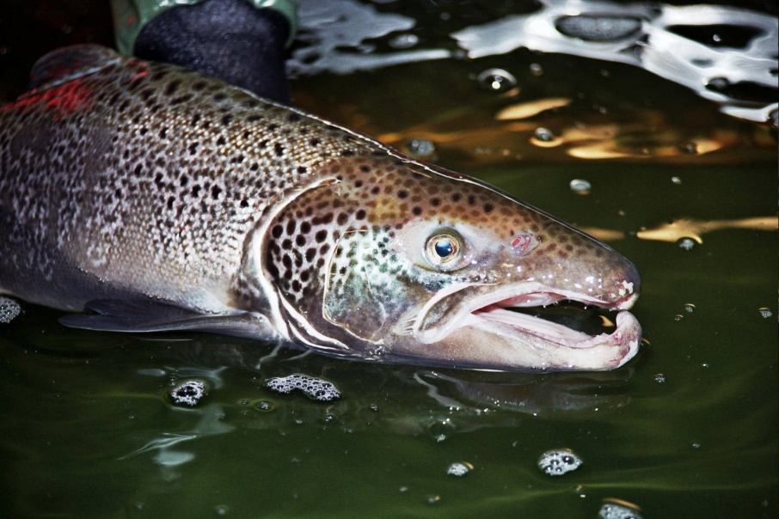
Applications of a high-resolution version of the New England spatial statistical network model to
the Meduxnekeag: Restoration potential for thermal regimes
Naomi Detenbeck (U.S. EPA ORD)
Stephanie Figary (former ORISE at ACESD)
Cara O’Donnell (Houlton Band of Maliseets)
Maine Water Temperature Working Group Meeting
Augusta, ME
December 3, 2019
Office of Research and Development
Center for Environmental Measurement and Modeling/Atlantic Coastal Environmental Sciences Division Division
12/03/2019

Slide 2
Goals
Overall: Expand habitat for brook trout and restored native Atlantic salmon populations
Determine location of existing cold water refuges for salmonids and brook trout
Select areas for riparian restoration

Slide 3
Spatial Statistical Network Models
Linear regression models
Built on stream/river network (e.g., NHDPlus)
Account for spatial autocorrelation (tendency for points close together to be more similar)
If spatial autocorrelation is ignored, this increases the probability of Type I errors – assuming effects are significant when they aren’t
Use watershed area (indicator of discharge) as a weighting factor for relative influence

Slide 4
Spatial Statistical Network Models
SSN model: quick review
Linear regression models
Built on stream/river network (e.g., NHDPlus)
Account for spatial autocorrelation (tendency for points close together to be more similar)
If spatial autocorrelation is ignored, this increases the probability of Type I errors – assuming effects are significant when they aren’t
Use watershed area (indicator of discharge) as a weighting factor for relative influence

Slide 5
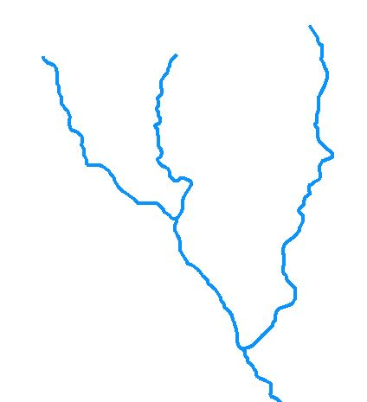
Spatial Statistical Network Models
SSN model: quick review
Linear regression models
Built on stream/river network (e.g., NHDPlus)
Account for spatial autocorrelation (tendency for points close together to be more similar)
If spatial autocorrelation is ignored, this increases the probability of Type I errors – assuming effects are significant when they aren’t
Use watershed area (indicator of discharge) as a weighting factor for relative influence
Stream network

Slide 6
Spatial Statistical Network Models
SSN model: quick review
Linear regression models
Built on stream/river network (e.g., NHDPlus)
Account for spatial autocorrelation (tendency for points close together to be more similar)
If spatial autocorrelation is ignored, this increases the probability of Type I errors – assuming effects are significant when they aren’t
Use watershed area (indicator of discharge) as a weighting factor for relative influence
Euclidean
Tail-Up (flow connected)
Tail-Down (flow
unconnected)
Stream network

Slide 7
SSN predictors of New England median July/August stream/river temperature
Shaded solar radiation
Topographic shading
Riparian shading
Median air temperature
Urban heat index
Percent coarse surficial deposits*
Main channel slope
Watershed storage (lakes + wetlands)
Upstream lake presence & depth
Energy inputs
Groundwater inputs
Retention time
* August only
6

Slide 8
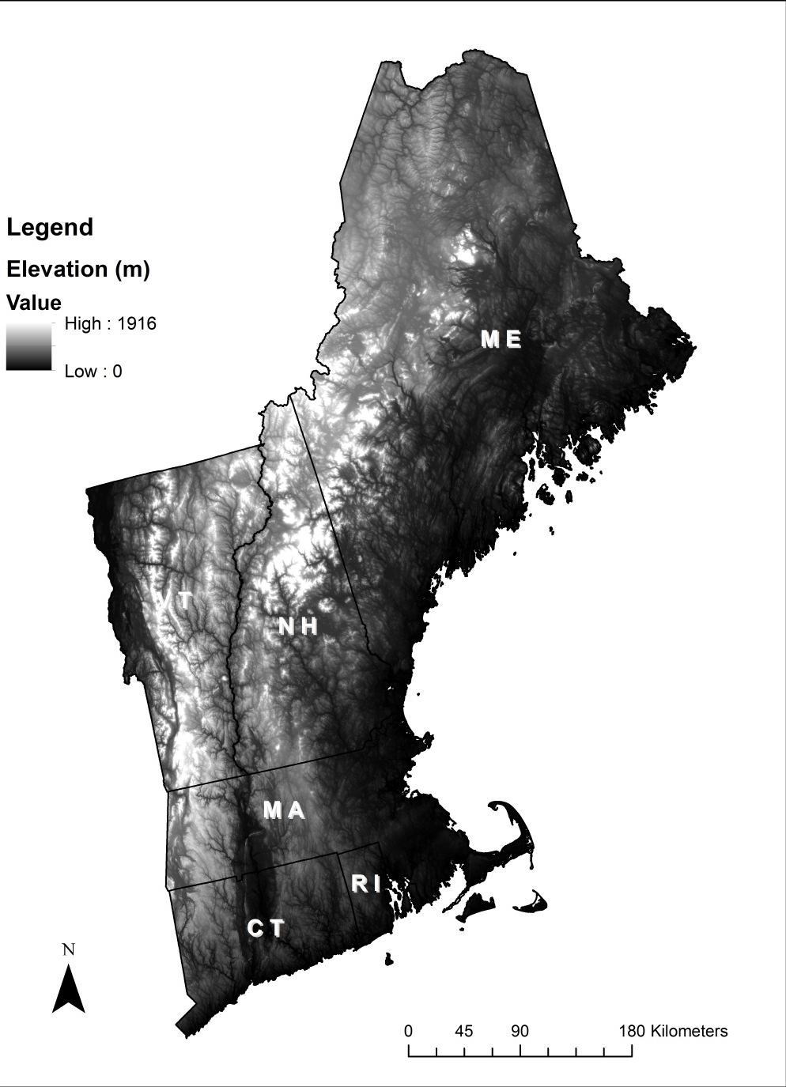
New England SSN model Riparian restoration scenario
2006 land cover
Canopy cover Watershed storage
Average 2002-2010 median July air temperature
Beachene et al. (2014) thermal regime classes
Tidal class assigned based on maximum elevation of reach < 3 meters
Watersheds extending into Canada not included
(1:100K)
->100%

Slide 9
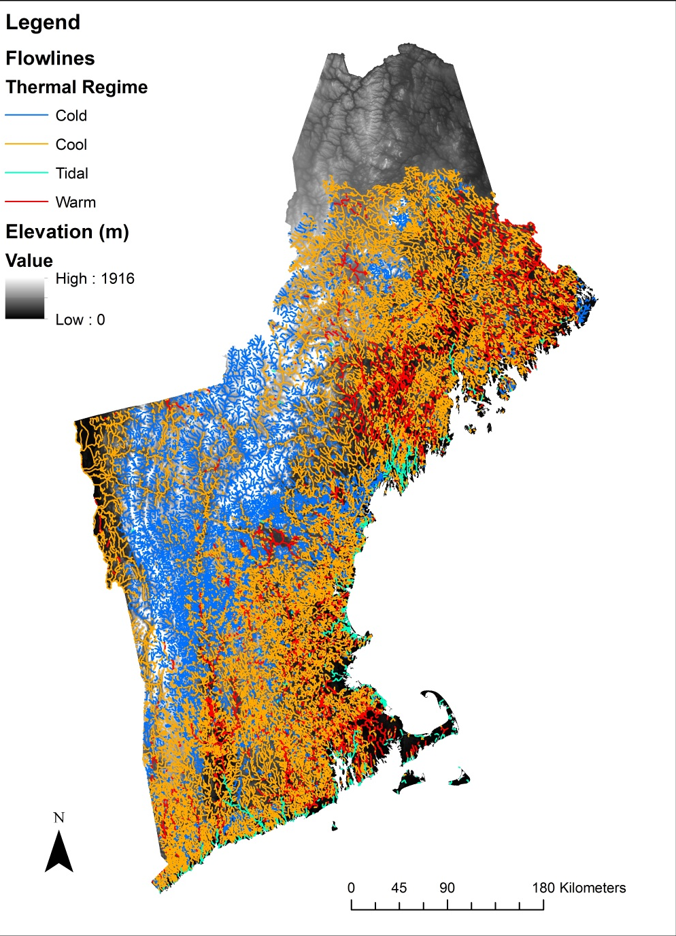
New England SSN model Riparian restoration scenario
2006 land cover
Canopy cover Watershed storage
Average 2002-2010 median July air temperature
Beachene et al. (2014) thermal regime classes
Tidal class assigned based on maximum elevation of reach < 3 meters
Watersheds extending into Canada not included
(1:100K)
->100%

Slide 10
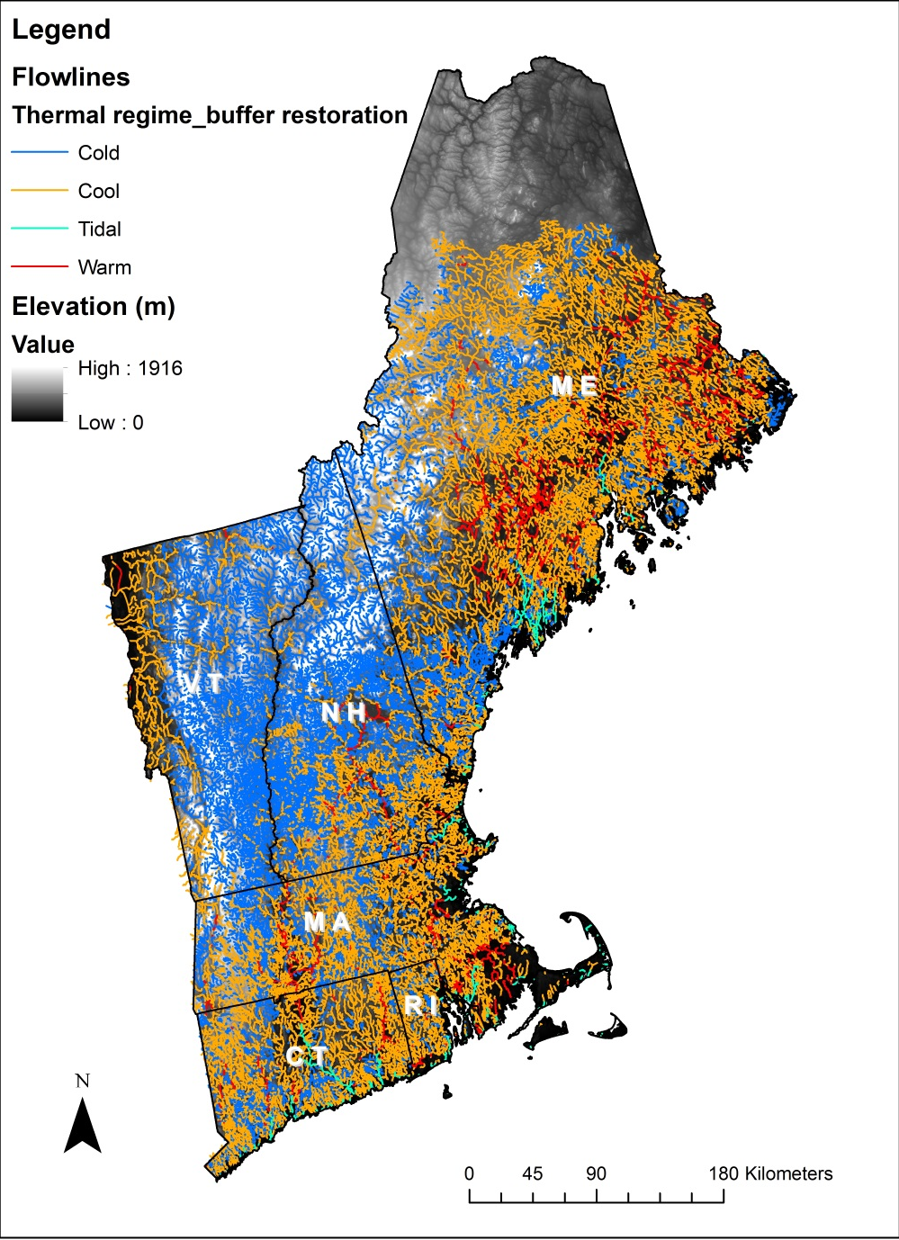
New England SSN model Riparian restoration scenario
2006 land cover
Canopy cover Watershed storage
Average 2002-2010 median July air temperature
Beachene et al. (2014) thermal regime classes
Tidal class assigned based on maximum elevation of reach < 3 meters
Watersheds extending into Canada not included
(1:100K)
->100%

Slide 11
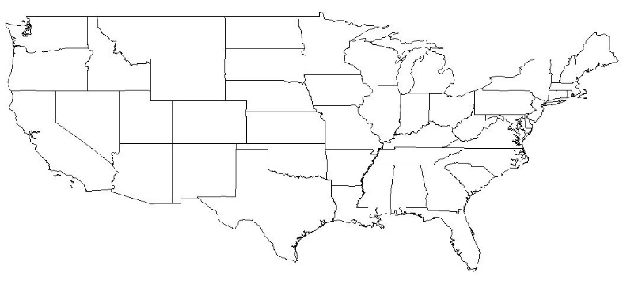
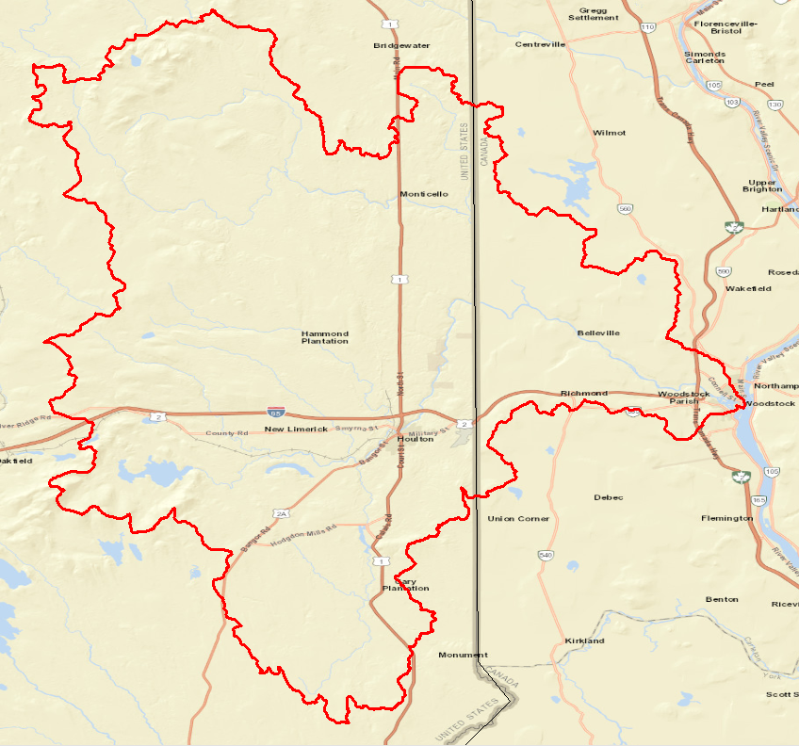
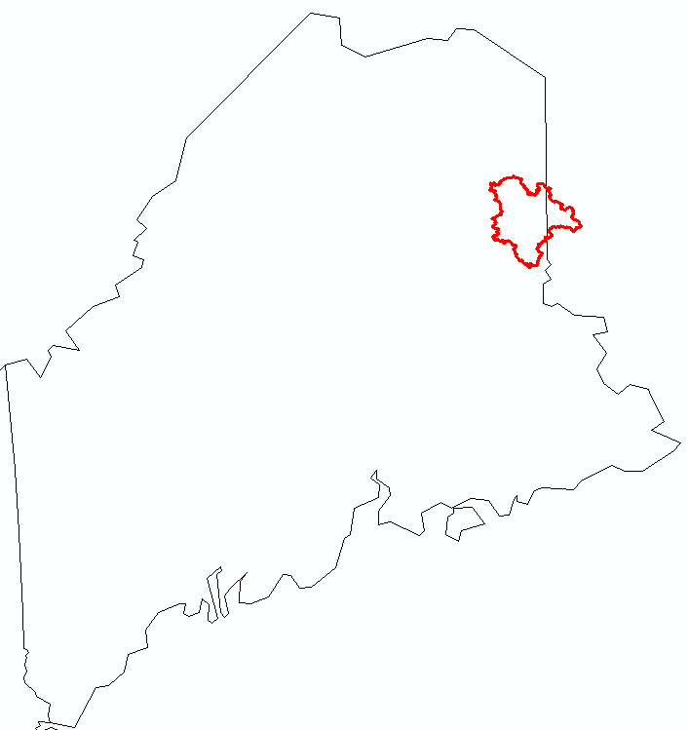
Background: Meduxnekeag Watershed
1336 km² watershed
Flows through the Houlton Band of Maliseet Indian’s Tribal Land
HBMI goals:
Project:
1: Determine the locations of existing cold water refuges
2: Select areas for riparian restoration
Overall: Expanding habitat for Brook Trout and restoring native Atlantic Salmon populations
New Brunswick
Maine
St. John River
New Brunswick
Maine

Slide 12
Scientific Objectives
Develop fine-resolution (1:24K) stream temperature prediction model for Meduxnekeag subwatershed
Spatial resolution appropriate for examining riparian buffer management scenarios
Address challenge of combining data sources across international boundary
Apply new method to fill in monitoring gaps (spatial coverage and key attribute ranges)
Evaluate alternative predictor variables (e.g. riparian buffer width, buffer distance upstream)
Predict thermal regime distribution across watershed
Monthly variation
Growing season maximum
Wet versus dry year comparison
Current conditions vs restored riparian zone condition
Wet year
Dry year

Slide 13
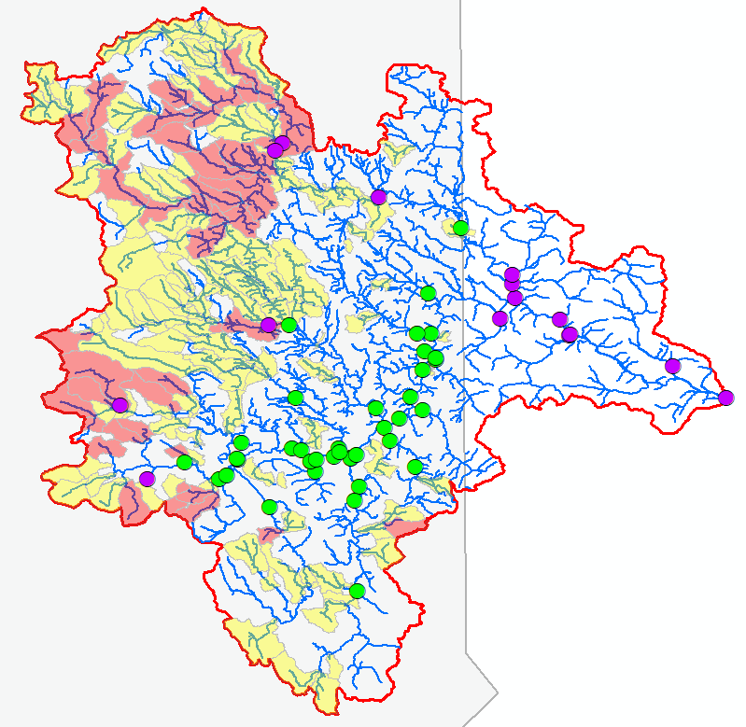
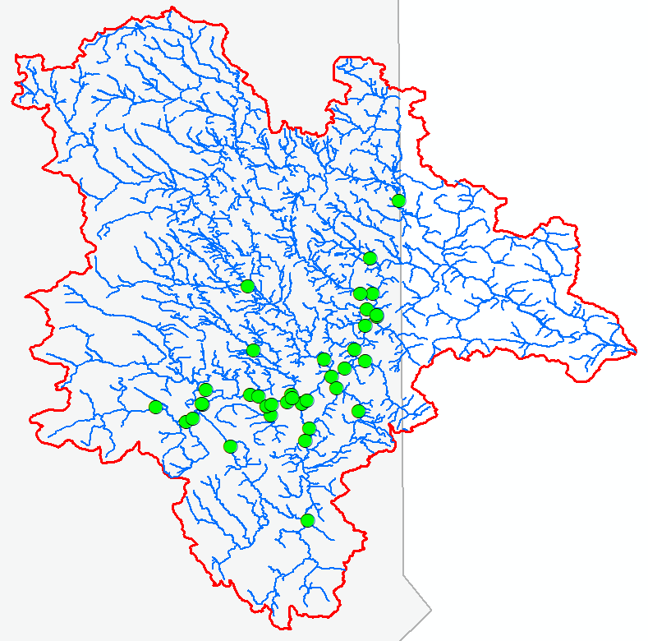
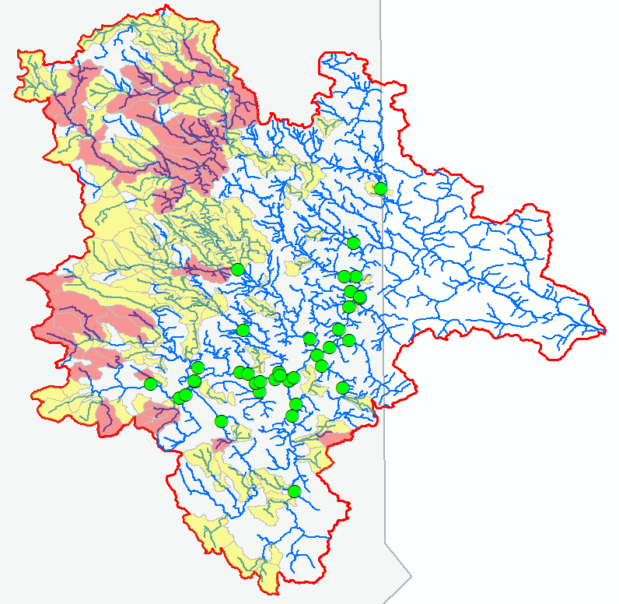
Monitoring stations
37 existing temperature stations (2009 - 2018)
Added stations in 2018:
Characterized site upstream drainage areas and watershed catchments (NHDplus V2):
Drainage area
Slope
Baseflow
Discharge
% Forested stream buffer
% Impervious cover
Elevation
Used principal component analysis to suggest areas for additional monitoring in 2018
12 new sites

Slide 14
Principal Components Analysis to find major axes of variation in subcatchments
 | Eigenvectors
Original variable | PC1 | PC2 | PC3
Drainage area | -.28 | .31 | -.39
Slope | .28 | -.19 | .29
July discharge/watershed area | .35 | -.24 | .27
Aug discharge/watershed area | .39 | -.12 | .18
Catchment % forested | .31 | .10 | -.28
Catchment buffer % forested | .28 | .18 | -.43
Catchment % impervious | -.31 | -.20 | .24
Catchment buffer % impervious | -.38 | -.19 | .16
Elevation | .38 | -.03 | -.15
Catchment baseflow index | .02 | .60 | .36
Watershed baseflow index | .10 | .56 | .41

Slide 15
Model development: Parameters
New England model as guidance:
Air temperature
Monthly and annual
Imperviousness or Urban heat island
Watershed area
Local channel gradient or main channel slope, squared, cubed
Extremely well drained soils or coarse surficial deposits
Drainage density
Lake and wetland storage
Discharge
Width to depth ratio
Lake upstream
Lake depth
Shaded solar radiation

Slide 16
Model development: Parameters
New England model as guidance:
Air temperature
Monthly and annual
Imperviousness or Urban heat island
Watershed area
Local channel gradient or main channel slope, squared, cubed
Extremely well drained soils or coarse surficial deposits
Drainage density
Lake and wetland storage
Discharge
Width to depth ratio
Lake upstream
Lake depth
Shaded solar radiation
Meduxnekeag adjustments al
% development
Baseflow recession coefficent
Upstream depth
+ % site in USA

Slide 17
Model fitting for each month
Started with the parameters in the NE model
Backwards step-wise regression
Substitute parameters (11)
Longitude
Latitude
Velocity
Elevation
Drainage Density
% wetlands and lakes
Monthly air temp
Annual air temp
% watershed in USA
Monthly reference flow
Baseflow recession coefficient
Stream Width:Depth
% development in last 500m of basin
Main channel slope
Maximum near-upstream depth
Shaded- solar radiation
Longitude
Drainage Density
% wetlands and lakes
Monthly air temp
% watershed in USA
Monthly reference flow
Baseflow recession coefficient
% development in last 500m of basin
Main channel slope
Maximum near-upstream depth
Shaded- solar radiation
Examples:
Site in Canada
% dev in 1 km/ whole watershed
Local gradient
Shaded-solar radiations (39)
Add in interaction terms
Squared main channel slope
Width:depth * monthly air
Select spatial autocorrelation model

Slide 18
Defining upstream riparian buffers
2 hr
2 km
1 km
1 hr
Distance upstream (as the fish swims)
Travel time upstream (as the water flows)
1km, 2km, 3km,4km,5km,10km,
full watershed
1hr, 2hr, 3hr, 4hr, 5hr, 6hr,12hr, 24hr

Slide 19
Monthly and growing season models
July | August | September | Grow season max
 |  | Longitude
 |  | Latitude | Latitude
Soil conductivity |  |  | Soil conductivity
Gradient |  |  | Gradient
 | Channel slope² | Channel slope² | Channel slope²
Mx upstr depth |  | Mx upstr depth
Depth |  | Depth | Depth
 | Width
 |  | Wshd storage
 | Elevation |  | Elevation
 | Canadian | Canadian
Month air temp | Month air temp | Month air temp | Mx GS air temp
Month ref flow | Month ref flow | Month ref flow | GS avg ref flow
 | Month ref flow²
3-h ups shaded solar | 3-h ups shaded solar | 3-h ups shaded solar | 1km ups shaded solar
Constant variables
*
Time-vary
*
*
Decrease temp
Bold: p < 0.05
Increase temp

Slide 20
Monthly and growing season models (cont’d)
Interactions
July | August | September | Grow season max
 |  |  | Air temp x WtoD
 |  |  | SoilCond x Main channel slope
Ref flow x airtemp
Spatial autocorrelation term
LinearSill tailup | Epanech tailup | LinearSill tailup | LinearSill tailup
Gaussian Euclidean | Gaussian Euclidean
Generalized r²
0.96 | 0.89 | 0.91 | 0.88
Root mean square prediction error (deg C)
0.52 | 0.94 | 0.86 | 1.18

Slide 21
Standardized regression coefficients
 | July | August | Sept | GS max
Depth | 1.01*** |  | 1.85*** | 3.25***
Width |  | 3.26***
Elevation |  | 1.58* |  | 2.57***
Monthly or growing season avg ref flow | -1.72*** | -2.21*** | -1.34*** | -1.58**
Monthly or max growing season air temp | 1.78*** | 2.30*** | 2.22*** | 1.56**
Canadian |  | -1.64* | -1.83***
Shaded solar (3-h monthly, 1-km gs) | 0.98*** | 1.21** | 0.47 | 1.27*
Gradient | -0.60* |  |  | -0.96(*)
Longitude |  |  | 0.95
Baseflow recession coefficient | -0.98** |  |  | 0.94
Channel slope² |  | -0.58*** | -0.17 | 0.69
Latitude |  |  | -1.00** | -0.53
Mx upstream depth | 1.21*** |  | 1.16**
Watershed storage |  |  | -0.61
Opportunities for moderating thermal regime

Slide 22
Issues
Is apparent depth effect real?
Both width and depth are empirical estimates based on drainage area and may be difficult to separate
Morphometry in Meduxnekeag constrained by valley walls, low depth to bedrock
Addition of actual channel morphometry measurements in future could improve model
Is elevation effect real?
Elevation effects related to air temperature should have been accounted for by Daymet equations
Comparison of Daymet with air temperatures from NE geographically weighted regressions show differences in estimated adiabatic effect
Elevation coefficients could represent a bias correction effect for air temperature at higher elevations

Slide 23
Effect of interannual variation in weather and month on thermal regime

Slide 24
Thermal regime | Range
Cold water | < 19 °C
Cool water | 19 – 22.5°C
Warm water | 22.5 – 27.0°C
No survival | > 27.0°C
- - - flagged
Indicates lower confidence in results because some predictor variables are < 90% of minimum value or > 10% greater than maximum value in observation data set

Slide 25
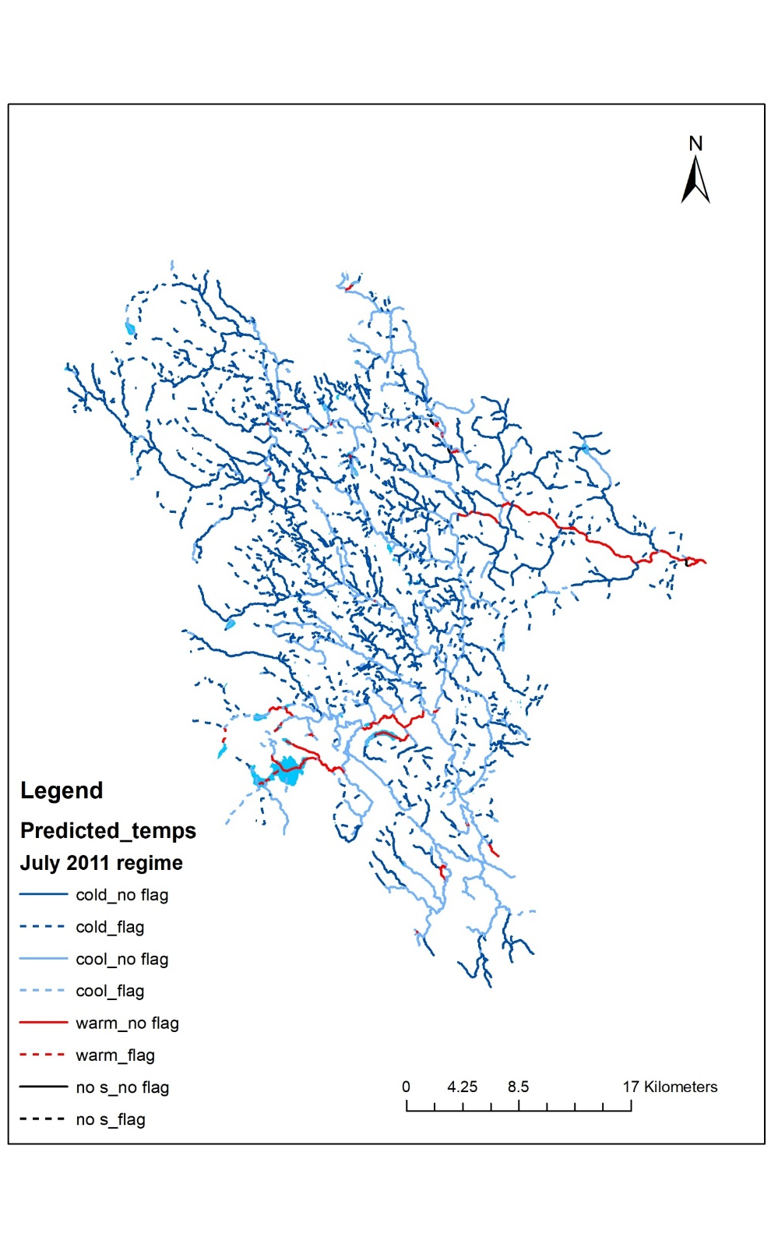
July thermal regime distribution
Dry
Wet
24

Slide 26
July thermal regime distribution
Dry year – current conditions
25

Slide 27
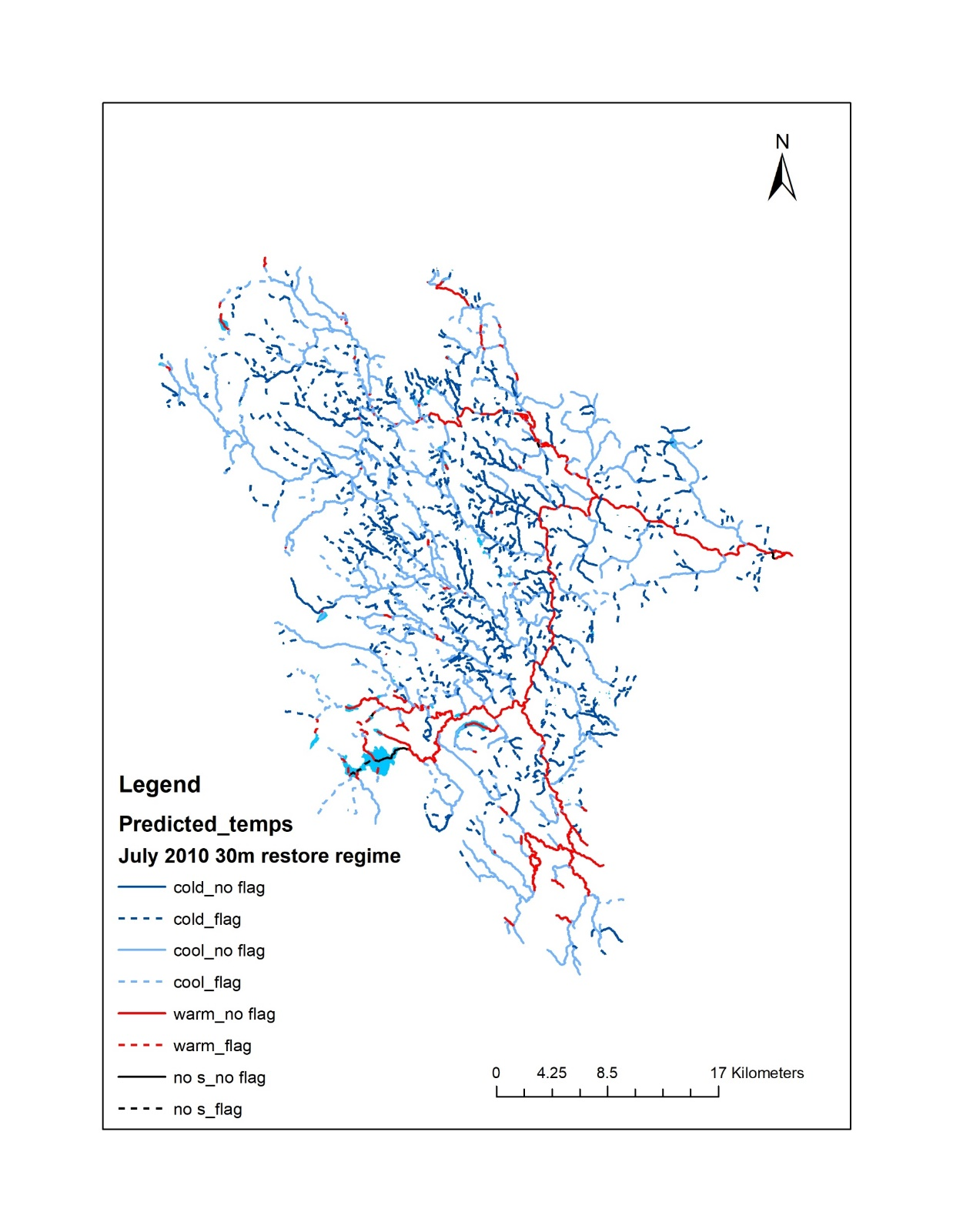
July thermal regime distribution
Dry year – Restore 30m forested buffer
26

Slide 28
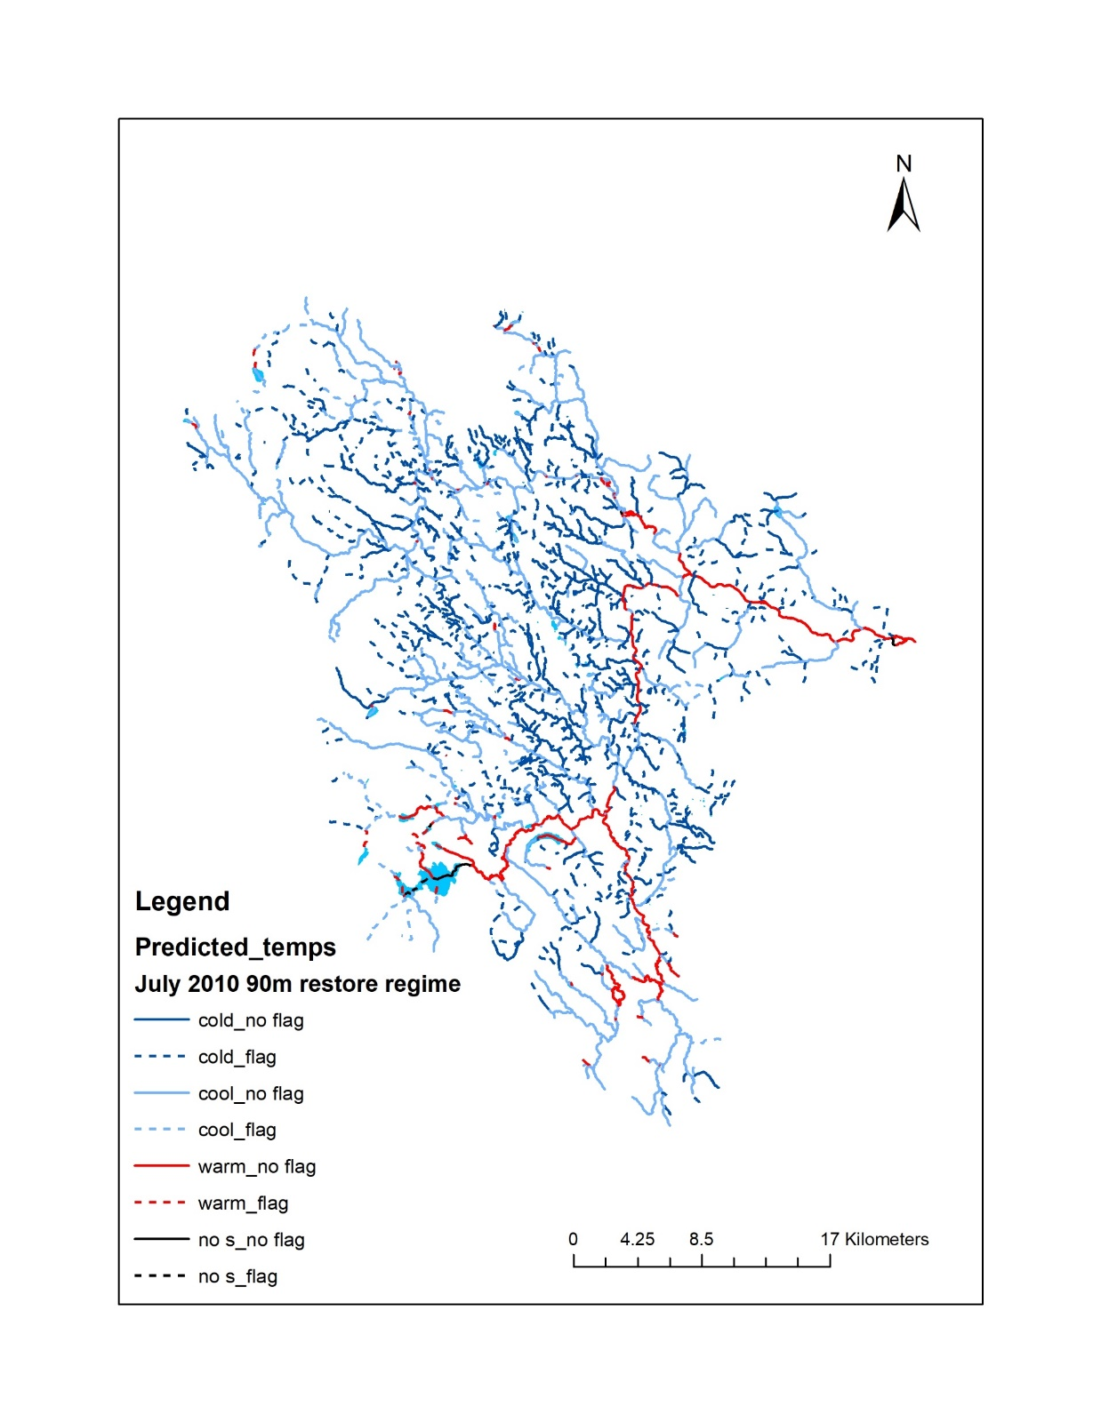
July thermal regime distribution
Dry year – Restore 90m forested buffer
27

Slide 29
Percentage of reaches by thermal regime
 |  | July 2010 | - dry | July 2011 - wet
 | current | restore 30 m | restore 90 m | current | restore 30 m | restore 90 m
cold | 27.8 | 45.3 | 51.7 | 67.7 | 76.7 | 79.3
cool | 57.1 | 42.7 | 40.1 | 28.1 | 21.3 | 19.5
warm | 14.6 | 11.6 | 7.8 | 4.0 | 1.9 | 1.2
beyond survival | 0.5 | 0.5 | 0.4 | 0.2 | 0.1 | 0.1
Cold water regime expands in wet year
Effect of restoration greater in dry year
Most restoration effect associated with first 30m

Slide 30
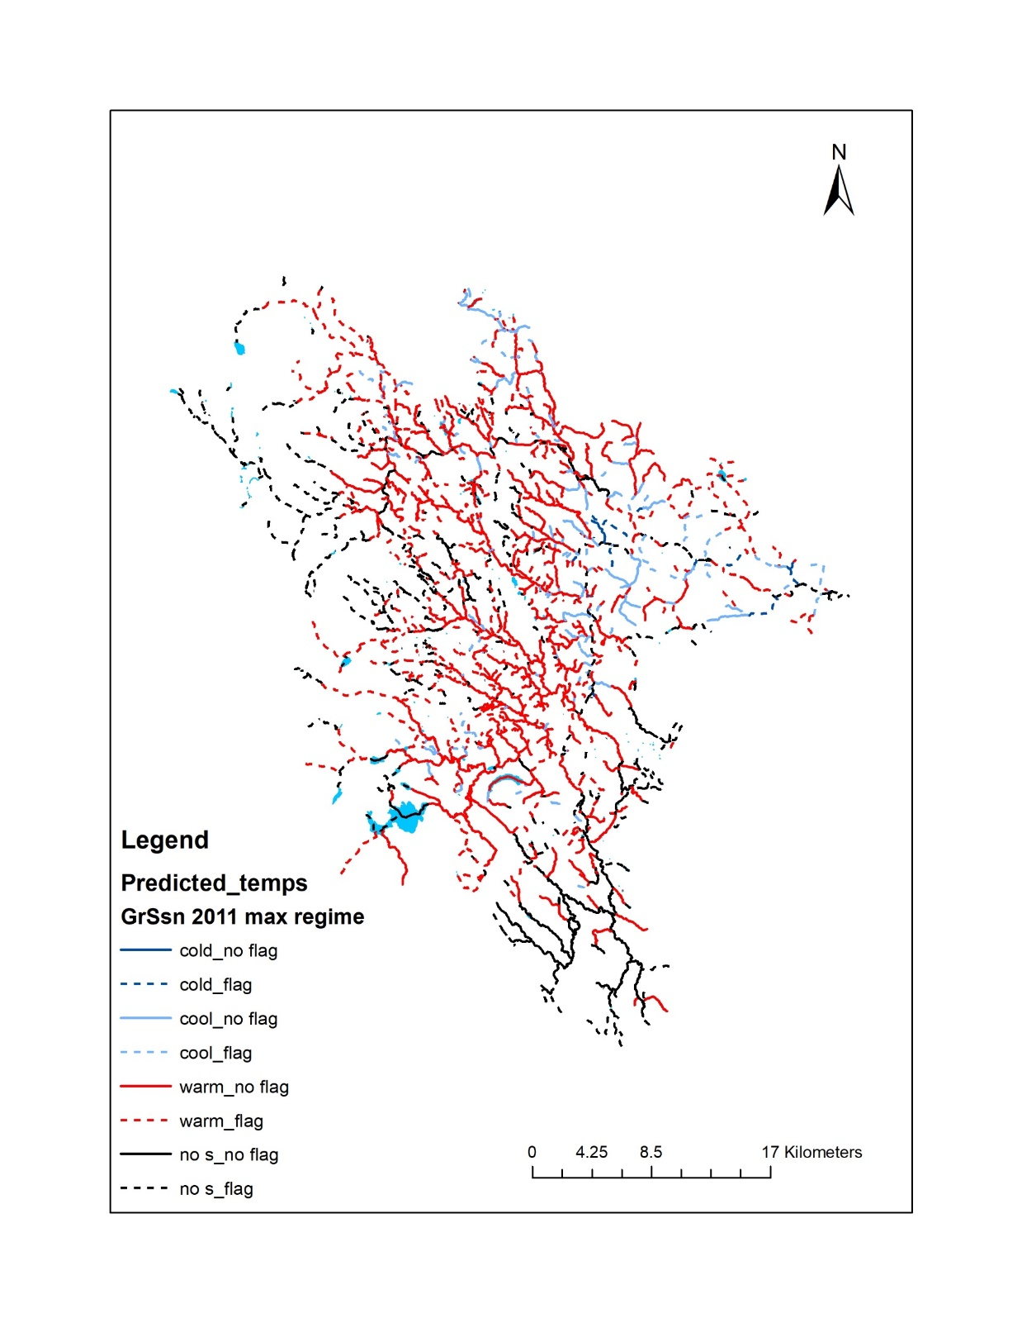
Growing season maximum thermal regime
Wet year – current conditions
Critical coldwater refuge areas in headwaters

Slide 31
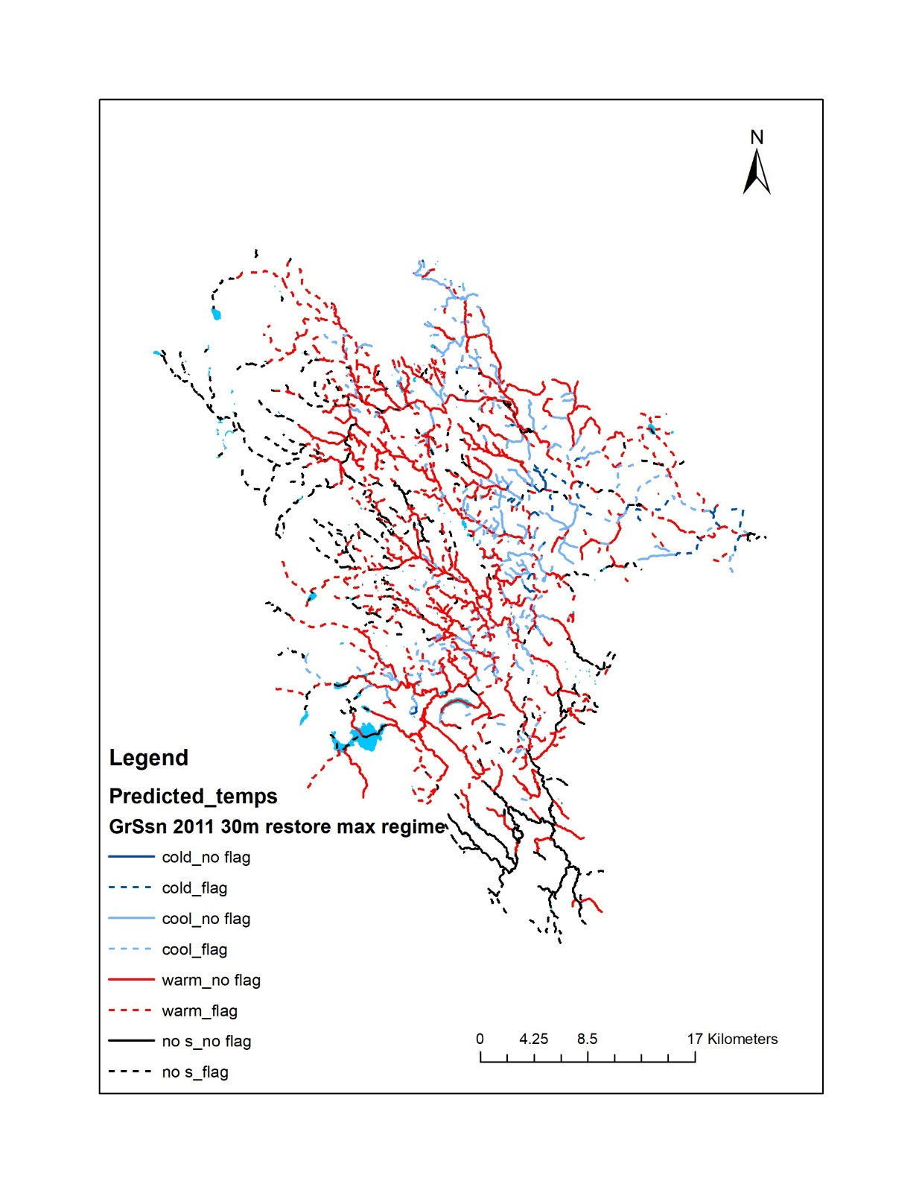
Growing season maximum thermal regime
Restored 30m width buffer
Critical coldwater refuge areas in headwaters

Slide 32
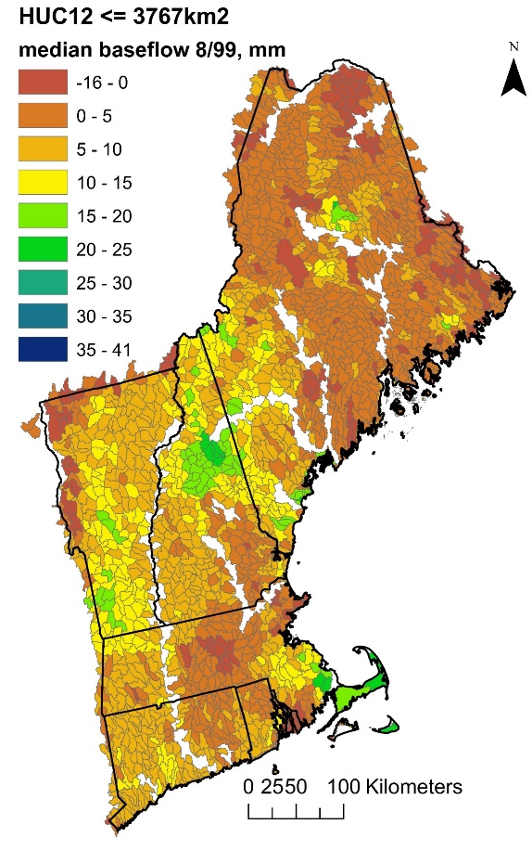
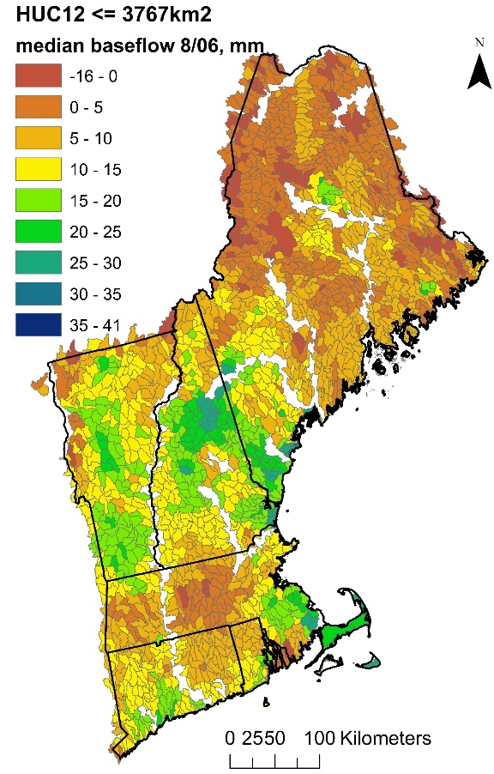
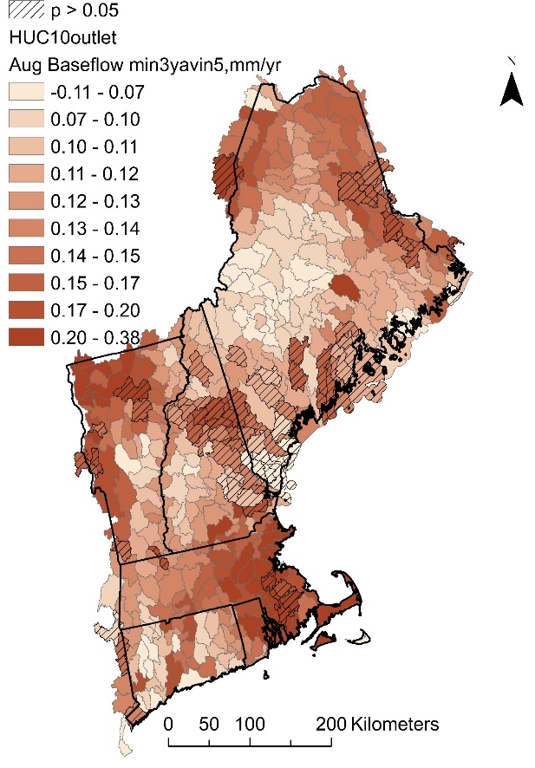
New England spatial statistical flow metric models
Base flow Aug 1999 – dry yr
Base flow Aug 2006 – wet yr
Aug base-flow
min 3-in-5 yr trend
*
* Indicator of brook trout population persistence

Slide 33
Conclusions
Potential for improved high accuracy stream temperature models, even crossing international boundaries
Potential for restoring thermal regimes through improvement of stream shading, flow regimes, stream morphometry
Most influence in first 30m width buffers
Buffer influence downstream: 3-hour travel time or 1 km
Critical current and future cold water refuge areas identified

Slide 34
Questions?
Naomi Detenbeck (detenbeck.naomi@epa.gov)
Stephanie Figary (sef92@cornell.edu)
Cara O’Donnell (water@maliseets.com)

Slide 35
Supplemental

Slide 36
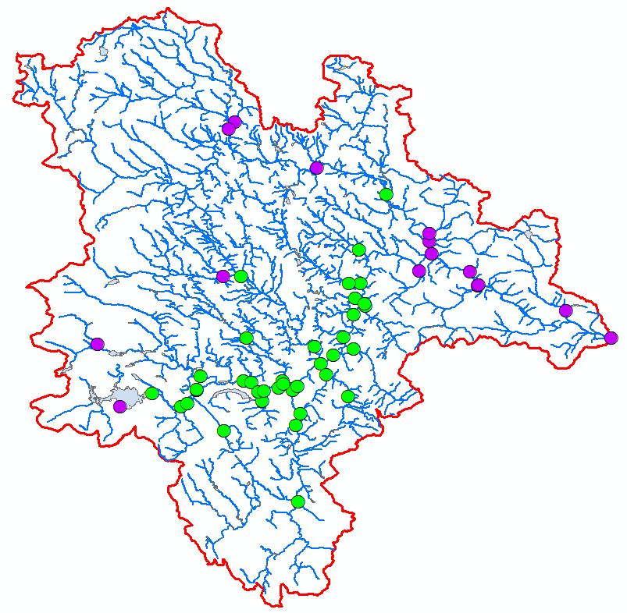
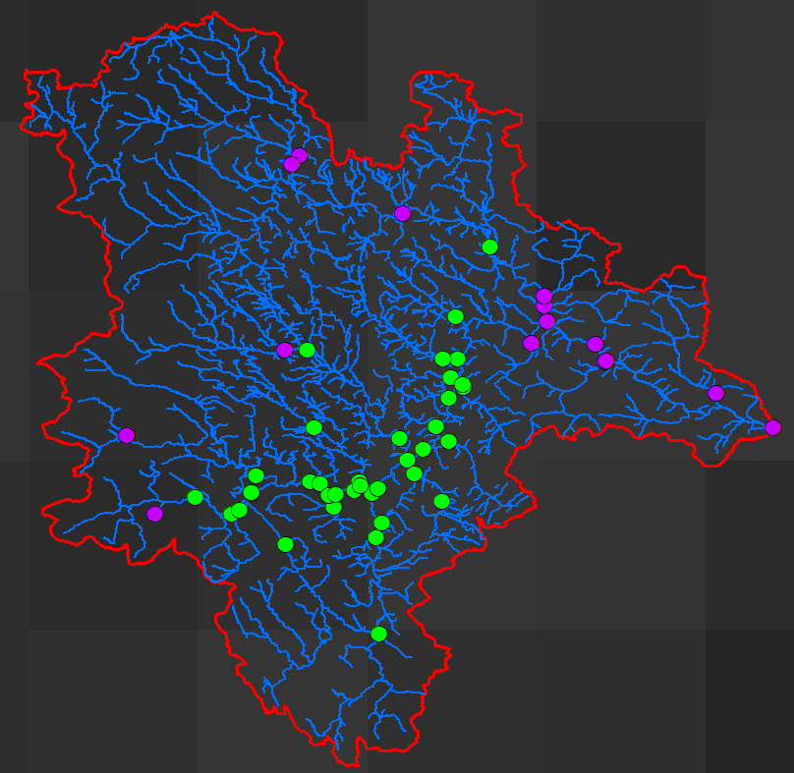
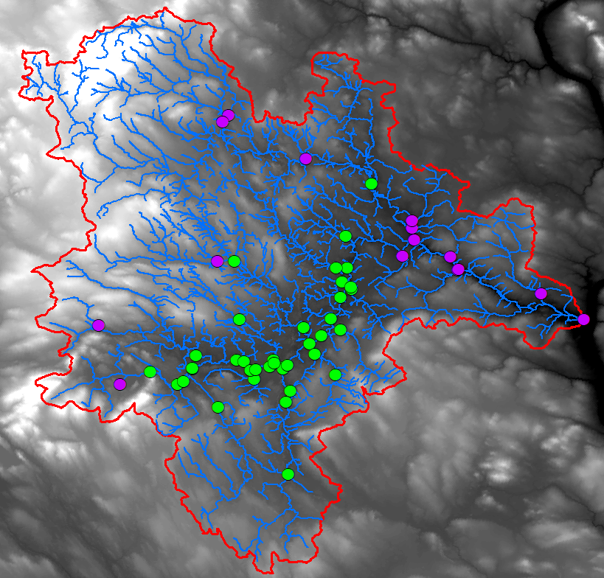
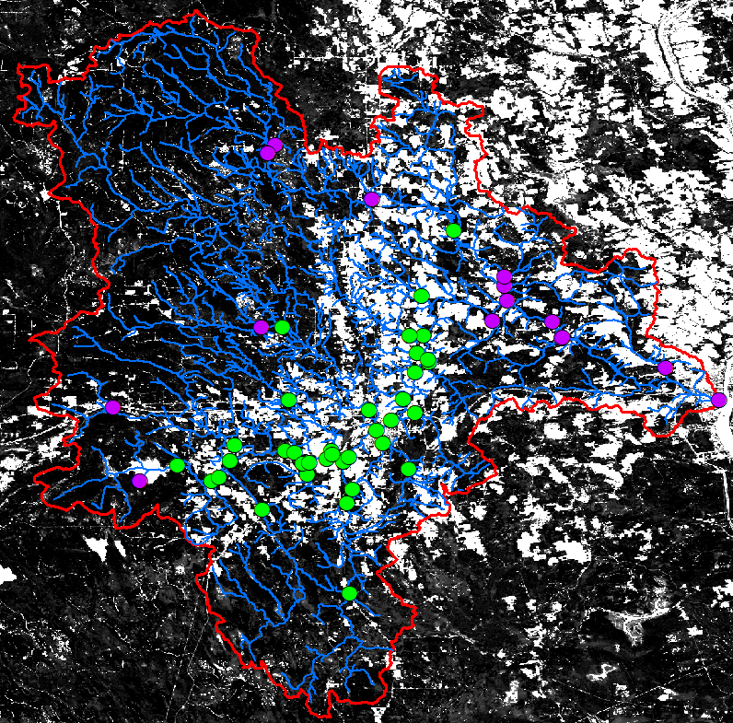
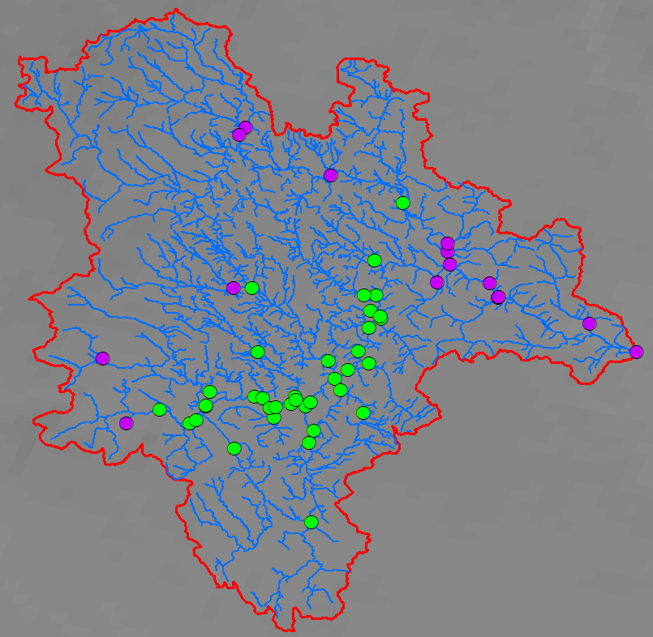
Challenge: International Boundaries
Air temperature matrix (2009-2018): DAYMET
Elevation, flowlines, discharge, velocity, lakes: NHDPlus High Resolution
Stream width and depth: Bent 2006
Canopy cover: Hansen Global Forest Change
Baseflow: Global streamflow characteristics
Lake depth: NHDPlus V2 or R package “lakemorpho”

Slide 37
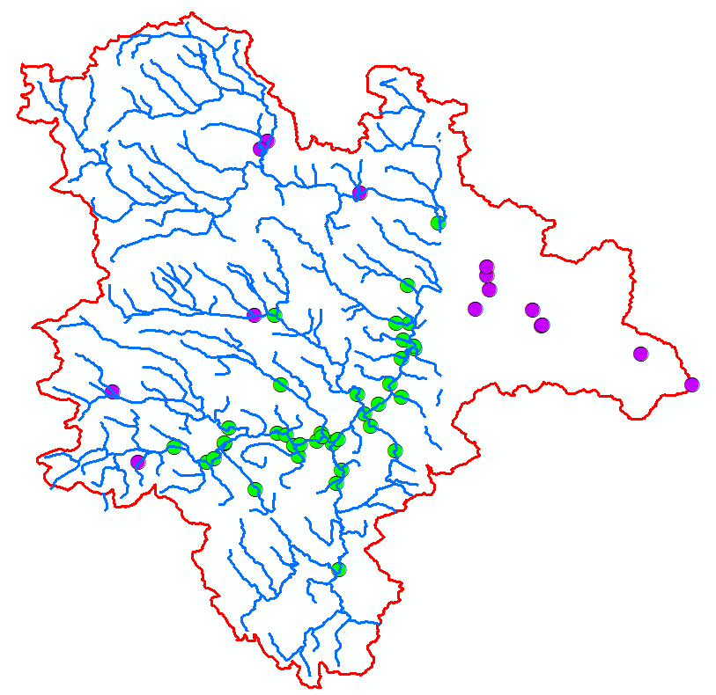
Challenge: International Boundaries
?

Slide 38
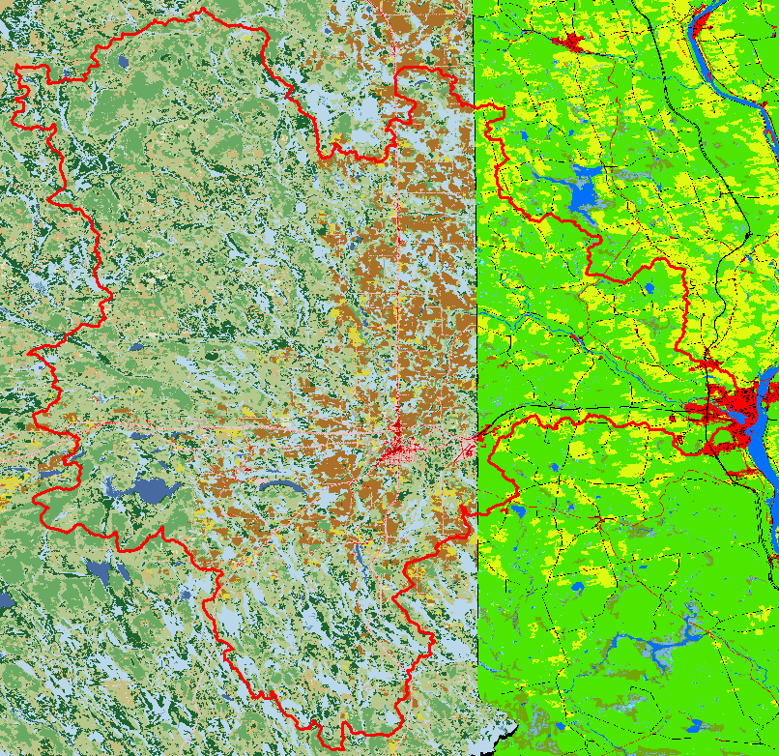
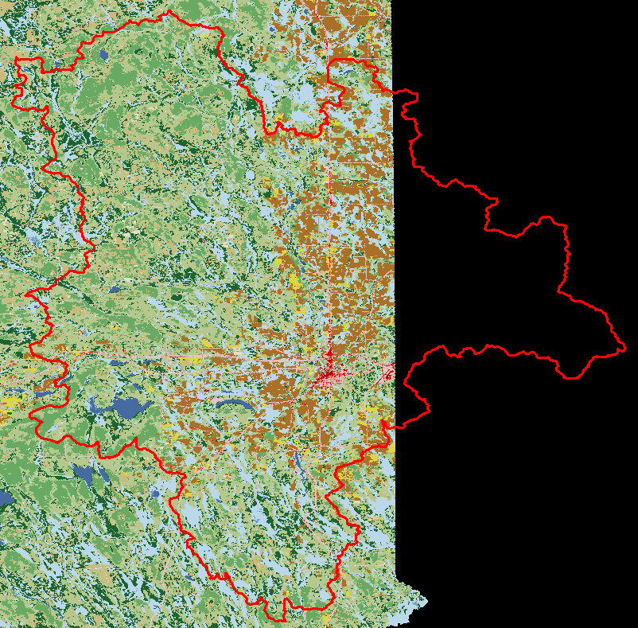
Challenge: International Boundaries
Land use:
US: National Land Cover Dataset
Canada: Land Use dataset
Existing vegetation height
US: LandFire
Canada: Some digital surface modeling, some extrapolation
Reference flow conditions
US: Miller et al 2018
Canada: extrapolation of Miller et al 2018 and Bent 2006

Slide 39
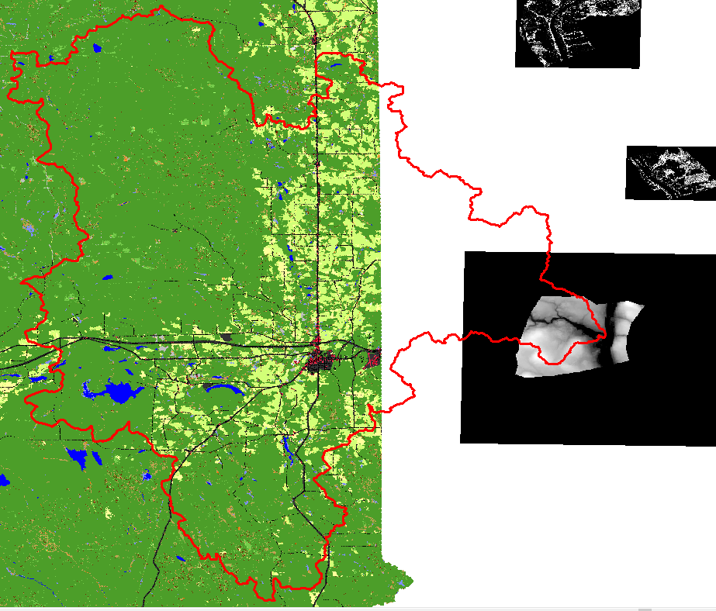
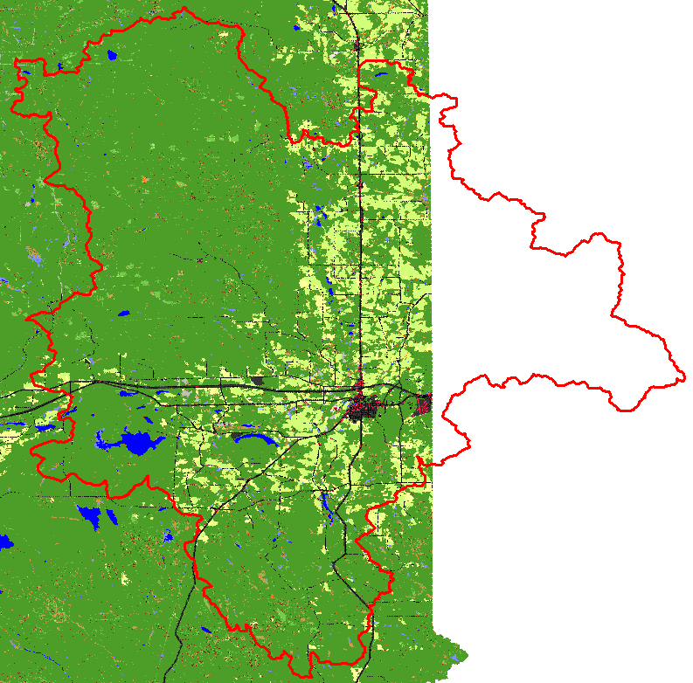
Challenge: International Boundaries
Land use:
US: National Land Cover Dataset
Canada: Land Use dataset
Existing vegetation height
US: LandFire
Canada: Some digital surface modeling, some extrapolation
Reference flow conditions
US: Miller et al 2018
Canada: extrapolation of Miller et al 2018 and Bent 2006

Slide 40
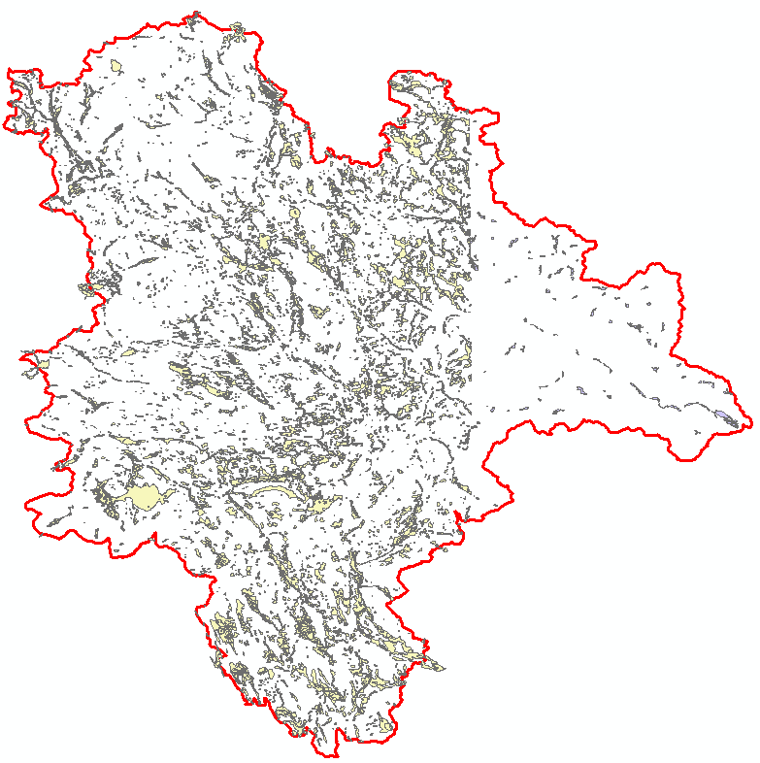
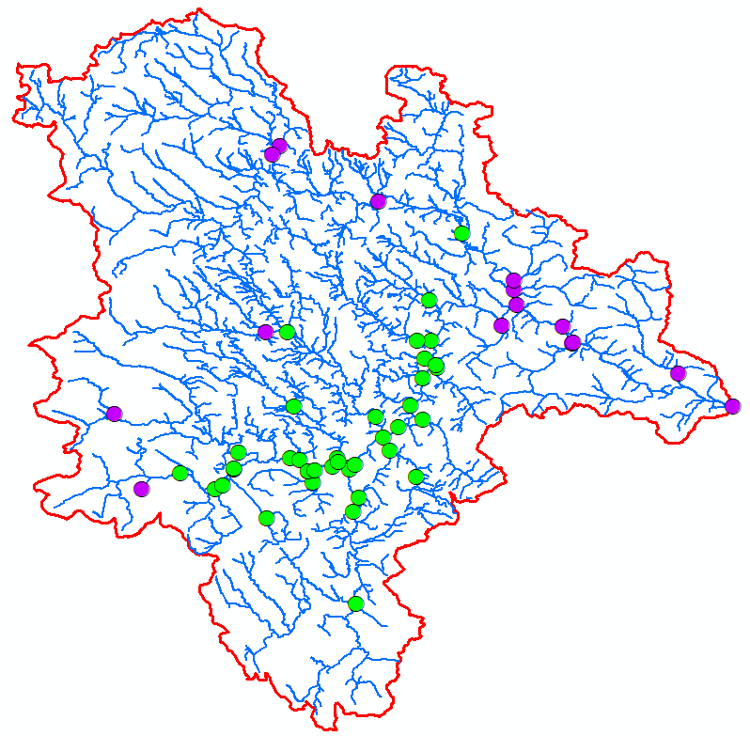
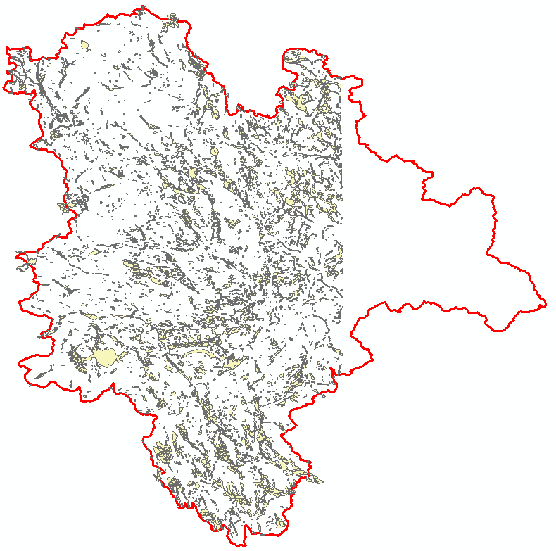
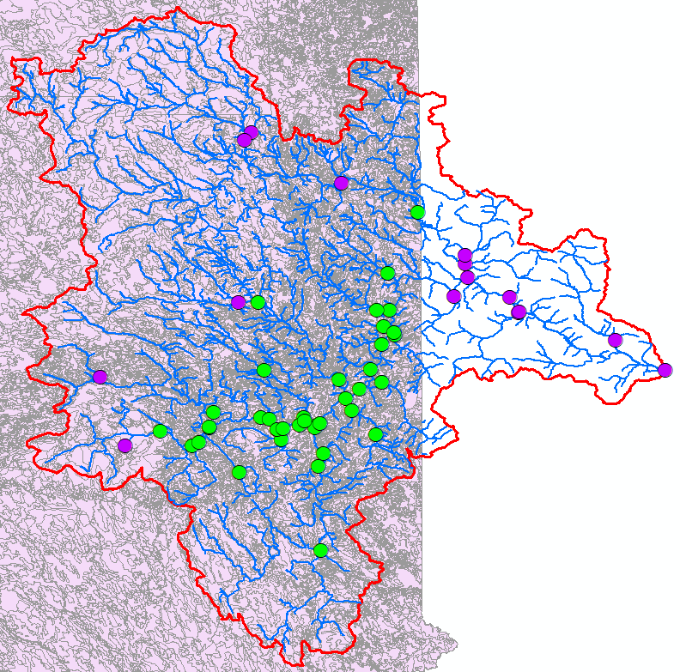
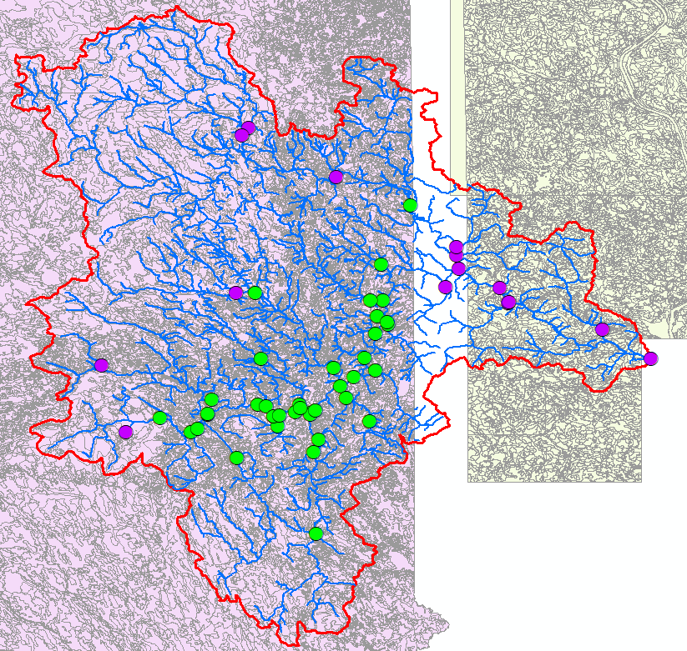
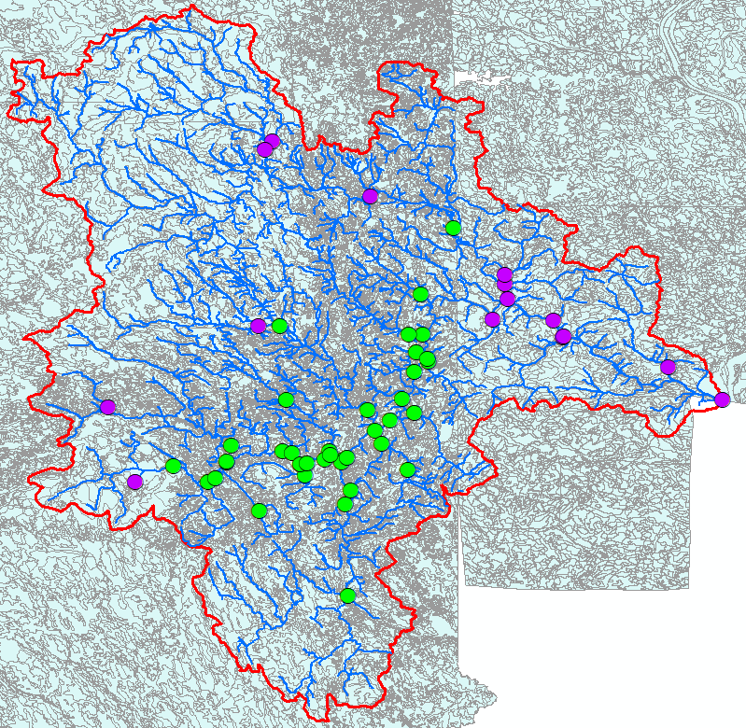
Challenge: International Boundaries
Soils:
US: SSURGO
Canada: National soils database
Wetlands
US: National Wetlands Inventory
Canada: New Brunswick wetlands
Added parameters for:
% watershed in USA
Dummy variable
?
Rubbersheeting
?

Slide 41
Challenge: International Boundaries
Soils:
US: SSURGO
Canada: National soils database
Wetlands
US: National Wetlands Inventory
Canada: New Brunswick wetlands
Added parameters for:
% watershed in USA
Dummy variable
?
Rubbersheeting
?

