Slide 1
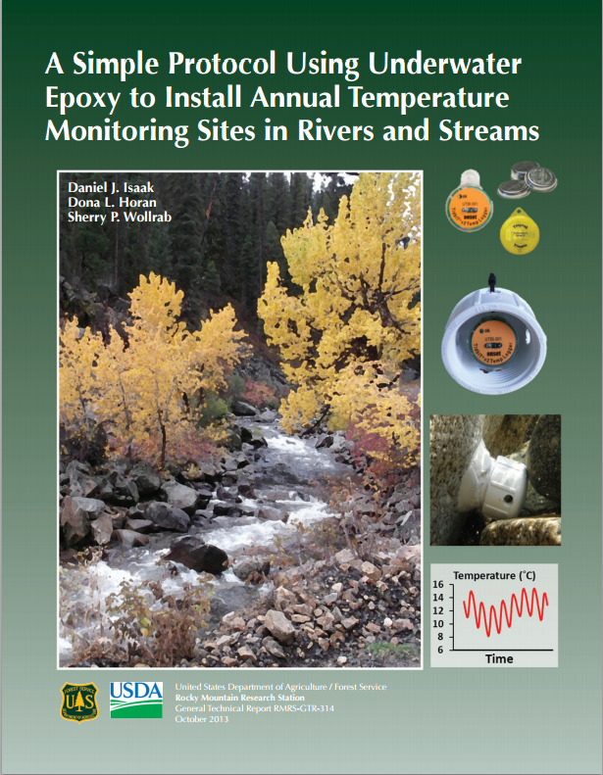
Notes:
USFS and Rocky Mountain Research Station protocol, published in 2013. Dan Isaak.
“Annual monitoring sites that use underwater epoxy to attach miniature sensors to large rocks and cement bridge supports, which then serve as protective anchors”
Out of 179 revisited sites, 88-100% sensors in <3% streams were retained.
70-78% of sensors in >3% streams were retained.

Slide 2
Why This method?
Good for annual sites
Inefficient to go out and retrieve loggers every season
Less prone to abrasion or burial by substrate
Less gear for remote sites
88-100% Retention in low gradient streams (<3%)
70%-80% retention in high gradient streams (>3%)
Ice scour factor!!!
Notes:
How to establish annual monitoring sites in a dynamic setting.
Can be re-visited.
Efficient- less visitation required (relies on long battery life, large data storage capacity)
Less prone to abrasion or burial by substrate (other methods, logger is in the stream bed itself)

Slide 3
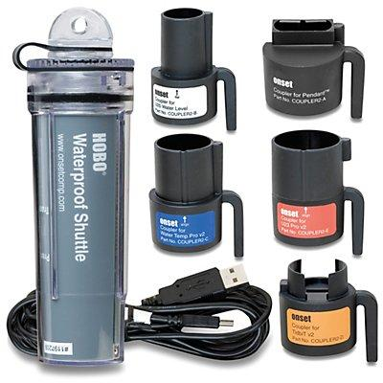
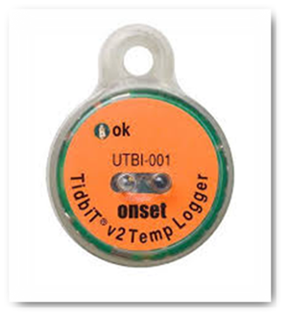
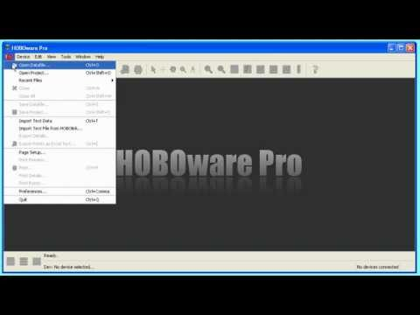
Materials
Onset UTBI-001 Tidbit V2
Water Temperature Data Logger ($133)
HOBO® Waterproof Shuttle U-DTW-1 ($249)
HOBOware Pro ($99)
Notes:
Tidbit accuracy (+/- 0.2 celsius), low annual drift rate (0.1 degrees C/year), large memory and long battery life (5+ years w/ 1 minute or greater logging interval), waterproof casing, ease of data retrieval w/ portable data shuttle or field computer. Waterproof up to 305 m (1000 feet).
Stores 64K of data

Slide 4
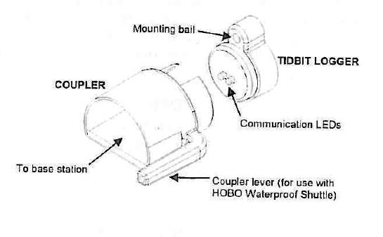
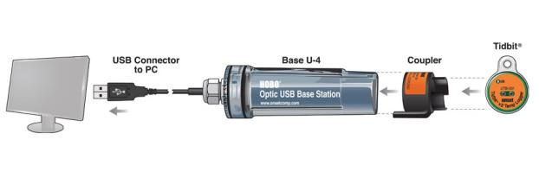
Launching your loggers
Immediate Launch
Delayed Launch
Triggered launch
Notes:
OK, so how do you get ready
Why choose certain launches.
Immediate Start: Blinks 1x every 1-4 seconds, light will blink faster if logging intervals are shorter
Delayed Start: Blinks 1x every 8 seconds
Triggered Launch: Any strong magnet placed near the face of the logger will trigger the launch (the coupler usually). Will rapidly flash 4x to indicate successful launch

Slide 5
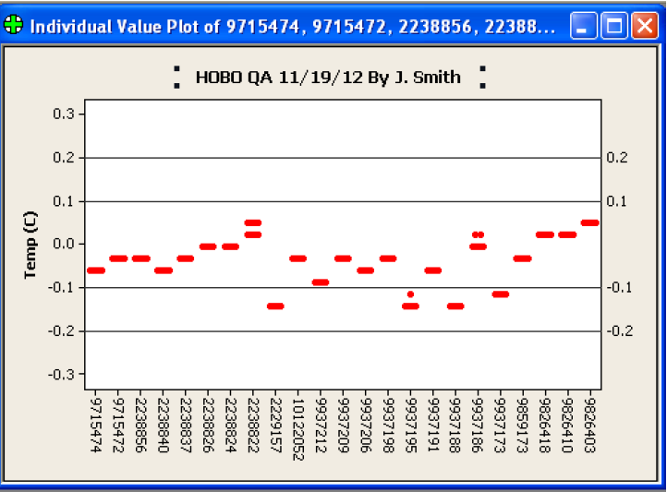
Logger calibration
Notes:
Data loggers should be checked for accuracy before field deployment using the following procedures…but they’re usually really accurate.
Ice bath Method – compare with NIST thermometer.
Uniform 0 degrees Celsius. Check to see if all were within the tolerances of the NIST recorded temperature
Also just good to practice launching and software, confirm battery is working, etc.
Many different protocols!!!

Slide 6
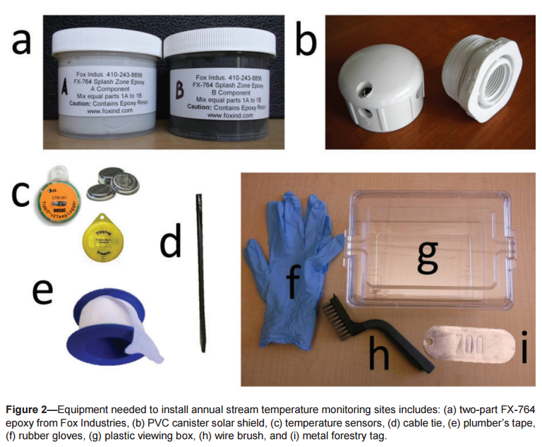
Notes:
FX-764 Hydro-Ester Splash Zone Epoxy, manufactured by Fox Industries (Baltimore, MD)
Importance of solar shields. PVC must have lip because epoxy will not adhere directly to PVC (or plastic culverts). 3/8 inch holes to facilitate water circulation. Plumbers tape wrapped to ensure easy removal of cap after extended deployment.
Can paint the PVC to camouflage it…

Slide 7
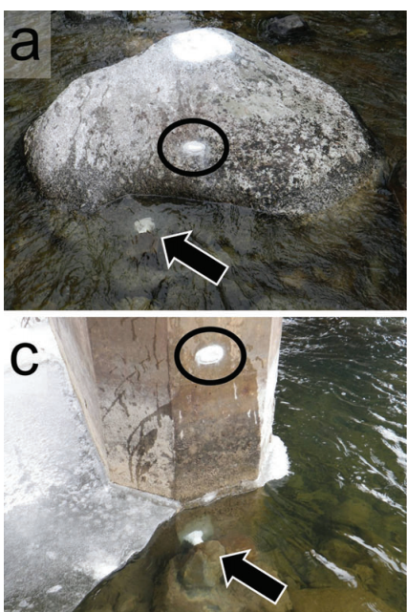
Step 1: Site Selection
Large rocks or cement structures
If you can move a rock, it’s too small!
Submerged year-round
Notes:
This is the most important step for establishing an annual monitoring site.
Flat downstream surface shielded during floods
Downstream side should have pocket of calm water with smaller substrate
Sheltered from main flow path, but with mixed flows and eddies

Slide 8
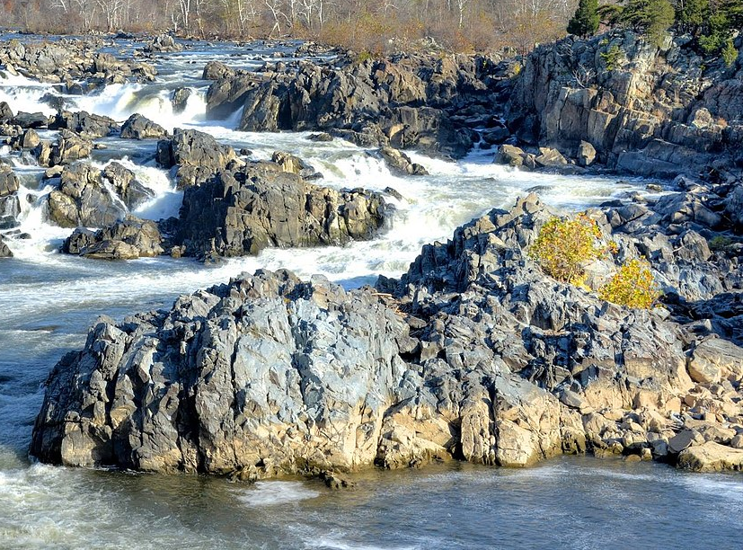
Look for a flat face on the downstream side w/ low flow, below the low water mark, above streambed to avoid burial by substrate
Avoid undercuts! High erosion/lost logger potential.

Slide 9
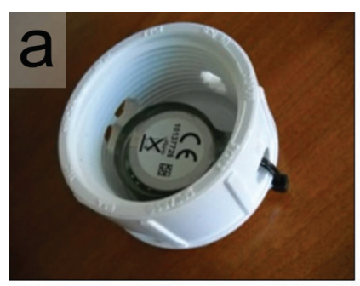
Step 2: fasten the sensor
Check that the sensor light is blinking
Record serial number of the sensor and the forestry tag on datasheet
Fasten sensor into PVC cap with cable tie, screw cap on base.

Slide 10
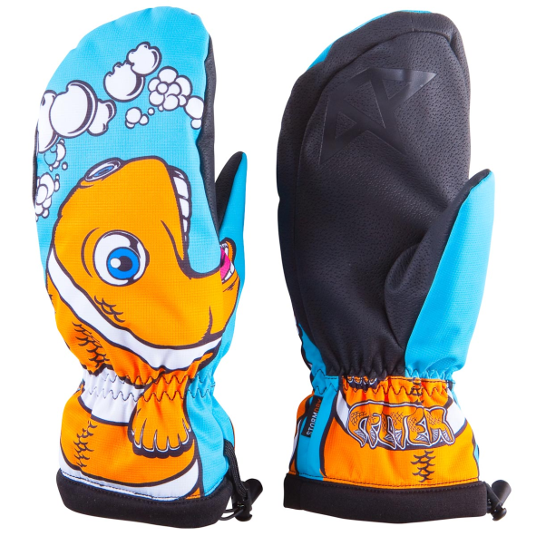
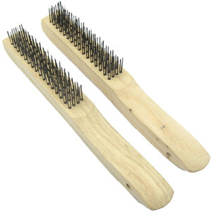
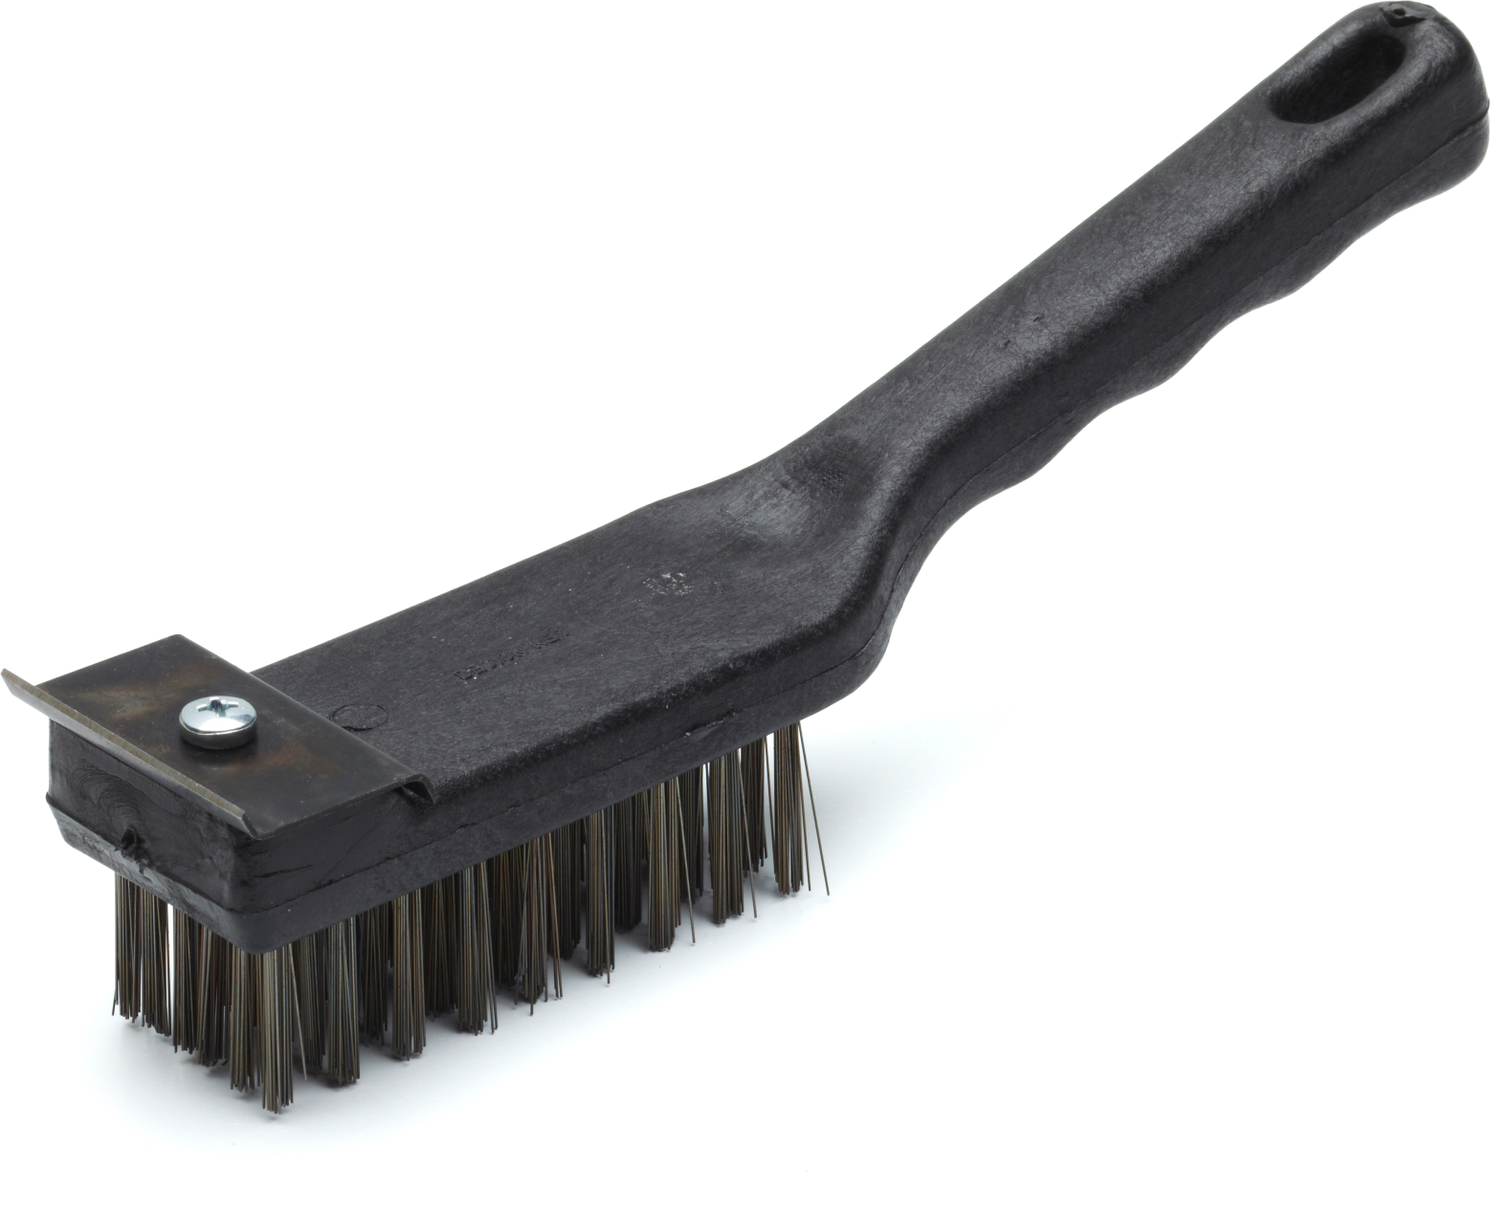
Step 3: Prepare the site
Put on rubber gloves
Use wire brush to scrub surface
Below low flow but above streambed- don’t want to be buried!

Slide 11
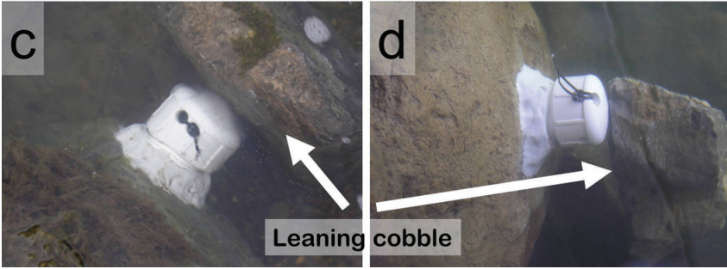
Step 4: grab a cobble

Slide 12
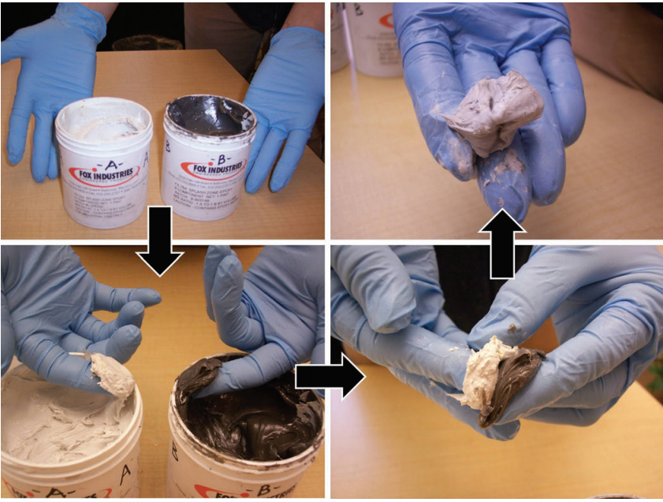
Step 5: mix the epoxy
Notes:
WET gloved fingers in stream
Scoop out equal amounts of white and black epoxy
Mix until gray color achieved (about 1 minute)
Roll into tube shape, apply to base of PVC canister
Should be about size of a golf ball
Set aside a small amount for the forestry tag
Mold over the lip. Don’t cement the cap to the base!

Slide 13
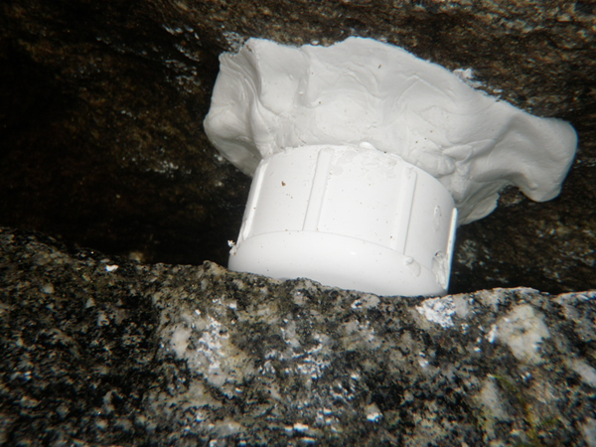
Step 6: attach the logger
Push and slowly twist on to the attachment site
Gently lean cobble against the PVC
Takes 24 hours to set!
Notes:
Steady pressure with no torque.

Slide 14
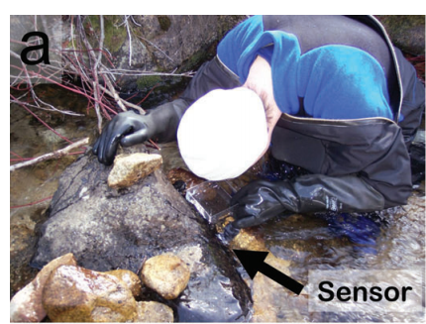
Step 7: view your work
Use the plastic viewing box to inspect your work
Use fingers to mold epoxy onto attachment surface

Slide 15
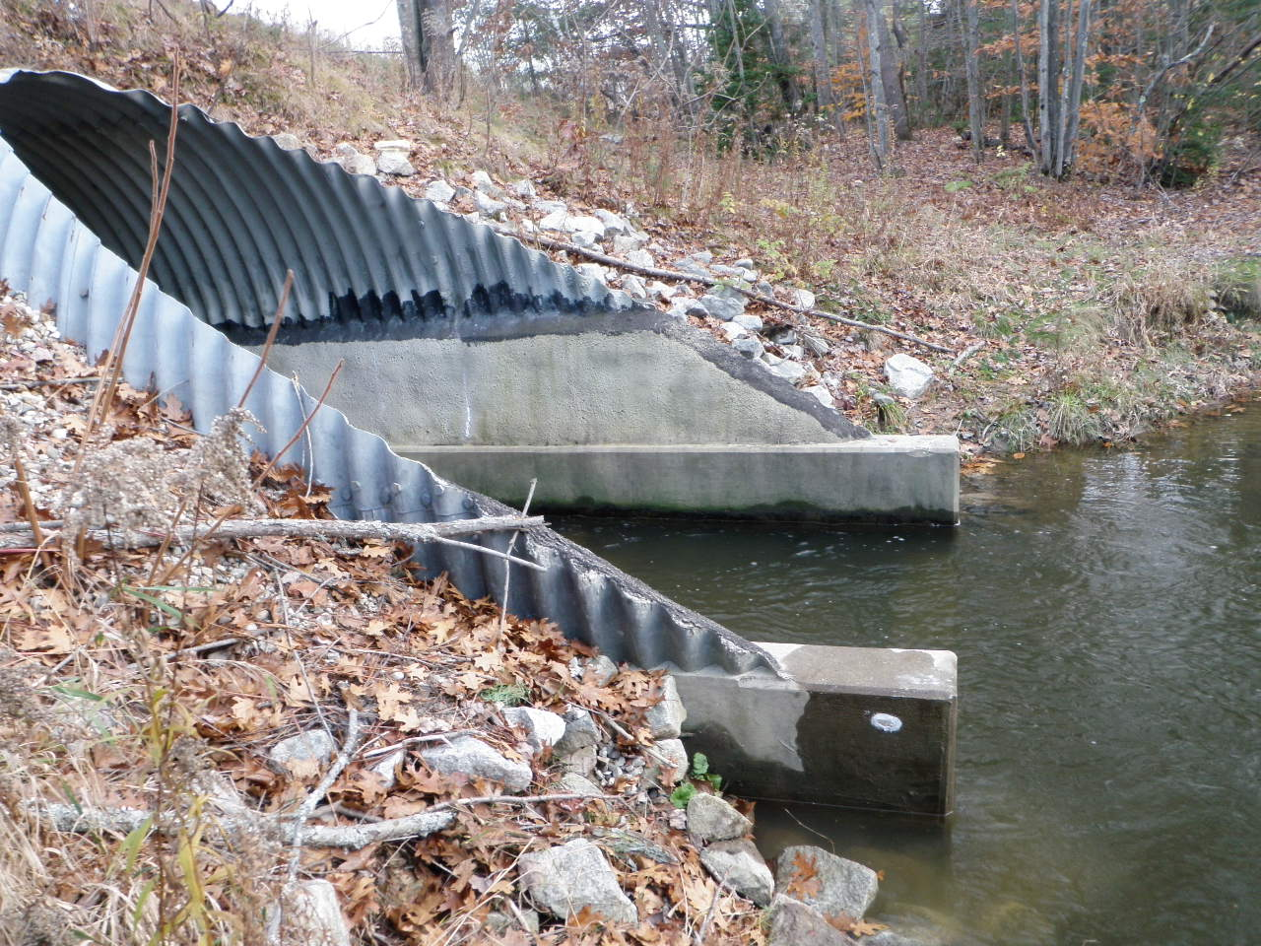
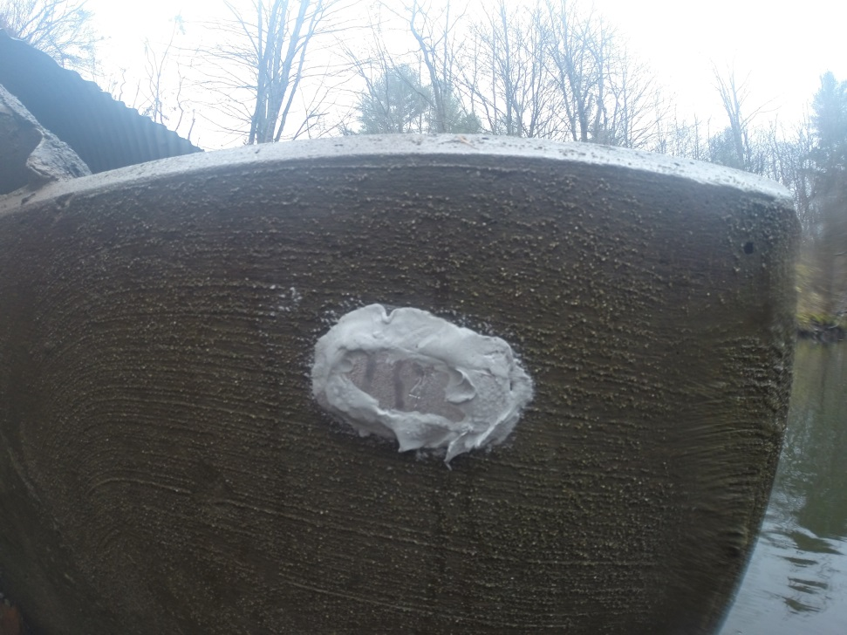
Step 8: forestry tag
Save some epoxy to attach the metal forestry tag
Easy to relocate the sensor
Notes:
Becomes a unique site ID

Slide 16
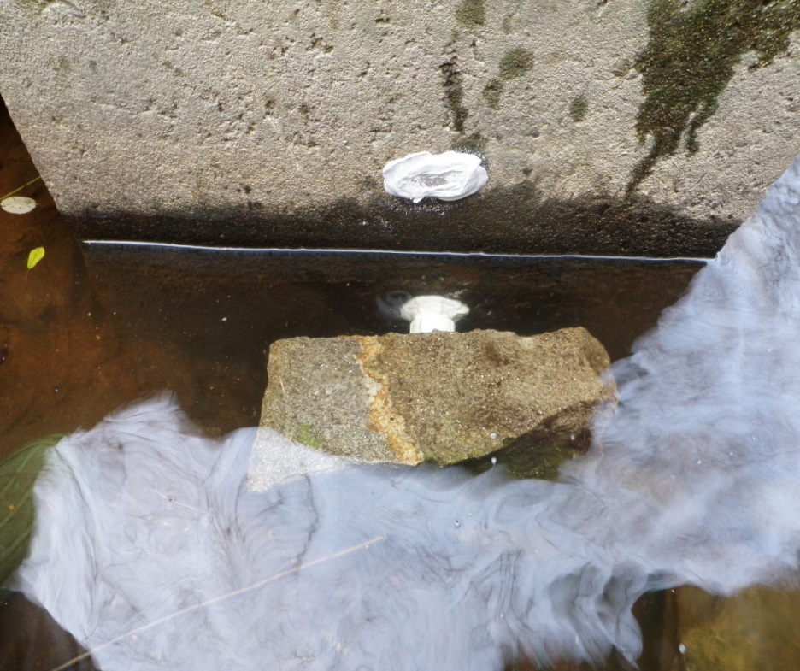
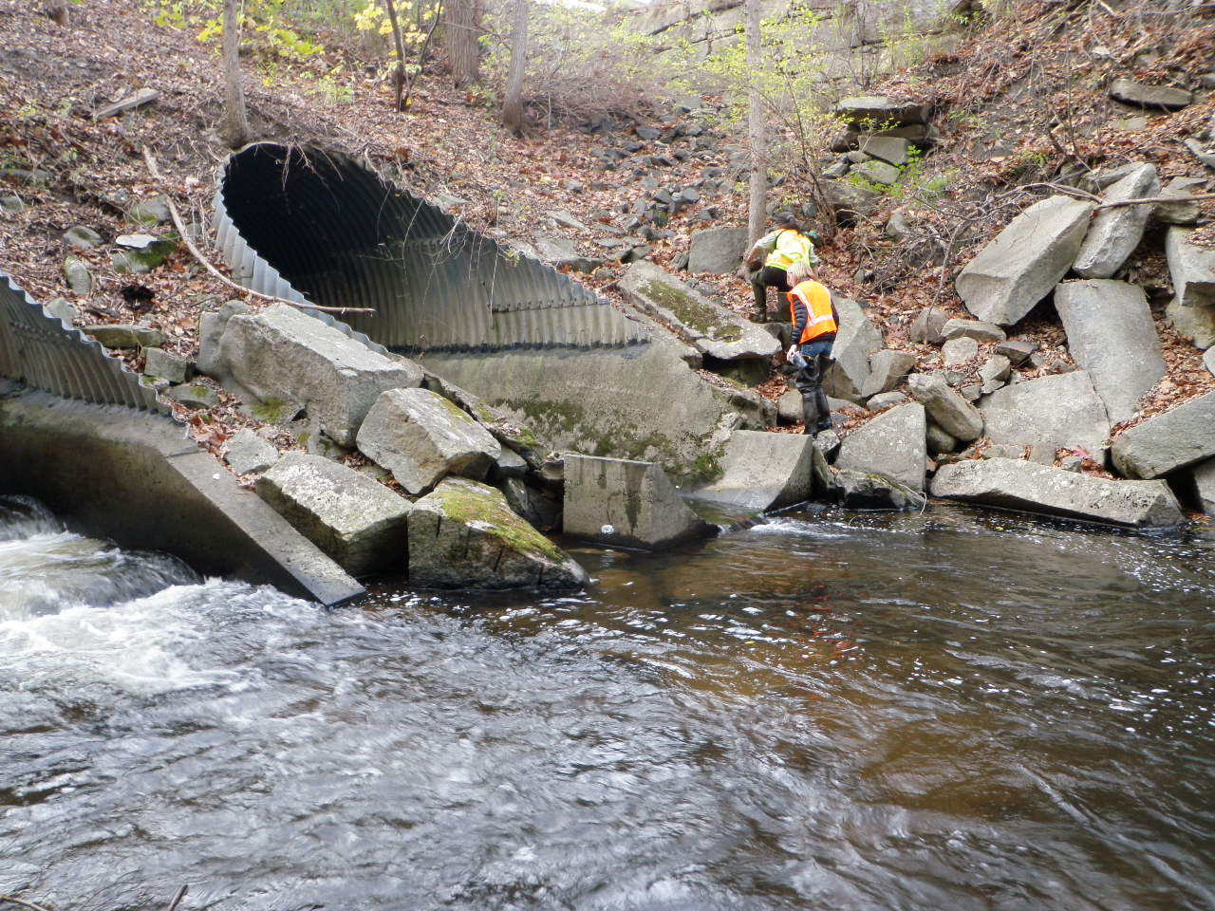
Step 9: record data
GPS point
Take photos of the attachment site and surroundings to aid in relocation
Fill out the datasheet!
Notes:
Describe features like upstream, downstream, X number of meters from X, etc.
Permanent landmarks/references
Water temp in
Site sketch, photo ID numbers

Slide 17
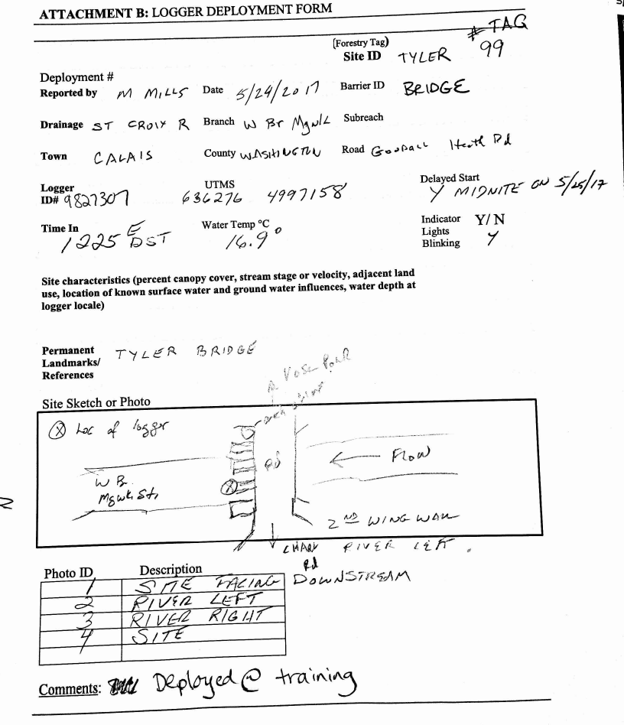

Slide 18
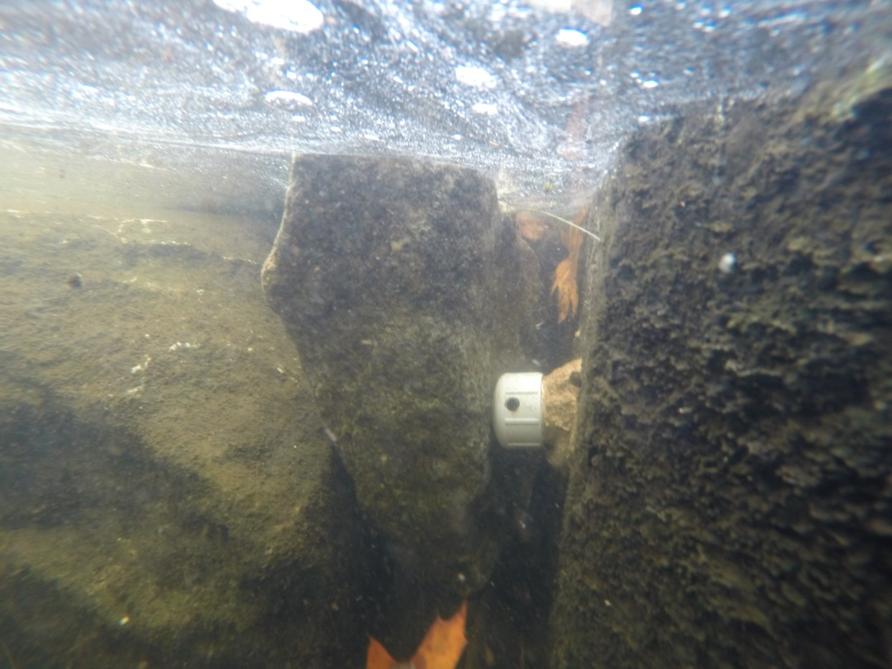
Mid-season site checks
Visit to verify site was successfully established
Transfer data to a data shuttle or field computer
Use NIST thermometer to serve as calibration point
Notes:
First often, then annually, then less

Slide 19
