Slide 1
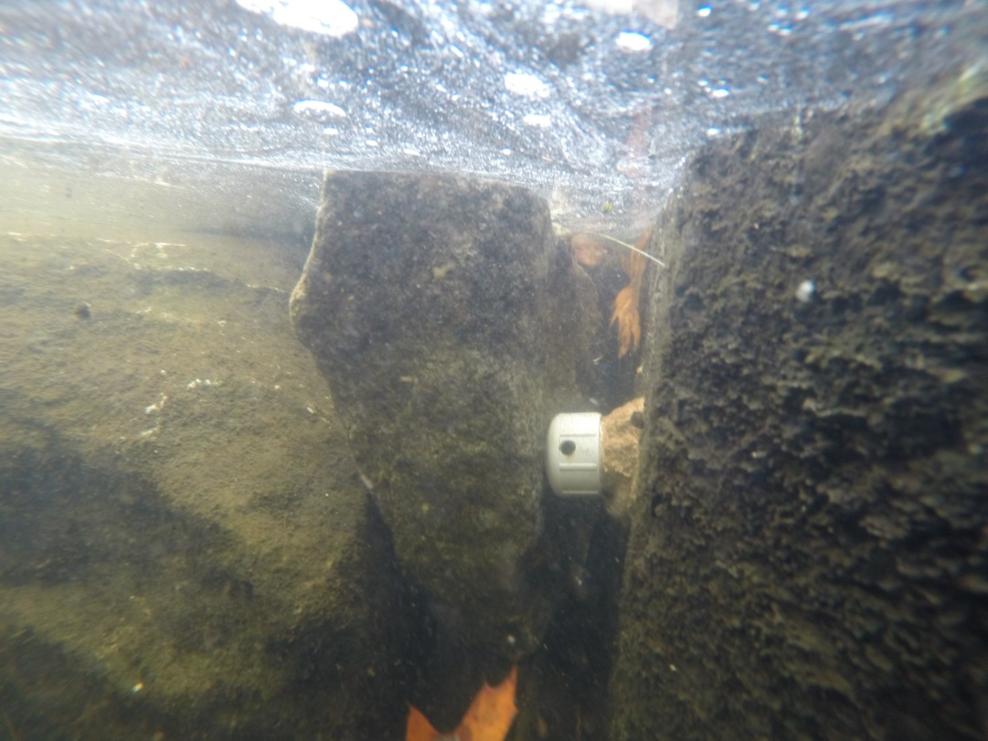
Stream Grade Considerations for Epoxy Method
Kirstin Underwood, USFWS
Water Temperature Working Group Meeting, 12/2/19

Slide 2
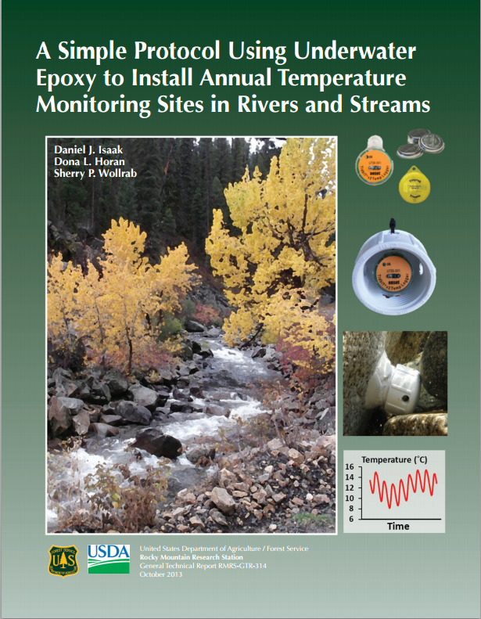
Temperature Monitoring Summary
2013 Protocol (epoxy with PVC canisters):
“In low-gradient streams (<3%), 100% of sensors (13 of 13) were successfully retained [after one year]. . .78% of sensors were retained in steeper streams.”
2010 Protocol (sensors epoxied to rocks without PVC):
“One-year retention rate: 88% in low-gradient streams and 70% in steeper streams, possibly due to unusually high snowmelt flood in 2011. . .second year retention rate slightly higher at 90% and 84%.”

Slide 3
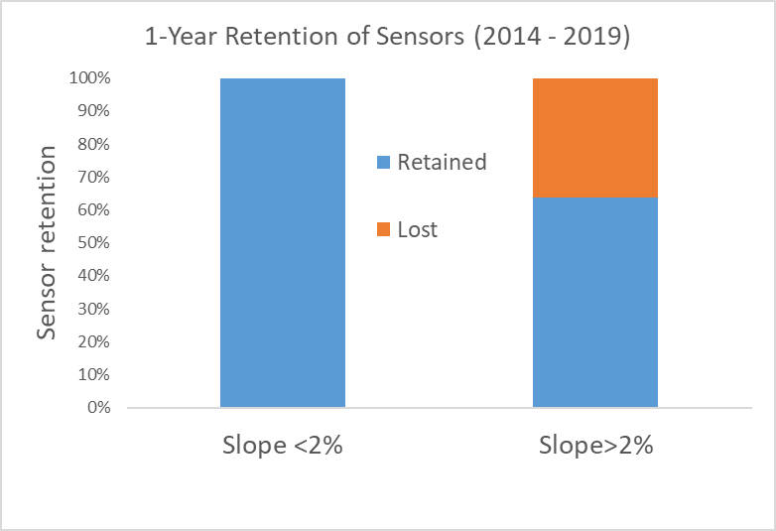
Summary of Logger Retention and Stream Grade
No sites in streams >3% slope
Most loggers lost in streams >2% slope
Total retention throughout entire sampling period (2015 – 2019, n=18): 72%
Low gradient streams (<2%):
1-year retention (n=7): 100%
2-year retention (n=7): 100%
4/5 loggers lasted 5 years!
High gradient streams (>2%):
1-year retention (n=11): 64%
2-year retention: TBD
1 logger lasted 5 years
Most loggers lost in high-gradient streams 2017 – 2018
Ice scour/flows/age of epoxy/site selection all factors
n = 7
n = 11

Slide 4
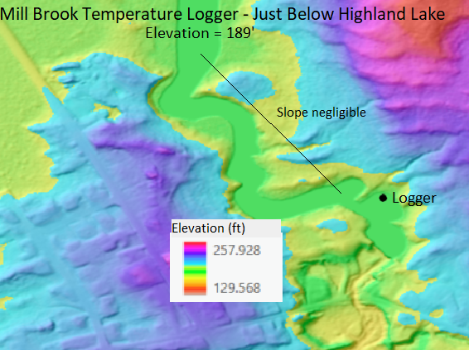
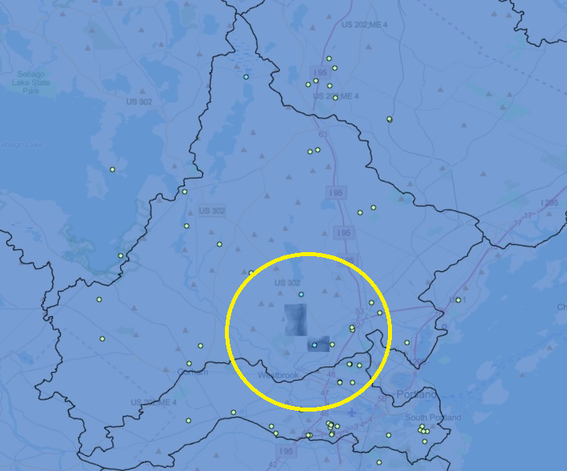
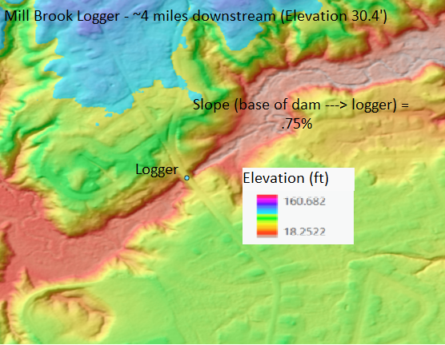
Low Gradient Streams (<2%): Presumpscot Watershed
2 sites on Mill Brook
Highland Lake: Active 2014 – 2019
Negligible Slope (189’ at base of dam and logger location)
Austin St: Active 2014 – 2018
4 miles from dam, elevation 30.4’
189 – 30.4 / 21,120 =.0075
.75% slope (base of dam to logger)
Active 2014 – 2018; lost in high flows 2019
(Austin St)

Slide 5
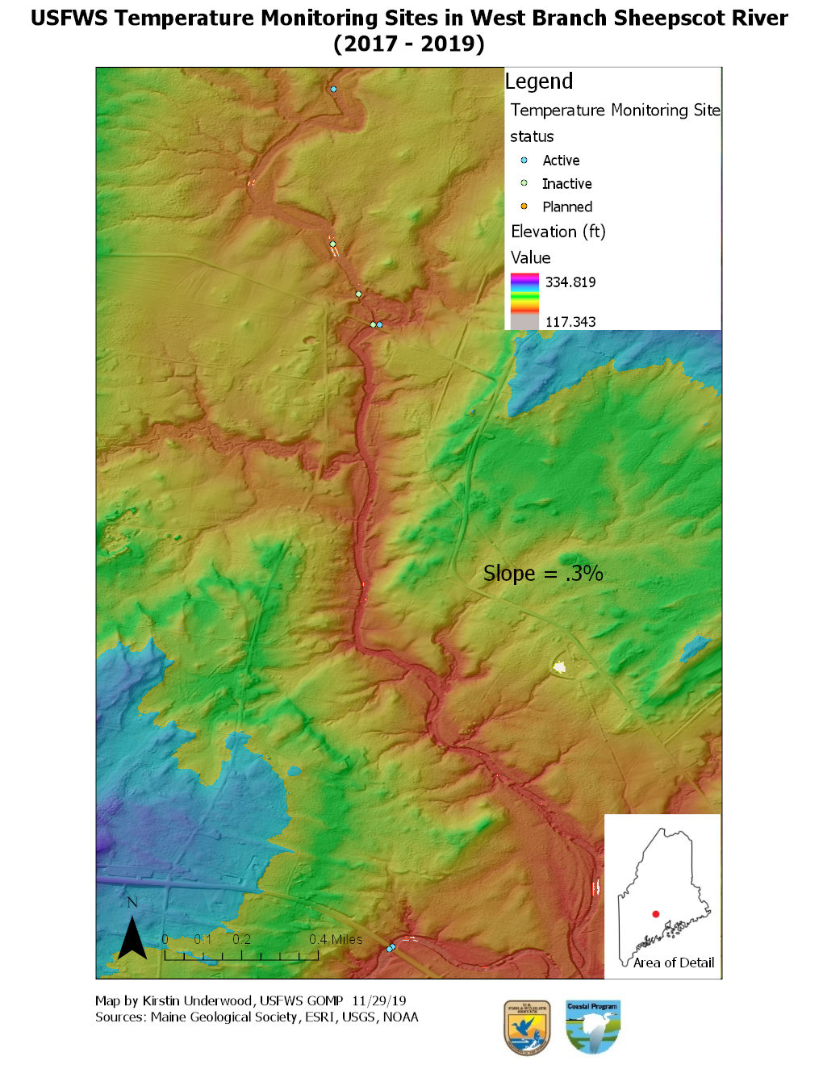
Low Gradient Streams (<2%)
Sheepscot/St George Watershed
(2017 – 2019): .3% slope
Retired Southern Maine sites (not shown)
Piscataqua River: 1 logger active 2014 - 2019
1.7% slope
Alewife Brook (Casco Bay watershed): 1 logger active 2014 – 2019
.1% slope
Summary
2 years: 100% retention (n = 7, 2% slope or less)
5 years: 75% retention (n = 4, 2% slope or less)

Slide 6
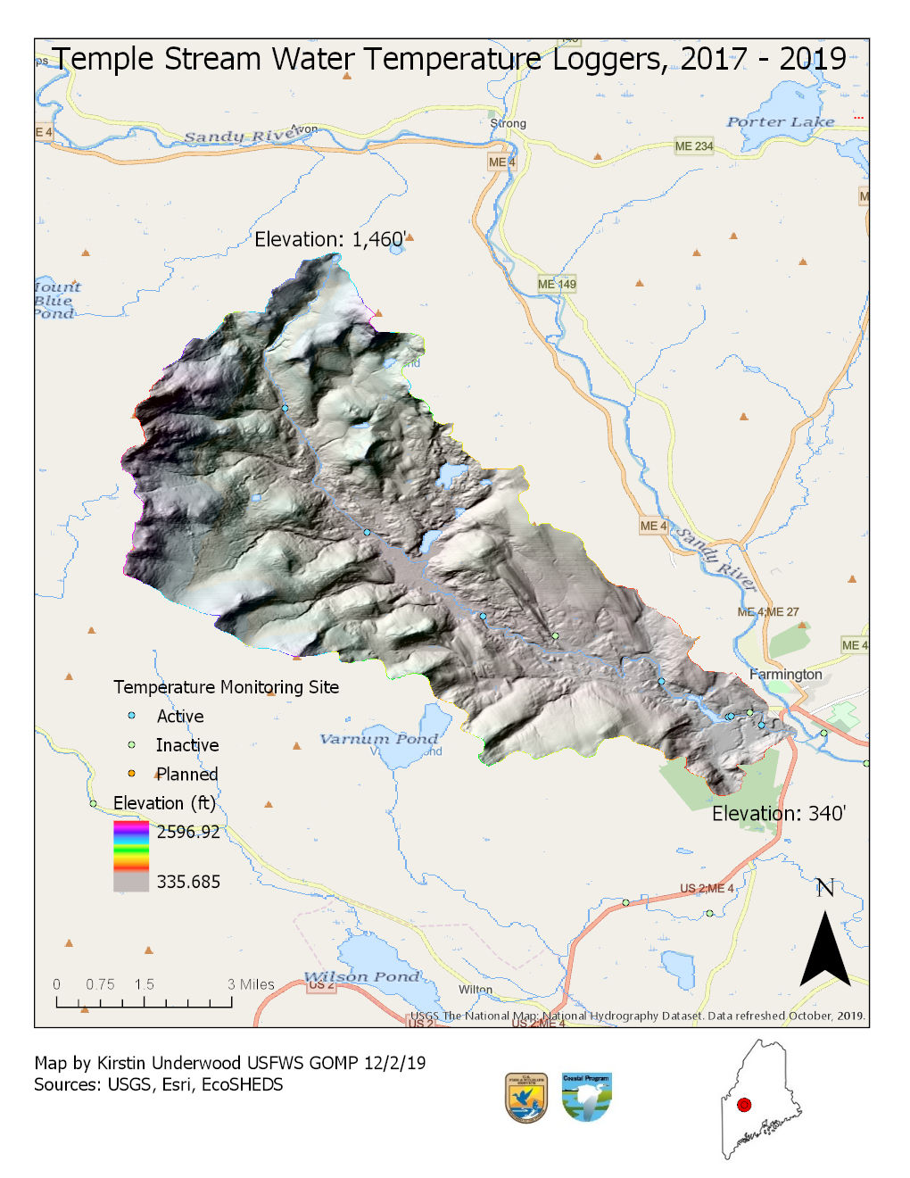
High Gradient Streams
Swett Brook (Crooked River trib): 2.2% slope
1 logger intact 2014 – 2019 (and counting)
100% 5-year retention rate (tiny sample size, n=1)
Temple Stream: 2.5% slope
2017-2018: 5 loggers placed, 3 lost (40% retention!)
2018 - 2019: 4 new loggers + 1 replacement, 1 lost (same replacement site – 80% retention)
Remaining 2017 sites (2) still present after 2 years
Total 2-year retention rate: TBD
Overall 1-year retention rate of high gradient streams (n=11): 64%
1460’ – 340’ = 1120’
1120’/45640’ = .0245
Slope = 2.5%

Slide 7
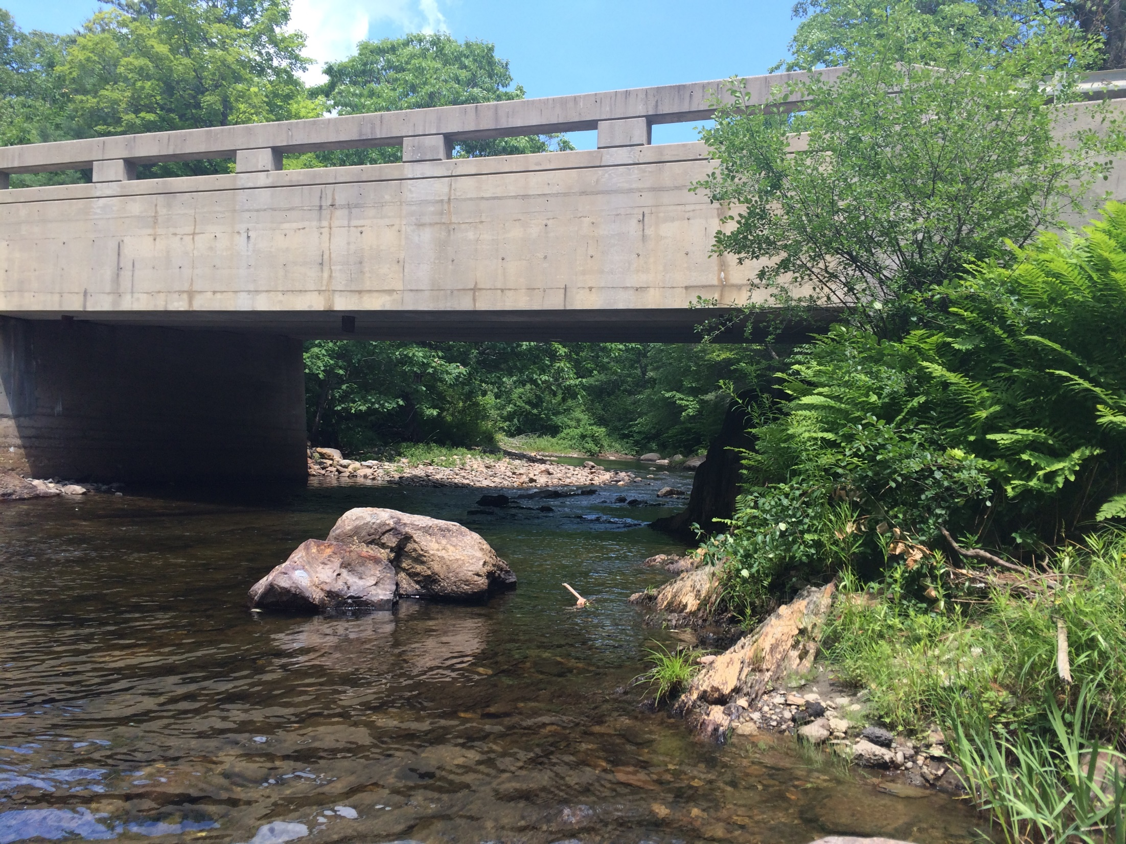
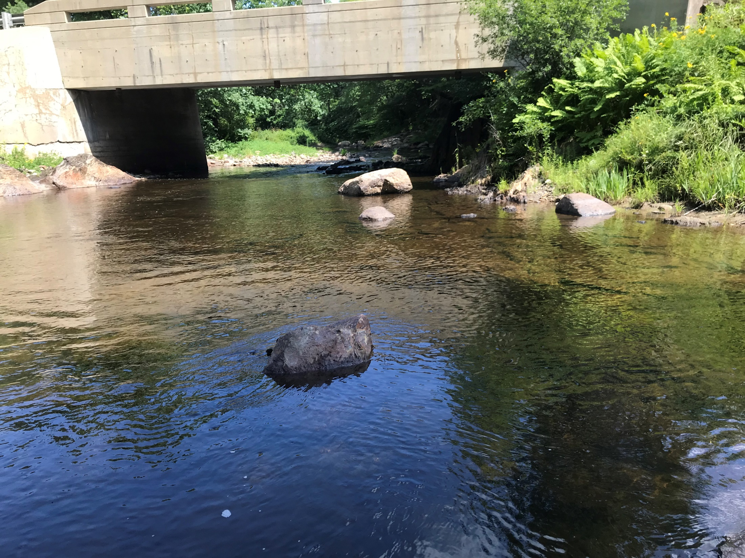
Check loggers more frequently and attach to bigger boulders if epoxy method is used in steep mountain streams with many tributaries!

Slide 8
Questions?

