Slide 1
The Maine Interagency Stream Temperature Monitoring and Modeling Network
Merry Gallagher, Native Fish Conservation Biologist

Slide 2
The Network’s specific goals:
expanding a statewide sensor network and managing a comprehensive, interagency stream temperature database
contributing data to an existing online stream temperature model that incorporates drivers that affect temperature
using the model to predict historic and future patterns in stream temperatures streams
translating stream temperatures to thermal habitat maps to assess species distributions and climate relationships across Maine
outreach to resource managers, landowners, and NGOs how to participate in the Network and use its products

Slide 3
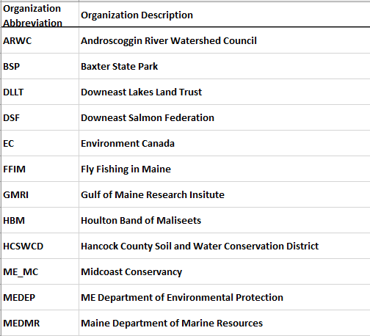
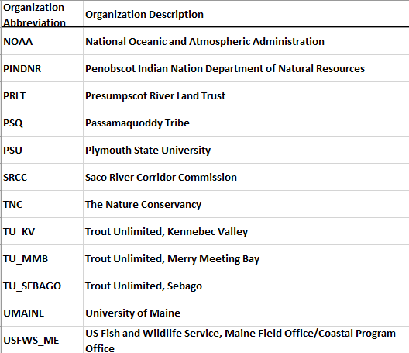
The Network’s current members:

Slide 4
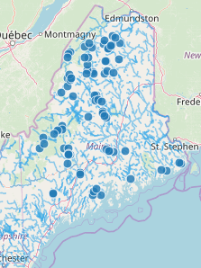
N = 79 sites monitored by IFW
http://ecosheds.org/

Slide 5
The Northeast Stream Temperature Model:
The stream temperature model is a nested hierarchical Bayesian model that predicts daily stream temperature based on catchment characteristics and climate conditions. An early version of this model can be found in Letcher et al. (2016).

Slide 6
Lots of calculus!

Slide 7
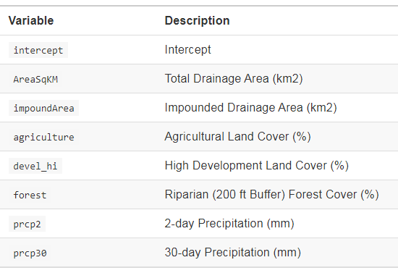
Fixed effects
HUC and Catchment effects – differ by scale and very likely no. of obs within the boundary!
And there are many interaction terms…..too numerous to fit on a slide. Go here if curious: http://ecosheds.org/models/stream-temperature/latest/index.html

Slide 8
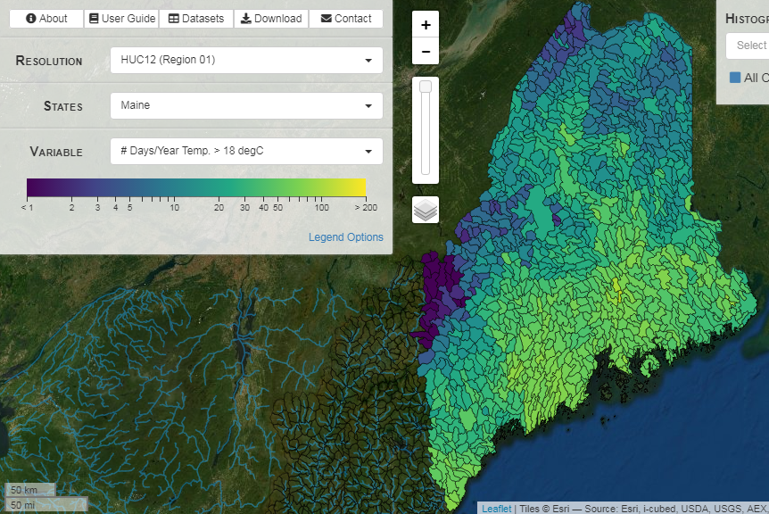
Current model outputs: Mean Summer Temp (degC),
# days/Year Temp > 18 degC, # days/Year Temp > 22 degC

Slide 9
Can the model be improved? YES!

Slide 11
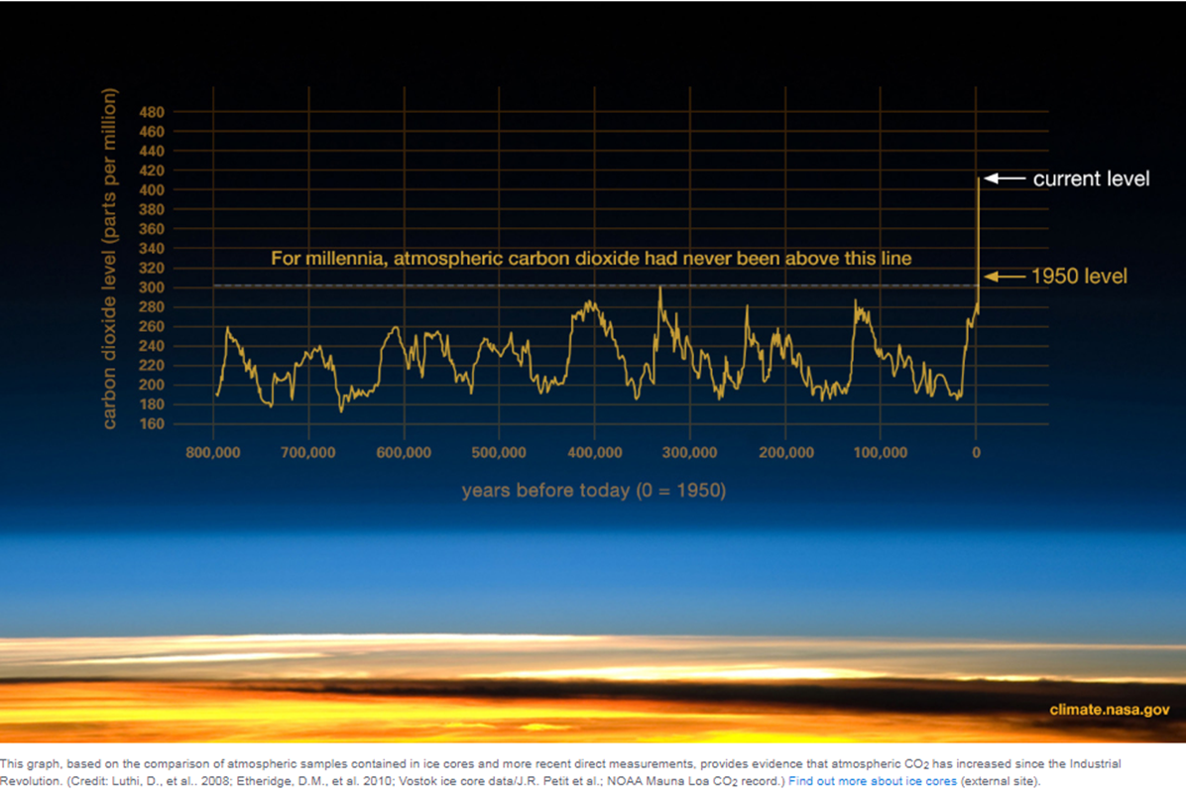

Slide 12
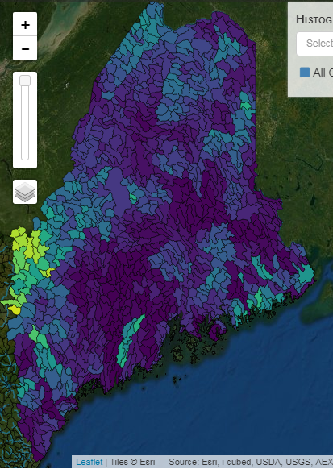
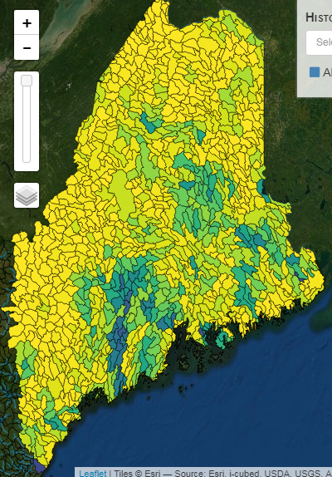
The future…..probability of wild BKT occupancy in a changing climate
Current Conditions
+4 degC in Mean July Temp

Slide 13
Our Mission
Maine Department of Inland Fisheries & Wildlife protects and manages Maine’s fish and wildlife and their habitats, promotes Maine’s outdoor heritage, and safely connects people with nature through responsible recreation, sport, and science.

Slide 14
Overview
Maine Department of Inland Fisheries of Wildlife (MDIFW) preserves, protects, and enhances the inland fisheries and wildlife resources of the state. Established in 1880 to protect big game populations, MDIFW has since evolved in scope to include protection and management of fish, non-game wildlife, and habitats, as well as restoration of endangered species like the bald eagle. In addition to its conservation duties, MDIFW is also responsible for enabling and promoting the safe enjoyment of Maine’s outdoors — from whitewater rafting to boating, snowmobiling, hunting, fishing, and wildlife observation. The agency’s constituents include the fish, wildlife, and people who call Maine home, as well as the visiting outdoor enthusiasts and ecotourists who call Maine Vacationland and contribute hundreds of millions of dollars each year to the state’s economy.

