Slide 1
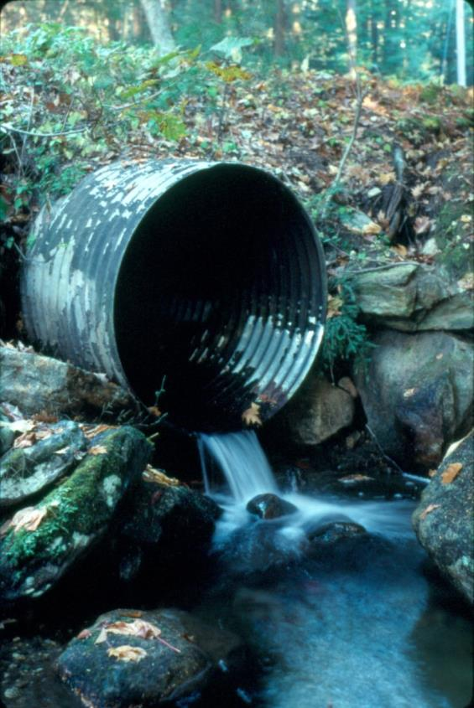
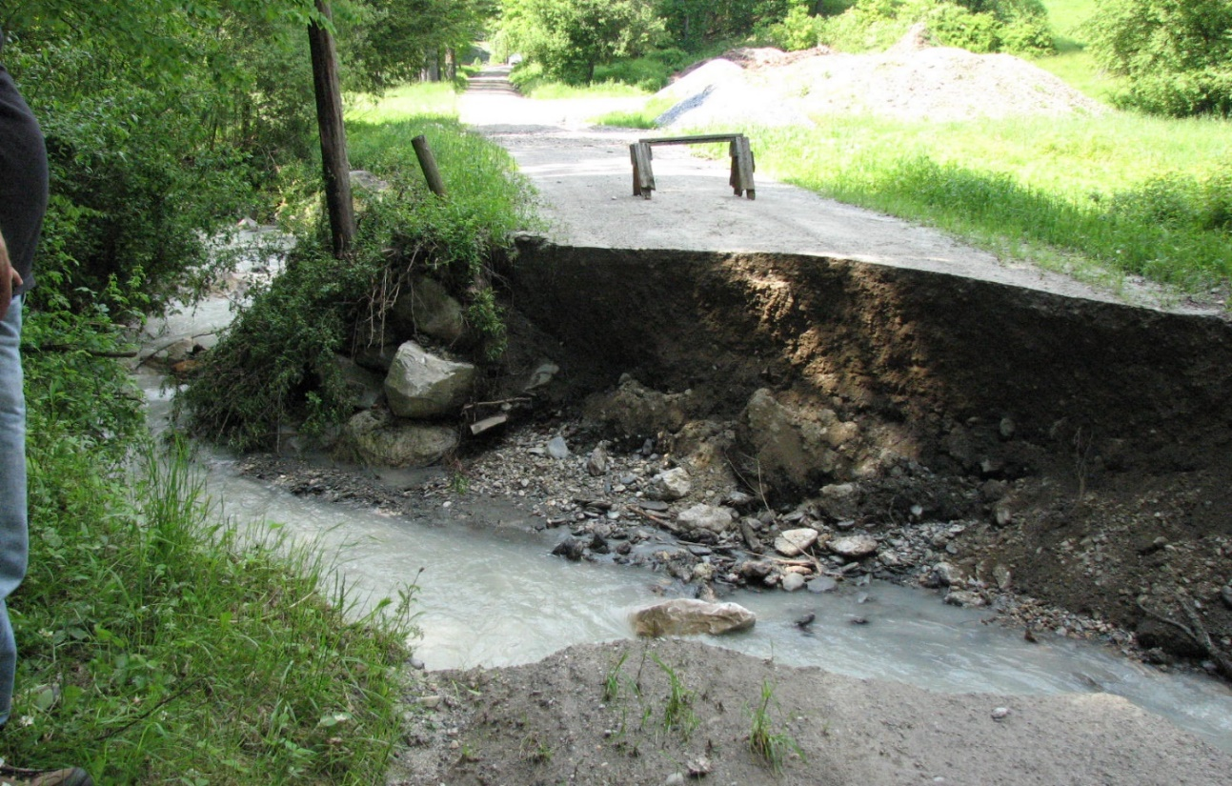





Assessing Transportation Vulnerability and Ecological Disruption of Road-stream Crossings in the Deerfield River Watershed
Scott Jackson
UMass Department of Environmental Conservation

Slide 2
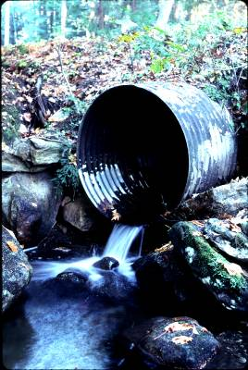
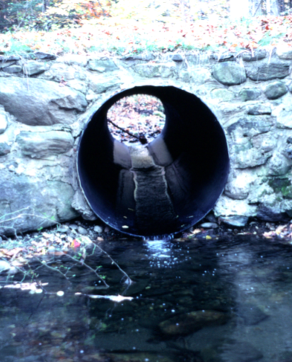
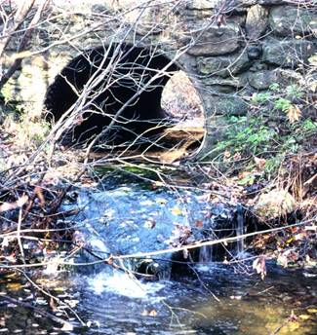
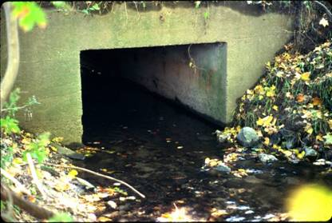
Sub-standard
Culverts

Slide 3
Glimpse of Existing Situation
A survey of 6,030 single and multiple culverts in five New England states:
 | Number | Percent
Severe barrier | 93 | 1.5
Significant barrier | 782 | 13.0
Moderate barrier | 2,347 | 38.9
Minor barrier | 2,539 | 42.1
Insignificant barrier | 269 | 4.5
Full passage | 0 | 0
53.4 % are moderate to severe barriers
None provided full aquatic organism passage

Slide 4
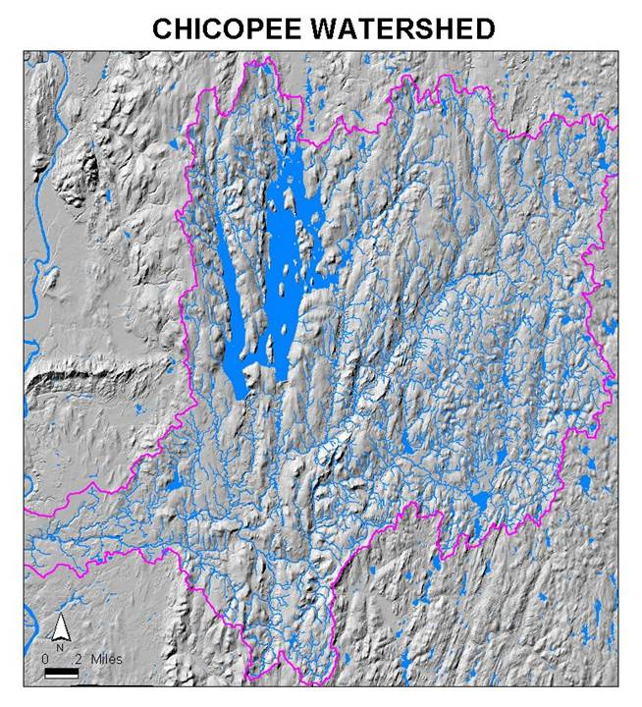
721 sq.mi.
Source:
MA Riverways Program

Slide 5
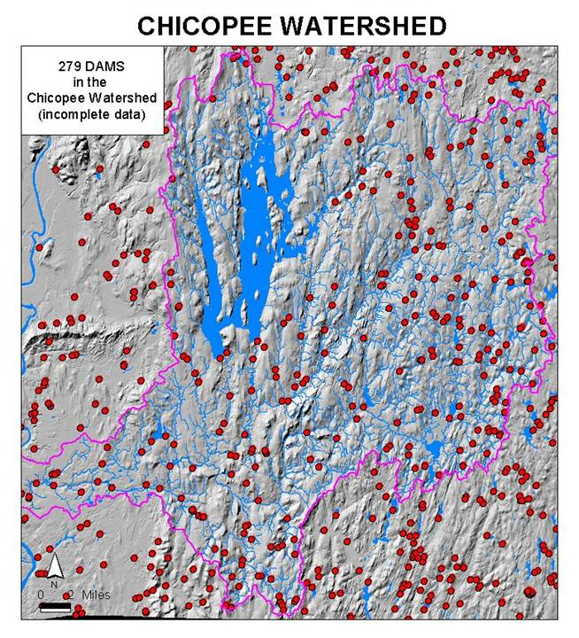
Source:
MA Riverways Program

Slide 6
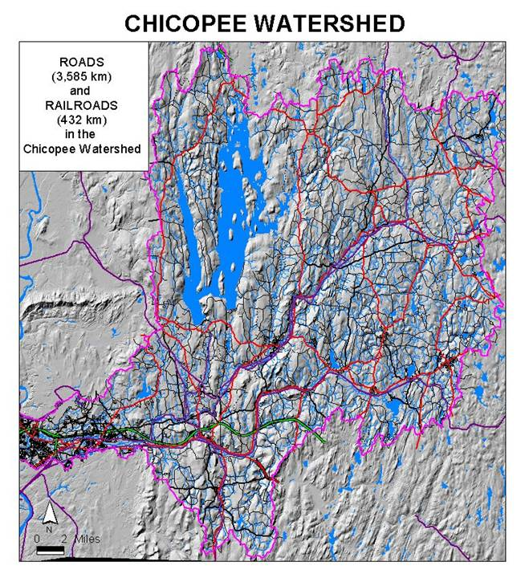
Source:
MA Riverways Program

Slide 7
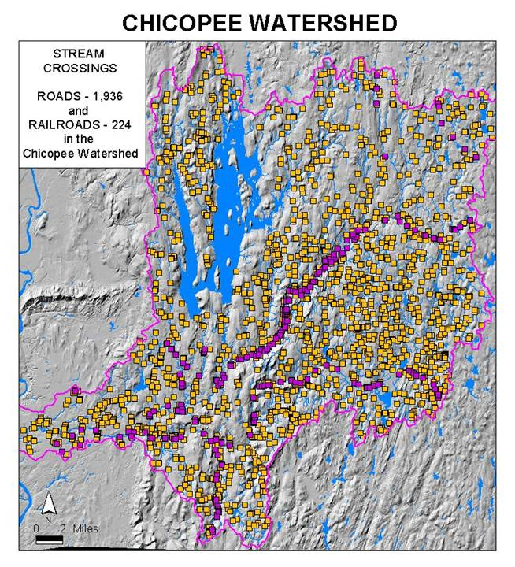
Source:
MA Riverways Program

Slide 8
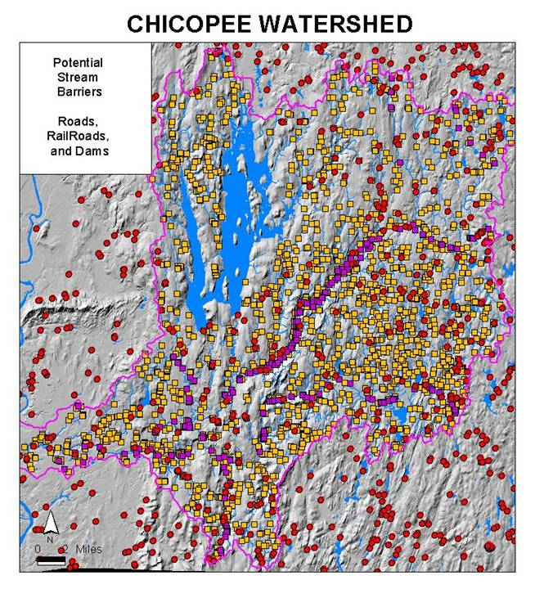
Source:
MA Riverways Program

Slide 9
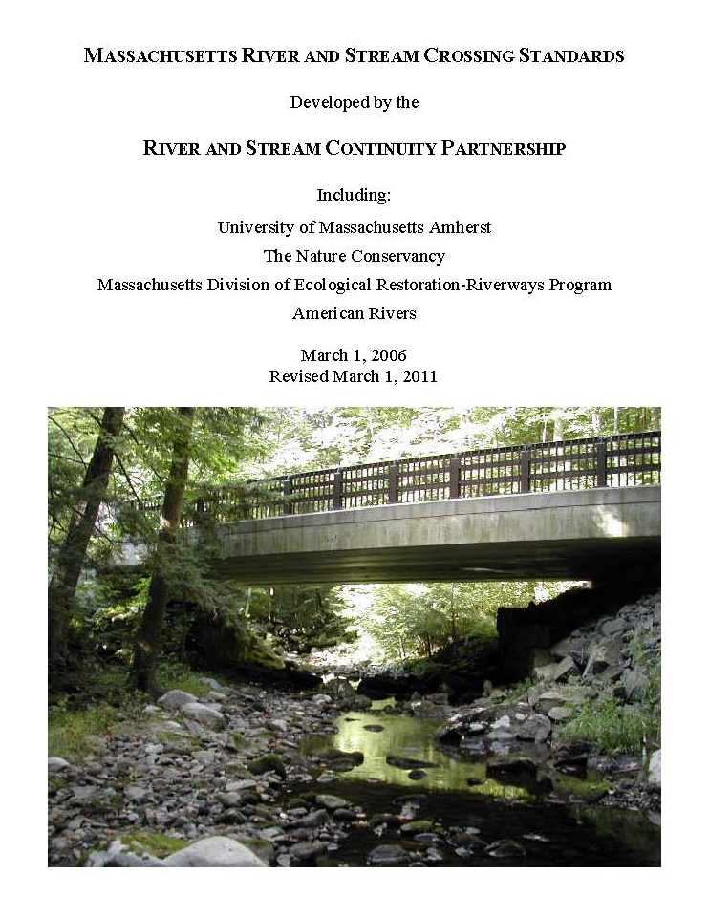
MA River and Stream Crossing Standards
General Standards
  Open-bottom span preferred
  If culvert, then embedded:
    Min. 2ft (and at least 25% for round pipe culverts)
    Include substrate >15 inches in diameter, depths at least 2x D84 of embed material
  Min. 1.2x bankfull width
  Matches stream substrate
  Water depths & velocities that match natural stream at a variety of flows (low-flow channel)
  Openness: 0.82 ft. (0.25m)
  Banks on both sides of stream, match horizontal profile of existing stream and banks

Slide 10
Nationwide Permit General Condition 2
“No activity may substantially disrupt the necessary life cycle movements of those species of aquatic life indigenous to the waterbody, including those species that normally migrate through the area, unless the activity's primary purpose is to impound water. All permanent and temporary crossings of waterbodies shall be suitably culverted, bridged, or otherwise designed and constructed to maintain low flows to sustain the movement of those aquatic species.”

Slide 11
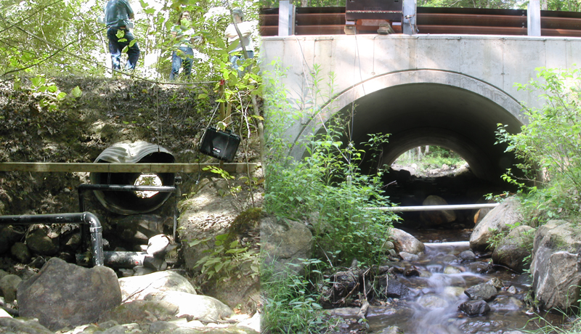

Slide 12
Evaluating Restoration Potential for Aquatic Barrier Removal
Habitat quality
  Occupancy
  Habitat suitability
  Habitat condition/ecological integrity
Enhanced connectivity
  Stream miles
  Connectivity metric

Slide 13
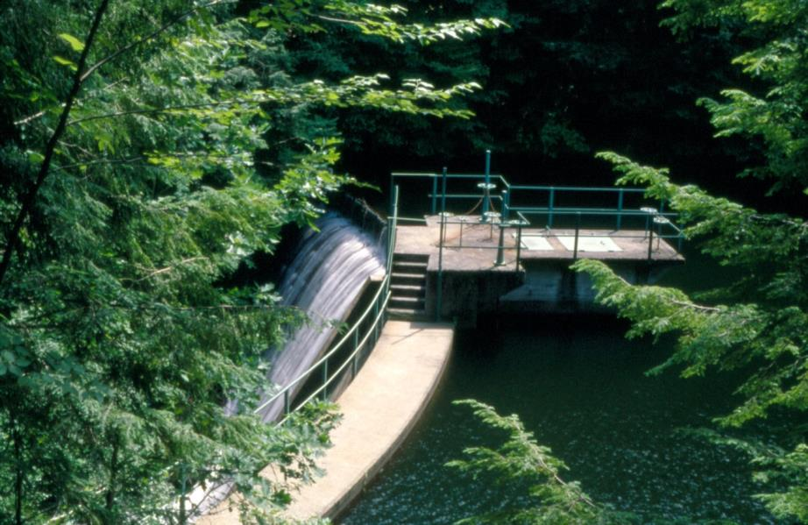
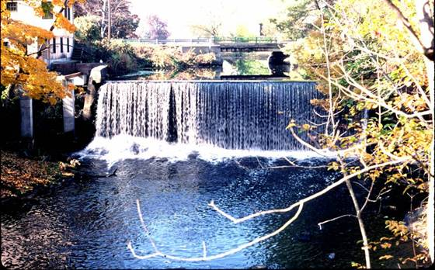
Dams

Slide 14
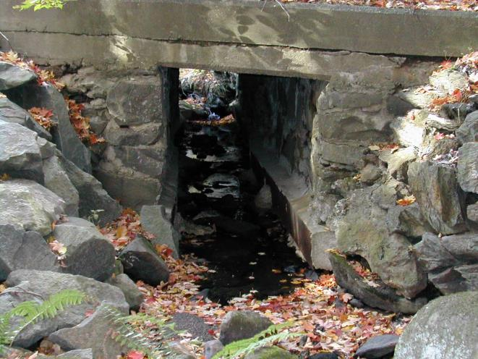
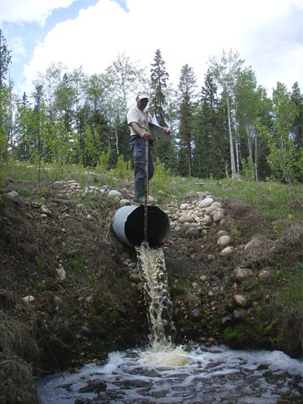
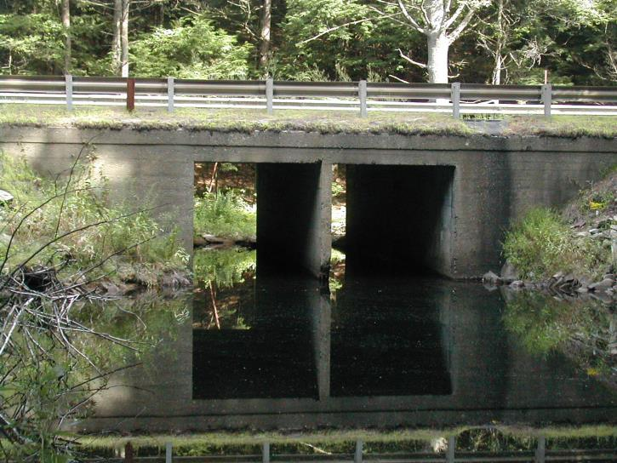
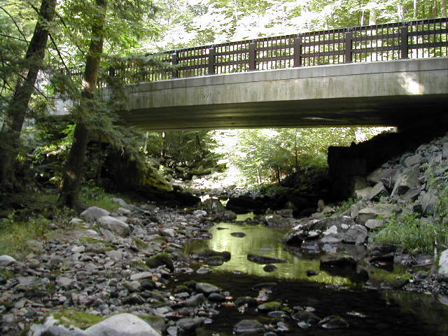

Slide 15


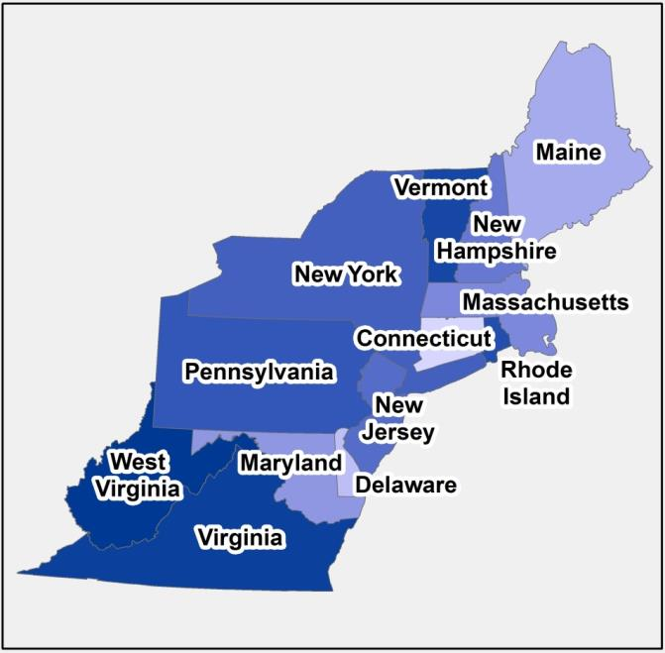




North Atlantic Aquatic Connectivity Collaborative (NAACC)

Slide 16

North Atlantic Aquatic Connectivity Collaborative (NAACC): Objectives
Reconnect streams & rivers to support healthier populations of fish & wildlife
Proactively identify and prioritize sites for stream crossing upgrades/replacements
Facilitate communication and information sharing among partners

Slide 17
Project Infrastructure
Crossing codes
Protocols & field data forms
Electronic data collection
Online Database
  Data storage & retrieval
  Scoring
  Mapping interface
Prioritizing crossings for assessment
Prioritizing crossings for mitigation
  TNC Northeast Connectivity Project
  UMass Critical Linkages Project

Slide 18
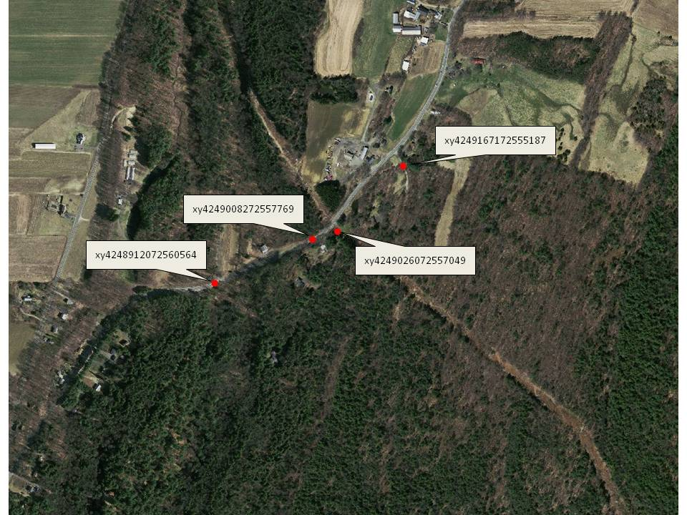

Slide 19
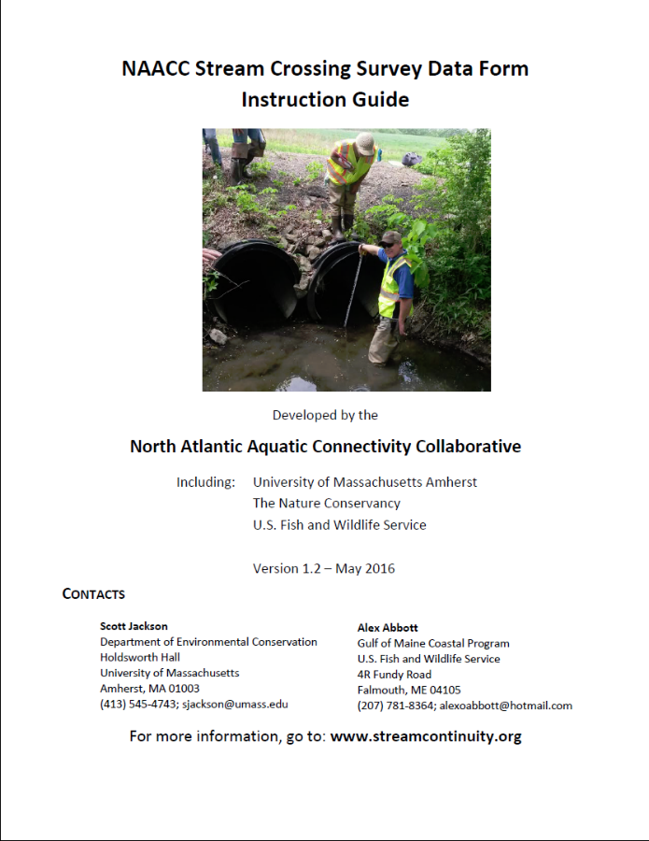
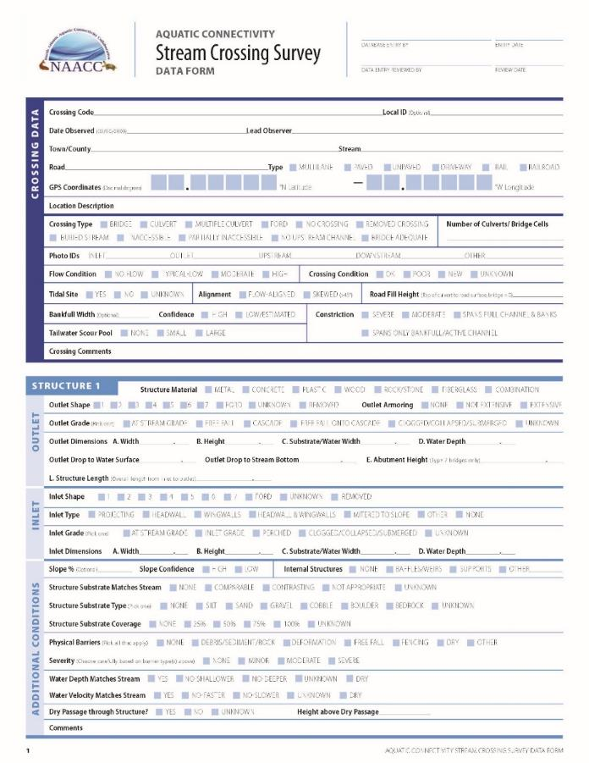
NAACC Aquatic Connectivity Assessment

Slide 20
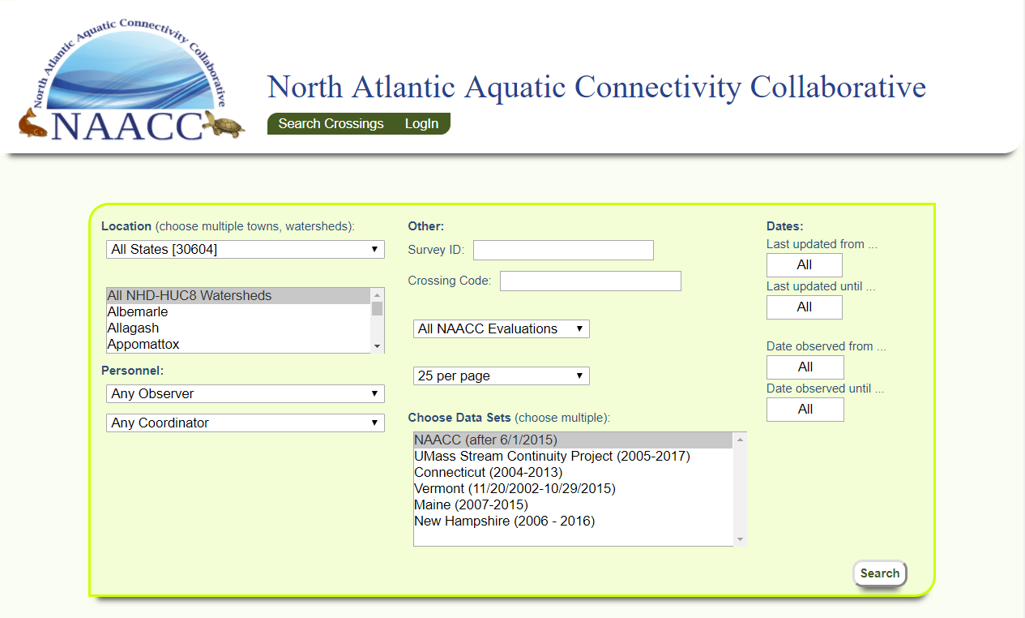
Online Crossings Database

Slide 21
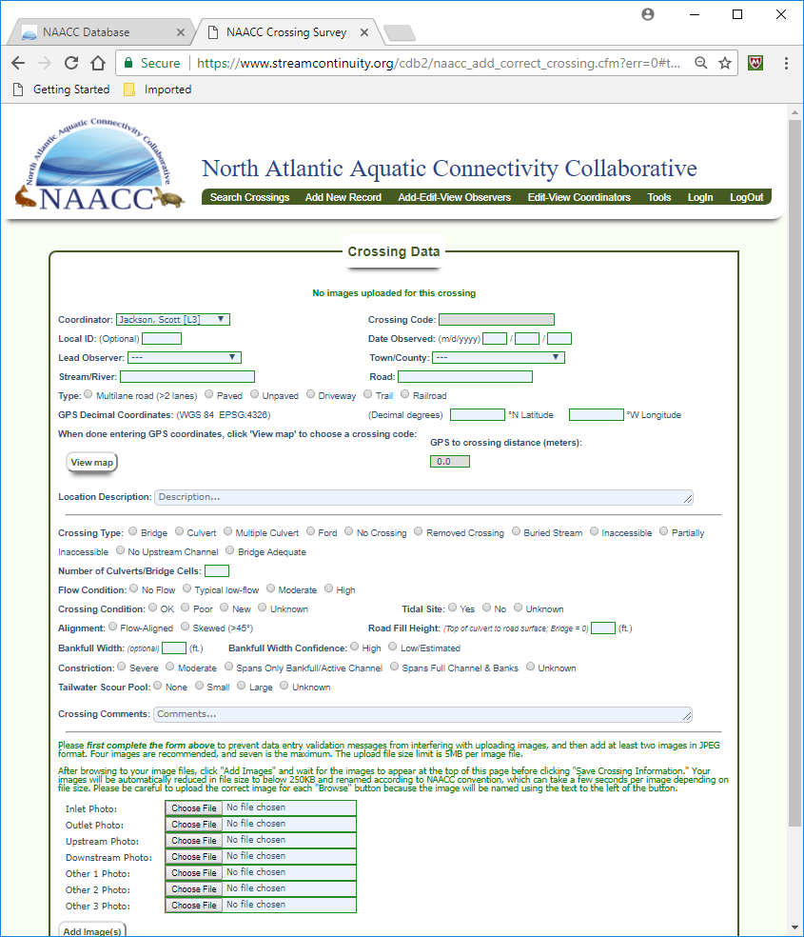
Data Input
Paper forms
Electronic data collection
Bulk uploads

Slide 22
Data Validation
Database rules that can’t be violated
Programmed in
Examples
  Required fields
  Acceptable range of measurements
  GPS units must be within bounding box
Electronic data collection: applied at time of collection in the field
Paper data collection: applied when data are entered to the database

Slide 23
Scoring Systems
AOP Coarse Screen
Categorization
Limited number of variables used
3 Categories
  No AOP
  Reduced AOP
  Full AOP
Aquatic Passability Score
Numeric scoring
Based on a weighted combination of 14 variables
Scores range from
  0.0 (impassable) to
  1.0 (fully passable)

Slide 24
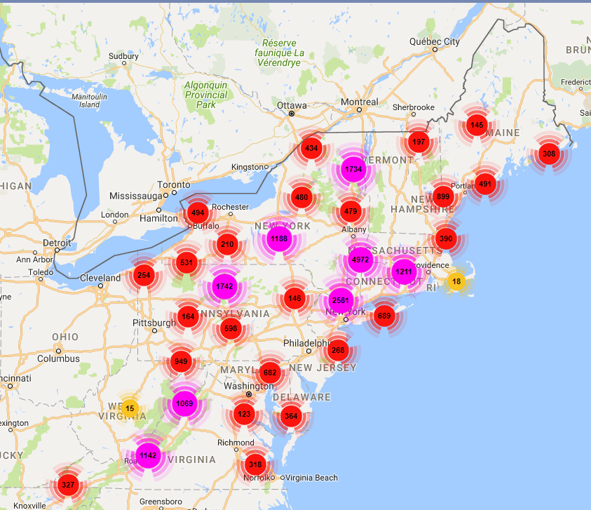
NAACC (since 6/1/15)
32,040 records
102 Coordinators
568 Lead Observers
Data from other Protocols
UMass: 11,626
Maine: 16,267
Vermont: 10,342
Connecticut: 2,493

Slide 25
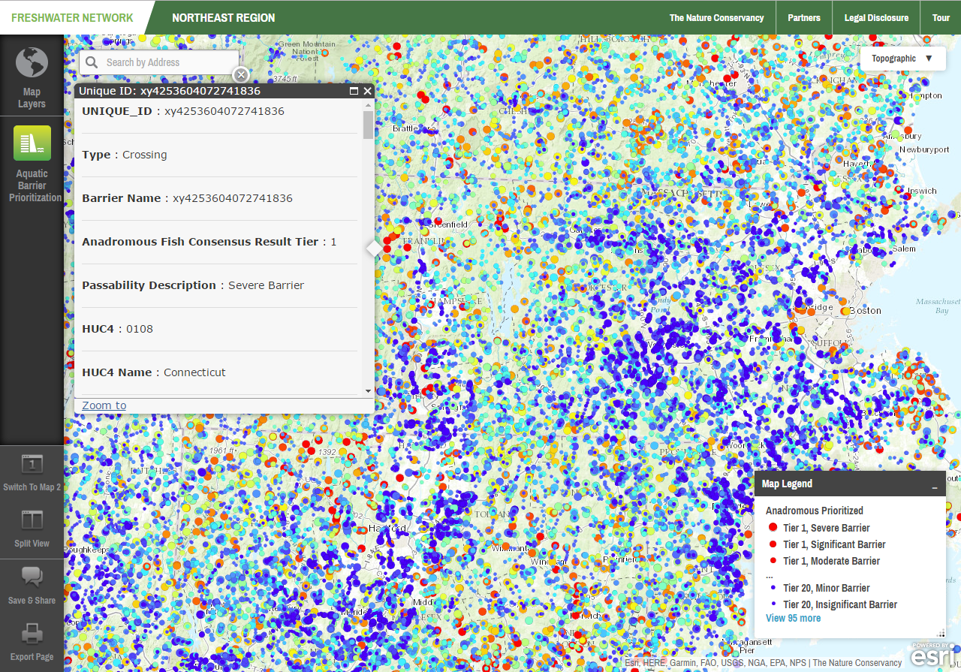
TNC Northeast Aquatic Connectivity Project

Slide 26
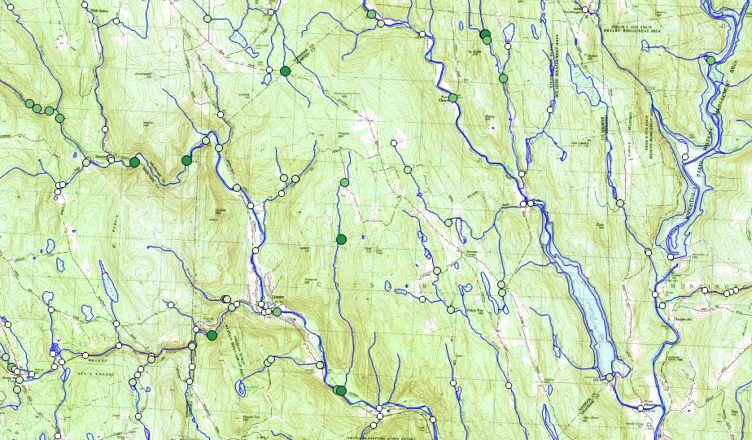
UMass Critical Linkages Assessment

Slide 27
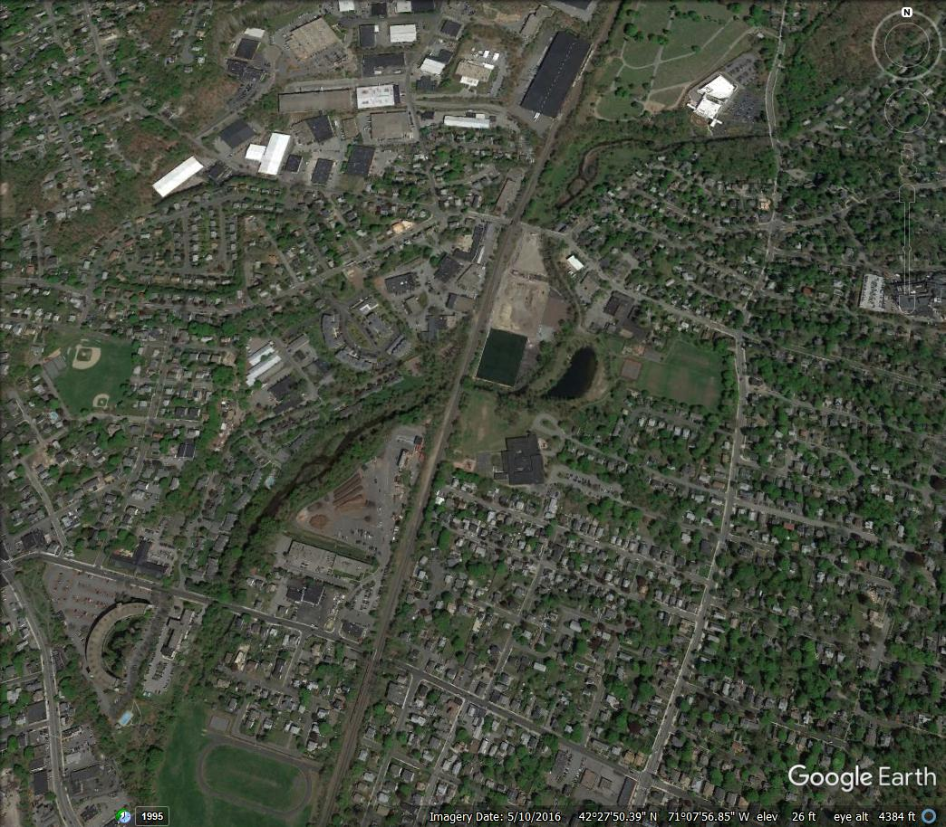
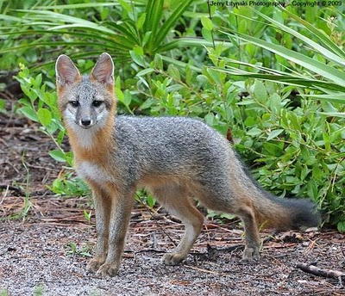
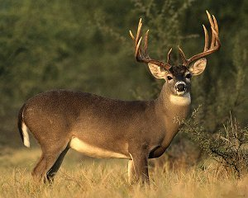

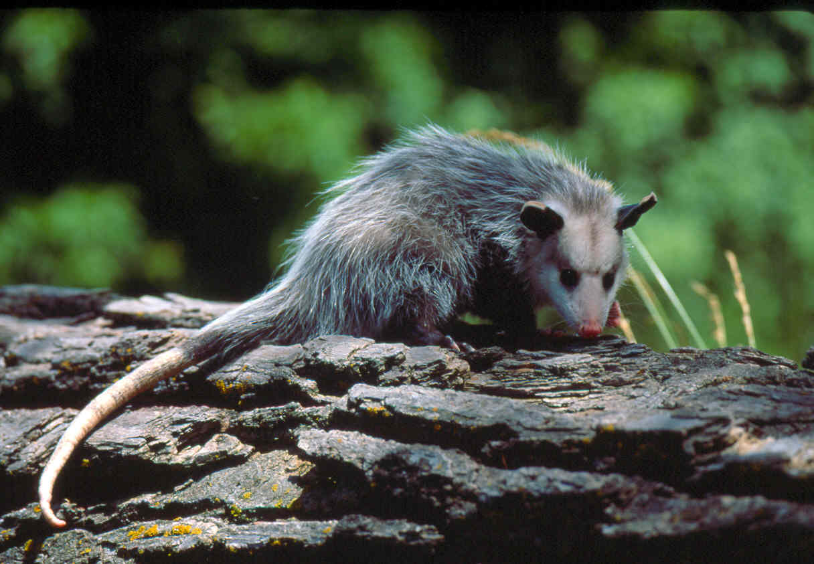

Slide 28
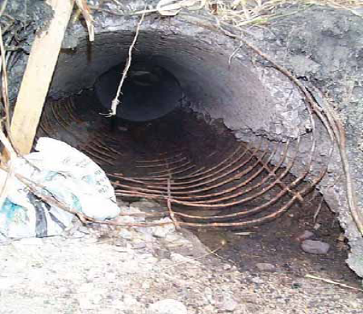
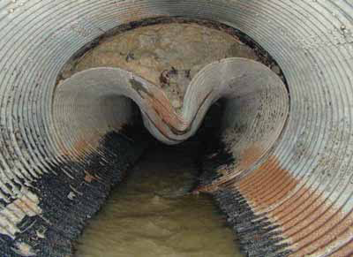
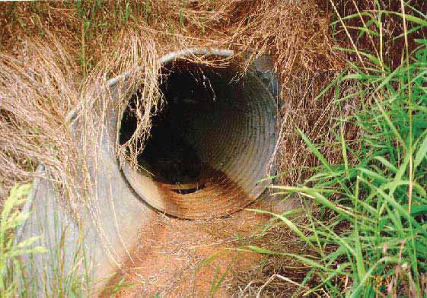
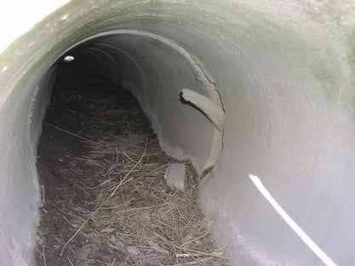

Slide 29
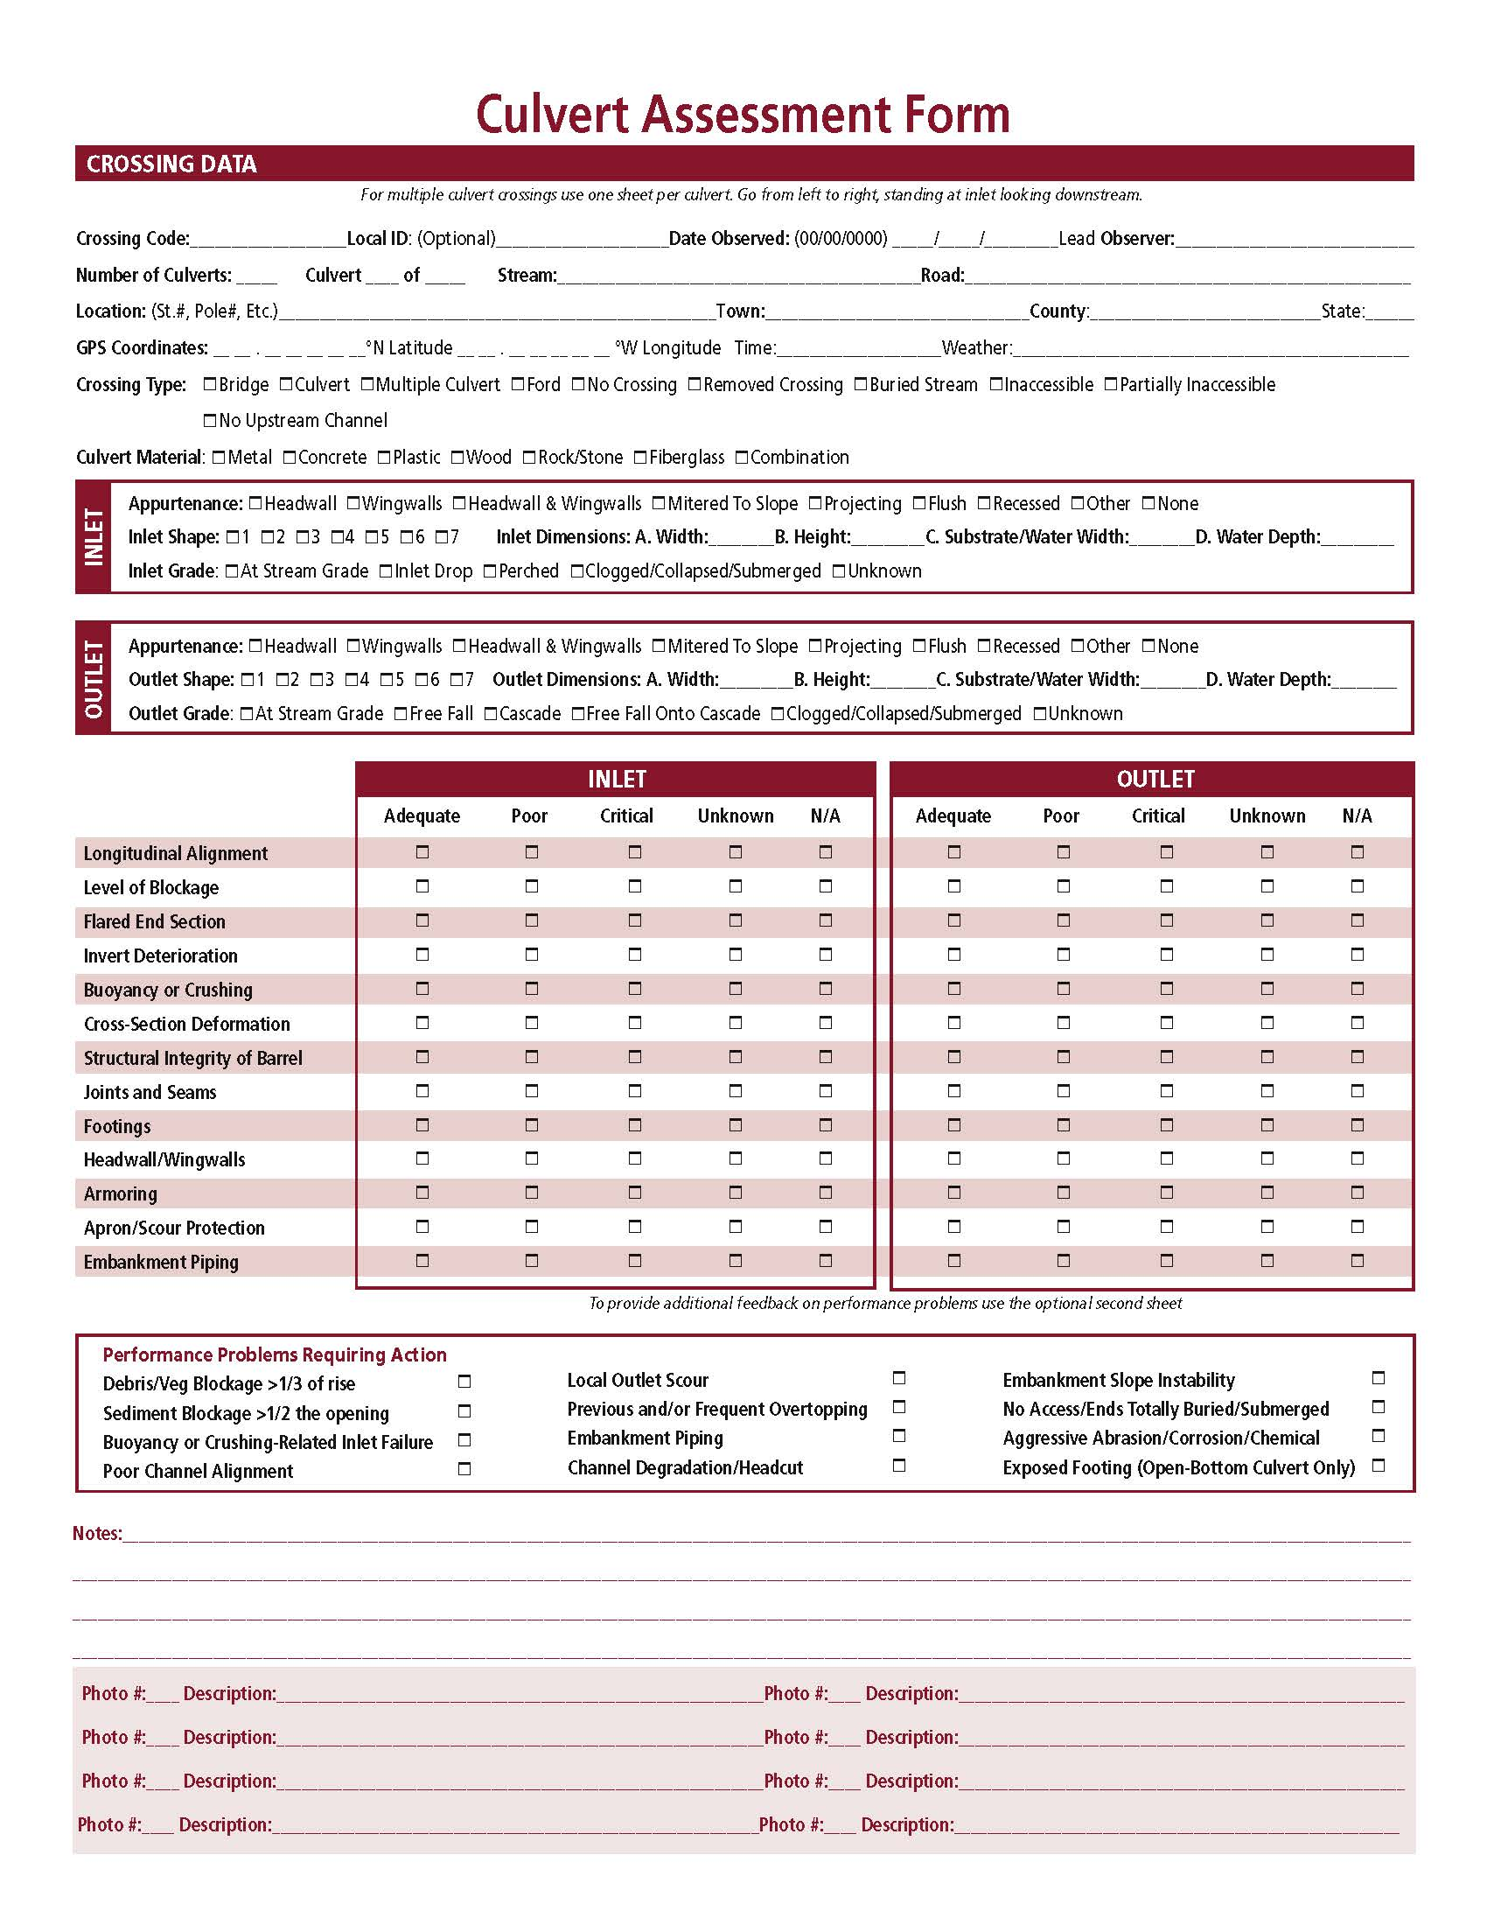
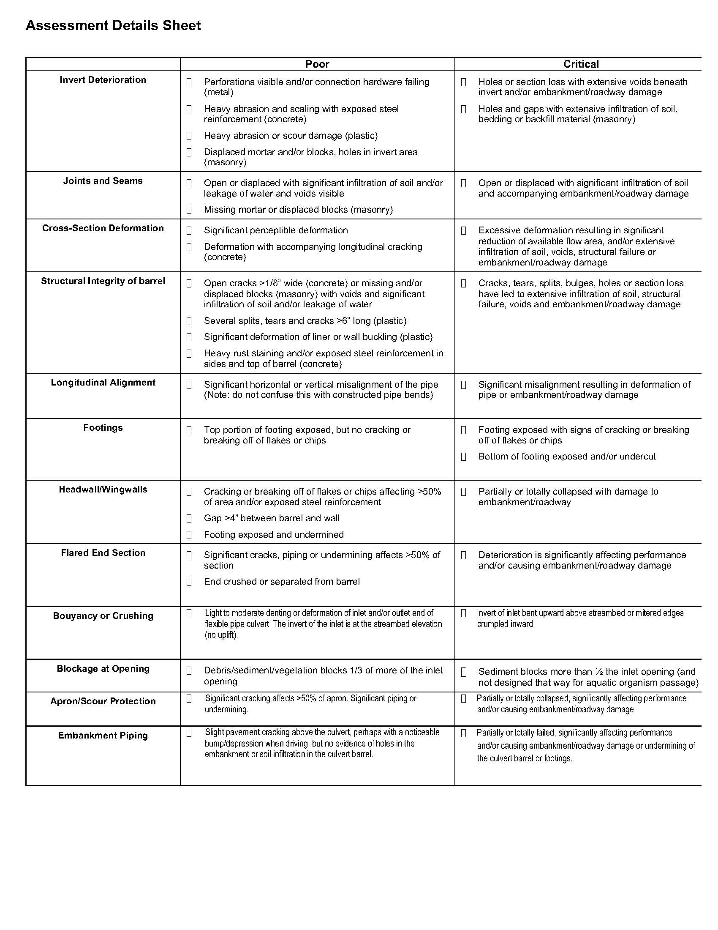
NAACC Culvert Condition Assessment

Slide 30
Crossing Assessment Modules
Expert detailed assessment
Depth (detail)
Expert rapid
assessment
Lay person rapid assessment
Aquatic
Connectivity
Geomorphic
Vulnerability
Condition
Breadth (objective)

Slide 31
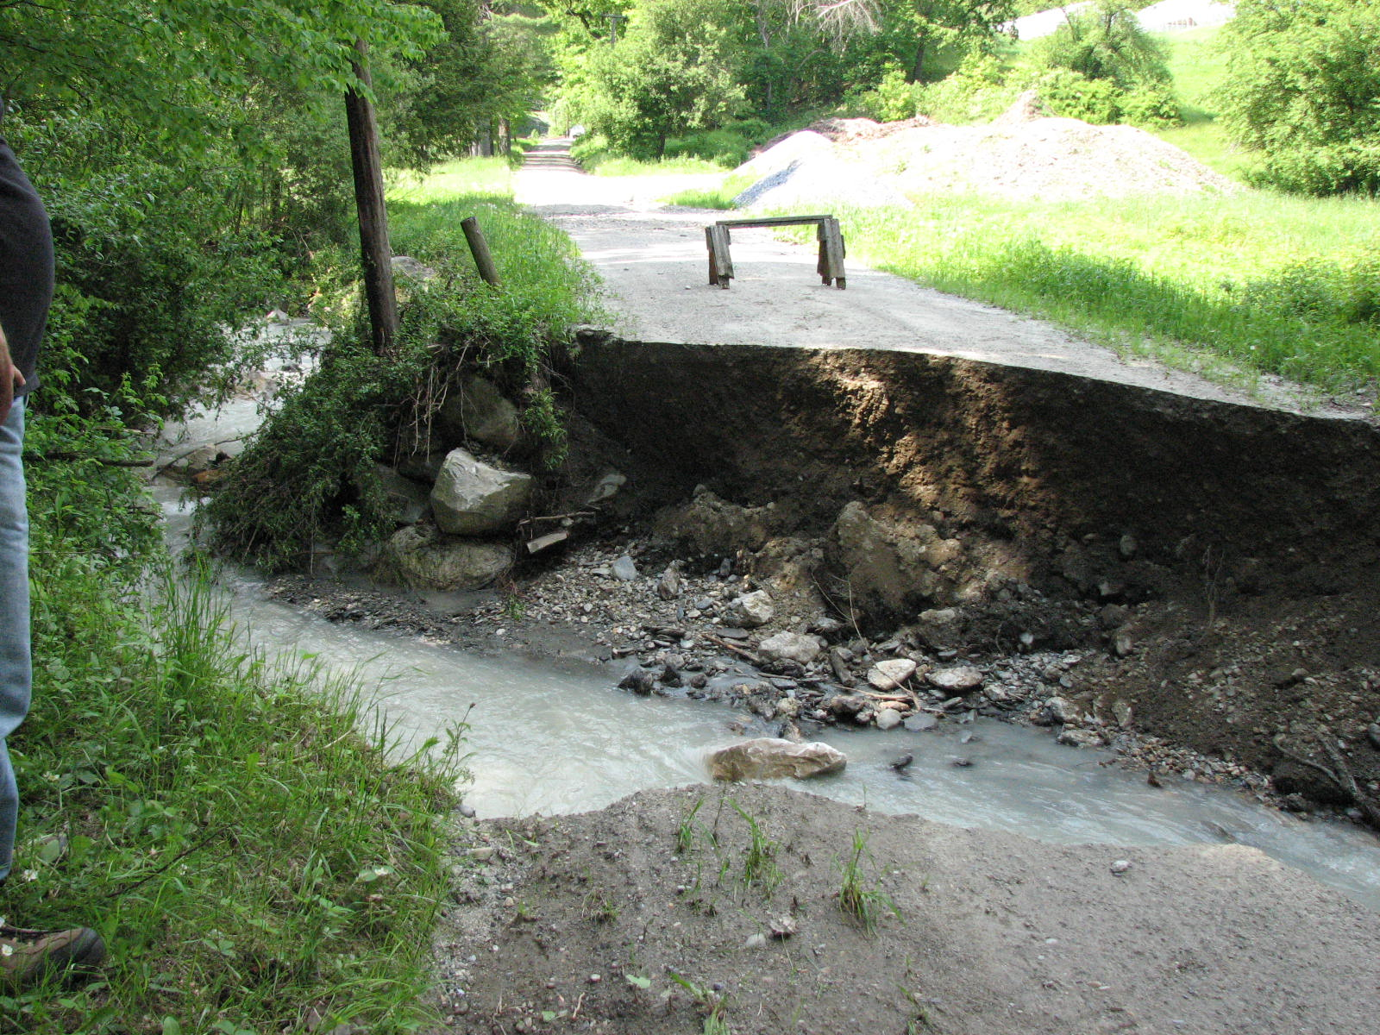
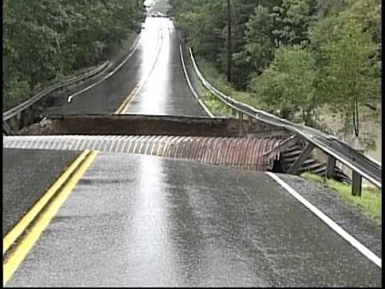

Slide 32
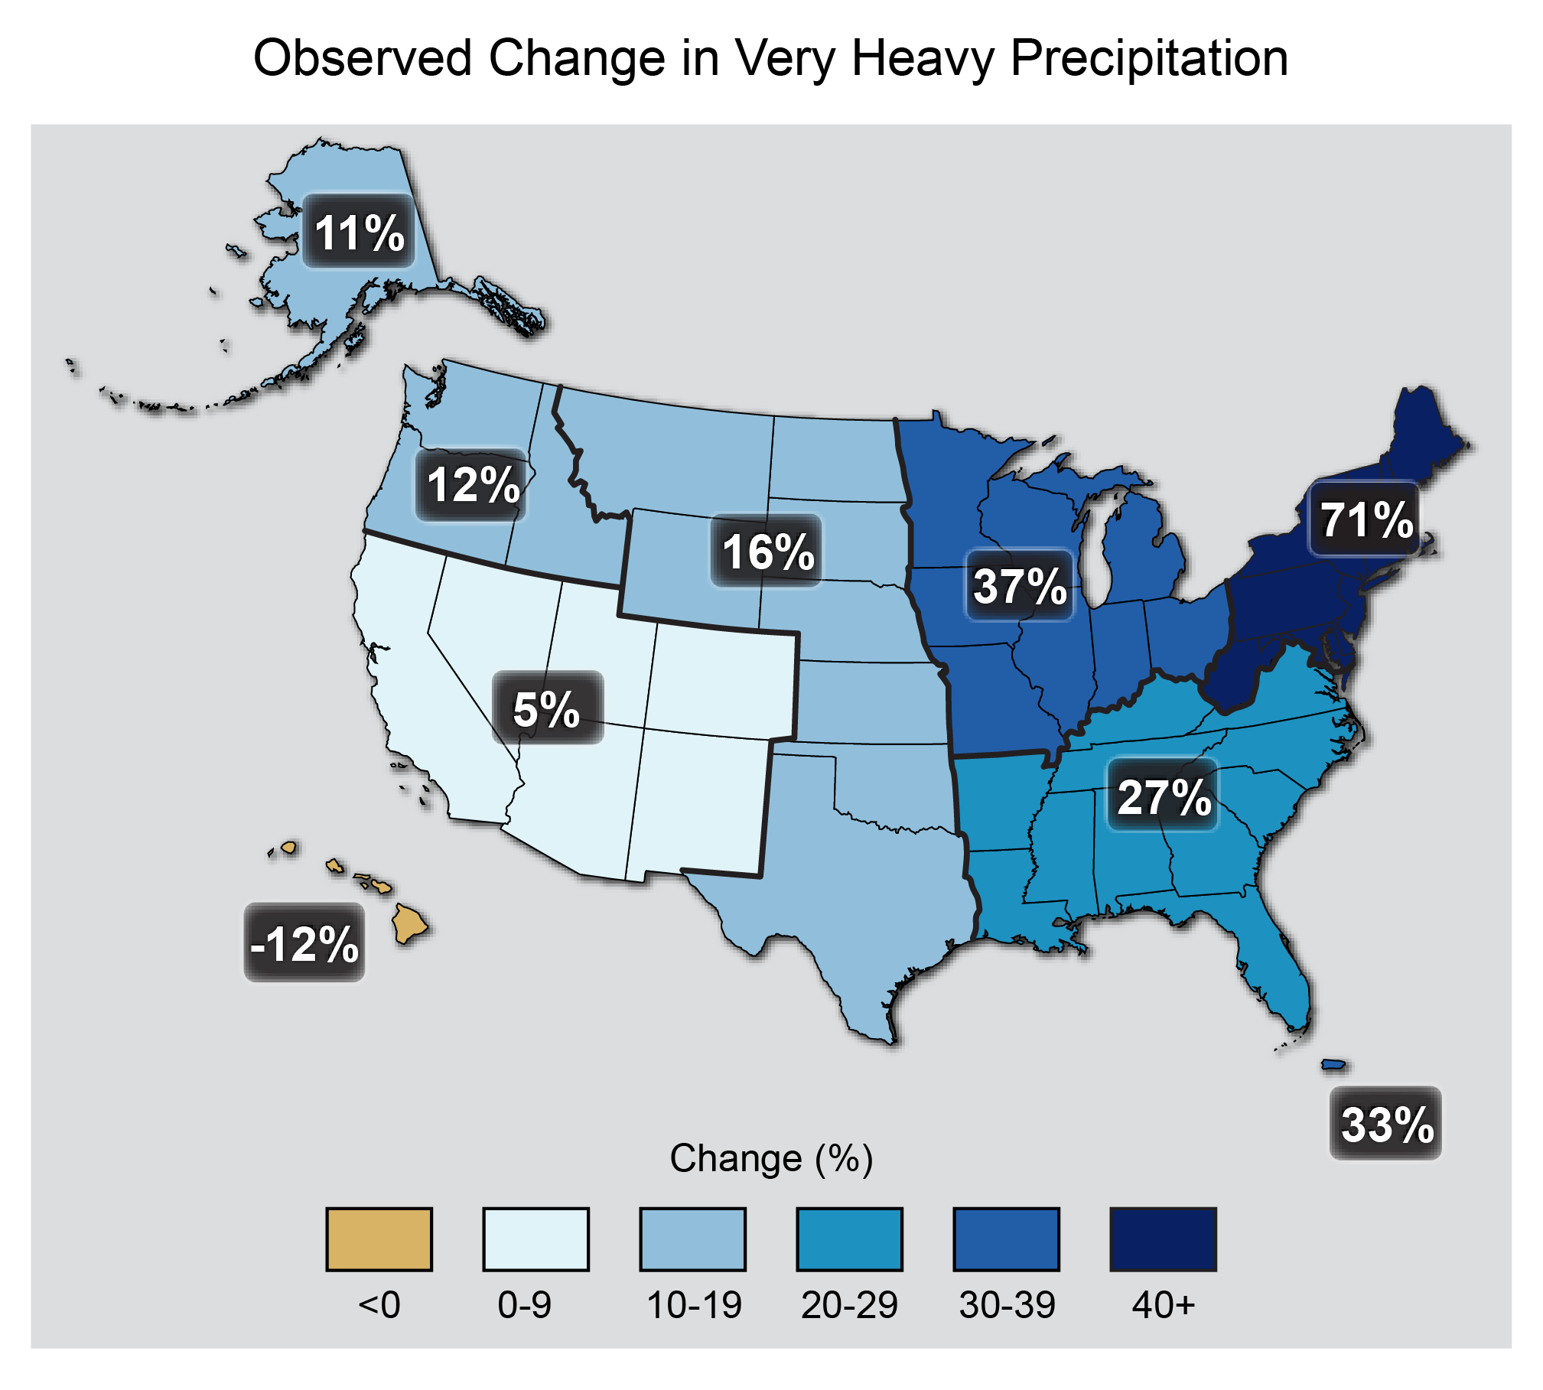
Percent increases in the amount of precipitation falling in very heavy events (defined as the heaviest 1% of all daily events) from 1958 to 2012 for each region of the continental United States
Source: updated from Karl et al. 2009
Notes:
The map shows percent increases in the amount of precipitation falling in very heavy events (defined as the heaviest 1% of all daily events) from 1958 to 2012 for each region of the continental United States. These trends are larger than natural variations for the Northeast, Midwest, Puerto Rico, Southeast, Great Plains, and Alaska. The trends are not larger than natural variations for the Southwest, Hawai‘i, and the Northwest. The changes shown in this figure are calculated from the beginning and end points of the trends for 1958 to 2012. (Figure source: updated from Karl et al. 2009¹). (U.S. National Climate Assessment, 2014)

Slide 33
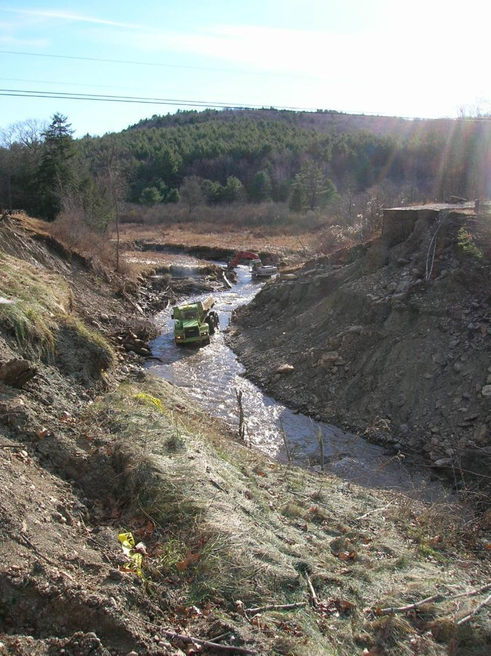
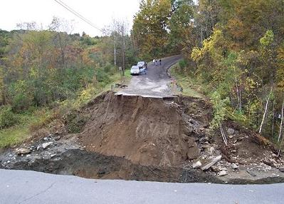
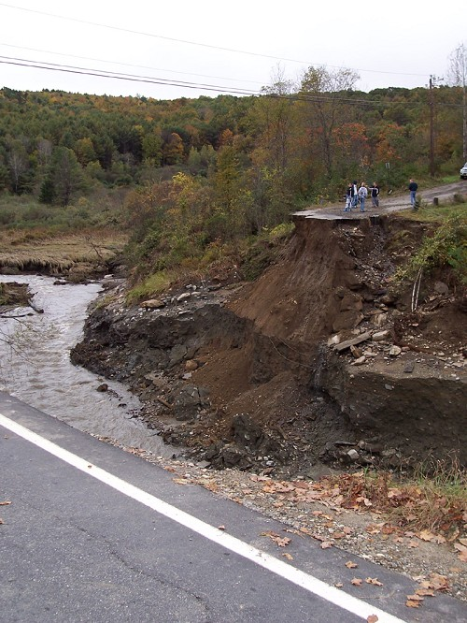

Slide 34
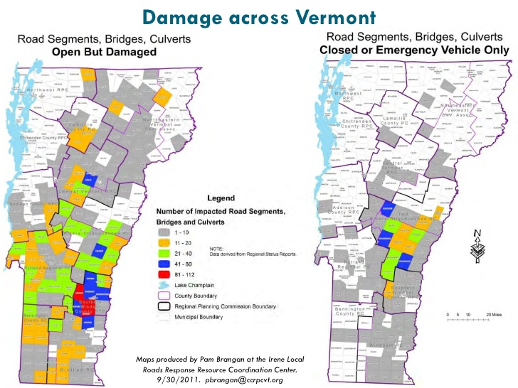
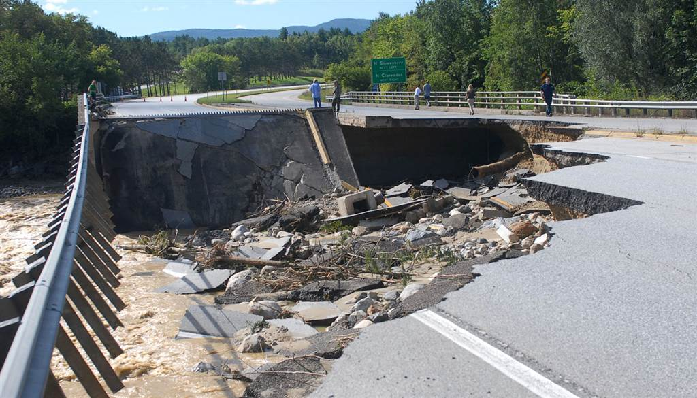
Tropical Storm Irene

Slide 35
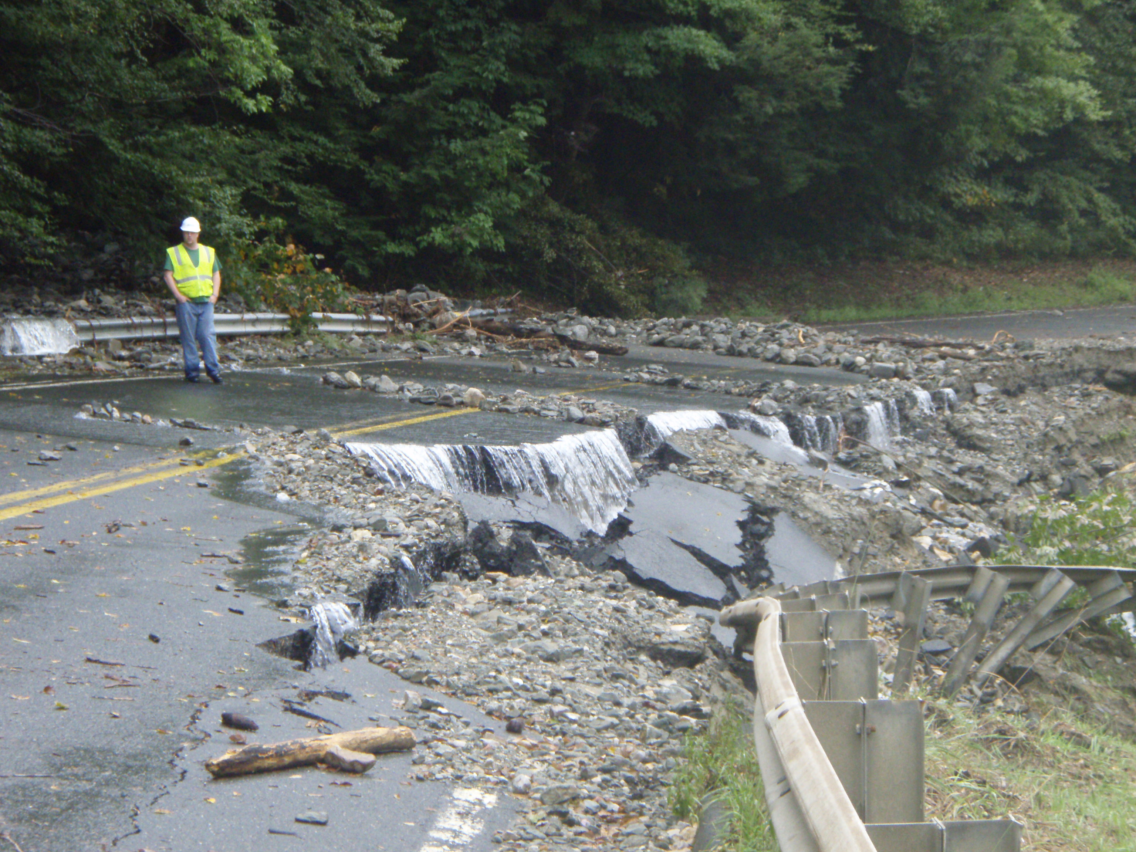
Assessing vulnerability of road-stream crossings in the Deerfield River watershed

Slide 36


Project Overview
How to assess and prioritize crossings for replacement
Deerfield River Watershed - road-stream crossings
Used existing methods to evaluate habitat fragmentation impacts
Developed new methods to assess vulnerability to extreme storm events under present and future climate conditions
Notes:
Pilot study focused inland. Impt potential pts of failure for transp. Integrate multiple elts of vulnerability under current and predicted future climate conds

Slide 37
Project Components:
Transportation Vulnerability Ecological Vulnerability
Risk of Failure (road unusable)
  Structural (condition)
  Hydrologic/Hydraulic
  (flow, stream power)
  Geomorphic
  (river response – scour)
Criticality
  EMS Disruption
Ecological Disruption
  Impassability for aquatic species
  Aquatic connectivity
  restoration potential
  Coldwater streams
Structural
Geomorphic
Risk & Vulnerability
Criticality
Ecological Disruption
Hydraulic
Notes:
To come up with vulnerability score, looked at several risk factors. Potential disruption to Emergency Medical Services. Env services of structures if upgrade.

Slide 38
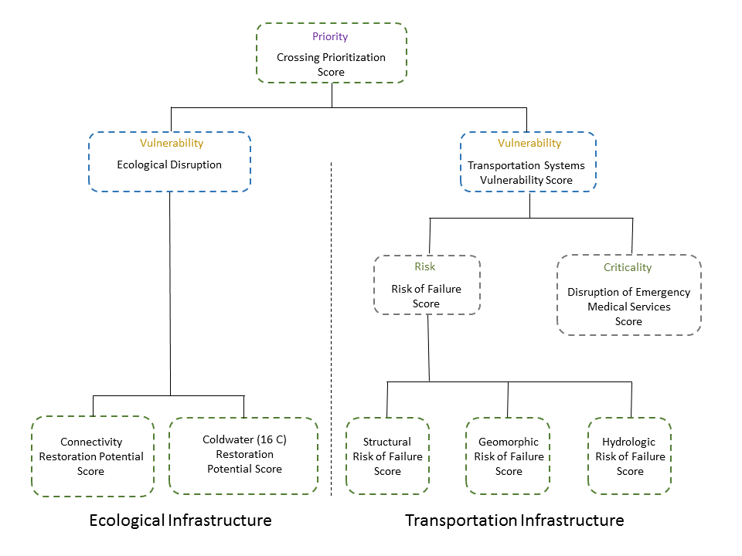

Slide 39
Structural Risk of Failure
Based on:
  Rapid field assessment for culverts
  MassDOT bridge inspection reports
  Scored from 0 (low risk) to 1 (high risk)

Slide 40
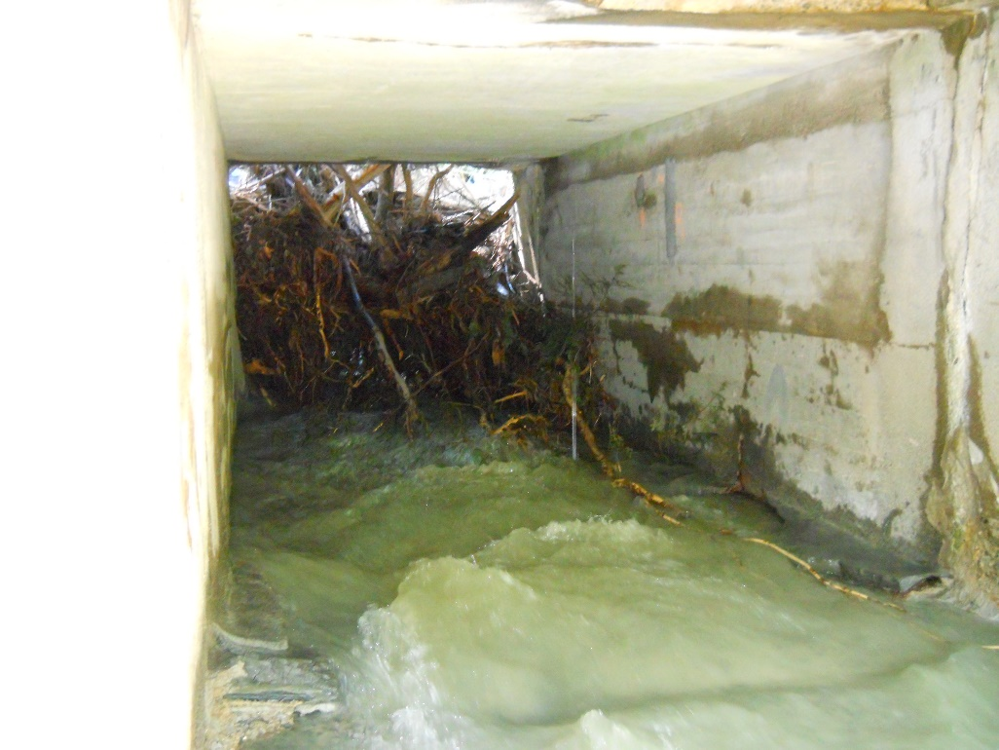
Geomorphic Risk of Failure
Failure mechanisms:
  Blockage by sediment
    Structure width/bankful width
    Specific stream power vs. bed resistance
    Observed erosion or aggradation
    Observed blockage
  Obstruction by woody debris
    Alignment
    Structure width
  Scour
    Specific stream power vs. bed resistance
    Sediment continuity
    Footing condition
    Downstream scour pool

Slide 41
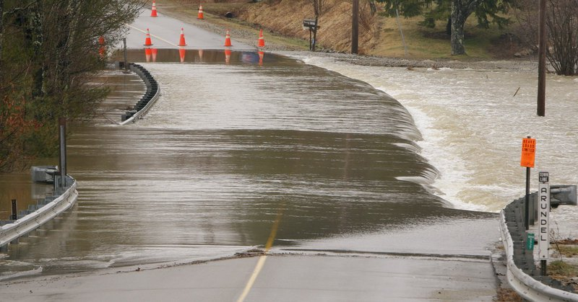
Hydraulic Risk of Failure
Hydrological models:
  Physical models
    HBV
    HSPF
    WRFH
  Statistical models
    Jacobs equation
    MA RPFE
Current vs Future:
  Mid-century
    9 climate models
  End-century
    Extrapolate from mid-century

Slide 42
Current Hydraulic Risk Scores for each Hydrological Model

Slide 43
Current and Mid Century Hydraulic Risk Scores for each Physical Model

Slide 44
Hydraulic risk scores - current
Hydraulic risk scores – mid-century
Hydraulic risk scores – end-century

Slide 45

Criticality: Disruption of Emergency Services
  Ambulance trips
  From depot to patient
  From patient to hospital
  Metrics
  Avg. delay
  Avg. affected delay
  Max. delay
  Integrated delay

Slide 46


Overview of Approach
5
10
5
8
Incident 1
20
20

Slide 47
Overview of Approach
5
10
5
8
Incident 1
20
20 minutes
20

Slide 48
Overview of Approach
5
10
5
8
Incident 1
20
23 minutes
Delay: 3
20

Slide 49
Overview of Approach
5
10
5
8
Incident 1
20
20 minutes
20

Slide 50
Overview of Approach
5
10
5
8
Incident 1
20
40 minutes
Delay: 20
20

Slide 51


3,144 real EMS calls
5,000 synthesized
EMS calls

Slide 52




Slide 53

Ecological Disruption
Based on:
  Aquatic Passability scores from NAACC
  Predicted temperature from Ecosheds.org
  UMass Critical Linkage analysis
  TNC aquatic barriers analysis
Metrics:
  Impassability (NAACC)
  Connectivity loss (Critical Linkages)
  Connectivity restoration potential (Critical Linkages)
  Anadromous restoration potential (TNC)
  Coldwater connectivity restoration potential (Critical Linkages)
    16 C, 18 C, 20 C, & 22 C
    Current & Future

Slide 54



Slide 55

Stream Crossings Explorer
sce.ecosheds.org

Slide 56










Thank You

Slide 57


Slide 58

Notes:
First screen that appears, once you have seen the video and the tutorial and checked the default attributes

Slide 59

Notes:
Can filter on state, town, road jurisdiction, DOT district, HUC12 watershed, etc.

Slide 60

Notes:
With charts you add what attribute you want to filter on

Slide 61

Notes:
Here we choseOverall EMS Delay, and filtered on scores>0.8

Slide 62

Notes:
Click on an individual crossing and see all the feature attributes you chose to see, for that crossing.

