Slide 1
Status of north atlantic tidal inlet and sandy beach habitat as of 2015
Tracy Monegan Rice
Terwilliger Consulting, Inc.
tracymrice@yahoo.com
March 23, 2017
Project funded by the North Atlantic Landscape Conservation Cooperative (LCC) & USFWS
Notes:
WHERE’S THE HABITAT?
First, we looked at 2 habitat types – tidal inlets and sandy beaches. A few years ago we did this for the migration and wintering range as part of the CCS project, assessing the habitat from NC to TX. After Hurricane Sandy, we had the opportunity to do this for the U.S. Atlantic Coast breeding range as well. We wanted to know:
Where are the tidal inlets within the U.S. Atlantic Coast breeding range of the piping plover?
How many tidal inlets are there?
Where are the sandy beaches within the U.S. Atlantic Coast breeding range of the piping plover?
How many beaches are there?
Surprisingly, the answers to these questions were not known and we had to map these two habitats and used Google Earth to do so since its free and readily available to everyone, with a time series of imagery that usually stretches back to 1989 or 1990 through 2015 now.
Next, we wanted to assess the condition of the habitat, how much of it has been modified by humans?
WHAT IS THE CONDITION OF THE HABITAT?
How many tidal inlets in the U.S. Atlantic Coast breeding range of the piping plover have been modified by humans?
How many inlets are stabilized with hard structures like jetties?
How many inlets have been dredged or mined for sediment?
How many inlets were artificially created, relocated or closed?
How many inlets have naturally opened and closed in historical times?
How much of the sandy beaches have been modified by humans?
How much of the sandy beachfront is developed?
How much of the sandy beaches are armored?
How much of the sandy beaches have been modified with sediment placement?
How much of the sandy beachfront is in public or NGO ownership?

Slide 2
Study area
Georgetown, ME, to New York
New Jersey to North Carolina

Slide 3
North Atlantic LCC Coastal Resiliency Project – Habitat inventories
Phase 1 (completed):
Inventory of Habitat Modifications to Tidal Inlets Prior to Hurricane Sandy (2012)
Inventory of Habitat Modifications to Sandy Beach Habitat prior to Hurricane Sandy (2012)
Habitat Modifications in the U.S. Atlantic Coast Breeding Range of the Piping Plover prior to Hurricane Sandy: A Synthesis of Tidal Inlet and Sandy Beach Habitat Inventories
Phase 2 (completed):
Storm-induced Habitat Modifications caused by Hurricane Sandy within the U.S. Atlantic Coast Breeding Range of the Piping Plover
Phase 3 (completed):
Inventory of Habitat Modifications to Tidal Inlets as of 2015
Inventory of Habitat Modifications to Sandy Beach Habitat as of 2015

Slide 4
Tidal inlets
Where are the tidal inlets within the U.S. Atlantic Coast breeding range of the piping plover?
How many tidal inlets were there in 2015?
How many of the inlets have been modified by humans as of 2015?

Slide 5
Tidal Inlet habitat
2012: 399 inlets
After Sandy: 428 inlets
2015: 412 inlets
Inlets south of Montauk, NY tend to be larger and fewer in number

Slide 6
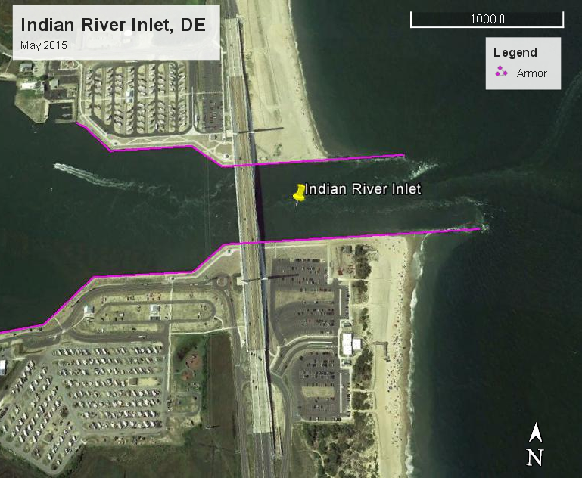
Tidal Inlet habitat modifications
68% (282 of 412) of the tidal inlets open in 2015 were modified
59% (242 of 412) had hard structures (i.e., jetties, groins, seawalls, revetments)
44% (182 of 412) had been dredged at least once
At least 29 (7%) had been mined for beach fill
At least 45 (11%) were artificially opened
At least 9 (2%) have been relocated
At least a separate 48 were artificially closed

Slide 7
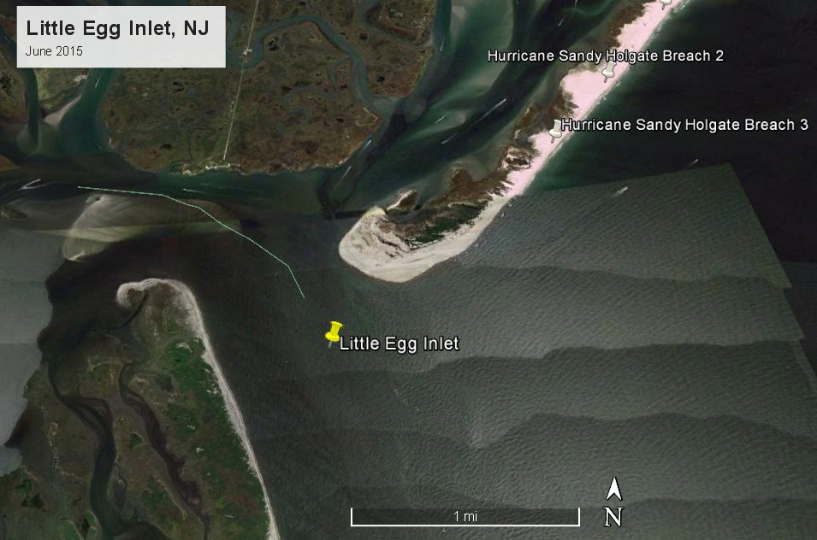
2015 Tidal inlet habitat modifications
68% of the 223 tidal inlets in the New England Recovery Unit were modified in 2015
73% of the 150 tidal inlets in the New York – New Jersey Recovery Unit were modified
9 of 10 inlets on South Shore of NY modified
10 of 11 inlets in NJ modified
51% of the 39 tidal inlets in the Southern Recovery Unit were modified

Slide 8
Tidal inlet habitat trends
Habitat is highly dynamic
Many coastal ponds are artificially breached annually
High numbers of contiguous inlets not modified are rare
Cumulative impacts are significant
Weekapaug Breachway, RI (April 2012)

Slide 9
Sandy Beaches
Where are the sandy beaches within the U.S. Atlantic Coast breeding range of the piping plover?
How many beaches were there in 2015?
How much of the sandy beaches have been modified by humans as of 2015?

Slide 10
Sandy beach habitat in 2015
1,650.68 miles of sandy beach
New England Recovery Unit: 651.43 miles
NY – NJ Recovery Unit:
516.12 miles
Southern Recovery Unit:
483.13 miles

Slide 11
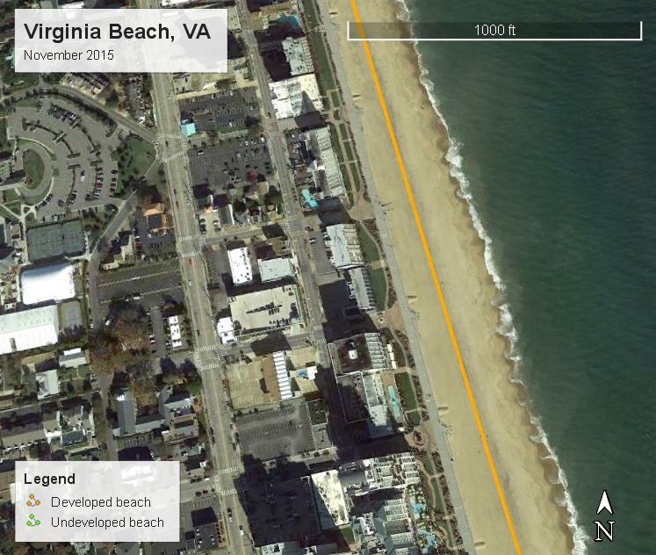
Beachfront development
45% (775.27 miles) of the sandy beachfront was developed prior to Hurricane Sandy
New England Recovery Unit: 45% developed
NY – NJ Recovery Unit: 49% developed
Southern Recovery Unit: 35% developed

Slide 12
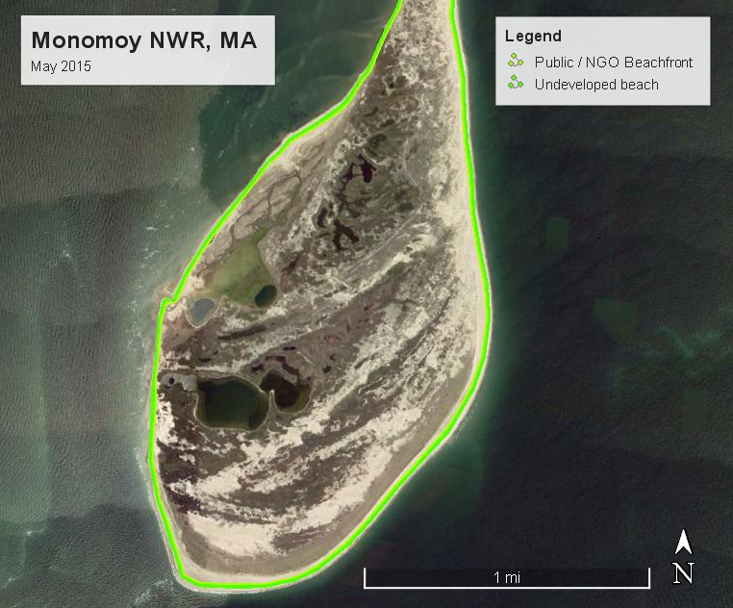
Public & ngo beachfront ownership
48% (828.15 miles) of sandy beachfront in public and/or NGO ownership
45% of the New England Recovery Unit
36% of the NY – NJ Recovery Unit
64% of the Southern Recovery Unit
MA (241+ miles) and NC (~179 miles) have the highest lengths of beachfront in public/NGO ownership
VA and MD have > 60% of their beachfronts in public/NGO ownership

Slide 13
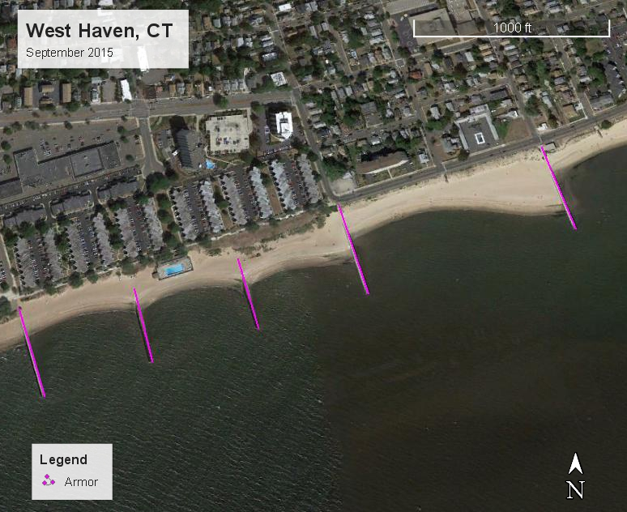
Beachfront armor
At least 385.93 miles of the sandy beach length had been armored in 2015
NH (72%) and NJ (62%) highest proportions modified
MA (~109 miles) and NJ (~77 miles) highest lengths modified

Slide 14
Habitat loss due to armor
~91 miles in 2015
Massachusetts = ~48 miles
Connecticut = ~18 miles
NY – Peconic Estuary = ~10 miles
All other states less than 4 miles

Slide 15
Armor structures in 2015
Up to 5,145 groins
235 jetties
96 breakwaters
2,886 contiguous sections of seawalls, bulkheads and/or revetments

Slide 16
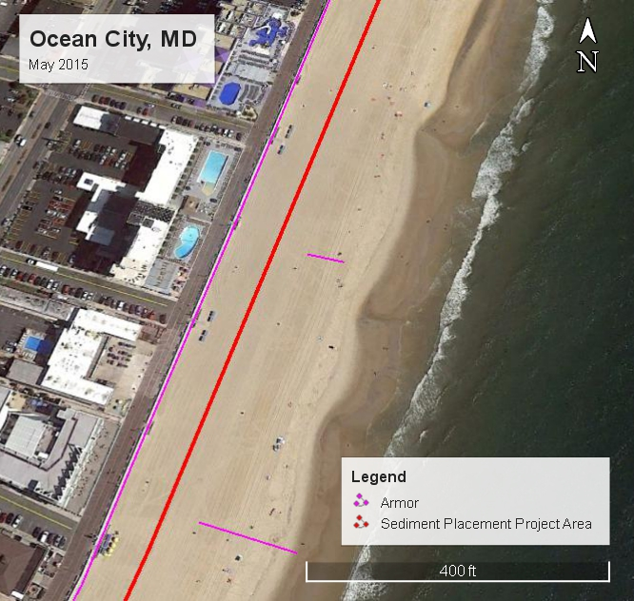
Sediment placement as of 2015
At least 24% (398.80 miles) of sandy beaches modified by sediment placement
Increase of ~60 miles from 2012 to 2015
NC (100+ miles), NJ (80+ miles) and NY-Atlantic (77+ miles) beaches have received the most beach and dune fill
Sediment placement projects differ in type and scale north and south of Montauk, NY

Slide 17
Beach scraping
~69 miles of sandy beach habitat modified between 2012 and 2015
NJ and NY – Atlantic most modified
New England, NY – LIS and NY – Peconic least modified
Long Beach Twp., NJ November 2012

Slide 18
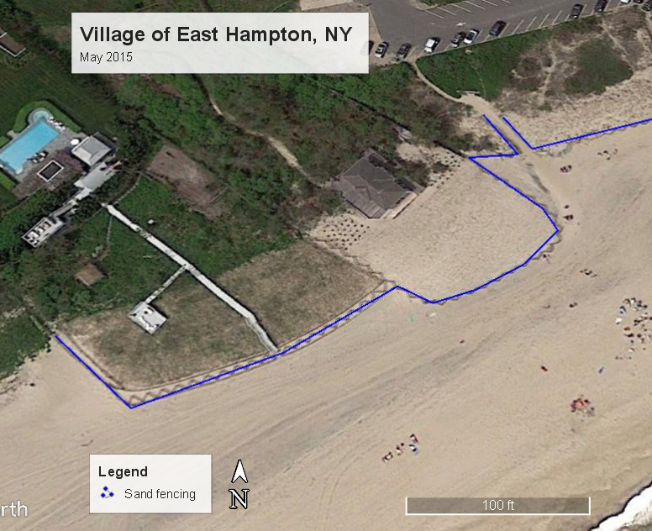
Sand fencing
~247 miles of sandy beach habitat modified between 2012 and 2015
NC, NJ and NY – Atlantic most modified
New England, NY – LIS and NY – Peconic least modified

Slide 19
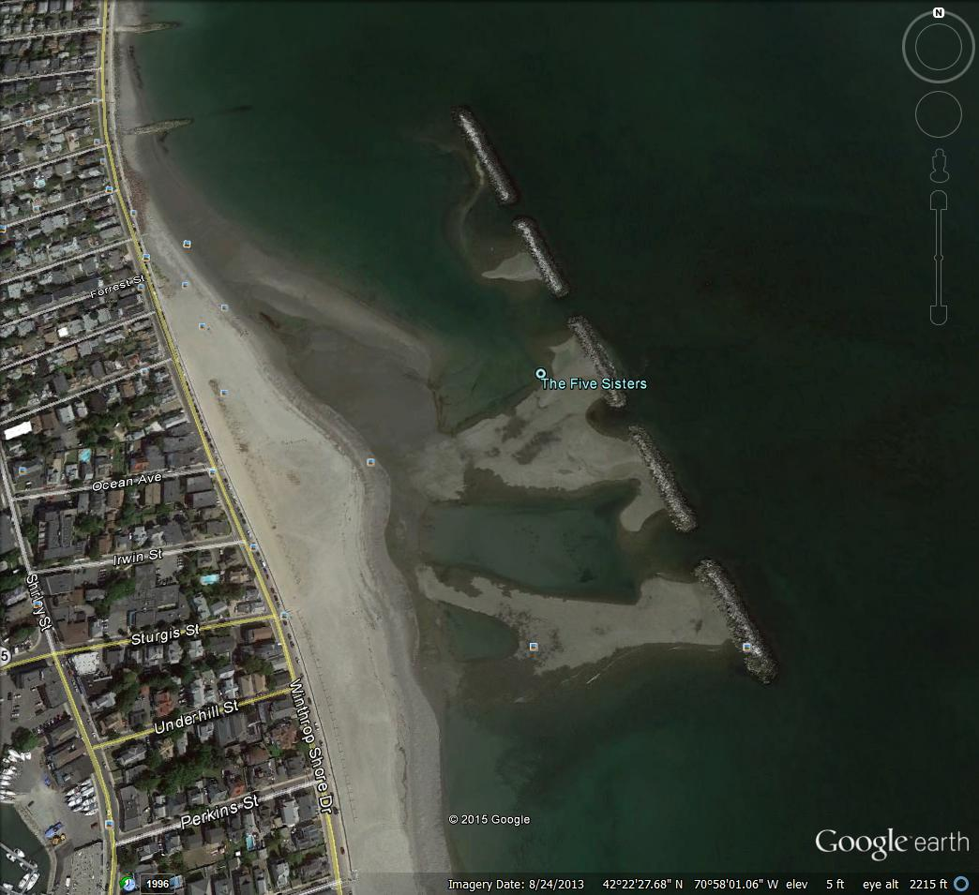
Sandy beach habitat trends
Cumulative impacts of human modifications to sandy beach habitat are significant
44% developed
> 27% armored
> 24% modified by sediment placement
14% modified by sand fencing
> 4% modified by beach scraping
> 91 miles habitat lost in 2015
Extent of habitat modifications increased significantly in the three years after Hurricane Sandy
Habitat modifications interfere with long-term habitat sustainability
Winthrop, MA, breakwaters (2013)

Slide 20
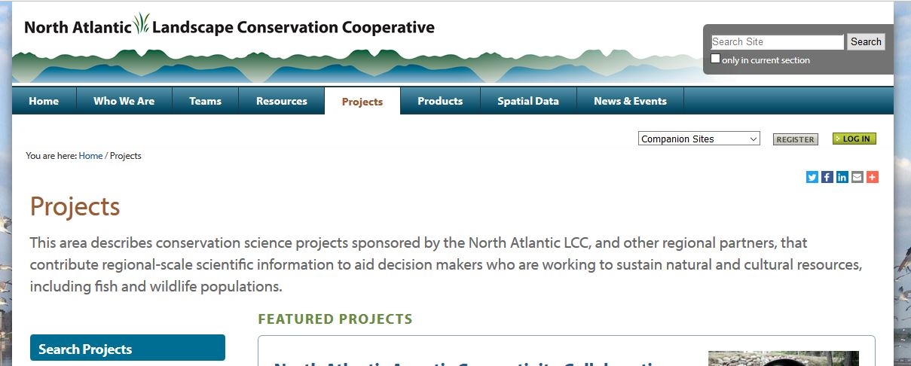
Northatlanticlcc.org

Slide 21
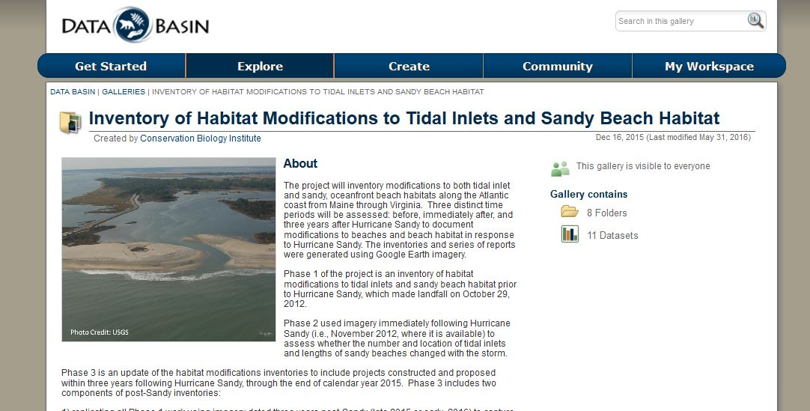
www.databasin.org
Search for this Gallery

Slide 22
Use of data products
ESA, FWCA & CWA consultations
NEPA analyses
Coastal zone management permits
Coastal engineering inventories
GMPs and CCPs
SWAPs
Atlantic Flyway Shorebird Initiative
Input for habitat modeling
Cumulative impact assessments
Conservation planning
And much more !

Slide 23
Tracy Monegan Rice - tracymrice@yahoo.com north atlantic lcc: bart Wilson - Bartholomew_Wilson@fws.gov Scott schwenk - William_schwenk@fws.gov Bridget macdonald - bridget_macdonald@fws.gov
CONTACT INFO
Northatlanticlcc.org

