Slide 1
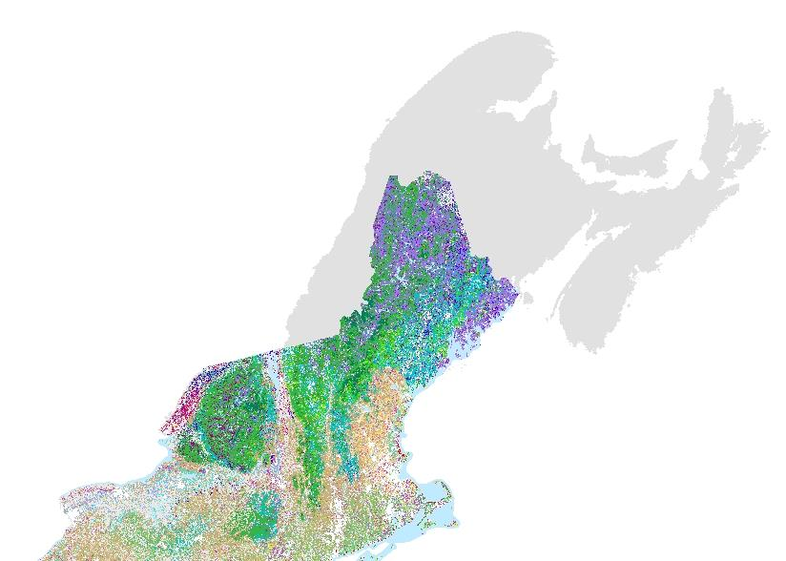
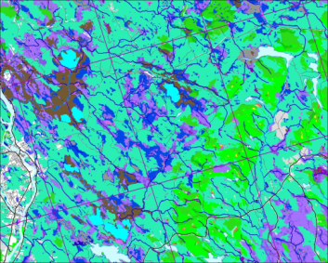
Mapping Ecological Systems in the Northeast:
The Northeast Terrestrial Habitat Map
Low elevation Spruce-Fir–Hardwood
Sub-boreal Spruce Flat
Northern Hardwood forest
Pine-Hemlock Hardwood Forest
Proposed area for expansion
Dr. Mark Anderson
Charles Ferree
The Nature Conservancy

Slide 2
Steering Committee Role
Review datasets and provide guidance on decisions
Review the modeling results for familiar areas
Review final products
Ensure that the final products are accurate and useful
We anticipate six two-hour Web Ex calls, plus time reviewing written materials. Nov 2013-Dec 2014

Slide 3
Agenda
1) Classification team: update
Data Review
2) Regional data sets
Elevation, landforms & topographic indices
Geology, climate, insolation
Land use / land cover
3) Provincial data sets
Wetlands, Soils, Surficial geology
Forest inventory data
Land Classifications, Secured lands
4) Assembly Approach
5) Confirming Points - CDC data
6) Round Robin

Slide 4
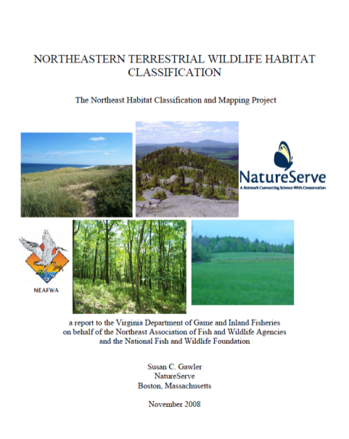
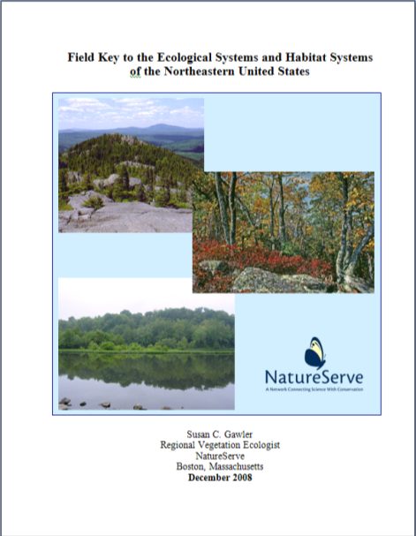
Standard Ecological System Classification

Slide 5
Classification Team
Deanna McCullum
Don Faber-Langendoen
Frédéric Poisson
Josh Noseworthy
Katie Porter
Lesley Sneddon
Margo Morrison
Marie-Josée Côté
Matt Smith
Mélanie Major
Mike Montigny
Peter McLaughlin
Peter Neily
Rob Cameron
Sarah Robinson
Sean Basquill
Sean Blaney
Vince Zelazny
First of four meetings
March 5th 1-3 / 2-4 pm
Forests
Wetlands
Other upland systems
Tagging

Slide 6
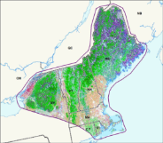
We sent the subset of systems for this area
55 systems described for this area

Slide 7
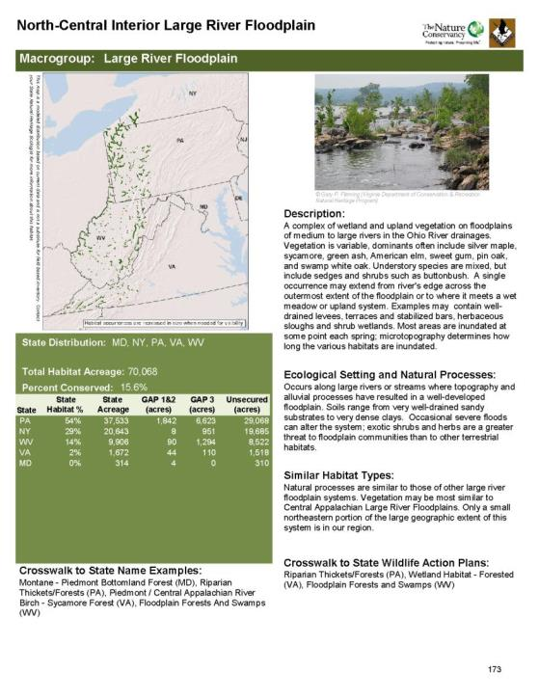
System Descriptions:
Description (NS)
Distribution
Similar Habitats
Ecological Signature
Crosswalk
Associated Species
  Birds
  Herptiles
  Mammals
  Herbs

Slide 8
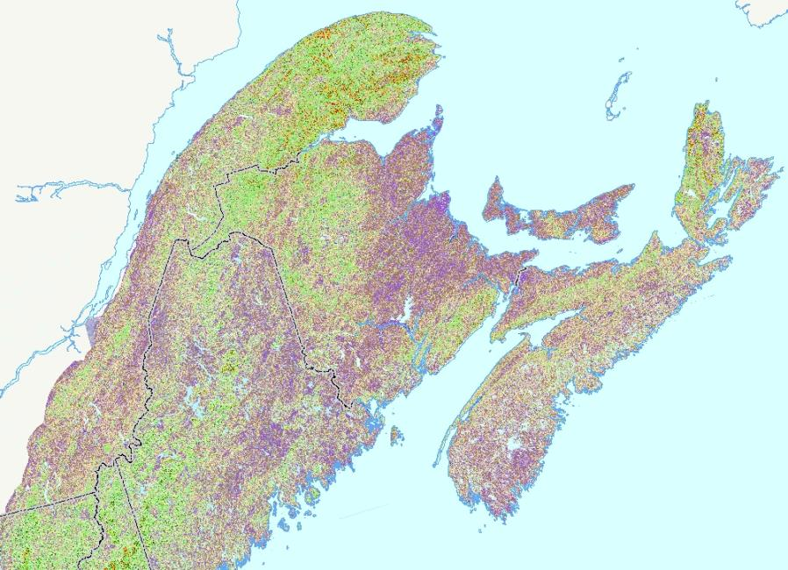
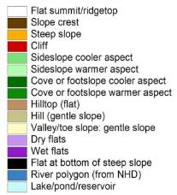
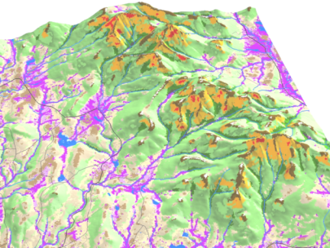
Foundation Data: Region-wide Grids

Slide 9
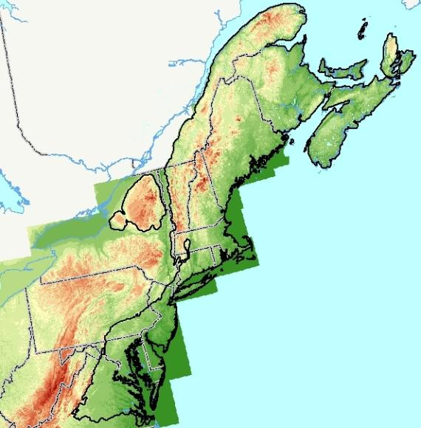
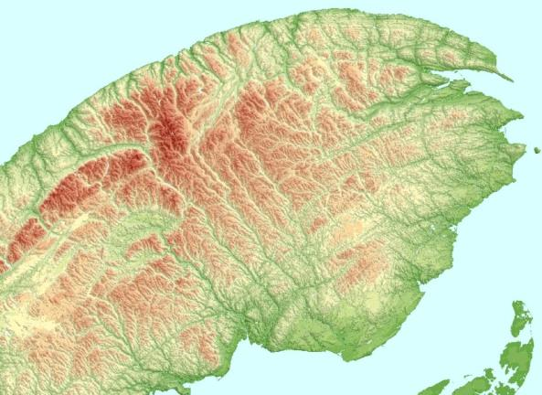
Elevation: 30 m DEM
Notes:
Elevations from 30 meter DEM. The US Fish & Wildlife Service’s North Atlantic Landscape Conservation Cooperative CC is outlined in black in the image at left. The Gaspé is the highest part of the project area.

Slide 10
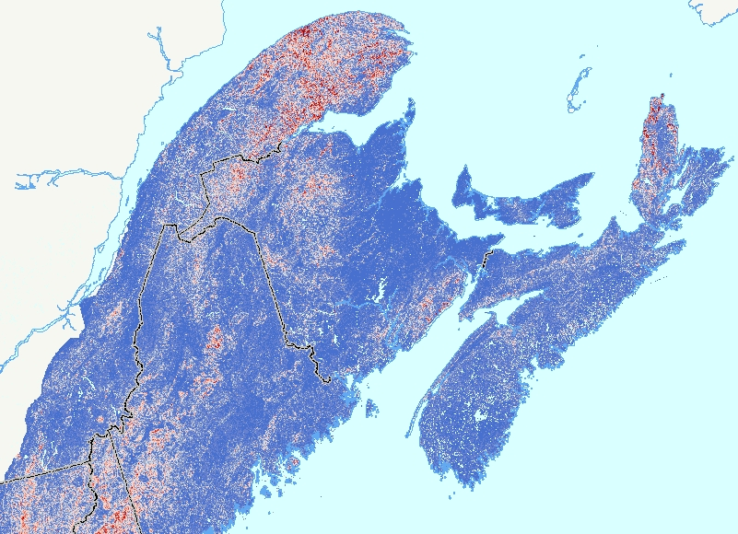
Slope: 30 m DEM

Slide 11

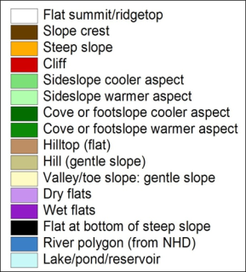
Landforms: 30 m DEM
Notes:
Landform model– in current versions of the model warm and cool aspects are also split out on steep slopes

Slide 12
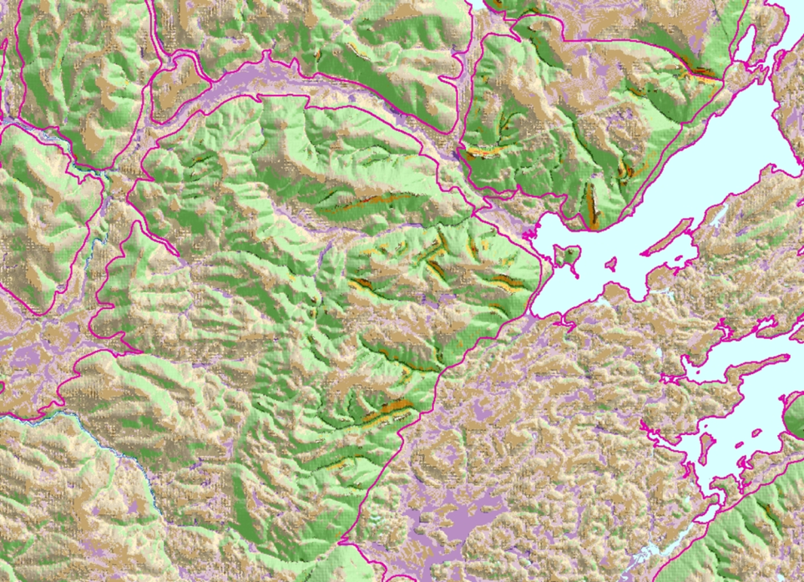
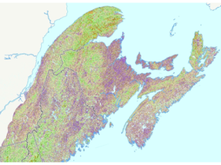
Landforms: 30 m DEM
Notes:
Landforms in SW part of Cape Breton Island– gray-scale transformed aspect display partly transparent laid over

Slide 13
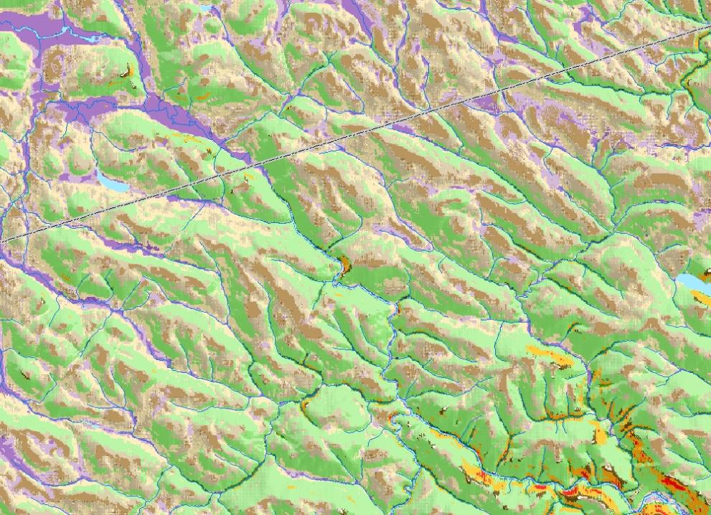
Landforms Along a Portion of the QC-NB Border
Notes:
Landforms in an area of Crown lands along the QC-NB border– straight border segment cuts across image; image is about 25 km across. Next slide is same area.

Slide 14
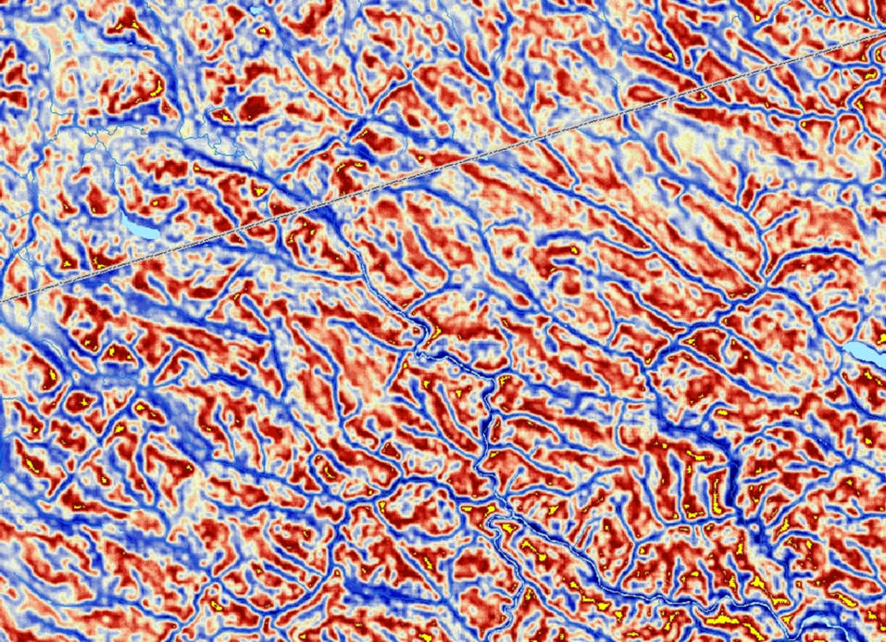
Land Position Index Along a Portion of the QC-NB Border

Slide 15
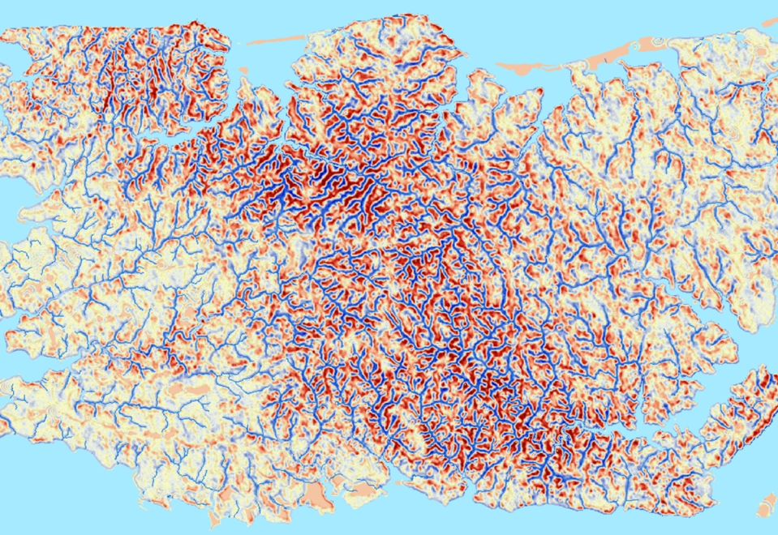
Landposition Index: Central PEI

Slide 16
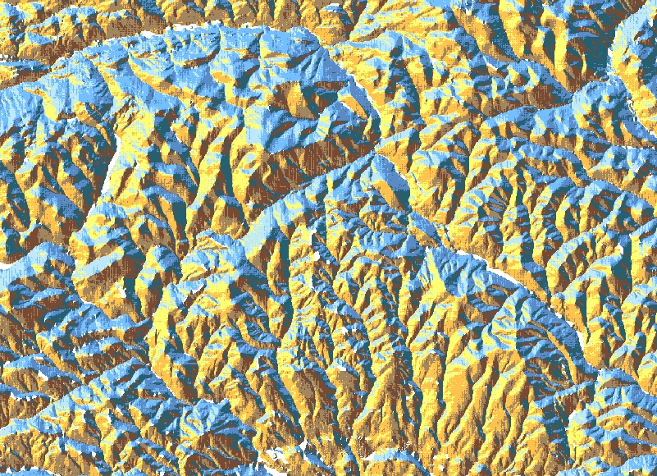
Categorical Aspect: 8 classes: Parc de la Gaspésie
Notes:
Aspect: categorical (classes are the 8 points of the compass): Mont Albert in Parc de la Gaspésie

Slide 17
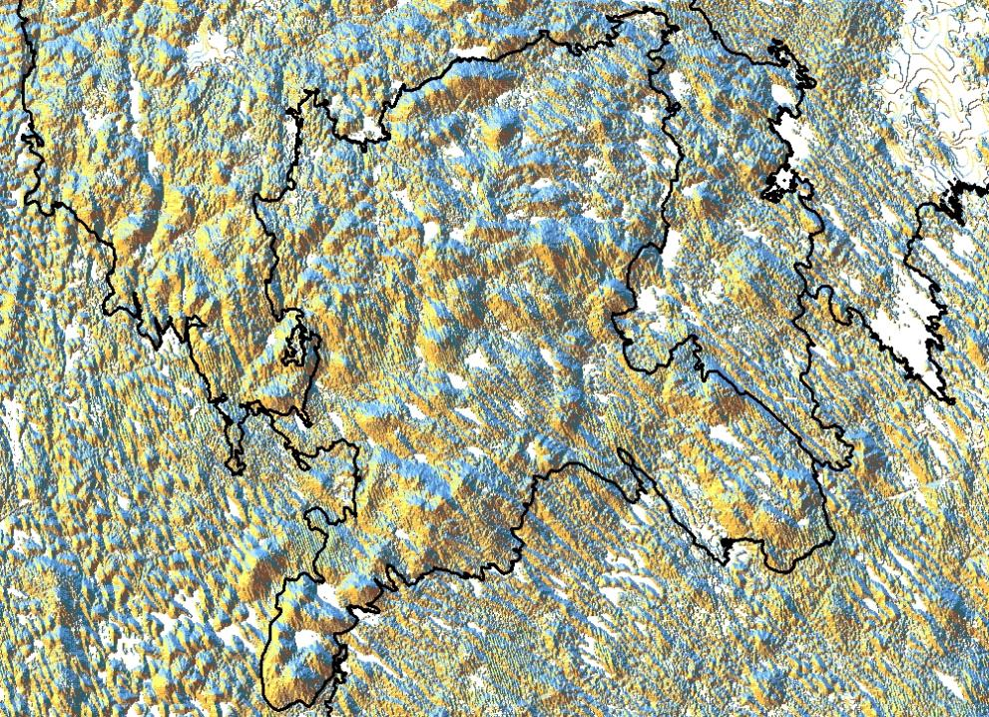
Categorical Aspect: Flint Ecodistrict, SW Nova Scotia
Notes:
Aspect: categorical– Flint Ecodistrict in SW Nova Scotia; tracks glacial movement nicely

Slide 18
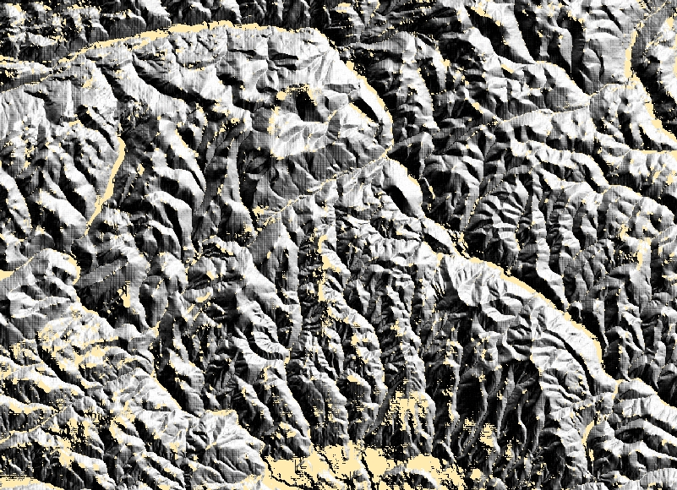
Transformed Aspect: values 0-1000: Parc de la Gaspésie
Notes:
Transformed aspect: numeric values from 0 to 1000– shows relief nicely (Parc de la Gaspésie again)

Slide 19
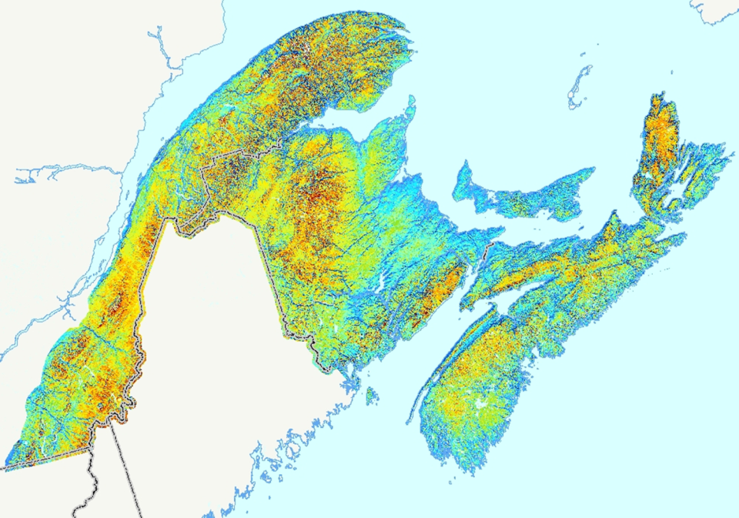
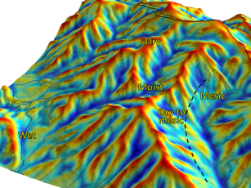
Solar Radiation: 30 m DEM

Slide 20

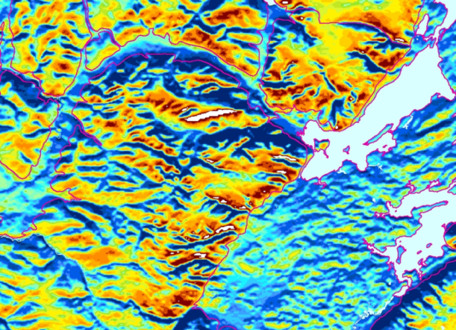
Solar Radiation: 30 m DEM
Solar Radiation index being used to identify warmer and cooler exposures in Cape Breton landscape

Slide 21
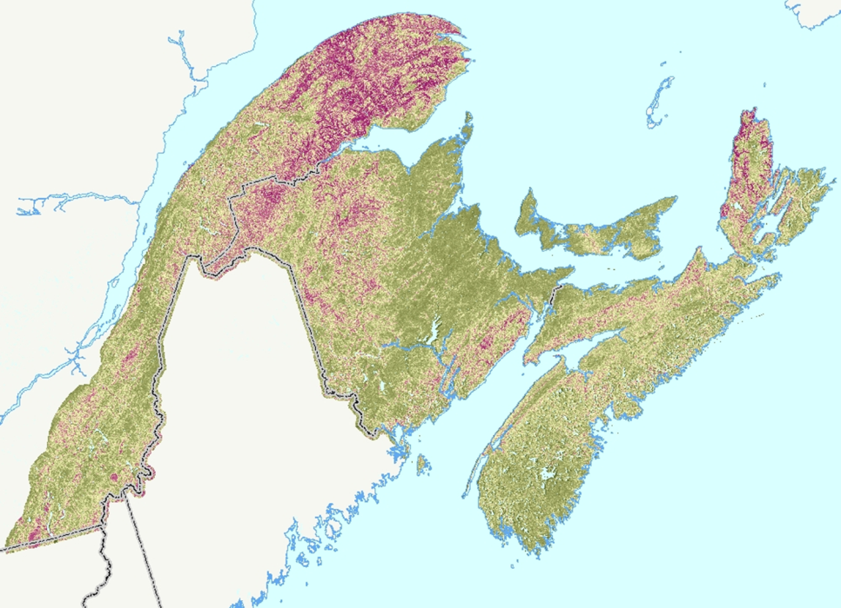
Topographic Roughness: 30 m DEM
Notes:
Landform-based topographic roughness index (TRI)– areas of highest rugosity are in purple, flattest in deep green.

Slide 22
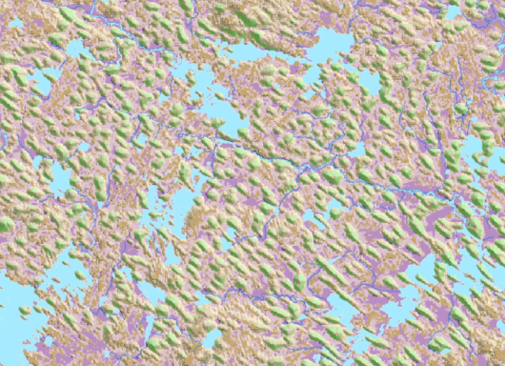
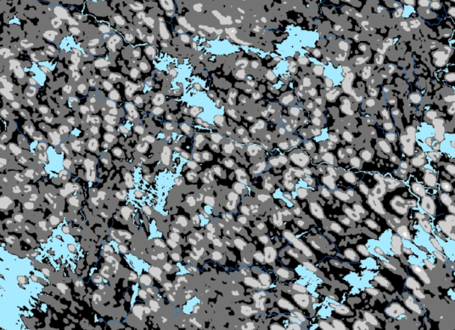
Topographic Roughness: 30 m DEM
TRI being used to identify and map drumlins in southern Nova Scotia (red rectangle in previous slide)
Notes:
The drumlinized till plain in the LaHave Ecodistrict in NS.

Slide 23
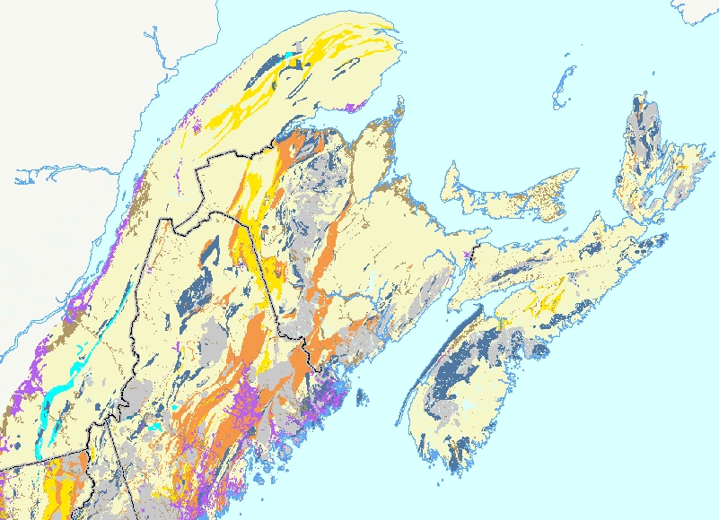
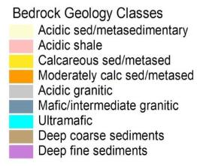
Bedrock Classes: 9 classes
Assembled from Provincial Sources

Slide 24
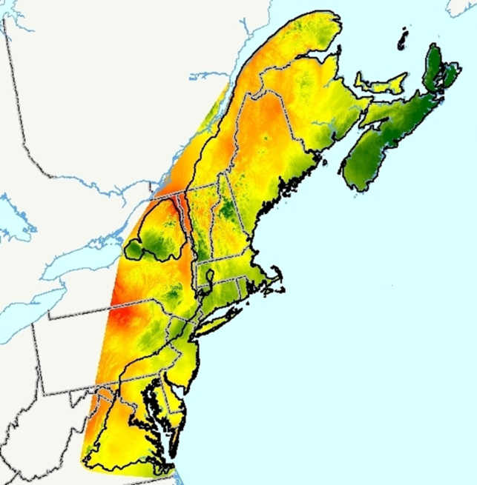
Climate
Mean Annual Precipitation
Low = Red
Mid = Yellow
High = Green

Slide 25
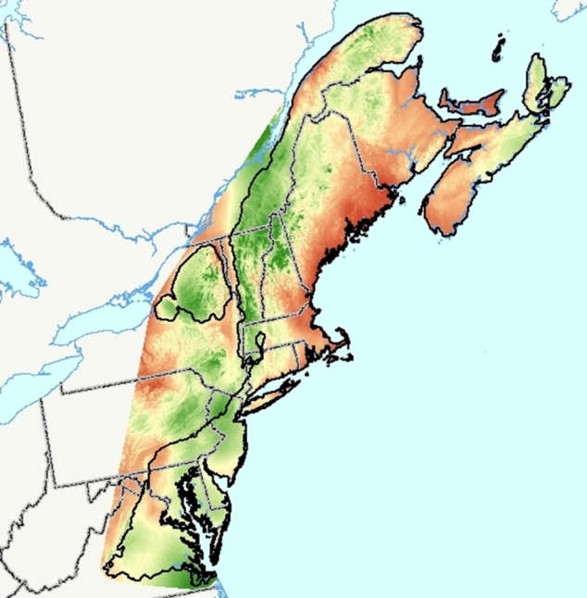
Climate
Precipitation in the Warmest Month:
Low = Red
High = Green

Slide 26
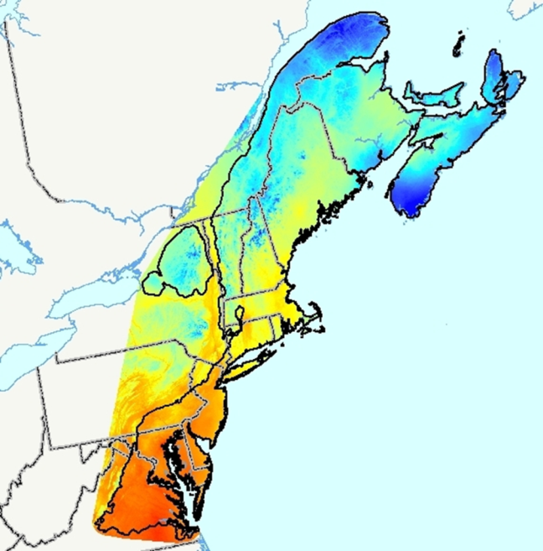
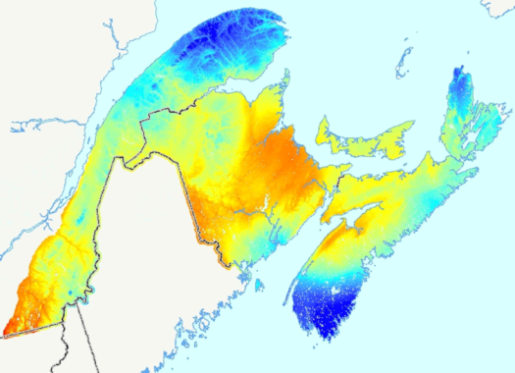
Climate
Maximum Temperature in the Warmest Month:
Low = Blue
High = Red
Canada only
Notes:
Why does the SW part of Nova Scotia map so blue?

Slide 27
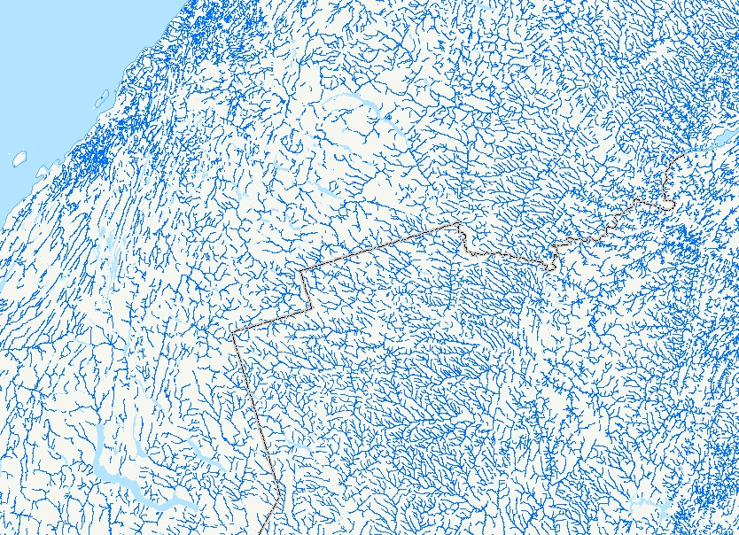
National Hydro Network
Notes:
NHN compiled at scales from 1:10,000 to 1:50,000. About 230,ooo stream arcs in the project area.

Slide 28
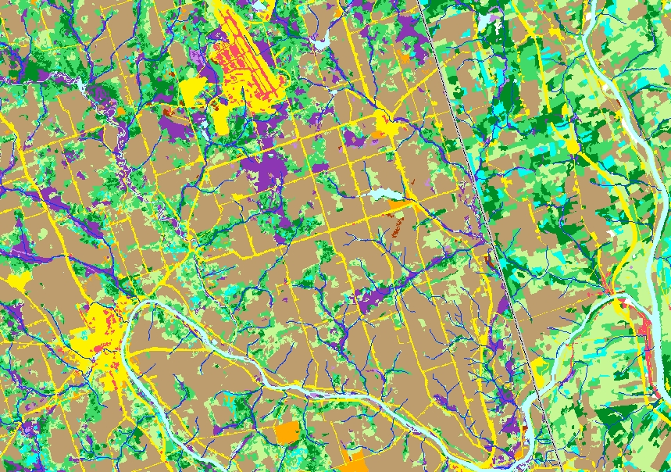
National Hydro Network Along the ME/NB border
Notes:
Caribou, ME at lower left, Loring AFB upper center, Aroostook R. across bottom, St. John River far right. This is an area where both the US Nat’l Hydrography Dataset (NHD) and the NHN are mapped.

Slide 29
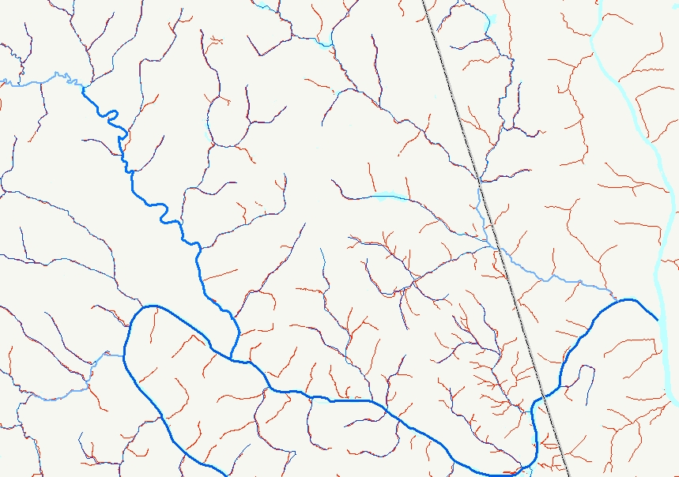
National Hydro Network (red) & US Nat’l Hydrography Data (blue)
Notes:
Less detailed NHD (nominal scale about 1:100,000) is mapped over the more detailed NHN in red.

Slide 30
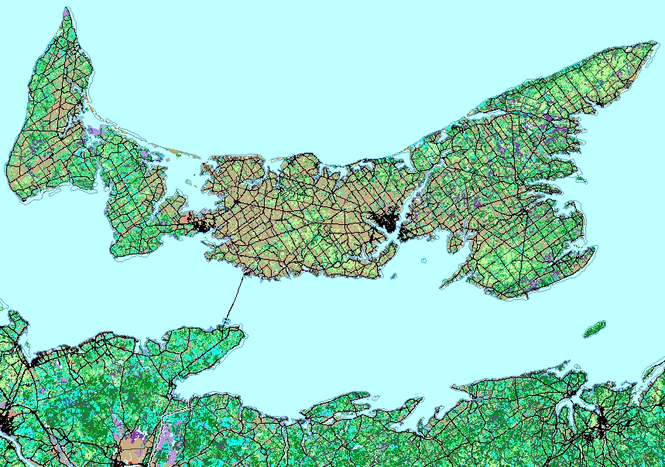
National Roads Network

Slide 31
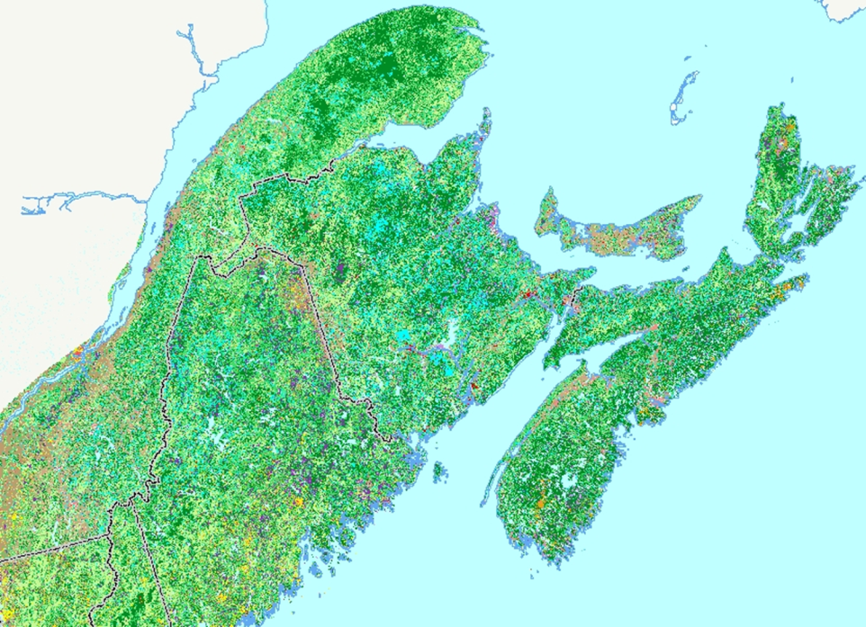
Ecoregional Landuse / Landcover: 30m Grid
Northern Appalachians / Boreal Forest Ecoregion
Assembled by Dan Coker, Gillian Woolmer
Notes:
LULC for the NAP Ecoregion compiled by Coker (TNC) & Woolmer (WCS Canada): 30 meter grid. Close-up in next slide.

Slide 32
NAP Ecoregional Landuse / Landcover: Sources
Southern Quebec: Landsat-7 classified 25m images, 1999-2003, CWS-Québec
Region, Faune Québec, DUC, MRNFP, MAPAQ, AAC, SLC.
Ecosystems conservation Section, Canadian Wildlife Service, Environment Canada
Prince Edward Island: Department of Agriculture, Fisheries, Aquaculture and
Forestry. Generalized from 1:10,000 forest stand data c. 1990's.
New Brunswick: Department of Natural Resources & Environment. Generalized
1:10,000 forest stand data - published 2009, Most stand data 2006.
Data for large industrial landownerships was taken from original TNC NAP-wide
landcover dataset (assembled 2003).
Nova Scotia: Department of Natural Resources, Ecosystem Management Group.
Generalized from 1:10,000 forest stand data. Current forest data (Cycle 2 & 3
with additional updates). Approx 2003 – 2005.

Slide 33
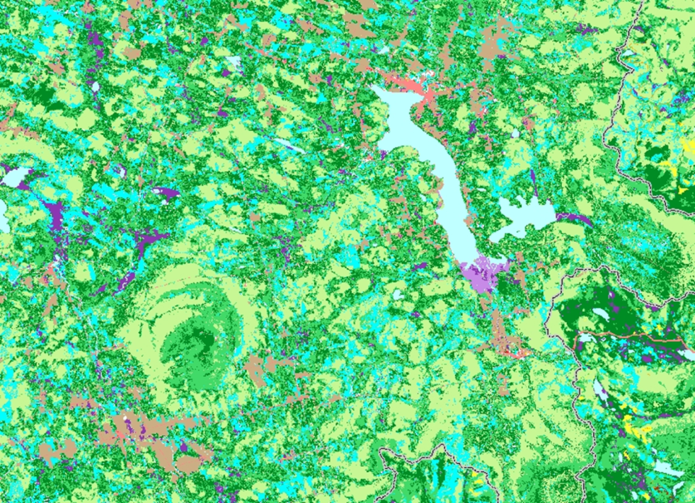
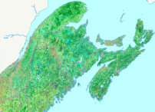
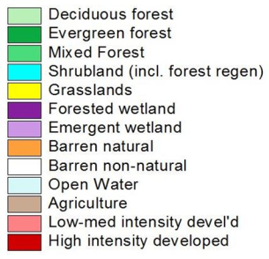
NAP Landuse/Landcover along Quebec/Maine border
Notes:
NAP landcover grid: Mont Mégantic / Lac Mégantic area in Quebec (Quebec-Maine border in grey at image right). Image is about 50 km across.

Slide 34
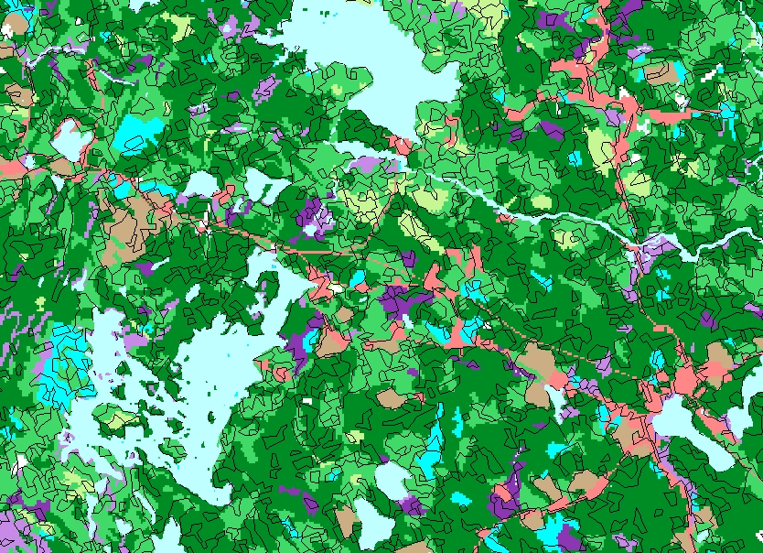
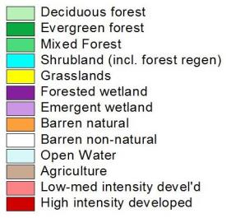
Geobase Canada LULC Polygons Laid Over NAP Grid
Notes:
NAP landcover grid overlaid with Geobase Canada “Circa 2000” vector LULC. This is a little closer look at the Nova Scotia till plain w/ drumlins we saw earlier– it’s about 10.5 km across the image. Next 2 slides look at particular landcover classes from the vector dataset laid over the NAP landcover grid.

Slide 35
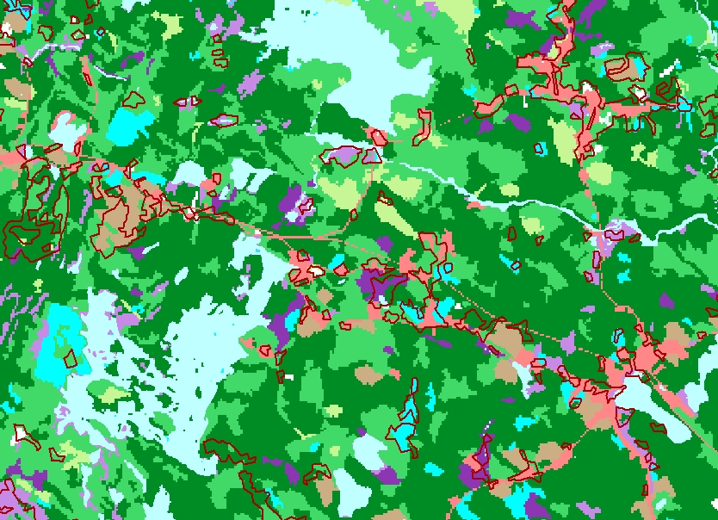
Geobase Canada Low Shrub Polygons (red outline) Over NAP Grid
Notes:
Low shrub polygons in the Geobase Canada dataset. Poor agreement between the 2 landcover datasets.

Slide 36
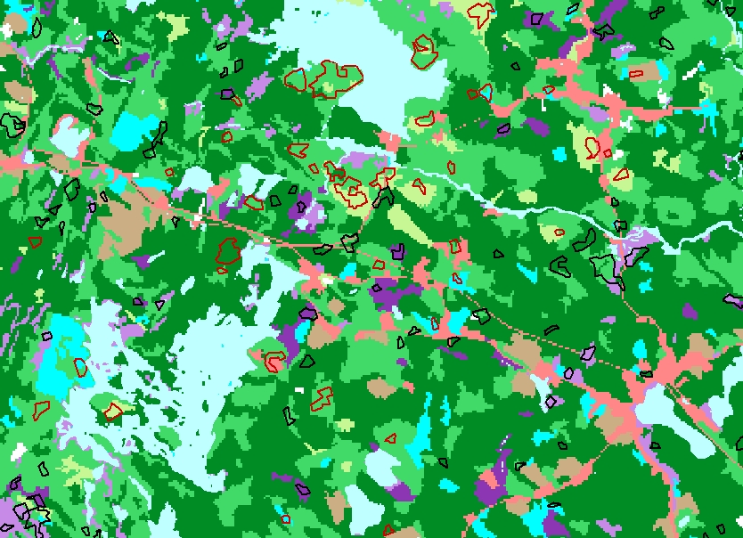
Geobase Canada Sparse Conifer Polygons (black outline)
And Dense Deciduous Polygons (red outline) Over NAP Grid
Notes:
The set of “coniferous sparse” polygons (black outline) from the Geobase Canada dataset seems to track wetlands in the NAP grid at least as well as it does upland conifers. The “broadleaf dense” polygons (red outline) occur in all 3 forest classes in the grid.

Slide 37
Provincial Forest Inventory Datasets: Sources
Nova Scotia: Department of Natural Resources: In hand
New Brunswick: Department of Natural Resources: Data
Use Agreement has been signed
Quebec: Ministry of Natural Resources: Data Use Agreement
being set up
PEI: Dept of Agriculture and Forestry: In hand

Slide 38
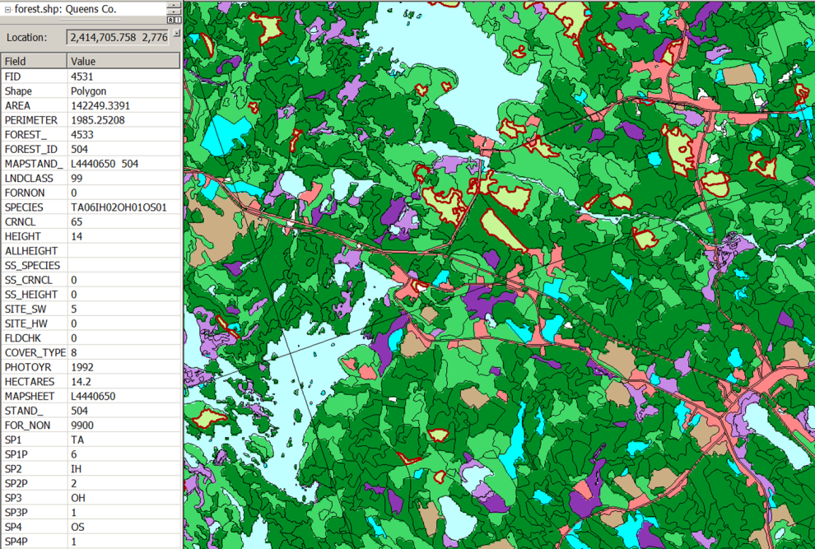
Nova Scotia Forest Inventory Data on the Drumlin Till Plain
US/Canada
Assembled by Dan Coker, Gillian Woolmer
Notes:
The forest inventory data for Nova Scotia, laid over the NAP landcover grid. The forest data were the parent data for the landcover classes in the NAP grid– lookup tables were built that cross-walked polygon attributes to landcover classes. The “Fornon” & “Cover_type” fields were the critical ones. Deciduous forest polygons are outlined in red, and the attributes for one of them are listed.

Slide 39
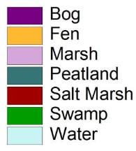
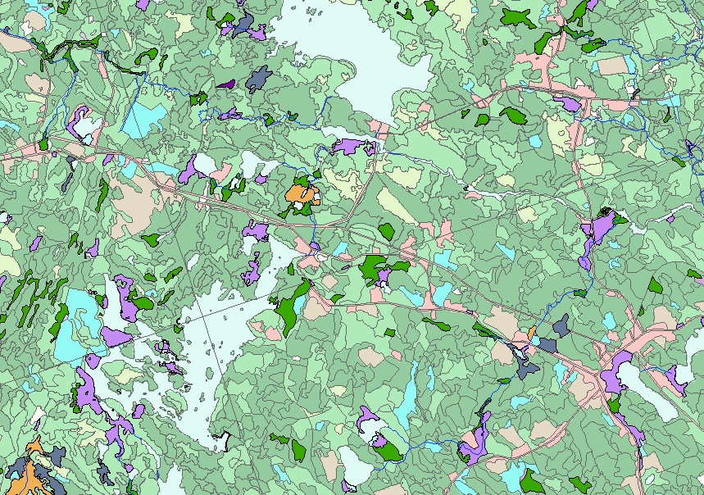
Nova Scotia Wetlands Dataset: Wetland Type
Notes:
The polygons in NS’s wetlands dataset are the same ones that appear as general wetlands or bogs in the forest dataset, but they carry more information about wetland type.

Slide 40
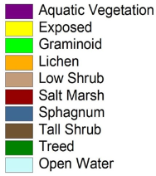
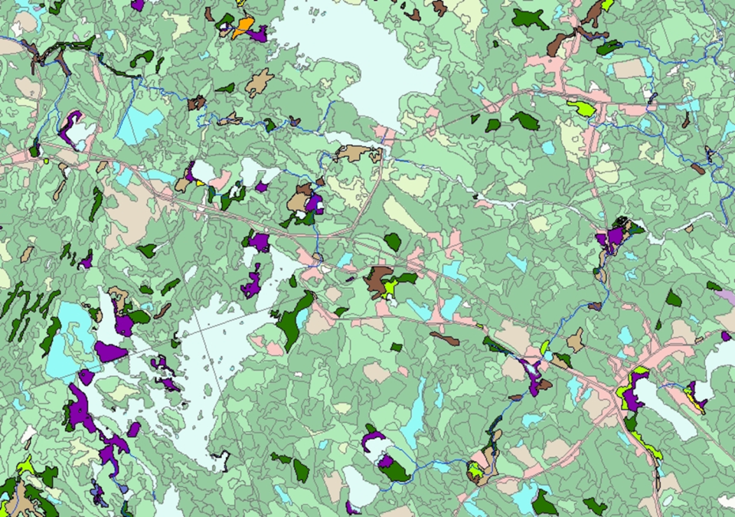
Nova Scotia Wetlands Dataset: Vegetation Type
US/Canada
Assembled by Dan Coker, Gillian Woolmer
Notes:
The same wetlands also occur in this separate wetlands vegetation dataset; polygons carry additional information about dominant vegetation types in the wetland complexes.

Slide 41

Ecosections & Surficial Information:
Nova Scotia’s Ecological Land Classification
Notes:
Ecosections are the third level of Nova Scotia’s Ecological Land Classification hierarchy. They carry general (and spatially generalized) information on the drainage properties and textures of surficial deposits, and topographic character.

Slide 42

Ecosections & Surficial Information: “Silty drumlin” polygons in red hatch, “Stony till plain” in blue hatch
Notes:
The 3 smaller polygons in red hatch at upper left are attributed as well-drained, medium texture, “drumlinoid”; the larger one at lower right as imperfectly drained, medium texture, and drumlinoid.

Slide 43

Ecological Land Classification in NS & NB: Ecoregions
Notes:
Ecological Land Classification in NB & NS: ecoregions– tend to track elevation (represented here) and climatic factors assoc’d with elevation change. USDA-Forest Service subsections in Maine for comparison.

Slide 44

ELC in NS & NB: Ecodistricts and geology
Notes:
Ecodistricts in NB & NS, outlined in purple (w/ ecoregions overlaid)– next finer level of the hierarchical ELC in both provinces. This level tends to reflect changes in bedrock and large-scale geomorphology. Red rectangle on Cape Breton Island is the next slide.

Slide 45

ELC: Ecodistricts on Cape Breton Island: Landforms
Notes:
Ecosections in NW Cape Breton Island– this level of the ELC hierarchy tends to reflect local topography and all that it is associated with: moisture and nutrient availability, exposure, erosion/deposition, prevailing disturbance regimes,…

Slide 46
Round Robin Questions
Are the datasets being assembled the right ones? Other data that we should try to compile?
Are there other people we should be in touch with that can help move the project forward?
Any thoughts on the approach?
The question of ecological potential versus current on-the-ground vegetation cover
Other questions/thoughts/points of discussion?

Slide 47
A few slides from former presentations

Slide 48


A systems/habitat classification not a land cover map
N. Hardwood Forest
Oak Pine Forest
Acidic Swamp
Pitch Pine Barren
Hemlock-N. Hardwood Forest
Pine Barren
Acidic swamp
Dry Oak-Pine Forest
Rocky woodland
Wet flatwoods
Rich swamp
Circumneutral Cliff & Talus

Slide 49
Ecological System Definition: NatureServe
A mosaic of plant community types/associations that
co-occur within landscapes with similar ecological processes (nutrient cycling, disturbance, flooding, fire)
on similar substrates, and/or similar environmental gradients (elevation, moisture regime, topographic setting/local climate, …)
in a pattern that repeats itself across landscapes.

Slide 50


Slide 51
Region- Wide Grids of
Ecological Information
Confirming Points
Models for each
System

Slide 52

Confirming Samples: US
NHP Veg Maps FIA
NA-LCC
NAP
NAC
LNE
CBY
APP-LCC
HAL
CAP
SAP
CUP
Natural Heritage Community Element Occurrences and Plot Data: 50,000+
Vegetation Maps: 100’s
Forest Inventory and Analysis Points: 21,000

Slide 53


Confirming Samples: Crosswalk
Forest Inventory and Analysis
Confirming Points
All the point and polygon datasets must be attributed to the correct ecological system – CDC is critical
Notes:
Aspect: N/NE/E/SE/S/SW/W/NW

Slide 54

MODELS: Samples + Environmental Data
Final maps are based on models that relate system distribution to ecological variables.
Variable | AHNHF | CADOPF | LANHF | LAPHHF | NECIPOF | NEIDMOF | MeanDecreaseAcc
ELEV_MEAN | 0.29 | 1.11 | 2.57 | 1.37 | 2.76 | 0.94 | 0.66
LPOS_MEAN | 0.75 | 1.49 | -0.27 | 0.54 | 1.27 | 0.67 | 0.63
P_CONIF | 0.05 | 1.16 | 1.46 | 2.66 | 3.2 | 1.31 | 0.61
SUBSEC2NAM | 0.43 | 1.21 | 1.47 | 2.27 | 2.57 | 1.2 | 0.6
D2H2O_MEAN | 0.71 | 0.93 | 1.13 | 0.36 | 0.91 | 0.85 | 0.57
LONG | 0.16 | 1.03 | 1.64 | 2.05 | 3.13 | 1.1 | 0.55
TEMP_MAXWM | 0.21 | 1.03 | 2.03 | 1.5 | 2.49 | 0.86 | 0.55
PRECIP_WQ | 0.25 | 1.04 | 1.8 | 0.19 | 2.56 | 0.71 | 0.55
P_SUMMIT | 0.27 | 1.27 | -0.11 | 0.34 | 1.37 | 0.68 | 0.55
P_DECID | 0.11 | 1.03 | 0.88 | 2.66 | 2.93 | 1.11 | 0.55
LAT | 0.47 | 0.87 | 1.8 | 1.51 | 1.57 | 1.16 | 0.54
TEMP_MINCM | 0.33 | 1.11 | 1.86 | 2 | 1.37 | 1.11 | 0.53
TEMP_MDQ | 0.18 | 0.98 | 1.91 | 2.02 | 1.32 | 0.96 | 0.52
P_WETFLAT | 0.15 | 0.89 | 1.28 | 0.91 | 1.43 | 0.5 | 0.48
TR_INDEX | 0.28 | 0.85 | 0.73 | 0.73 | 1.72 | 0.55 | 0.47
TEMP_ANNRG | 0.37 | 0.87 | 1.35 | 1.16 | 0.98 | 0.75 | 0.46
TEMP_MDR | 0.26 | 1.02 | 1.25 | 0.86 | 0.72 | 0.4 | 0.46
LPOS_MIN | 0.1 | 0.91 | 0.58 | 0.51 | 1.56 | 0.68 | 0.46
PRECIP_MA | 0.17 | 0.77 | 1.09 | 0.59 | 1.44 | 0.66 | 0.45
SOLRAD_STD | 0.18 | 1.05 | 0.63 | 0.44 | 1.34 | 0.13 | 0.45
ELEV_RANGE | 0.17 | 0.4 | 0.86 | 0.55 | 1.96 | 0.61 | 0.43
P_HILLS | 0.19 | 0.56 | 0.85 | 0.47 | 0.6 | 0.61 | 0.43
LPOS_STDEV | 0.05 | 0.8 | 0.95 | 0.96 | 1.52 | 0.6 | 0.43
PRECIP_CV | 0.14 | 0.94 | 1.12 | 0.63 | 0.94 | 0.58 | 0.42
Acadian Low Elevation
Spruce-Fir-Hardwood
Random forest output for dominant forest types
Notes:
Variables in pinkish-shaded cells are climate-related; ones in green-shaded cells are topography/landform-related

