Slide 1
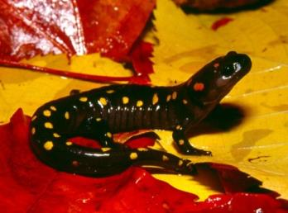
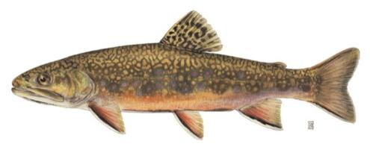
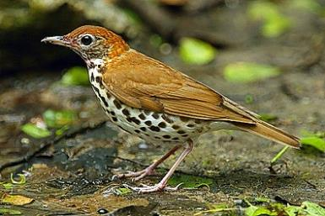
Designing Sustainable Landscapes in the Northeast A Potential Application for Vernal Pool Results
Scott Schwenk, Ph.D.
Science Coordinator
North Atlantic Landscape Conservation Cooperative
Vernal Pool Mapping and Conservation Workshop
April 7, 2014

Slide 2
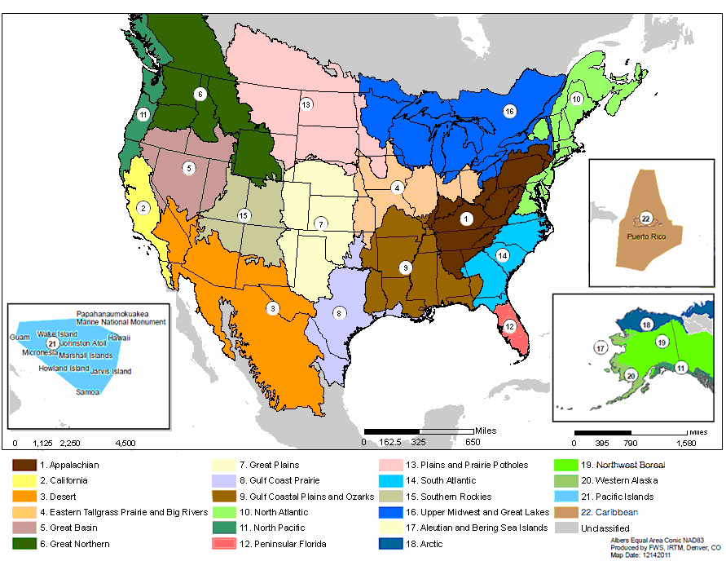
Landscape Conservation Cooperatives
LCCs Fundamental Objective
To define, design, and help partners deliver landscapes that can sustain natural and cultural resources at desired levels nationwide.
Notes:
Regional, self-directed science-management partnerships known as Landscape Conservation Cooperatives have been established in 22 geographic areas around the country and adjacent portions of Canada and Mexico with the fundamental objective of developing the partner and science capacity in these areas and across this network to help define, design and help partners deliver landscapes that can sustain natural and cultural resources at desired levels nationwide
NALCC vision and mission similar to national vision – emphasize LCC is a cooperative partnership; adds mention of land use pressures and changing climate; specifically mentions fish and wildlife as part of goals

Slide 3
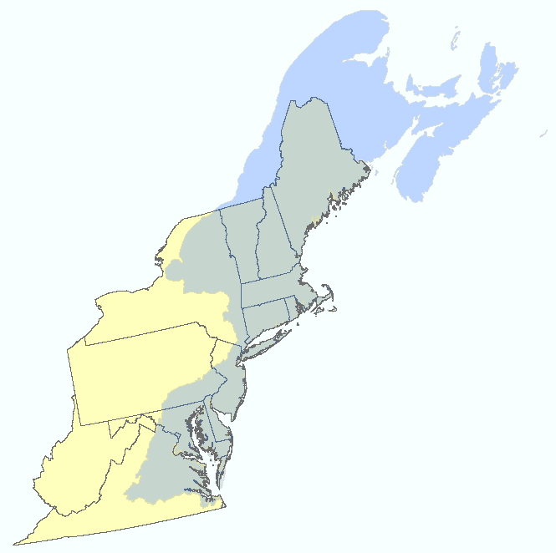
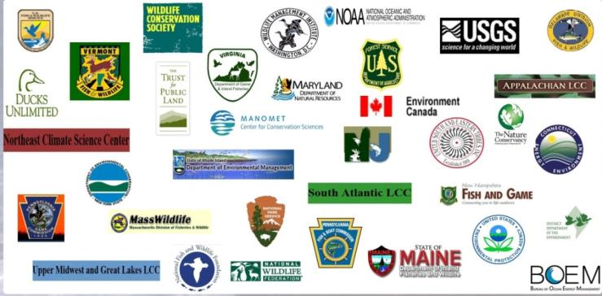
North Atlantic LCC
LCC Partners
32 Steering Committee
Members – federal, state,
tribal, NGO
Notes:
The North Atlantic LCC extends from Southeast Virginia to and including Atlantic Canada and part of Southern Quebec. The self-directed LCC partnership is guided by a Steering Committee of 32 federal, state, tribal and NGO partners and existing partnerships.

Slide 4
North Atlantic LCC
15 Conservation Science Projects Underway -
Aquatic, coastal, wetland,
and terrestrial
Vernal Pool Mapping and Conservation
Designing Sustainable Landscapes
Priority Amphibian and Reptile Conservation Areas (PARCAs)
Notes:
The North Atlantic LCC extends from Southeast Virginia to and including Atlantic Canada and part of Southern Quebec. The self-directed LCC partnership is guided by a Steering Committee of 32 federal, state, tribal and NGO partners and existing partnerships.

Slide 5
Foundational Concepts of Landscape Conservation
Landscape Scale: The scale necessary to ensure the future of ecosystems, fish and wildlife in the face of development, climate change, and other pressures
It is not enough anymore to work parcel by parcel, refuge by refuge, stream by stream, and hope it all fits together into a larger system. We need to work cooperatively and strategically.

Slide 6
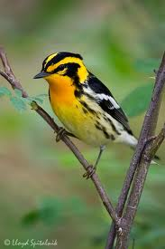
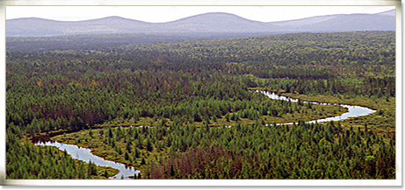
What are we designing conservation for? Inclusive view of biodiversity and natural resources
Species
Species that represent the needs of others (surrogate species)
Priority species not well-represented (e.g., rare)
Ecosystems [habitat types]
Including the functions they perform and services they produce

Slide 7
What are we designing conservation for? Inclusive view of biodiversity and natural resources
Species
Species that represent the needs of others (surrogate species)
Priority species not well-represented (e.g., rare)
Ecosystems [habitat types]
Including the functions they perform and services they produce

Slide 8
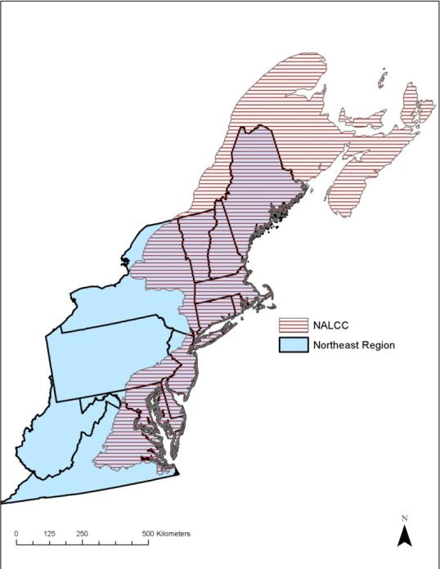
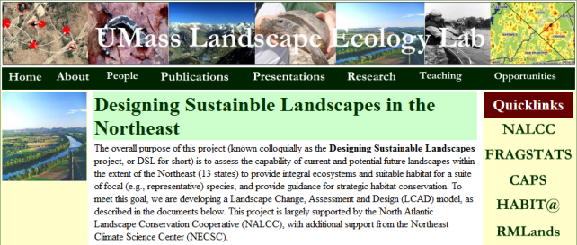
Designing Sustainable Landscapes in the Northeast Kevin McGarigal, UMass Amherst
Project website:
www.umass.edu/landeco/research/dsl/dsl.html
Phase 1: pilot areas (2011-2012)
Phase 2: full Northeast (2012-2014)
+ Conn. River pilot watershed work

Slide 9
Purpose & Need
The purpose of the Designing Sustainable Landscapes (DSL) project is to:
﻿Assess the capability of current and potential future landscapes to provide intact ecosystems and suitable habitat for a suite of representative species, and provide guidance for strategic habitat conservation
Landscape
Change
Assessment
Design
Model

Slide 10
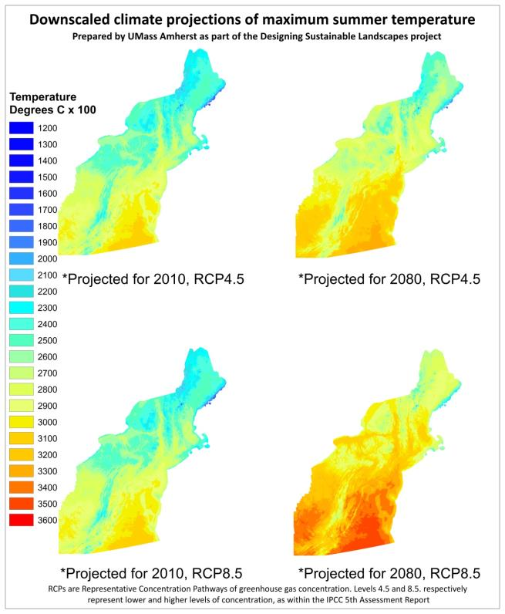
Modeling Approach
Landscape change model to predict changes in ecological integrity and habitat capability driven by:
urban growth
climate change
other disturbances
And using the results to
develop landscape designs
and guide conservation decisions
Notes:
Pilot the implementation of the landscape change and assessment portion of the LCAD model in three study areas: 1) Kennebec River watershed, 2) middle Connecticut River watershed, and 3) the combined Pocomoke-Nanticoke River watersheds. The model results in these three study areas will be presented in a final phase I report and presented and discussed with managers during a series of workshops in October 2012. The results in phase I are limited to the three study areas; the model will be extended to the entire Northeast region in phase II.

Slide 11
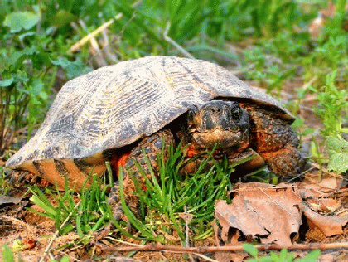
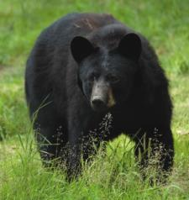
Initial Representative Species Models (30 models in development)
Ecosystem/Habitat Types | Initial Set of Species
Deciduous forest, mature | Wood Thrush
Deciduous forest, young | American Woodcock, Ruffed Grouse
Forest, large blocks | Black Bear

Slide 12
Initial Representative Species Models (30 models in development)
Ecosystem/Habitat Types | Initial Set of Species
Deciduous forest, mature | Wood Thrush
Deciduous forest, young | American Woodcock, Ruffed Grouse
Forest, large blocks | Black Bear
Mixed (coniferous) forest | Moose, Blackburnian Warbler
Spruce-fir forest | Blackpoll Warbler
Grasslands | Eastern Meadowlark
Riparian and floodplain forest | Louisiana Waterthrush
Forested wetlands | Northern Waterthrush, Wood Duck
Streams (+ associated uplands) | Brook Trout, Wood Turtle
Marshes | Marsh Wren

Slide 13
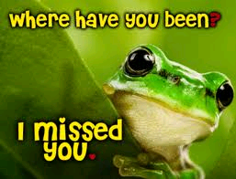
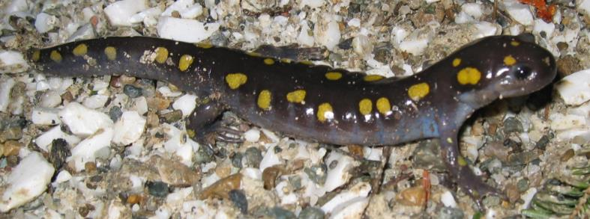
Missing! Unable to model due to lack of vernal pool information
Ecosystem/Habitat Types | Representative Species
Vernal pools (and surroundings) | Spotted Salamander
Vernal pools (and surroundings) | Wood Frog

Slide 14
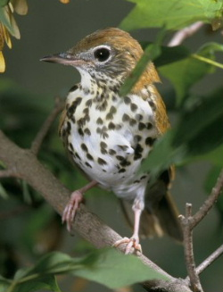
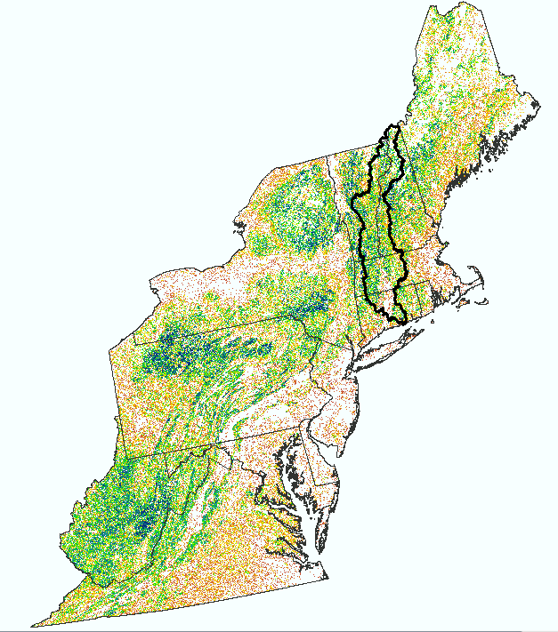
Representative (Surrogate) Species
Wood Thrush
Habitat capability models based on:
Known habitat associations and effects of stressors - reflects the quantity, quality and accessibility of habitat within a potential homerange centered on each cell
+
Actual field data (e.g., Breeding Bird Survey routes) where available

Slide 15
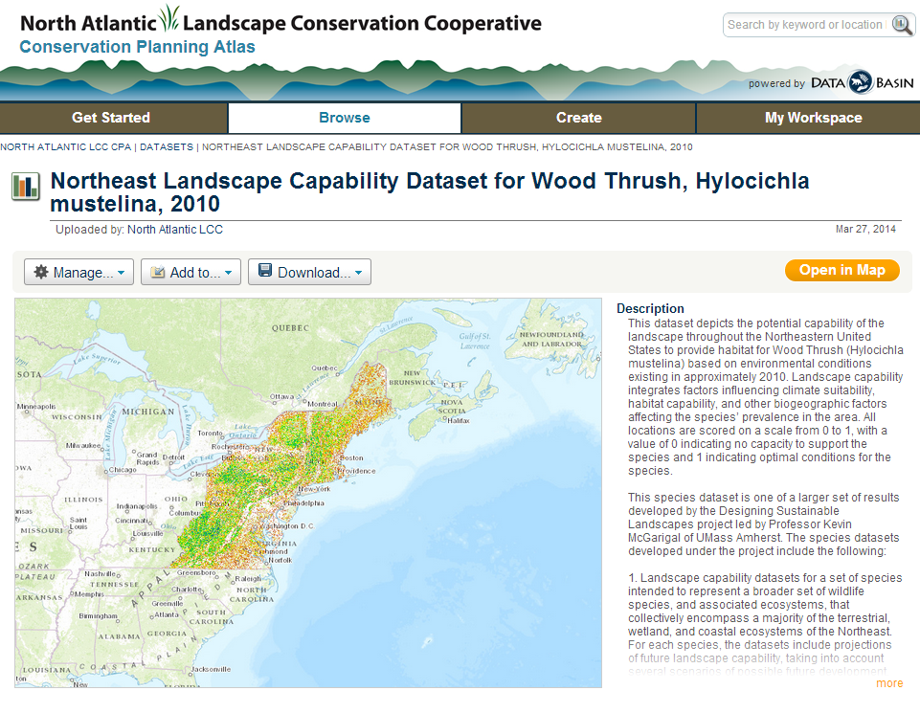

Slide 16
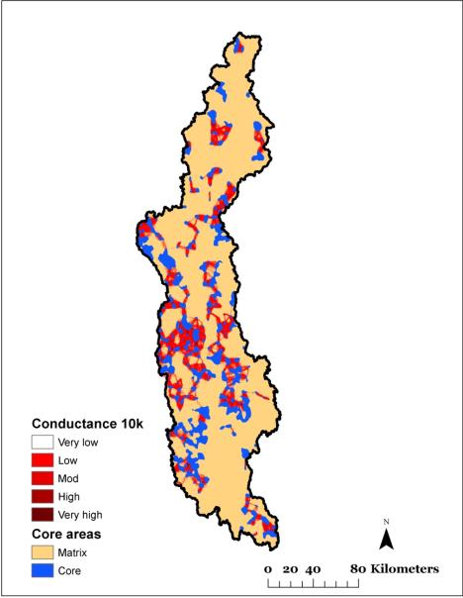
Landscape Conservation Design
Integrating the Elements
Surrogate Species
Unrepresented Species
Ecological Integrity and Resilience
Landscape
Conservation
Design
Notes:
Design informs where to invest in land conservation and how much, how to manage lands, and where to invest in restoration

Slide 17
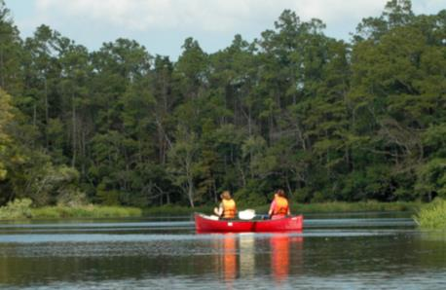
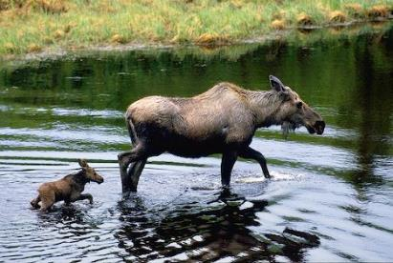
Why landscape-level conservation?
An interconnected, resilient network of lands and waterways has many benefits for society:
Fish and wildlife populations
Clean water
Flood and erosion control
Storm protection
Forest and farm products
Recreation and tourism
Quality of life
Employment

Slide 18
Acknowledgements and Collaborators
Thanks to our many investigators, their students and staff, and our partners
www.northatlanticlcc.org
Scott Schwenk – william_schwenk@fws.gov
UMass Team: Kevin McGarigal, Brad Compton, Bill DeLuca, Joanna Grand, Ethan Plunkett, Liz Wiley, Carly Chandler, Janice Zepko
North Atlantic LCC Coordinator: Andrew Milliken
LCC Information Management and GIS:
BJ Richardson, Lori Pelech, Renee Vieira

