Slide 1
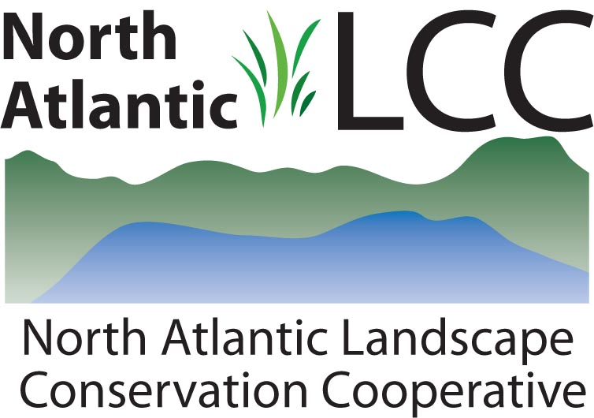
Science Delivery in the North Atlantic LCC
Overview for LCC Network Council
Jad Daley, Trust for Public Land
Andrew Milliken, North Atlantic LCC Coordinator
Steven Fuller, North Atlantic LCC Science Delivery Coordinator
Notes:
Thank you to the LCC Network Council for the opportunity to talk with you about the overall approach and examples of delivering science in the North Atlantic LCC

Slide 2
Northeast
Conservation Framework (2011)
GOAL-SETTING
Which species/habitats to conserve? At what levels?
Who decides?
CONSERVATION DESIGN
BIOLOGICAL ASSESSMENT
What should landscapes look like to conserve species and habitats at goal levels
What do we know about the status of priority wildlife?
INFORMATION MANAGEMENT
PRIORITIES
SCIENCE TRANSLATION
Which species and issues demand immediate attention?
How will we manage the demand for and creation of data?
How do we make science solutions useful?
MONITORING, EVALUATION AND RESEARCH
CONSERVATION ADOPTION
What new information will we gather to support conservation?
How do we get partners communities and landowners engaged in conservation?
CONSERVATION DELIVERY
Science Delivery
How will we most efficiently put conservation on the ground?
Notes:
Partners in the Northeast Region and North Atlantic LCC recognized early on in the development of the LCC the importance of science delivery. They agreed on a conservation framework in 2011 (building on the Strategic Habitat Conservation Framework of the Fish and Wildlife Service), that links together planning, design, delivery and evaluation and puts focus not just on science development but also on (click for animation) translation adoption and information management to ensure the information and tools are available, understood and used.

Slide 3
Vision
Why Science Delivery?
“Why does this magnificent applied science which saves work and makes life easier bring us so little happiness? The simple answer: because we have not learned to make sensible use of it.” Albert Einstein
Need Science Delivery to ensure that partners understand:
what information and tools are available for what purposes;
how to access them;
how to use them; (how not to use them);
how to provide feedback to improve them;
why they are relevant;
how to integrate them; and
how they can effectively distribute them through their networks.
Notes:
The conundrum of applied science being available but not used has been recognized by great minds for a long time. In our case, although partners in the North Atlantic LCC have been involved in identifying science needs and in many cases been involved in collaboratively developing information and tools to address those needs, they are not fully using what is available - the amount and complexity of information being developed is hard for partners to keep track of, understand and take the time to learn and use. (Click for animation). We need science delivery to…

Slide 4
Vision
Science Delivery Program
Program Objective
Advance the best-available science by establishing a knowledge base in the conservation community and facilitating a network of partners to access and apply landscape science products to conservation at multiple scales.
Notes:
To address these needs, the North Atlantic LCC has prioritized science delivery and established a program of Science Delivery to…

Slide 5
Vision
Science Delivery Program
Program Components
Information Management
Data portals and website
Online tools
Program Development and Capacity
Team, staff, contracts
Initial knowledge transfer, training, communications, tech. assistance
Partner Support Grants and Demonstration Projects
Develop and demonstrate specific applications
Support partners and partnerships to deliver through their networks
* In addition to involving partners in projects and conservation design
Notes:
This program has three major components: managing information; developing and maintaining capacity for an ongoing process of delivering science; and supporting partners to demonstrate applications and deliver information through their networks. I will provide more detail and examples of each of these components. I should note that in addition to these components, the involvement of likely users of information in the development of that information and its integration in conservation design is critical and assumed but not covered in detail in this presentation.

Slide 6
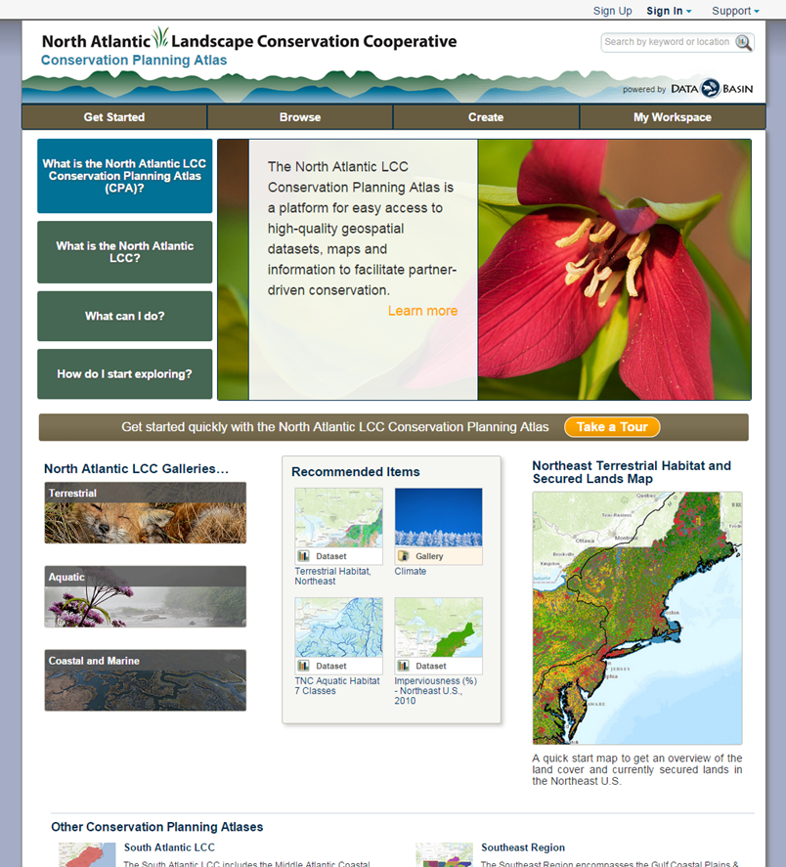
Information Management
Easy Access to and Use of Spatial Data
Conservation Planning Atlas on Data Basin
Resource Category | Number of Datasets
Climate change | 65
Terrestrial | 57
Aquatic | 19
Coastal and marine | 36
Conservation Design | 59
TOTAL | 236
Notes:
With regard to information management, most if not all LCCs now have spatial data portals, many using Data Basin which will help make spatial data accessible across the network. The North Atlantic Conservation Planning Atlas (on Data Basin) is being used not just for access but by groups as a workspace for their own work drawing from the information developed by the LCC, the Northeast States through their Regional Conservation Needs Program (that David Whitehurst can talk more about) and other partners. Most of this information was developed and is available for the entire northeast FWS and NEAFWA administrative region and designed to be used at multiple spatial scales.

Slide 7
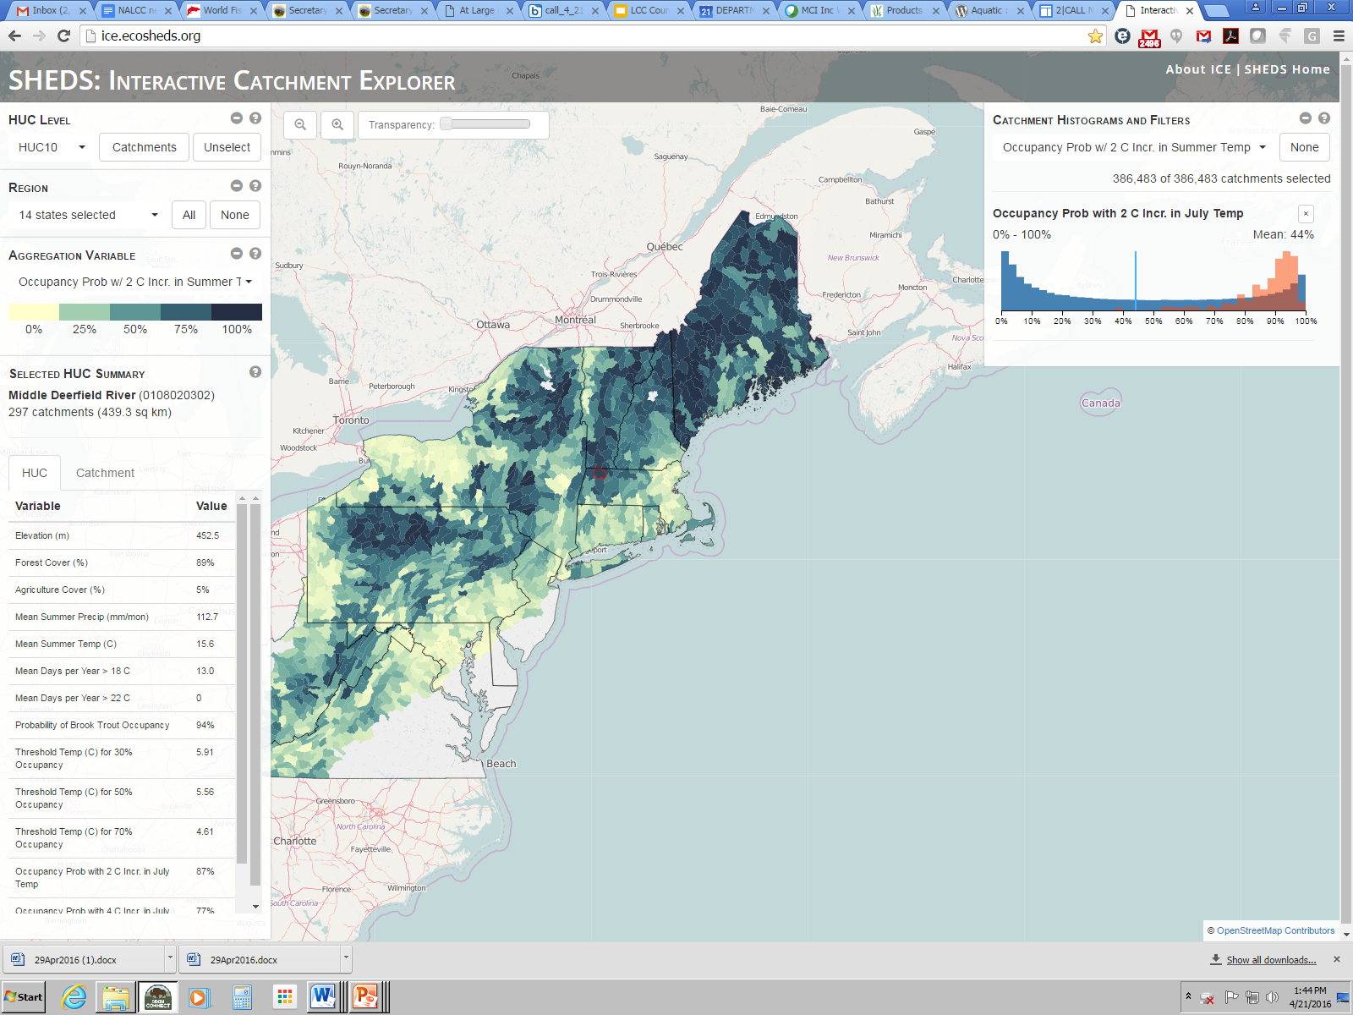
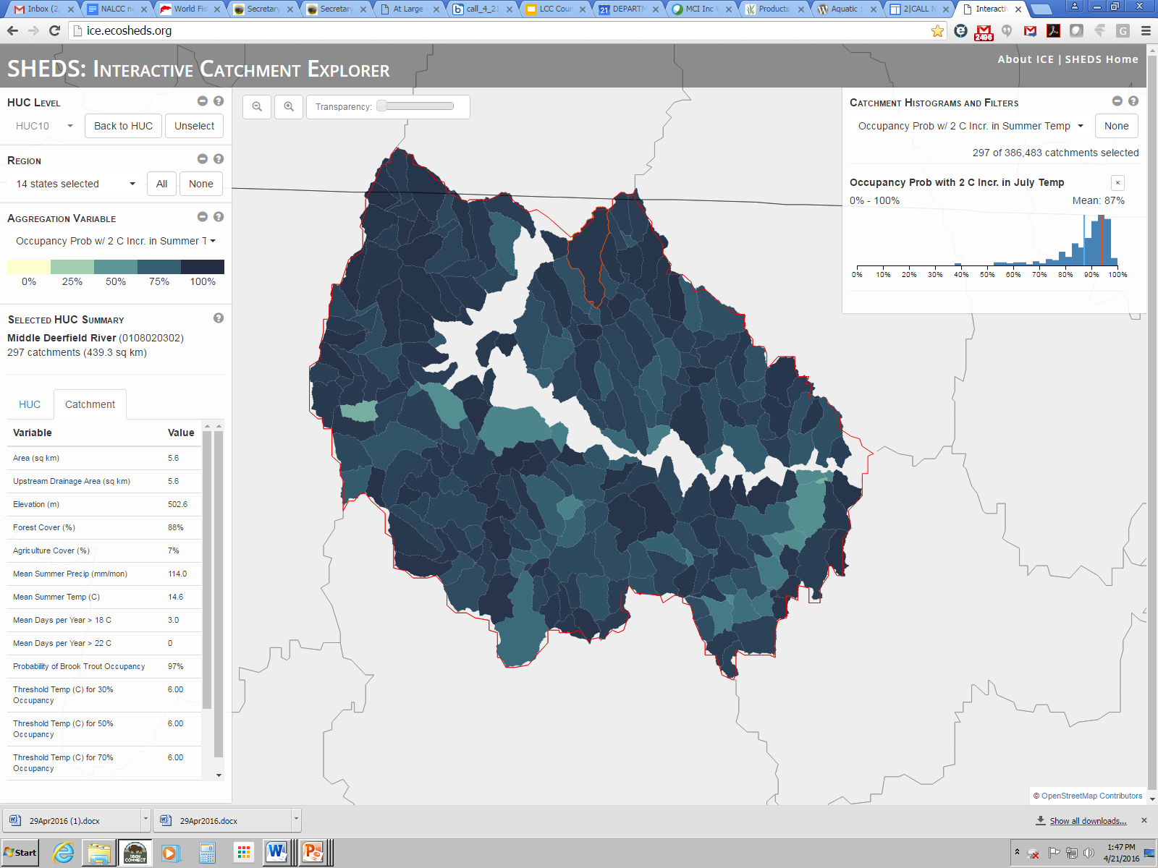
Information Management – Online Query Tools
Notes:
In addition to this overall online conservation planning atlas and landscape conservation designs, the LCC is increasingly delivering science through specific online tools that allow partners to query and assess results for specific conservation targets or actions at multiple spatial scales. An example shown here is the Interactive Catchment Explorer (developed by USGS and UMass) that allows you to look at variables such as the probability of brook trout occupancy under a 2 degrees increase in air temp across the region at coarser watershed scales as a screening tool and then users are also to zoom in and look at this same data at the scale of individual stream reaches or catchments as in shown for catchments in the middle Deerfield River watershed in Massachusetts and Vermont that allows users to target those catchments with high future brook trout probability for protection or restoration actions.

Slide 8
Vision
Science Delivery Program
Program Development and Capacity
Science Delivery Team
30 members (8 State, 10 Fed., 9 NGO, 3 LCC)
Develop and oversee delivery strategy
Recommend science delivery grants
Staff
Science Delivery Coordinator (half-time); GIS Coordinator & GIS Analyst; Communications Coordinator
Plus part of all staff member’s responsibility
Contracts to address specific needs
User partner relationships, communications, initial knowledge transfer, webinars, workshops, training, online learning specific applications, ongoing technical assistance
Notes:
The second major component is developing capacity for an ongoing process of delivering science including a diverse team of partners to guide the process and strategy and recommend funding and a commitment of all staff focused on various aspects of science delivery. Staff are now involved on a daily basis on maintaining relationships with key user groups, communications, increasing awareness with key partners, various methods of informing and training partners and being available to provide technical assistance. Long term relationship building has been key, one example is working with Wildlife Diversity Program Managers in NEAFWA the 13 Northeast States for six years to support regional information and context for State Wildlife Action Plans.

Slide 9
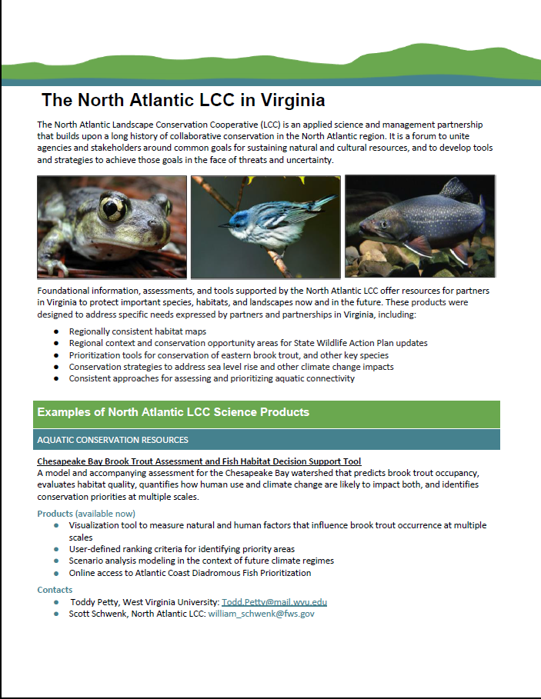
Communications
Customized for Specific Delivery Partners
e.g., State Fact Sheets
Communication Use Cases
Notes:
Communications are developed with specific user groups in mind, for example facts sheets for each state with available products and partners involved in that state to facilitate science delivery in that state.

Slide 10
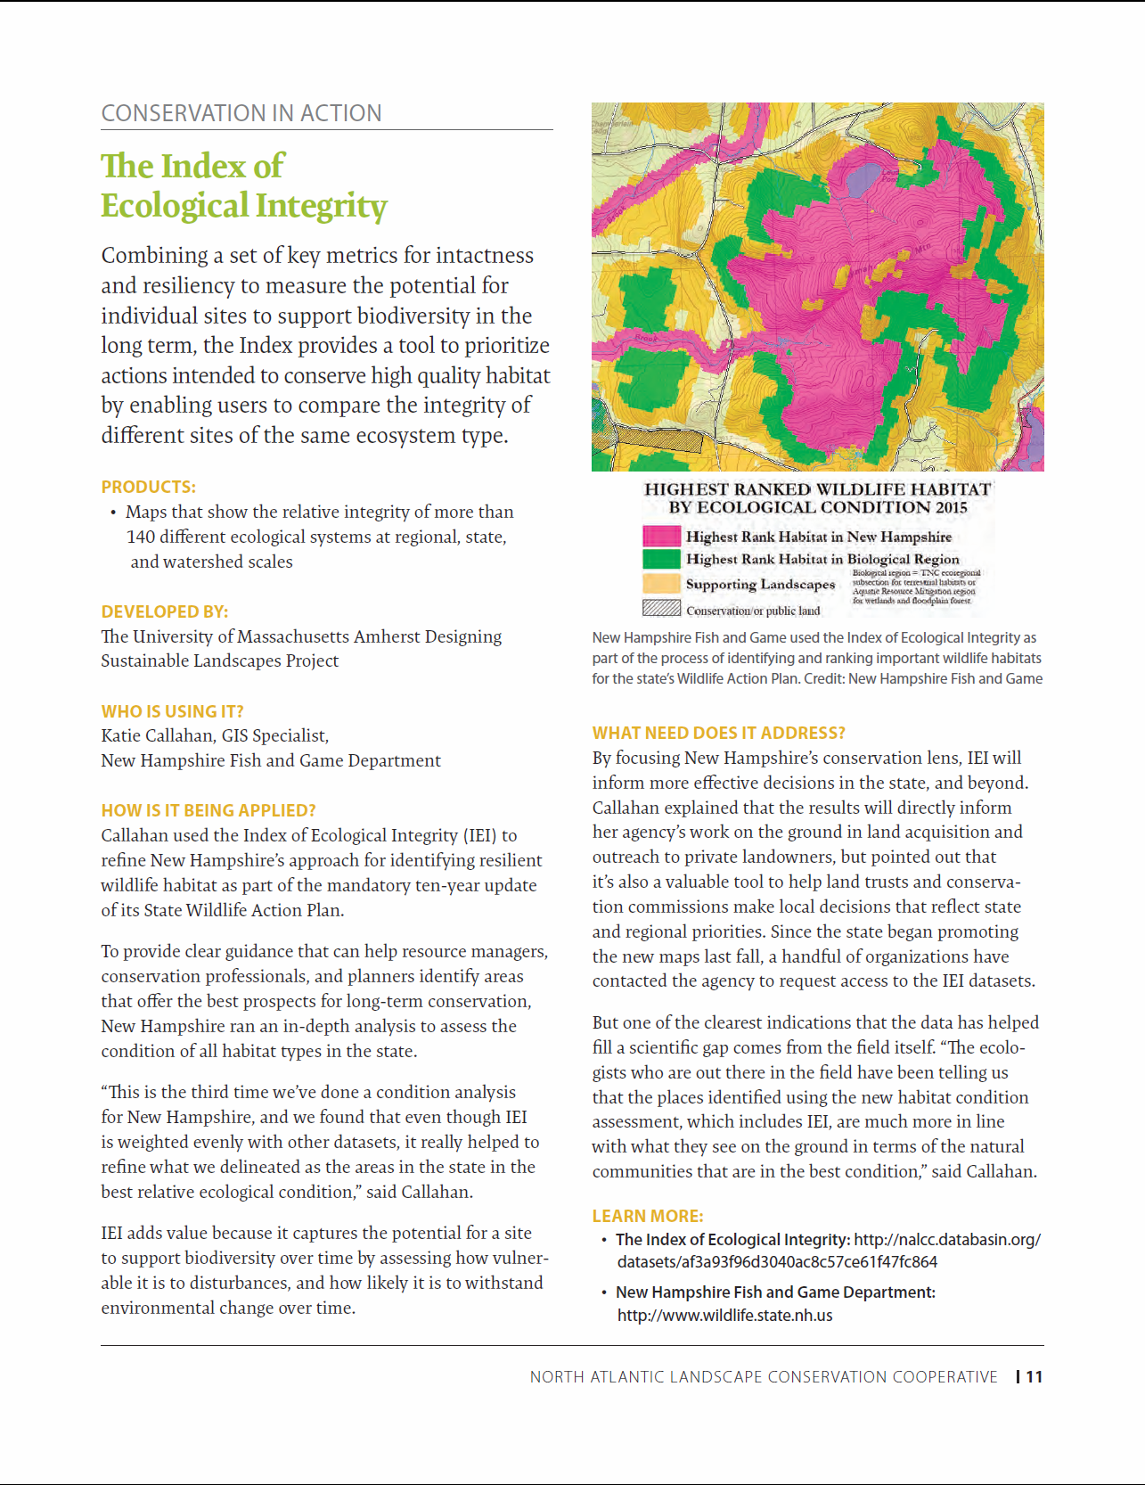
Communications
Examples of application of specific tools to support conservation:
Conservation in Action
Focus on:
Who is using it?
How is it being applied?
What conservation need does it address?
Notes:
And communications are increasingly focused on Conservation in Action - examples of how LCC information and tools are being applied by partners and helping to answer questions including:

Slide 11
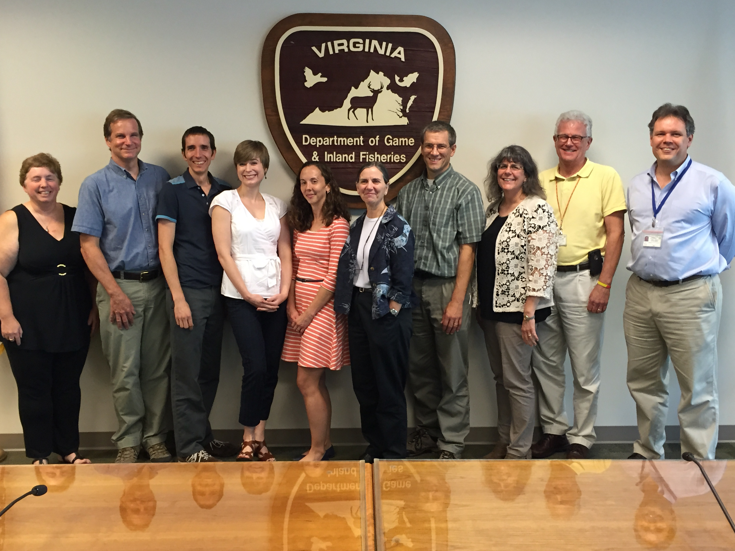
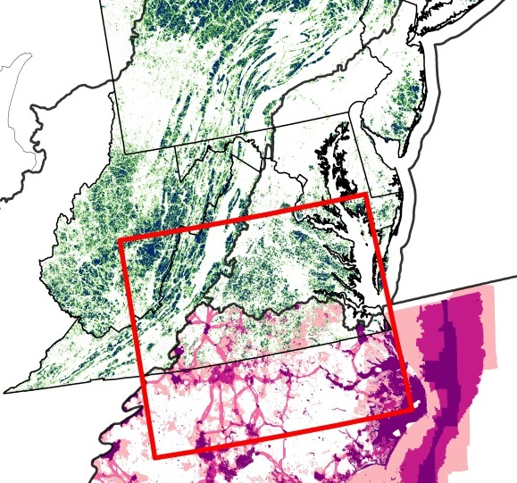
Initial Knowledge Transfer
Meetings/workshops with key LCC partners to review progress, get feedback and identify next steps
e.g., Joint meeting at Virginia Dept. of Game and Inland Fisheries with 3 LCCs and 40 VA staff
Notes:
Initial knowledge transfer is an important first step with key LCC partners to keep them informed - can be through webinars but ideally happens in person to review what is valuable and get feedback and agree on next steps to take together for science delivery. Initial knowledge transfer workshops with State agencies, FWS programs, National Fish and Wildlife Foundation are examples from past year including this multi-LCC meeting hosted by VA Dept. of Game and Inland Fisheries As a multi-LCC meeting it was also critical that all LCCs were represented and to address how LCC science fits together as part of science delivery as is shown in the overlap zone between the North and South Atlantic LCCs (David Whitehurst may want to add comments here).

Slide 12
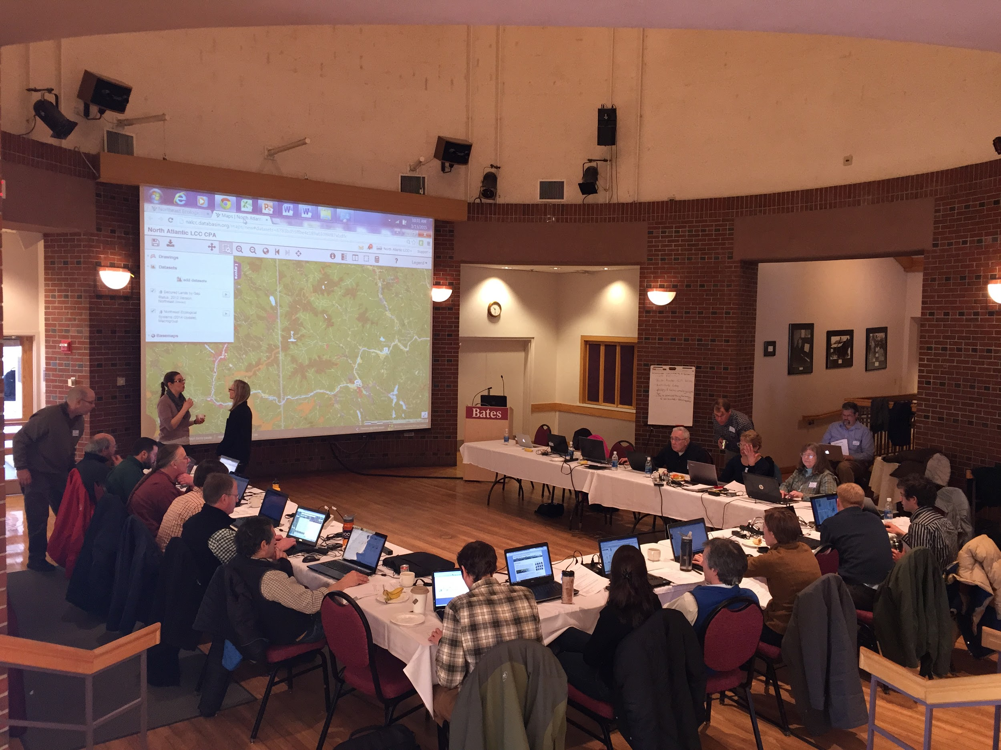
Training
Focus on in-person, hands-on training
Partners walk away comfortable using Conservation Planning Atlas and relevant tools
But labor intensive. Partners can help
Notes:
Our experience so far is that presentations/webinars are an important first step but that there is no substitute for in-person hands on training that facilitates discussion and results in partners walking away as users and hopefully as future trainer for their colleagues. But a major investment of staff time is required so will need partners to help.

Slide 13
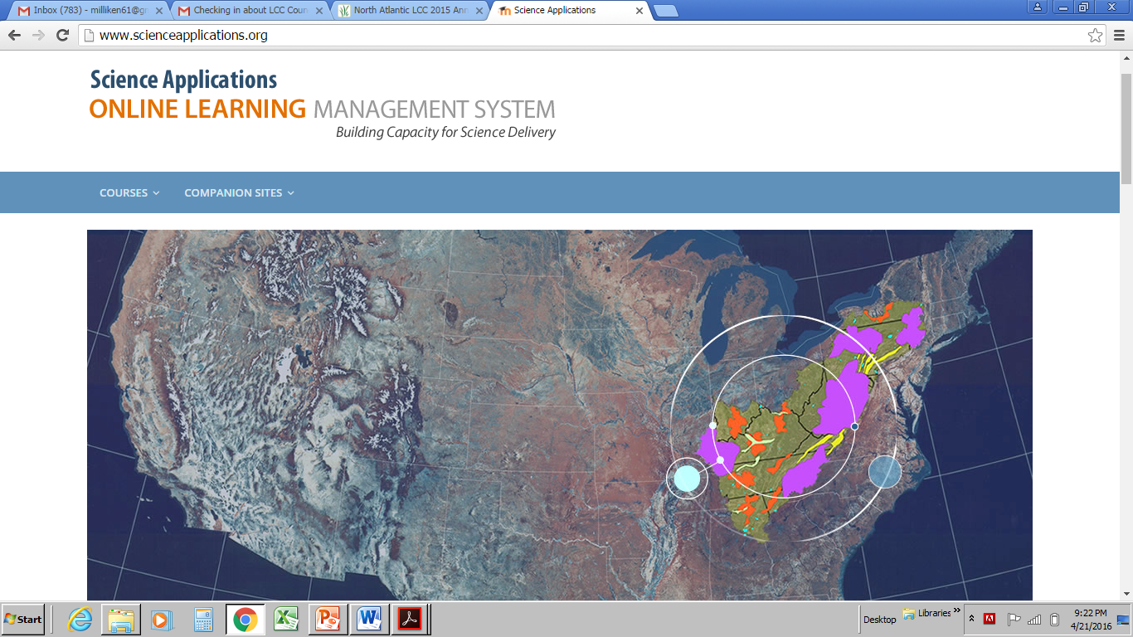
Training
Piloting on-line learning systems with App LCC
On-line courses to supplement in-person efforts
scienceapplications.org
Notes:
We are also working with the App LCC to pilot online courses for using LCC tools potentially as a follow-up to hands-on workshops. Dedicated website at scienceapplications.org, available to other LCCs.

Slide 14
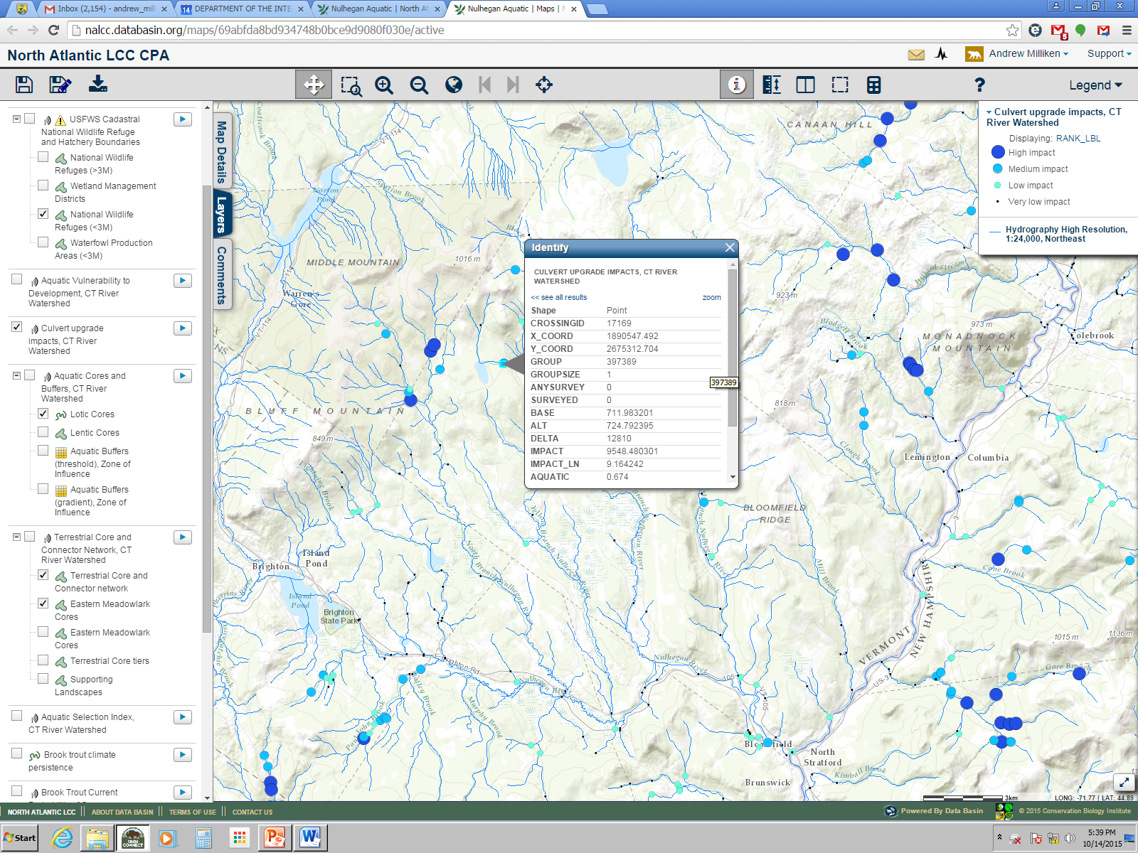
What culvert upgrades on or near my NWR would have the greatest impact?
Specific Applications
Worked with Regional Refuge Biologists to Customize LCC Information and Tools for NWR Habitat Management Plans
Conducted training at Regional NWR meeting
LCC Information Now Providing Landscape and Regional Context for 70 Refuges across the Northeast Region
Notes:
Specific applications for specific user groups can help insure information is relevant and used. One example - the LCC recently working with Regional Refuge Biologists to customize LCC Information and Tools for NWR Habitat Management Plans; LCC staff then designed and co-taught training with NWR biologists at a regional workshop. Result is that LCC Information is now providing landscape and regional context for 70 Refuges across the Northeast Region through their HMPs and making a significant contribution to regional conservation.

Slide 15
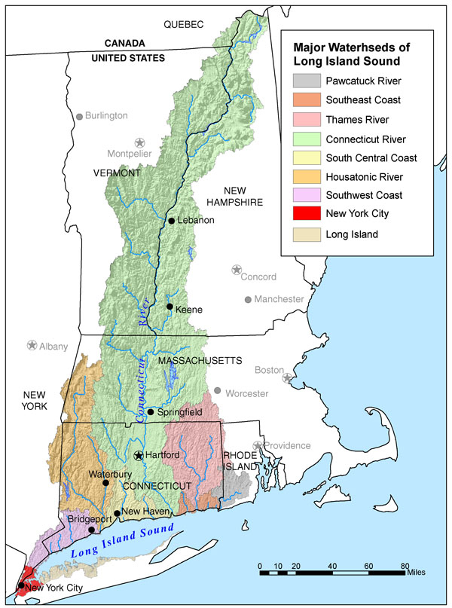
Specific Applications
Collaborated on successful application for NRCS RCPP funds of Connecticut River Long Island Sound
Using LCC LCD products including core areas, connectors and representative species models as criteria for land acquisition under this grant
Notes:
Another recent specific application was the successful application with partners for a NRCS Regional Conservation Partnership Program grant for the Connecticut River-Long Island Sound Watershed and the use of LCC Landscape Conservation Design products including core areas, connectors and representative species models as criteria for land acquisition under this grant resulting in conserved lands that meet the LCC’s biodiversity goals and improve water in Long Island Sound.

Slide 16
Vision
Science Delivery Program
Partner Support Grants and Demonstration Projects
Use Project funds to Support Science Delivery
RFPs designed to address delivery needs in two areas:
Develop and demonstrate specific applications
Four completed projects
Support partners and partnerships to deliver through their networks
Focus on local partners
Notes:
The third major component of the science delivery program is funding delivery projects in two areas 1) the demonstration of the application of LCC tools and 2) supporting science delivery by partners in their networks particularly in local networks (e.g. communities and land trusts).

Slide 17
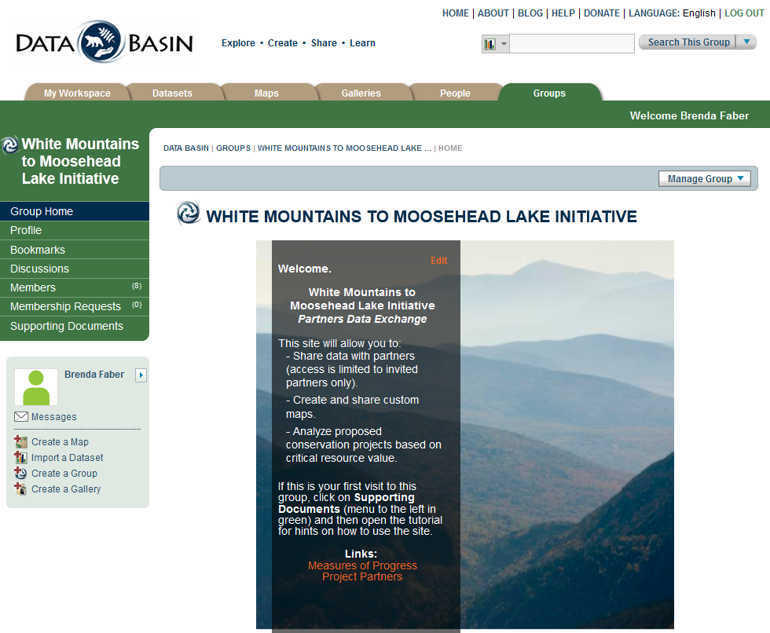
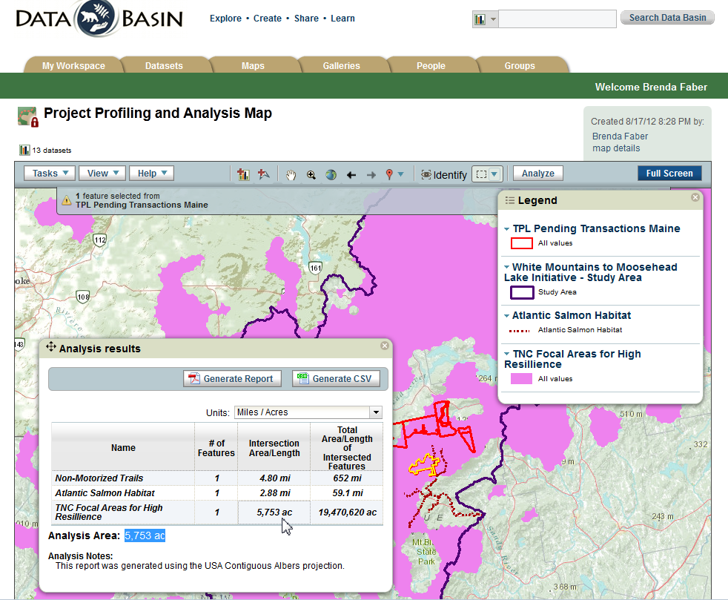
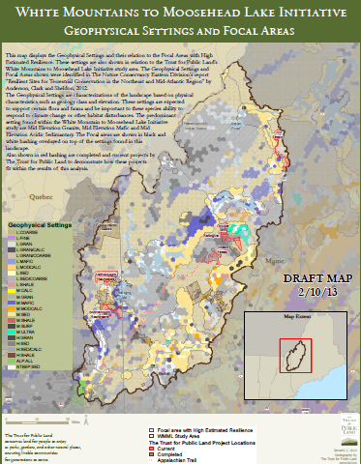
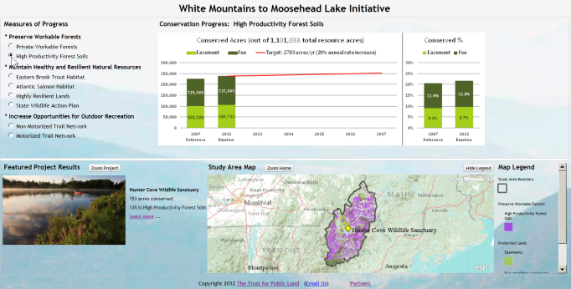
Science Delivery Demonstration Project - TPL Application of
LCC Info. for Land Acquisition - White Mountains to Moosehead
Notes:
One early demonstration project for using LCC information and tools was conducted by Trust for Public Land… (Jad)

Slide 18
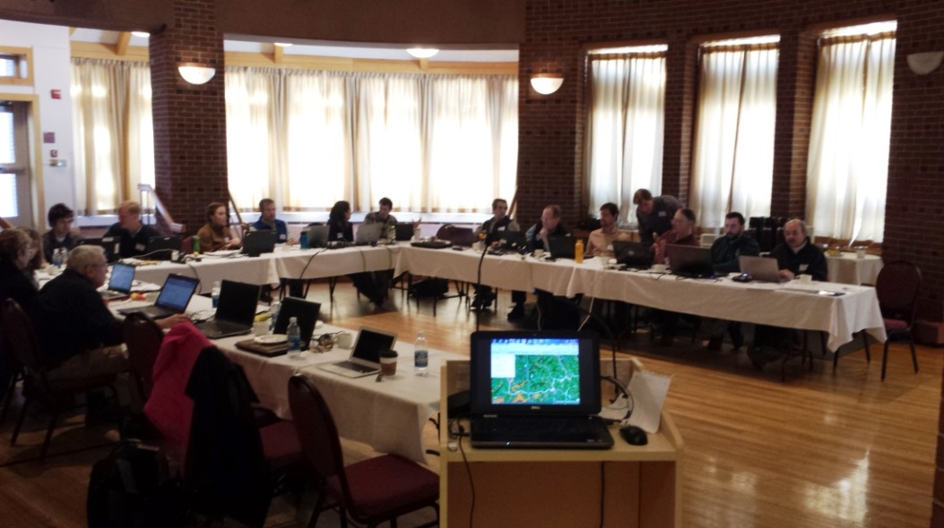
RCP Network Science Delivery Workshops on NALCC Data Sets, LCD, and Guidance Documents Sept. 2014 - April 2015
Science Delivery Networks
515 Participant-hours
22 RCPs
Notes:
One example of supporting science delivery networks is a grant to the Highstead Foundation that worked with land trusts across New England through Regional Conservation Partnerships to train them on the use of LCC tools to guide land acquisition planning and implementation reaching important partners that the LCC could not reach directly.

Slide 19
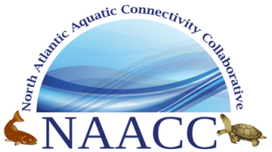
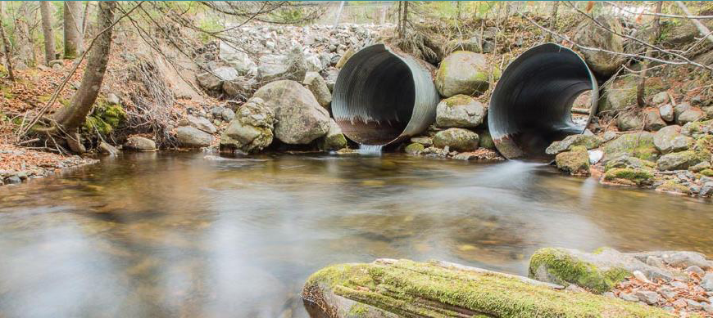
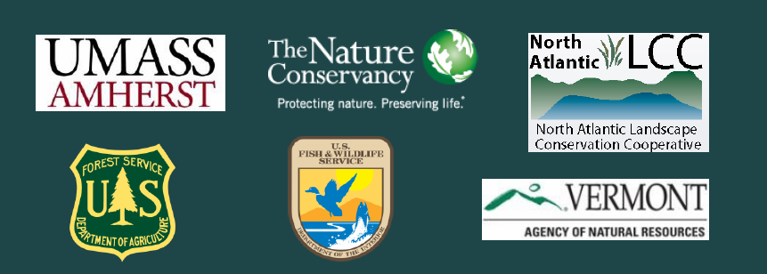
North Atlantic Aquatic Connectivity Collaborative Assessing road-stream crossings to improve river and stream continuity across the North Atlantic U.S. (streamcontinuity.org)
Science Delivery Networks
Products/Outcomes
Regional network of practitioners
Linking natural resources, transportation, emergency management sectors
Standard road-stream crossing survey protocol and training
Regional online database
Support for targeted crossing assessments
Tools to prioritize crossings for upgrade based on increasing ecological benefit and resiliency to floods
Notes:
In addition to working with existing regional partnerships there may be opportunities to help create and facilitate new partnerships to take on a key need as was done by the North Atlantic LCC by helping to create the North Atlantic Aquatic Connectivity Collaborative. This new partnership has built momentum very quickly with 80 partners in 13 states to address the challenge of aquatic connectivity and road stream crossing resilience and has science delivery from the LCC built in right from the start.

Slide 20
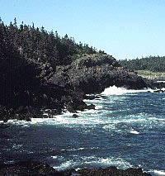
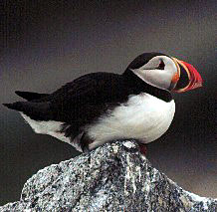
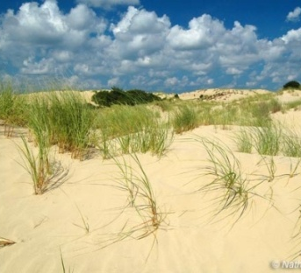
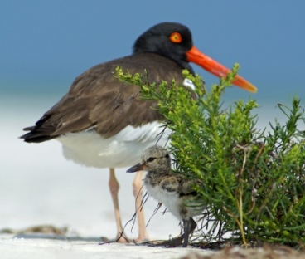
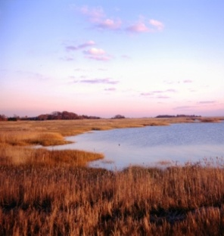
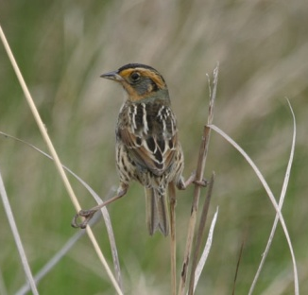
Vision
Science Delivery Program
Summary
The North Atlantic LCC recognized the need for and dedicated resources to deliver science
The delivery of science through multiple approaches will be critical for the ensuring the relevance of LCCs
Ongoing investments for delivery and learning and sharing across the network will be needed
Notes:
In summary The North Atlantic LCC recognized the need for and dedicated resources to develop and implement a program of science delivery. It is clear from our experience that the delivery of science through multiple approaches will be critical for the ensuring the relevance of LCC but that has to be done with realization that ongoing investments for delivery and learning and sharing across the network will be needed.

