Slide 1
Coastal and Marine Technical Team
Conference Call 6/12/14 11:00 a.m.–12:30 p.m.
Agenda
Introductions, review call agenda and goals
Review of Projects
Discussion of Funded Hurricane Sandy Projects and Competitive Grants
Discussion of Any Next Phases Needed
Discussion of Additional Priority Needs
Recommendations for Full Technical Team
Next Steps for Team

Slide 2
Coastal and Marine Technical Team
Team Members
Susan Adamowicz, U.S. Fish and Wildlife Service
Karel Allard, Environment Canada
Amanda Babson, National Park Service
John Coluccy, Ducks Unlimited
Darlene Finch, NOAA
Hector Galbraith, National Wildlife Federation
Mitch Hartley, U.S. Fish and Wildlife Service
Kevin Kalasz, Delaware Division of Fish and Wildlife
Dawn McReynolds, New York State DEC
Ellen Mecray, NOAA
Andrew Milliken, North Atlantic LCC
Rob Thieler. USGS
Adam Whelchel, TNC
John Catena, NOAA?

Slide 3
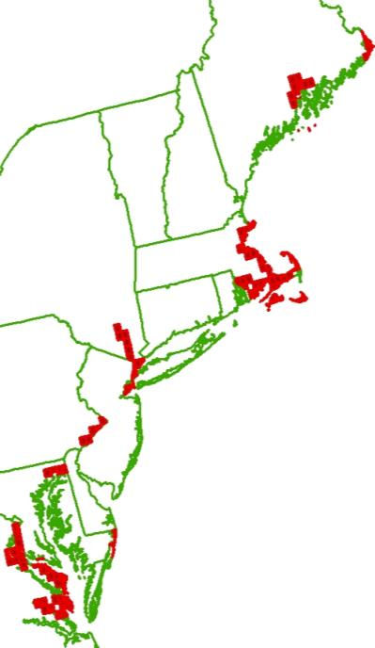
Foundational Mapping: Coastal Update to National Wetlands Inventory
North Atlantic LCC Role | Sponsoring update to NWI for coastal areas
Products | Updated wetland mapping in 162 coastal areas in 7 states
Available Now | Project is complete (Sept. 2013); incorporated into Northeast Terrestrial Habitat map by Umass; Results fully integrated into the National Wetlands Inventory
Next Steps | None anticipated

Slide 4
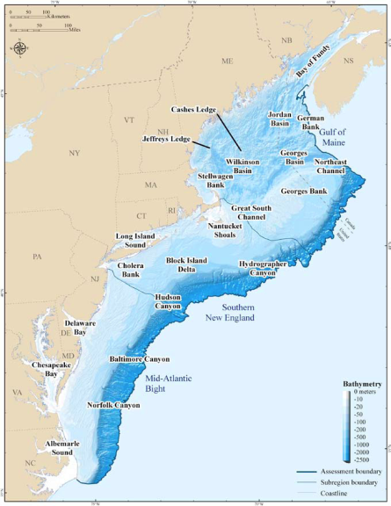
Foundational Mapping: Coastal and Marine Ecological Classification
North Atlantic LCC Role | Sponsoring project by TNC, Mass. DFG, and U. of RI
Products | Report and maps testing the classification at 3 spatial scales
Available Now | Draft final maps and report
Available within 3-6 months | Peer-reviewed final report
Longer Term/next steps | Future phases could include crosswalks and mapping of North Atlantic with NROC and MARCO depending on user needs

Slide 5
Foundational Mapping: Coastal and Marine Ecological Classification
Recommendations
Communication between environmental managers and crosswalkers/mappers about goals – what habitat information is essential to convey?
Discussion within the community about what map products and formats are most useful for particular goals
Careful consideration of the quality, resolution, and general limitations of existing datasets prior to attempting to crosswalk to CMECS.

Slide 6
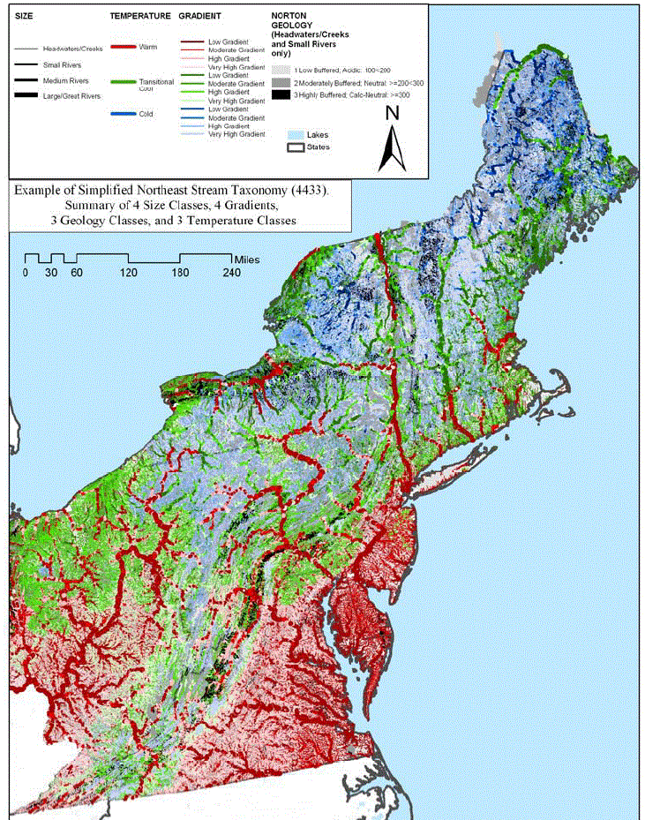
Foundational Mapping: Northeast Aquatic Classification
North Atlantic LCC Role | NEAFWA Project; support TNC revisions to streams (tidal component) and lakes
Products | Classification of Northeast streams and lakes
Available Now | Stream classification including new tidal component + guide
Available within 3-6 months | Enhanced lake classification including lake depth
Longer Term

Slide 7
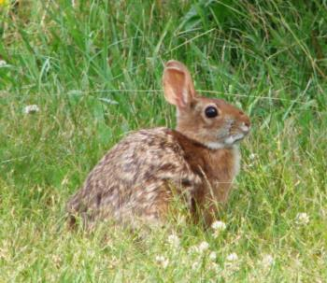
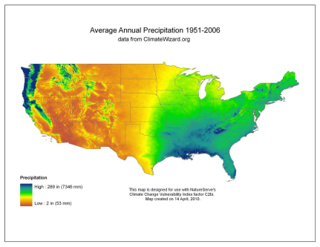
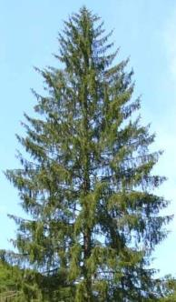
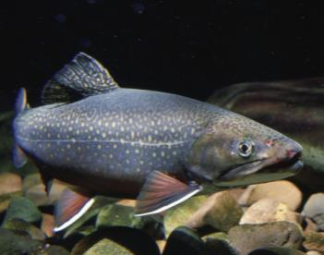
Vulnerability Assessments: Species Vulnerability to Climate Change
North Atlantic LCC Role | Supporting assessment by NatureServe using Climate Change Vulnerability Index (CCVI)
Products | Report on vulnerability of 64 high regional concern, representative, and foundational species includes tidal marsh and beach species
Available Now | Final report
Available within 3-6 months
Longer Term/next steps | None anticipated

Slide 8
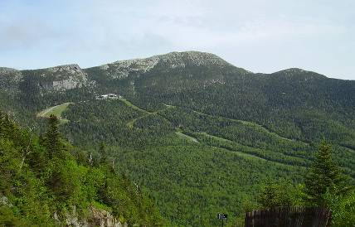
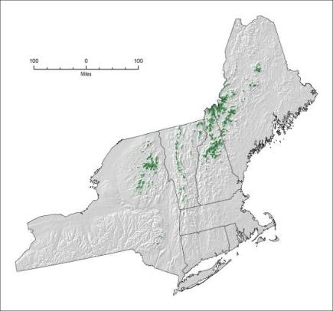
Vulnerability Assessments: Habitat Vulnerability to Climate Change
North Atlantic LCC Role | Completing NEAFWA-sponsored project by Manomet/NWF
Products | 3 reports: terrestrial/wetland; cold water; and coastal habitats
Available Now | Reports completed; northeast climate database (neclimateus.org)
Available within 3-6 months | Final reports
Longer Term/next steps | Not anticipated; regional adaptation plan?

Slide 9
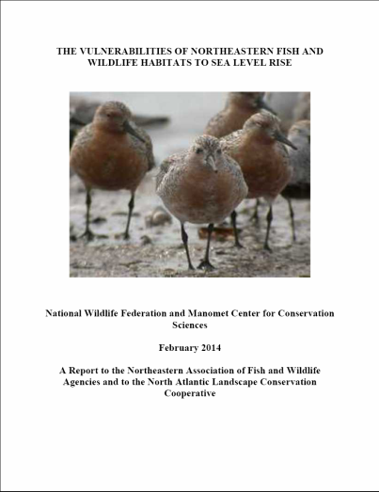
Vulnerability Assessment Reports Complete
Recommendations
Monitor salt marsh accretion rates to determine whether accretion remains stable or is being overtaken by sea level rise.
Develop new habitat change models
Refine assumptions about SLR
Study human responses to SLR
Understand the relationship between shifting coastlines, land ownership and future conservation
Study populations and metapopulations from a region-wide context
Incorporate climate change impacts elsewhere

Slide 10
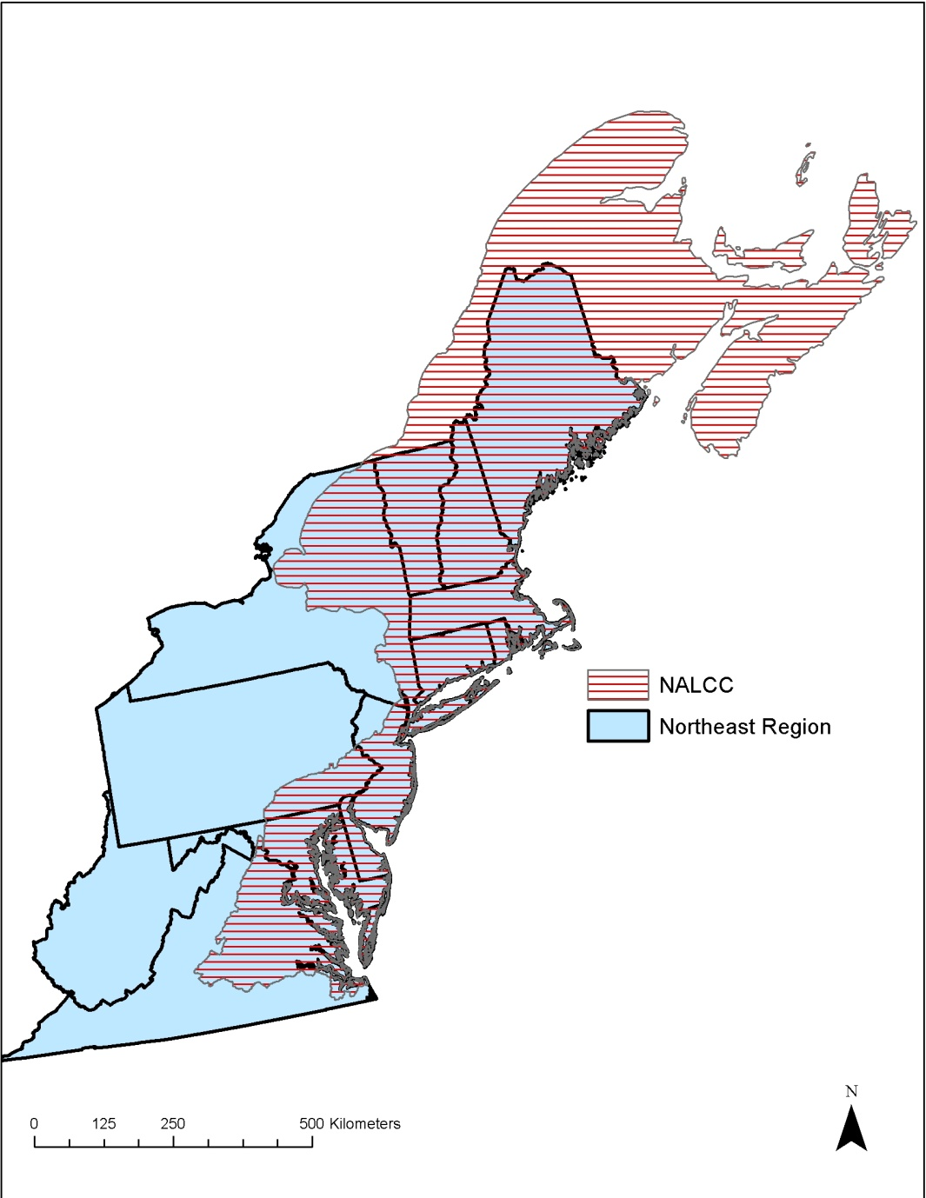
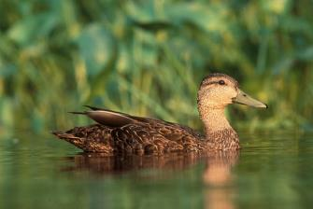
Conservation Design: Designing Sustainable Landscapes
North Atlantic LCC Role | Sponsoring project led by UMass Amherst
Products | Extensive spatial datasets, current and future species capability and ecological integrity, decision support tool for landscape design (June 2014)
Available Now | Many spatial datasets for entire Northeast, including initial species
Available within 3-6 months | Additional regional spatial data Regional models for 30 rep. species Pilot design effort in CT River watershed Incorporation of SLR (from USGS)
Longer Term | Potential future phase could extend and enhance conservation design work including coastal component (built into Hurricane Sandy Marsh resiliency project)

Slide 11
Conservation Design: Designing Sustainable Landscapes
Next steps supported through H.S. project
Incorporate SLR response from USGS
Incorporate high/low marsh mapping
Refine ecological integrity for salt marshes
Including tidal restriction stressor metric and salt marsh ditching stressor metric
Complete species habitat capability models for beach and marsh species

Slide 12
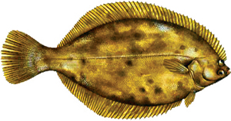
Conservation Design: Aquatic and Coastal Decision Support Tool
North Atlantic LCC Role | Sponsoring project with Atlantic Coastal Fish Habitat Partnership, led by Downstream Strategies
Products | Aquatic and coastal species models and decision support tools
Available Now
Available within 3-6 months | Pilot models for winter flounder and for brook trout in the Chesapeake Bay watershed; river herring
Longer Term | Multi-species decision support tools for restoration and conservation (2015)

Slide 13
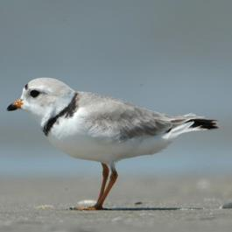
Conservation Design: Piping Plovers and Sea-level Rise
North Atlantic LCC Role | Sponsoring project by Virginia Tech
Products | Assessment of threats to Piping Plover from SLR and recommendations for habitat conservation
Available Now | Published model linking coastal processes and beach habitat
Available within 3-6 months | Final report and tools including projected impacts of sea level rise and management
Longer Term/next steps | Expand model across North Atlantic through Hurricane Sandy Beach Resiliency Project

Slide 14
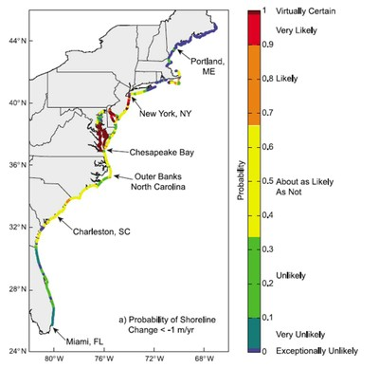
Conservation Design: Decision Support Tools for Sea-level Rise Impacts
North Atlantic LCC Role | NE Climate Science Center project to USGS; LCC facilitated model development through structured decision making
Products | Geospatial data on SLR inundation and dynamic response, decision support models
Available Now | Geospatial data on SLR inundation and dynamic response
Available within 3-6 months | Initial regional decision model; incorporated into Designing Sustainable Landscapes
Longer Term | Reports, tools, and recommendations; next steps through Hurricane Sandy projects

Slide 15
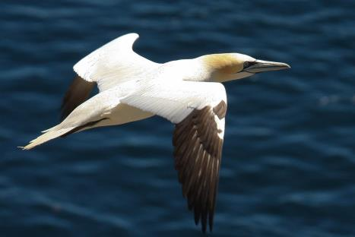
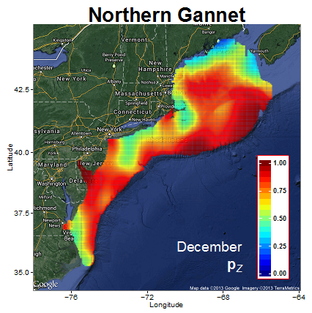
Conservation Design: Marine Bird Mapping and Risk Assessment
North Atlantic LCC Role | Sponsoring a project by NC State U., NOAA, BRI, CSI/CUNY
Products | Mapping of seasonal seabird abundance to inform marine planning
Available Now | Initial set of marine bird species maps
Available within 3-6 months | Final report and maps (June 2014)
Longer Term

Slide 16
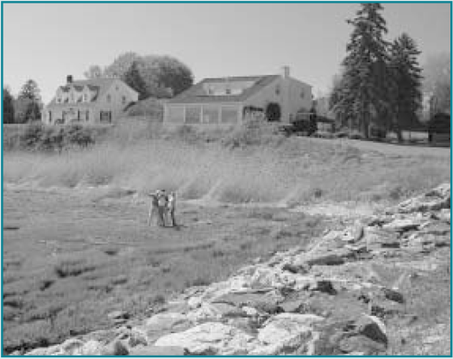
Demonstration Project: Integrating Science into Policy: Local Adaptation for Marsh Migration
North Atlantic LCC Role | Supporting Demonstration Project by Maine Inland Fisheries and Wildlife
Products | Identification of the most resilient marshes in Maine; incorporation of results in Beginning with Habitat
Available Now
Available within 3-6 months | Results of meetings with coastal towns in Maine
Longer Term | Facilitating local actions to assist marsh migration

Slide 17
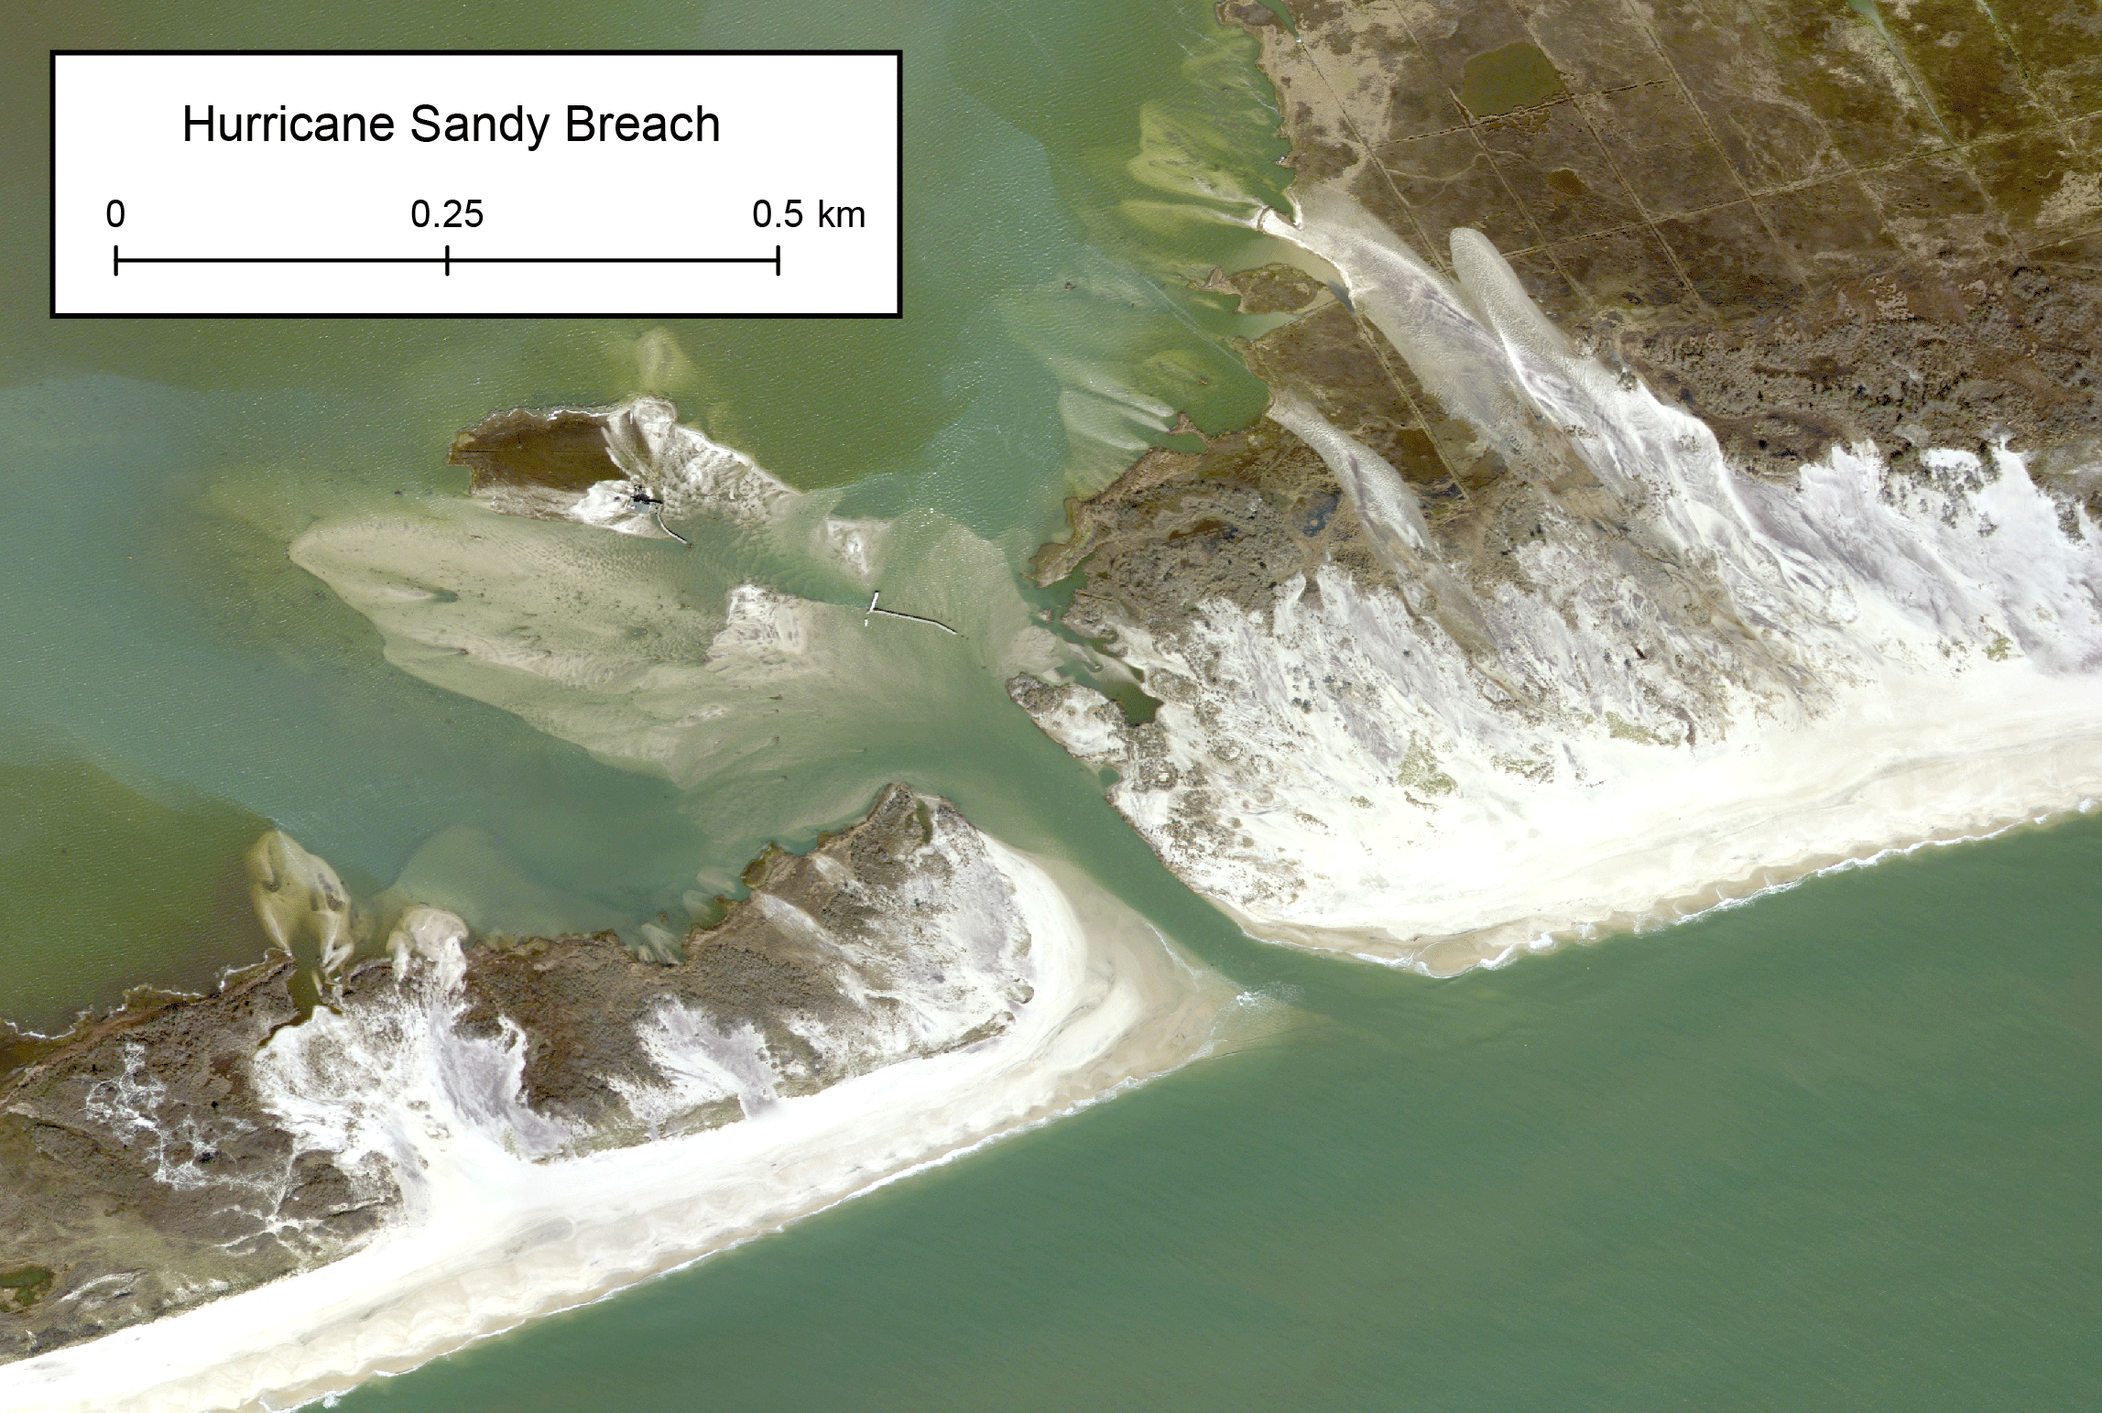
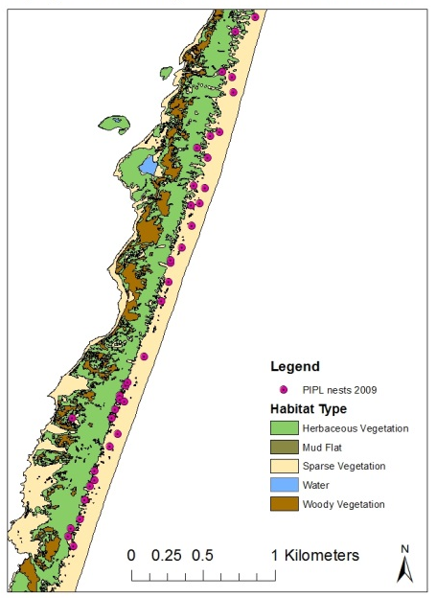
Conservation Design: Increasing Resiliency of Beach Habitats and Species in the Face of Storms & Sea Level Rise
North Atlantic LCC Role | Coordinating overall project among P.I.s, LCC and CSC partners and with P.I.s USGS, FWS, Virginia Tech, Rutgers, TCI
Products | Regional decision support models for coastal beach management and restoration for beach habitats and species in the face of storms and SLR; evaluation of the effectiveness of beach restoration and management
Available Now
Available within 3-6 months | Pre-hurricane survey results of inlets and beaches
Longer Term | Complete models and results delivered to partners (2016)

Slide 18
Increasing Resiliency of Beach Habitats and Species in the Face of Storms & Sea Level Rise
Expand SLR response/plover model to Region
USGS, Virginia Tech
Collect beach-nesting bird location and habitat data on NWRS and NPs
USFWS, NPS, USGS (iPlover)
Inventory of beach and inlet modifications before and after H.S.
Terwilliger Consulting
Assess effects of beach stabilization projects in NY& NJ on beach habitats and species
Virginia Tech, Rutgers, Conserve Wildlife NJ
Deliver results to partners
Rutgers, TBD

Slide 19
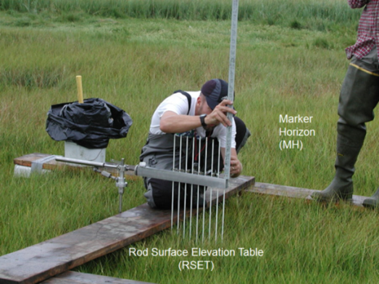
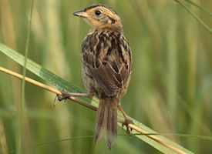
Conservation Design: Increasing Resiliency of Tidal Marsh Habitats and Species in the Face of Storms & Sea Level Rise
North Atlantic LCC Role | Coordinating overall project among P.I.s, LCC and CSC partners and P.I.s FWS, USGS, SHARP, UMass
Products | Regional decision support models for tidal marsh restoration and management for marsh habitats and species in the face of storms and SLR; evaluation of the effectiveness of different marsh restoration approaches for increasing resiliency
Available Now
Available within 3-6 months | Consistent monitoring metrics; initial assessments of tidal marsh integrity
Longer Term | Complete models and results delivered to partners (2016)

Slide 20
Increasing Resiliency of Tidal Marsh Habitats Habitats and Species in the Face of Storms & SLR
Develop/refine models for understanding future impacts of sea level rise and storms on tidal marshes and marsh species
Geological/physical response TBD (USGS)
Marsh community response TBD (USGS, USC, VIMS)
Wildlife response TBD (SHARP)
Decision support models and incorporation into decision model framework
UMass
High/low marsh mapping
UMe
Monitoring and assessment of effectiveness of restoration for marsh resiliency
USFWS, NPS, SHARP (Ume, UConn, Udel, SUNY)
Delivery of results to partners
TBD (NROC, MARCO)

Slide 21
Next Phases or Additional Needs
Incorporate SLR and coastal elements into Designing Sustainable Landscapes (funded)
Designing Sustainable Landscapes next phase
Conservation Design Decision-Support Tool
Habitat management and restoration
Timber harvest
Climate change impacts of flow, temperature and brook trout
Coordination of monitoring, databases and models
Other coastal/marine immediate needs

