Slide 1
Coastal and Marine Technical Team
Conference Call 2/27/15 2:00 pm–4 pm
Agenda
Introductions, review call agenda and goals, review science needs process
Review of LCC, Hurricane Sandy and related projects and products
Discussion of Any Next Phases Needed
Discussion of Additional Priority Needs
Recommendations for Full Technical Team
Next Steps for Team
  NOAA analysis of LCC Science Needs Assessments and Recommendations for Near-term NOAA Engagement

Slide 2
Coastal and Marine Technical Team
Team Members
Susan Adamowicz, US Fish and Wildlife Service
Karel Allard, Environment Canada
Amanda Babson, National Park Service
John Coluccy, Ducks Unlimited
Darlene Finch, NOAA
Hector Galbraith, National Wildlife Federation
Mitch Hartley, US Fish and Wildlife Service
Lisa Havel, Atlantic Coastal Fish Habitat Partnership
Roselle Henn, US Army Corps of Engineers
Chris Hilke, National Wildlife Federation
Kevin Kalasz, Delaware Division of Fish and Wildlife
Regina Lyons, US EPA, Region 1
Dawn McReynolds, NY Bureau Marine Resources
Ellen Mecray, NOAA Climate Service
Andrew Milliken, North Atlantic LCC
Caleb Spiegel, US FWS Atlantic Coast Joint Venture
Rob Thieler. USGS
James Turek, NOAA Restoration Ctr.
Megan Tyrrell, North Atlantic LCC
Adam Whelchel, TNC

Slide 3
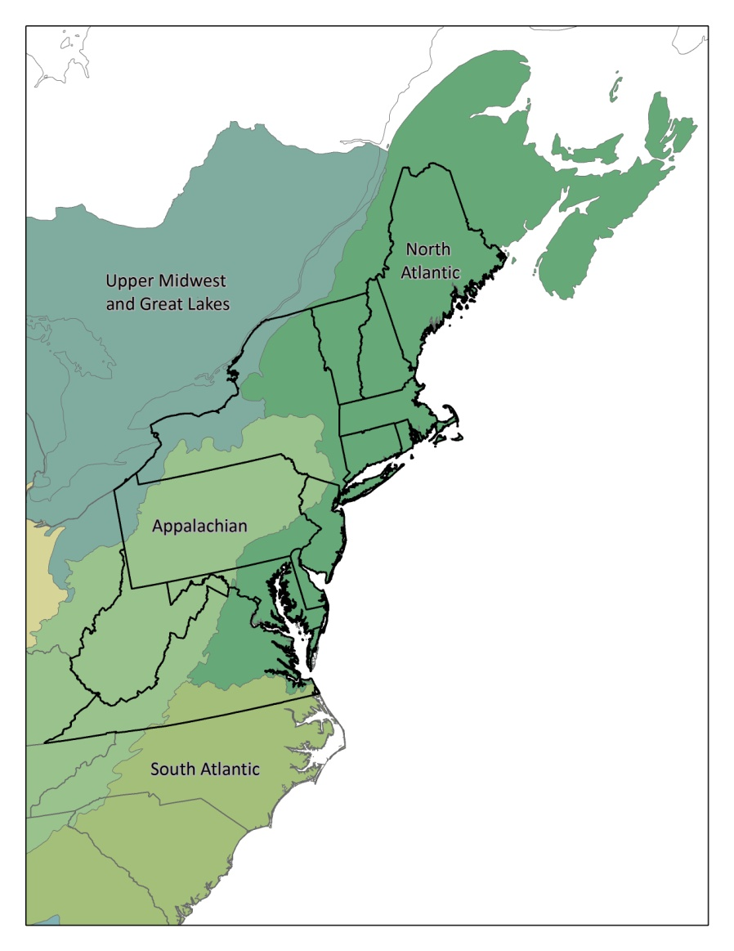
North Atlantic LCC
Mission:
provides a partnership in which the conservation community works together to address increasing land use pressures and widespread resource threats and uncertainties amplified by a rapidly changing climate
by jointly developing and delivering scientific information and tools needed to prioritize and guide more effective conservation actions towards common goals
Notes:
The North Atlantic LCC is one of 22 of regional self-directed science-management partnerships across the United States and adjacent portions of Mexico and Canada. With support from the Department of the Interior, these partnerships set out 3 years ago to achieve a vision of sustainable landscapes for natural and cultural resources. In the North Atlantic LCC, one of four LCCs partially or wholly in the Northeast Region we started out by by agreeing on this two part mission, first to develop the partnerships needed to address threat and unceratinties in this region and second to develop and deliver the science needed to prioritize and guide more effective conservation actions towards common goals
Info. on the Apps at applcc.org

Slide 4
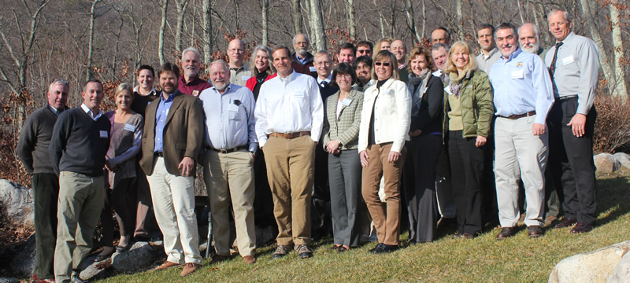
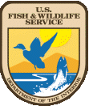



North Atlantic LCC - Governance
Steering Committee
Technical Committee
  3 Subteams: aquatic (freshwater), coastal & marine, and terrestrial & wetland (> 40 members)
Science Delivery Team
Project Teams (Principal Investigators plus oversight team)
Staff
Notes:
The formal partners of the LCC are represented on the Steering Committee by a higher level director or manager. The Steering Committee makes decisions about the overall direction, priorities and budget of the LCC. Technical teams are technical level staff of these agencies and organizations that are organized around systems (terrestrial, aquatic, coastal and marine).

Slide 5
Overview of LCC Science Needs Process
Technical Committee recommends highest priority science needs + continued phases of existing projects
Steering Committee considers recommendations (typically, April meeting)
As needed, Technical Committee advises/assists LCC staff in translating science needs into science projects
  RFP or directed funding
Steering Committee approves projects (typically, summer or October meeting)

Slide 6
Criteria for Prioritizing
Science Needs
Address LCC Strategic Plan and Northeast Conservation Framework
Foundational needs (building blocks, modeling frameworks, information management tools)
Address major threats and uncertainties (land use, climate impacts, energy)
Needed to inform applied conservation decisions
Priorities for existing partnerships
Regional or multi-state (“landscape”) scale

Slide 7
February 2015 Completed Projects with coastal relevance
CMECS application for the NE
Marine Bird Mapping and Risk Assessment
NWI coastal wetlands update
SDM for sea level rise and resulting model
Piping Plovers and Sea-level Rise
Designing Sustainable Landscapes
CC Vulnerabilities of fish and wildlife habitats and species

Slide 8
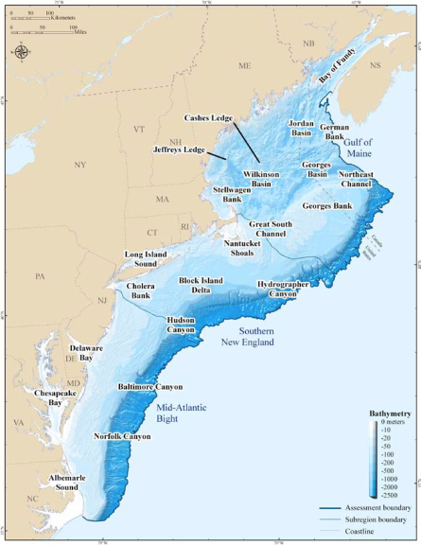
Foundational Mapping:
Coastal and Marine Ecological Classification
North Atlantic LCC Role | Sponsoring project by TNC, Mass. DFG, and URI; coordination with NROC
Products | Report, crosswalk and maps testing the classification at 3 spatial scales
Available Now | Peer-reviewed final report; spreadsheet with crosswalks; CMECS maps with habitats classified at the regional subregional, and local scales.
Longer Term/next steps | Include crosswalks and mapping of North Atlantic with NROC, MARCO, and Regional Planning Bodies; additional mapping?
Intended users | NROC, MARCO, state & fed agencies that are mapping, environmental managers

Slide 9
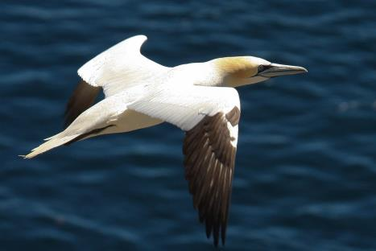
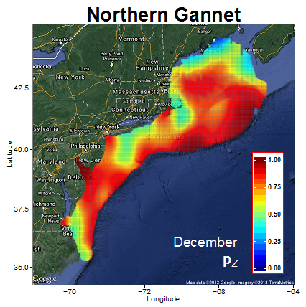
Conservation Design:
Marine Bird Mapping and Risk Assessment
North Atlantic LCC Role | Sponsoring a project by NC State U., NOAA, BRI, CSI/CUNY
Products | Mapping of seasonal seabird abundance of 24 species to inform marine planning
Available Now | Draft report; initial set of marine bird species maps by species and season
Available within 3-6 months | Final report and maps (Spring 2015)
Intended Users | Regional Ocean planning for wind energy, aquaculture, marine infrastructure

Slide 10
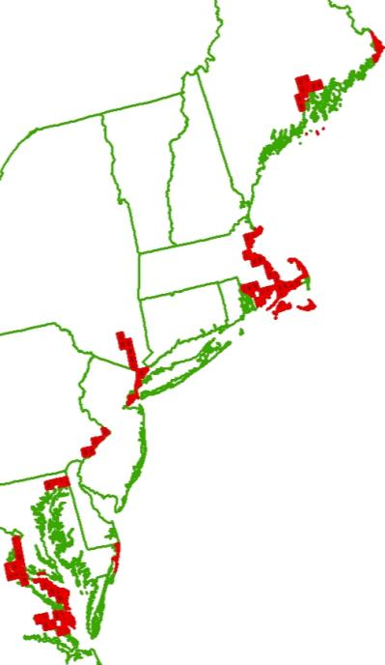
Foundational Mapping:
Coastal Update to National Wetlands Inventory
North Atlantic LCC Role | Sponsoring update to NWI for coastal areas
Products | Updated wetland mapping in 162 coastal areas in 7 states
Available Now | Project is complete (Sept. 2013); data incorporated into Northeast Terrestrial Habitat map by UMass; Results fully integrated into the National Wetlands Inventory online
Longer Term/next steps | None anticipated
Intended users | Planners, land managers

Slide 11
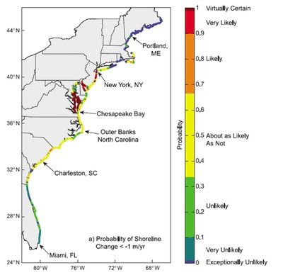
Conservation Design:
Decision Support Tools for Sea-level Rise Impacts
North Atlantic LCC Role | NE Climate Science Center project to USGS; LCC facilitated model development through Structured Decision Making; application to conservation design through Designing Sustainable Landscapes
Products | Final report, Geospatial data on SLR inundation and dynamic response with uncertainty
Available Now | Geospatial data on SLR inundation and dynamic response
Available within 3-6 months | Initial regional decision model; incorporated into Designing Sustainable Landscapes (ecological integrity and species habitat)
Intended Users | Planning, natural resource management agencies, coastal zone agencies and communities

Slide 12
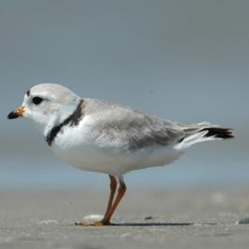
Conservation Design:
Piping Plovers and Sea-level Rise
North Atlantic LCC Role | Sponsoring project by Virginia Tech with USGS
Products | Assessment of impact to Piping Plover from SLR and recommendations for habitat conservation/management
Available Now | Published model linking coastal processes, beach response and beach habitat, second report includes hindcast-based prediction nesting suitability impacted by SLR and beach management actions
Longer Term/next steps | Expand model to wider geography through Hurricane Sandy Beach Resiliency Project; predict impacts from wider range of SLR and other management actions
Intended Users | Beach managers, shorebird community
Connections to other projects/products | Hurricane Sandy beach resiliency project including iPlover

Slide 13
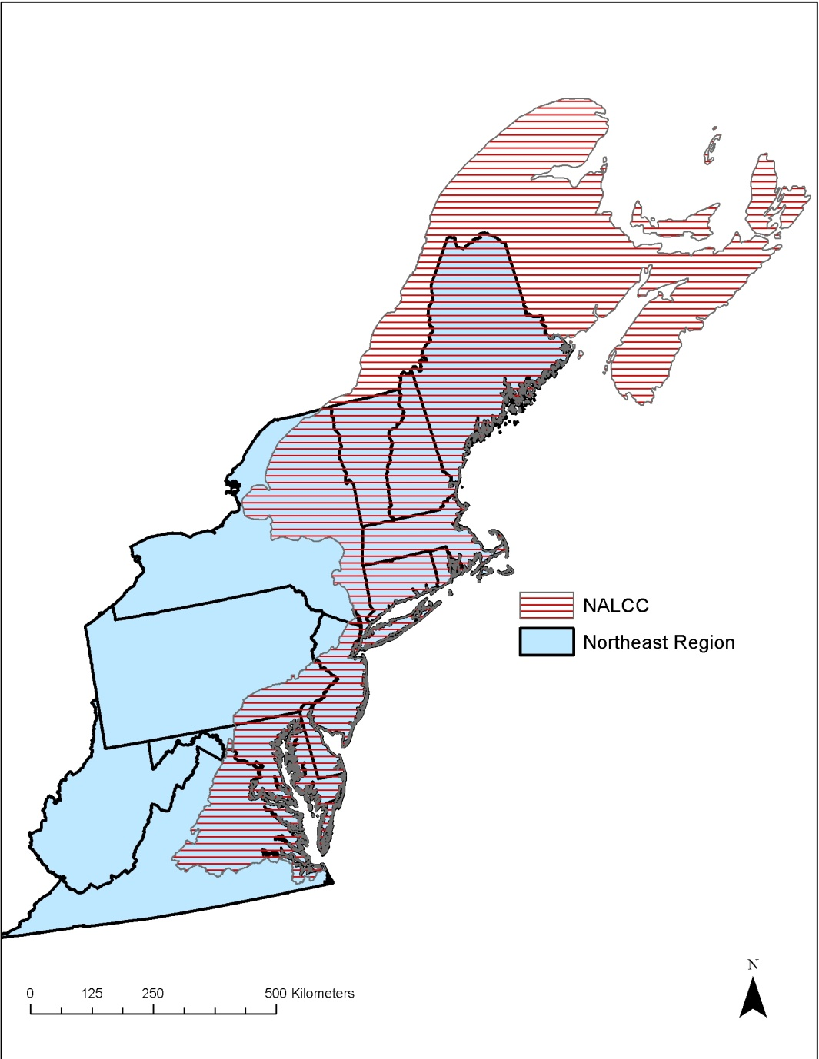
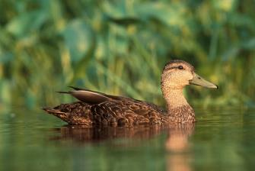
Conservation Design:
Designing Sustainable Landscapes
North Atlantic LCC Role | Sponsoring project led by UMass Amherst
Products | Extensive spatial datasets, current and future species capability and ecological integrity, decision support tool for landscape design (June 2014)
Available Now | Landscape capability at regional scale available for Marsh Wren (and other terrestrial & aquatic species); Pilot design effort in CT River watershed
Available within 3-6 months | Additional regional spatial data for: American Oystercatcher, Saltmarsh Sparrow, Sanderling, Diamondback Terrapin, American Black Duck Regional models for 30 rep. species Incorporation of SLR (from USGS)
Intended Users | State natural resource and planning agencies

Slide 14
Vulnerability Assessments:
Species Vulnerability to Climate Change
North Atlantic LCC Role | Supporting assessment by NatureServe using Climate Change Vulnerability Index (CCVI)
Products | Report on vulnerability of 64 high regional concern, representative, and foundational species including tidal marsh and beach species
Available Now | Final report with vulnerability scores
Coastal/marine species | Saltmarsh Sparrow, Diamond-backed Terrapin, Smooth Cordgrass, Oystercatcher, Eastern Beach Tiger Beetle, Common Tern, Least Tern, Horseshoe Crab, Piping Plover
Intended users | Environmental managers, scientists

Slide 15
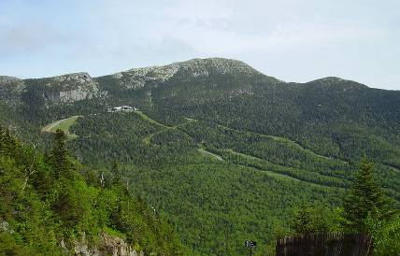
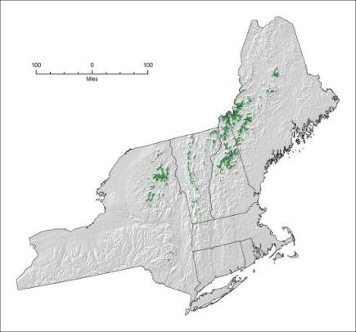
Vulnerability Assessments:
Habitat Vulnerability to Climate Change
North Atlantic LCC Role | Completing NEAFWA-sponsored project by Manomet/NWF
Products | 3 reports: terrestrial/wetland; cold water; and coastal habitats
Available Now | Reports completed; northeast climate database launched (neclimateus.org)
Intended Users | State and regional level managers
Connections to other projects/products | State Wildlife Action Plans, regional adaptation plans

Slide 16
Projects in progress
Aquatic and Coastal Fish Habitat Decision Support Tool
Integrating Science into Policy: Local Adaptation for Marsh Migration
Hurricane Sandy Projects
  Tidal Marsh Resiliency
  Beach Resiliency
  Stream Resiliency

Slide 17
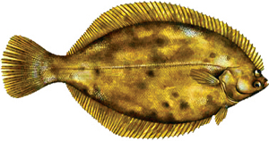
Conservation Design:
Aquatic and Coastal Decision Support Tool
North Atlantic LCC Role | Sponsoring project with Atlantic Coastal Fish Habitat Partnership, led by Downstream Strategies
Products | Aquatic and coastal species models and decision support tools
Available Now | Brook trout in Chesapeake Bay
Available within 3-6 months | Pilot models for winter flounder in the Narragansett Bay watershed; river herring in North Atlantic LCC
Intended users | Watershed planning, natural resource management agencies, fisheries managers
Connections to other projects/products | Forecasting changes in aquatic systems and resilience of brook trout

Slide 18
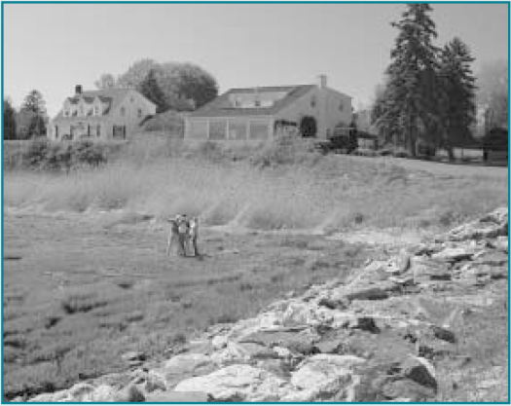
Demonstration Project:
Integrating Science into Policy: Local Adaptation for Marsh Migration
North Atlantic LCC Role | Supporting demonstration project by Maine Inland Fisheries and Wildlife
Products | Identification of the most resilient marshes in Maine; incorporation of results in Beginning with Habitat
Available Now | Final report, decision support tool
Available within 3-6 months | Facilitating local actions to assist marsh migration
Intended Users | Local & state planning, conservation groups
Connections to other projects/products | Decision support tools for SLR impacts, Hurricane Sandy Marsh Resilience projects, TNC’s salt marsh advancement zones

Slide 19
Hurricane Sandy Funded Projects
Increasing Resiliency of Tidal Marsh Habitats and Species in the Face of Storms & Sea Level Rise
Increasing Resiliency of Beach Habitats and Species in the Face of Storms & Sea Level Rise
Collaboratively Increasing Resiliency and Improving Standards for Culverts and Road Stream Crossings to Future Floods While Restoring Aquatic Connectivity
  All HS projects must be complete by Nov 2016

Slide 20
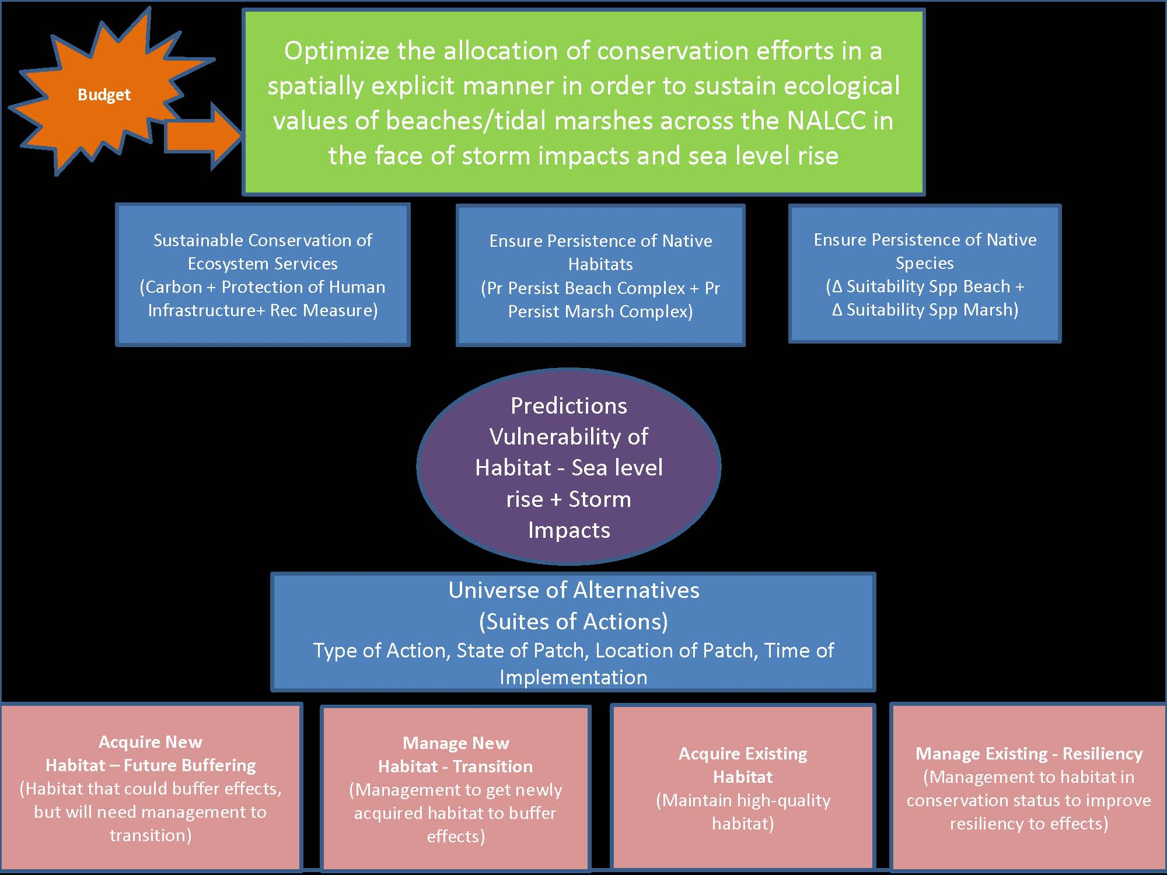

Slide 21
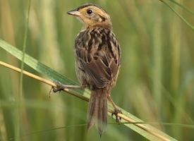
Increasing Resiliency of Tidal Marsh Habitats Habitats and Species in the Face of Storms & SLR
Develop/refine models for understanding future impacts of sea level rise and storms on tidal marshes and marsh species
  Geological/physical response (USGS)
  Marsh community response (USGS, USC, LSU)
  Wildlife response (SHARP)
Decision support models and incorporation into decision model framework
  UMass, USGS
High/low marsh mapping
  SHARP (U Maine)
Monitoring and assessment of effectiveness of restoration for marsh resiliency
  USFWS, NPS, SHARP (U Maine, U Conn, U Del, SUNY)
Delivery of results to partners
  NROC, MARCO

Slide 22
Increasing Resiliency of Beach Habitats and Species in the Face of Storms & Sea Level Rise
Expand SLR response/plover model to Region
  USGS, Virginia Tech
Collect beach-nesting bird location and habitat data on NWRS and NPs
  USFWS, NPS, USGS (iPlover)
Inventory of beach and inlet modifications before and after H.S.
  Terwilliger Consulting
Assess effects of beach stabilization projects in NY& NJ on beach habitats and species
  Virginia Tech, Rutgers, Conserve Wildlife NJ
Deliver results to partners
  Rutgers, NROC, MARCO

Slide 23
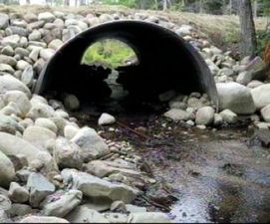
Collaboratively Increasing Resiliency & Improving Standards for Culverts & Road Stream Crossings to Future Floods While Restoring Aquatic Connectivity
Coordination of regional team; consistent online database, regional protocols for assessing culvert condition and suitability for fish passage, passage assessment criteria
  UMass, TNC
Prioritization of road stream crossings for surveys, targeted surveys
  TNC, UMass, FWS, WMI, states
Pilot project on vulnerability of road-stream crossings to future floods
  UMass, NE Climate Science Center
Training for states, towns
  Trout Unlimited, FWS

Slide 24
Coastal & Marine Science Needs
Foundational needs/mapping
  Additional application of CMECS
  Regional seagrass distribution and resilience
  Compilation of core coastal, estuarine and nearshore environmental datasets (salinity, temperature, circulation)
  High resolution data on infrastructure in coastal environments
  Expansion of completed/ongoing projects into Canada
  Integrated ecosystem assessments (Gulf of Maine Integrated Ecosystem Research Program)

Slide 25
Coastal & Marine Science Needs
Vulnerability assessments
  Methods for mitigation of ocean acidification
  Rapid response for selected new marine invasive species
  Viability thresholds for priority coastal species under different rates of SLR, information gaps and priority actions

Slide 26
Coastal & Marine Science Needs
Decision Support Tools
  Habitat modeling for coastal fish and other aquatic species (ACFHP lead)
  Salt marsh advancement zone planning
  Providing information on benefits of nature-based approaches to increasing coastal community resilience

Slide 27
Coastal & Marine Science Needs
Complement/leverage Hurricane Sandy projects
  Rapid, site specific assessment of marsh accretion/erosion rates and suspended sediment concentrations
  Extend data collection efforts for hi/low marsh mapping into upland
  Improve understanding of distribution of marsh vegetation in relation to tidal regimes and sediment characteristics
  Include tidally influenced culverts for aquatic connectivity assessment
  Other marine ecosystem focused needs?

