Slide 1
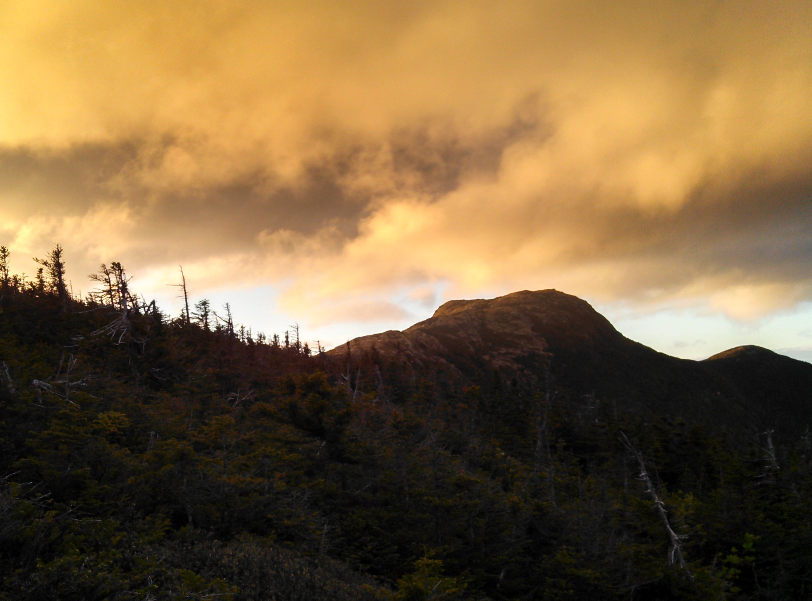
Designing Sustainable Landscapes for Species in the Northeast
BJ Richardson
GIS Coordinator
US Fish and Wildlife Service
Northeast Region
North Atlantic Landscape Conservation Cooperative

Slide 2
William V. DeLuca^{1,2}, Kevin McGarigal¹, Ethan Plunkett¹, Joanna Grand¹, Bradley Compton¹ ¹Department of Environmental Conservation, UMass, Amherst ²Northeast Climate Science Center, UMass, Amherst

Slide 3
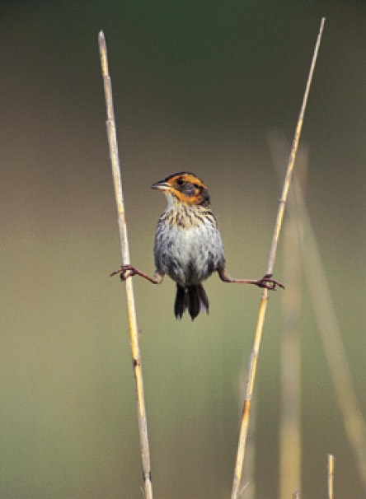
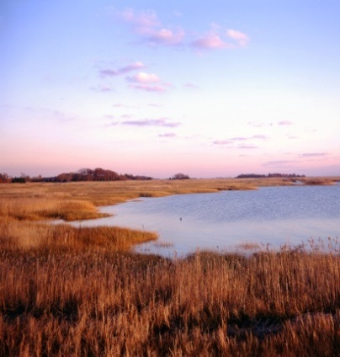
What are the issues with species data?
Often inconsistent/not enough location data, especially over large areas
Often not enough resources available for follow up and monitoring of many species
One possible solution? Representative, surrogate, keystone, apex predator, etc

Slide 4
Representative Species: What and Why?
What: “a species whose habitat needs, ecosystem function, or management responses are similar to a group of other species”
Why: not feasible to individually assess all fish and wildlife species
To guide strategic decisions about what habitat conservation actions are needed where, and in what quantity, to sustain populations

Slide 5
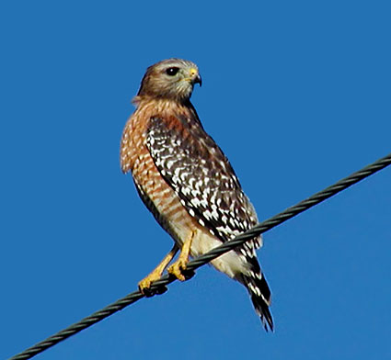
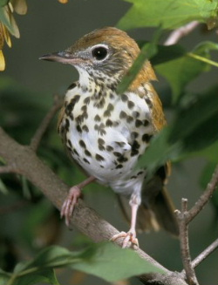
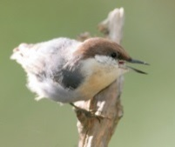
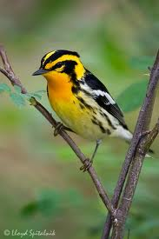
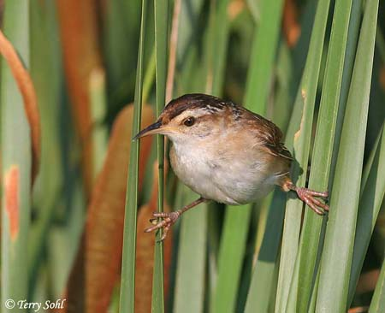
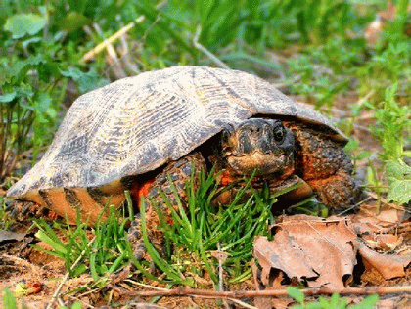
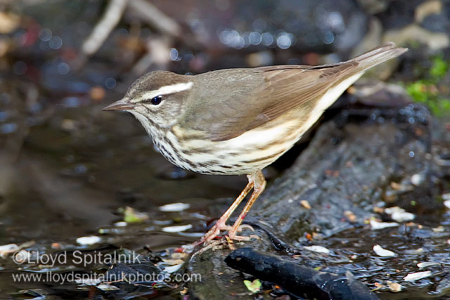
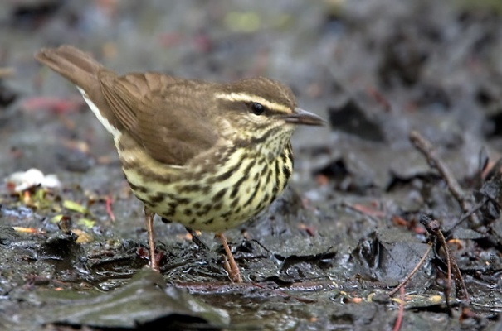
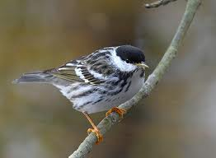
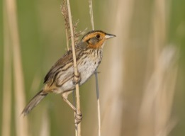
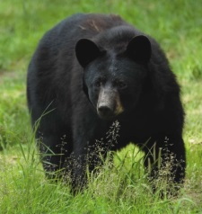
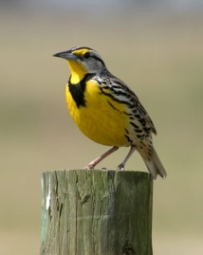
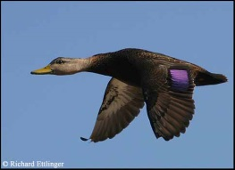
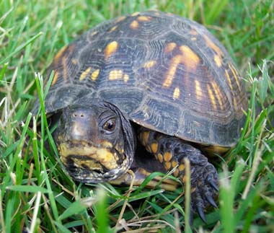
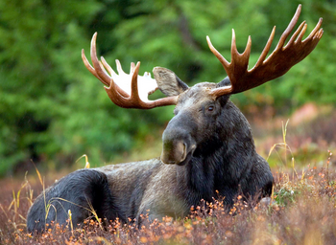
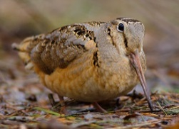
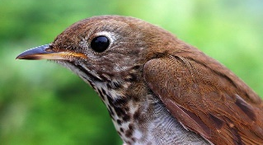
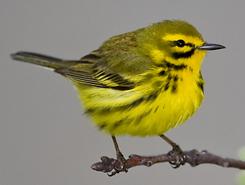
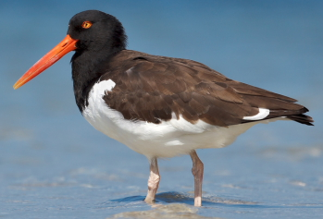
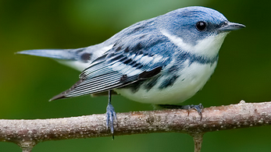
Designing Sustainable Landscapes
30 surrogate species
LC to assess current landscape and impacts of future landscape/climate change
Ultimately informs landscape conservation design
Notes:
Project objectives
Part of selecting surrogate species is the need to pick species that have at least some data associated with them so that modeling can be done. Thus many surrogates are birds, which tend to have more data available than other species.

Slide 6
Notes:
Moving on to talk about the DSL project, which uses the LCAD model

Slide 7
Notes:
Just for context for the overall project and model to illustrate that the species part is only one piece of a much larger model that includes analysis of overall ecological integrity on the landscape. The species part is highlighted in the dashed line, and is the part I will be overviewing today.

Slide 8
Notes:
The output of the species models results in what is called a landscape capability grid.

Slide 9
Notes:
Here is an generalized overview of the various settings data sets and analyses that go into the final landscape capability layer.

Slide 10
Moose Landscape Capability Model
Habitat
Capability
Climate
Suitability
Prevalence
Landscape
Capability
Notes:
I’m going to take one species as an example, keeping mind that the models vary a bit from species to species depending on their biological requirements and the data available to assess them. I’ll be running through each of these inputs to show some of the components that go into them.

Slide 11
Moose Habitat Capability
Foraging
(throughout the
annual cycle)
Cover and
Thermoregulation
(throughout the
annual cycle)
Small extent
development
Large extent
development
Habitat
Capability
Notes:
First is the habitat capability, which in the case of the moose, consists of their foraging habitats, cover and thermoregulation, and incorporates both small and large extent development.

Slide 12
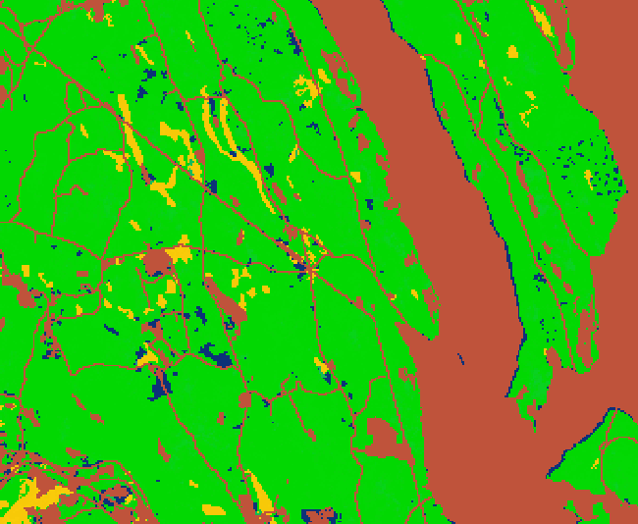
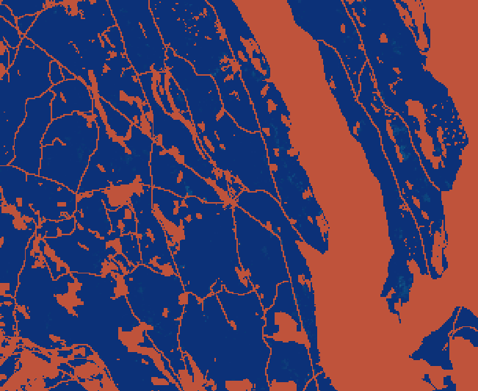
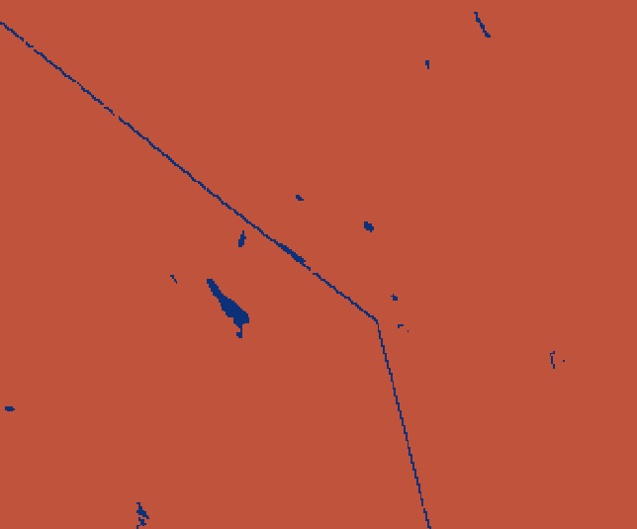
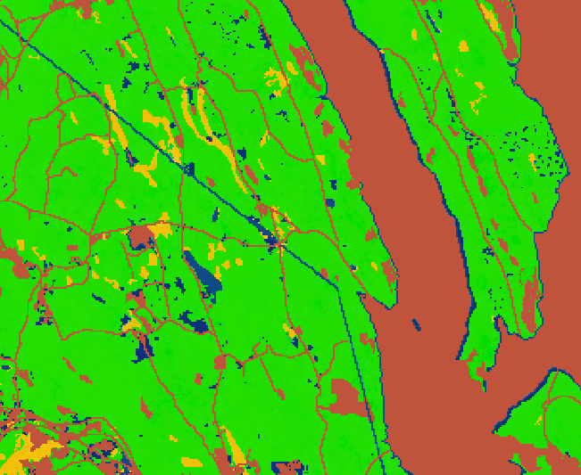
Moose Habitat Capability
Early
successional
forest
Mature conifer
forest
Wetlands
Open water
edges
Unsuitable
Suitable
Foraging Habitat
Notes:
But as you can see, there are multiple components, or “settings” layers that combine to make up the foraging habitat layer. In the case of moose, it is these (list), based on the literature.

Slide 13
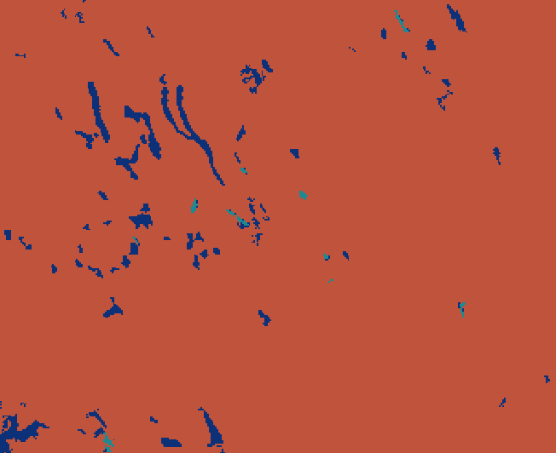
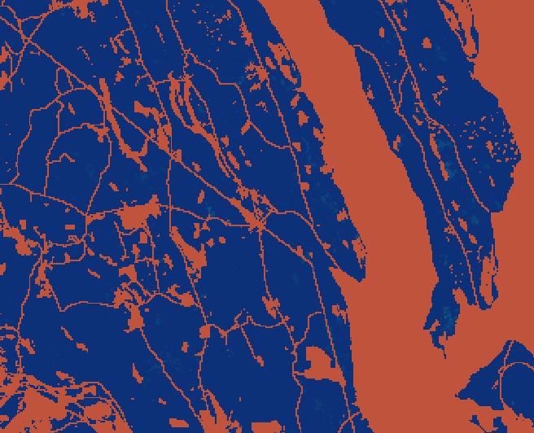
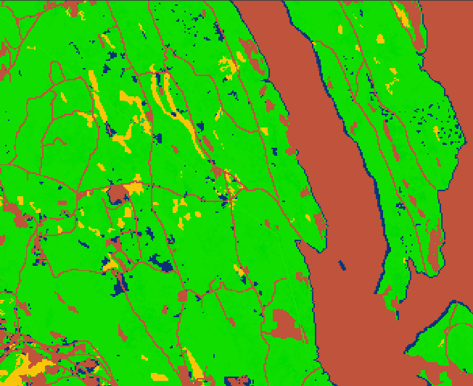
Moose Habitat Capability
Forested wetlands
Mature conifer
forests
Open water
edges
Unsuitable
Suitable
Cover and Thermoregulation
Notes:
Same situation for cover and thermo

Slide 14
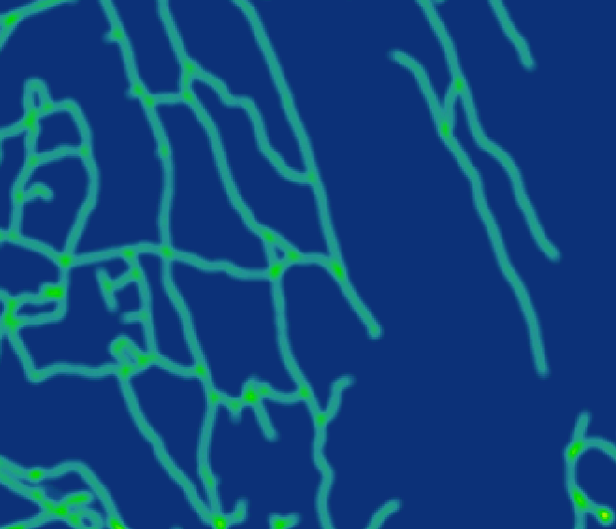
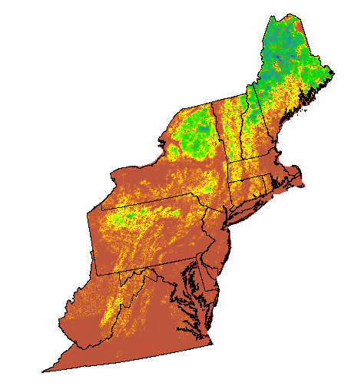
Moose Habitat Capability
Foraging habitat
Cover and
thermoregulation
Small scale
development
Large scale
development
Unsuitable
Suitable
Habitat Capability

Slide 15
Moose Habitat Capability
Unsuitable
Suitable
Notes:
As you can see, this piece of the model identifies moose habitat in areas where we are pretty sure there are no moose. So what do we do about that?

Slide 16
Moose Landscape Capability Model
Habitat
Capability
Climate
Suitability
Prevalence
Landscape
Capability

Slide 17
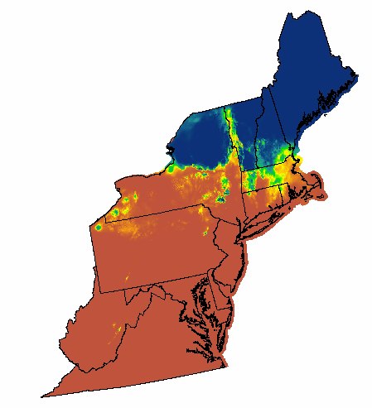
Moose Climate Suitability Model
10k points in and outside of
moose range
6 climate variables; gdd, temp,
tmin, tmax, precip, precipgs
Logistic regression
Unsuitable
Suitable
Notes:
One way to put constrictions on the Habitat Capability is through a climate suitability modeling, which is done by a regression between 6 climate variables and existing moose location points. But that still results in some areas where we are fairly sure that moose don’t exist. So we need to constrain the data a bit more to deal with that.

Slide 18
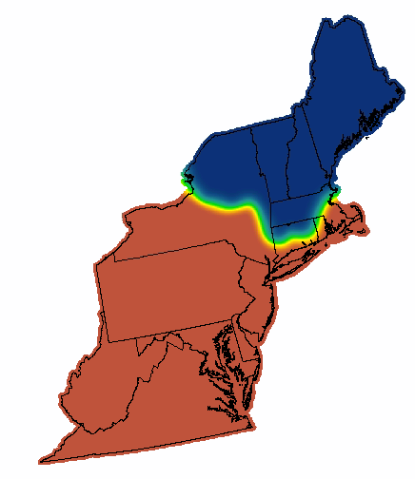
Moose Prevalence
Smoothing of moose range
Reflect other mechanisms that limit distribution other than climate and habitat
Unsuitable
Suitable
Notes:
So we use the moose data again to create a “soft” delineation of the actual moose range which helps account for other mechanisms: development, predation, disease

Slide 19
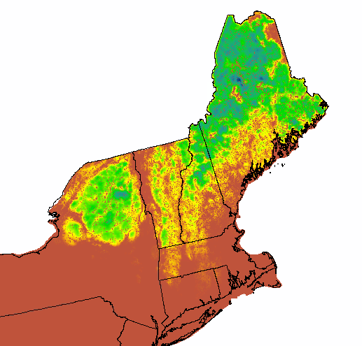
Moose Landscape Capability
Habitat Capability
Climate Suitability
Prevalence
Unsuitable
Suitable
Landscape Capability
Notes:
So the habitat capability combined with the constraints of climate and prevalence results in the final landscape capability map

Slide 20
2010 Moose Landscape Capability
Unsuitable
Suitable

Slide 21
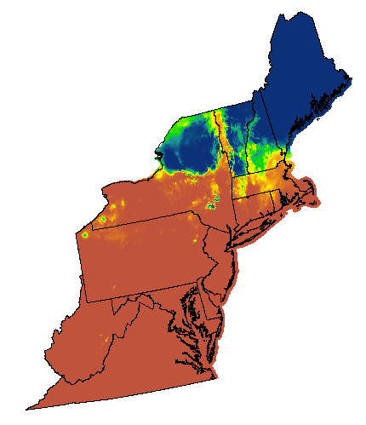
Change in Climate Suitability
2010
2080

Slide 22
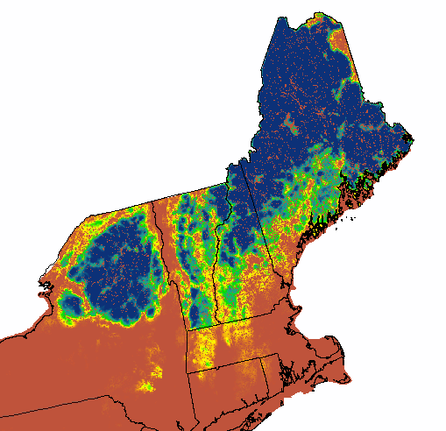
2080 Climate Persistence
High 2010 Landscape Capability
Climate suitability is
maintained in 2080
Low
High

Slide 23
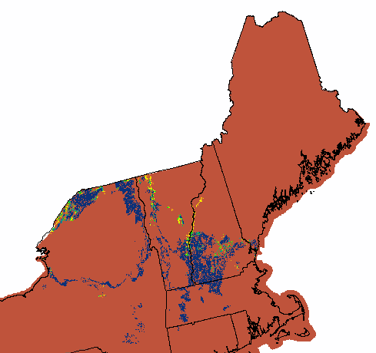
2080 Climate Vulnerability
Suitable 2010 Landscape Capability
Climate suitability is
lost in 2080
Low
High

Slide 24
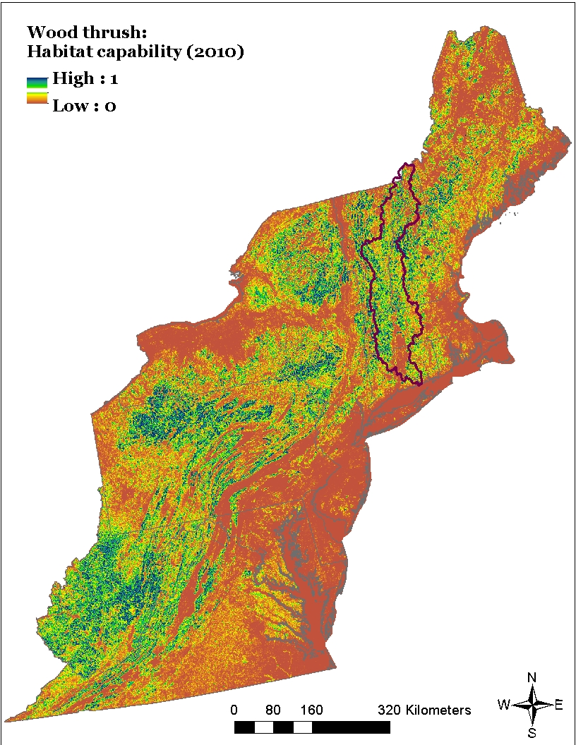
Landscape Assessment
Species
Habitat capability index
Where is the capable habitat in 2010, without regard to climate suitability and species’ prevalence?
Wood thrush

Slide 25
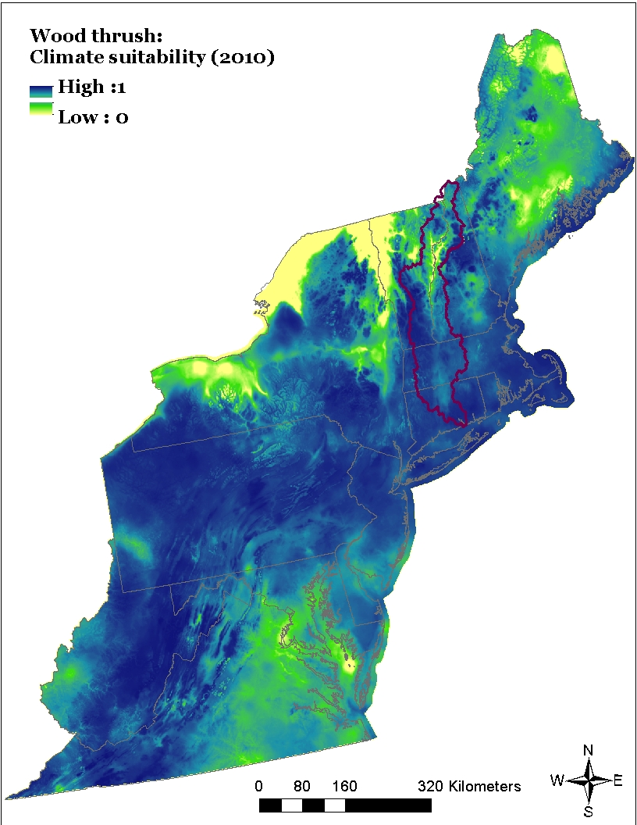
Landscape Assessment
Species
Climate suitability index
Where is the suitable climate in 2010, without regard to habitat and species’ prevalence?
Wood thrush

Slide 26
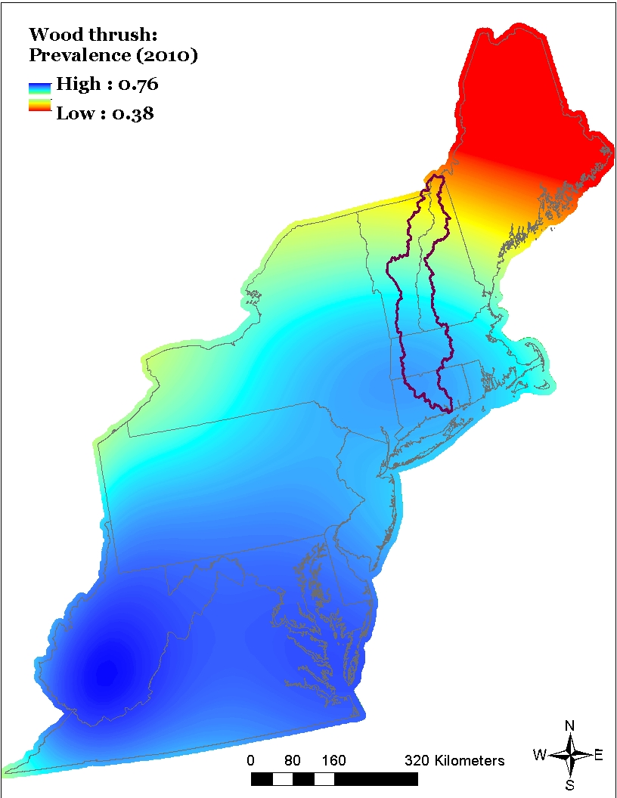
Landscape Assessment
Species
Prevalence index
Where is the species most prevalent in 2010, without explicit regard to habitat and climate suitability
Wood thrush

Slide 27
Landscape Assessment
Species
Landscape capability index
Where is the species’ most likely to occur in 2010, based on habitat capability, climate suitability and prevalence?
Wood thrush

Slide 28
Moose Landscape Capability Model
Open wetland
Ecological Systems
LR2a
Water edges
LR2b
Early
Successional
Forest
LR1a
Mature
Conifer
Forest
LR1d
Wetland
Ecological
Systems
LR1b
Water edge
lr1c
Mature Forest
Ecological Systems
LR2c
Foraging
(throughout the
annual cycle)
LR1
Cover and
Thermoregulation
(throughout the
annual cycle)
LR2
Small extent
Development
Large extent
Development
Habitat
Capability
HC
Prevalence
Climate
niche
CN
Landscape Capability
LC

Slide 29
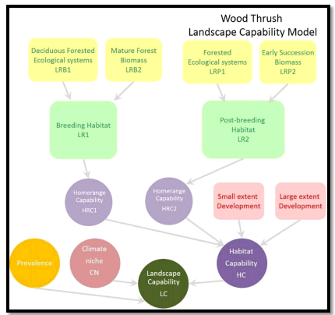
Wood thrush graphic

Slide 30
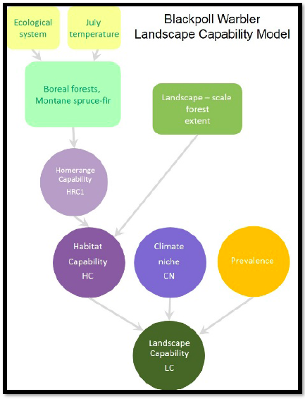

Slide 31
Notes:
Just for context for the overall project and model to illustrate that the species part is only one piece of a much larger model that includes analysis of overall ecological integrity on the landscape. The species part is highlighted in the dashed line, and is the part I will be overviewing today.

Slide 32
Questions?

Slide 33
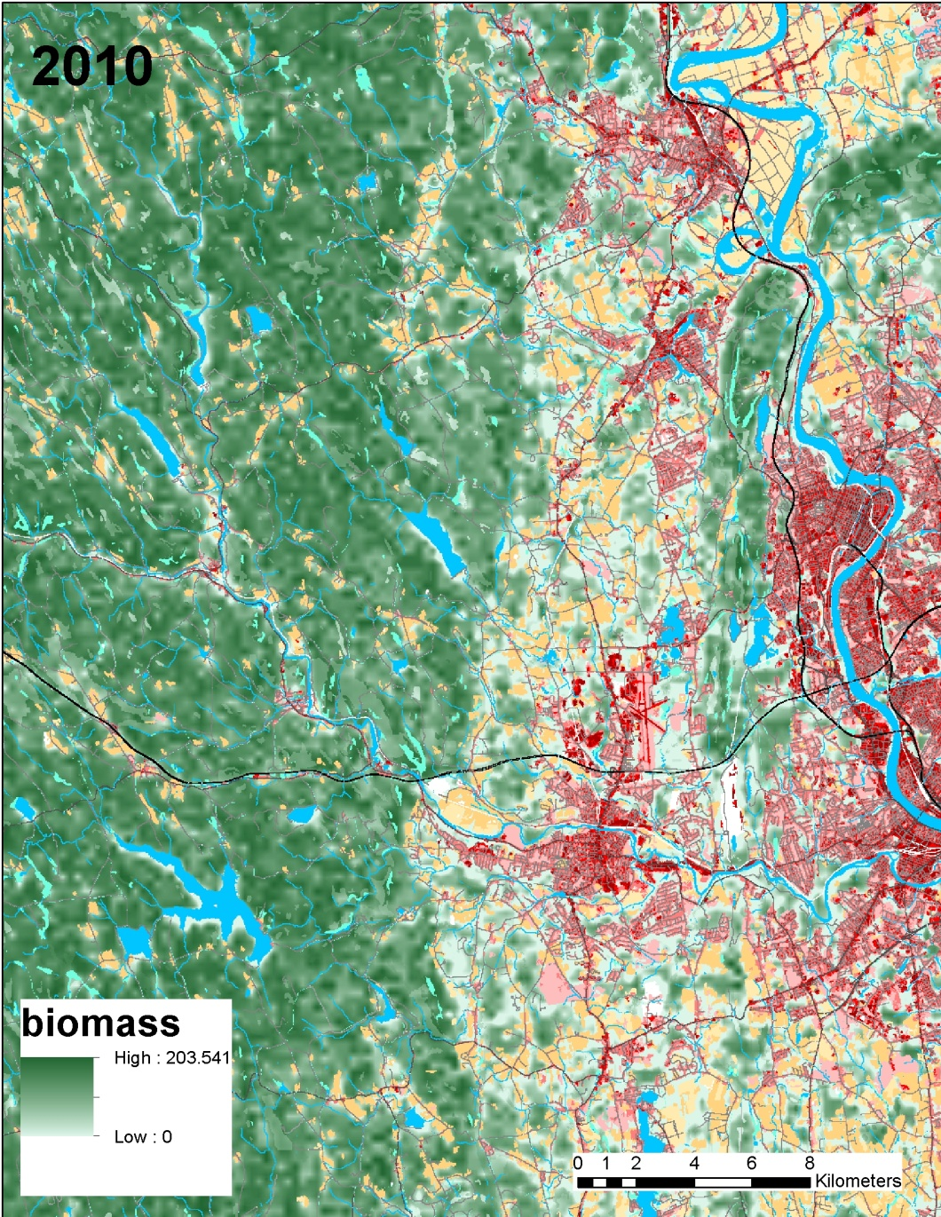
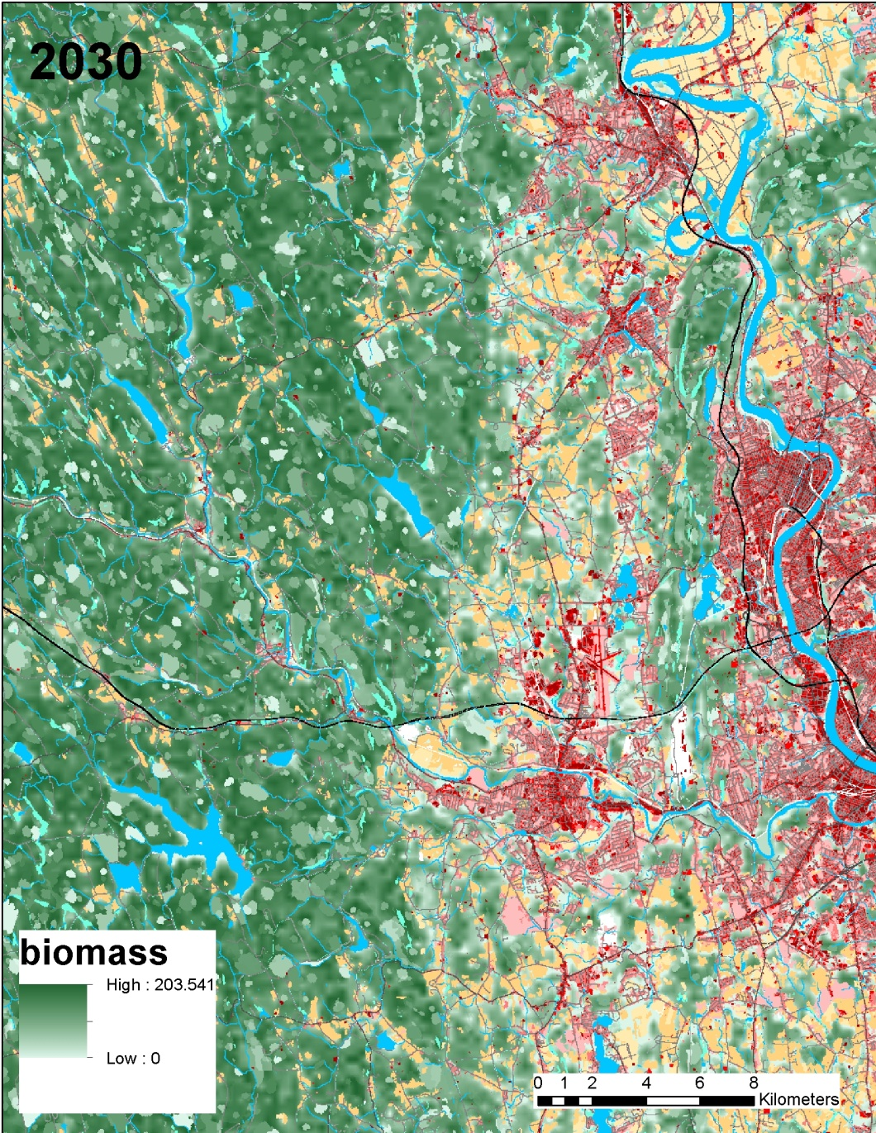
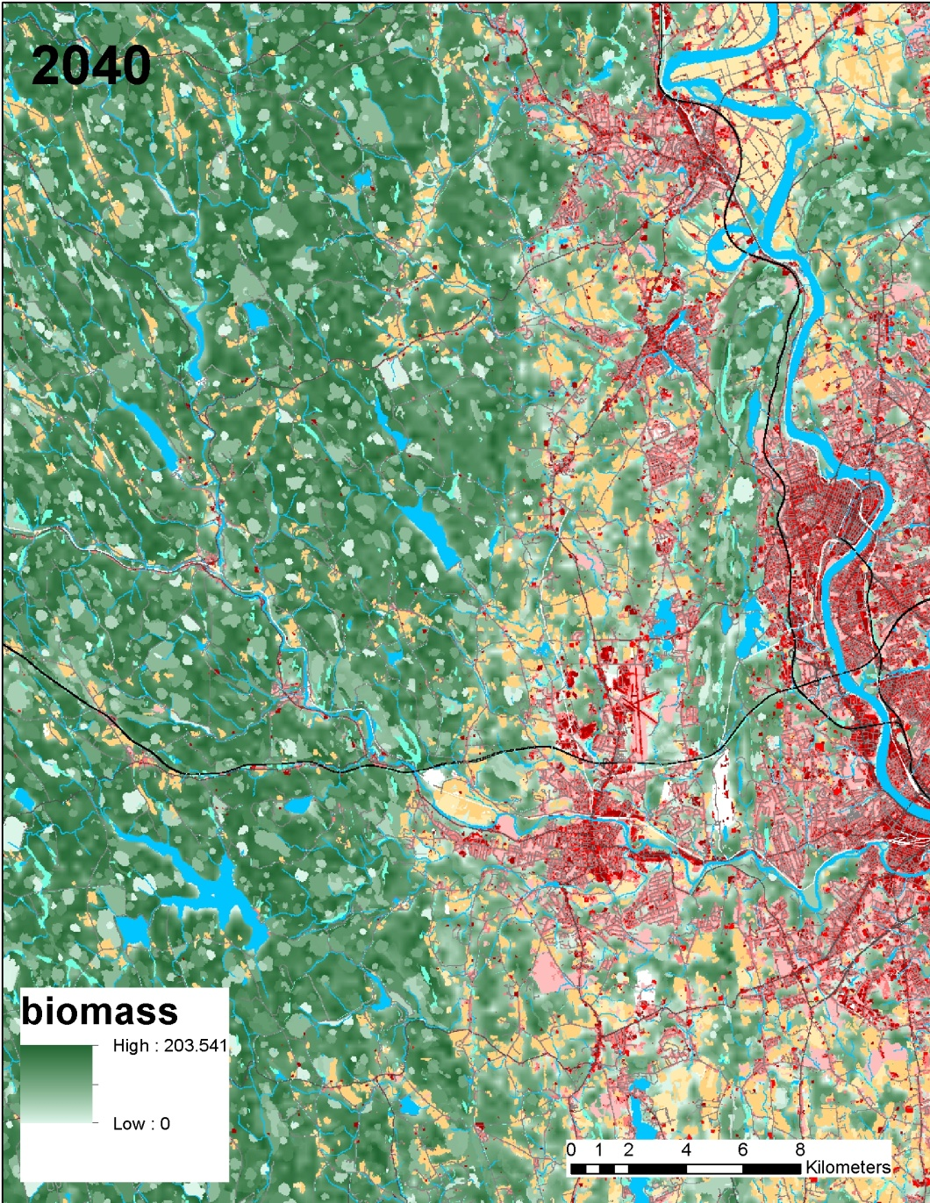
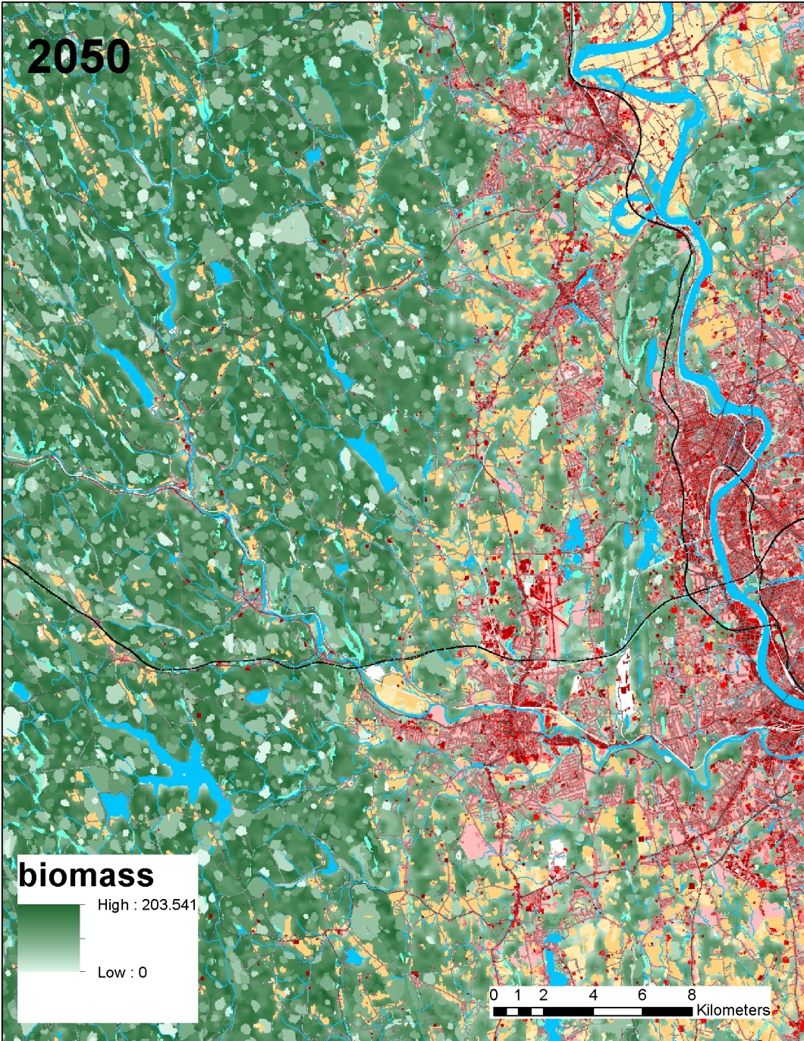
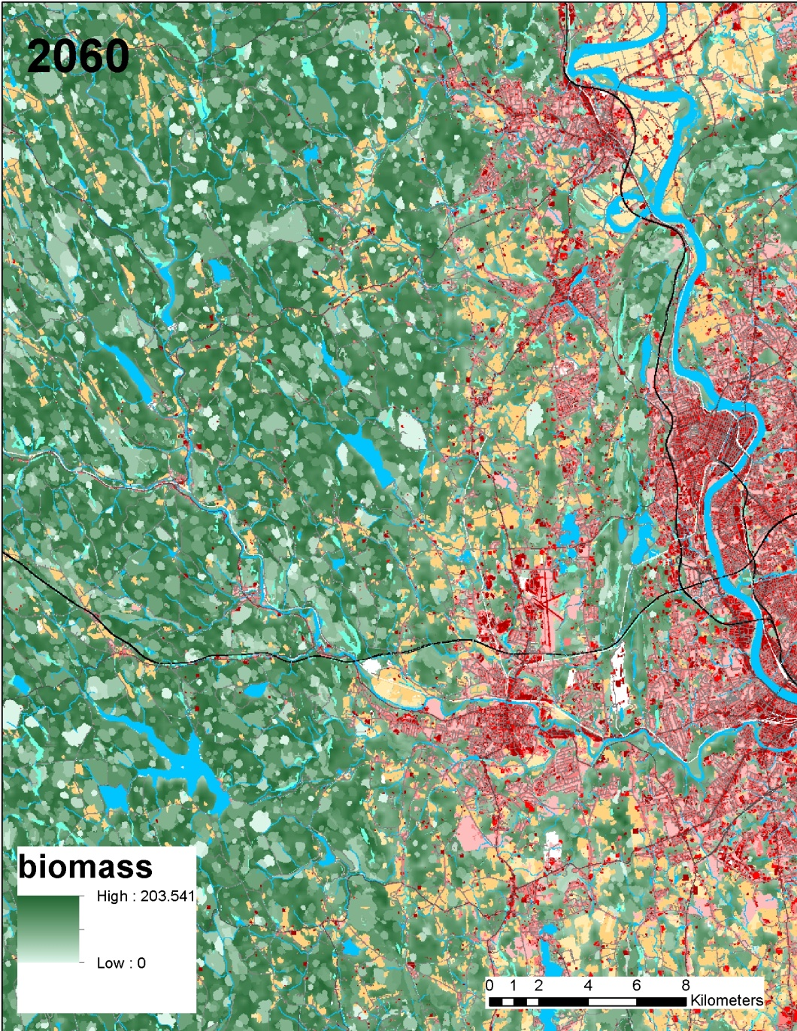
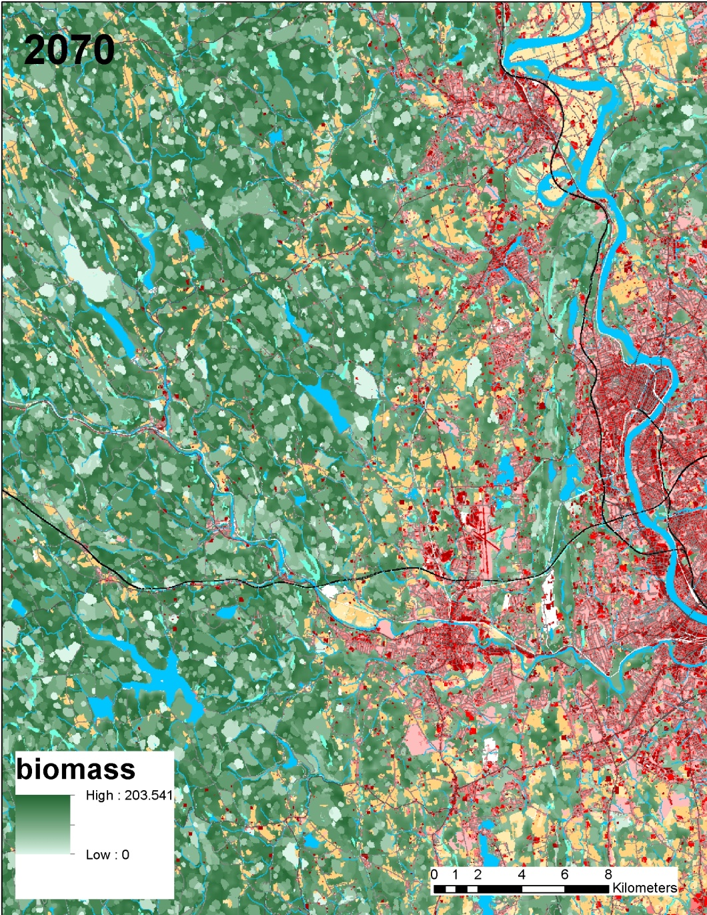
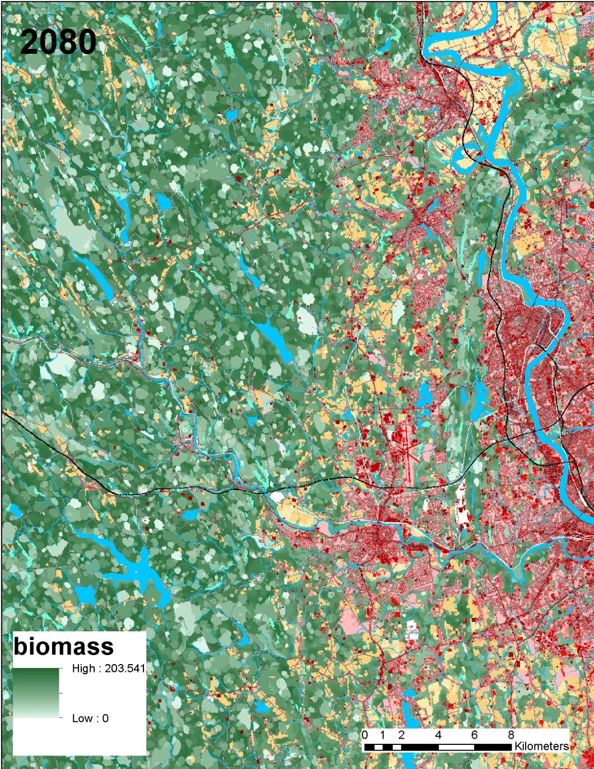
Landscape change model, urban growth & disturbance / succession

