Slide 1
RCN 2009-11 Development of an Online Database to Enhance the Conservation of SGCN Invertebrates in the Northeastern Region
James W. Fetzner Jr. & John E. Rawlins Carnegie Museum of Natural History Pittsburgh, PA
Project Description: This project is developing a suite of online-accessible tools that will allow operation of a database of occurrence records (spatial and temporal) to enhance conservation management of invertebrate species of greatest conservation need (SGCN) in the Northeast Region. The data to be exploited are derived from authoritatively determined specimens in institutional collections, and a wide range of other information not documented directly by specimens (literature, notes, reports, etc.). The tools will allow the scientific community to add, edit and download species-specific data records in a secure manner for the purpose of generating distribution maps, phenological plots, and directly improving efforts for invertebrate conservation.

Slide 2
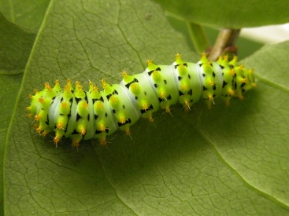
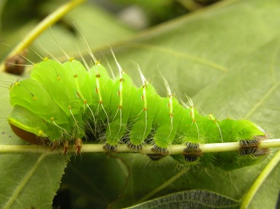
RCN Needs Solutions
Lack of a basic understanding of rarity, range and distribution, and habitat associations for many SGCN taxa.
Digitize museum and university invertebrate collections.
Link existing on-line databases to increase data availability and improve understanding of species rarity and distribution.
Creation of a species database providing information that will facilitate the inventory and conservation of SGCN invertebrates in the Northeast.
Build a database and associated website that will display museum specimen records.
Output distribution maps, phenologies and other data based on specimen records contained in the database.
Include annotated specimen photos to aid identification and show within-species variation.
Provide links to other taxon-based web resources.

Slide 3
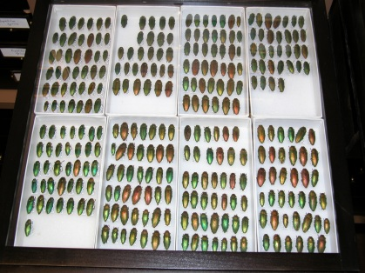
The Role of Museum Collections
Impediments to successful conservation of SGCN invertebrates
Lack of available data documenting historical ranges
Inability to define current distributions and abundances
Taxonomic impediments
(i.e., lack of input from appropriate experts, delimitation and validity of species concepts, accurate and authoritative determination, and correct nomenclature).
Data accumulation inadequacies
(e.g., missing, incomplete, or unverified data from museum collections, field notes, etc.).
Insufficient mechanisms for gathering and rapidly sharing sensitive data
Much data applicable to these problems are already housed in historical museum collections!
BUT, Data can be difficult to gather (labor intensive)
Often involves retrospective data capture from individual specimen labels

Slide 4
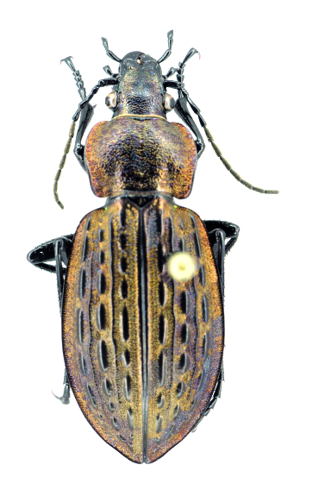
Project Products
An interactive website (SGCN Invertebrates), Available soon….
Initial test database of SGCN invertebrate occurrence records (>17,000) from the Carnegie Museum collection.
Distribution maps and phenology charts (generated from records contained in the database).
Photographs of representative specimens to aid in the identification of taxa, and annotated to show diagnostic identification features.
Species life history information (where available).
List of associated references.
Notes and comments that allow for easy addition of data to individual species pages.

Slide 5
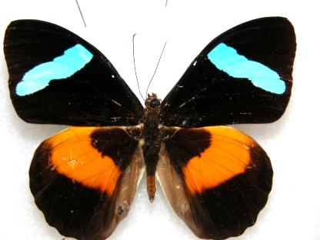
Some Lessons Learned
Accurate specimen-based information is critical to conservation efforts.
Major challenges in utilizing specimen data.
Need to verify and update historical data (geographic localities & species ID).
Many taxa can be extremely difficult to properly identify.
May require a knowledgeable expert.
Museums can help, BUT…
Most large museums are under-staffed.
Most lack sufficient funding to make retrospective label data capture a priority, and thus need funding support in order to do so.
If NEAFWA (and others) would set these data capture and taxonomic initiatives as a priority for funding, it would help get critically needed data into the hands of invertebrate conservation programs and would help foster the continued growth and usefulness of the SGCN Invertebrates database.

