Slide 1
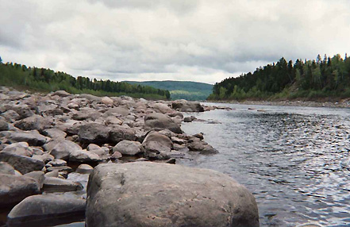
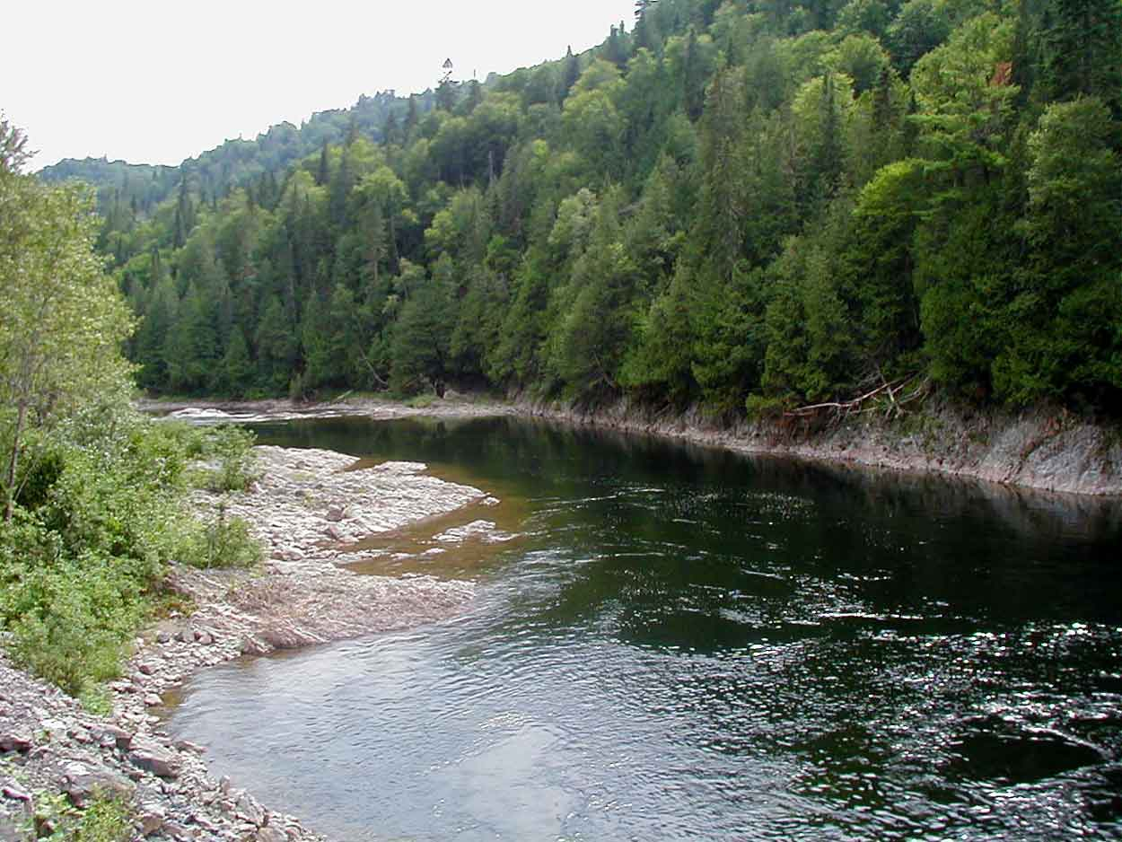
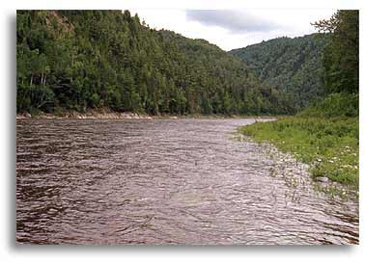
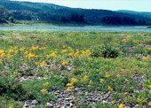
Mapping Rivers Systems

Slide 2
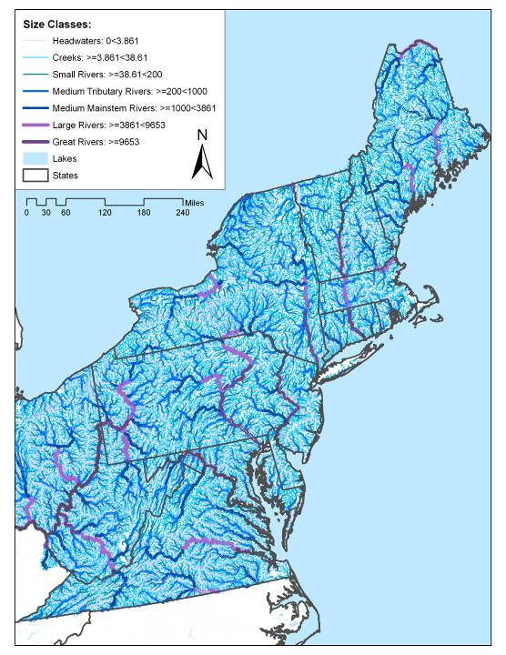
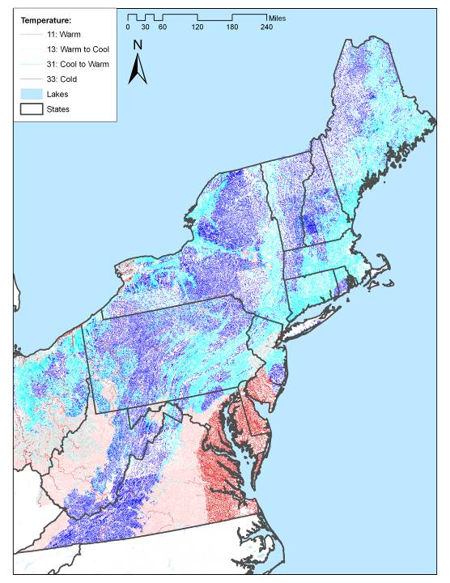
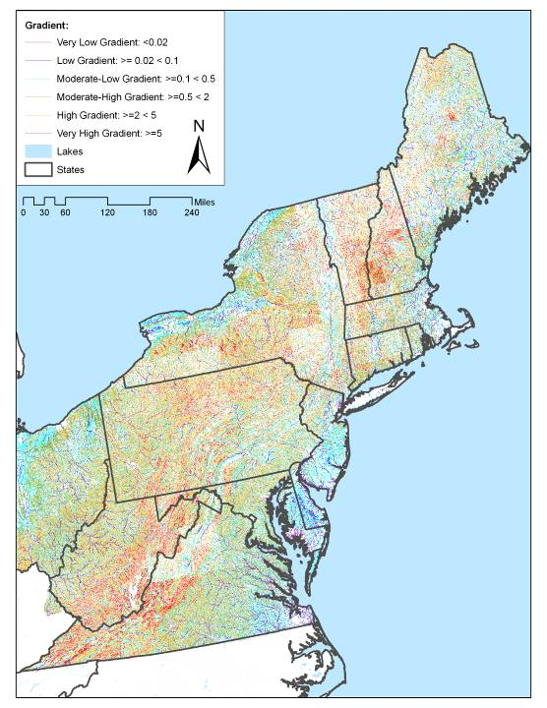
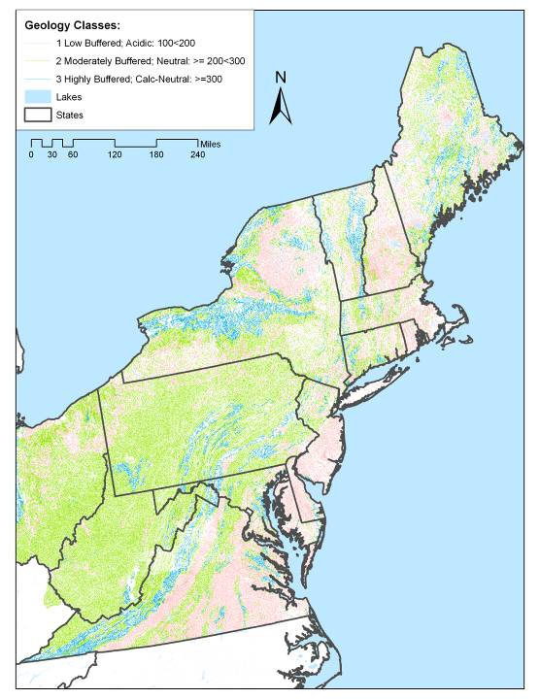
Key Habitat Variables
SIZE (Drainage Area)
Temperature
Gradient
Geology (pH)

Slide 3
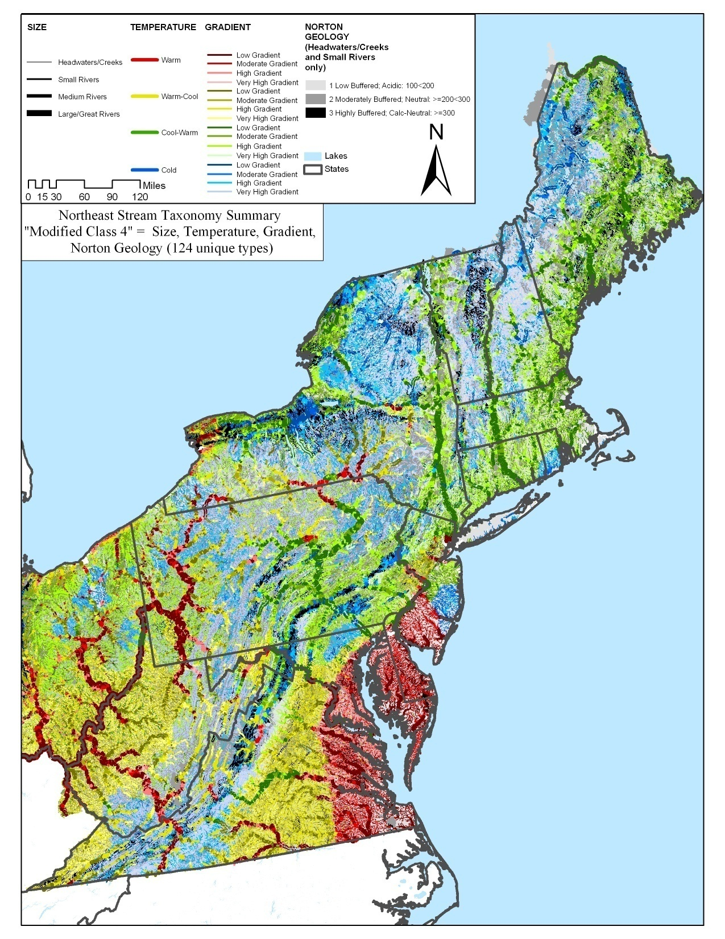
Results
NEAFWA Stream Classification includes 257 types,
This simplified map groups them into 96 types.
From
Very high gradient, acidic, cold headwater creek
(1a_6_1_1)
To
Very low gradient, calcareous, warm Great River
(5_1_3_3)
Code =
Size, Gradient, Geo, Temp

Slide 4
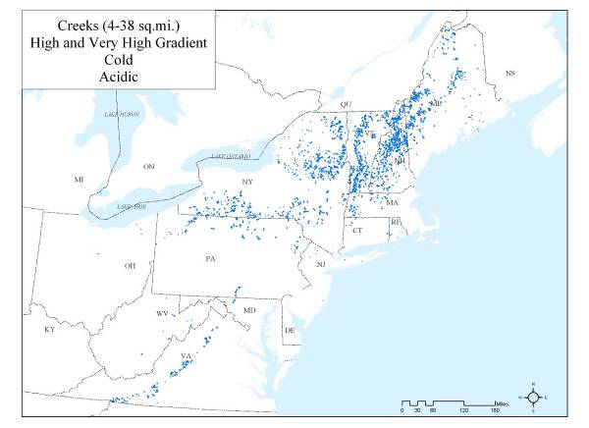
High gradient acidic cold headwater stream.
Regional Size Class (1b): Northeast Headwaters
Regional Gradient Class
(5): High
Regional Norton Geology Class
(1): Low Buffering Capacity, Acidic
Regional Temperature Class
(1): Cold
1b511:
High gradient acidic cold headwater stream
Linked State Names:
MA Small Streams,
VT Cold headwater acidic streams,
NY Coldwater Stream,
CT Coldwater Stream,

