Slide 1
Conservation Status of Fish, Wildlife and Natural Habitats in the Northeast and Mid Atlantic Region
Mark Anderson and
Arlene Olivero Sheldon

Slide 2
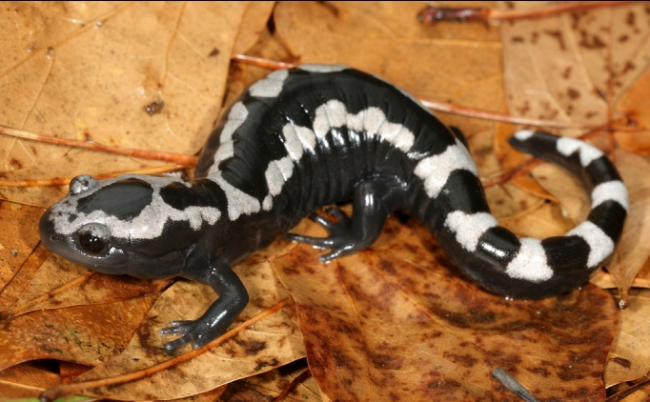
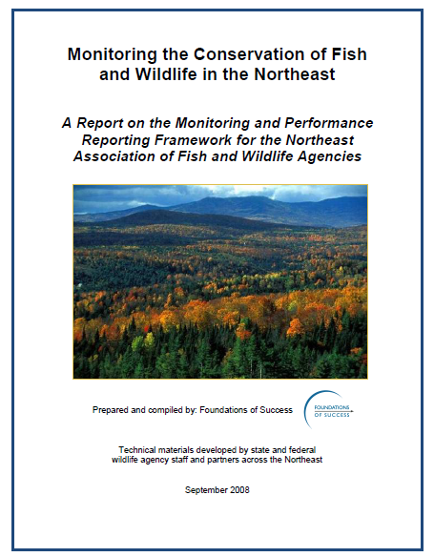
Project Overview
Guiding Document
Advisory Committee
Secured Lands
Habitats & Species
  Forest
  Wetland
  Unique habitats
  Rivers and Streams
  Lakes and Ponds
  SGCN Species.

Slide 3
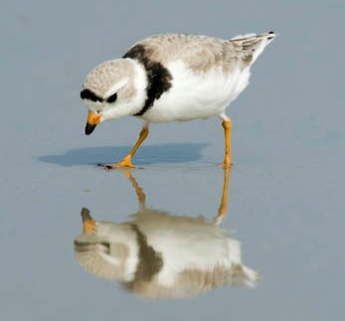
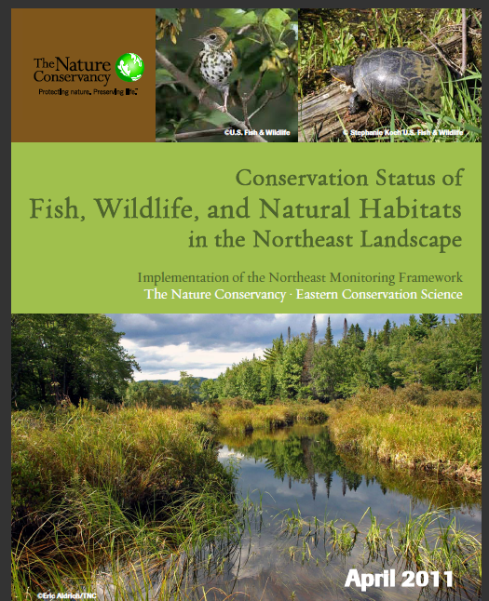
Report and Advisory Committee
Representatives from every State
Jenny Dickson and Rick Jacobson of CT DEP;
Robert Coxe and Kevin Kalasz of DE DFW;
John O'Leary and Thomas O'Shea of MA DFW;
Glenn Therres, Lynn Davidson, Scott Stranko, and
Dana L.Limpert of MD DNR;
George Matula and Sandy Ritchie of ME DIFW;
Jim Oehler, John Kanter, Matt Carpenter, Steve Fuller,
and John Tash of NH DFG;
Dave Jenkins, Kris Schantz, and Miriam Dunne of NJ DFW,
Tracey Tomajer, Greg Edinger, Dan Rosenblatt,
and Erin White of NY DEC;
Dan Brauning and Lisa Williams of PA GC,
Dave Day of PA FBC,
Jeffrey Wagner of PA WPC/NHP;
Jon Kart and Rod Wentworth of VT DFW; Gary Foster of
WV CNR; Becky Gwynn of VA DGIF,
Dave Tilton, Genevieve Pullis LaRouche, Ron Essig,
and Ken Sprankle of USFWS;
Don Faber-Langendoen of NatureServe,
Dan Lambert of American Bird Conservancy,
Dave Chadwick of the AFWA, Mary Anne Theising of USEPA,
James McKenna of USGS.
: http://conserveonline.org/workspaces/ecs/documents/northeast-conservation-status-report-april-2011/

Slide 4
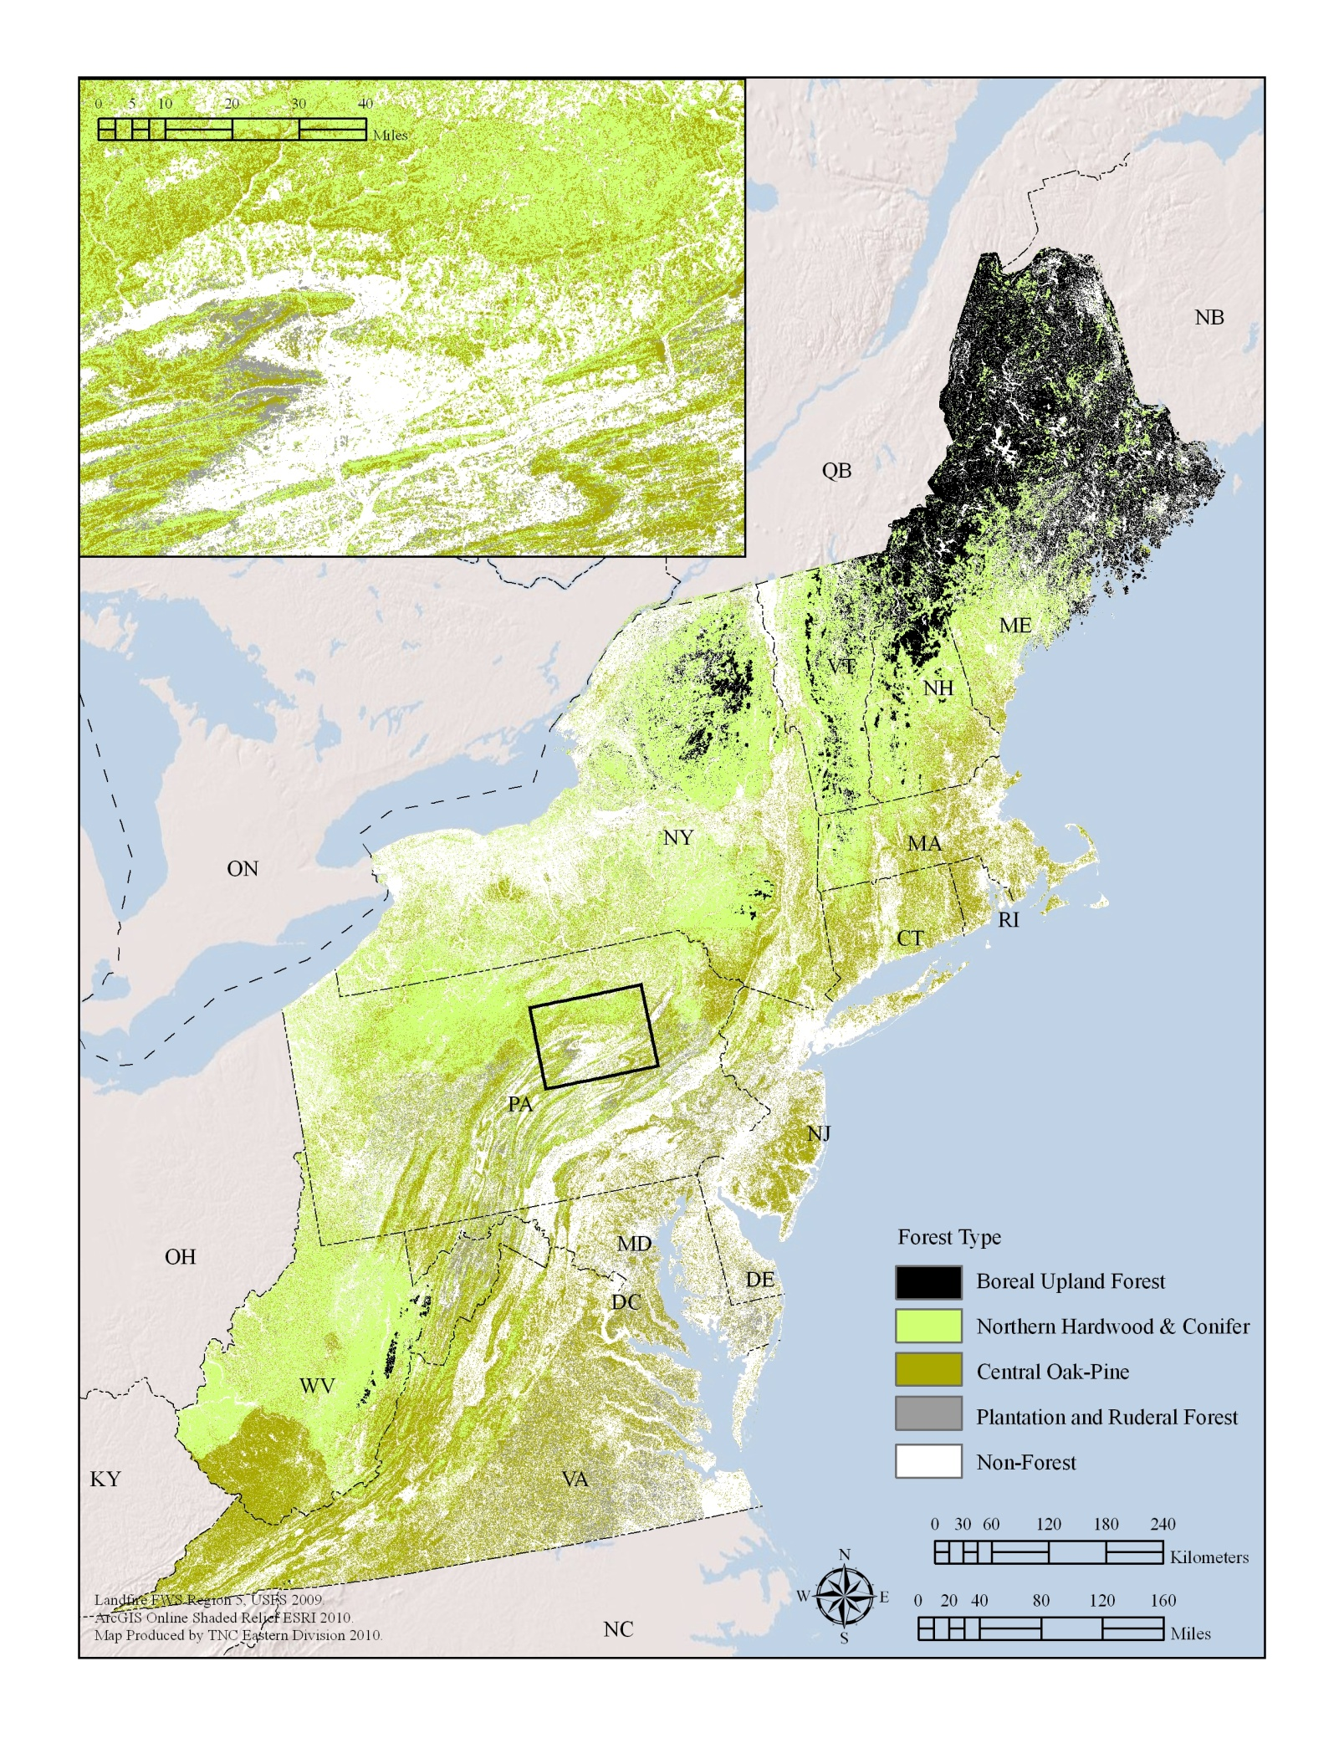
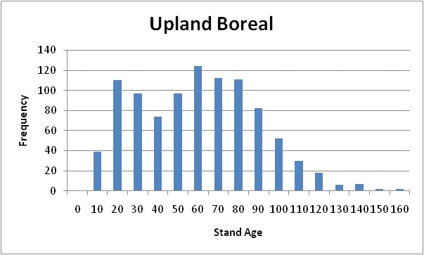
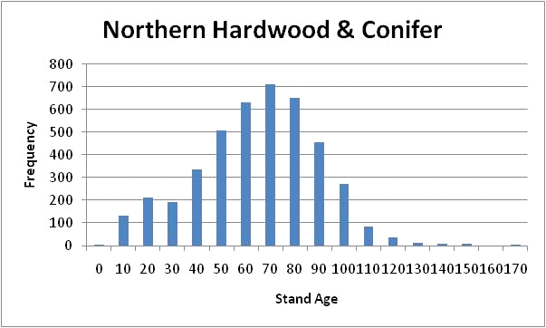
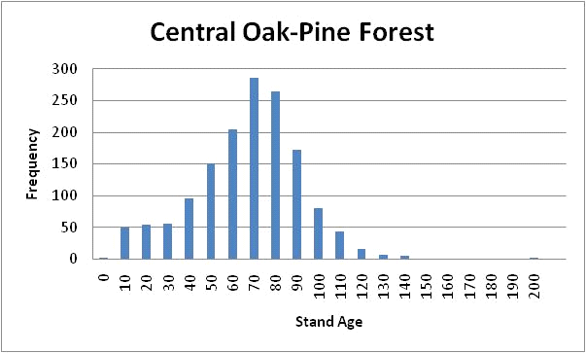
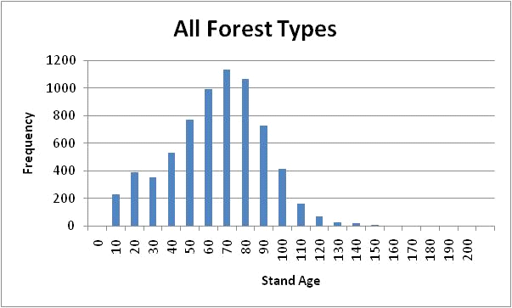
Example: Forests: Age Structure
LANDFIRE MAP
FIA data
6952 stands

Slide 5
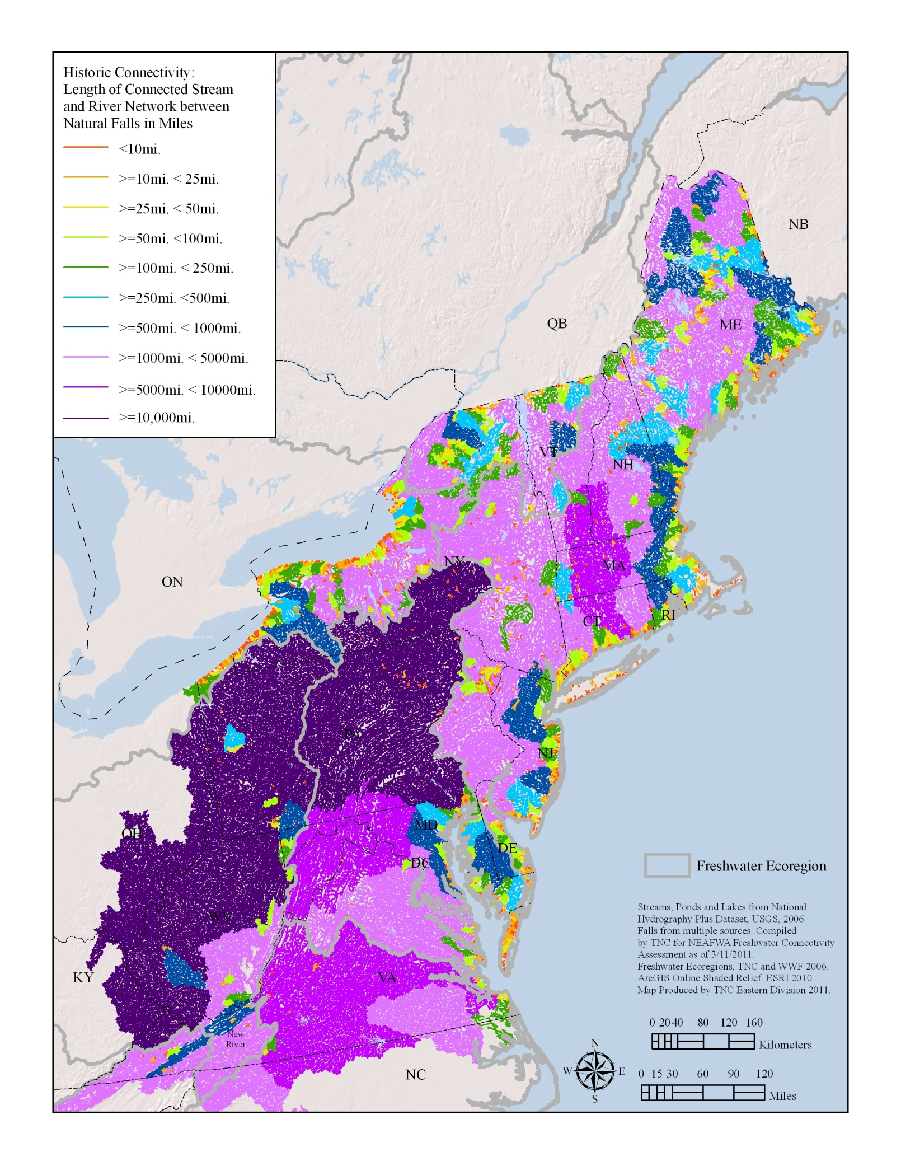
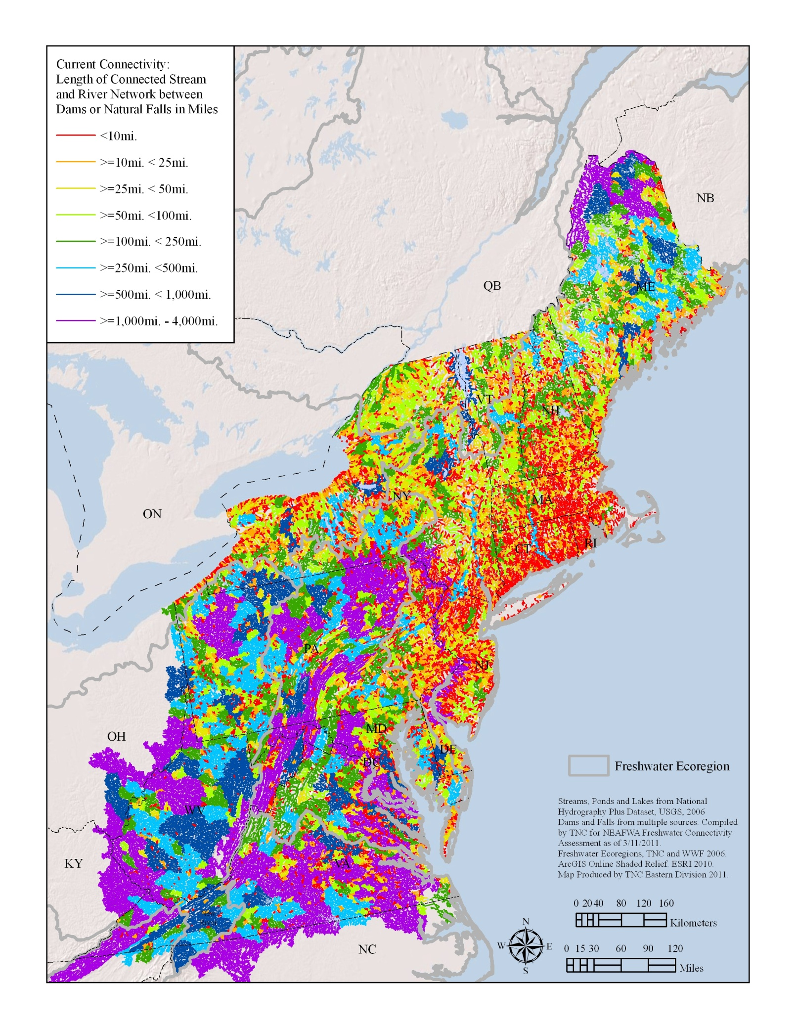
Example: Rivers: Connected Networks
Original State: falls only
Current State: falls and dams
FIA data
6952 stands
Original = 41 % in networks over 5,000 miles
Current = 0 %
Original = 3 % in networks 1-25 miles
Current = 23 %

Slide 6
Example: Securement by Category
Concern trumps Responsibility?

