Slide 1
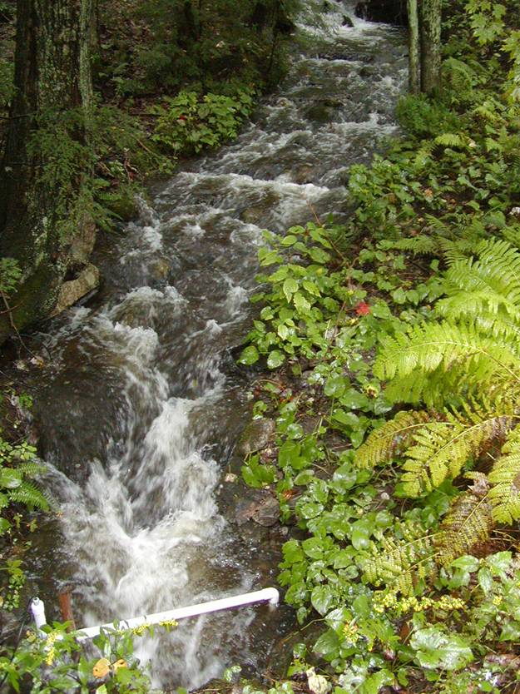
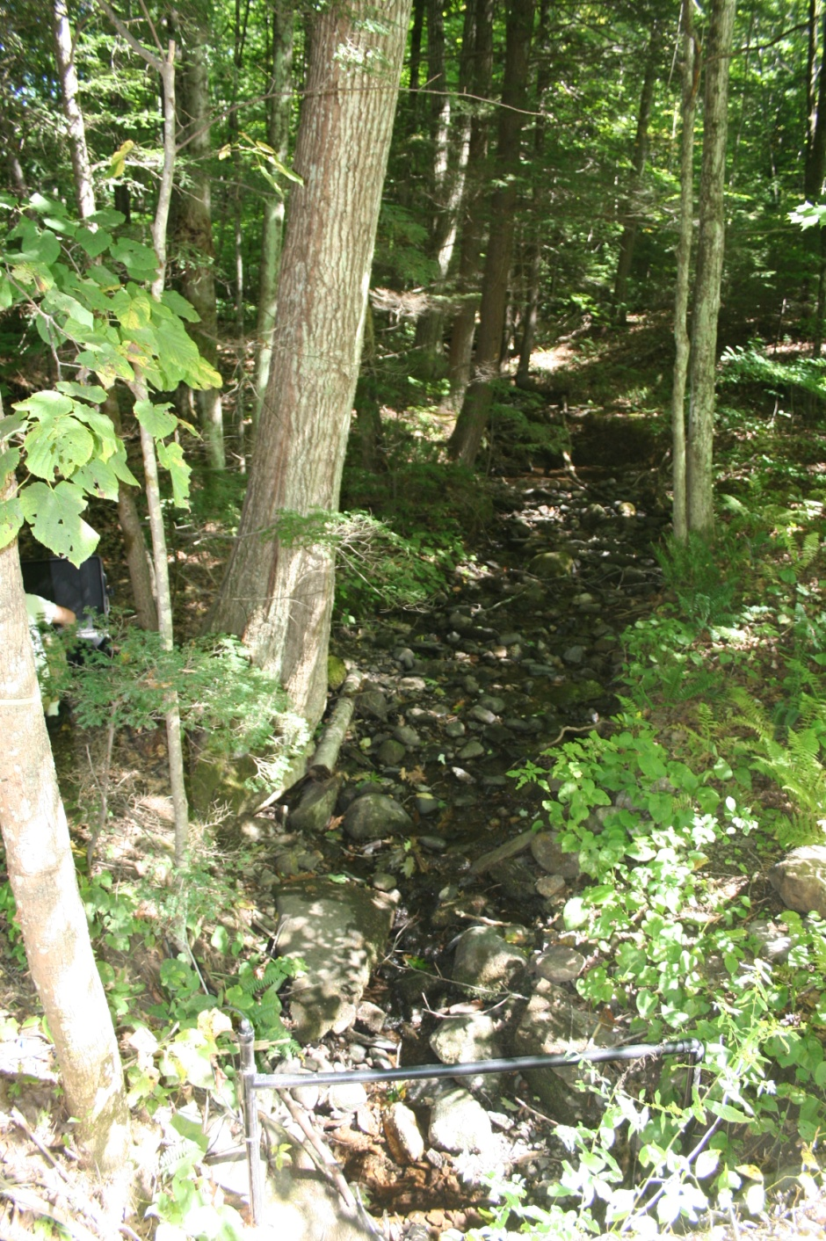
Salmonid (Brook trout) population persistence
Ben Letcher
USGS, Conte Anadromous Fish Research Center, Turners Falls, MA
Keith Nislow
USFS, Northern Research Station, Amherst, MA
Development of a DSS

Slide 2
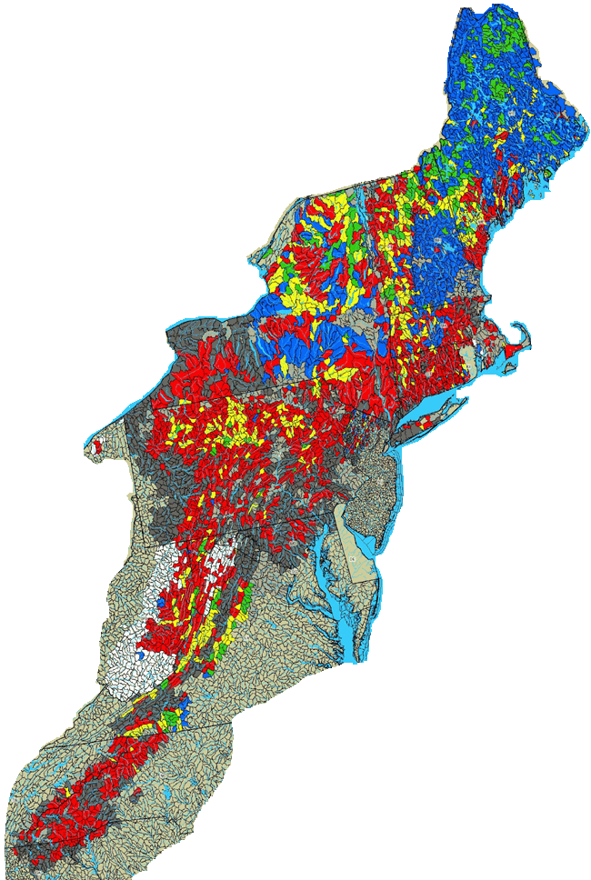
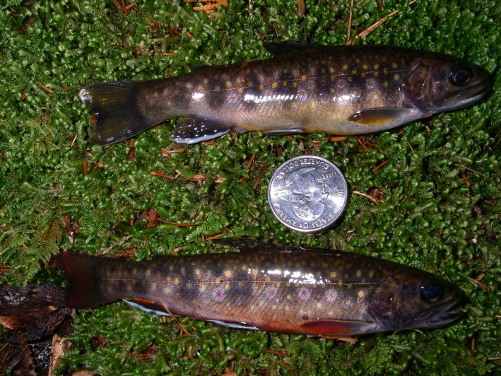
Overall goal
Understand how populations work
What affects local population persistence?
Endpoint – probability of persistence after x years
Body size distributions
Develop DSS tool for managers
Probability of population persistence under varying management scenarios
Eastern brook trout joint venture, 2007

Slide 3
Approach
Data
Analysis
Model
Simulation
Management
tool
Since 1997, over 35,000 individually-tagged fish
4 streams with 2 new streams in 2011

Slide 4
Approach
Data
Analysis
Model
Simulation
Management
tool
Population
processes
Outcome
Stressors
Environment
Reproduction
Body growth
Survival
Movement
Climate change
Fragmentation
Flow management
Stream Temperature
Stream flow
Habitat
Population persistence
Scalable stream temperature and flow model

Slide 5
Approach
Data
Analysis
Model
Simulation
Management
tool
Capability to run model scenarios
Test management alternatives

Slide 6
Approach
Data
Analysis
Model
Simulation
Management
tool
Decision support system for evaluating effects of management alternatives on local population persistence
Map-based
Input local conditions
Temp, flow, global climate change
Input existing fish data
Abundance, body sizes, fish community
Model based on individual-based data will be ‘fine-tuned’ to local conditions
Output
Effects of management alternatives
Probability of persistence after x years
Body size distributions

Slide 7
Links to Terrestrial project
Probability of persistence
Fish model
Probability of persistence
Fish model
Probability of persistence
Fish model
Seasonal setting
Precip, air T
Stream flow, water T
Drivers
Climate change
Hydrologic model
Scenarios
Succession
Decadal setting
Impervious…
Drivers
Urban growth, etc
Habitat
Caps
Seasonal
Resulting DSS: evaluate alternate management strategies
Decadal
Notes:
If you need this…

