Slide 1
Inventory & Monitoring Program U.S. National Wildlife Refuge System
U.S. Fish & Wildlife Service
Natural Resources Program Center
National Office
USFWS

Slide 2
U.S. Fish & Wildlife Service
Agenda
Origins
History
I&M Program
Architecture
Status
Tasks

Slide 3
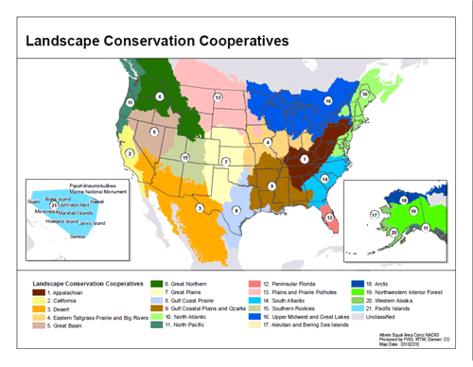
Notes:
*Reference slide
LCCs will comprise a seamless national network focused on helping conservation agencies and organizations maintain landscapes capable of sustaining abundant, diverse and healthy populations of fish, wildlife and plants.
I&M will connect efforts of LCCs by identifying information needs and providing information to refuges, fws programs and partners for landscape conservation.

Slide 4
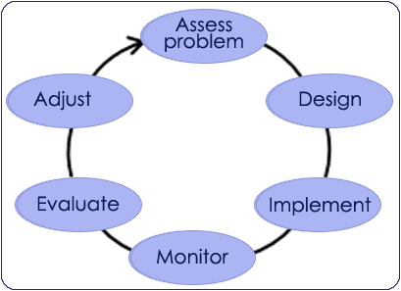
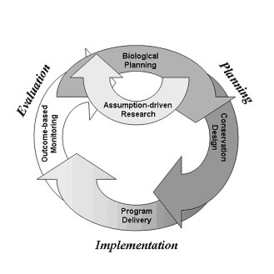
Foundational Pillar of AM and SHC
U.S. Fish & Wildlife Service
If you aren’t monitoring, you aren’t doing AM (adaptive management) or SHC (strategic habitat conservation!
Notes:
AM & SHC - FWS approaches to landscape conservation
SHC is to make the Service more efficient in fulfilling our conservation mandate by making new and better information available to all Service staff
Adaptive management is a systematic approach for improving resource management by learning from management outcomes.

Slide 5
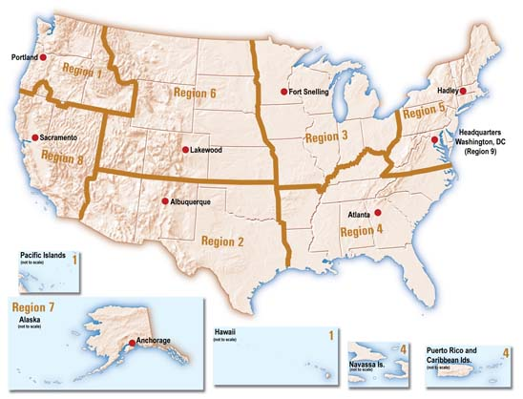
U.S. Fish & Wildlife Service
USFWS Regions
Notes:
FWS includes 8 regions and one region representing the National Office. These regions are as diverse as the programs within the FWS and are generally run autonomously. Each region functions like a separate entity when collecting, storing and managing data. No coordination @ the National Level.

Slide 6
U.S. Fish & Wildlife Service
The Genesis
The National Wildlife Refuge System Improvement Act (NWRSIA) of 1997
Provide for the conservation of fish, wildlife, plants and their habitats;
Ensure the biological integrity, diversity, and environmental health ….;
Plan for the continued growth of the System;
Assist in the maintenance of adequate water quantity and quality….;
Acquire water rights….;
Monitor the status and trends of fish, wildlife, and plants in EACH refuge
Notes:
The NWRSIA of 1997 request that the NWRS be managed as a national system of related lands, waters, and interests for the protection and conservation of our Nation's wildlife resources. It provides guidelines and directives for management of all areas in the system.

Slide 7
U.S. Fish & Wildlife Service
Background/History
National Park Service begins I&M program in 1992
Regions 3&5 formed Biological Monitoring and Database Team in 2005
In August 2009, the Core Planning Team formed to draft strategic plan and operational blueprint for I&M effort
Notes:
NPS began its I&M program in the 90’s
R3/R5 acquired some funding to form a group for monitoring biological resources and developing a database
In 2009, NWRS started a work group that included a planning team, an executive team and two staff teams including personnel from each region. The Core Planning Team discussions lasted for about 5 months.
7

Slide 8
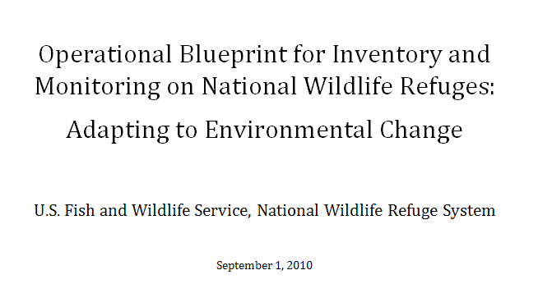
U.S. Fish & Wildlife Service
Foundations
Notes:
Blueprint outlines the I&M structure and the tasks during the 1st phase of the program, fiscal years 2010-2011.
Strategic plan explains the logistics and framework for the 1st phase tasks. It also includes tasks for FY 2012 and beyond.

Slide 9
U.S. Fish & Wildlife Service
Vision
A nationally coordinated program of inventory and monitoring on the National Wildlife Refuge System generates information critical to ensuring the System’s ongoing contributions to the conservation of the nation’s fish, wildlife and plant resources in the face of climate change and other environmental stressors… Inventory and monitoring documents status, assesses condition and detects changes in the Refuge System’s diverse fish, wildlife and plant communities, physical resources including water, air and soils, and ecological processes in order to support science-based conservation planning and management at multiple spatial scales…
Strategic I&M Plan September, 2010

Slide 10
U.S. Fish & Wildlife Service
Vision
“The purpose of this effort is to collect and synthesize information which supports management at multiple geographic scales and informs decisions at all organizational levels”
Strategic I&M Plan September 2010
Notes:
Positions the I&M program as the mechanism to inform and support management @ multiple geographic scale. It underlines a program that will set the standards for collection, management and production of information.

Slide 11
U.S. Fish & Wildlife Service
Implementation
Regions initiate hiring of 6 regional I&M staff in 2010.
one position must be a Database Manager
In 2010, headquarters begins hiring national I&M staff and establishes a new office co-located with the NPS I&M program staff in the Natural Resources Program Center in Fort Collins, CO
Notes:
Each region hired at least 6 employees for their I&M, some hire more. Some regions hire more than 1 data manager. (Same PD was used for each I&M coordinator, a different PD for data managers).
A total of 62 employees compromise the I&M across the Nation. About 14 people are located in the National Office in Ft. Collins.
11

Slide 12
FY 2010= $12m
FY 2011= $8m
I&M Program
Natural Resources &
Landscape Ecology
Data and Information
Management
National I&M
Data Standards
Team
Natural
Disturbances
Biotics
Abiotic &
Physical
I&M
Data Base
Info Portal
Standards &
Protocols
VEG
Water
Fire
Birds
Soil
Geospatial
Invasive
Species
Geomorphology
Parameters ?
Notes:
Objectives of the program are: compiling, standardizing and managing information. Avoid redundancy and prevent the collection of information that is never analyzed.
NR and Landscape – design and implement mechanism to inventor biotic and abiotic resources, natural disturbances and environmental conditions.
Data & Information Management Team – ensure excellent management and distribution of high quality data.
Scientifically credible data system wide, proper sampling design, standardized protocols, quality control. Not going to be easy.
We have to thoughtfully design the management system so stovepipe application aren’t created.
The NWRS I&M program can deliver consistent, high-quality data that, when leveraged with NPS, BLM, USDA-FS, states and others, paints a picture across a broad landscape scale.
These data, about conditions of resources, will be available to the broader scientific community, including the LCC staffs.

Slide 13
U.S. Fish & Wildlife Service
Projects with NPS
http://nrinfo.nps.gov/Home.mvc/showWelcomePage
Notes:
Collaboration with NPS on creating a place for all FWS offices to store final documents, reports, geospatial datasets….etc. Mirrored copy of the application with FWS branding will be developed. Allow us to get information that only resides at a field station into a system with metadata to make it discoverable to others.
NPS uses service oriented architecture for the development design philosophy. So in order for this to work we need to provide a “unit service” in order to implement.
13

Slide 14
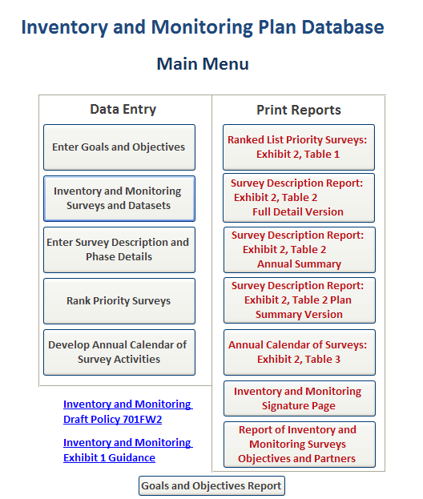
U.S. Fish & Wildlife Service
Notes:
Here is a project that demonstrates our early success working together as a system.
14

Slide 15
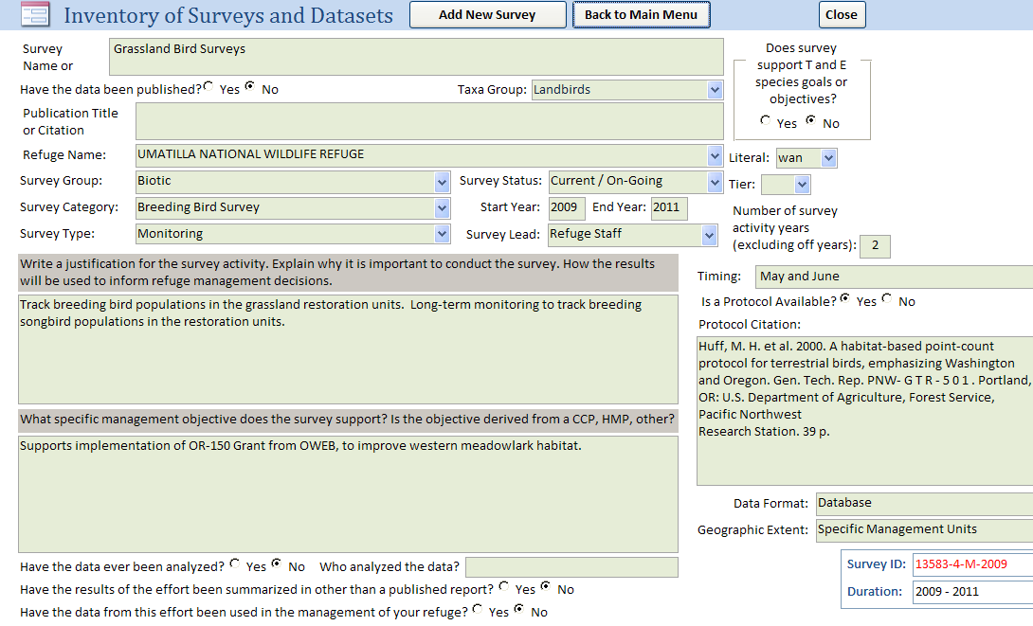
U.S. Fish & Wildlife Service

Slide 16
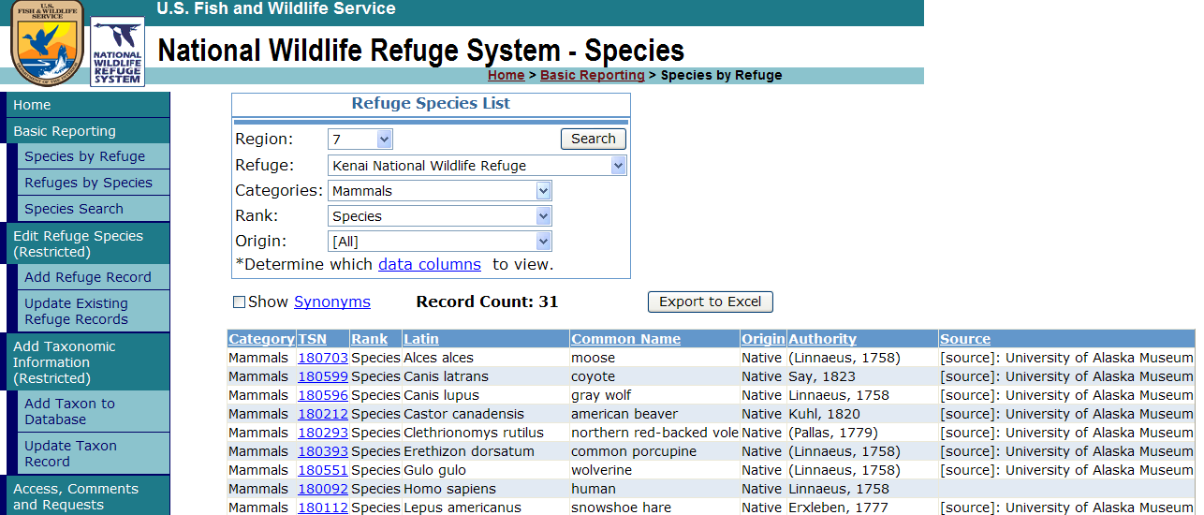
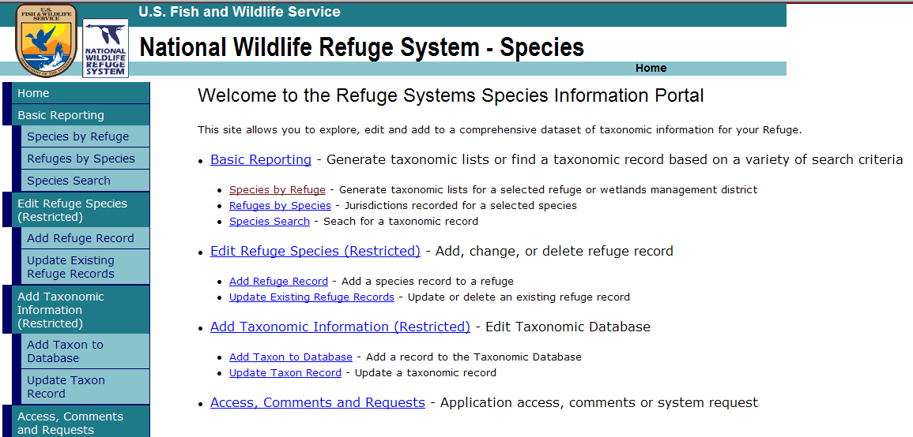
U.S. Fish & Wildlife Service
Ongoing Projects
Notes:
In addition to building a web service to get Service units…..we also need a “web service” for taxonomic information. I&M will be building database apps that need standardized species lists. This is another building block, or foundational service.
16

Slide 17
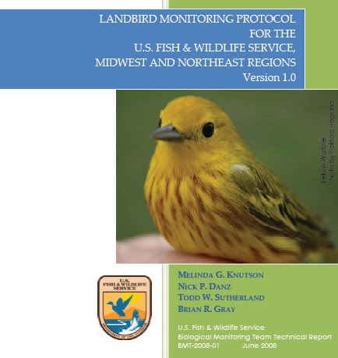
U.S. Fish & Wildlife Service
Ongoing Blueprint Tasks
Develop Protocols standards
Notes:
Once we have a list of the survey priorities across the system. We can find commonalities and work on things that would benefit from a standardized protocol across. These are examples of products developed by BMDT which have applicability across several regions.
17

Slide 18
U.S. Fish & Wildlife Service
Ongoing Blueprint Tasks
Design and develop a database for documenting legacy data along with historic and current occurrences of species
Complete baseline hydrogeomorphic (HGM) analyses at selected NWRS stations.
Complete a baseline, reconnaissance-level inventory of water resources, including an assessment of water quality, at all refuges.
Notes:
Measure status, trends and disturbances due to climate change.

Slide 19
U.S. Fish & Wildlife Service
Ongoing Blueprint Tasks
Prioritize geographic areas and species based on ecosystem vulnerability
Coordinate bird monitoring with Migratory Birds and other partners
Coordinate with science partners to understand relevance of models and predictors of change in Arctic and high-latitude environments

Slide 20
U.S. Fish & Wildlife Service
Planned Blueprint Tasks
Assemble existing abiotic data sets needed by NWRS managers to set management objectives
Fire Regimes - Scope an approach for establishing and reporting standard reference points for measuring long-term, landscape-scale, fire regime shift under climate change and other stressors.
Coordinate with science partners to understand relevance of models for various oceanographic variables

Slide 21
U.S. Fish & Wildlife Service
Collaborations
Other FWS programs (IT)
Landscape Conservation Cooperatives (LCCs)
Local universities
Other agencies (NPS)
http://science.nature.nps.gov/im/index.cfm
Neighboring countries
Notes:
To succeed, the best technology will be employed and vigorous communication maintained with I&M coordinators, regions and partners.
Neighbor countries can become key partners to define parameters that will help monitor the effects of CC in the landscape.
The major cost to achieve a successful program is from those performing the field work to collect and manage information.
21

Slide 22
U.S. Fish & Wildlife Service
National Office Contacts
Natural Resources Program Director
Mark Chase (mark_chase@fws.gov)
National I&M Program Manager
Jana Newman (jana_newman@fws.gov)
Notes:
22

