Slide 1
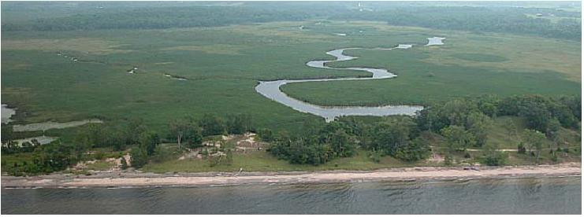
Developing recommendations for sustainable flows in the Great Lakes Basin of New York and Pennsylvania
Sandy Creek and the shore of Lake Ontario, Lakeview Wildlife Management Area @Baird Associates
Sustainable Flows:
The flow of water in a natural river or lake that sustains healthy ecosystems and the goods and services that humans derive from them
Primary Threats:
Water withdrawal & return
Dam management
Land use changes
Climate change

Slide 2
The Great Lakes Compact protects the waters of the basin from diversion ….
And obligates the states to take steps toward water management:
Within one year – establish a baseline of current withdrawals and consumptive uses
Within two years – promote environmentally sound and economically feasible water conservation measures
Within five years – conduct assessment on the cumulative impacts of withdrawals and consumptive uses
Within five years – create a management program for new/increased withdrawals and consumptive uses
(This RCN grant will provide the scientific basis for such a program)

Slide 3
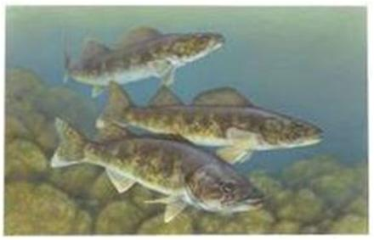
The Objectives of This Project:
Classify streams (by hydrology & geomorphology), and characterize the current hydrologic conditions in each class
Establish clear links between degrees of hydrologic alteration and ecological impacts to sensitive biota through literature & data analysis
Recommend flow goals and/or limits on flow alteration, spatially and temporally specific, with documentation on the needs of target species, natural processes, and habitats
Broader benefits of the project:
Guide implementation of the Compact in other states
Test and document these methods for other NEAFWA states

Slide 4
Project Partners:
New York State Department of Environmental Conservation
The Nature Conservancy
Cornell University, New York Cooperative Fish and Wildlife Research Unit
U.S. Geological Survey
Completion: January 2013

