Slide 1
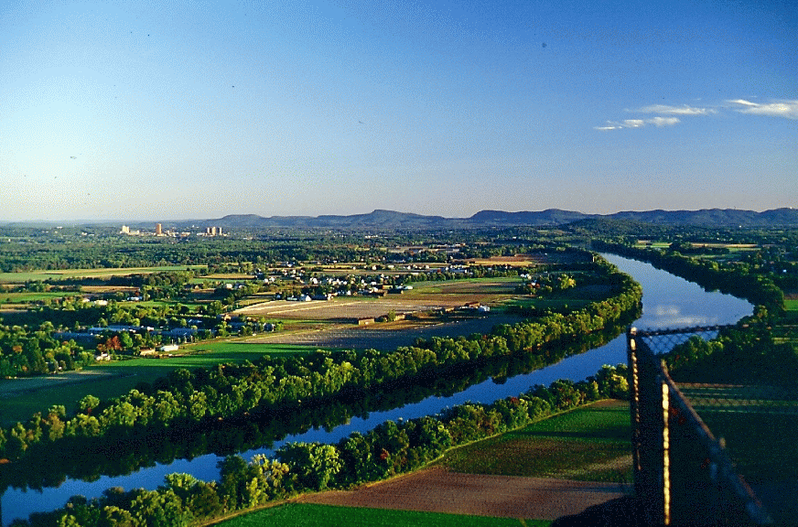
Assessment of Landscape Change in the North Atlantic Landscape Conservation Cooperative: Decision-Support Tools for Conservation
Kevin McGarigal, Brad Compton, Ethan Plunkett,
Liz Willey, Bill Delucca, Joanna Grand, Scott Schwenk

Slide 2
Purpose (phase 1)
Assess changes in ecological integrity (coarse filter) and habitat capability for representative species (fine filter) under alternative future scenarios driven (initially) by urban growth and climate change that will inform conservation design in the North Atlantic LCC.
Piloted in 3 watersheds:
Kennebec (15,264 km²)
Lower Connecticut (8,579 km²)
James (16,747 km²)

Slide 3
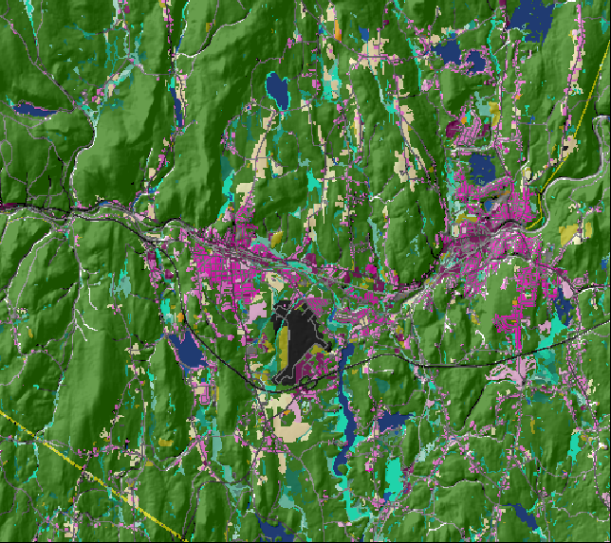
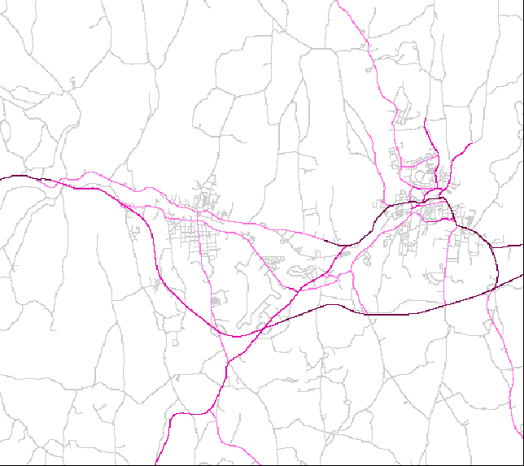
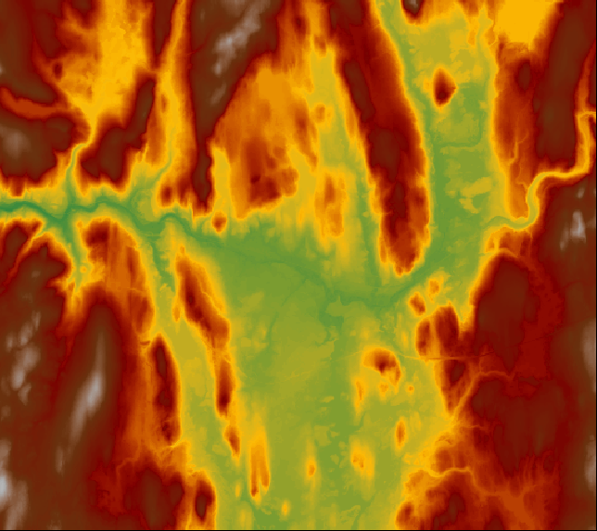
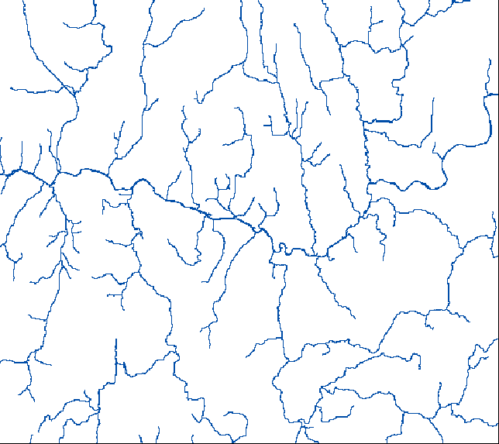
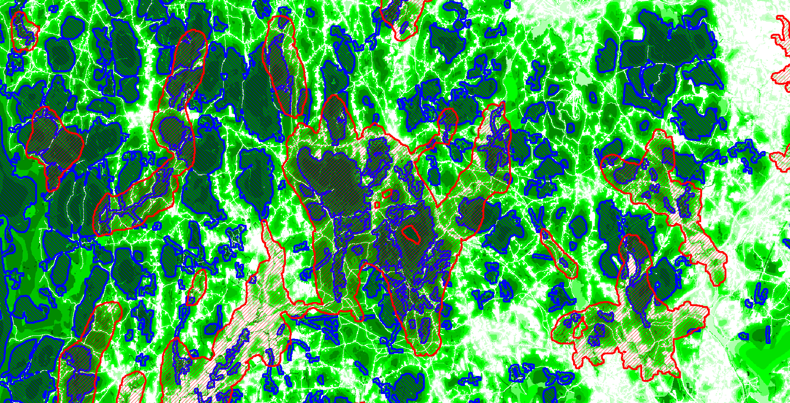
Approach
Develop and compile spatial data
Build landscape change model – climate change, urban growth, succession
Assess landscape ecological integrity (coarse filter: intactness, resiliency, buffering, diversity, and connectivity) and habitat capability for representative species (fine filter) under alternative future scenarios
Identify and map priorities for conservation (land protection, management and restoration)

Slide 4
Approach
Aquatic
Terrestrial

Slide 5
Products & Opportunities
Maps of all spatial data layers input to landscape change, assessment and design model for the entire NALCC
Maps of ecological integrity under alterative future scenarios for the pilot watersheds
Maps of habitat capability for a suite of representative species under alternative future scenarios for the pilot watersheds
Maps of conservation priorities for land protection, management and restoration for the pilot watersheds
Strategy for maximizing the complimentarity of the coarse- and fine-filtered approaches

Slide 6
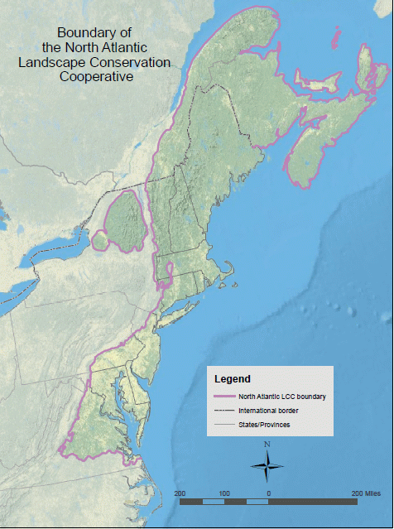
Project Outlook
Pilot study complete May 2012
Next steps (phase 2):
Expand to full NALCC
Develop additional modules (drivers, e.g., timber harvest)
Upgrade wildlife models to occupancy/population
Develop optimal landscape design algorithms
Develop decision-support tool
www.umass.edu/landeco/research/nalcc/nalcc.html
www.fws.gov/northeast/science/nalcc.html

