Slide 1
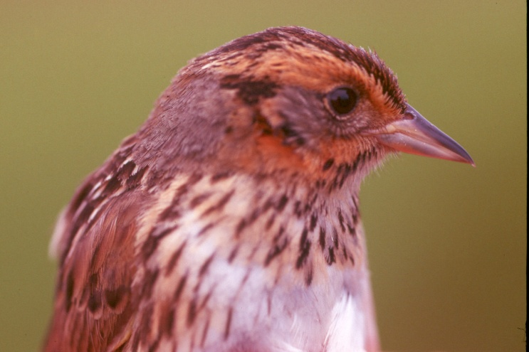
The Conservation of Tidal Marsh Birds: Guiding action at the intersection of our changing land and seascapes
provide the information necessary for states in BCR30 to protect regionally important habitats for tidal marsh birds
provide a regionally consistent platform for tidal marsh bird monitoring
www.tidalmarshbirds.org

Slide 2
Objectives
1) Fill gaps in current surveys
2) Produce population estimates and identify regional population centers
3) Repeat historic surveys
4) Model geographic variation in productivity and survival
5) Provide a detailed description of states regional responsibility
6) Identify the most critical areas for the long-term preservation of the tidal marsh bird community within each state

Slide 3
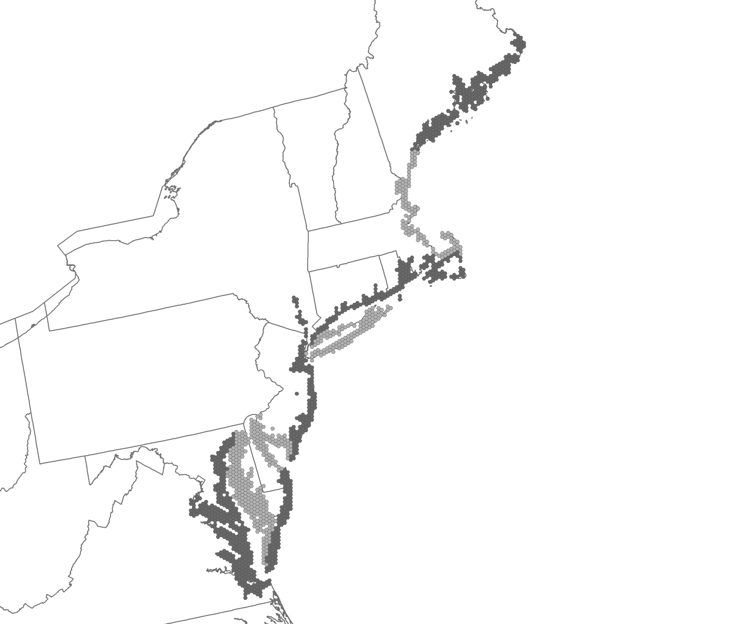
Regional Survey: population centers
change over time
landscape effects
REGION
(1) Coastal Maine
(2) Cape Cod – Casco Bay
(3) Southern New England
(4) Long Island
(5) Coastal New Jersey
(6) Delaware Bay
(7) Coastal Delmarva
(8) Eastern Chesapeake Bay
(9) Western Chesapeake Bay

Slide 4
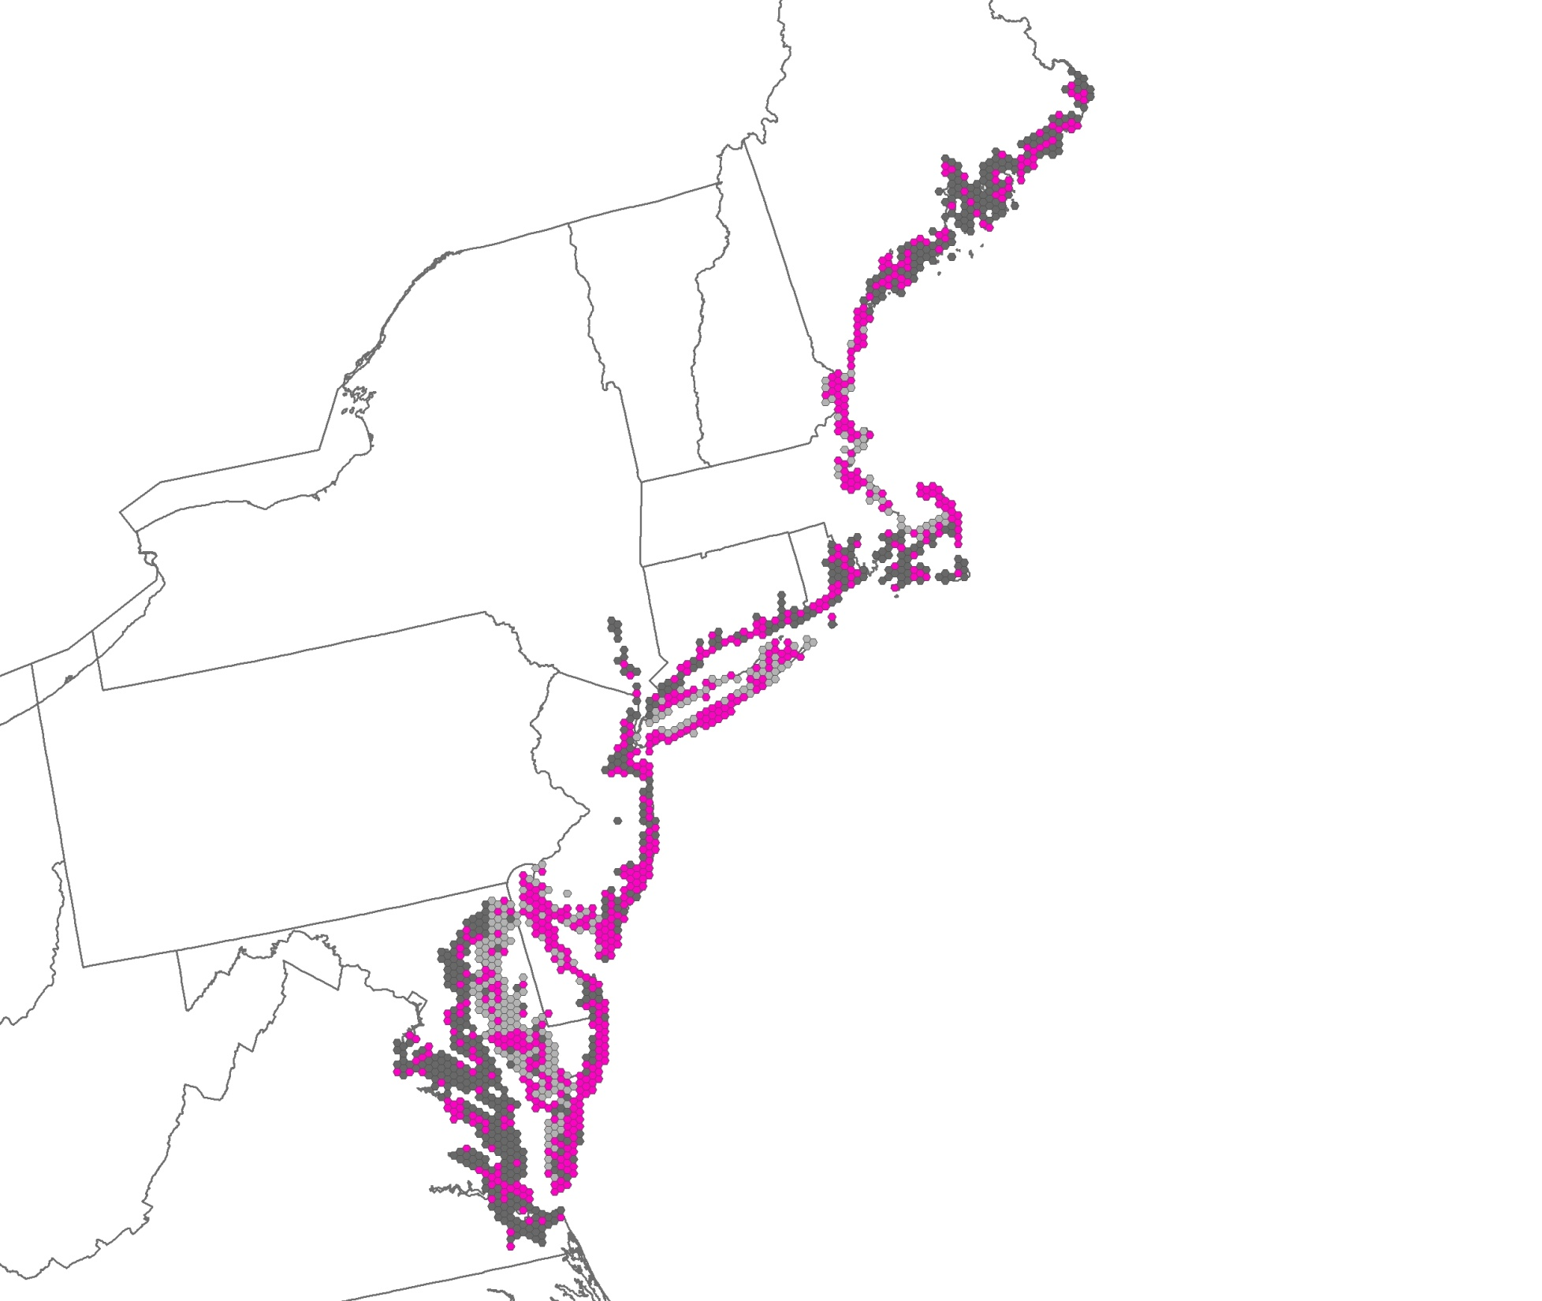
598 Primary Sampling Units (PSUs)
*One PSU = one 40 km2 hexagon
REGION
(1) Coastal Maine
(2) Cape Cod – Casco Bay
(3) Southern New England
(4) Long Island
(5) Coastal New Jersey
(6) Delaware Bay
(7) Coastal Delmarva
(8) Eastern Chesapeake Bay
(9) Western Chesapeake Bay
Notes:
Generalized Random Tessellation Stratified (GRTS) Spatially-Balanced Survey Design using spsurvey package in Program R. 549 + 49 net = 598

Slide 5
Demographic Patterns
5 plots per area nest finding and monitoring color banding adults & nestlings
Maine
Connecticut
New Jersey
Model seasonal fecundity across region Population Viability Analysis
Notes:
Generalized Random Tessellation Stratified (GRTS) Spatially-Balanced Survey Design using spsurvey package in Program R. 549 + 49 net = 598

Slide 6
Avian data entered into marsh bird point count database
Data-sharing portal at:
www.tidalmarshbrids.org
Communicate results at Annual Northeast Association of Fish and Wildlife Agencies
http://www.pwrc.usgs.gov/point/mb/

