Slide 1
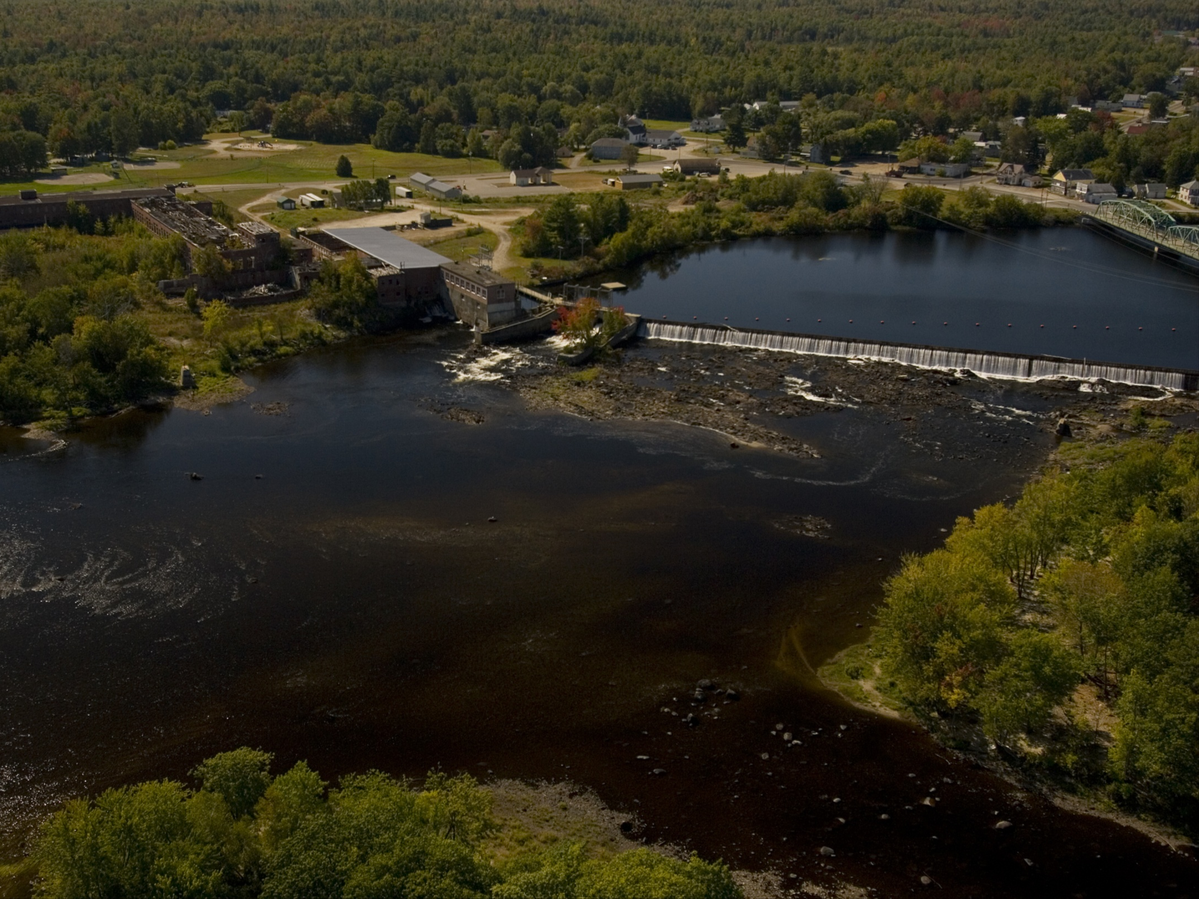
NEAFWA Aquatic Connectivity
Colin Apse & Erik martin,
The nature conservancy

Slide 2
Purpose
This project endeavors to produce a tiered list of dams in the Northeast US based on their potential ecological benefit if remediated for fish passage, and develop a tool that allows managers to re-rank dams at multiple spatial scales
Dams and other barriers to the free movement of fish and other aquatic organisms have had a negative impact on the health and viability of these populations for well over a century in the eastern United States.
Removing or otherwise mitigating dams can improve the health of aquatic ecosystems and allow fish populations to recover.
Given the financial and organizational obstacles to dam removal projects, it is critical that managers focus their efforts and resources where they can have the greatest ecological impact.

Slide 3
Methods
Data Collection & Preparation
Dams, waterfalls, anadromous fish habitat collected from states & other sources, processed, iteratively reviewed with state contacts
Metrics calculated in GIS for every dam. Metrics grouped in 5 categories. The Barrier Analysis Tool (BAT), an ArcGIS plug-in developed for this project, was used to calculate many of the metrics.
Connectivity Status
Connectivity Improvement
Watershed & Local Condition
Ecological
Size Class
Ranking
Dams ranked based on the metrics calculated in GIS and weighted based on relative weights developed by workgroup for anadromous fish and resident fish scenarios

Slide 4
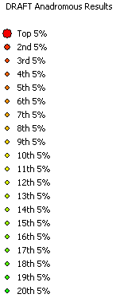
Status & Utility
2nd draft of results are currently being reviewed by state workgroup participants
Final results: end of August
Potential utility of results (as suggested by workgroup participants)
Project evaluation
Communicating with owners/funders
Grant writing
Justifying projects during funding allocation
Bring attention to new projects that may not have been looked at before
Developing basin-level plans
Local-level communication
Inform advocacy efforts
Stimulate proactive action rather than opportunistic removals

