Slide 1
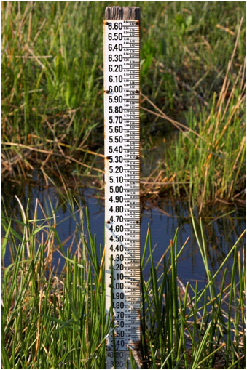
NOAA Sea Level Rise and Tidal Wetland Restoration Guidance
Developed by diverse steering committee summer and fall 2010
Provides 5-step process for evaluating sea level rise impacts on project site and incorporating SLR into project design
Uses Army Corps methodology for predicting SLR (multiple scenarios)
Draft guidance under review

Slide 2
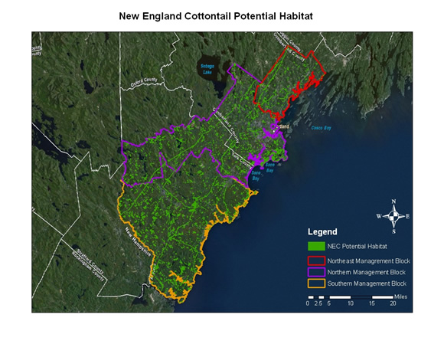
Habitat Priority Planner
Developed by the NOAA Coastal Service Center
Nationwide GIS-based tool
Allows testing and mapping of different management scenarios
Used with C-CAP data to conserve New England Cottontail habitat in coastal Maine
http://www.csc.noaa.gov/digitalcoast/tools/hpp/

