Slide 1
Forecast effects of accelerating sea-level rise (SLR) on the habitat of Atlantic Coast piping plovers and identify responsive conservation strategies
Partnership between USFWS, USGS, Virginia Tech, and others
  PIPL habitat virtually certain to be impacted by accelerating SLR
    Potential impacts are rangewide
    Natural and human responses to coastal change are poorly quantified
Research group using common Bayesian approach to integrate geologic, biologic and other relevant data
  Convey what we know and what we know we don’t know
  Synthesize data and models for habitat evolution and plover behavior
  Provide basis to focus research resources
Develop science-based decision tools for managers to inform conservation recommendations to land managers and regulators

Slide 2
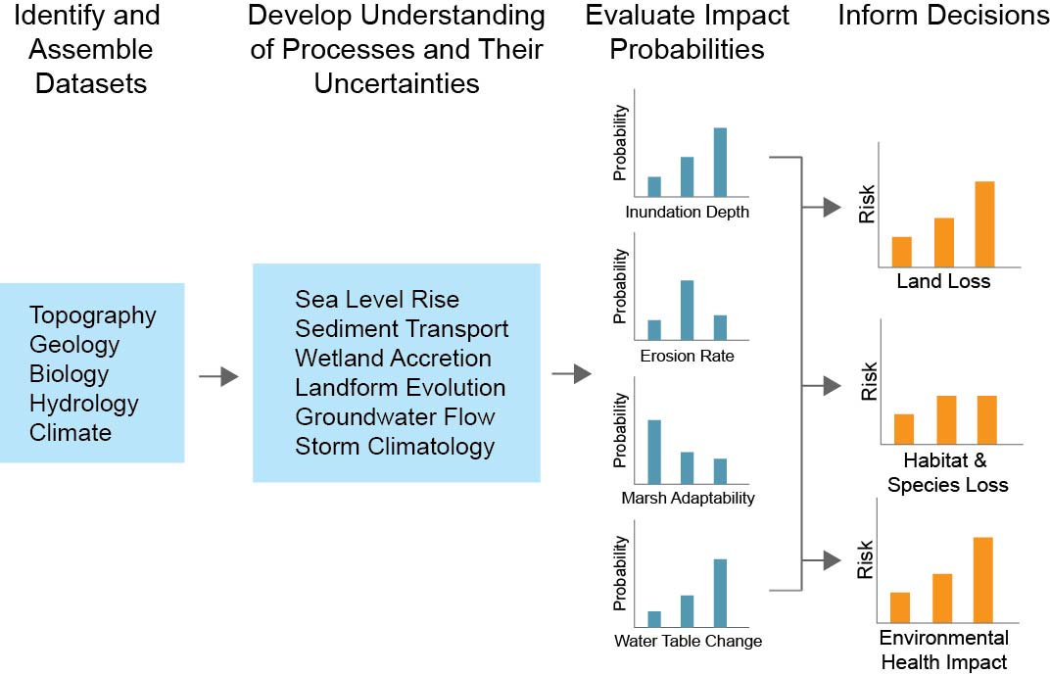
A conceptual approach to the multivariate, uncertainty problem for coastal change (and plovers)
Explicitly include uncertainties, as well as management application
Notes:
We started by looking at things the USGS is good at (research, assessments), and moved through from left to right.

Slide 3
Simple Bayesian Network for Coastal Vulnerability
(uses existing USGS data from Thieler and Hammar-Klose, 1999)
Driving Forces
Tide
Range
Wave
Height
Relative
Sea-level Rise
Coastal
Slope
Geologic
Constraints
Shoreline
Change
Geomorphology
Coastal
Response
(Gutierrez et al., 2011)
Notes:
We picked a couple variables we know are important in determining shoreline change. There are some driving forces, some geologic constraints, and a ‘response variable’ which is the rate of shoreline change. The arrows indicate correlations between the connected variables that the Bayesian network ‘learns’ about when we compile it. As will be seen in the next slide, these are conveniently drawn from the Thieler and Hammar-Klose CVI work.

Slide 4
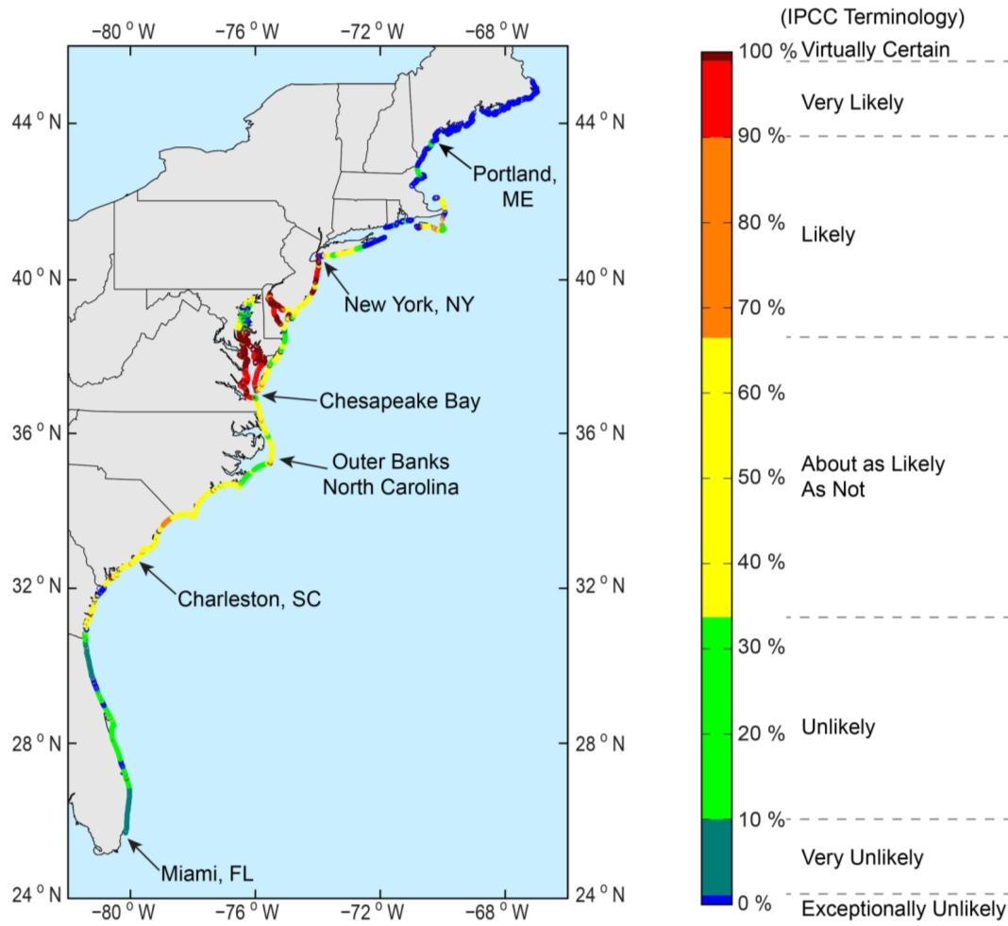
Mapping Erosion Risk Using Bayesian Networks
Probability of shoreline erosion >2 m/yr
Boston
New York
D.C.
Charleston
Miami
(Gutierrez et al., 2011)
Notes:
This is a map of our Bayes CVI showing the probability of shoreline change > 2 m/yr under current conditions. You can see that for the Chesapeake Bay it is virtually certain in some areas that it’s already > 2 m/yr. Also that in Maine it’s exceptionally unlikely that erosion is > 2 m/yr. And so on along the coast.

Slide 5
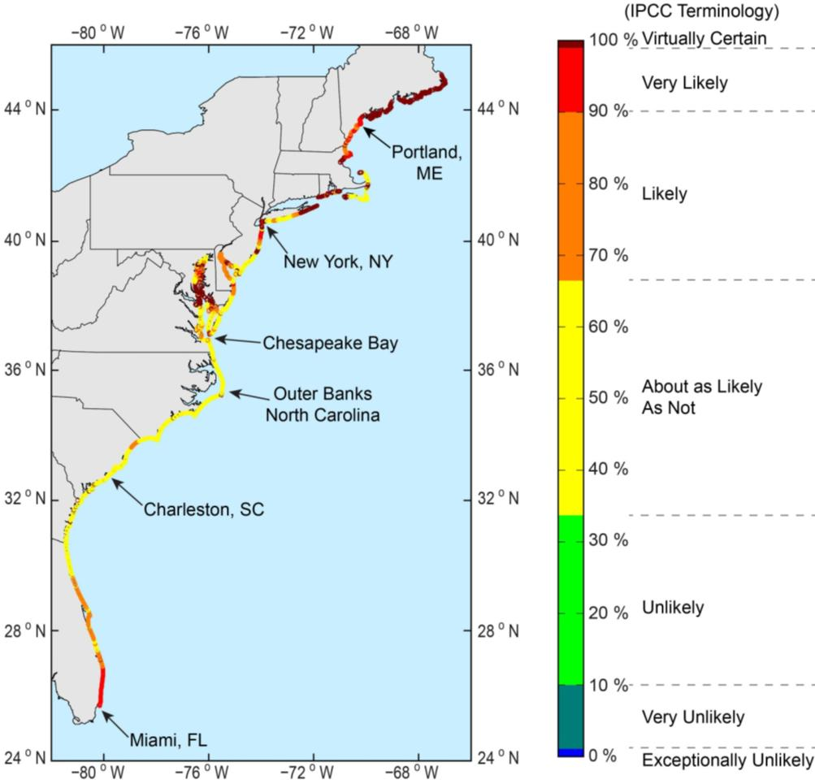
Mapping Prediction Uncertainty
Higher probability = higher certainty of outcome
Uncertainty map can be used to identify where better information is needed
Areas of low confidence require
  better input data
  better understanding of processes
Can use this map to focus research resources
(Gutierrez et al., 2011)
Notes:
Maximum Shoreline Change Probability: Higher probability = higher certainty of outcome. Basically shows how we can map the probabilities in a way that tells us where our predictions are good and where they are not. For example, we are “virtually certain” of our predictions in the Chesapeake Bay (it’s already eroding like crazy) but also virtually certain of our predictions in Maine (it’s a bedrock coast and won’t be eroding fast, if ever). That’s pretty cool. The rest of the area has different probabilities. To improve predictions, we can apply the approaches listed in the bullets.

Slide 6
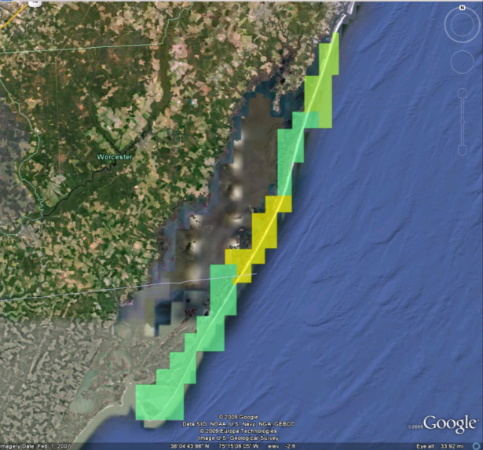
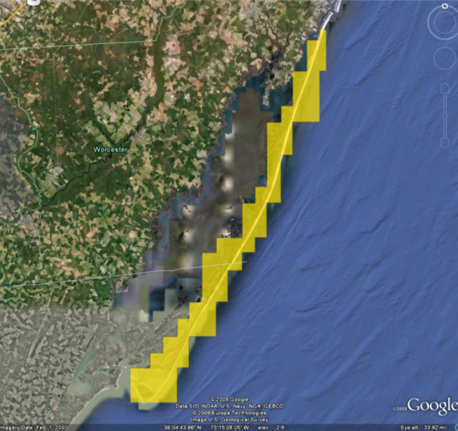
Application of a Bayesian network to an uncertain future: Probability of shoreline erosion >1 m/yr at Assateague Island National Seashore
Current conditions
SLR +1 mm/yr, Wave ht. +10%
High
1
0.8
0.6
Probability
0.4
0.2
0.2
Low
0
Narrow probability distributions
Relatively low uncertainty
Higher likelihood of erosion
Broader distributions
Increased uncertainty
Erosion rate
Erosion rate
Notes:
Left side image shows probability of shoreline change >1 m/yr under current/existing conditions. Basically this means our Bayes CVI says there is higher probability of shoreline change – right now –at any given point where it’s yellow (~60% probability) compared to where it’s greenish (lower probabilities). You can see in the graph below that there is a fairly narrow distribution of erosion rates (just one long bar with the other three short), and thus relatively low uncertainty about that rate.
Right side image shows results of increasing rate of SLR by 1 mm/yr over present values, and also increasing the average wave height by 10% (That just a guess at what a stormier Atlantic might produce. It’s not a quantitative forecast, just something we made up to see what happens to the predictions.) Now you see the whole area light up as yellow-ish orange. What has happened is that we are more certain the erosion rates will be >1 m/yr, but we have a broader distribution of erosion rates in the graph below (bars mostly the same length) and thus have increased uncertainty about the exact rate any one place will experience.
A good point to make here is that maps like this can help managers understand that what may be relatively slow-moving today, may be moving faster in the future as the forcing changes, and that while we are more certain things will go faster, we are uncertain as to how much at any given spot.

Slide 7
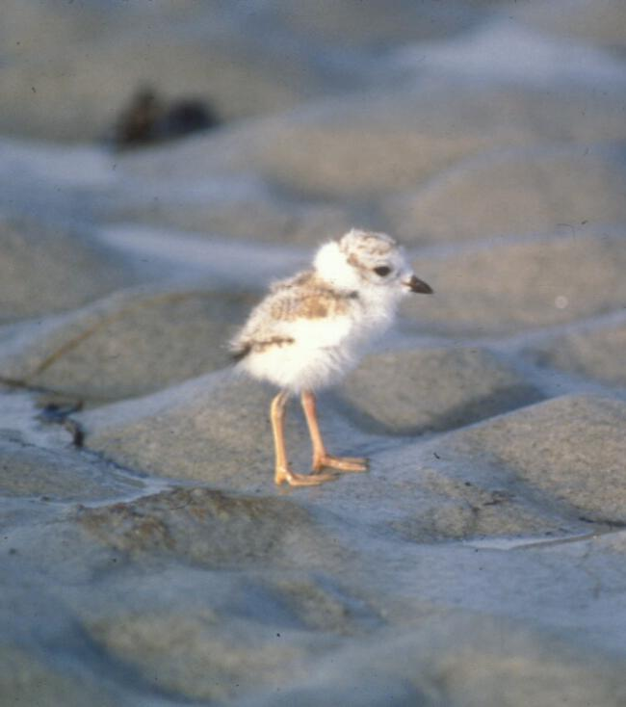
Decision Support for DOI Agencies
Piping plover, C. melodus
Listed species
DOI management responsibility
Lifecycle includes substantial time on NPS lands for breeding, migrating, wintering
Have interesting and specific habitat requirements that we can predict
  Rangewide habitat availability
  Attributes and distribution of breeding, foraging areas
  Wave run-up and inundation sensitivity (morphologic and hydrodynamic detail)
Can feed predictions back into population dynamics models
Bill Byrne, MA F&W
Notes:
This is what we’re currently doing with USFWS and VT – esp the third bullet – making predictions about the future state of plover habitat from seasonal availability of sites to long-term (centennial) prediction of habitat availability along the entire Atlantic and Gulf ranges. Obviously we could substitute people, development, economics, etc. for the plover in our general framework. That’s ultimately where we’d like to end up.

Slide 8
Plovers in a Bayesian Network
Barrier island
cross-sectional
area or width
Prey
abundance
Elevation
Foredune
height
Geomorphic
Setting
Overwash fan
Dune
Marsh
Ephemeral pool
Plover Presence
(outcome)
Vegetation Density
Absent/Light
Woody dense
Herbaceous dense
Sediment
type
Horiz. dist
to MHW
Horiz. dist
to MOSH
Shoreline change
rate for x-section
Horiz. dist
to ephem.
pools
Notes:
8
Schematic (not real, yet!) Bayesian network that includes habitat attributes we think are important to the presence of plovers. As this network is populated and tested, we should gain insight into what are important variables, what data are essential (or not), etc.

