Slide 1






Forecast effects of accelerating sea-level rise (SLR) on the habitat of Atlantic Coast piping plovers and identify responsive conservation strategies
  Piping plover habitat virtually certain to be impacted by accelerating SLR
    Potential impacts are rangewide
    Natural and human responses to coastal change are poorly quantified
Research group using common Bayesian approach to integrate geologic, biologic and other relevant data
  Convey what we know and what we know we don’t know
  Synthesize data and models for habitat evolution and plover behavior
  Provide basis to focus resources
Develop science-based decision tools for managers to inform conservation recommendations to regulators
Current partners
Notes:
Recognizing that 1) Piping plover habitat is certain to be impacted by accelerating SLR and other factors associated with climate change, such as altered storminess, and 2) Natural and human responses to coastal change are poorly quantified…
our objective is to use a common Bayesian approach to integrate geologic, biologic, and other relevant data to 1) convey what we know and what we don’t know, 2) synthesize data and models for habitat evolution and plover behavior, and 3) provide a basis to focus management, research, and conservation resources.
Our ultimate goal is to develop science-based decision tools for managers to inform conservation recommendations to regulators.
In this first year of the project, the research activities are focused on Assateague Island National Seashore in Maryland and Chincoteague National Wildife Refuge in Virginia. We are actively partnering with these two organizations. The research effort is being led by scientists at USGS in the sea level rise hazards project and at Virginia Tech in the department of fish and wildlife conservation. We are also partnering with numerous offices in the USFWS, and with the state DNR in MD and Virginia department of game and inland fisheries. As we expand this project to other sites along the Atlantic coast, we will be seeking additional interested state and federal partners.

Slide 2
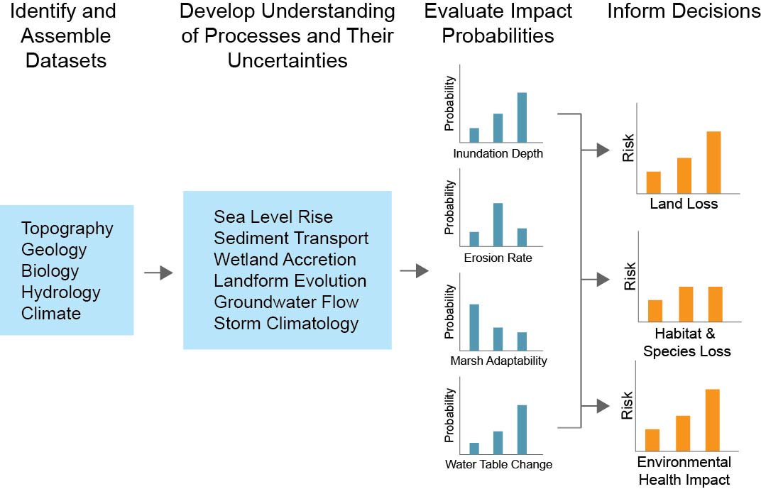
A conceptual approach to the multivariate, uncertainty problem for coastal change (and plovers)
Explicitly include uncertainties, as well as management application
Notes:
Conceptually, this is a sketch of what we are doing. USGS has a tremendous amount of experience conducting research and assessments in this bayesian framework as it relates to sea level rise hazards, which allows us to quantify risk and uncertainty. By partnering with Virginia Tech which has the in-depth knowledge on the listed piping plover, we can unite our expertise in all these factors to quantify the effects of habitat change on plover biology, and then assess the impacts of various possible management strategies on mitigating any effects.

Slide 3
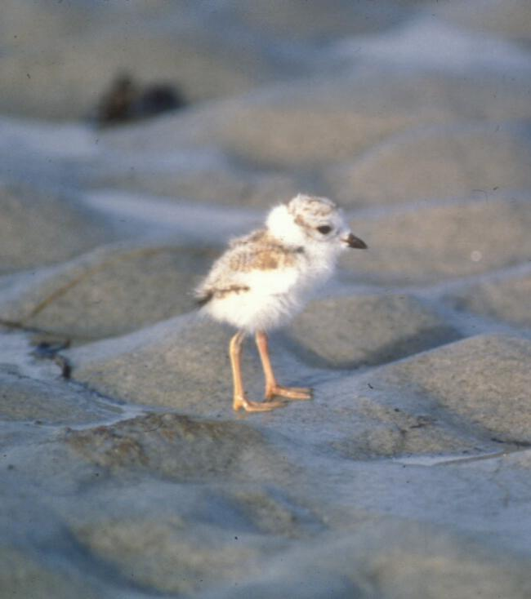
Decision Support for DOI Agencies: Why are we starting with Piping Plovers?
Atlantic coast breeding population is listed as a threatened species; wintering populations are a mixture birds with threatened and endangered status
DOI management responsibility
Lifecycle includes substantial time on federal lands for breeding, migrating, wintering
Have interesting and specific habitat requirements that we can predict from measurable physical variables
Can feed predictions back into population dynamics models
Piping plover, C. melodus
Bill Byrne, MA F&W
Notes:
Our goal is really to provide decision support for various DOI agencies. Why are we starting with PIPL? First, it is a listed species (threatened atlantic coast breeding pop, endangered great lakes breeding pop, threatened great plains pop; all mix on wintering grounds on atlantic and gulf coasts)
Many DOI management agencies have responsibility for the PIPL as its life cycle includes substantial time on federal lands during migration, breeding, and wintering seasons.
Most important, PIPL have interesting and specific habitat requirements that we can predict from measurable physical variables that will be affected by SLR and altered storminess.
We can then feed predictions back into population dynamics models for this species.
Currently, we are developing a linking models of habitat change and plover behavior. We will then make predictions about the future state of plover habitat from seasonal availability of sites to long-term (centennial) prediction of habitat availability along the entire Atlantic and Gulf ranges. Obviously we could substitute people, development, economics, etc. for the plover in our general framework. That’s ultimately where we’d like to end up.

Slide 4
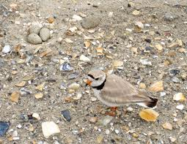
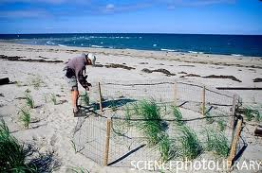
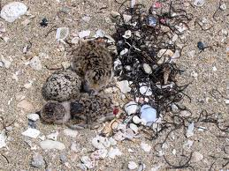
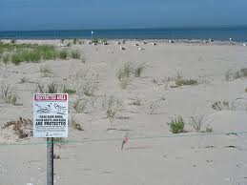
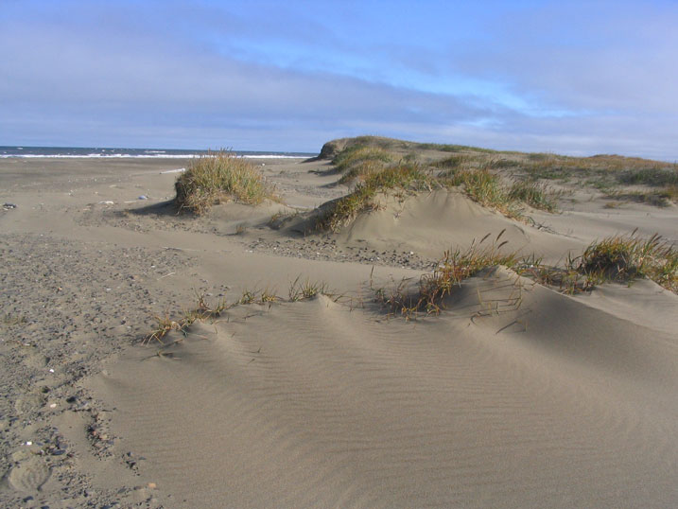
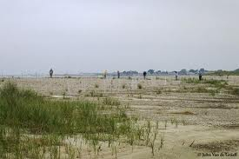
Piping plover habitat and SLR
Breed in dry open areas, sparsely vegetated adjacent to moist substrate habitats
Stopover on migration, and winter in similar habitats
Notes:
The photos here of typical breeding plover habitat illustrate why this species is an interesting first model for studying the impacts of SLR on a listed species.
Plovers typically nest on dry open sand. Habitat selection is a balance of access to food sources and ability to detect approaching predators. Previous research has indicated that plovers nest in sparsely vegetated areas adjacent to MOSH (moist substrate) that provide a rich food source. We suspect distance to MOSH, vegetation density, and relatedly elevation to be a key variable for breeding plovers.

Slide 5
An Example Bayesian Network for Piping Plover Habitat and SLR effects
We are developing a coupled model predicting climate change effects on piping plover behavior.
Dune height
Beach width
Elevation
Tidal range
Wave height
Relative SLR
Geomorphic habitat
Coastal slope
Piping Plover presence
Vegetation density
Shoreline change rate
Horizontal distance to ephemeral pools
Horizontal distance to moist habitat
Horizontal distance to sparse veg
Geomorphic setting
Notes:
In this schematic diagram, we wanted to illustrate the beginnings of the larger bayesian network that will couple models of how climate change will affect measureable physical variables which will then be used to predict plover behavior.
For example, in this diagram we sketch out how the plover model (on the right, predicting simply plover presence or absences) will be coupled to a larger model aimed at predicting the rate of shoreline change resulting from factors such as coastal slope, tidal range, wave height, and SLR. The predictive capabilities of this model will be tested by using historical data to predict effects back in time. If the model prediction performs well it will be used to evaluate future effects of different SLR scenarios. Being Bayesian in design, it can be continually updated with present or newly emerging data from various sources.

Slide 6
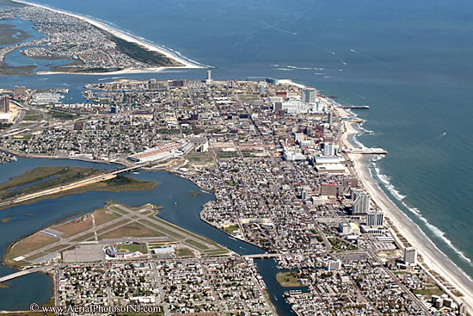
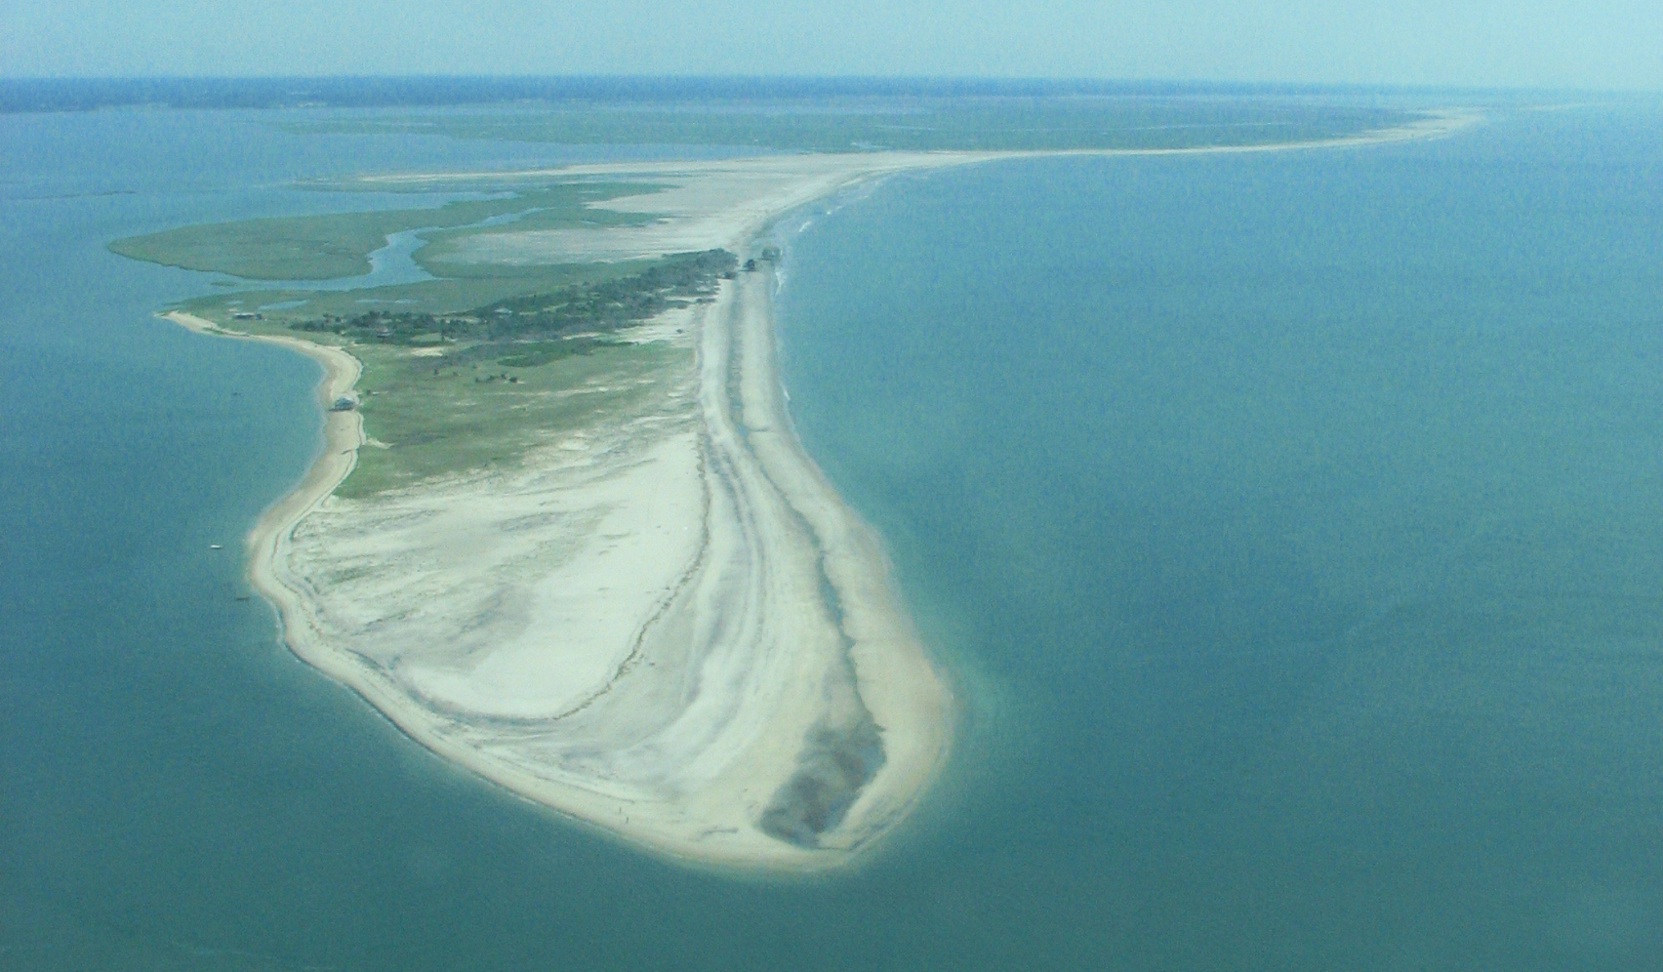
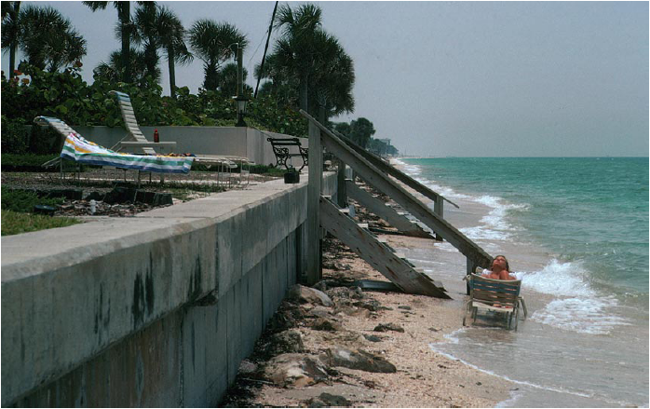
In the end…
We will test multiple possible scenarios of the future of our coasts
We will incorporate practical application guidelines and case studies to inform current and near-term decisions regarding coastal stabilization
Please come see our poster
Notes:
Self explanatory I hope

Slide 7
Notes:
Subsequent slides present an example of an effectively implemented bayesian network by the usgs team. On our poster, we will explain in more detail the methods and this example than I think that you have time for in the powerpoint, but I leave these in here in case you do want to present more of the story in this presentation.

Slide 8
Simple Bayesian Network for Coastal Vulnerability
(uses existing USGS data from Thieler and Hammar-Klose, 1999)
Driving Forces
Tide
Range
Wave
Height
Relative
Sea-level Rise
Coastal
Slope
Geologic
Constraints
Shoreline
Change
Geomorphology
Coastal
Response
(Gutierrez et al., 2011)
Notes:
We picked a couple variables we know are important in determining shoreline change. There are some driving forces, some geologic constraints, and a ‘response variable’ which is the rate of shoreline change. The arrows indicate correlations between the connected variables that the Bayesian network ‘learns’ about when we compile it. As will be seen in the next slide, these are conveniently drawn from the Thieler and Hammar-Klose CVI work.

Slide 9
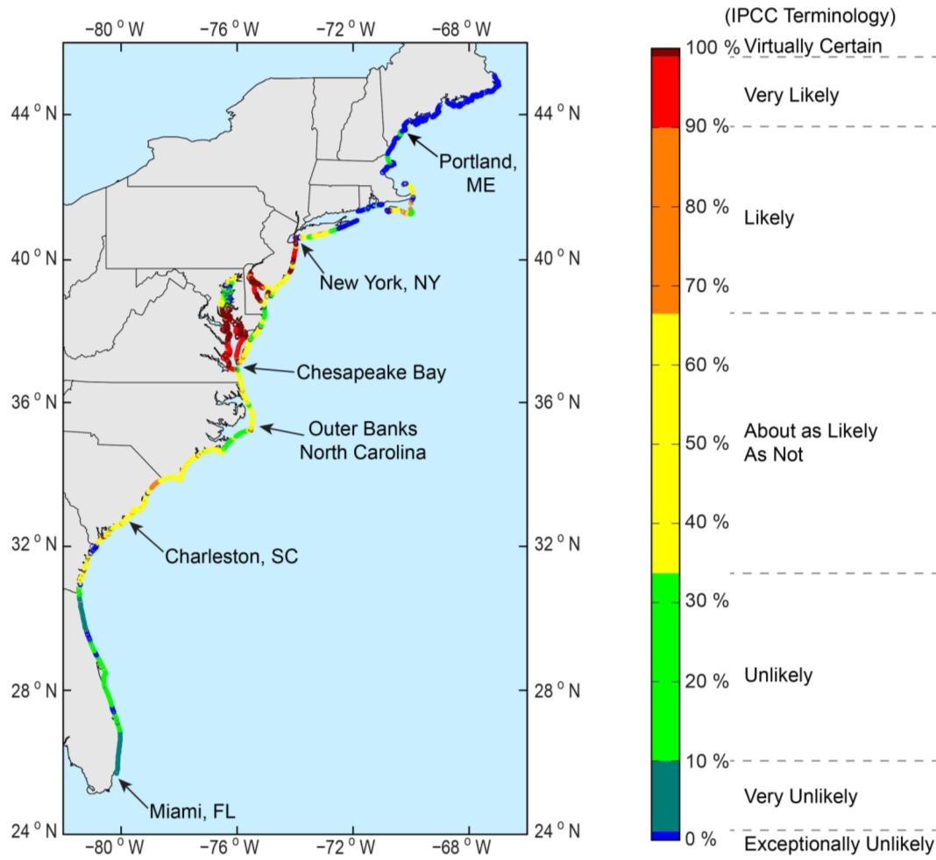
Mapping Erosion Risk Using Bayesian Networks
Probability of shoreline erosion >2 m/yr
Boston
New York
D.C.
Charleston
Miami
(Gutierrez et al., 2011)
Notes:
This is a map of our Bayes CVI showing the probability of shoreline change > 2 m/yr under current conditions. You can see that for the Chesapeake Bay it is virtually certain in some areas that it’s already > 2 m/yr. Also that in Maine it’s exceptionally unlikely that erosion is > 2 m/yr. And so on along the coast.

Slide 10
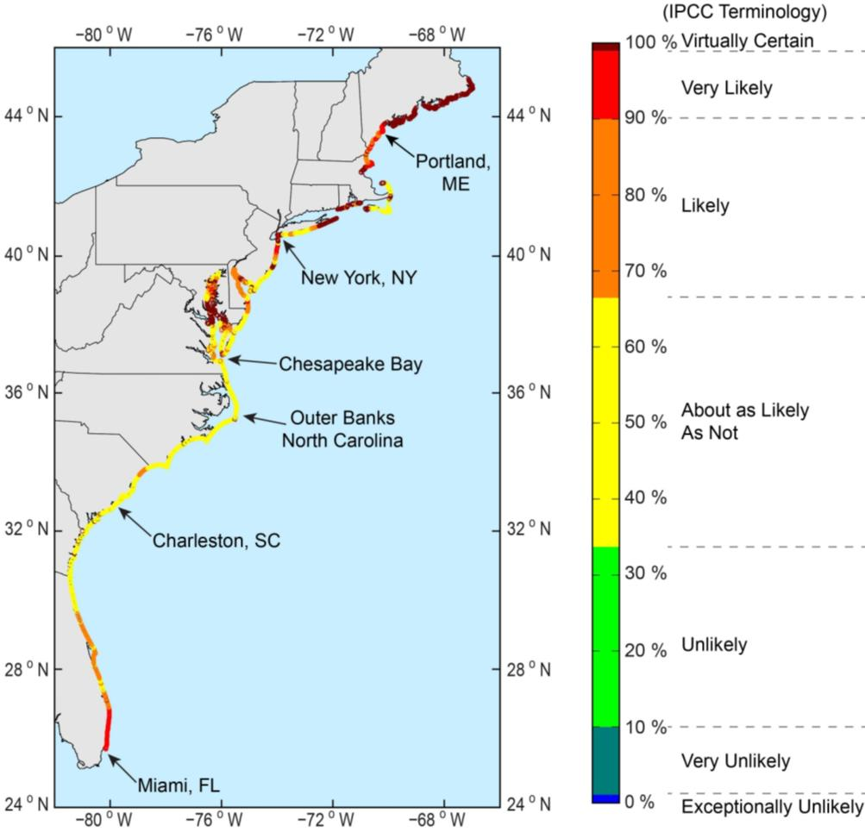
Mapping Prediction Uncertainty
Higher probability = higher certainty of outcome
Uncertainty map can be used to identify where better information is needed
Areas of low confidence require
  better input data
  better understanding of processes
Can use this map to focus research resources
(Gutierrez et al., 2011)
Notes:
Maximum Shoreline Change Probability: Higher probability = higher certainty of outcome. Basically shows how we can map the probabilities in a way that tells us where our predictions are good and where they are not. For example, we are “virtually certain” of our predictions in the Chesapeake Bay (it’s already eroding like crazy) but also virtually certain of our predictions in Maine (it’s a bedrock coast and won’t be eroding fast, if ever). That’s pretty cool. The rest of the area has different probabilities. To improve predictions, we can apply the approaches listed in the bullets.

Slide 11
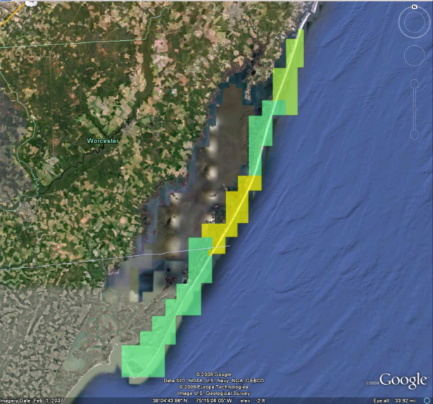
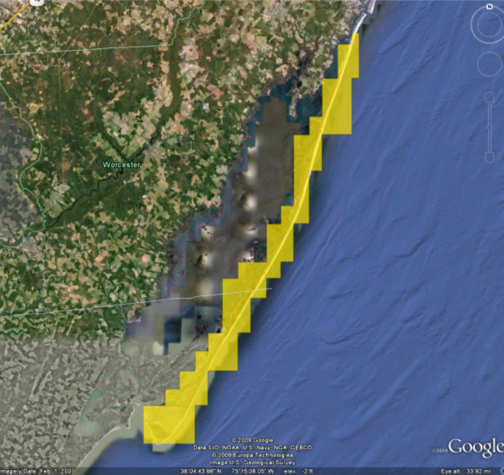
Application of a Bayesian network to an uncertain future: Probability of shoreline erosion >1 m/yr at Assateague Island National Seashore
Current conditions
SLR +1 mm/yr, Wave ht. +10%
High
1
0.8
0.6
Probability
0.4
0.2
0.2
Low
0
Narrow probability distributions
Relatively low uncertainty
Higher likelihood of erosion
Broader distributions
Increased uncertainty
Erosion rate
Erosion rate
Notes:
Left side image shows probability of shoreline change >1 m/yr under current/existing conditions. Basically this means our Bayes CVI says there is higher probability of shoreline change – right now –at any given point where it’s yellow (~60% probability) compared to where it’s greenish (lower probabilities). You can see in the graph below that there is a fairly narrow distribution of erosion rates (just one long bar with the other three short), and thus relatively low uncertainty about that rate.
Right side image shows results of increasing rate of SLR by 1 mm/yr over present values, and also increasing the average wave height by 10% (That just a guess at what a stormier Atlantic might produce. It’s not a quantitative forecast, just something we made up to see what happens to the predictions.) Now you see the whole area light up as yellow-ish orange. What has happened is that we are more certain the erosion rates will be >1 m/yr, but we have a broader distribution of erosion rates in the graph below (bars mostly the same length) and thus have increased uncertainty about the exact rate any one place will experience.
A good point to make here is that maps like this can help managers understand that what may be relatively slow-moving today, may be moving faster in the future as the forcing changes, and that while we are more certain things will go faster, we are uncertain as to how much at any given spot.

Slide 12
Plovers in a Bayesian Network
Barrier island
cross-sectional
area or width
Prey
abundance
Elevation
Foredune
height
Geomorphic
Setting
Overwash fan
Dune
Marsh
Ephemeral pool
Plover Presence
(outcome)
Vegetation Density
Absent/Light
Woody dense
Herbaceous dense
Sediment
type
Horiz. dist
to MHW
Horiz. dist
to MOSH
Shoreline change
rate for x-section
Horiz. dist
to ephem.
pools
Notes:
12
Schematic (not real, yet!) Bayesian network that includes habitat attributes we think are important to the presence of plovers. As this network is populated and tested, we should gain insight into what are important variables, what data are essential (or not), etc.

