Slide 1
Conservation Status of Fish, Wildlife and Natural Habitats in the Northeast and Mid Atlantic Region
Mark Anderson and
Arlene Olivero Sheldon

Slide 2
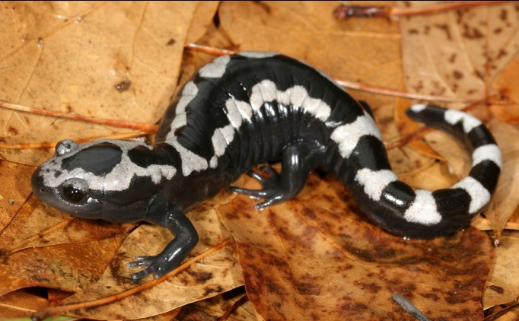
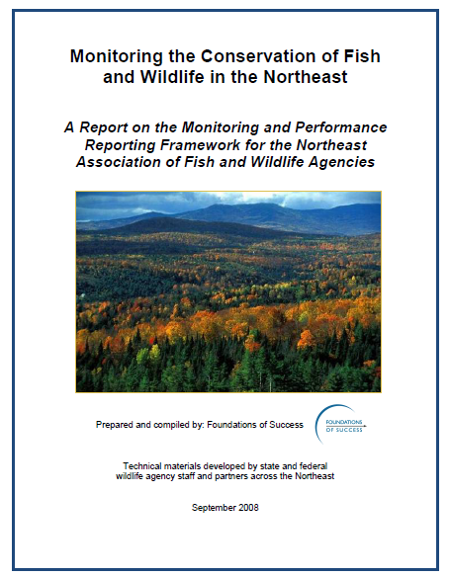
Project Overview
Guiding Document
Advisory Committee
Secured Lands
Habitats & Species
  Forest
  Wetland
  Unique habitats
  Rivers and Streams
  Lakes and Ponds
  SGCN Species.

Slide 3
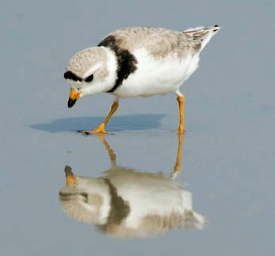

Report and Advisory Committee
Representatives from every State
Jenny Dickson and Rick Jacobson of CT DEP;
Robert Coxe and Kevin Kalasz of DE DFW;
John O'Leary and Thomas O'Shea of MA DFW;
Glenn Therres, Lynn Davidson, Scott Stranko, and
Dana L.Limpert of MD DNR;
George Matula and Sandy Ritchie of ME DIFW;
Jim Oehler, John Kanter, Matt Carpenter, Steve Fuller,
and John Tash of NH DFG;
Dave Jenkins, Kris Schantz, and Miriam Dunne of NJ DFW,
Tracey Tomajer, Greg Edinger, Dan Rosenblatt,
and Erin White of NY DEC;
Dan Brauning and Lisa Williams of PA GC,
Dave Day of PA FBC,
Jeffrey Wagner of PA WPC/NHP;
Jon Kart and Rod Wentworth of VT DFW; Gary Foster of
WV CNR; Becky Gwynn of VA DGIF,
Dave Tilton, Genevieve Pullis LaRouche, Ron Essig,
and Ken Sprankle of USFWS;
Don Faber-Langendoen of NatureServe,
Dan Lambert of American Bird Conservancy,
Dave Chadwick of the AFWA, Mary Anne Theising of USEPA,
James McKenna of USGS.
: http://conserveonline.org/workspaces/ecs/documents/northeast-conservation-status-report-april-2011/

Slide 4
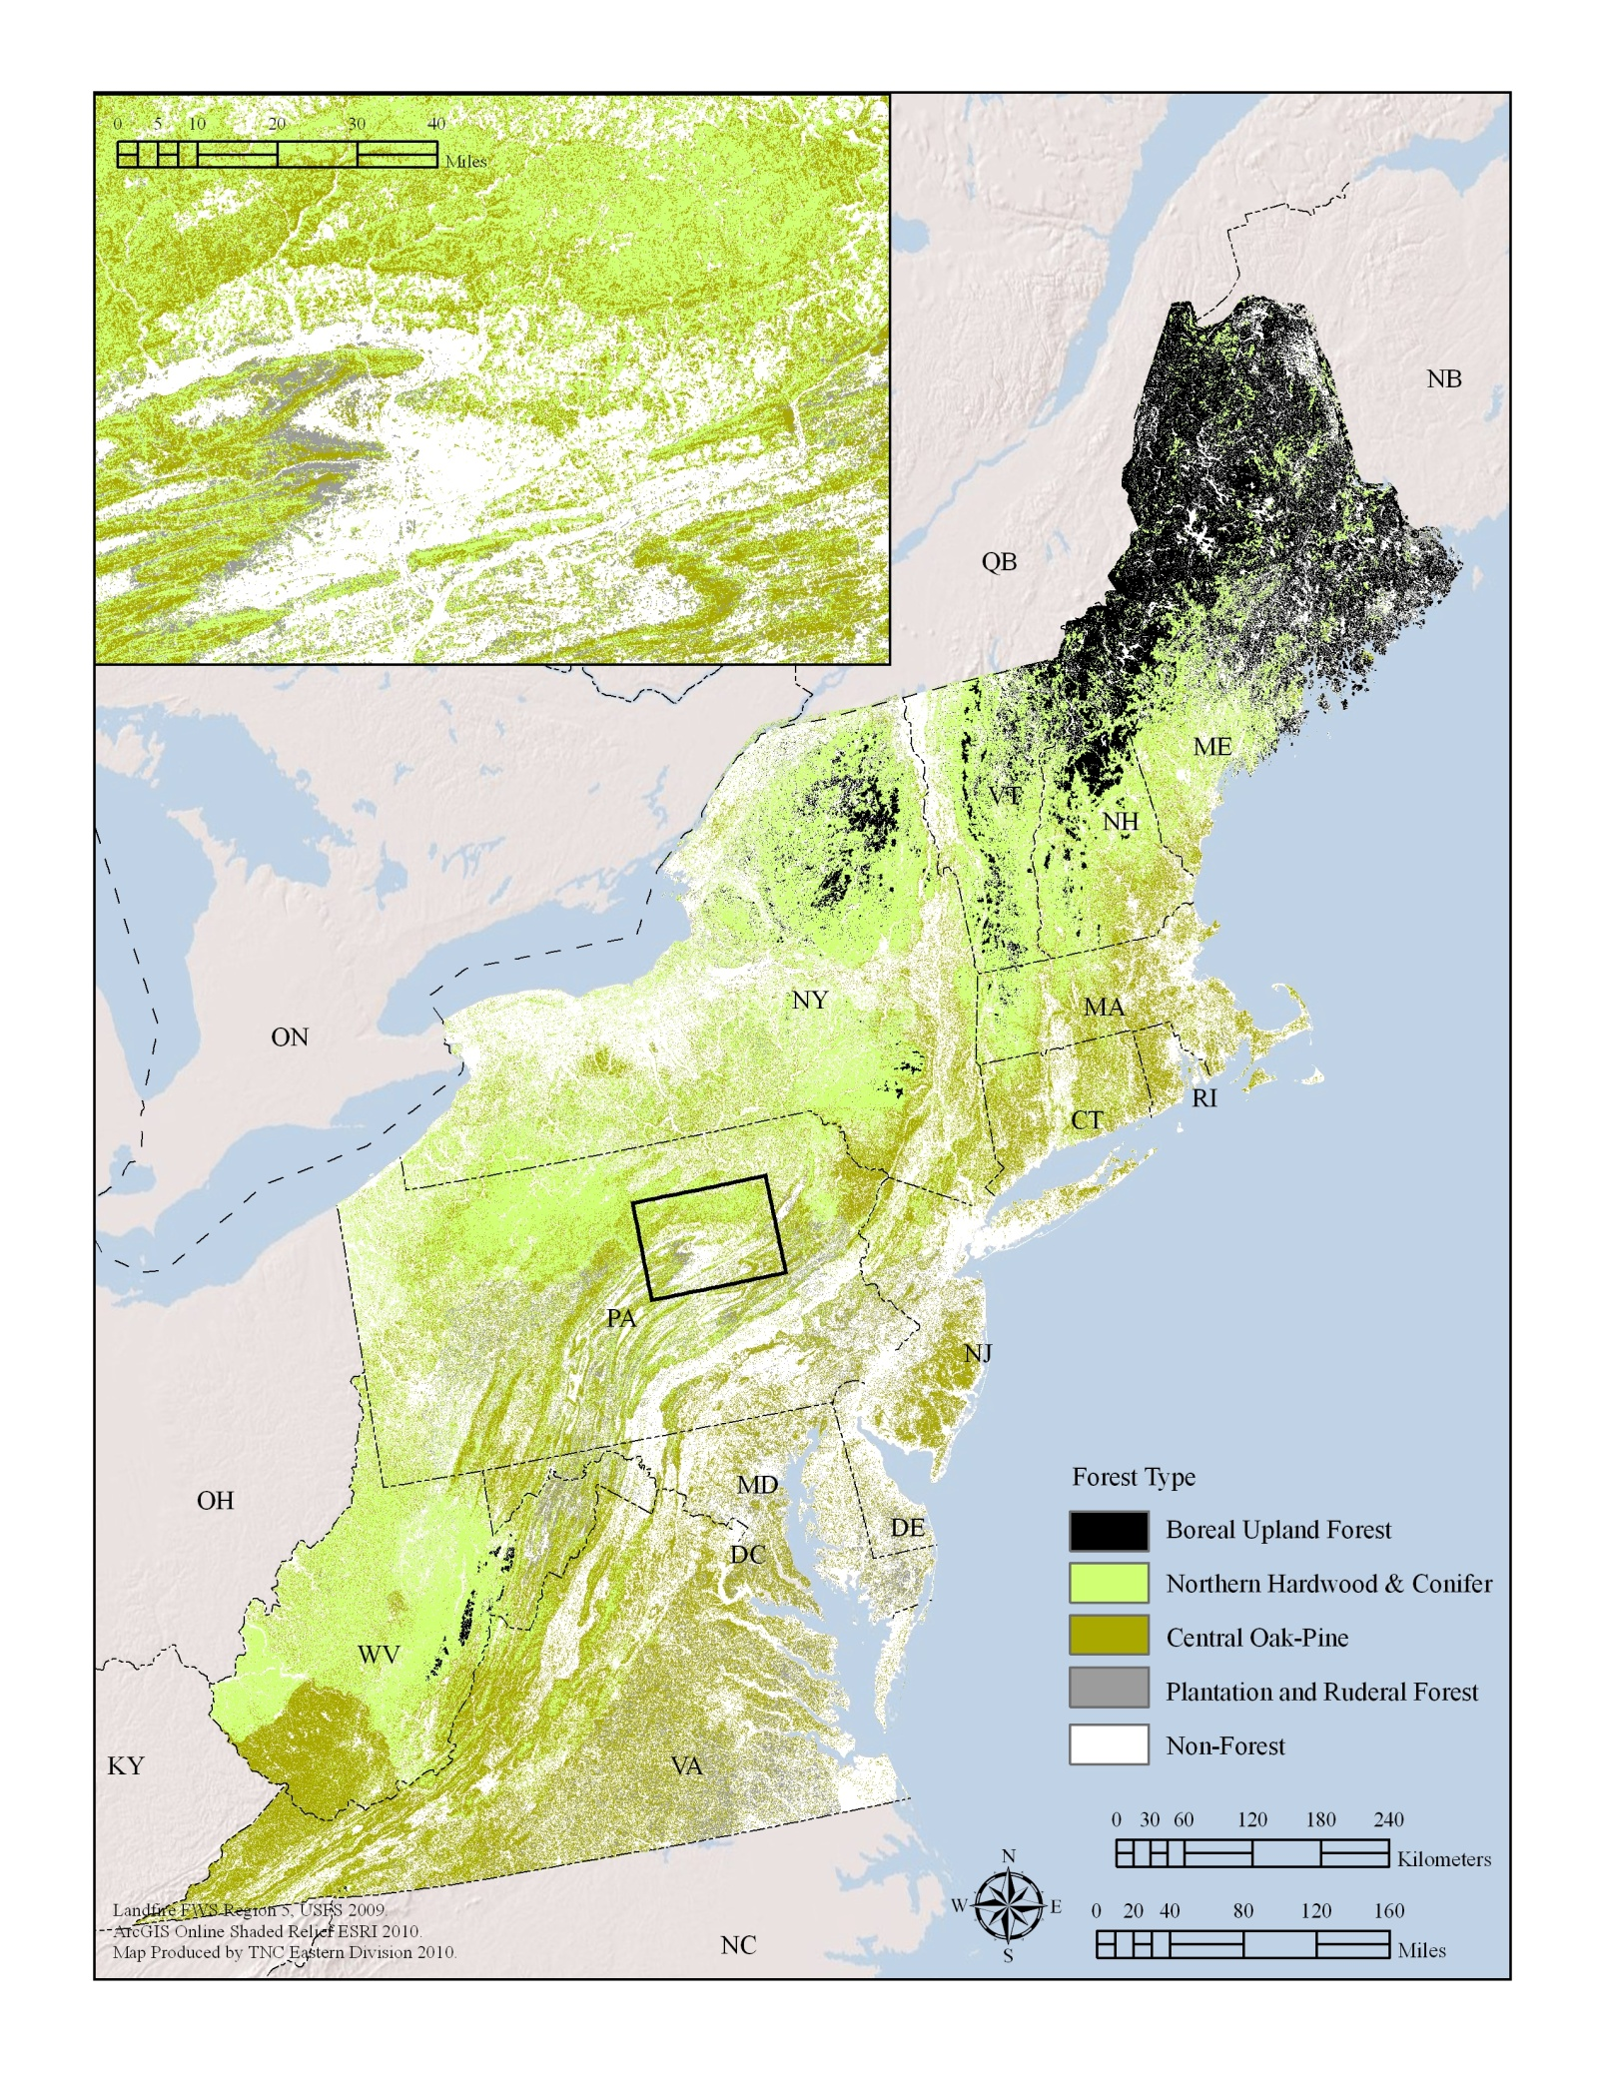
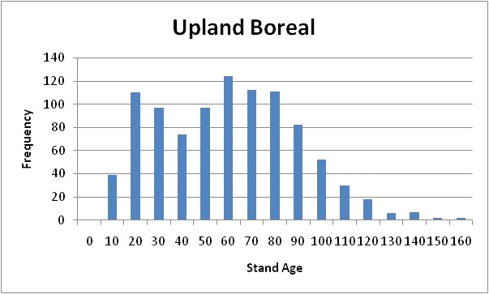
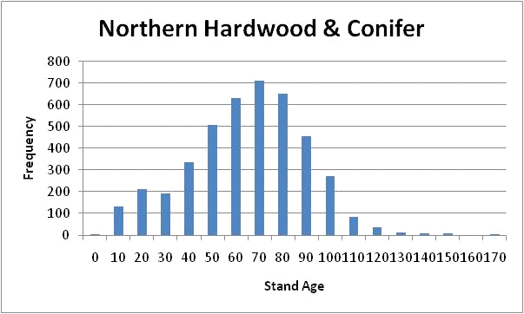
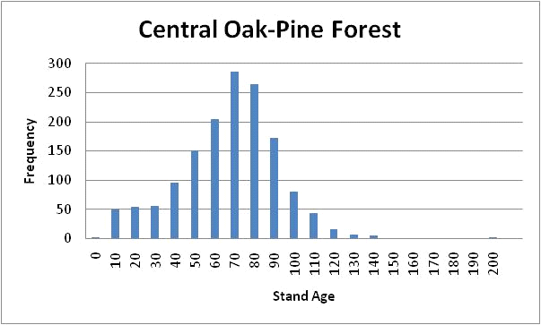
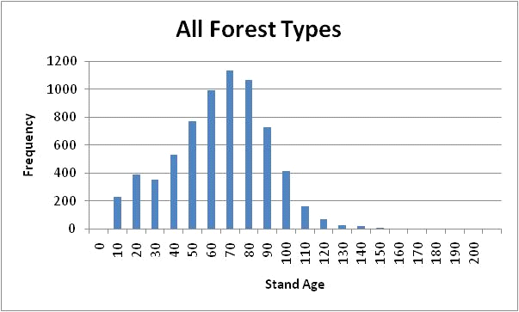
Example: Forests: Age Structure
LANDFIRE MAP
FIA data
6952 stands

Slide 5
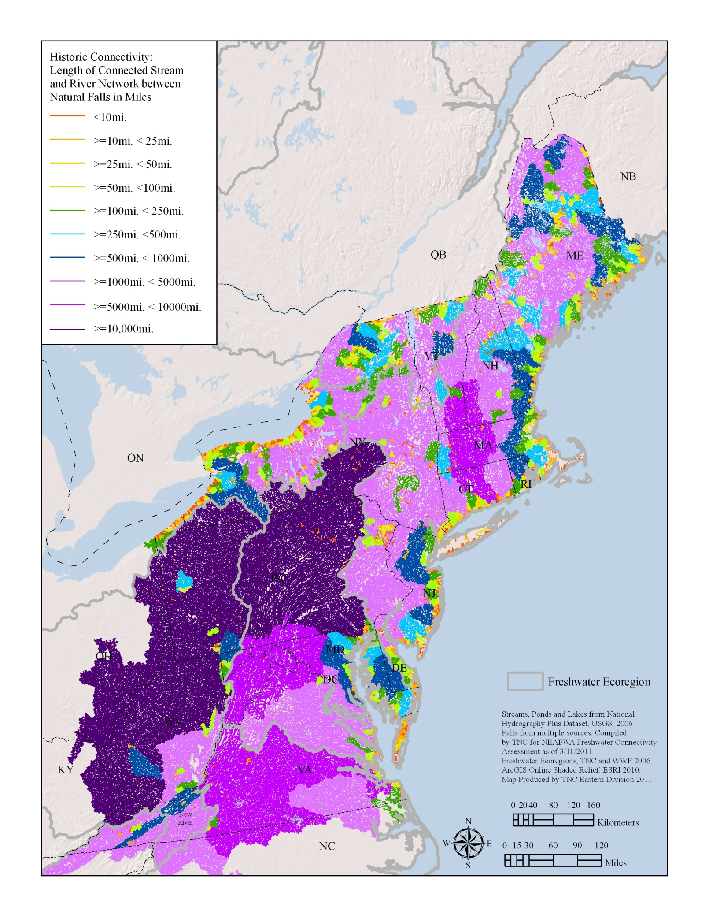
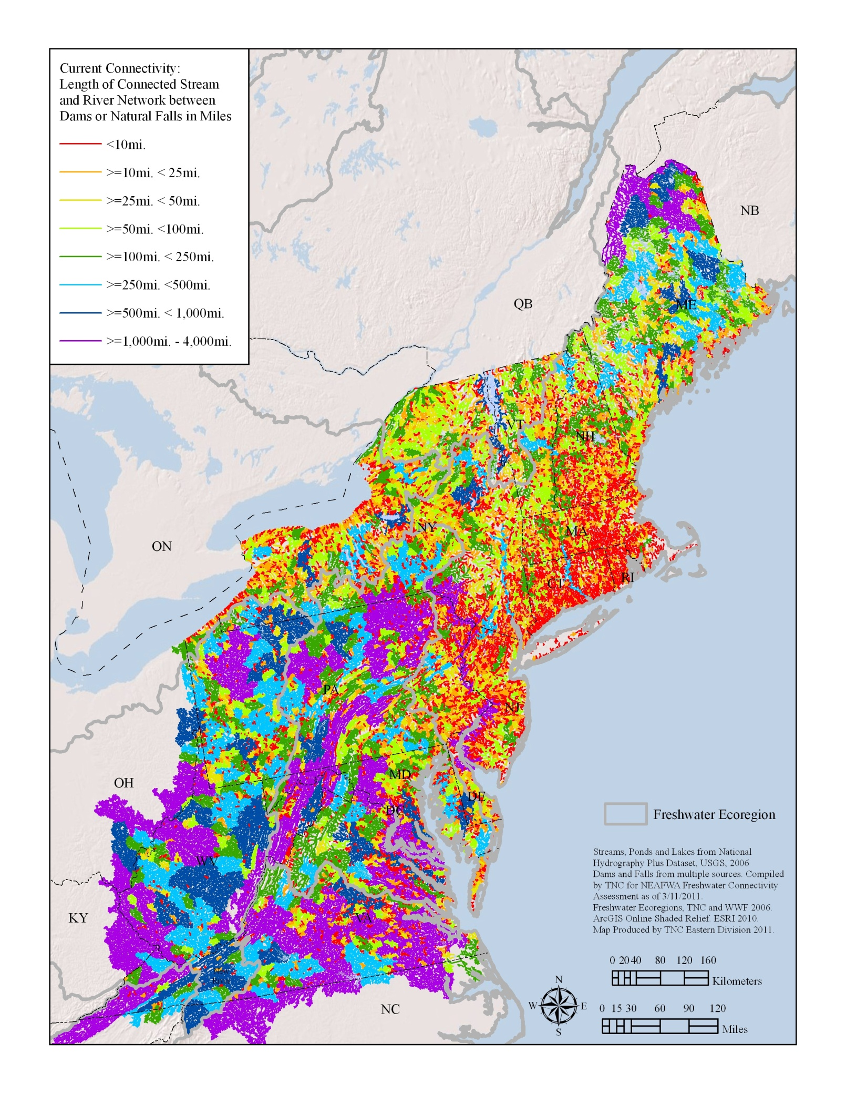
Example: Rivers: Connected Networks
Original State: falls only
Current State: falls and dams
FIA data
6952 stands
Original = 41 % in networks over 5,000 miles
Current = 0 %
Original = 3 % in networks 1-25 miles
Current = 23 %

Slide 6
Example: Securement by Category
Concern trumps Responsibility?

Slide 7
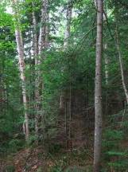
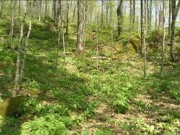
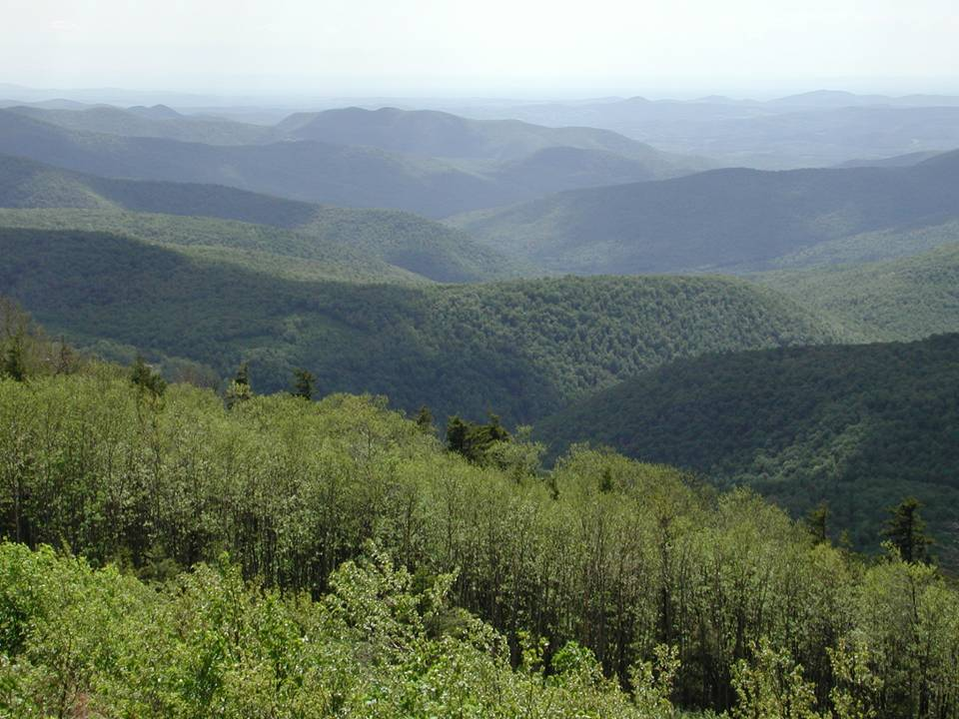
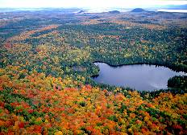
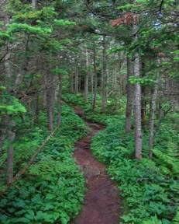

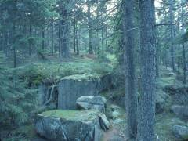
Mapping Terrestrial Habitats
Base on NatureServe Ecological Systems
Tidal marsh & Beach

Slide 8
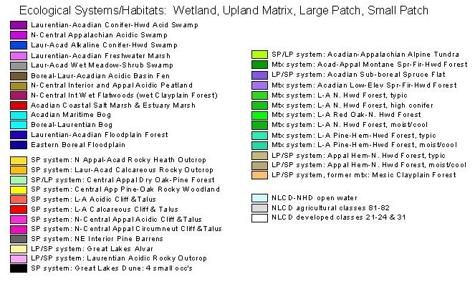
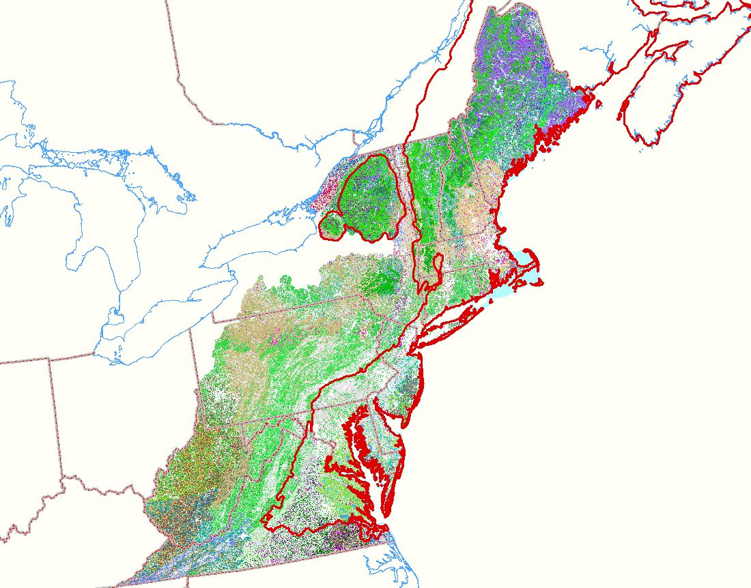
Terrestrial Habitats
Systems types determined by
Previous RCN grant

Slide 9
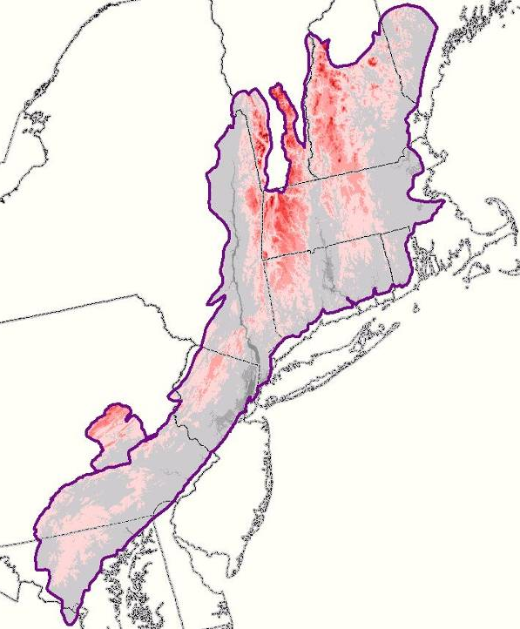
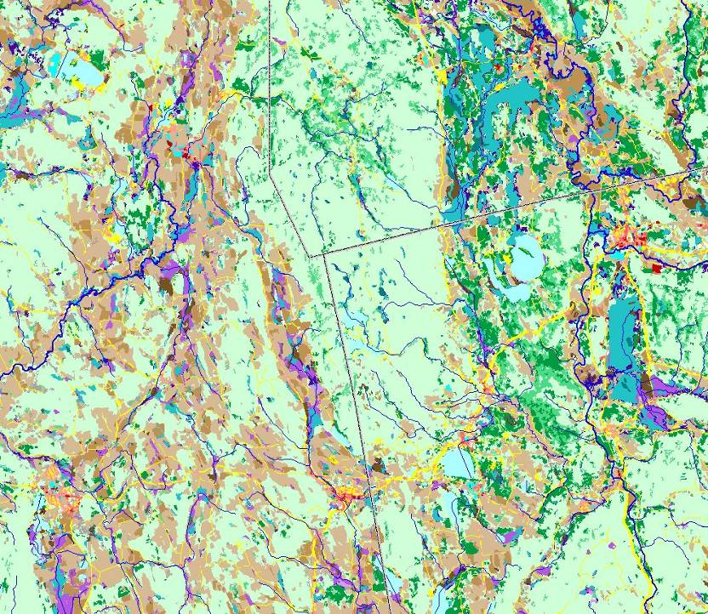
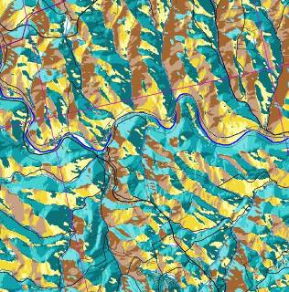
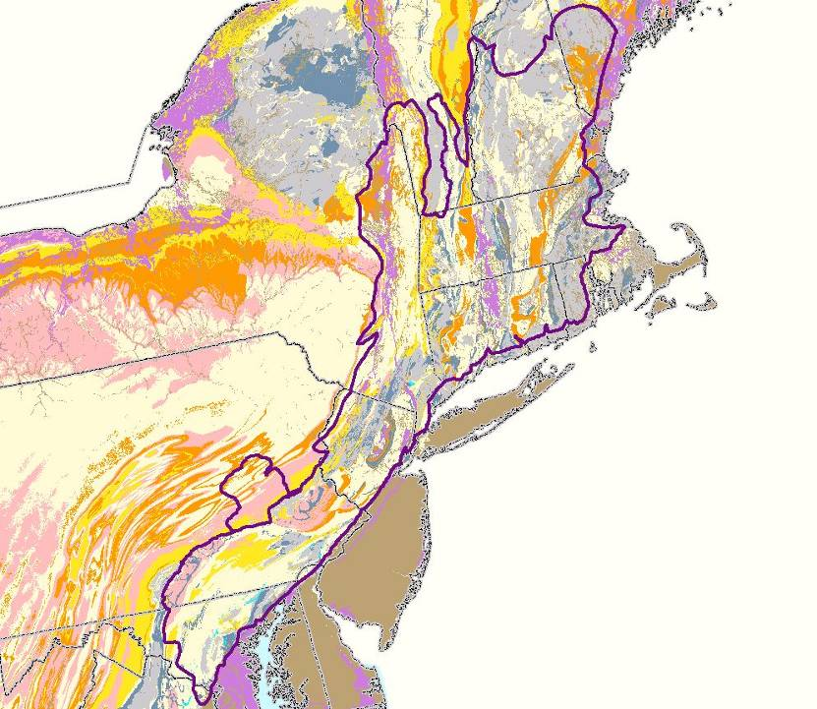
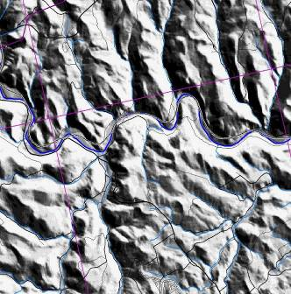
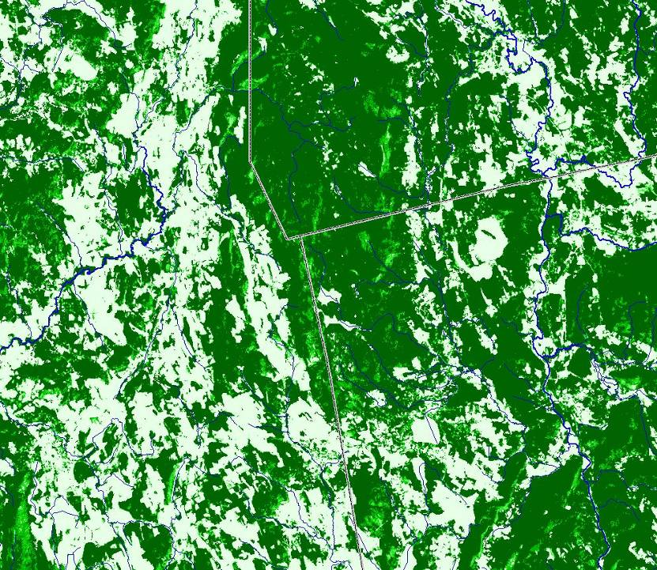
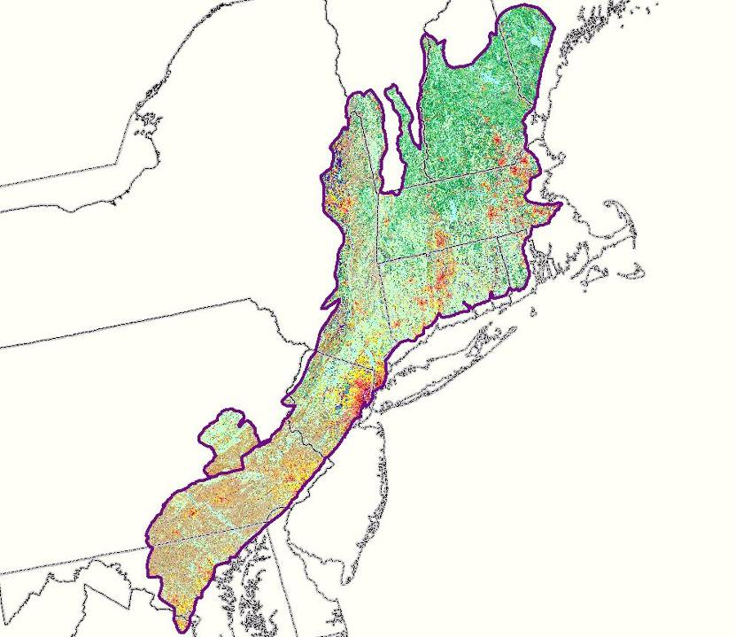
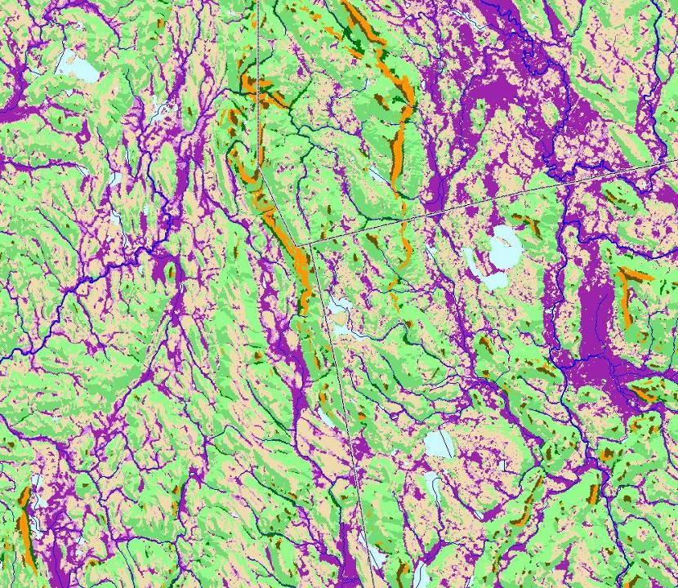
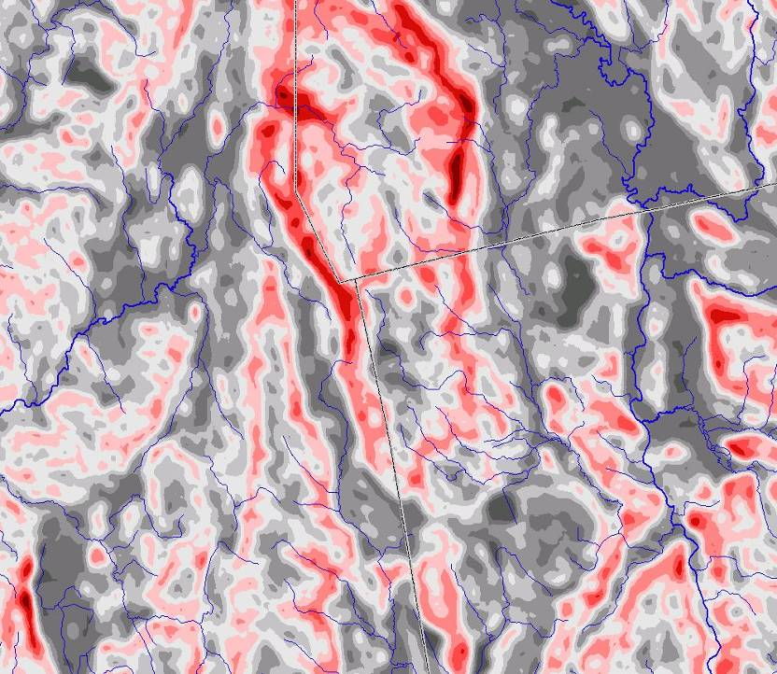
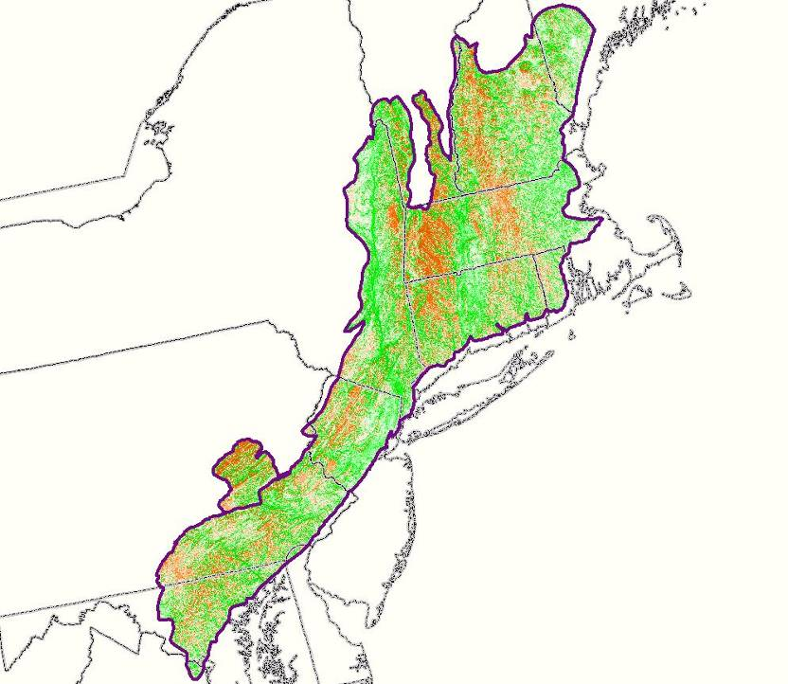
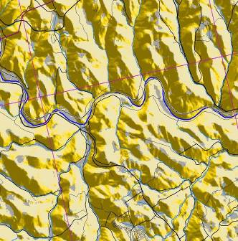
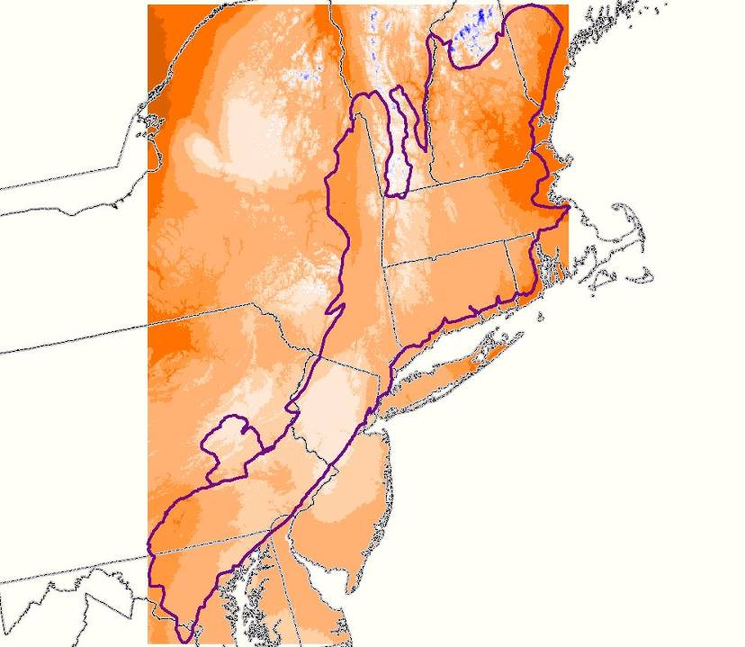
Data Driven:
Wall to wall grids and confirming points
Elevation
Geology
Landcover
Solar
radiation
Precipitation
NWI
Wetland
Canopy
closure
Landforms
Aspect
Categorical Aspect
Shaded
Relief
Rugosity
Over 10,000
FIA and NHP
data points
Notes:
Elevation: 30m DEM

Slide 10
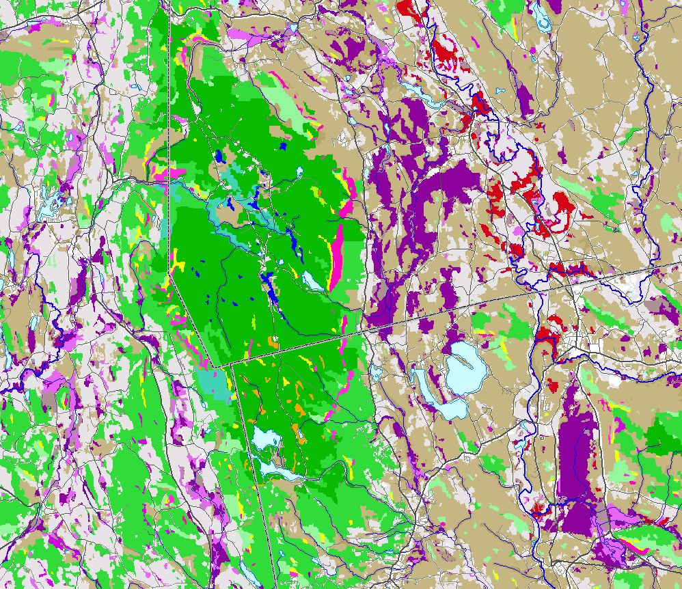
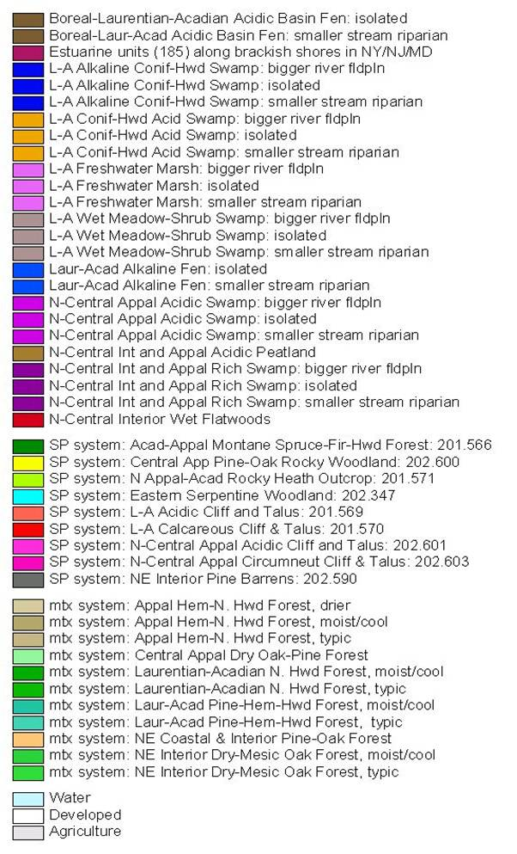
UPLAND
Underlying patterns
Related to physical
Features.

Slide 11
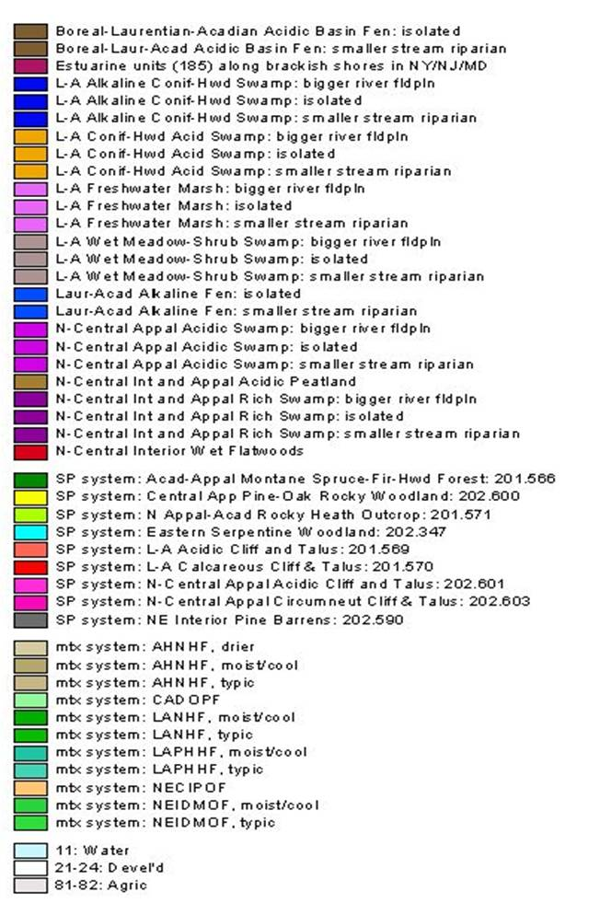
WETLAND

Slide 12
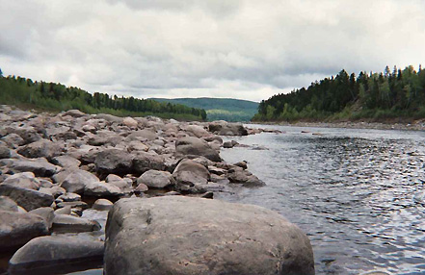
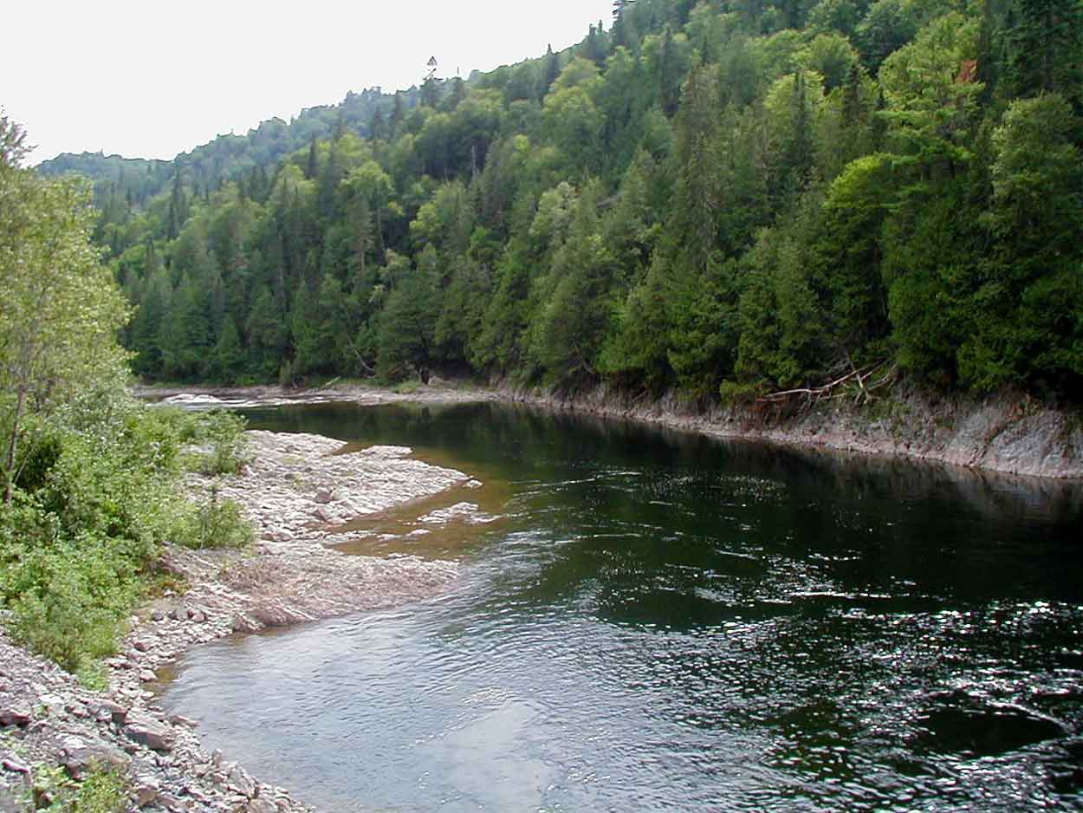
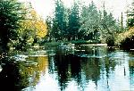
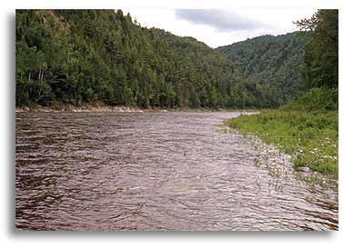
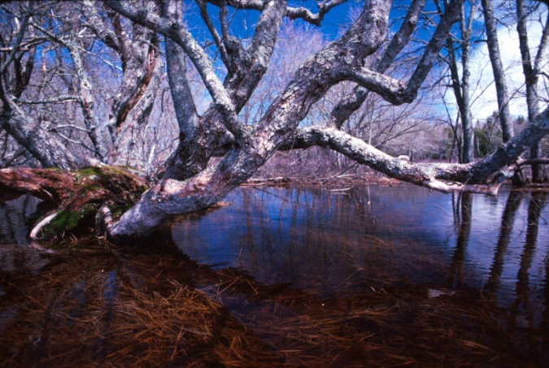
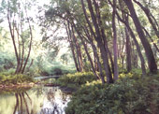
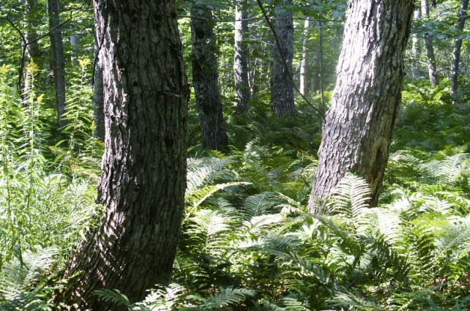
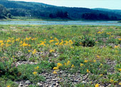
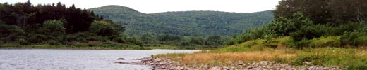
Mapping Rivers Systems

Slide 13
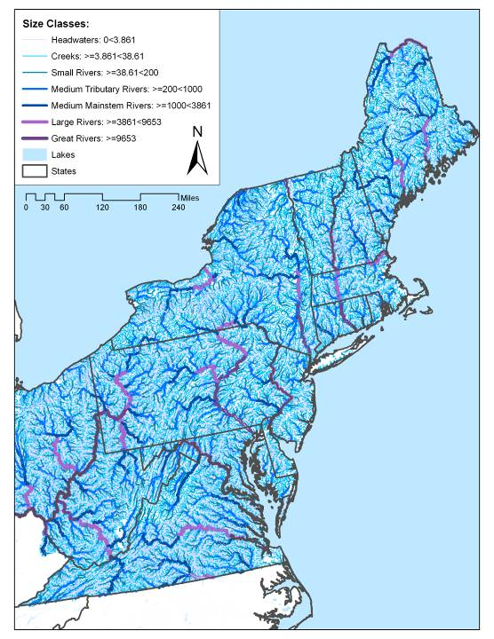
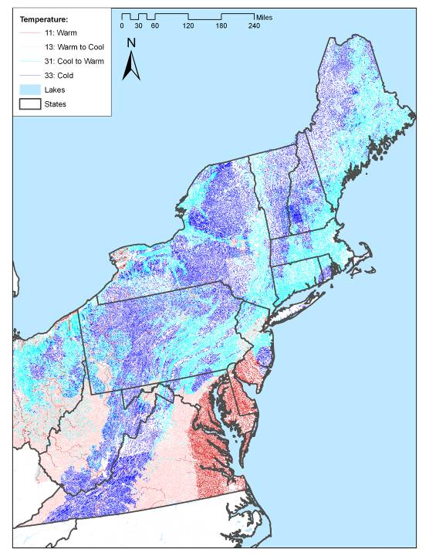
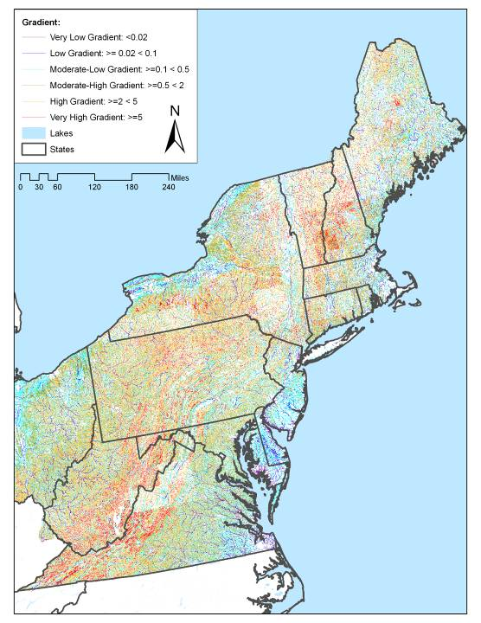
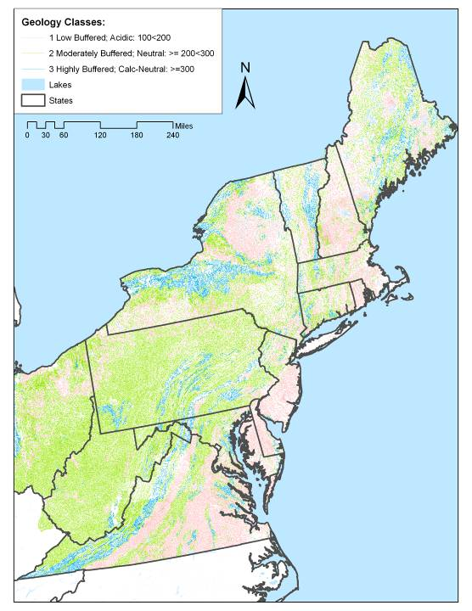
Key Habitat Variables
SIZE (Drainage Area)
Temperature
Gradient
Geology (pH)

Slide 14
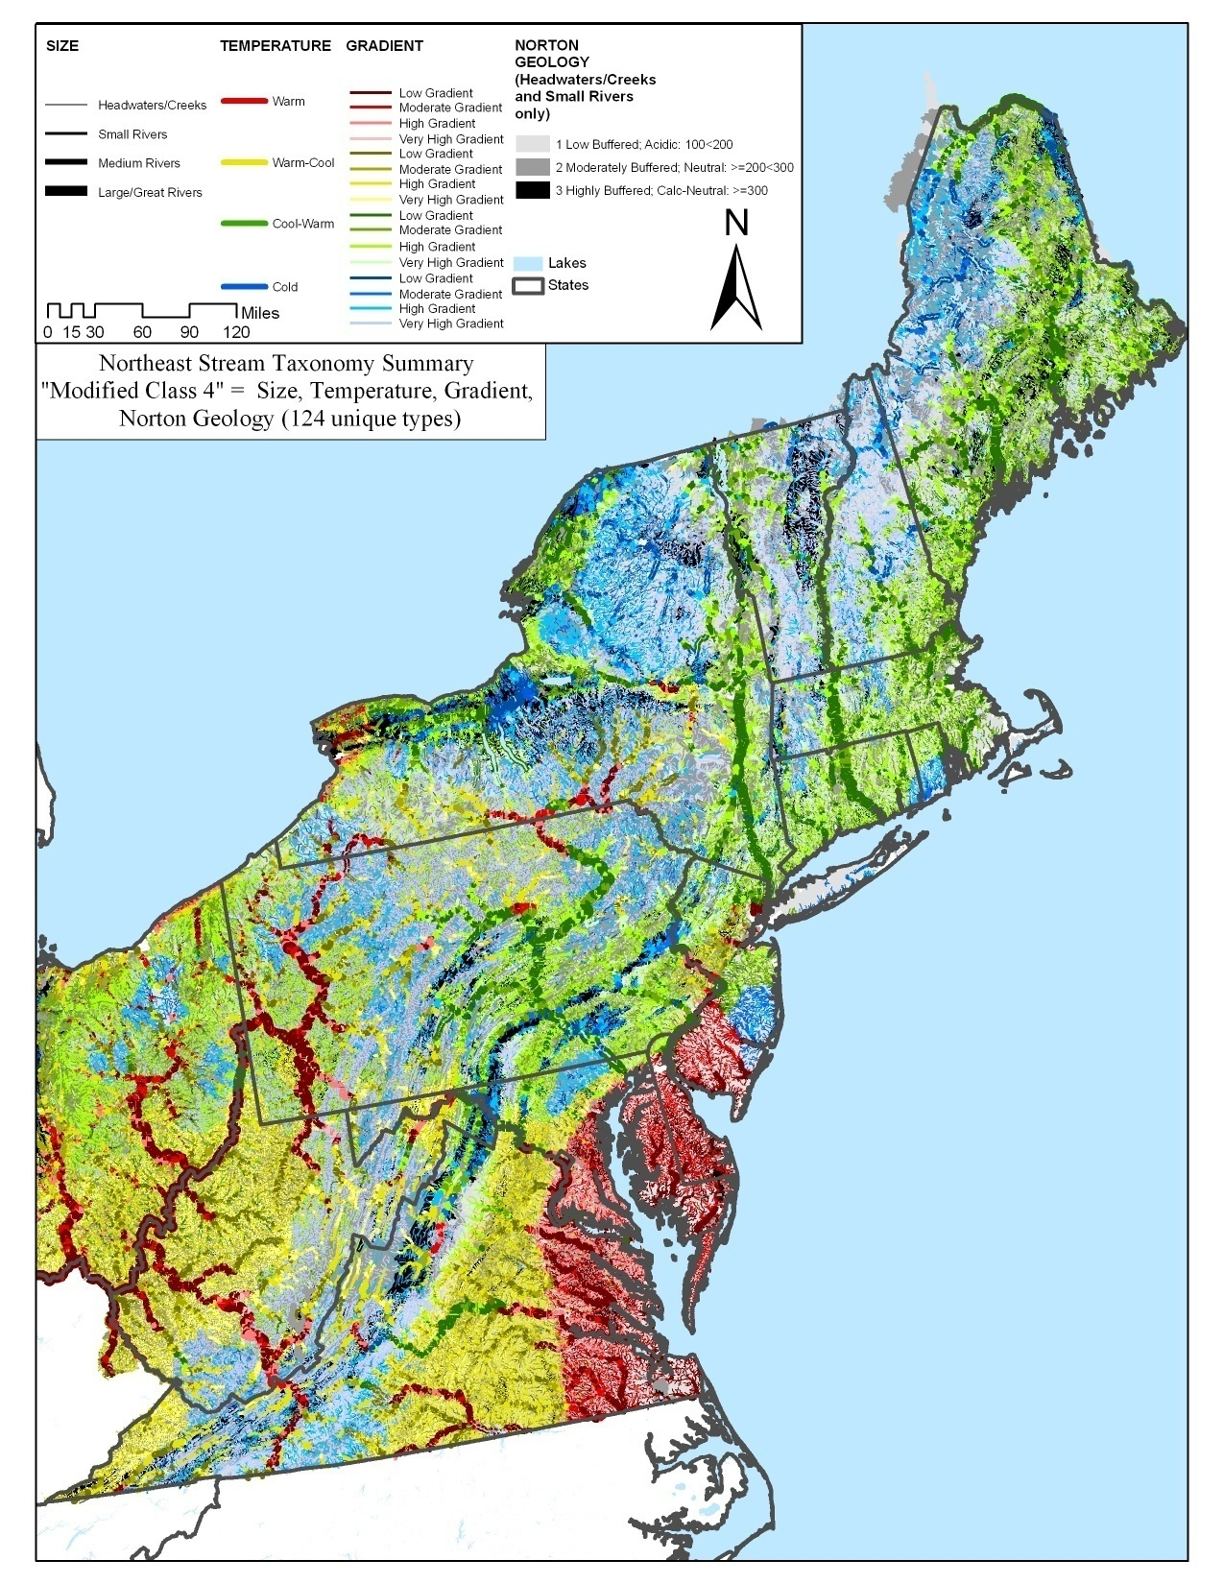
Results
NEAFWA Stream Classification includes 257 types,
This simplified map groups them into 96 types.
From
Very high gradient, acidic, cold headwater creek
(1a_6_1_1)
To
Very low gradient, calcareous, warm Great River
(5_1_3_3)
Code =
Size, Gradient, Geo, Temp

Slide 15
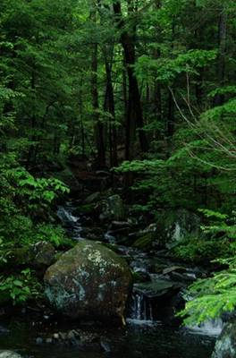
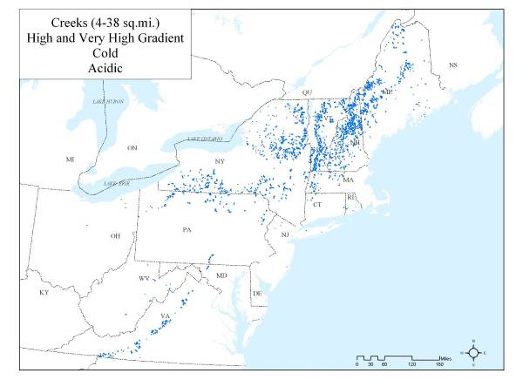
High gradient acidic cold headwater stream.
Regional Size Class (1b): Northeast Headwaters
Regional Gradient Class
(5): High
Regional Norton Geology Class
(1): Low Buffering Capacity, Acidic
Regional Temperature Class
(1): Cold
1b511:
High gradient acidic cold headwater stream
Linked State Names:
MA Small Streams,
VT Cold headwater acidic streams,
NY Coldwater Stream,
CT Coldwater Stream,

Slide 16
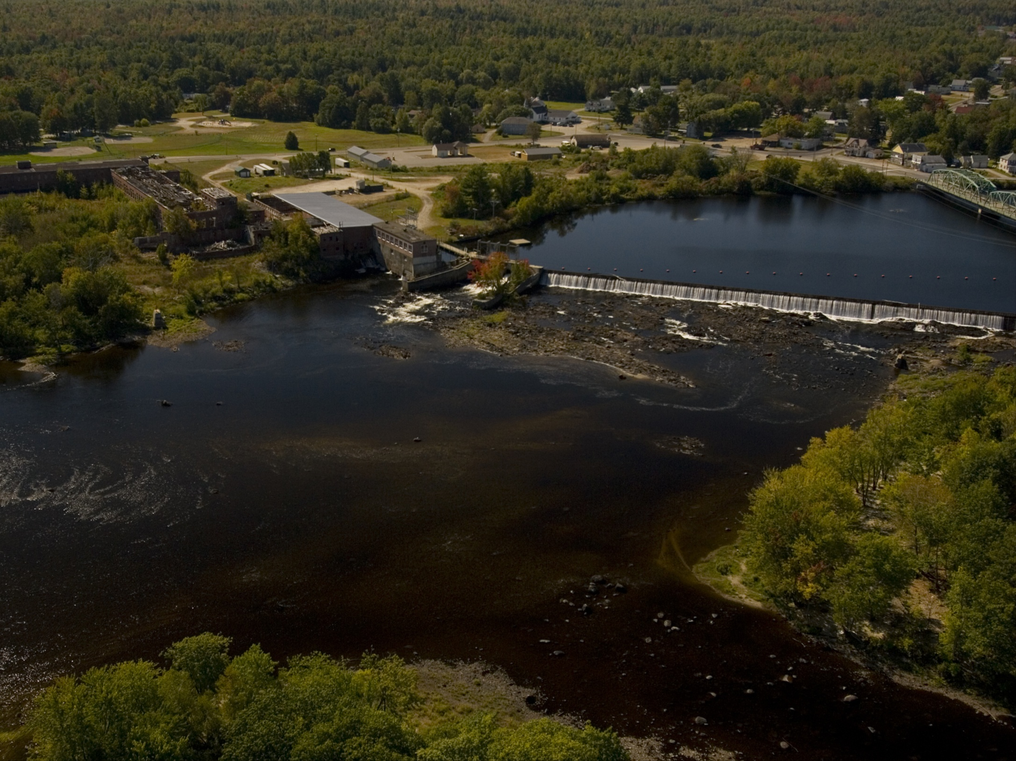
NEAFWA Aquatic Connectivity
Colin Apse & Erik martin,
The nature conservancy

Slide 17

Purpose
This project endeavors to produce a tiered list of dams in the Northeast US based on their potential ecological benefit if remediated for fish passage, and develop a tool that allows managers to re-rank dams at multiple spatial scales
Dams and other barriers to the free movement of fish and other aquatic organisms have had a negative impact on the health and viability of these populations for well over a century in the eastern United States.
Removing or otherwise mitigating dams can improve the health of aquatic ecosystems and allow fish populations to recover.
Given the financial and organizational obstacles to dam removal projects, it is critical that managers focus their efforts and resources where they can have the greatest ecological impact.

Slide 18
Methods
Data Collection & Preparation
  Dams, waterfalls, anadromous fish habitat collected from states & other sources, processed, iteratively reviewed with state contacts
Metrics calculated in GIS for every dam. Metrics grouped in 5 categories. The Barrier Analysis Tool (BAT), an ArcGIS plug-in developed for this project, was used to calculate many of the metrics.
  Connectivity Status
  Connectivity Improvement
  Watershed & Local Condition
  Ecological
  Size Class
Ranking
  Dams ranked based on the metrics calculated in GIS and weighted based on relative weights developed by workgroup for anadromous fish and resident fish scenarios

Slide 19


Status & Utility
2nd draft of results are currently being reviewed by state workgroup participants
Final results: end of August
Potential utility of results (as suggested by workgroup participants)
  Project evaluation
  Communicating with owners/funders
  Grant writing
  Justifying projects during funding allocation
  Bring attention to new projects that may not have been looked at before
  Developing basin-level plans
  Local-level communication
  Inform advocacy efforts
  Stimulate proactive action rather than opportunistic removals

