Slide 1
Development of Noninvasive Monitoring Tools for New England Cottontail Populations
Project Director: Adrienne Kovach, University of New Hampshire
Graduate Student: Daniel Brubaker, University of New Hampshire
Partners: Kate O’Brien, Walter Jakubas, Anthony Tur, Steve Fuller, Kelly Boland, Heidi Holman, Paul Novak, Howard Kilpatrick, Eileen McGourty, David Scarpitti

Slide 2
NEAFWA RCN project developed in response to need for tools to evaluate management actions for NEC
Problem
Adaptive management of New England cottontails requires knowledge of both patch occupancy and abundance.
Current monitoring approaches are suitable for evaluating the species’ distribution on a range- wide scale, but may not be optimal for detecting cottontails on a patch-specific scale.

Slide 3
Goal: Develop optimal monitoring protocols for tracking patch-specific New England cottontail occupancy and abundance and for performance evaluation.
Objectives
Determine detection rates and factors that affect detection of NEC during winter surveys range-wide
Develop genetic population estimation protocol & apply to sites range-wide

Slide 4
Range-wide Detection
& Population Estimation Sites
Complete surveys:
38 detection sites (≥4 surveys per site)
23 population sites (1 exhaustive survey)

Slide 5
Approach: Genetic Monitoring via Fecal Pellet Surveys
Diagnostic mtDNA test for species id
occupancy
unique genotypes
Genetic mark-recapture
population estimation

Slide 6
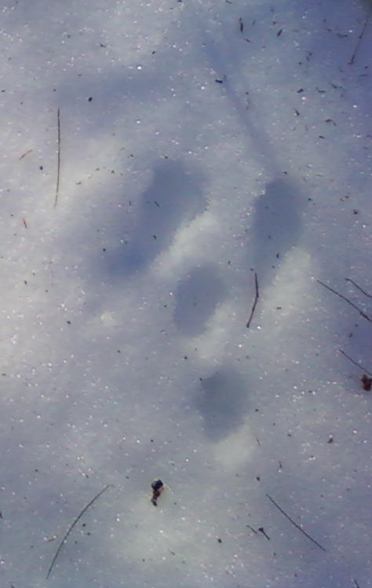
A Problem of Detection?
Covariates analyzed in an occupancy modeling framework to evaluate factors that influence detection:
snow conditions (depth; powder; days since snow)
temperature
weather events (wind, rain)
observer
search effort
patch size
prior knowledge
habitat (stem density)

Slide 7
Project Status
2 field seasons completed (winters 2010 and 2011).
265 pellet samples collected & analyzed in Year 1, served as pilot, as poor survey conditions prevented sufficient detection visits.
Genetic species identifications for up to 550 Year 2 pellet samples to be completed by August, enabling modeling of detection factors on all 38 range-wide sites by September.
Preliminary results for 22 detection sites in ME/NH indicate snow conditions (depth & powder) and prior knowledge of NEC activity influence detection.
Genotyping of up to 500 population estimation samples underway; abundance estimates to be completed by December.

Slide 8
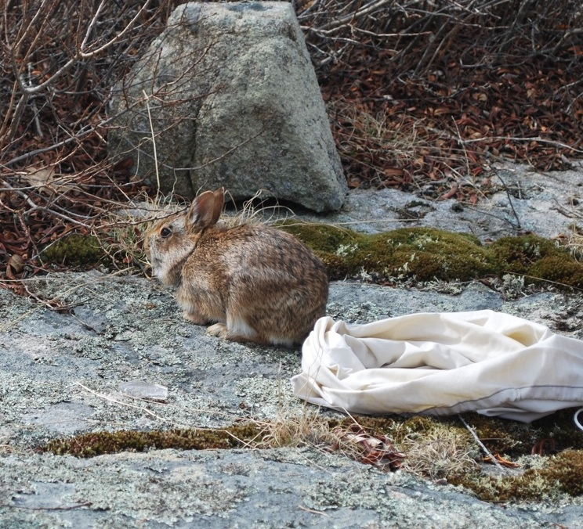
Detection & Population Monitoring Outcomes
Evaluation of presence/absence survey protocol and factors that influence detection
– guidelines for optimal survey
First patch-specific abundance estimates
– establish baseline
Tools for monitoring effectiveness of management actions

