Slide 1
A Regional Initiative to Support Biomass Energy Development Practices Benefitting Early-Succession SGCN in the Northeast
Scott D. Klopfer
Conservation Management Institute
Virginia Tech
Notes:
Supplied for contact info only if needed.

Slide 2
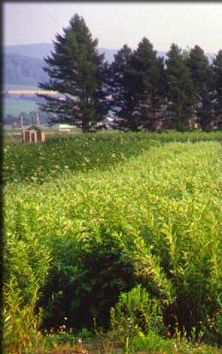
Evaluate Potential Impacts
Biomass practices
Examine process (planting, management, harvest impacts)
SGCNs
Look at SGCN needs and status
Evaluate impacts
http://www.esf.edu/willow/

Slide 3
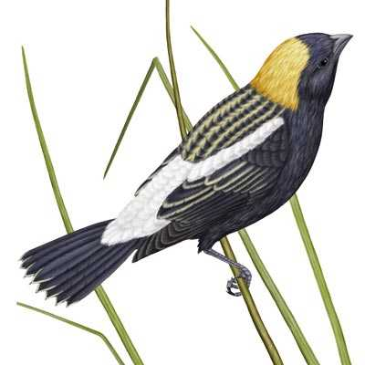
Basic Analysis
Total net SGCN
# positively impacted - # negatively impacted
So,
11 positive – 19 negative = -8

Slide 4
All SGCN (470) | Existing Land Cover
 | Row Crop | Mature Deciduous | Mature Coniferous | Shrubland / Young forest | Pasture / Hay
Native NWSG mix | 95 | -71 | -1 | 32 | 95
Monoculture grass (dedicated) | 28 | -71 | -1 | 22 | 0
Dedicated mono. deciduous woody | 118 | -103 | -33 | -57 | 118
Dedicated mono. coniferous woody | 55 | -124 | 16 | -35 | 55
Native early successional | 73 | -26 | 44 | 0 | 73
Thinned timber stand | 234 | 16 | 93 | 103 | 234

Slide 5
Summary points
New biomass activities that involve planting grass or woody material should be focused on existing row crop or pasture land.
The best option for forested systems is to utilize practices that result in native regeneration and decrease fragmentation
Wildlife managers and biologists must work cooperatively with biomass developers early in the process

