Slide 1
Identifying Relationships Between Invasive Species and SGCNs in the Northeast Region
Scott D. Klopfer
Conservation Management Institute
at Virginia Tech
College of Natural Resources and Environment

Slide 2
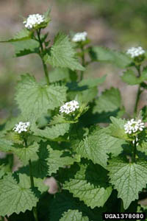
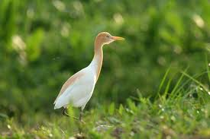
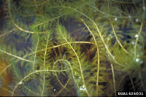
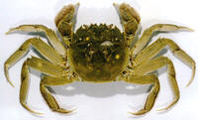
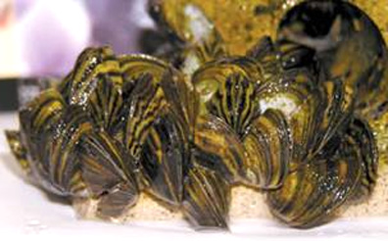
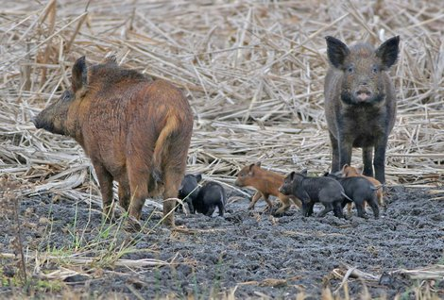
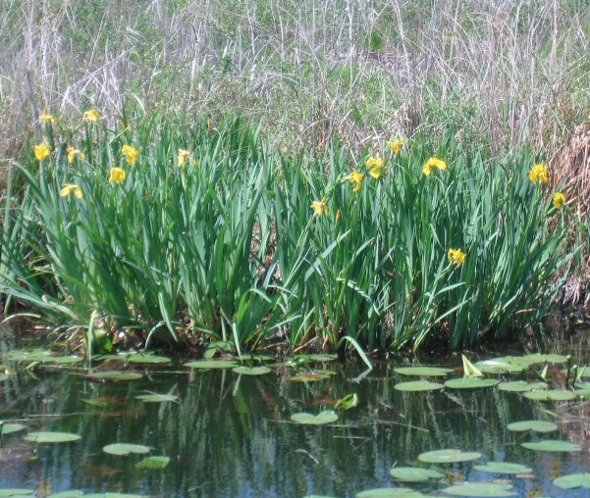
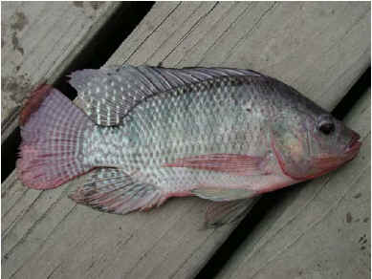
SGCN
Alison Fox-University of Florida
Chris Evans, River to River CWMA
Lee Mecum, California Dept. of Fish and Game
Pam Fuller, USGS
Notes:
SGCNs in the Northeast are subjected to a number of threats and stressors. Invasive plants and animals often impact SGCNs either directly or indirectly. While all invasive species are detrimental to native fish and wildlife, some are likely to affect more SGCNs than others. Those may be the most significant threat.

Slide 3
Which invasives are the most important…
Those that impact the most SGCN?
Those that change ecosystem processes?
Those listed in the majority of the Northeastern states?
The objective of this project was to gather information to begin to answer these questions and to develop lists for the region and each state.

Slide 4
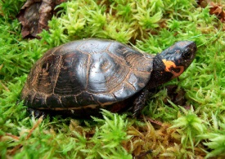
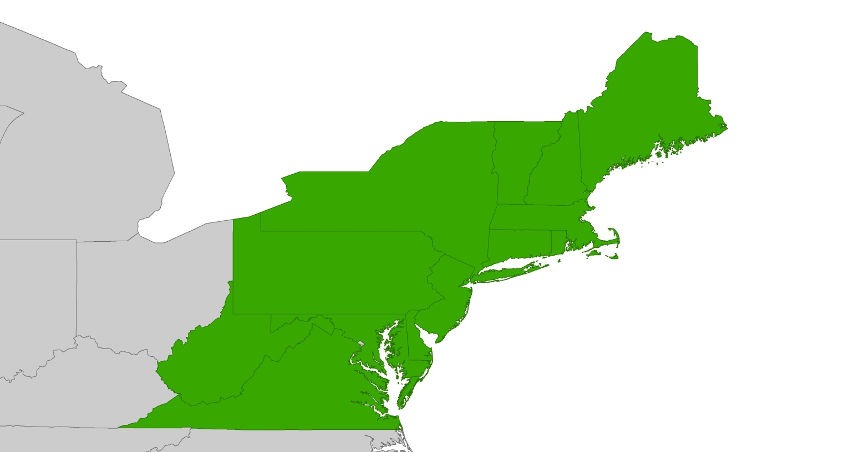
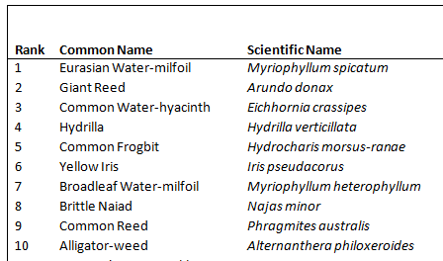
Compiled a list of SGCNs in the Northeast (terrestrials and fish)
Compiled a list of invasive species
Created matrices to classify interaction between SGCNs and invasive species by habitat
Developed ranking criteria
Created ranked lists of the most important invasive species based on those criteria
 | S | S | S
I | 2 | 0 | 1
I | 0 | 3 | 0
 | S | S | S
I | 0 | 0 | 1
I | 1 | 1 | 1
X

Slide 5
Products
General habitat classifications for both SGCN and invasive species
All base data to permit customized analysis
Lists of the “most important” invasive species by:
Region
State
SGCN Taxonomic group
Alison Fox-University of Florida
SCGN Enemy Number One: Eurasian milfoil

