Slide 1
Northeast State of the Frogs: Development of regional analysis for frog call survey data from the North American Amphibian Monitoring Program
Linda Weir & Andy Royle
USGS Patuxent Wildlife Research Center

Slide 2
NAAMP Protocol & Partnership
Collaborative program between USGS, State Agencies, and other partners to monitor calling frogs and toad
Over 20 states participating, including 11 Northeast states
Use common protocol
Random roadside routes surveyed 3+ time per year
10 stops per route; listen for 5 minutes at each stop
Observers pass an online frog call quiz to ensure able to identify calling amphibian species by sound

Slide 3
RCN Funding
Provide ability to hire post-doc to work on Northeast NAAMP data analysis
Using occupancy modeling approach to:
Develop regional model to look at species trends for the Northeast as a whole
Incorporate calling index data for species with sufficient data, which will allow for greater sensitivity in detecting change (instead of truncating to presence-absence)

Slide 4
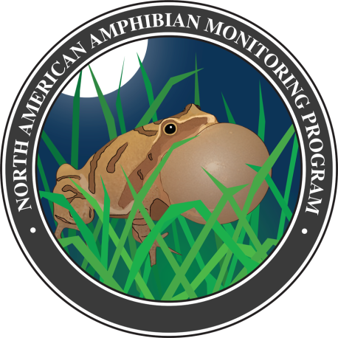
Planned Products
Presentation at Northeast Fish & Wildlife Conference
Submit manuscript of regional trend analyses to scientific journal
Create regional trend results webpage on NAAMP website

