Slide 1
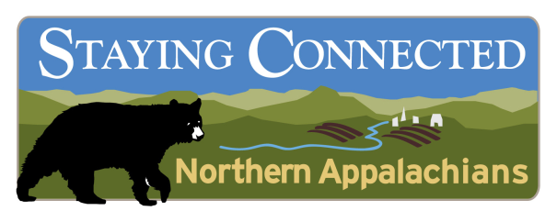
Staying Connected in the
Northern Appalachians
Geography: 7 linkage areas across the Northern Appalachians where regional connectivity is at risk.
Partners: 21 State agency and NGO partners across NY, VT, NH, and ME
Key Strategies
Conservation science
Targeted land protection
Technical assistance to local communities
Increase the permeability of key roads
Model conservation easement language
Measures framework
Key Funders: (1) USFWS Competitive State Wildlife Grant; (2) WCS/Duke Wildlife Action Opportunities Fund
Notes:
Staying Connected in the Northern Appalachians
Vision: An entire ecoregion with functioning habitat linkages
Staying Connected Goal: To maintain, enhance and restore habitat connectivity for Species of Greatest Conservation Need across the Northern Appalachian Ecoregion in order to mitigate the impacts of habitat fragmentation and climate change.
Approach: This will be achieved by deploying a suite of related strategies within and across key connectivity linkage areas throughout the ecoregion.
Linkage Areas: Based on a suite of areas identified under theTwo Countries, One Forest umbrella through a collaborative, science-based, partner-engagement process. These are the places where regional-scale connectivity is most at-risk.
Tug Hill Plateau ⇔ Adirondack Mountains (NY)
Adirondack Mountains ⇔ Green Mountains (NY-VT)
Taconic Mountains ⇔ Southern Green Mountains (NY-VT)
Northern Green Mountains (VT-Canada)
Worcester Range ⇔ Northeast Kingdom (VT)
Northeast Kingdom ⇔ Northern NH ⇔ Western Maine Mountains (VT-NH-ME)
Maine’s North Woods ⇔ Quebec’s Gaspe Peninsula (ME-Canada)

Slide 2
Using Circuitscape to model areas of concentrated and diffuse flow patterns in northeastern VT – northern NH – western ME
Red: concentrated flow pattern (= energy funneling here)
Orange: diffuse flow pattern (= highly permeable landscape pattern)
Green: area of low flow (=impermeable landscape pattern)

Slide 3
Road crossing and habitat linkage priorities in the Adirondacks-Greens Linkage
Science Inputs
Least cost path, Fun Conn, & circuitscape GIS models
Selective groundtruthing
Wildlife tracking surveys
Outputs to Guide Action
Structural connectivity priorities for land protection and community planning strategies
Priority road segments for road crossing strategies

Slide 4
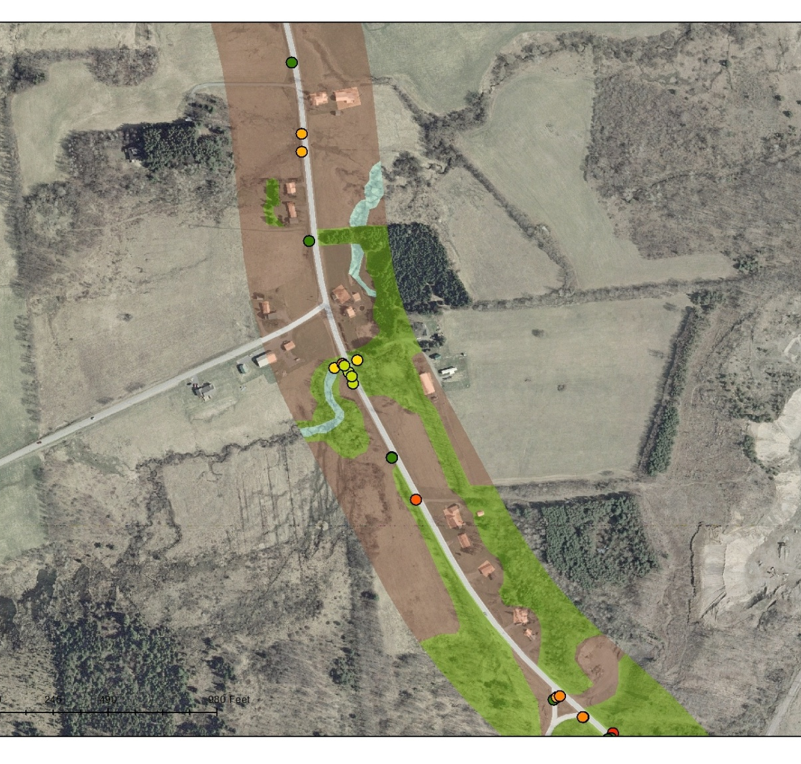
Wildlife Crossing and Road Infrastructure Inventory in the Black River Valley, NY
Objectives
Develop data on wildlife road crossings, road infrastructure, and adjoining land cover and use patterns
Inform NY DOT road management plans (e.g., rights of way management, signage, fencing, culvert retrofits)
Develop remote model to predict potential road permeability over large areas
Notes:
Tracked animal crossings through winter tracking (3 mo)
Digitized crossings along the road and overlaid on aerial photography
Inventoried road infrastructure along the road (culverts, guardrails, fences, bridges, road type, media)
Developing model designed to identify stretches of road that have higher permeability potential. Can use to focus field survey and more detail analysis effort.

