Slide 1
North Atlantic LCC Science Needs and Projects Background
Vision and Mission
2010 Projects (review, status, next steps)
2011 Science Needs Assessment, Workshop & Strategic Plan
2011 Projects approved and status

Slide 2
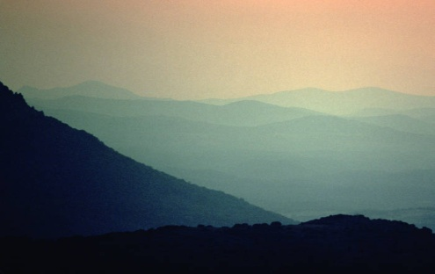
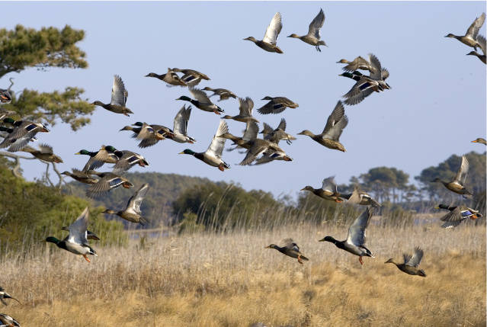
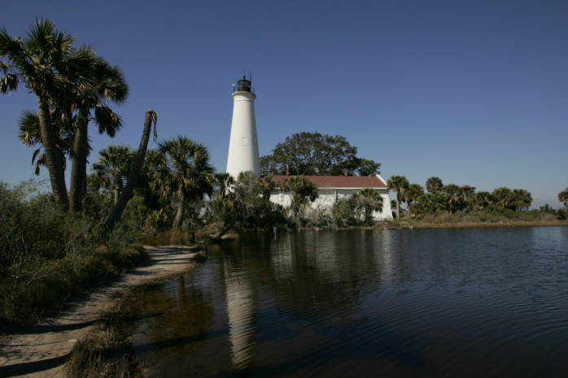
National LCC Objective
To define, design, and deliver landscapes that can sustain natural and cultural resources at desired levels nationwide
North Atlantic LCC - Vision
Landscapes that sustain our natural resources and cultural heritage maintained in a healthy state through active collaboration of conservation partners and partnerships in the North Atlantic region.

Slide 3
North Atlantic LCC - Mission
The North Atlantic Landscape Conservation Cooperative provides a partnership in which the private, state, tribal and federal conservation community works together to address increasing land use pressures and widespread resource threats and uncertainties amplified by a rapidly changing climate.
The partners and partnerships in the cooperative address these regional threats and uncertainties by agreeing on common goals for land, water, fish, wildlife, plant and cultural resources and jointly developing the scientific information and tools needed to prioritize and guide more effective conservation actions by partners toward those goals.

Slide 4
North Atlantic LCC Components of Mission
Ecological Planning
Conservation Design
Conservation Adoption and Delivery
Monitoring and Evaluation
Research
Information Management
Communication and Outreach
Coordination & Organization

Slide 5
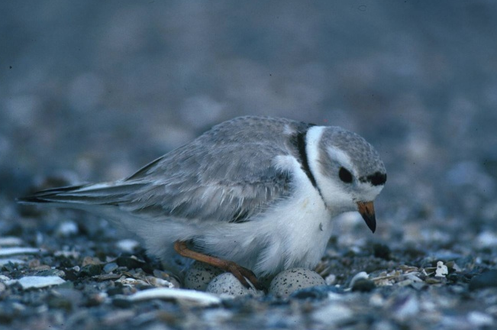
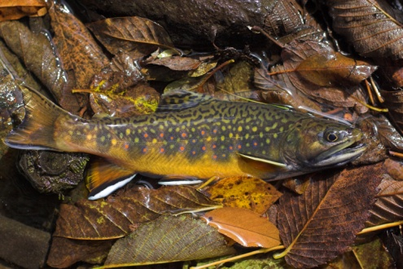
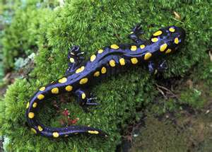
Initial North Atlantic LCC Projects
Regional Climate Change Vulnerability Assessments – Habitat and Species
Landscape Change & Decision Support Tools
Coastal
Sea level rise, beaches and piping plovers
Aquatic
Stream flow, temperature, and brook trout
Terrestrial
Species/habitat
Ecological integrity
Connectivity
Notes:
Initial projects funded last year include a regional climate change vulnerability assessment and landscape change analyses and related decision support tools for coastal aquatic and terrrestrial systems. What these project have in common is that they are foundational projects that help us understand how land use change and climate change are going to affect landscapes habitats and species and how that information should inform our decisions

Slide 6
North Atlantic LCC Science Needs Assessment
Request for Science Needs (Jan. 5- Feb. 25)
207 needs submitted
Needs by component
Monitoring - 34
Ecological Planning - 39
Conservation Design - 68
Research - 46
Conservation Adoption- 5
Information Management - 15

Slide 7
North Atlantic LCC Science Needs Assessment
Request for Science Needs (Jan. 5- Feb. 25)
207 needs submitted
Needs by system
Coastal- 73
Terrestrial- 97
Aquatic- 37

Slide 8
North Atlantic LCC Needs Review Process
Criteria for Prioritizing Needs for LCC
Foundational needs for landscape conservation
Address major threats and uncertainties to sustaining natural or cultural resources
Landscape or regional in scale
Can be applied to multiple species
Will inform conservation decisions and actions
Priorities for existing partnerships

Slide 9
North Atlantic LCC Needs Review Process
Criteria for Prioritizing Needs for LCC
Foundational needs for landscape conservation
Address major threats and uncertainties to sustaining natural or cultural resources
Landscape or regional in scale
Can be applied to multiple species
Will inform conservation decisions and actions
Priorities for existing partnerships

Slide 10
North Atlantic LCC 2011 Needs Review Results (8a)
17 top common science needs
3 aquatic, 4 coastal, 6 terrestrial, 4 multiple
4 top information management needs
Linked to about 80 more specific needs and projects
Top needs with clearly articulated projects supported by regional partnership

Slide 11
North Atlantic LCC Recommended Projects
Assessing Priority Amphibian and Reptile Conservation Areas (PARCAs) and Vulnerability to Climate Change
Mapping the Distribution, Abundance and Risk Assessment of Marine Birds in the Northwest Atlantic

Slide 12
Assessing Priority Amphibian and Reptile Conservation Areas (PARCAs) and Vulnerability to Climate Change
AFWA, UGA, MCFWRU, NEPARC
Identify PARCAs
Project regions of climate suitability for priority amphibians and reptiles
Assessment of resiliency of PARCAs identified with respect to those that may provide refugia as the climate changes
Identify data gaps

Slide 13
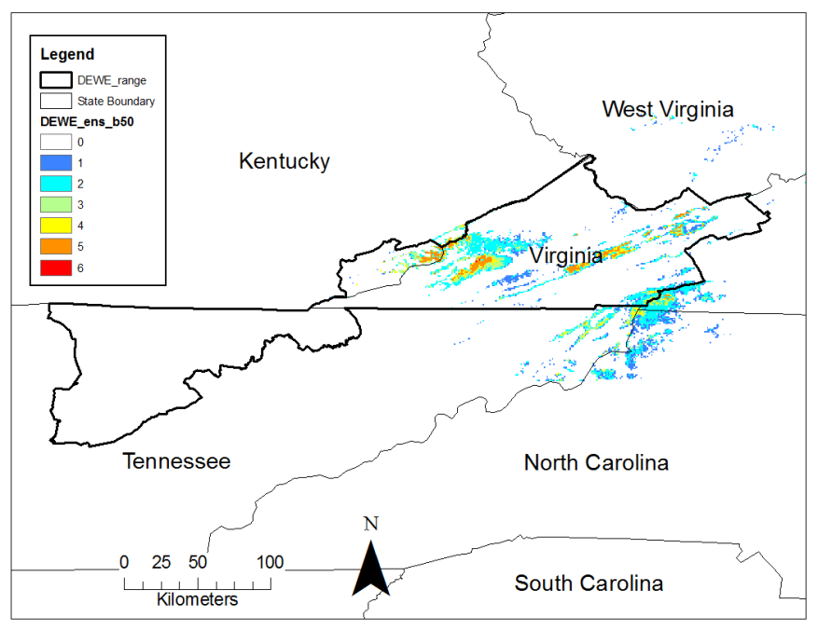
Assessing Priority Amphibian and Reptile Conservation Areas (PARCAs) and Vulnerability to Climate Change

Slide 14
Mapping the Distribution, Abundance and Risk Assessment of Marine Birds in the Northwest Atlantic
ACJV, BRI, NOAA, CUNY, FWS, USGS, DE
Series of maps depicting the distribution, abundance and areas of high, medium and low risk to marine birds from offshore activities in the northwestern Atlantic Ocean
Collation of historical and extant survey efforts and analyses
Predictive Modeling
Risk Assessment
Model Validation

Slide 15
Mapping the Distribution, Abundance and Risk Assessment of Marine Birds in the Northwest Atlantic

Slide 16
Northeast
Conservation Framework
GOAL-SETTING
Which species/habitats to conserve, when, how much, and who will work on it?
CONSERVATION DESIGN
BIOLOGICAL ASSESSMENT
Where are the best places to conserve the most species and habitats?
What do we know about the status of priority wildlife?
INFORMATION MANAGEMENT
PRIORITIES/TRIAGE
SCIENCE TRANSLATION
Which issues demand immediate attention?
How will we manage the demand for and creation of data?
How do we maximize the utility of science?
MONITORING, EVALUATION AND RESEARCH
CONSERVATION ADOPTION
What new information will we gather to support conservation?
How do we get the right people in the right places to adopt prescribed conservation actions?
ACTION DELIVERY
How will we most efficiently put conservation on the ground?

Slide 17
North Atlantic LCC Next Steps with Existing Information
Complete terrestrial habitat map in VA and MD Piedmont
Conservation atlas - compilation, synthesis, modification, translation and adoption of existing spatial data and tools
Pilot implementation of Information Management System

Slide 18
North Atlantic LCC Further Articulation Needed
Work group assessment of next steps for vulnerability of coastal wetlands, beaches and species to sea level rise
Work group assessment of next steps for aquatic mapping and modeling

Slide 19
North Atlantic LCC FY 2011 Projects (9)
1-5 approved in August
Work group assessment of next steps for aquatic mapping and modeling
TC recommends support for 6, 7, 9
TC and staff recommend balance go to 10 and 11
TC and staff recommend further articulation of 12 and 13

