Slide 1
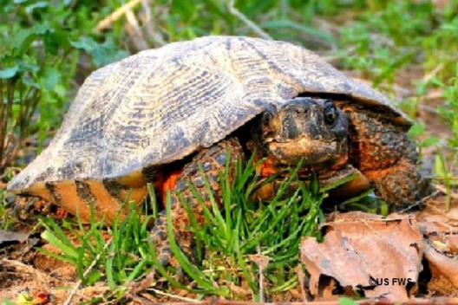
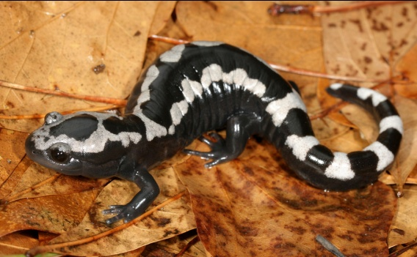
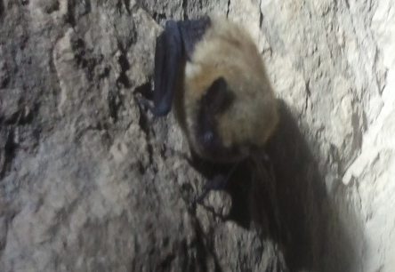

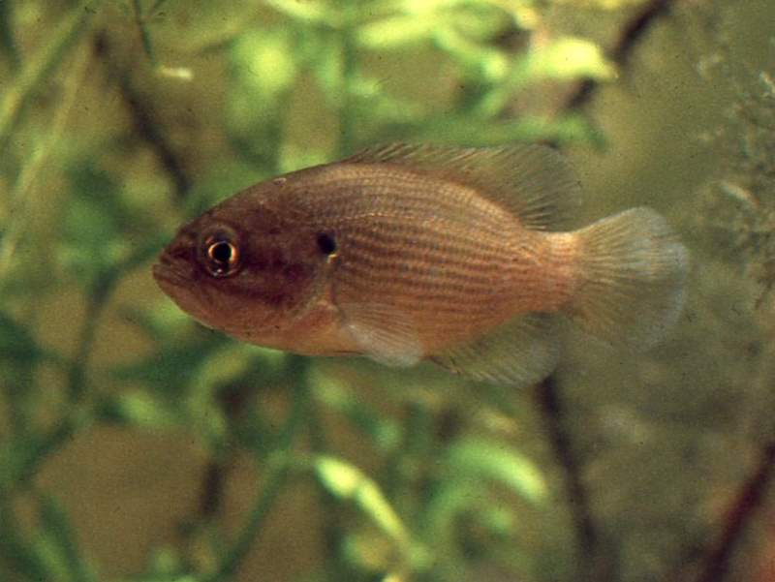
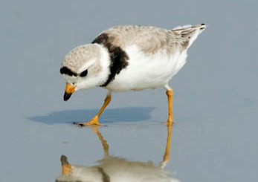
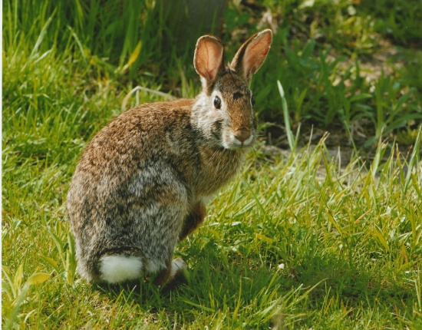
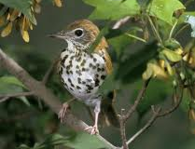
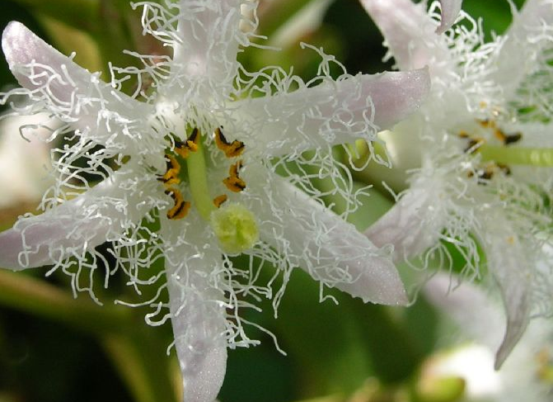
Species Resilience
Regionally Significant Species of Greatest Conservation Need

Slide 2
Responsibility and Concern
360 Species > 1 state
Level of Regional Concern: SWAPS
Low concern = listed in < 25% of states that contained it.
Moderate = 25-50%,
High = 50-75%,
Widespread >75%
Level of Regional Responsibility:
High responsibility = >= 50 percent of the U.S. distribution in the 13 states
Low responsibility = <= 50 percent of the U.S. distribution in the 13 states

Slide 3
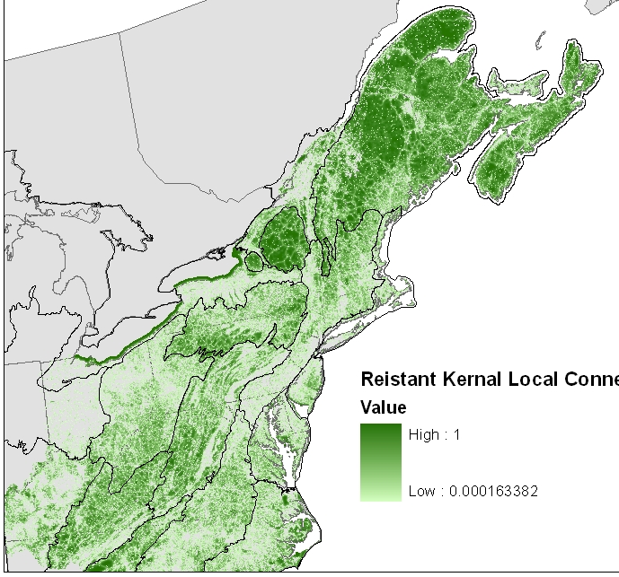
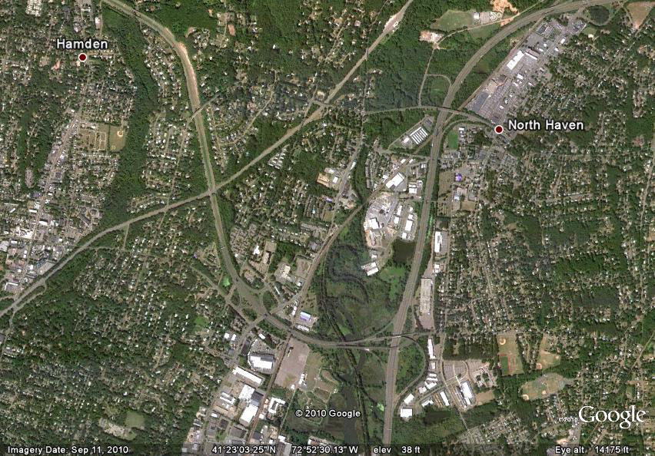
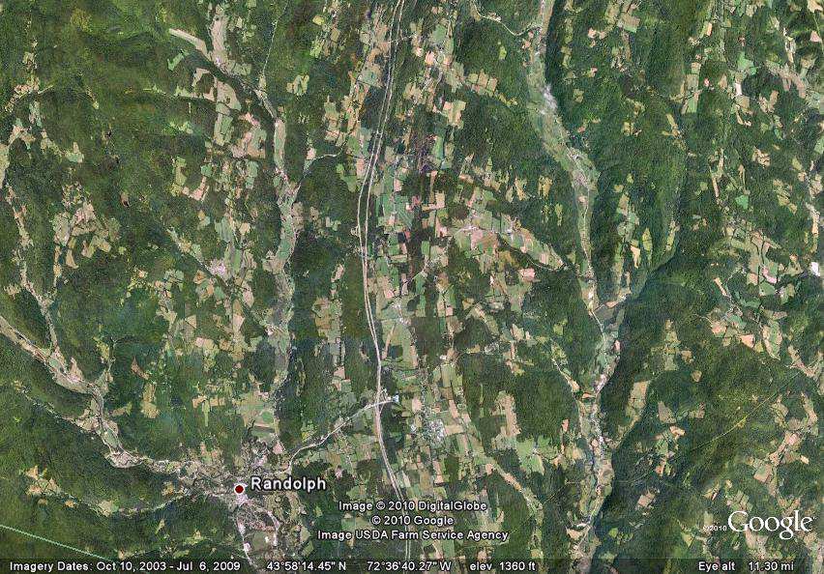
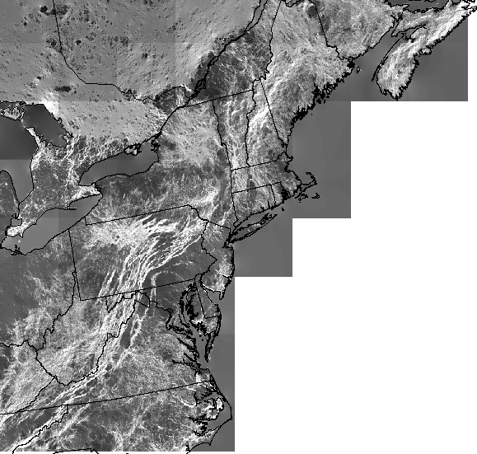
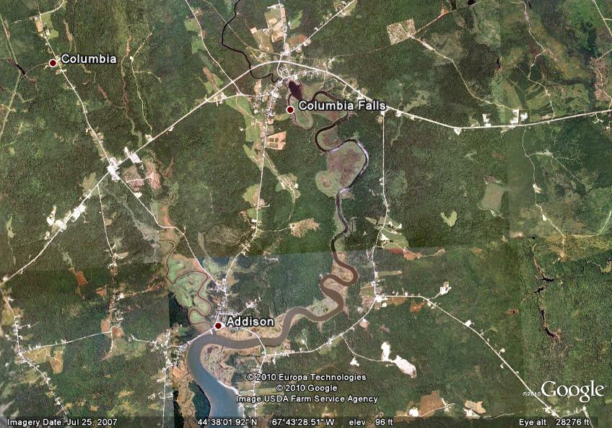
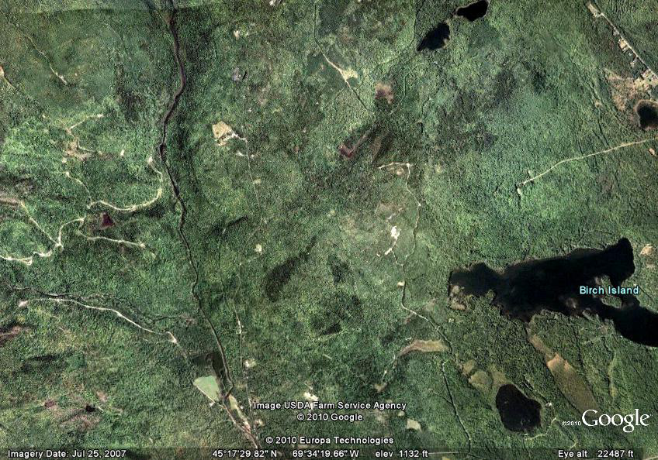
Situational Resilience: 1
Local Connectedness
Landscape Permeability
Measures of the resistance of the direct neighborhood surrounding the location (1) or of the potential concentration of flows through the location point (2).
Flow Concentrations

Slide 4
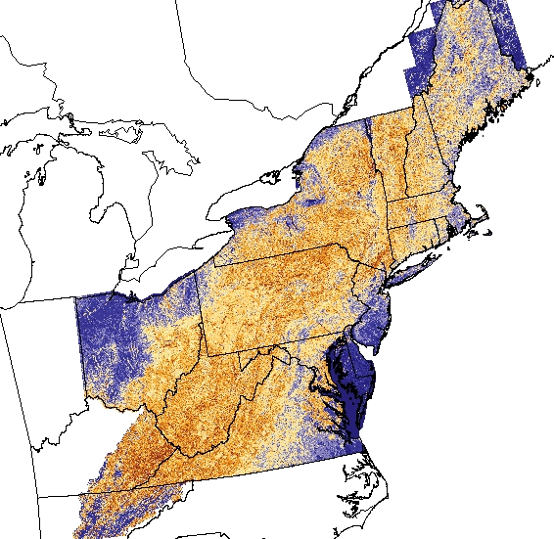
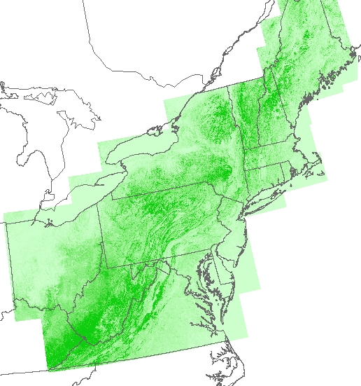
Situational Resilience: 2
Landform Diversity
Landscape Diversity
Measures of the topographic , elevation diversity, and wetland density in the direct neighborhood surrounding the location
What are the options for species to rearrange at the site level
Elevation range

Slide 5
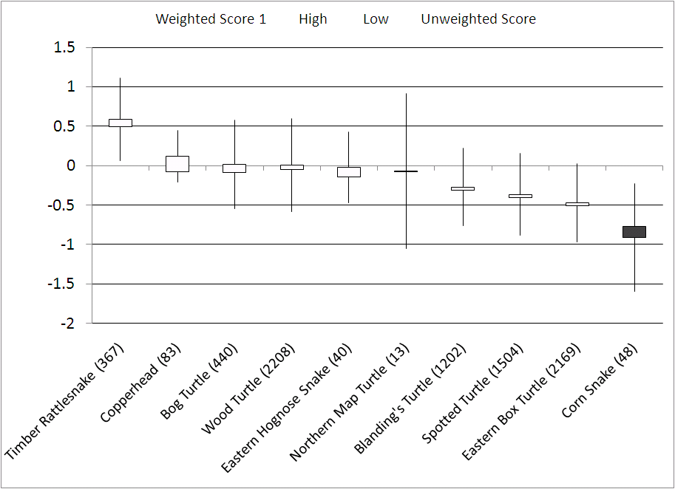
Example Results: Resilience Scores compared to Regional Mean
Based on 8074 locations
MEAN

