Slide 2
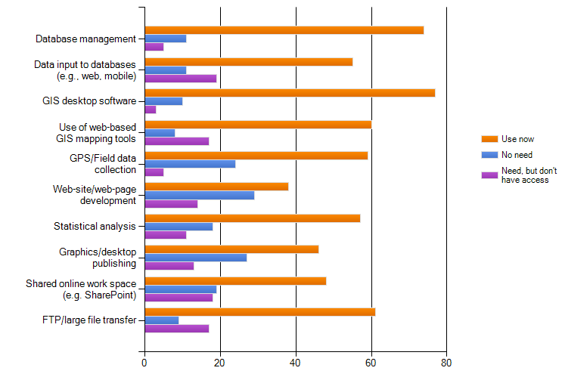
Technology Profile: What IT/GIS needs could NALCC be providing
Q# 10, Sec. 3
Full Sample
Greatest Need

Slide 7
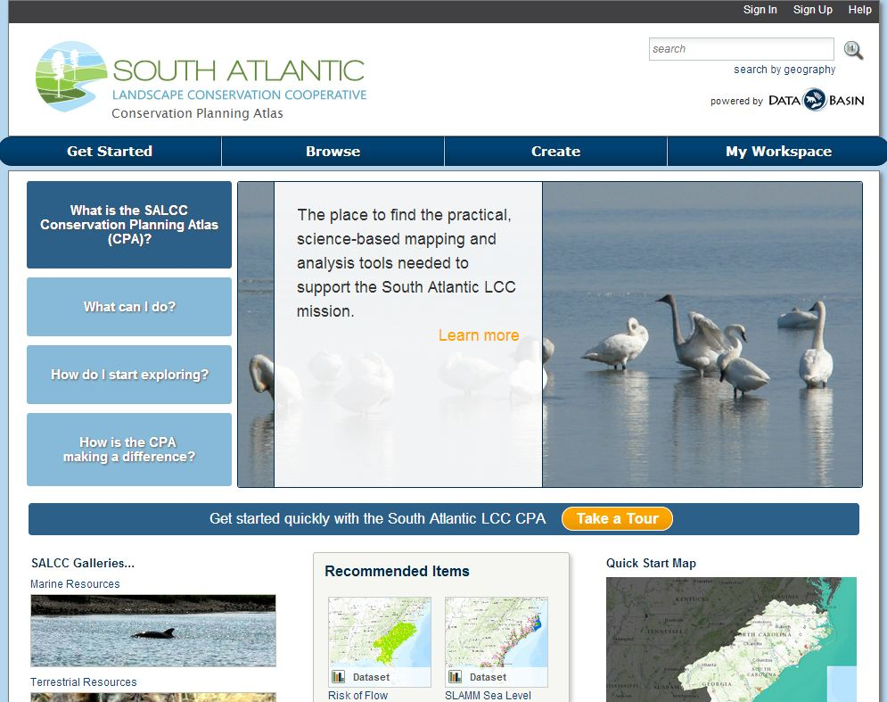

Slide 8
