Slide 1
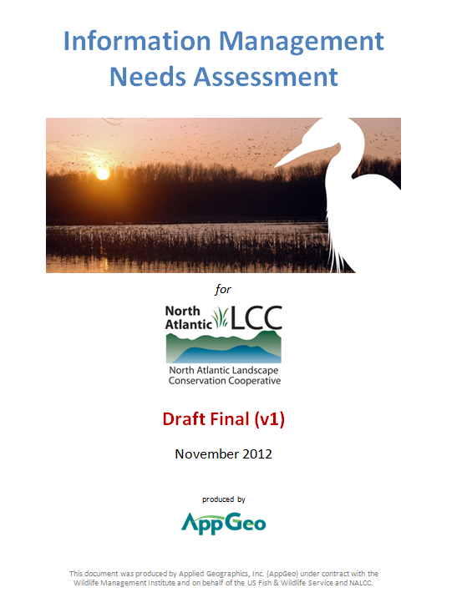
North Atlantic Landscape Conservation Cooperative New Paltz, NY – December, 2012 Information Management Needs Assessment FINAL PRESENTATION
Michael Terner
Executive Vice President

Slide 2
Overview
What we did
What we found out
What we recommend
Answering your questions

Slide 3
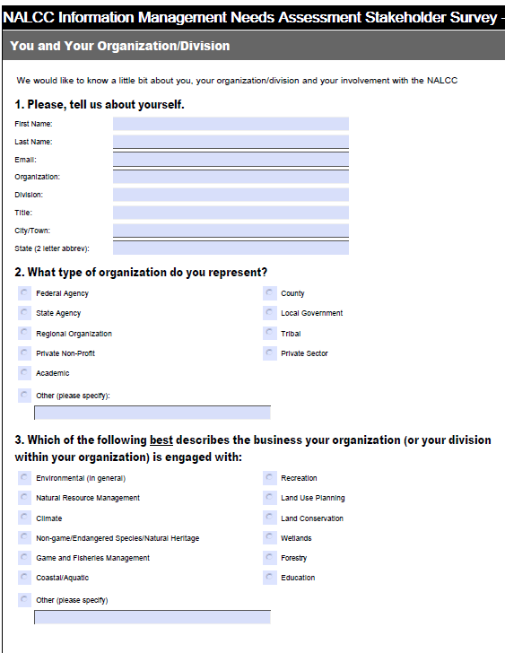
What we did
Project committee coordination
BJ Richardson as our point of contact
Briefing the Steering Committee
On-line survey
110 response
Two focus groups
19 participants
8 Stakeholder interviews
NALCC, FWS, WMI, NJ, UMass, TNC
Analysis, assessment & write-up of findings

Slide 4
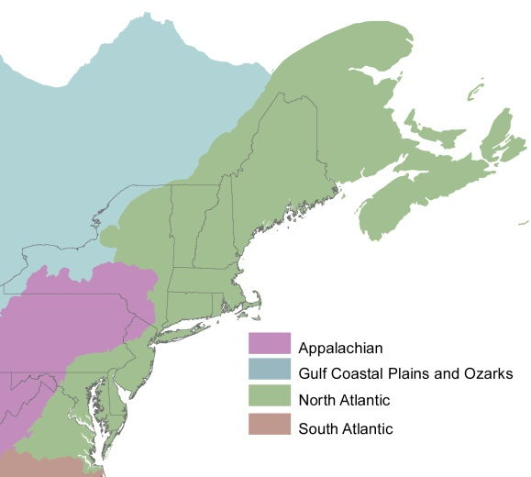
What we found out
Technology is key for 2 key goals of all LCCs:
Providing science to support landscape level conservation planning
Promoting collaboration
Two unique challenges:
Designing for a cooperative vs. an “organization”
Large and diverse in:
Geographic scope : inter-state and international
Organizational membership: science, government, non-profit

Slide 5
Strengths & weaknesses
Strengths
There’s lots of data
Lots of expertise within members
Great culture of cooperation
Head start in some areas (e.g., new regional data person in Hadley)
Weaknesses
Lack of a clear, obvious information management leader that might house the system
Questions about data stewardship and authoritative sources
Duplicative investments have been made due to lack of awareness of others’ efforts (e.g., landcover change)

Slide 6
Two significant drivers “Needs” that were repeated often and in many contexts
Ability to provide a holistic view across the region
To place local actions within a regional context
Ability to see all NALCC sponsored activities
What are we spending money on?
Where might there be data?
Who’s doing what?

Slide 7
Use Cases What are the questions that will be put to the system?
Providing the regional context: Statewide Wildlife Action Plans (SWAP) are aggregated to create "Regional Wildlife Action Plan"
Assessing the effectiveness of management activities: Planning for management activities at the "land parcel" or "refuge" level
Is this particular place important?
What are its vulnerabilities?
Are we monitoring to validate success/failure?
Aligning priorities across organizations: Private non-profit conservation planning to align with established governmental priorities

Slide 8
So what do we propose to do about it?

Slide 9
This is about needs; not architecture

Slide 10
A Potential Vision
NALCC will establish an info management system
This system will:
Provide a holistic, region-wide view
Be information rich and readily available
Provide data and tools to facilitate planning and “deliver conservation on the ground”

Slide 11
Three Strategic Goals To move us towards realizing the vision
Design and create a regional information management system (IMS) capacity
Populate the IMS with relevant, region-wide data
Provide tools for accessing and portraying the data

Slide 12
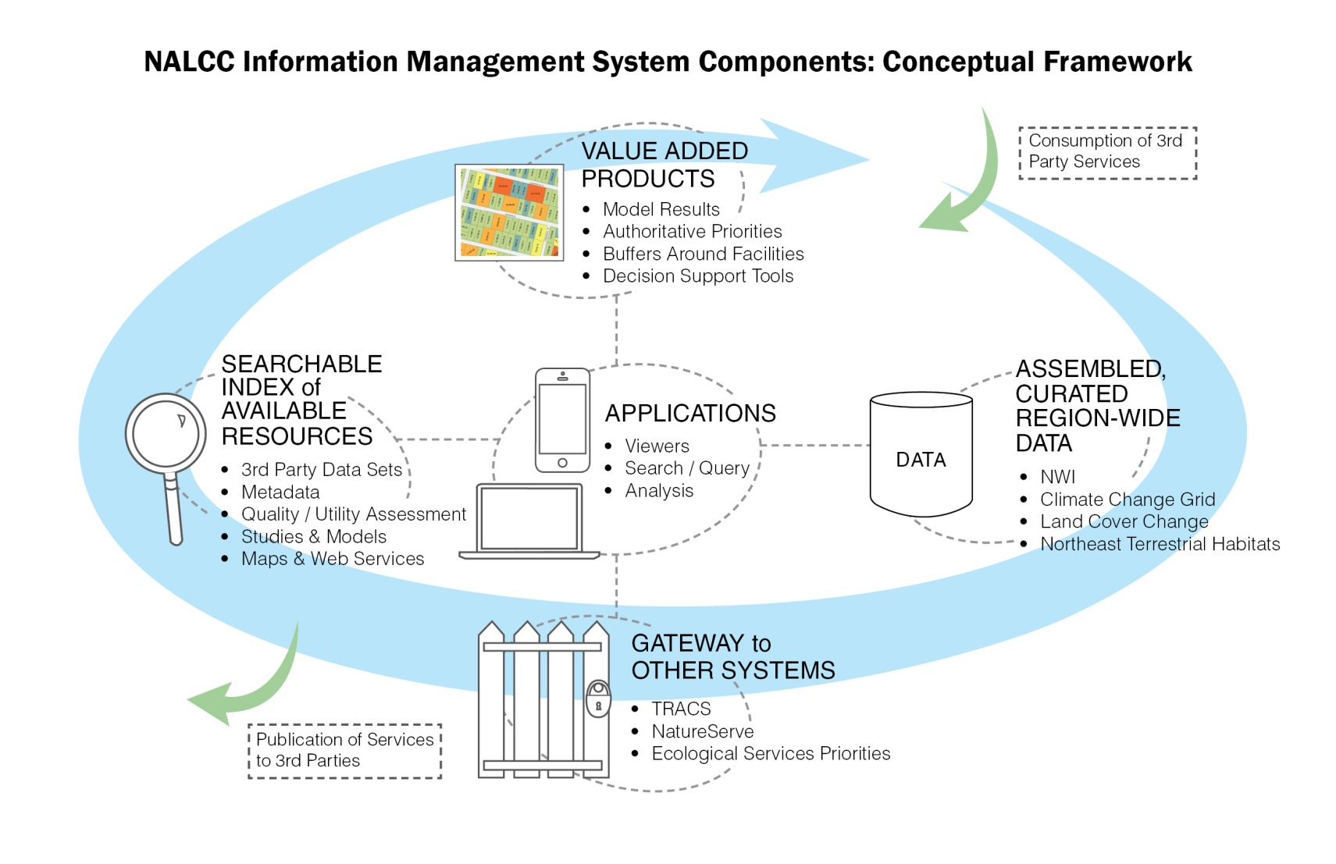
Programmatic Goals Recommendations To move us towards achieving the strategic goals
Design and create a regional information management system (IMS) capacity
Design and architect the actual system
Engage with members who could potentially host it
Budget and find funding to begin

Slide 13
Programmatic Goals/Recommendations To move us towards achieving the strategic goals
Populate the system with relevant, region-wide data and actively steward those data
Perform a detailed inventory of available data
Identify work necessary to create regional data from existing state data sets
Begin assembling region-wide data
Commence planning for non-existing data sets
Inventory of NALCC activity; Extracts from state SWAPs; etc.
Establish standards to routinely receive information management products as part of projects/procurements

Slide 14
Programmatic Goals/Recommendations To move us towards achieving the strategic goals
Provide tools for accessing and portraying NALCC region-wide data
Plan and identify funding to develop priority tools/applications for general access to NALCC data
Publishing data sets
General viewers of data
Plan and identify funding to develop priority, specialized and workflow oriented tools/applications
E.g., Provide regional conservation context for a location

Slide 15
Implementation Guidance Because this study is about needs, not implementation
Keep the effort manageable
Five $50k projects may be better than one $1M project
Use agile development & deployment
Like a “design-build” for technology
Plan for technology change
Think mobile from the outset
Think about third-party/outsource hosting of the system
Don’t forget that data can be the most expensive part
Leverage existing projects when possible
NALCC web-site re-design; ScienceBase; et al
Prioritize carefully

Slide 16
What might this cost? 24 month budget estimate

Slide 17
Your questions
?
Michael Terner
mgt@AppGeo.com

