Slide 1
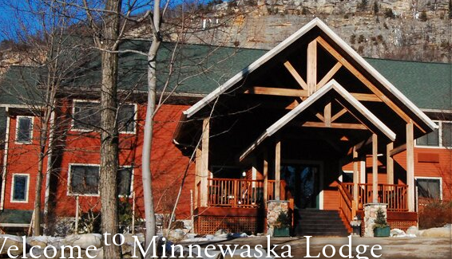
Northeast Climate Science Center
Standing Up and Walking
Mary Ratnaswamy¹ and
Richard Palmer²
Director, DOI Northeast Climate Science Center
Professor and Head, Department of Civil and Environmental Engineering, UMass Amherst
North Atlantic Landscape Conservation Cooperative Workshop, Minnewaska Lodge, Gardiner, NY

Slide 2
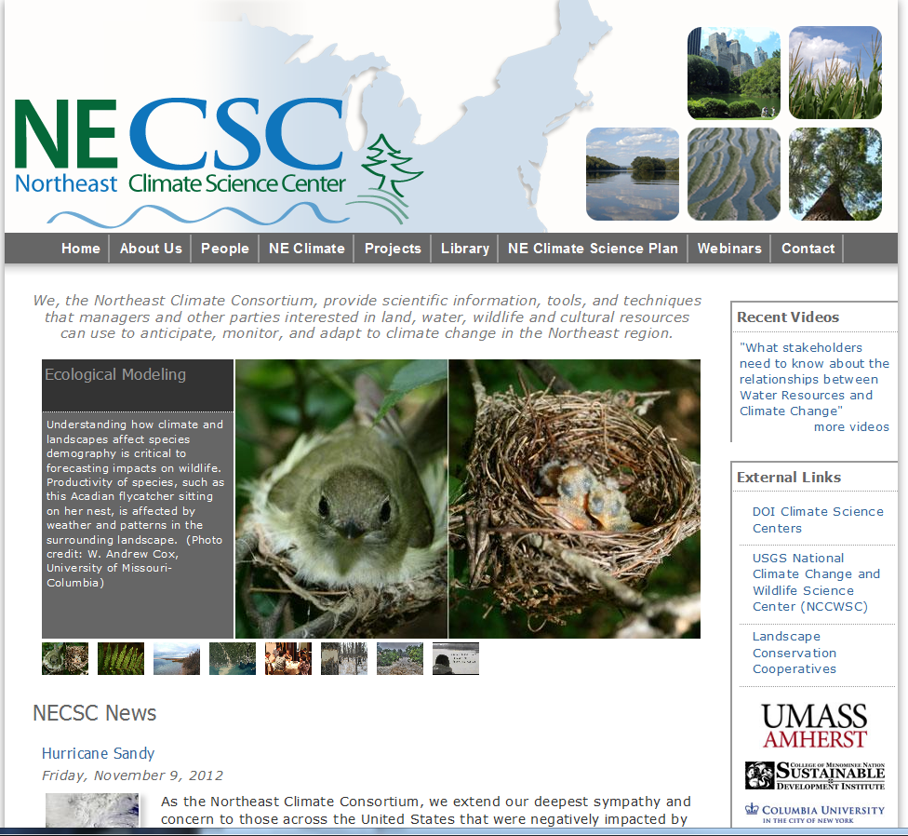

Slide 3
Talk Outline
What is the Northeast Climate Science Center ?
Purpose, Geographic scope, Partners
Principal Themes and Strategic Science Agenda
Current sponsored research
Strategic and Operational Aspects of CSC
Building Blocks and Next Steps

Slide 4
What is the NE CSC?
The Northeast Climate Consortium provides scientific information, tools, and techniques that managers and other parties interested in land, water, wildlife and cultural resources can use to anticipate, monitor, and adapt to climate change in the Northeast region.

Slide 5
What is the NE CSC?
The Center will actively engage LCCs and other partners in translating science into management decisions.

Slide 6
What is the Geographic Range of the NE Climate Science Center?
Notes:
Region 10 – North Atlantic
Region 1 – Appalachian
Region 4 – Eastern Tallgrass Prairie and Big Rivers
Region 16 – Upper Midwest and Great Lakes
Region 14 – South Atlantic
Region 9 – Gulf Coastal Plains and Ozarks
Region 13 – Plains and Prairie Potholes

Slide 7
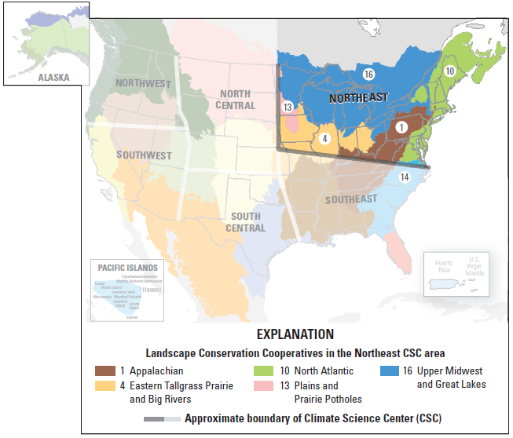
Notes:
Region 10 – North Atlantic
Region 1 – Appalachian
Region 4 – Eastern Tallgrass Prairie and Big Rivers
Region 16 – Upper Midwest and Great Lakes
Region 14 – South Atlantic
Region 9 – Gulf Coastal Plains and Ozarks
Region 13 – Plains and Prairie Potholes

Slide 8
Northeast Region
22 states, 10 of the 22 LCC regions, over 130 million people and multiple ecoregions
Extreme gradients in environments and threats
Limited federal lands, pattern of ownership and management dominated by relatively small and privately owned parcels
Complex history of species extirpations, invasions, range extensions, and restorations
Complex climate predictions of regional impacts
Wide array of stakeholders
Notes:
Update number of LCCs covered?

Slide 9
Vision
A stakeholder-driven, interdisciplinary, and geographically distributed team that:
Empowers decision makers with appropriate climate information and knowledge
Supports resource conservation for climate adaptation and mitigation
Operates with a high level of transparency and engagement
Engage appropriate partners with appropriate resources

Slide 10
University of Massachusetts Amherst
Richard Palmer (Lead PI)
Ray Bradley (PI)
Curt Griffin (PI)
Keith Nislow (PI)
College of Menominee Nation
Chris Caldwell (Lead PI)
Columbia University
Radley Horton (Lead PI)
Marine Biological Laboratory
Linda Deegan (Lead PI)
University of Minnesota
Anthony D’Amato (Lead PI)
University of Missouri Columbia
Frank Thompson III (Lead PI)
University of Wisconsin-Madison
Ken Potter (Lead PI)

Slide 11
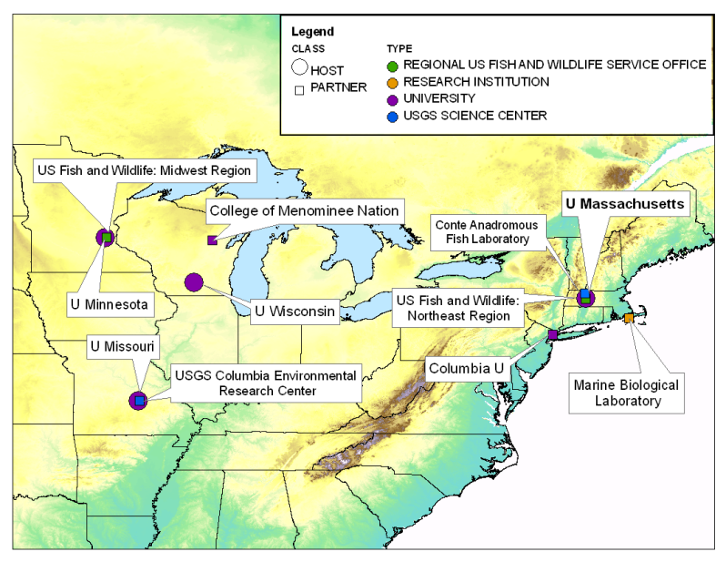
Notes:
Need to update?

Slide 12
Typical Large Proposal Process
(Rumors about opportunities)
Call for proposal
Complicated Dances
Disillusion
Create the proposal
Unwarranted Optimism
Selection of finalist
Site visit
Final Selection

Slide 13
Climate Change Projections
Freshwater Resources
Coordination & Outreach
Marine Environment
Land Use and Land Cover
Ecosystem and Species Response
Cultural Resources
Research Institutions
Participation USGS, LCCs, others
Decision Frameworks
Coordination and Outreach
Notes:
13

Slide 14
Financial Aspects of NE CSC
UMass Amherst is lead academic institution
Palmer is Principal Investigators, Bradley, Griffin, and Nislow are Co-PIs
Base funding is $1.5 million per year
60% of funding goes to UMass, other is distributed between other coalition members
Vast majority of funding going to support Post-docs and graduate students

Slide 15
NECSC Science Agenda
Climate change projections for decision making by resource managers
Climate impacts on freshwater resources and ecosystems
Coastal and near shore response to climate change
Climate impacts on land-use and land-cover change
Ecosystem vulnerability and species response to climate change
Impacts of climate change on cultural resources
Decision frameworks for evaluating risk and managing natural resources under climate change
Notes:
ongoing research and research capacity in the Consortium/associated researchers and USGS including Nislow, Letcher, Polebitski, Palmer, Stewart, Grant (ARMI), others?

Slide 16
NECSC FY12 Projects
Temperature inventory mapper to evaluate climate change impacts on regional streams
Impacts of climate change on stream temperature
Evaluation of sea-level rise impacts in the NE U.S.
Terrestrial and wetland habitat classification and mapping including of climate sensitive systems
Variability in fish response to climate change
Developing fish trophic interaction indicators of climate change for the Great Lakes
Mapping the terrestrial habitats of Atlantic Canada
Interaction of agriculture with climate change

Slide 17
Climate impacts on freshwater resources and ecosystems
Climate Change in the Headwaters
Important as aquatic refugia
Addressing impacts of climate change on stream temperature and stream flow
Using data and modeling frameworks
Partners/stakeholders:
U.S. Forest Service
USGS
U Mass
Notes:
“What data and modeling frameworks are needed to provide scientists reliable, climate-informed, water temperature estimates for freshwater ecosystems that can assist watershed management decision making?”

Slide 18
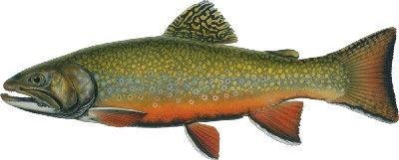
Climate impacts on freshwater resources and ecosystems
Great Lakes
Developing Fish Trophic Interaction Indicators of Climate Change in the Great Lakes
Wetland mapping
…and other regional stream systems
Stream temperature inventory mapper and data portal for evaluating climate change effects
Notes:
What will be achieved in three to five years?
Currently building on initial projects – expanding in scientific and geographic scope

Slide 19
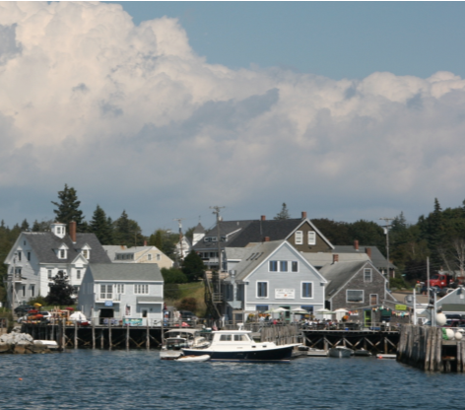
Coastal and near shore response to climate change
Characterize impacts of sea-level-rise, flooding, etc.
Address uncertainty around extreme weather events
Understand the effects of sea-level rise and nutrient loading on saltmarsh ecosystem function
Notes:
-Characterize the impacts and vulnerabilities of wetlands, marshes, and estuaries to sea-level-rise, flooding, and other anthropogenic stressors
-collaborations with the SECSC on sea-level rise
Deegan work on nutrient enrichment
What will be achieved in three to five years?

Slide 20
The Approach
LCAD model
Landscape Change
Hydrology
Fish
Ecological
Settings
Drivers:
Climate
Urban growth
Veg disturb
Uncertainty
Scenarios
Succession
Conservation
Scenarios
Species
Ecosystems
Landscape Assessment
Landscape Design
Climate-habitat
capability index
Ecological integrity index

Slide 22
Strategic and Operational Aspects of the Center
Financial Aspects
Science Planning
Coordination with Stakeholders
Tribal Outreach
Education

Slide 23
Financial Aspects of NE CSC
In addition to base funding, USGS provides annual research to address specific climate science needs of stakeholders
This sponsored funding is competitively awarded
Next year funding will be $1 million, although some funds are allocated to complete year 1 projects
Anticipate this funding level to slowly grow over time

Slide 24
Science Planning
Draft Science Agenda (5 year science plan)
- review
- revise
- approval process
- publish as open file report

Slide 25
Coordination with Stakeholders
Coordination with LCCs; federal and state partners
Stakeholder Meetings
Interim Stakeholder Advisory Committee
Technical Committee (SIP)

Slide 26
Tribal Outreach
Tribal Outreach Strategy
Letter sent to 75 recognized Tribes
Informal Consultation
Formal Consultation
SAC
Stakeholder meetings

Slide 27
Science Capacity and Education
Graduate Student Cohort
Seminars
Boot camp
Cross-CSC details
Early days

Slide 28
BUILDING BLOCKS AND NEXT STEPS
Draft Science Agenda (2013-2018)
Interim Stakeholder Advisory Committee (SAC)
Formal Stakeholder Meetings in January
Tribal Outreach Strategy
FY13 Annual Priorities and RFP
FY14 Annual Priorities and RFP
Building Science Capacity/Mentoring Students

Slide 29
Schedule for Submission, Review, Awards:
Deadline for submission of Statements of Interest February 8, 2013
Reviews with Regional Partners and Technical Review Week of February 11
Applicants Notified and Full Proposals Requested February 25
Invited Full Proposals Due March 25
Technical and Other Reviews Mar-Apr
Final Candidate Projects Identified NLT May 1
Cross-Project and Cross-CSC Reviews May
Applicants Notified of Intent to Award NLT June 1
(“Intent to Award” means a CSC has selected the project for funding, pending completion of all administrative reviews and processing to complete formal awards. See below for additional details.)
(all due dates are “by midnight Mountain Standard time”)

Slide 30
Thanks!

Slide 32
Science Agenda
Develop strategies with regional stakeholders to identify the key research and scientific questions of immediate and long-term importance to the region in coping with challenges posed by climate variability and climate change.
Determine appropriate role of global and regional climate models for informing short-term and long-term decision making in the Northeast.
Pioneer new analytical and science support tools for landscape scale analyses of climate change effects, and regional conservation networks.
Characterize water resources and needs on public lands for conservation of priority fish and wildlife resources.

Slide 33
Science Agenda
Develop information that reduces uncertainty related to habitat fragmentation and connectivity, species mobility, and species tolerance.
Explore climate change on sea level rise and its associated impacts on coastal processes, habitat, and conservation activities.
Develop and apply disciplined and structured decision making processes and tools spatially and temporally integrating habitat objectives and management options for priority species/populations in the region.

