Slide 1
Science Translation, Conservation Adoption and Delivery: Revised process for needs and projects related to science translation and adoption
Background:
An ad hoc demonstration projects committee was convened in 2011 to address demonstration projects. The work of the ad hoc committee resulted in submission at the April meeting of the NALCC of three proposals for the application and testing of science and tools. The proposals were advanced for further development, were submitted and were approved by the LCC Steering Committee in September.
Steve Fuller
Conservation Design Specialist
U.S. Fish and Wildlife Service

Slide 2
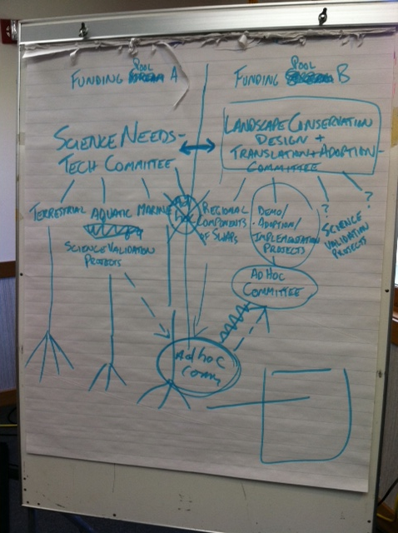
The ad hoc demonstration projects committee was asked to develop a framework for demonstration projects;
The committee recognized that demonstration projects are part of a broader need for assessment of science delivery projects in NALCC;
…and better inclusion of land mangers, NGOs, land trusts, including NEHTC and other delivery oriented entities in the development of projects

Slide 3
Northeast
Conservation Framework
GOAL-SETTING
Which species/habitats to conserve? At what levels?
Who decides?
CONSERVATION DESIGN
BIOLOGICAL ASSESSMENT
What should landscapes look like to conserve species at goal levels
What do we know about the status of priority wildlife?
SCIENCE DELIVERY
INFORMATION MANAGEMENT
PRIORITIES
SCIENCE TRANSLATION
Which species and issues demand immediate attention?
How will we manage the demand for and creation of data?
How do we make science solutions useful?
MONITORING, EVALUATION AND RESEARCH
CONSERVATION ADOPTION
What new information will we gather to support conservation?
How do we get communities and landowners engaged in conservation?
CONSERVATION DELIVERY
How will we most efficiently put conservation on the ground?

Slide 4
Science Delivery has unique needs beyond our current activity
Requested Actions:
1. Initiate a Science Delivery needs assessment process in parallel with the science needs assessment over the next year to reflect the broad need of managers and decision-makers to develop and use specific applications of NALCC science products in support of the implementation of landscape conservation. This needs assessment is consistent with elements of the Northeast Conservation Framework related to Conservation Design, Science Translation, Conservation Adoption, and Conservation Delivery.
2. Integrate demonstration projects broadly as one of the approaches to address priority needs identified by the Science Delivery needs assessment.
3. Dissolve the ad hoc demonstration committee established in November, 2011.Establish a standing Science Delivery team that would focus on the tasks above and would complement the LCC Technical Team.

Slide 5
To date, certain science translation, conservation adoption and conservation delivery needs have been identified through the Northeast Conservation Framework Workshop, the North Atlantic LCC Conservation Science Strategic Plan and prior LCC science needs assessments. Several LCC projects are now developing decision support tools and engaging partners to get their input on what their decision support needs are.

Slide 6
Science Delivery Overlaps with Conservation Design
Conservation Design
Regional consistent spatial data
NEAFWA/LCC Regional Synthesis
Habitat condition, capacity & objectives
Designing Sustainable Landscapes; geospatial condition analysis; secured and managed lands status
Predicting Landscape Change
Designing Sustainable Landscapes; brook trout; piping plovers & SLR; PARCA
Landscape Designs/ Decision Support tools
Designing Sustainable Landscapes; PARCA; marine birds; brook trout; piping plovers, geospatial condition analysis

Slide 7
Science Delivery has unique needs beyond our current activity
Conservation Translation Adoption and Delivery
Science Translation
Northeast Landscape Conservation Design: Conservation Design Specialist, GIS Analysts, NEAFWA/LCC Regional Synthesis
Assess Decision Support Needs
Decision-maker workshops: Designing Sustainable Landscapes; Forecasting Changes in Aquatic Systems
Conservation Adoption
Demonstration Projects
Conservation Design Specialist
Science Delivery Team
Support for regional geographic partnerships (e.g. Gulf of Maine, Connecticut River Watershed, Chesapeake Bay

Slide 8
Science Delivery has unique needs beyond our current activity
Preliminary Needs Assessment Categories:
Testing Landscape Design Tools
Science Translation
Adoption Tools and Strategies
Enhancing Practitioner Networks
Data management tools

Slide 9
Science Delivery has unique needs beyond our current activity
Examples:
Engage implementers such as NGOs, NE Habitat Technical Committee, and Regional Planners in assessment process
Develop desktop GIS tools for local management decisions
Develop Strategies to use science to identify and recruit specific landowners for conservation
Develop step-down products from regional plans
Provide training and support to users of NALCC science
Develop database tools to track habitat management and land protection

Slide 10
Science Delivery has unique needs beyond our current activity
Suggested Next Steps:
Develop timeline for assessment
Identify key members of a Science Delivery Team
Allocate funds to priority needs based on scope of needs

