Slide 1
Update on Northeast Landscape Conservation Design and Synthesis for SWAP Revisions
Steve Fuller
Conservation Design Specialist
U.S. Fish and Wildlife Service

Slide 2
NE Landscape Design Expected Outcome:
Create baseline landscape conservation designs, without which past, present, and future investments in landscape analysis will remain unrealized, underutilized, or ungrounded:
Identification of landscape elements important to diverse partners, including cultural elements, rare species, ecological systems, landscapes, or watersheds;
Data layers summarizing environmental conditions that describe the status of each landscape element;
Data layers summarized at multiple scales to describe the collective status of all the landscape elements within important geographies or jurisdictions.

Slide 3
Objective NE Conservation Synthesis for SWAPs:
To synthesize regional conservation information including ongoing and completed work from the RCN program and LCCs into a format that states can easily access and incorporate into their SWAP revisions, and to influence continued implementation of regional priorities by making this information easily accessible to states and conservation partners.

Slide 4
Conservation Design Advisory Committee
LCC Project:
Northeast Landscape Conservation Design
LCC Project:
Data Needs Assessment Contractor
RCN Proposal:
SWAP Database Framework Contractor
RCN Proposal:
Regional SWAP Synthesis Contractor
SWAP Database Design
PHASE 1
SWAP Database Construction
An ad hoc group of LCC and RCN leaders have been working to assemble the team
SGCN screening is complete and data requests are processing
NALCC and TNC have hired GIS Analysts
The RCN SWAP Database project is on hold for TRACKS
RCN SWAP Synthesis contractor has a contract in hand: Terwilliger Associates
FWS has identified 13 representatives to assist the Advisory Committee

Slide 5
Conservation Design Advisory Committee
LCC Project:
Northeast Landscape Conservation Design
LCC Project:
Data Needs Assessment Contractor
RCN Proposal:
SWAP Database Framework Contractor
RCN Proposal:
Regional SWAP Synthesis Contractor
SWAP Database Design
PHASE 1
SWAP Database Construction
PHASE 2
Maps and Spatial Data Summaries for Regional Components of the 8 SWAP Elements
Populate Database to complete Regional component of the 8 SWAP Elements
CompileText and Tabular Regional Components of the 8 SWAP Elements
The function of NALCC and TNC GIS analysts is to facilitate spatial data acquisition for SWAPs
Lori (NALCC) as assembling landscape data for U.S. and Canada, and SGCNs
Alex (TNC) will help align TNCs ongoing RCN products with needs of SWAP Synthesis
We need continued support on SGCN data request.

Slide 6
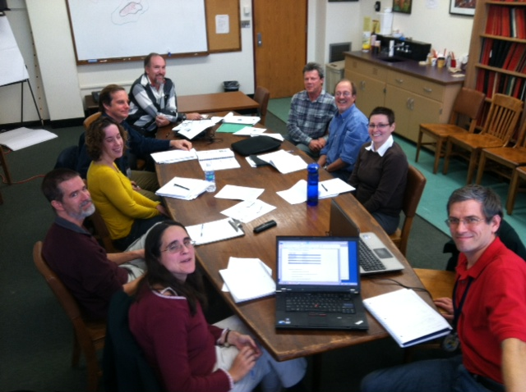
WCS Canada

Slide 7
Conservation Design Advisory Committee
LCC Project:
Northeast Landscape Conservation Design
LCC Project:
Data Needs Assessment Contractor
RCN Proposal:
SWAP Database Framework Contractor
RCN Proposal:
Regional SWAP Synthesis Contractor
SWAP Database Design
PHASE 1
SWAP Database Construction
PHASE 2
Maps and Spatial Data Summaries for Regional Components of the 8 SWAP Elements
Populate Database to complete Regional component of the 8 SWAP Elements
CompileText and Tabular Regional Components of the 8 SWAP Elements
PHASE 3
LCC Project:
Website & Portal Development
Voluntary Inclusion
14 SWAPs
Web Portal for:
Regional “Roll-down”
State “Roll-up”
14 SWAPS

Slide 8
the RCN-funded project to develop a SWAP database is on hold…the emphasis of that project will be “Roll-Up” of completed SWAPs;
SWAP database needs to be piloted via the Synthesis and “Roll-Down” process;
our Info Needs Assessment indicates states have the “best” data;
NALCC website can provide a portal for SWAP roll-down;
We are using Amazon Cloud for easy data access;
Specialized querying and report generation needs to be developed in support of SWAP Synthesis.

Slide 9
TO GET STARTED, we need an organized place to put the information we gather

Slide 10
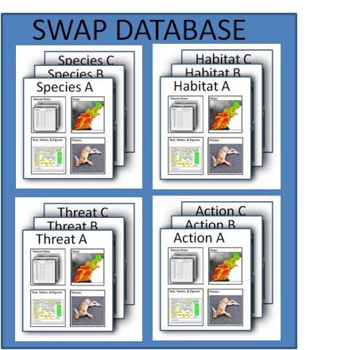
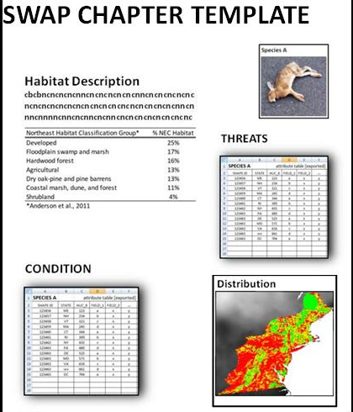
Summary of SWAP data flow
Files & records within files are identified by Species, Habitats, Threat, Actions
and/or a nested categorical location
Database can be queried to summarize complex information…
TO FINISH, we need efficient information summary capability

Slide 11
Summary:
NatureServe estimate is >$20,000
NatureServe does not have data for all the top priority species…
We need continued state help to assemble “the best” information
We need information management support to develop queries and SWAP template reports efficiently from information gathered…rough estimate is $30,000…this will serve as a pilot for RCN project to roll-up finished SWAPs
Need continued support for project staff beyond year 1

