Slide 1
Designing Sustainable Landscapes Decision Support Tools Progress and Next Steps
North Atlantic LCC
Steering Committee Meeting
Gardiner, New York
December 12, 2012
Scott Schwenk, Science Coordinator
Andrew Milliken, Coordinator
Ken Elowe, Chair
North Atlantic Landscape Conservation Cooperative

Slide 2
Designing Sustainable Landscapes
Led by Kevin McGarigal, UMass Amherst
Assessing capability of current landscapes to sustain wildlife and ecosystem integrity
Predicting effects of landscape-scale changes – climate change and urban growth
Decision support tools to help managers target conservation work

Slide 3
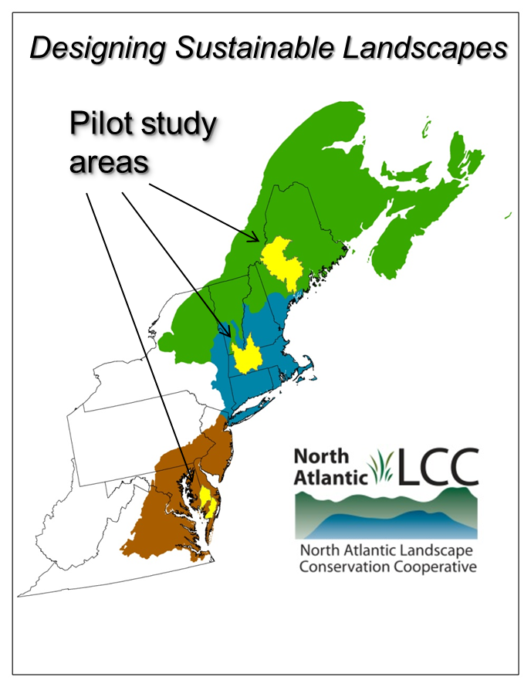
Project Scope
Phase 1 – pilot areas
(2010 – June 2012)
Phase 2 – full Northeast
(1st year June 2012-2013)
Decision support tools &
additional species

Slide 4
Decision Support Tools
Designing Sustainable Landscapes Workshops
three day-long workshops, October 2012
Maine, Maryland & Massachusetts
Over 100 partners attended
Federal, State, NGO, local
Broadcast live, to be archived
Presented background, project overview, products, options for decision support tools, opportunity for feedback

Slide 5
Decision Support Tools
General Feedback
Enthusiastic about progress; envisioned using tools in conservation planning
Downloading and using regionally consistent raw and synthesized data will be useful, especially in conjunction with local data;
Standard products will also be useful at multiple spatial scales (region, state, watershed, ecoregion);
Ability to develop custom analyses (on the web) could be desirable in the future;
Packaging and marketing information in relatively simple form will be important for some audiences

Slide 6
Decision Support Tools
Decision Support Tool Feedback
Deciding on goals and how to weight various tools is both important and challenging;
Being able to use these tools to begin answering the “how much” question will be important;
Consideration of agricultural lands as ecological systems and habitats important;
Suggestions that tools address how to prioritize restoration of agricultural lands;
Addressing coastal areas in the future will be critical;
Indices of species response to climate change will be useful .

Slide 7
Decision Support Tools
Next Steps
Partners downloading, using and testing data
Decision support work groups in three LCC subregions to be formed
Decisions needed on standard scales
Need to articulate goals (conservation targets) for landscape designs and decision support tools

