Slide 1
North Atlantic LCC RFP Topics 1&2: Recommendations for Funding
North Atlantic LCC
Steering Committee Meeting
Gardiner, New York
December 12, 2012
Scott Schwenk, Science Coordinator
Andrew Milliken, Coordinator
North Atlantic Landscape Conservation Cooperative

Slide 2
North Atlantic LCC RFP Topic 1: Aquatic and Coastal Species Science Needs
Purpose and Background:
To better understand distribution, habitats, and threats for key aquatic/coastal species across the North Atlantic to enhance conservation decisions
High priority:
Atlantic Coastal Fish Habitat Partnership (ACFHP)
NALCC Technical Committee
Complements existing LCC work (brook trout; stream flow and temperatures; aquatic integrity)

Slide 3
Process
January to March: Technical Committee review of science needs
April 18: Steering Committee approval of topic
July 6: WMI issues RFP
August 17: RFP closes; 14 proposals received
August – October: technical review panel assembled and reviews proposals
Co-chaired by Emily Greene, ACFHP
15 reviewers
4 state agencies
EPA, NOAA, USGS, USFWS

Slide 4
Results of Technical Panel Review
Top 5 proposals: addressed majority of NALCC geography
Initial scoring: proposal by Downstream Strategies ranked highest
Technical review panel discussion and follow-up questions confirmed scoring results
Consensus recommendation of the review panel: NALCC Steering Committee select Downstream Strategies for full $250,000 funding

Slide 5
Downstream Strategies Proposal
Stakeholder / expert involvement to inform assessment process
End result: Decision Support Tool
Visualize, rank, and manipulate inputs to prioritize conservation
Regional users: use to target conservation projects where most effective in a regional context
Local users: understand and address conditions and stressors at catchment scale

Slide 6
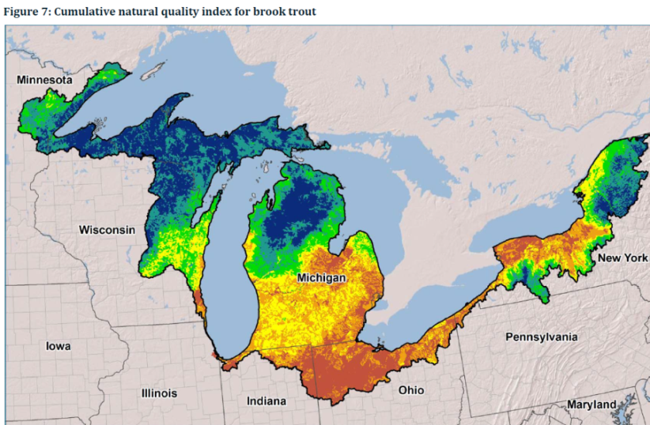
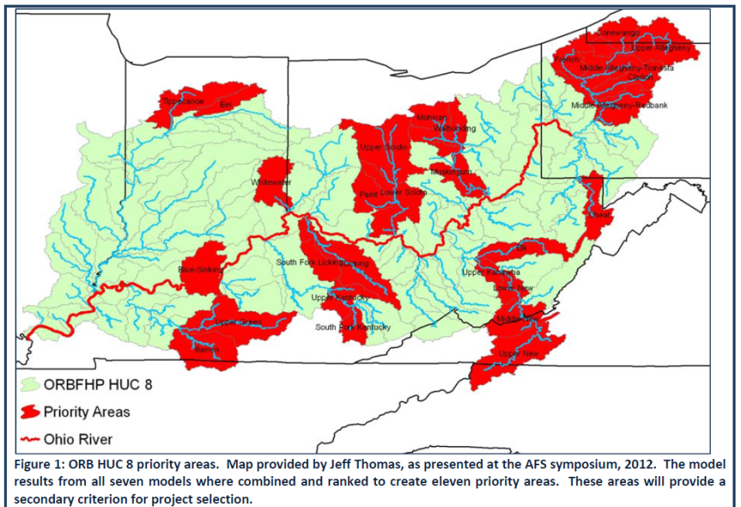
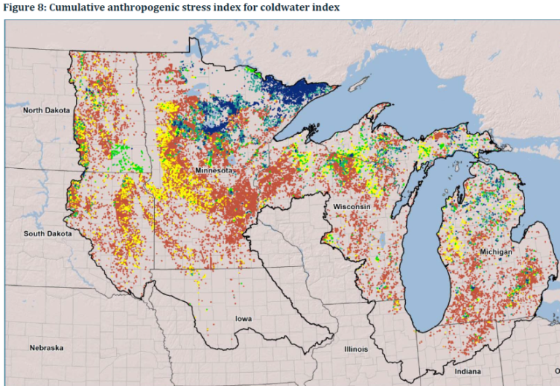
Related Work by Downstream Strategies
Evaluating aquatic habitat condition for Great Lakes Basin Fish Habitat Partnership
Developing priorities for the Ohio River Basin Fish Habitat Partnership
Working with the Midwest and Great Plains Fish Habitat Partnerships, USFWS, and Plains & Prairie Potholes

Slide 7
North Atlantic LCC RFP Topic 2: Evaluation of restoration methods that allow salt marshes to adapt to sea-level rise
Purpose and Background:
To evaluate salt marsh restoration, enhancement and management methods in order to learn and help design approaches to help North Atlantic marshes adapt and persist
High priority:
NALCC Technical Committee and Coastal sub-team

Slide 8
Process
January to March: Technical Committee review of science needs
April 18: Steering Committee approval of topic
July 6: WMI issues RFP
August 17: RFP closes; 3 proposals received
September – October: technical review panel assembled and reviewed proposals
Co-chaired by Amanda Babson (NPS) and Susan Adamovicz (FWS NWRs)
11 reviewers
2 state agencies
EPA, NOAA, CWS, USFWS, LCC

Slide 9
Results of Technical Panel Review
All 3 proposals reviewed and scored
High variability in scores
Technical review panel discussion and follow-up questions confirmed scoring results
No project supported by consensus
Concerns related to project designs, ability to collect adequate data & applicability across LCC
Consensus recommendation: revise and reissue RFP
Revision needed based on Hurricane Sandy?

