Slide 1
Setting a Course for a Sustainable Landscape

Slide 2
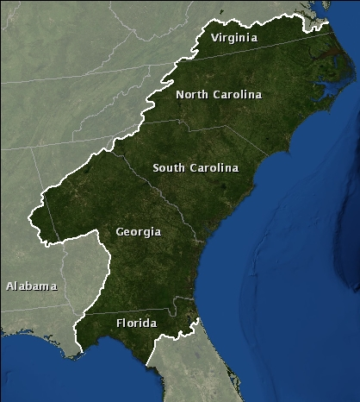
What does the SALCC do?
Mission: Create a shared blueprint for landscape conservation actions that sustain natural and cultural resources

Slide 3
Progress so far
Objectives
Adjust
Design
Evaluate
Implement
Monitor

Slide 4
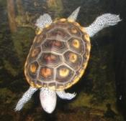
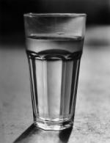
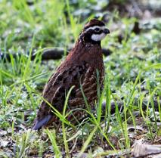
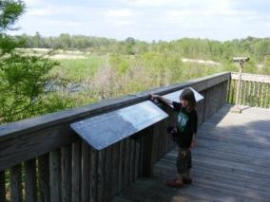
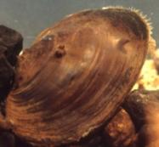
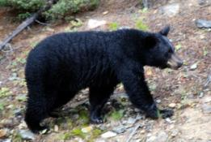
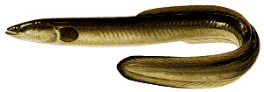
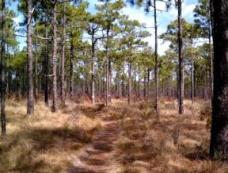
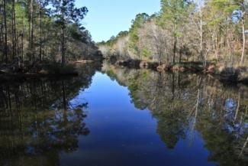
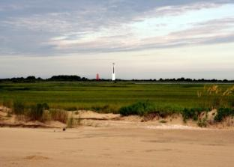
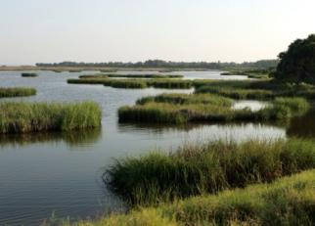
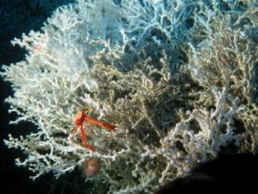
Indicators and Targets: Why do they matter?
The blueprint will need to paint a compelling picture of the future of the South Atlantic region

Slide 5
Indicators and Targets: Why do they matter?
The blueprint will need to paint a compelling picture of the future of the South Atlantic region
It needs to represent why we care about the ecosystems of the area

Slide 6
Where we’ve been
Developed and approved indicator process

Slide 7
Natural Resource Indicators Process Team
Purpose: To develop the process for building off existing efforts to set indicators and measurable targets for SALCC natural resource goals

Slide 8
Who was on the team?
Jon Ambrose GA DNR / SWAP
Shannon Deaton NC WRC / SWAP
John Stanton FWS / ACJV
Linda Pearsall NC DENR / Natural Heritage
Robert Boyles SC DNR - Marine division
Pete Campbell FWS / ENCSEVA
Dean Carpenter NC DENR / APNEP
Maria Whitehead TNC

Slide 9
Who was on the team?
Mary Long USFS
Tim Pinion NPS
Wilson Laney FWS/ Numerous partnerships
Roger Pugliese SAFMC
Reggie Thackston GA DNR / Private lands
Breck Carmichael SC DNR
Rick Durbrow EPA
Vic Engel USGS / Everglades restoration
Jimmy Evans GA DNR

Slide 10
Indicator process flowchart (Sept - Nov)
SALCC community
Web community
Raleigh workshop
Savannah workshop
Web community
Indicator team
Draft process from indicator team
Revised process
Steering committee
Process approved
September October November

Slide 11
Definitions

Slide 12
Terms
Goal: Desired conservation outcome that is difficult to measure Indicator: A metric that is designed to inform us easily and quickly about the conditions of a system Target: A measurable endpoint for an indicator

Slide 13
Indicator framework

Slide 14
Broad goals
Natural resources
Integrity of ecological
systems
Viability of key species
Cultural resources
Sites
Objects
Biotic cultural resources
Socioeconomic resources
Recreation
Human health
Economy

Slide 15
Ecosystems (Natural Resources)
Marine
Estuarine
Beach and dunes
Forested wetlands
Tidal and nontidal freshwater marshes (managed and unmanaged)
Freshwater aquatic (streams, lakes, ponds)
Scrub-shrub (includes cliffs and outcrops)
Pine woodlands, savannas, and prairies (includes longleaf, loblolly, and slash systems)
Upland hardwood forests
Landscapes (Habitat aggregate)
Waterscapes (Habitat aggregate)

Slide 16
Crosswalk of partners indicators to framework

Slide 17
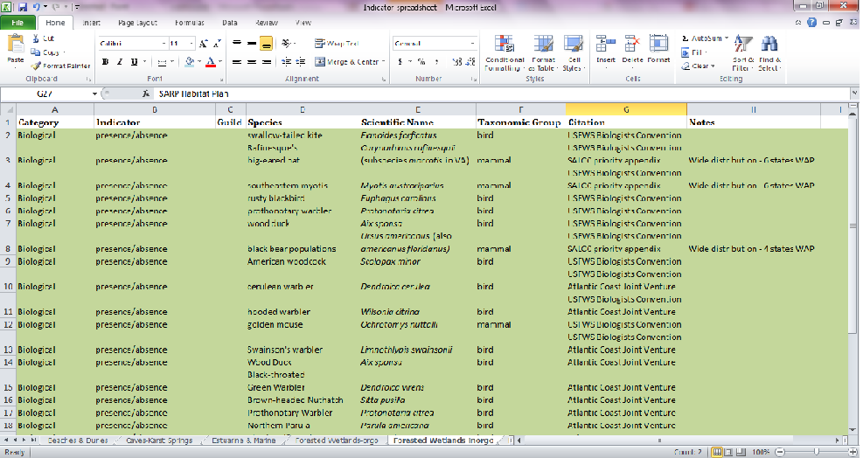
Synthesis of existing plans
Compile spreadsheet of existing indicators for each habitat type
Build off existing work to minimize redundancy

Slide 18
Sources
Current sources
SWAPs
Atlantic Coast Joint Venture
Albemarle-Pamlico National Estuary Program: 2012 Ecosystem Assessment
Southeast Aquatic Resources Partnership: Southeast Aquatic Habitat Plan
USFWS Southeast Biologist Conference
NOAA Southeast and Caribbean Regional Team (SECART)
NPS Inventory and Monitoring Program
National Bobwhite Conservation Initiative 2.0
Fishery Management Plans
USFS Management Indicator Species
America’s Longleaf Conservation Plan
National Fish and Wildlife Foundation Longleaf Stewardship Fund
In the works
ENC/SEVA Strategic Plan

Slide 19
Selection criteria

Slide 20
Criteria for indicator selection
Can be a species, collection of species, or habitat metric (biotic or abiotic)
~ 3 indicators per habitat

Slide 21
Criteria for indicator selection
Ecological criteria
Ability to represent a variety of organisms and ecological attributes within that habitat type throughout a major portion of the LCC
Sensitivity to big landscape threats in the region while having predictable and limited sensitivity to other factors such as natural variations or disturbances (i.e., high signal to noise ratio)
Practical criteria
Ease of monitoring with existing programs and resources
Amount of overlap with existing plans and processes
Ability to model indicator based on current data or existing projects

Slide 22
Criteria for indicator selection
Social criteria
Ability to resonate with the American public
Ability to link with an economic value
Level of interest by public land or water managers
Level of interest by private land or water managers

Slide 23
Criteria for target selection
Amount of overlap with existing plans and processes
Is the target achievable?
Is there enough capacity to monitor the target?
[In the future] Amount of overlap with cultural and socioeconomic goals

Slide 24
Selection process

Slide 25
Simple timeline

Slide 26
Simple timeline
Nov 2012: Form two teams to select and revise indicators
Selection team role
Revision team role

Slide 27
Simple timeline
Dec 2012: ID key indicators not in crosswalk of partner indicators
Selection team gathers input and makes decision
Revisions team captures lessons learned

Slide 28
Simple timeline
Jan 2013: Key audiences score potential SALCC indicators
Selection team gathers input
Revisions team captures lessons learned

Slide 29
Simple timeline
Feb 2013: Recommendations from selection and revisions team
Selection and revisions team meet to make final recommendations

Slide 30
Simple timeline
Mar 2013: Steering committee decision on indicators and process to test
and revise
Decision on recommendations from selection and revisions team

Slide 31
Simple timeline
Spring 2013?: Assessment of indicator function
Begin implementation of revision process

Slide 32
Where we are
Implementing the process

Slide 33
Indicator selection team members
Joe DeVivo NPS
Tim Pinion NPS
Brian Watson VA DGIF
Beth Stys FL FWC
Wilson Laney FWS
John Stanton FWS
Maria Whitehead TNC
David Whitaker SC DNR
Mark Scott SC DNR
Breck Carmichael SC DNR
Billy Dukes SC DNR
Reggie Thackston GA DNR
Jan MacKinnon GA DNR
Jimmy Evans GA DNR
Jon Ambrose GA DNR
Duke Rankin USFS
Roger Pugliese SAFMC
Ryan Heise NCWRC
Scott Anderson NCWRC
Lisa Perras Gordon EPA

Slide 34
Phase 1: Finalize potential indicators
Which indicators have the highest potential?
Were high potential indicators missed in the synthesis?

Slide 35
Phase 1: Tools to finalize potential indicators
Team discussion
Individual interviews

Slide 36
Indicator revision team members
Joe DeVivo NPS
Tim Pinion NPS
Dave Steffen VA DGIF
Brian Branciforte FL FWC
Laurel Barnhill FWS
Greg Moyer FWS
Jan MacKinnon GA DNR
Chris Goudreau NCWRC

Slide 37
Phase 1: Tools to draft revision process
Team discussion
Individual interviews

Slide 38
Where we’re going
Expert reviews and final recommendations from teams

Slide 39
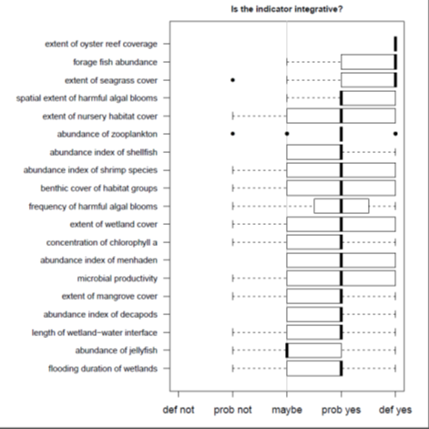
Phase 2: Score indicators
How well do indicators perform based on our criteria?
Are there other issues with certain indicators we should consider?

Slide 40
Phase 2: Tools for scoring indicators
Team discussion
Individual interviews
Online surveys

Slide 41
The approach to expert review
A representative sample of reviewers get interviews
Everyone else gets the online review form

Slide 42
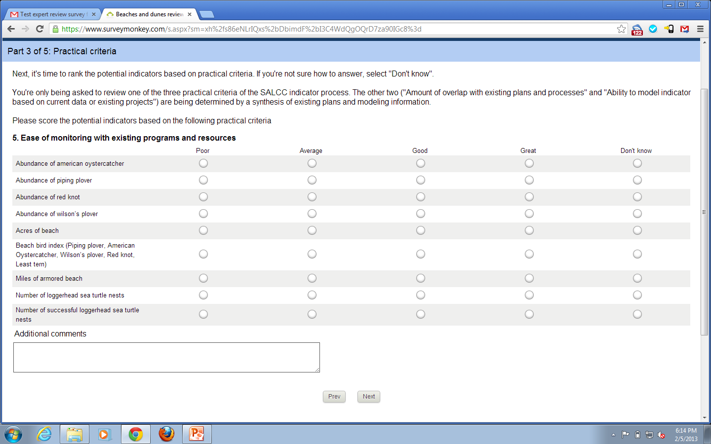

Slide 43
Examples of indicators going out for review
Abiotic / ecosystem processes
Flow alteration - % rivers with > 20% change in high/low flows or > 60-day change in flow timing since the 1970s (Freshwater aquatic)
Habitat
Area of forest interior habitat (Landscapes)
Species groups
Freshwater wetland bird index - King Rail, American Black Duck, Northern Pintail, Least Bittern, Whimbrel, Wood Stork (Tidal and nontidal freshwater marshes)
Individual species
Abundance of Red drum (Marine)

Slide 44
Phase 3: Make recommendations
Individual interviews
Online surveys
Team recommendation

Slide 45
Summary
Develop and approve process
Form teams
Identify indicators with highest potential for review
Develop draft testing and revision process
Final recommendations for Steering Committee

Slide 46
Summary
Develop and approve process
Form teams
Identify indicators with highest potential for review
Develop draft testing and revision process
Final recommendations for Steering Committee

Slide 47
Summary
Develop and approve process
Form teams
Identify indicators with highest potential for review
Develop draft testing and revision process
Final recommendations for Steering Committee

Slide 48
Summary
Develop and approve process
Form teams
Identify indicators with highest potential for review
Develop draft testing and revision process
Final recommendations for Steering Committee

