Slide 1
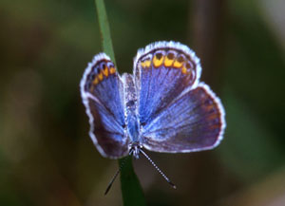
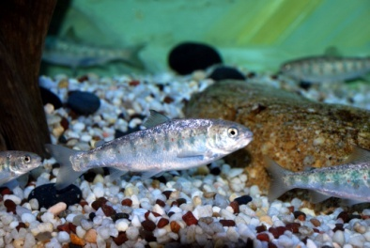
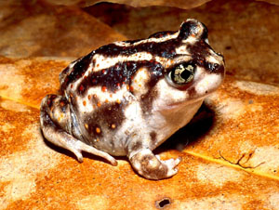
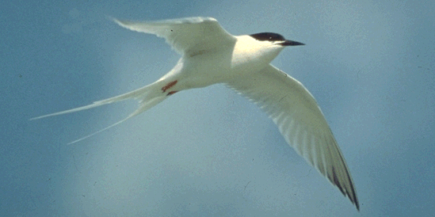
LCC Role in Conservation Science and Science Delivery
Andrew Milliken
North Atlantic Landscape Conservation Coordinator
U.S. Fish and Wildlife Service
North Atlantic LCC Technical and Science Delivery Team Meetings Hadley, Massachusetts
March 10, 2015

Slide 2
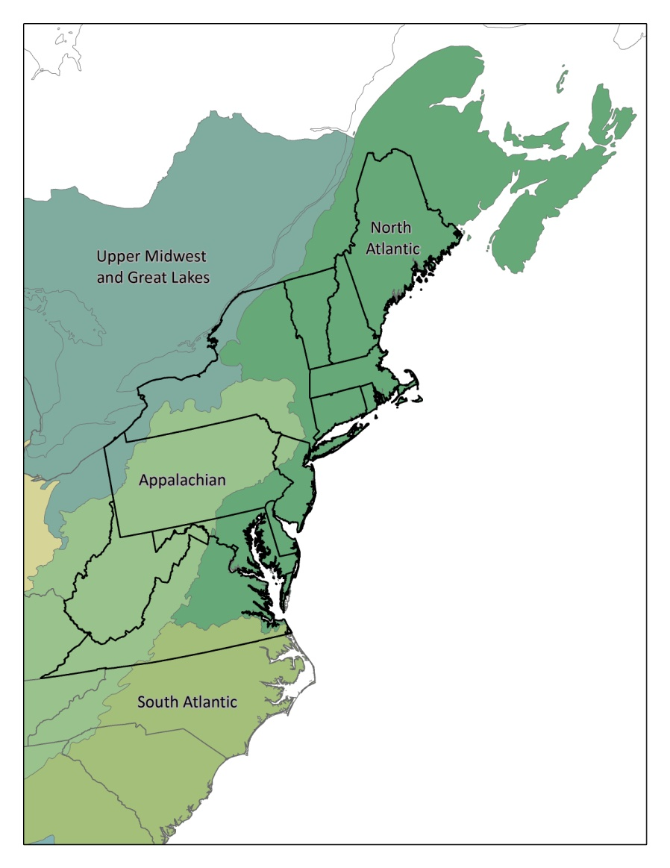
The North Atlantic Landscape Conservation Cooperative
Geographic Scope, LCC Network
Mission, Components, Framework, Strategic Plan
Multiple Scales of Conservation Planning and Design
Guidance from Steering Committee

Slide 3
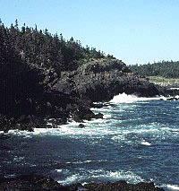
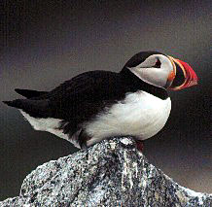
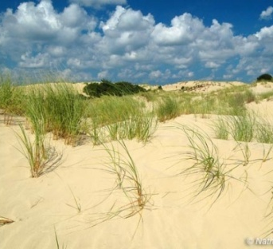
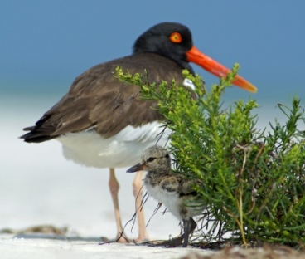
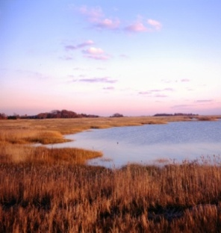
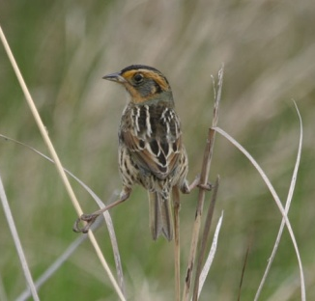
North Atlantic LCC - Mission
The North Atlantic Landscape Conservation Cooperative provides a partnership in which the conservation community works together to address increasing land use pressures and widespread resource threats and uncertainties amplified by a rapidly changing climate.

Slide 4
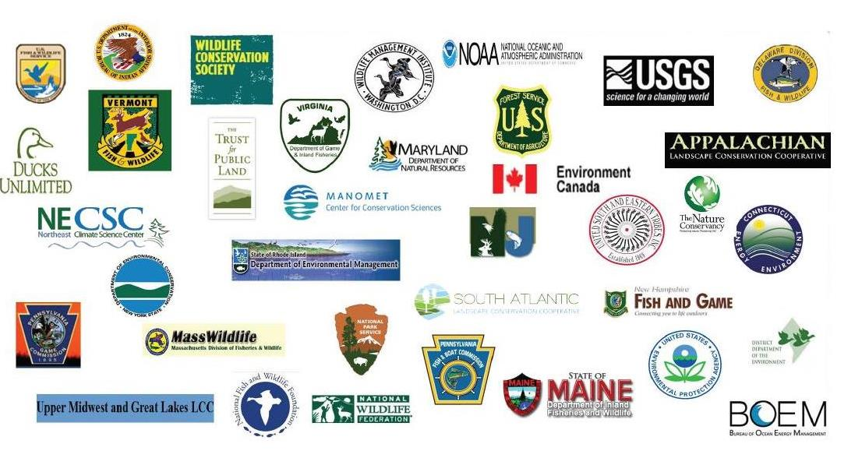
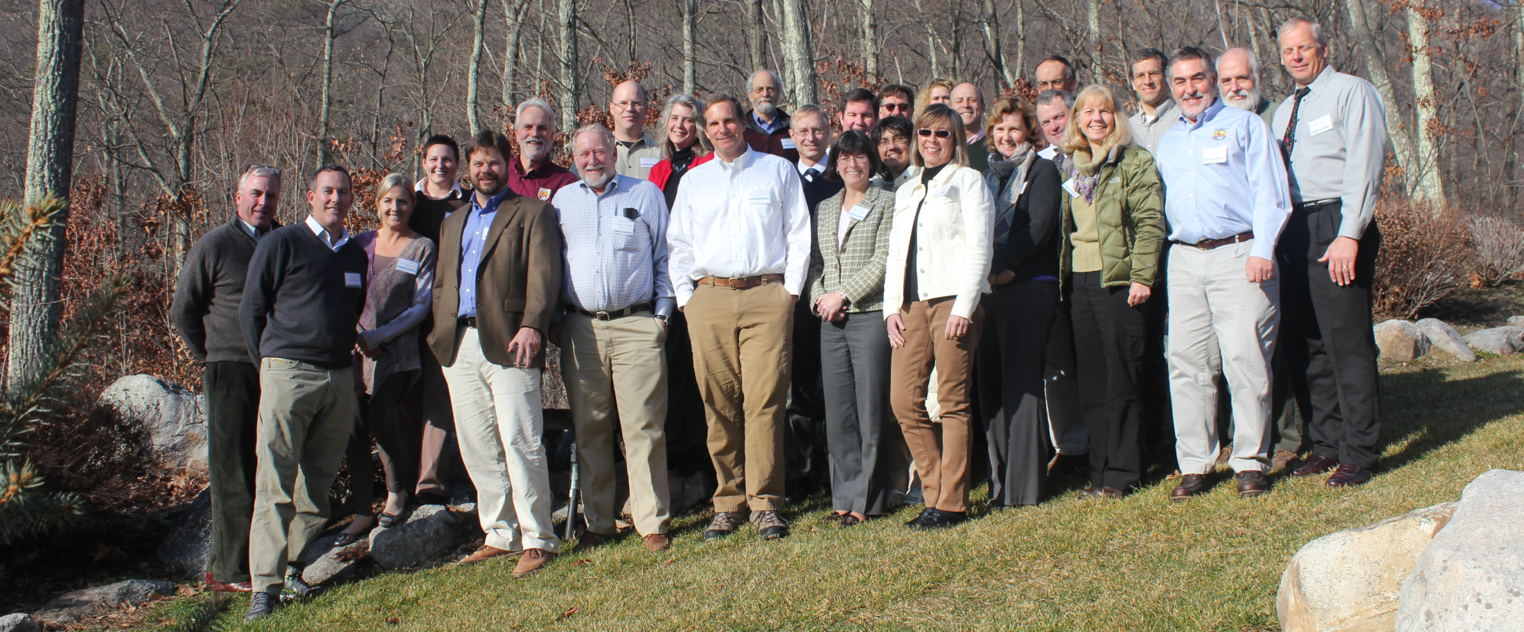
LCC Partnership

Slide 5
LCC Technical Teams
Science Technical Committee
51 members (9 State, 26 Fed., 2 Can., 10 NGO, 4 LCC)
subteams - aquatic (16), terrestrial/wetland (15) and coastal/marine (20)
Science Delivery Team
30 members (8 State, 10 Fed., 9 NGO, 3 LCC) formed in 2013
Regional Conservation Opportunity Areas Team
20 members assessing options for identifying Regional Conservation Opportunity Areas for Regional Species of Greatest Conservation Need and their habitats. 2014/2015
Plus: project oversight teams, proposal review teams, peer review teams

Slide 6
North Atlantic LCC - Mission
The North Atlantic Landscape Conservation Cooperative provides a partnership in which the conservation community works together to address increasing land use pressures and widespread resource threats and uncertainties amplified by a rapidly changing climate.
The partners and partnerships in the cooperative address these regional threats and uncertainties by agreeing on common goals and jointly developing (and delivering) the scientific information and tools needed to prioritize and guide more effective conservation actions by partners toward those goals.

Slide 7
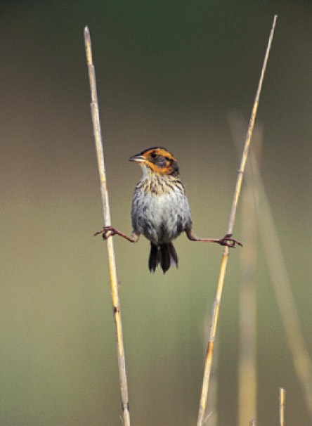
North Atlantic LCC Components of Mission
Ecological Planning
Conservation Design
Conservation Adoption and Delivery
Monitoring and Evaluation
Research
Information Management
Communication and Outreach
Coordination and Organization

Slide 8
Northeast
Conservation Framework
GOAL-SETTING
Which species/habitats to conserve? At what levels?
Who decides?
CONSERVATION DESIGN
BIOLOGICAL ASSESSMENT
What should landscapes look like to conserve species at goal levels
What do we know about the status of priority wildlife?
INFORMATION MANAGEMENT
PRIORITIES
SCIENCE TRANSLATION
Which species and issues demand immediate attention?
How will we manage the demand for and creation of data?
How do we make science solutions useful?
MONITORING, EVALUATION AND RESEARCH
CONSERVATION ADOPTION
What new information will we gather to support conservation?
How do we get communities and landowners engaged in conservation?
CONSERVATION DELIVERY
How will we most efficiently put conservation on the ground?
Notes:
These components fit into this northeast conservation framework that links together planning, design, delivery and evaluation.
The partners in the LCC at the Albany II Northeast Conservation Workshop and other venues have asked that we focus on conservation design and the set of activities that make up science delivery including translation, adoption and information management.
Conservation Science Strategic Plan built around these components and this framework. The matrix of actions in that strategic plan are kept up to date but the overall strategic plan need to be assessed revised added to and updated. If we have time at this meeting it would be great to get your input on what is needed.

Slide 9
Science Needs & Projects
Criteria for prioritizing needs
Foundational needs for organizing landscape conservation (consistent mapping, decision frameworks)
Needs that address major threats and uncertainties to sustaining natural or cultural resources in the North Atlantic LCC (land use change, climate impacts, energy)
Needs that address threats and uncertainties to multiple species or habitats at landscape scales.
Needs that will inform applied conservation decisions and actions (in the face of change and uncertainty)
Needs that are priorities for existing partnerships in the North Atlantic LCC (NEAFWA, JVs, FHPs, NEPARC etc.)

Slide 10
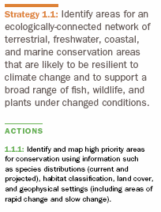

Slide 11
Multiple Scales of Conservation Planning and Design
Spatial scales that match the decisions being made
Ability to have scales inform each other
Regional context for watershed, state and local actions
Plan based on both current and projected future conditions
Climate change
Urban growth

Slide 12
Multiple Scales of Conservation
Type of Unit | Administrative | Watersheds | Terrestrial Ecological Regions | Coastal/Marine Ecoregions
Scale Extent
Regional | Northeast Region (13 northeast states, could include provinces) | Drainage Area (e.g. Northwest Atlantic) | Bird Conservation Regions, Landscape Conservation Cooperative areas, TNC Ecoregions | Realm: Cold Temperate Northwest Atlantic
Sub-regional | Subregion (e.g. New England or Mid Atlantic states) | Drainage area (e.g. Gulf of Maine, Mid Atlantic, Chesapeake Bay Watershed) | EPA/Omernik Level III, USFS/Bailey Divisions (e.g. Eastern Broadleaf Forest) | Provinces, e.g. Acadian, Virginian
Landscape or State | State or Province | Large watersheds (HUC level 4), e.g. Connecticut River watershed) | EPA/Omernik Level IV USFS/Bailey Provinces | Large Estuaries, e.g. Narragansett Bay
Sub-Landscape or State | County | Tributary sub-watershed (HUC 8) | Major component of a province; e.g. forest, valley or ridge | Small estuary or bay
Local | Municipality | Catchment or HUC 12 | Forest stand or large road-bounded block | Wetland or beach complex
Site | Landholding (e.g. refuge) | Stream reach | Habitat patch or small road-bounded block | Tidal wetland or beach patch
LCC facilitated process to apply science and tools in collaborative conservation design process at these scales and apply learning to future efforts
LCC information management and science delivery support for partner networks to deliver translate and help partners apply science and tools at these scales

Slide 13
Steering Committee Guidance
Increased focus on science delivery including communications, inform. man., demonstration projects, training, networks and capacity
LCC should take advantage of delivery networks and reinforce existing partnerships
Information and tools should be as simple to use (with training) and flexible as possible
Information and tools need to be relevant to and reach partners making decisions on the ground
Information and tools need to more fully incorporate other elements including plants and natural communities and cultural and socioeconomic needs

Slide 14
The North Atlantic Landscape Conservation Cooperative
Thanks!

