Slide 1

Department of the Interior
Northeast Climate Science Center
North Atlantic Landscape Conservation Cooperative Steering Committee
April 6, 2016
Notes:
Mary

Slide 2

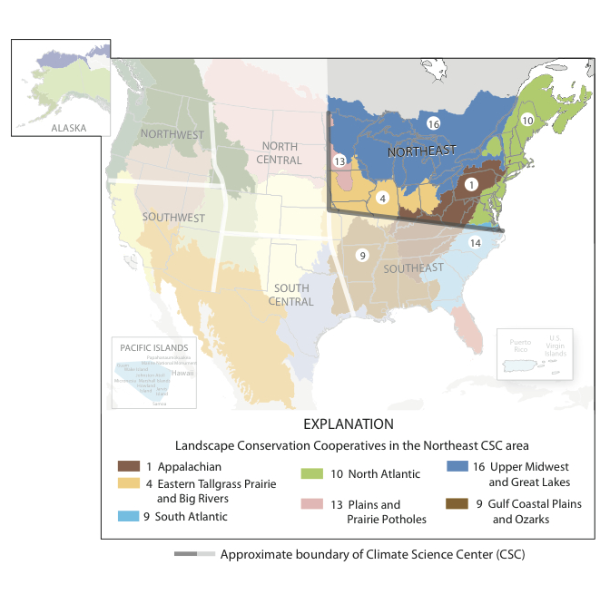










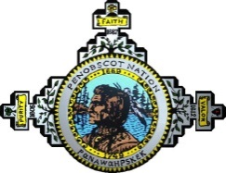







+ LCC Partners
DOI Northeast Climate Science Center
Stakeholder Advisory Committee
*Host
+
Consortium
Notes:
Notes:
Established in 2012 at Host/Lead university of UMass Amherst
A stakeholder driven federal-university research partnership
Consortium includes the College of Menominee Nation, a Tribal college with a strong program in sustainable development
LCCs, NIACS, CAKE, EPA, BIA, ITEP, NOAA,

Slide 3
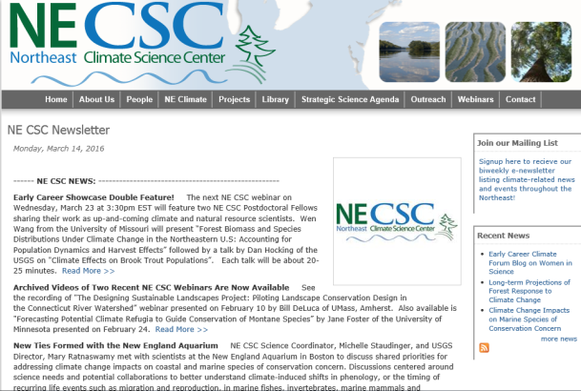
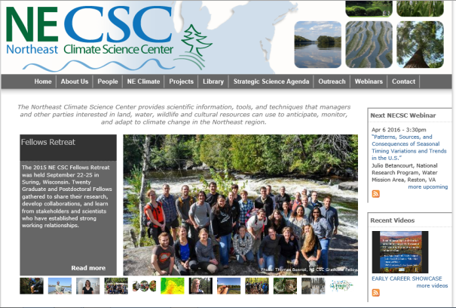

NE CSC Strategic Science Plan
Regional science needs
NE CSC Annual Science Planning/Workplan
LCCs + Resource Managers
Funding &
Priorities
Data, tools, etc.
RFP and Directed Projects
NE CSC Newsletter
http://necsc.umass.edu/
Notes:
Providing science and tools for natural and cultural resource managers
to help fish, wildlife, ecosystems, & the communities they support
adapt to climate change.
Tools examples
SWAPS
Climate Change Visualization and Integration of Ecological and Watershed Resources (CCVIEWeR)
Project: A Decision Support Mapper for Conserving Stream Fish Habitats of the Northeast Climate Science Center (NE CSC) Region
NorEaST-Stream Temperature Web Portal Demonstration and Application
Our projections of climate change impacts on the behavior and distribution of deer and ducks will guide conservation planning.
Project: Development of Dynamically-Based 21st Century Projections of Snow, Lake Ice, and Winter Severity for the Great Lakes Basin to Guide Wildlife-Based Adaptation Planning, with Emphasis on Deer and Waterfowl

Slide 4




Portfolio of Research
# of projects
Notes:
Jeanne
$7.5 million dollars in USGS funding supporting consortium, RFP and Directed projects – plus staff contributions (post docs etc)
NE CSC efforts spread across 7 stakeholder defined themes.
FY15 projects focus on three of the NE CSC’s science priorities:
1) Effects of Climate Change on Hydrologic Regimes, Ecological Flows, and Aquatic Connectivity (NE CSC Science Theme 3).
2) Species Intrinsic Adaptive Capacity to Climate Change (NE CSC Science Theme 5).
3) Effects of climate change on the sustainability of cultural resources, including approaches that utilize Traditional Ecological Knowledge (TEK), human dimensions, and adaptation strategies (NE CSC Science Theme 6)

Slide 5
LCC-CSC Collaborations: Projects and Progress
Designing Sustainable Landscapes (DSL)
  Assessing the capability of landscapes in the Northeast to provide guidance for strategic habitat conservation.
Critically Evaluating Existing Methods and Supporting a Standardization of Terrestrial and Wetland Habitat Classification and Mapping that Includes Characterization of Climate Sensitive Systems
  Review of existing habitat classification and mapping products in the Northeast region
Stream Temperature Mapping in the Northeast
  NorEaST web portal - maps and stores continuous stream temperature locations and data for New England, Mid Atlantic, and Great Lakes States
Notes:
nat resource expertise and programs
Notes
Mention involvement of Early Career Scientists on these projects
http://necsc.umass.edu/projects/designing-sustainable-landscapes
http://necsc.umass.edu/projects/critically-evaluating-existing-methods-and-supporting-standardization-terrestrial-and-wetla
http://necsc.umass.edu/projects/noreast-%E2%80%93-stream-temperature-web-portal-demonstration-and-application

Slide 6
BONUS SLIDES

Slide 7
Partnerships
Relevance to stakeholders
  % of projects that align with expressed stakeholder needs
Notes:
Who do all project PIs name as their stakeholders? Data from website partners list provided by PI’s
Trout Unlimited = 2
TNC 9 – part of NGOs?
EPA 1
USACE 1
BIA 1
NOAA 1
Tribal Land Management Organizations 9 –
Institute for Tribal Environmental Professionals (ITEP) 1
Public 4 ??

Slide 8
NE CSC Science Themes
Climate change projections and assessments
Climate impacts on land-use and land-cover
Climate impacts on freshwater resources and ecosystems
Climate impacts on Atlantic and Great Lakes coastal and nearshore environments
Ecosystem vulnerability and species response to climate variability and change
Impacts of climate variability and change on cultural resources
Decision frameworks for evaluating risk and managing natural resources under climate change
Notes:
- nat resource expertise and programs

Slide 9



