Slide 1
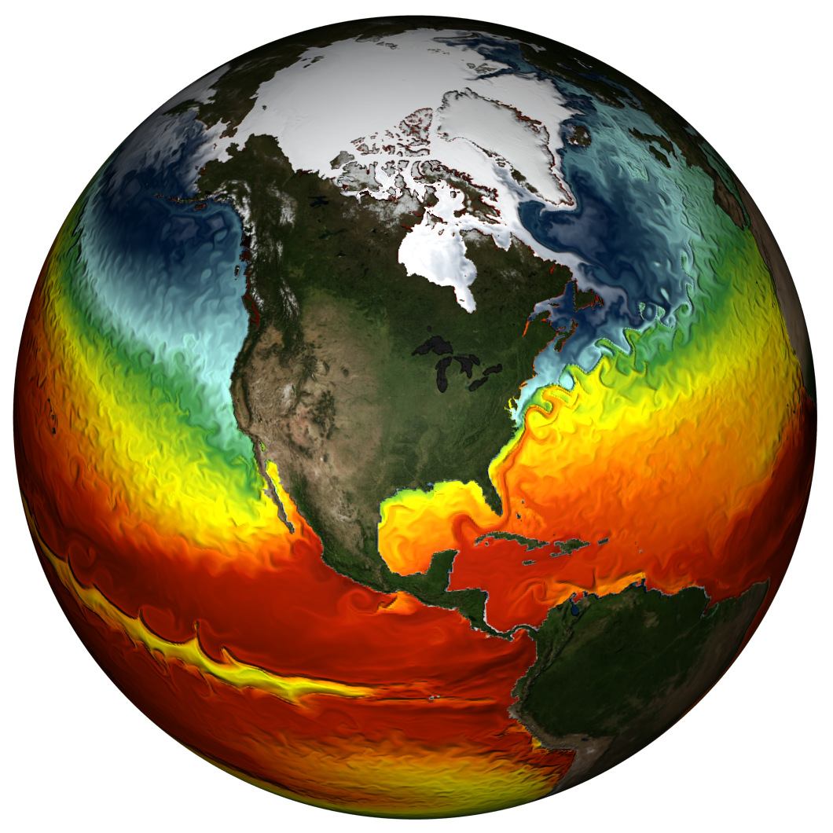
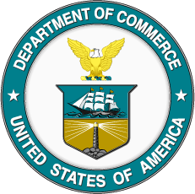
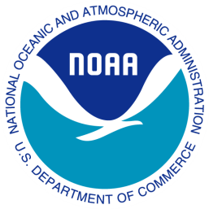
NOAA and the NALCC-
Partners, Customers, and Interagency Resources
Ellen L. Mecray
National Oceanic and Atmospheric Administration (NOAA)
Eastern Region Climate Services Director
Taunton, MA
Ellen.L.Mecray@noaa.gov
508-824-5116 x263

Slide 2
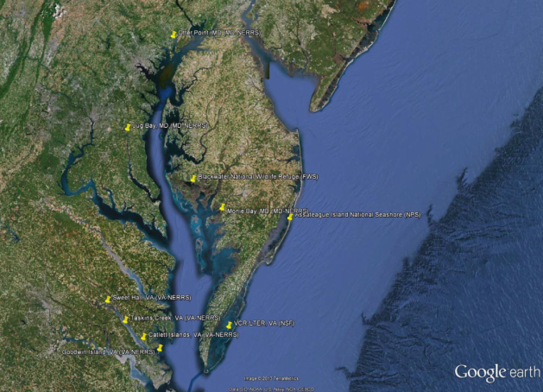
NOAA, Why are we on the LCC
There are many overlaps in federal science and service delivery to be leveraged
Multiple audiences for the science
Listening for opportunities to offer NOAA information to LCC audiences
Work together to inform on-the-ground conservation and stewardship
GFDL CM2.4
climate model
SSTs
Central NH, Flooding 2010
Notes:
----------
Image: Modeled sea surface temperatures simulated by NOAA GFDL CM2.4 climate model.
Source: NOAA GFDL Climate Change, Variability & Prediction Group (http://www.gfdl.noaa.gov/ccvp)
Related content:
http://www.gfdl.noaa.gov/e-media-produced-by-gfdl-ccvp#oceancurr
Common themes across New England and Maine:
Increasing annual precipitation
Increasing frequency of heavy rains
Warming annual temperatures
Earlier “ice out” and peak spring flows
Shift in precipitation frequency
For smaller (<800 sq. mi) basins in southern and western Maine
Trend toward increased flood magnitude and/or frequency
Most pronounced where significant land use change and/or urbanization has occurred

Slide 3
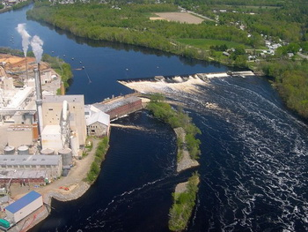
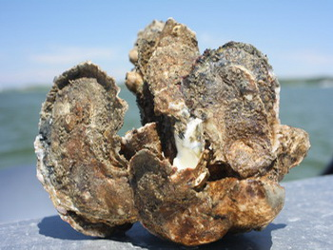
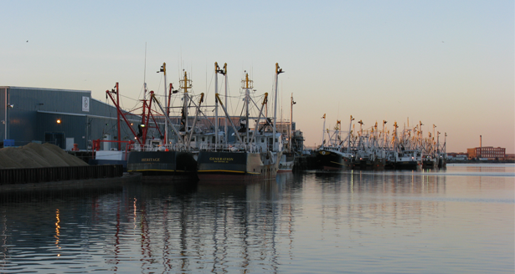
Tools and Resources Useful to
NALCC Members- Programs
Habitat Focus Areas
  Chesapeake Bay- Wetland and near-shore habitat loss from SLR; focus on oyster reefs and fish passage; climate vulnerability assessment
  Penobscot Bay- fish passage, migratory fish
Sentinel Sites
  Chesapeake Bay- subsidence, water quality, temp and salinity to monitor SLR in the Bay (interagency partners)
Integrated Ecosystem Assessments
  Northeast Shelf- Science to management for fisheries; new era of ocean management
Regional Climate Services
  State Climatologists, Regional Climate Centers, RCSDs
Notes:
Choptank HFA:
HFA Objectives-
• Restore degraded oyster reef habitat and significantly increase
native oyster populations
• Rebuild and sustain important fish populations (including
striped bass, shad, herring, American eel and other species)
• Document and quantify the benefits oyster reefs and associated
habitats provide
• Improve the decision-making and resilience of coastal communities
by improving the delivery of NOAA’s habitat and
climate science
NOAA has a Climate Change Coordinator (Zoe Johnson) working to increase the climate resiliency of the Chesapeake Bay watershed. She is leading a workgroup for the Chesapeake Bay Program to consider changing climatic conditions in the pursuit, design, implementation and long-term maintenance of restoration and protection management practices. In some cases, this could mean using specific practices to address certain environmental needs, like restoring areas that would ease the inland migration of wetlands or planting vegetative buffers in areas that experience coastal floods. In other cases, it could involve factoring climatic conditions and sea level rise into the design of on-the-ground restoration work.
They have completed a draft climate resiliency workplan for the Bay watershed.
HFA Climate vulnerability assessment will collect and analyze data for integrated vulnerability assessments that includes social, economic, cultural, ecological, and hydrological components. Develop information products that can be used to inform community-led adaptation planning processes and identify restoration and protection opportunities to enhance resiliency.
CB Sentinel Site Cooperative:
http://oceanservice.noaa.gov/sentinelsites/chesapeake.html
Figure: Map of Chesapeake Bay Sentinel Site Cooperative ecological sentinel sites. Note that the Maryland NERRS and Virginia NERRS constitute two sentinel sites comprised of three and four components, respectively.
CBSSC Vision: Coastal community planners and natural resource managers understand and
are able to effectively plan for climate change impacts, within the Chesapeake Bay.
CBSSC Mission: To provide long term data, information, tools, and educational resources,
derived from local observations collected at rural and urban sentinel sites, to improve
management decisions regarding rising sea levels and inundation.
Five core ecological sentinel sites form the foundation of the CBSSC. These include: The
Chesapeake Bay National Estuarine Research Reserves (CBNERRS), Virginia Coast Long Term
Ecological Research Network (VCR-LTER), Blackwater National Wildlife Refuge (NWR) and
Assateague Island National Seashore. These sites collect a suite of parameters used to tell the
story of sea level rise and inundation in the Chesapeake Bay region. Each of these sites is
representative of a broad geography, such as coastal bays, salt marshes, island ecosystems, and
riverine environments.
These 5 ecological sentinel sites are interconnected by an existing distributed network of
observing stations collecting water level, temperature, and salinity data. This network is
comprised of NOAA buoys and water level stations, as well as fixed monitoring platforms
overseen by the State of Maryland and the Commonwealth of Virginia. Together, the
ecologically based sentinel sites and the distributed observational network provide extensive
spatial coverage to characterize and monitor sea level change and its effects on the Bay.

Slide 4
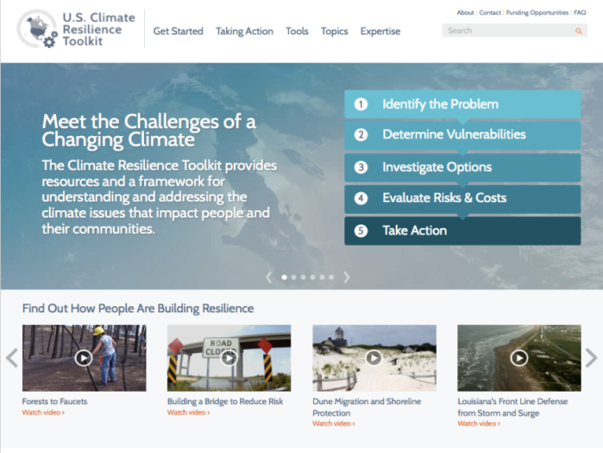
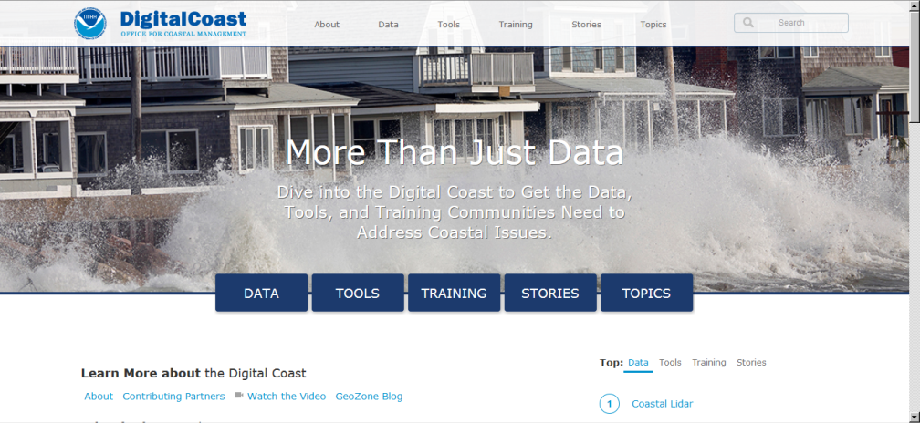
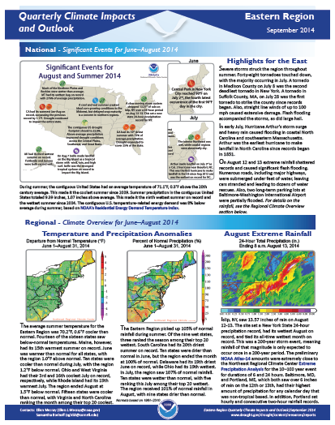
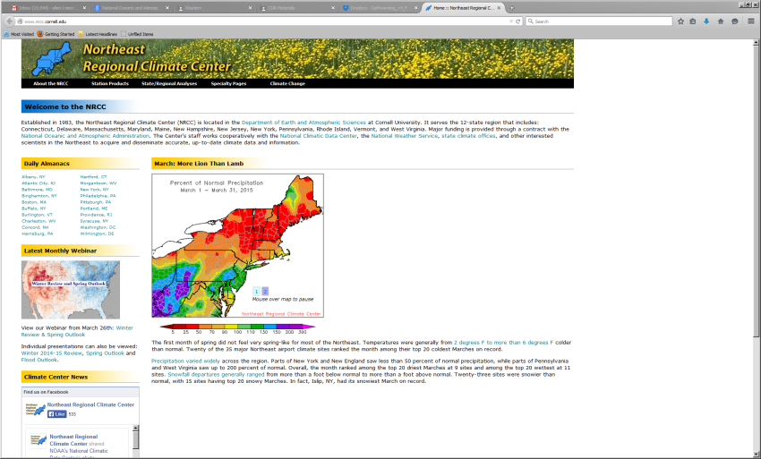
Tools and Resources Useful to
NALCC Members- Information
Fisheries
  Restoration
  Species vulnerability assessm.
Place-based stewardship
  Sanctuaries and NERR
Climate Info
  Climate at a Glance
  Climate Resilience Toolkit
  Information Dashboards
  Applied Climate Info System
Coastal resources
  Digital Coast
Sea Grant!

Slide 5
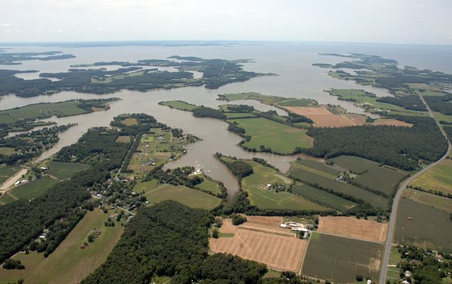
Opportunities
Leverage existing resources- Multiple agencies with existing assets at the table, waiting to hear from F&W users;
Science Delivery- A huge opening for educating the LCC audience on the science from the LCC *AND FROM ITS PARTNERS*
Expand the LCC topical and spatial coverage- with the regional, state, and local experts (e.g., Chesapeake Bay, Habitat Focus Areas, Sentinel Sites, Integrated Ecosystem Assessments)
Examples from other LCCs:
  AK- Changes in Coastal Storms and their Impacts
  CA- Adapting to SLR Along the Pacific Coast
  Gulf and SE- Vulnerability Assessments and Blueprint
Notes:
At risk are human lives, homes, businesses, valuable natural resources, and large amounts of money and jobs. We have to prepare ourselves to make good decisions to protect the things we care about. Thoughtful, well-informed plans and preparations that we make today will help us capitalize on opportunities, minimize risks and vulnerabilities, and ensure we are prepared for future extremes.
America’s economic and social well-being is tied to weather and climate. Routine weather events such as rain, cooler-than-average days, and prolonged heat and drought can add up to an annual economic impact of as much as $485 billion in the U.S. and includes impacts in such sectors as agriculture, energy, transportation, national security, water resources, health, construction, tourism and resource management.
As a country that experiences more severe weather than any other nation on Earth, we must not waiver in our investment in state of the art weather and climate science and services so we are better informed to make important decisions about our future, from where we cite a new power plants to where we locate our roads and homes & determining what crops to grow and when to plant.
Just as the nation invested in a weather service over 100 years ago to understand, predict, and plan for short-term weather conditions, our increasing vulnerability to longer-term variations and changes in climate conditions now requires us to better understand future conditions in order to manage risks and ensure our families, communities, and economy are resilient.
Our success as a nation depends on our ability to understand and predict the future and make informed decisions in response to anticipated challenges and opportunities. Having trusted and timely environmental intelligence that can inform our decisions, such as where to locate critical infrastructure or how we should plan for future growth is critical for America’s long-term prosperity and overall security.
Different regions and sectors face unique challenges and risks from extreme events. NOAA assesses stakeholders’ needs and tailors its data, products, and services for easy access and use (agriculture, energy, transportation, etc.). For example:
The U.S. home building industry estimates it saves $300 million per year in construction costs alone by using our long-term temperature trend data to design more efficient building foundations.
Electricity providers use our climate information to anticipate power demands for winter heating and summer cooling, and to set electricity prices—thus improving efficiency while saving money and ensuring there’s enough supply to meet demand.
Local counties and municipalities use our climate information, such as trends in precipitation, to make long-term investments in storm water management and storage capacity.
Insurance companies use our climate data—such as temperature, precipitation, frequency of 100-year storms, and sea level trends—to assess risks and to calculate premiums.
Farmers use our long-term temperature, precipitation and freeze information to determine what crops to plant, when to harvest, and whether to invest in equipment such as irrigation systems.

Slide 6
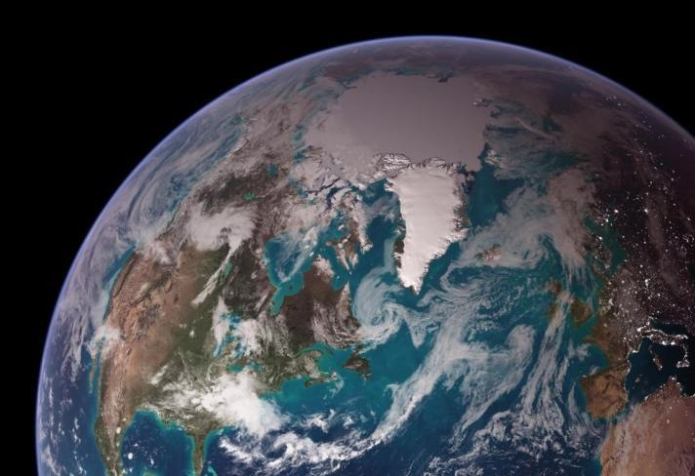
Questions?
Ellen L. Mecray
NOAA National Centers for Environmental Information
Eastern Region Climate Services Director
Ellen.L.Mecray@noaa.gov
http://www.ncdc.noaa.gov/rcsd/eastern
April 6, 2016
NALCC Steering Committee
Annapolis, MD
Notes:
True color MODIS composite image of Earth by Reto Stockli (under subcontract to SSAI working for NASA). City lights image on night side of terminator from DMSP OLS data, courtesy Chris Elvidge, NOAA.

