Slide 1
NALCC Science: Town Level Applications
Wildlife Conservation Society
Adirondack Program
Michale Glennon, Zoë Smith

Slide 2
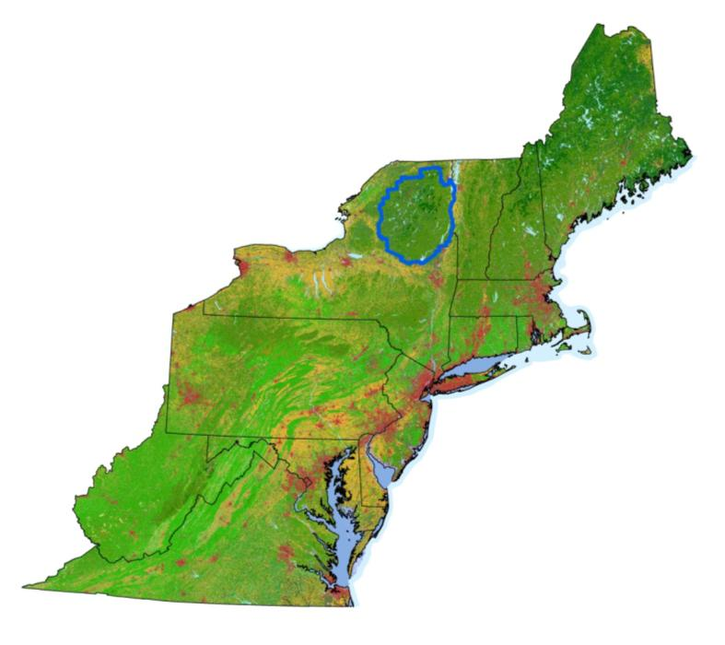
How do we make regional science relevant at a town level?

Slide 3
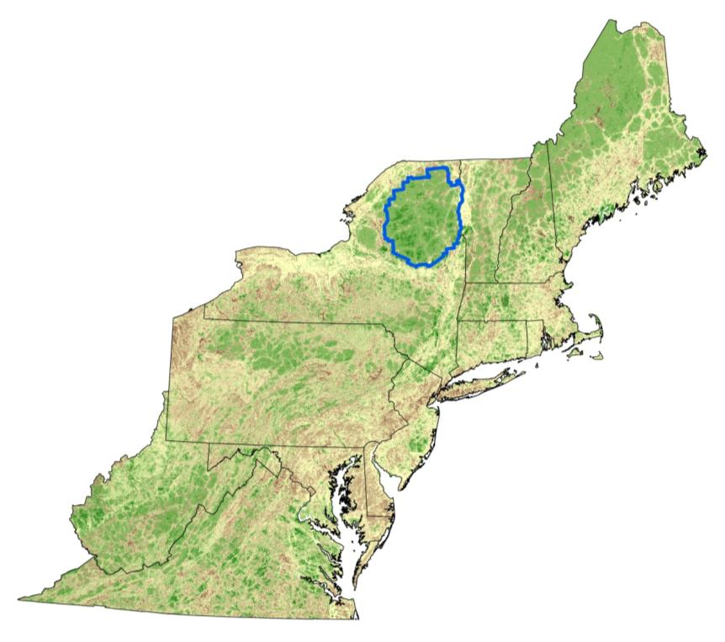
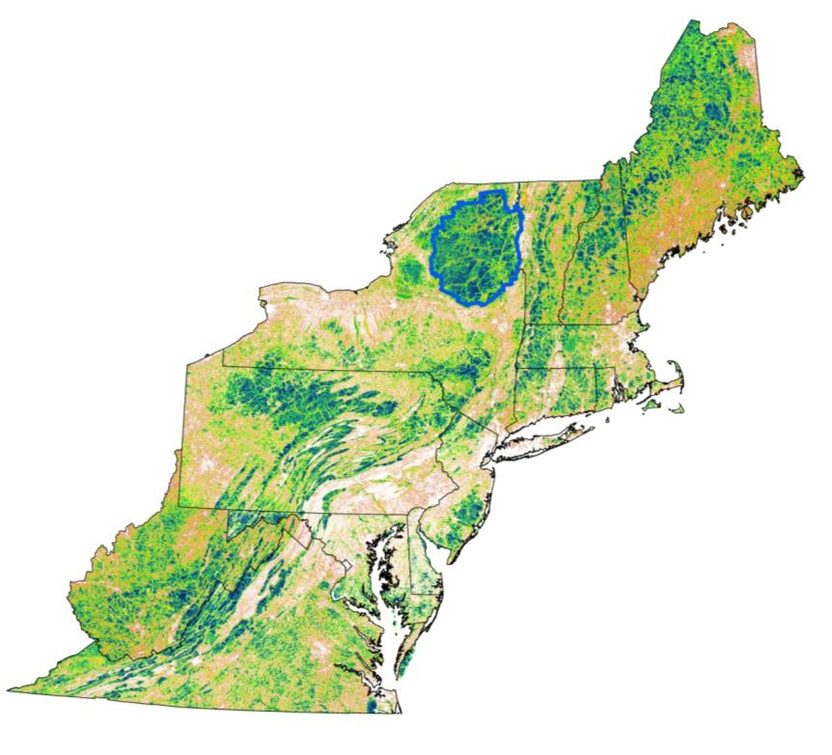
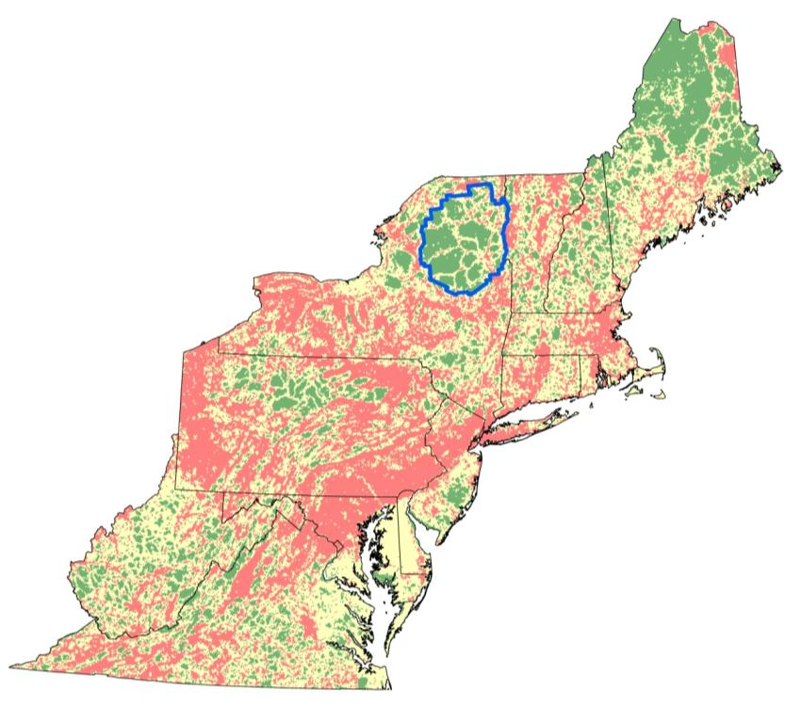
How do you get people to care in a place like the Adirondack Park?

Slide 4
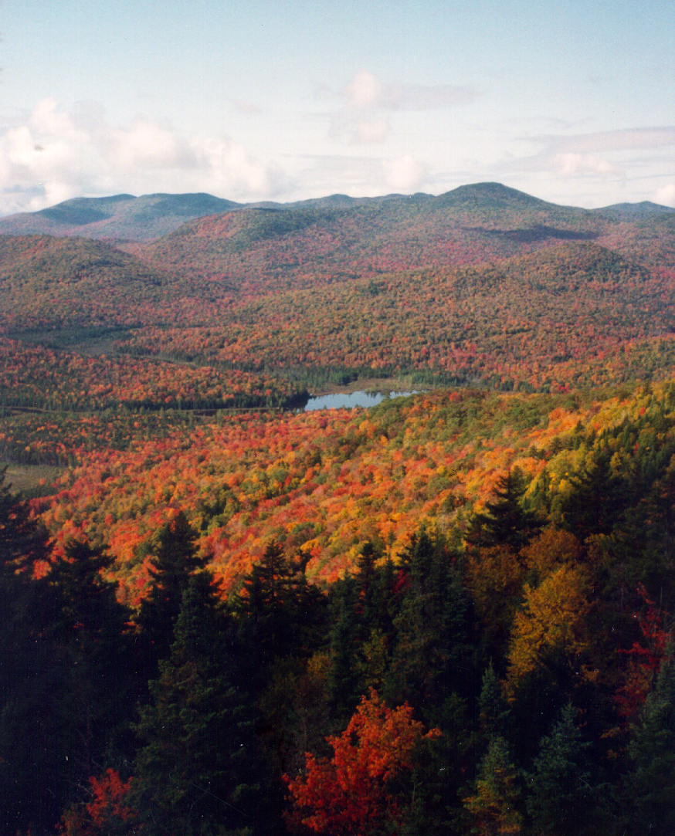
Context
Highly protected landscape
Highly regulated landscape
More connected
Higher integrity
More resilient
Far less developed
In comparison to the rest of the east...

Slide 5
What gets missed
More than half of development regulated by towns
Imperfect protection for
Vernal pools and other small wetlands
Rare habitats and ecological communities
Floodplains, viewsheds
Larger scale processes

Slide 6
Habitats by Protection Status
Glennon and Curran 2013, Adirondack Journal of Environmental Studies 19:36-46

Slide 7
Priority Setting
Resilience
Integrity
Projected Loss

Slide 8
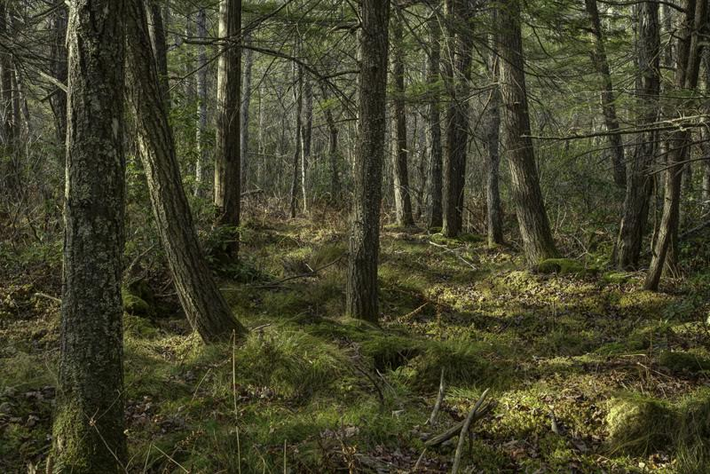
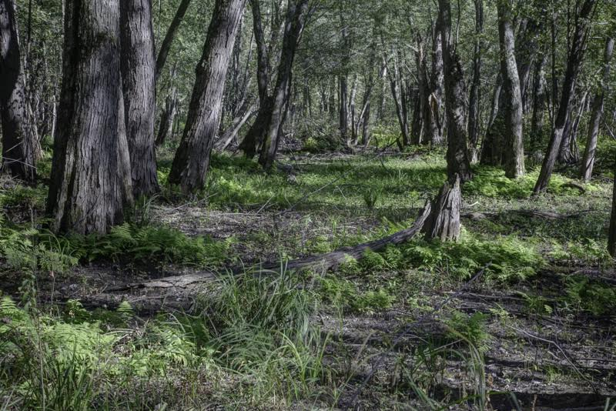
OSI Partnership
“Enhance the capacity of land trusts and public agencies to protect biodiversity in the face of climate change”
How can resilience science inform conservation of rare, underprotected habitats in the Adirondack Park?

Slide 11
Terrestrial Resilience
Ecological Integrity
High Peaks Complex
Boreas Tract
Local Connectivity
Regional Flow

Slide 12
Terrestrial Resilience
Local Connectivity
Ecological Integrity
85th percentile
90th percentile
50th percentile

Slide 13
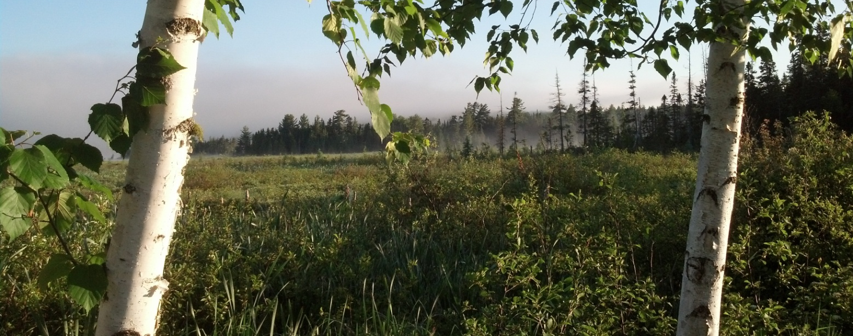
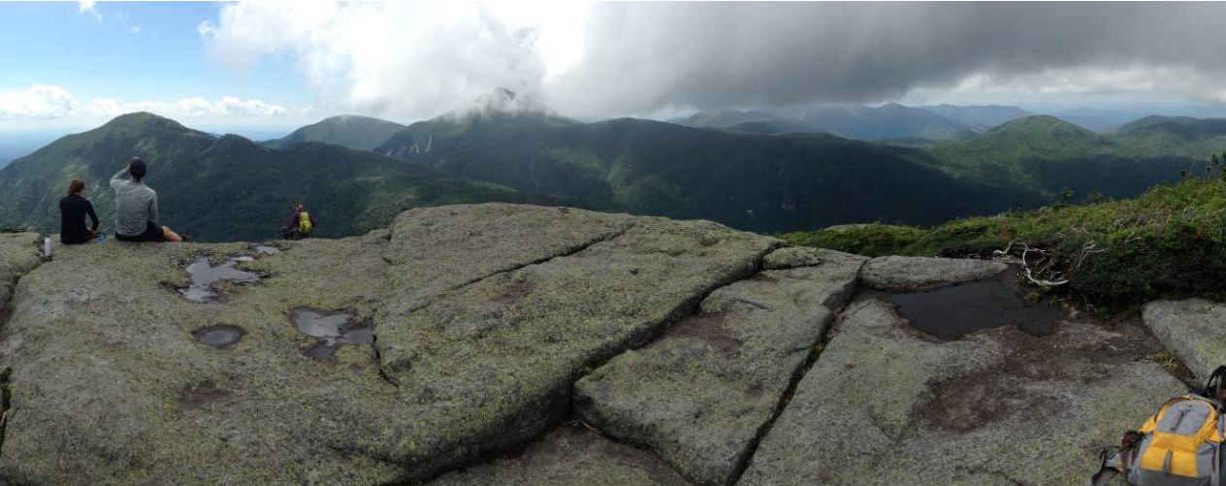
2,500 acres Northern Swamp
420 acres Summit and Cliff

Slide 14
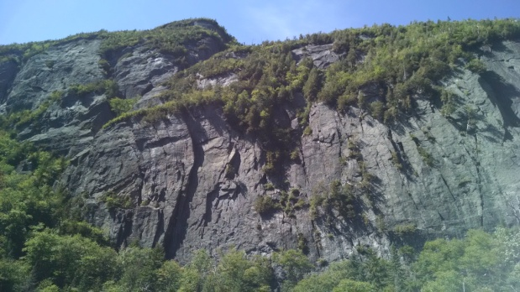
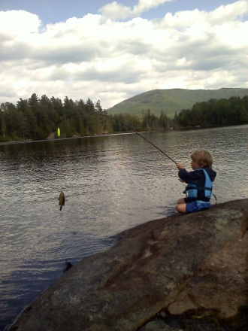
5 Town Region: Upper Hudson Recreation Hub

Slide 15
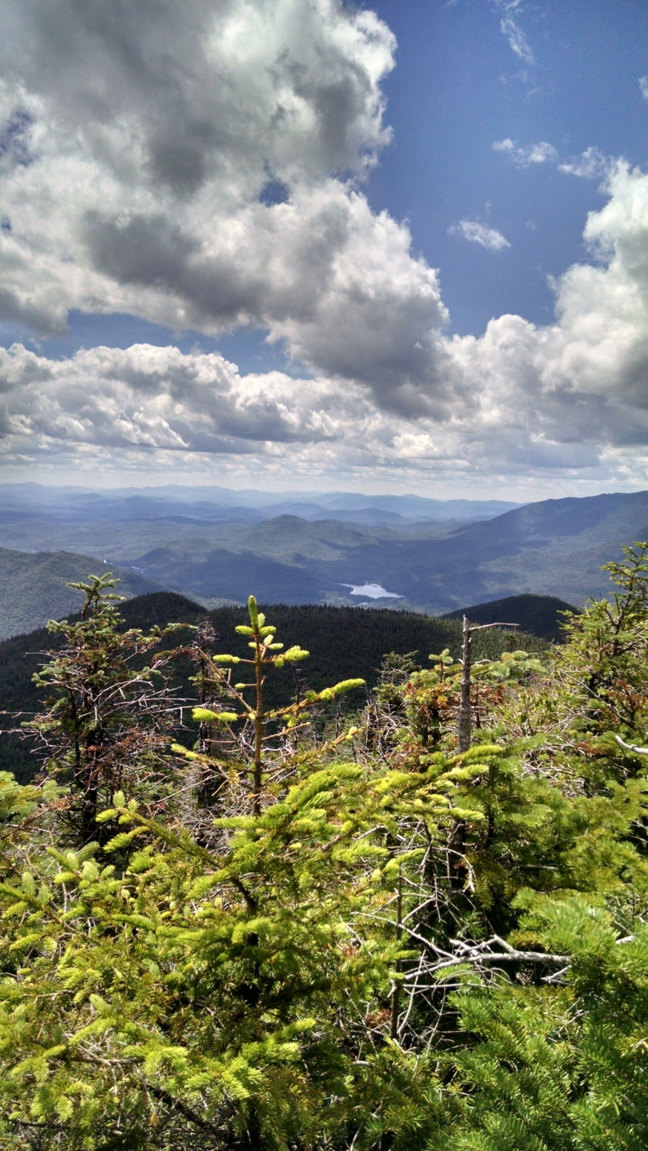
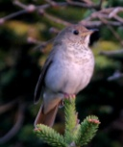
5 Town Region: Upper Hudson Recreation Hub
Highest Resilience, Connectedness
Highest Climate Stress
Highest Integrity

Slide 16
How do we deliver the science?
Case studies
Databasin Gallery for New York

Slide 17
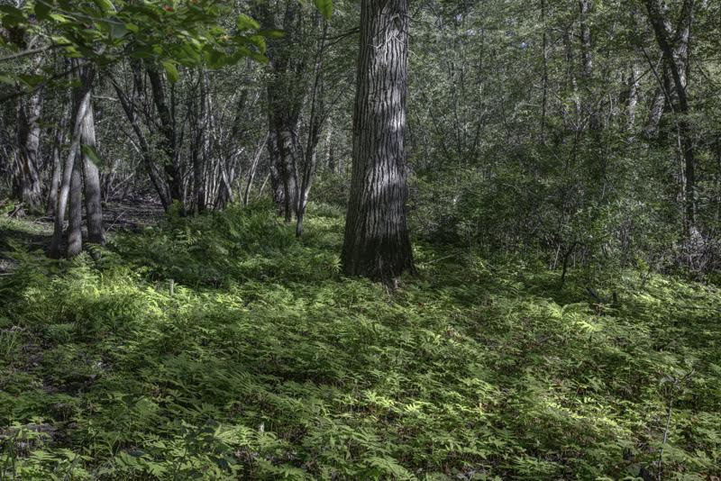
Case Study
Town of Willsboro

Slide 18
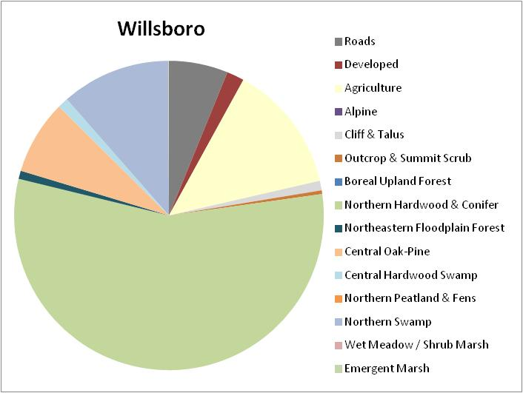
Conservation Profile

Slide 19
Conservation Profile

Slide 20
Conservation Profile

Slide 21
Conservation Profile

Slide 22
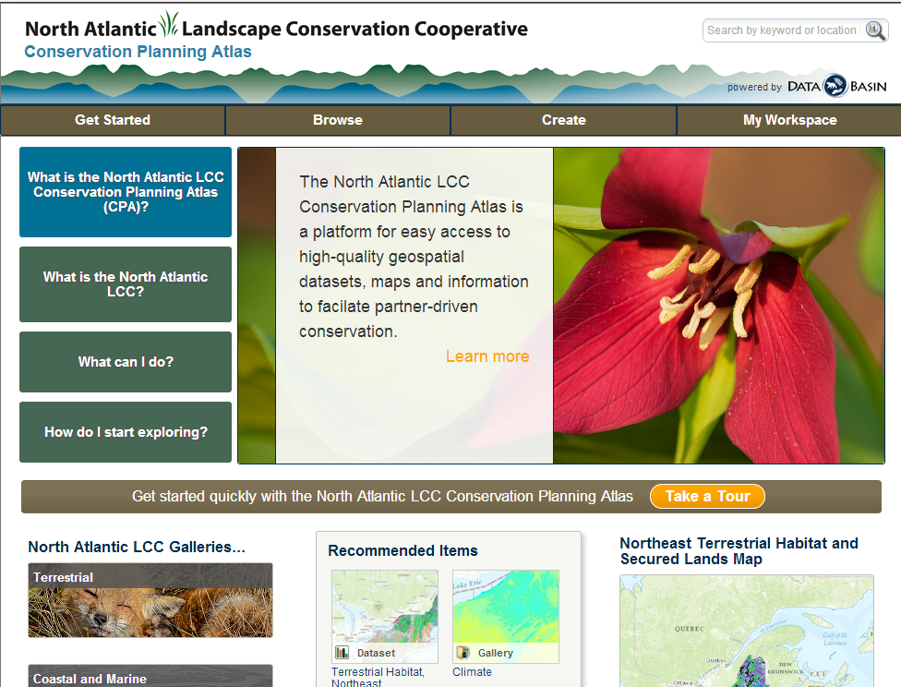
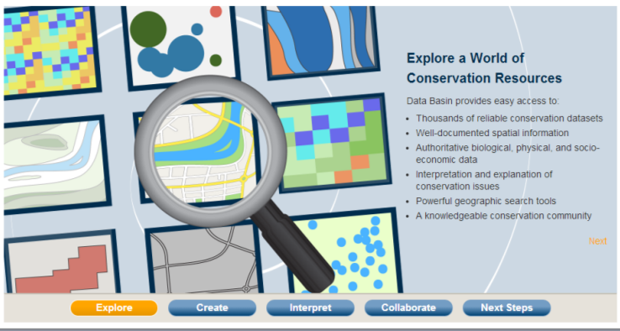
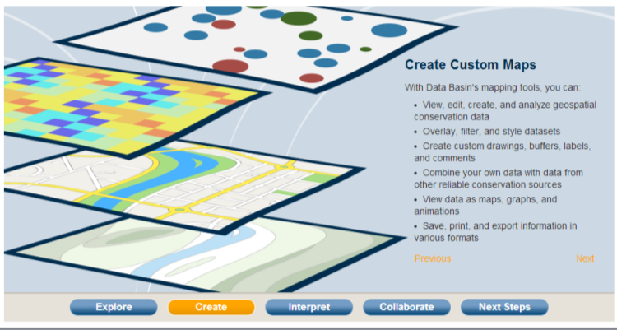
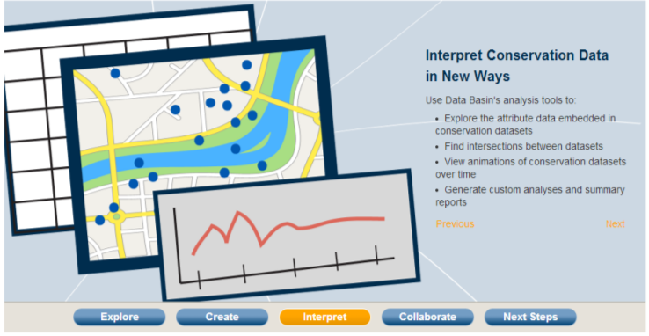
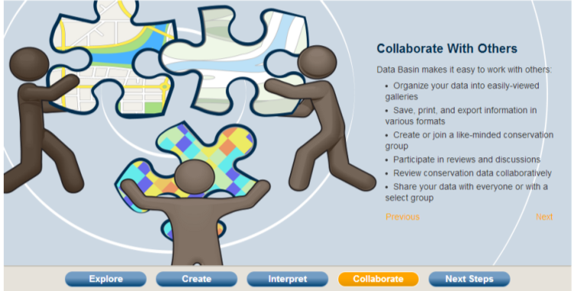
Databasin

Slide 24
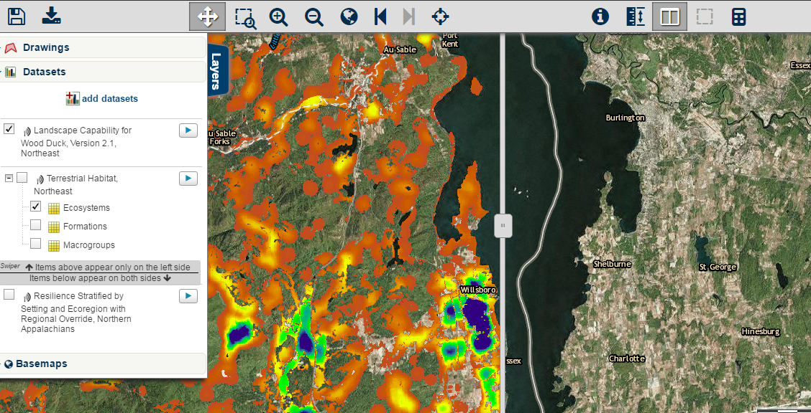
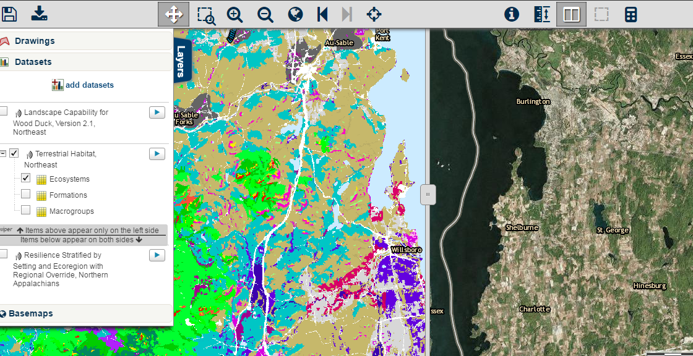
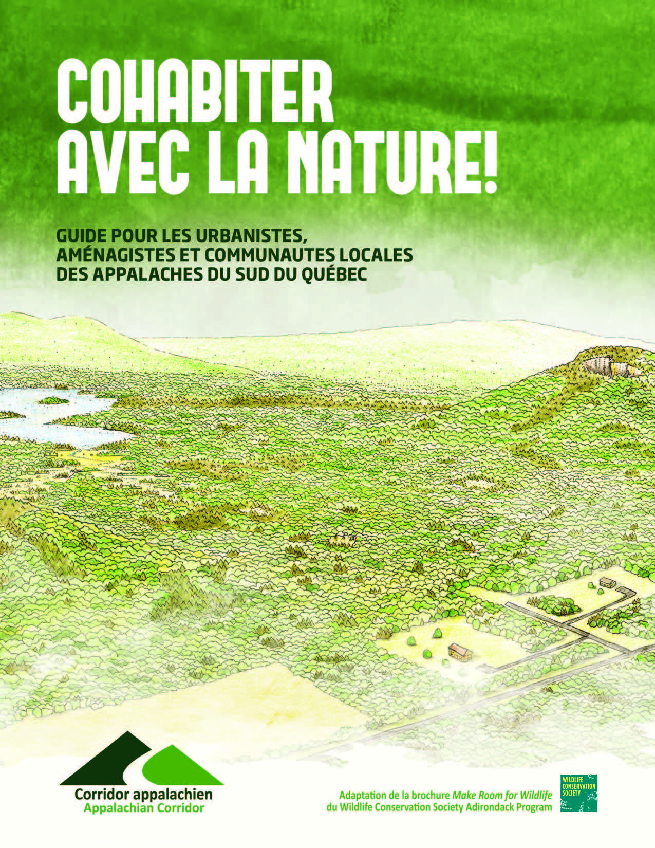

Slide 25
Messages
If you build it... they still may not come
BUT, regional science makes conservation
Faster
Better
More effective

