Slide 1
USGS Mission
Provide impartial information on the health of our ecosystems and environment, the natural hazards that threaten us, the natural resources we rely on, the impacts of climate and land-use change, and the core science systems that help us provide timely, relevant, and useable information.
Partners/Customers
DOI Bureaus, State Agencies, Other Federal Agencies, NGO’s, Scientific Community

Slide 2
USGS Mission Areas/Expertise
Ecosystems – species management, land management/ restoration, biological threats, CRU
Core Science System - modeling, mapping, data delivery
Climate/Land Use Change – LULC change rates, causes,
consequences ( e.g., floods, water availability);
Energy and Minerals – mapping, resource assessment
Environmental Health - ecological and human health,
exposure to disease agents
Natural Hazards - observations, analyses, and research
to increase resiliency to natural hazards
Water - capabilities, tools, and delivery systems to meet
the Nation’s water-resource needs

Slide 3
USGS – Relevance to Managers
Long term data/interpretation – NWIS, Chesapeake Bay nutrient/ sediment trends, breeding bird survey, SET network, NGS
Decision analysis and support tools –
SDM/AM - decisions with uncertainty, ESA species status assessments, Herring River Estuary Restoration,
Integrated spatial modeling – mapping groundwater
stream inputs, CBay fish habitat tool, ginseng on NF, Hurricane Sandy (surge, contaminants models)
Research Applications – Genetics/genomics, Lidar/3-D mapping, ecosystem services, weather radar/bird migration, Ford - acoustic bat monitoring
USGS Science at NEAFWA meeting – NAACC prioritization tool (StreamStats data); Restoring brook trout connectivity (King - genetics; Letcher – movement); Ches Bay fishery management (land-use trends analysis)

Slide 4
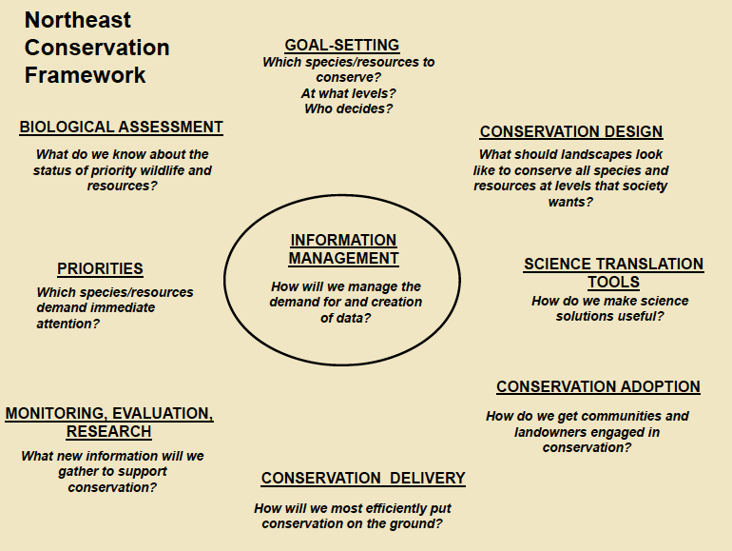
USGS – Collaborations

Slide 5
Landscape Conservation Research Framework
Ecological
research focus
Research applications
Decision-relevant management applications
Techniques
GIS and remote
sensing
Population Viability Analysis
Modeling and simulation
Evolutionary
Bioassessment
Decision Analysis
Population and community
Field surveys and experiments
Species distribution modeling
Risk /Vulnerability Assessment
Organismal
Genetics and genomics
Land-use analysis
Ecosystem services analysis
Physical/habitat
Experimental lab studies
Climate effects forecasting
Outreach
Water quality and habitat assessment
Assessing adaptive potential

