Slide 1
RCOA INTRODUCTION | 2016 NALCC
A Conservation Design for the Northeast Northeast Regional Conservation Opportunity Areas Version 1.0
Update for NEWA
October 17, 2016

Slide 2
Regional Conservation Design
Overview
Summary of process
Map components
Restoration tool
Next Steps Discussion
What does your staff need?
Implementation strategies?

Slide 3
Northeast
Conservation Framework
GOAL-SETTING
Which species/habitats to conserve? At what levels?
Who decides?
CONSERVATION DESIGN
BIOLOGICAL ASSESSMENT
What should landscapes look like to conserve species at goal levels
What do we know about the status of priority wildlife?
INFORMATION MANAGEMENT
PRIORITIES
SCIENCE TRANSLATION
Which species and issues demand immediate attention?
How will we manage the demand for and creation of data?
How do we make science solutions useful?
MONITORING, EVALUATION AND RESEARCH
CONSERVATION ADOPTION
What new information will we gather to support conservation?
How do we get communities and landowners engaged in conservation?
CONSERVATION DELIVERY
How will we most efficiently put conservation on the ground?
Notes:
The LCC recognized that to be strategic about our science investments we needed a common framework that builds on existing projects and priorities and links together planning, design, delivery and evaluation, Northeast conservation partners agreed on a common regional conservation framework and priorities at the Albany II meeting, June 2011.

Slide 4
What we did
The NA LCC facilitated a team from 13 states, USFWS, NGOs, and universities to work together to align priorities and map opportunities for unified conservation action across the Northeast region.

Slide 5
Vision
A connected network of resilient and ecologically intact habitats that will support species under changing conditions...

Slide 6
What it means
The project modeled a landscape pattern and created a suite of resources that states and partners can use voluntarily to complement their own information for conserving key habitats for multiple species.

Slide 7
Background
2015:
-NEAFWA and NALCC formed RCOA Team
-Alternatives evaluated by states and other experts
-Methodology drafted
2016:
-Version 1.0 analysis completed
-Briefings to NEWA, NALCC, and Directors
-Roll out Version 1.0
-Begin Version 2.0

Slide 8
Summary of Review Process
Snapshot of participants in August webinar series
TOPIC | ATTENDEES | AGENCIES/ORGS | STATES
Overview of Data Use & Application (Repeated 4 times) | 60 | 25 | MA, MD, NH, NJ, NY, PA, RI, VA
Terrestrial Core Networks | 19 | 10 | MA, ME, NH, NJ, PA, VA
Connectivity | 19 | 8 | ME, NH, NJ, VA
Restoration | 17 | 8 | MA, ME, NH, NJ, VA
Aquatic Core Networks | 11 | 8 | ME, NJ, VA
Important Habitats | 19 | 8 | NH, NJ, PA, RI, VA
Notes:
Description of data presented in Table:
ATTENDEES = Total number of attendees
AGENCIES/ORGS = Total number of different agencies/organizations represented
STATES = Including representatives from these states

Slide 9
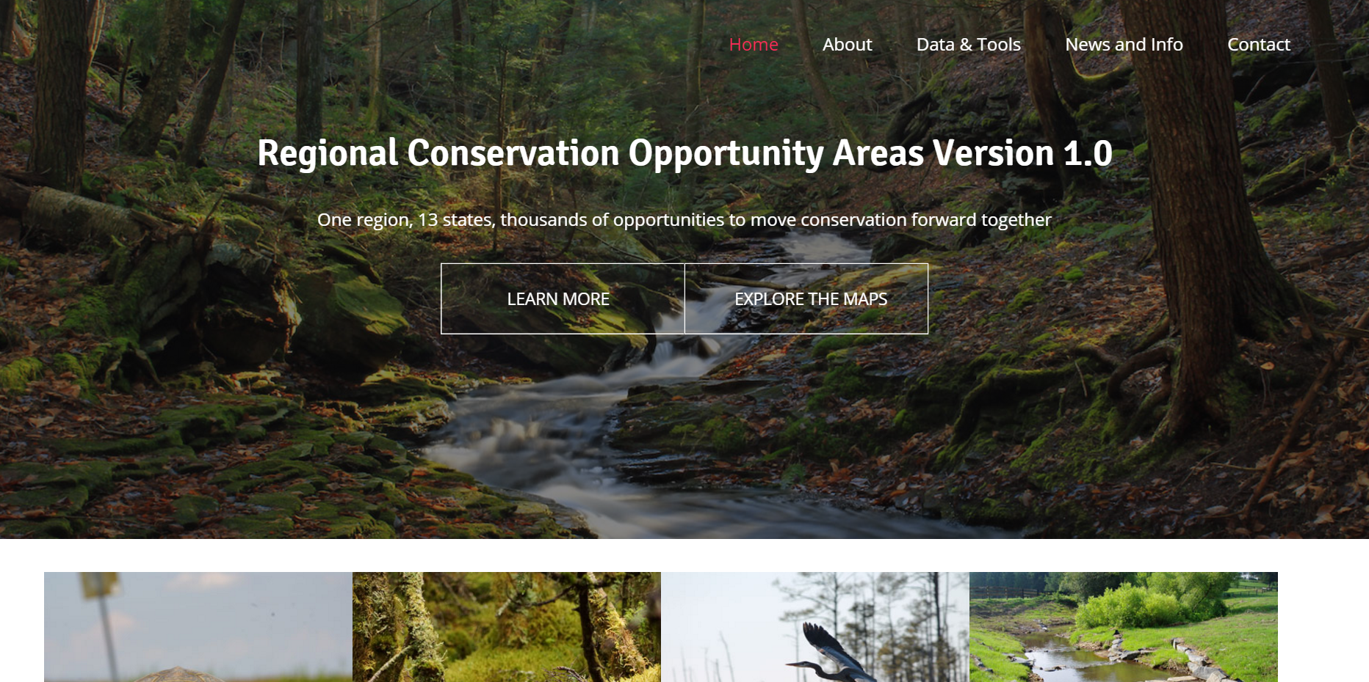

Slide 10
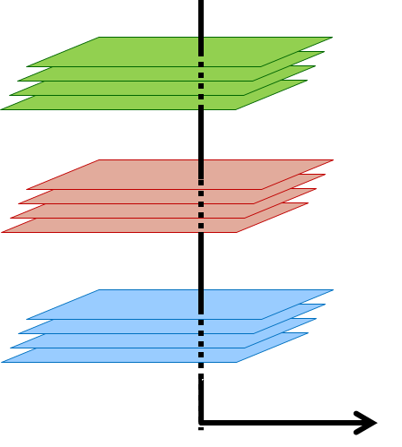
Design Builds Upon a Host of Datasets and Assessments
Habitat for dozens of species of fish and wildlife
Integrity and resilience of ecosystems
Locations of rare natural communities
Regional Conservation Opportunity Areas

Slide 11
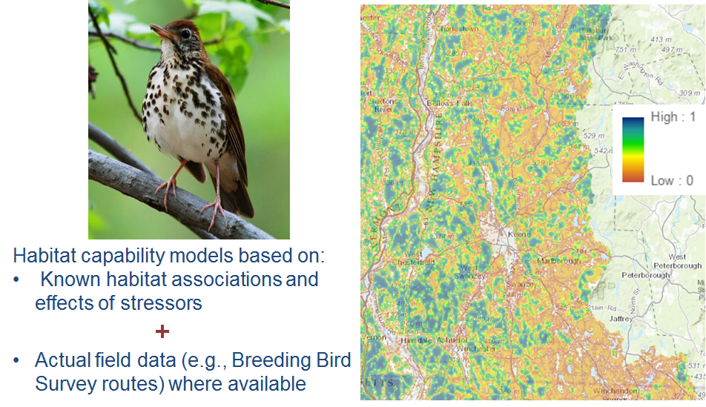
Habitat for Representative Species
UMass Designing Sustainable Landscapes project

Slide 12
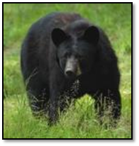
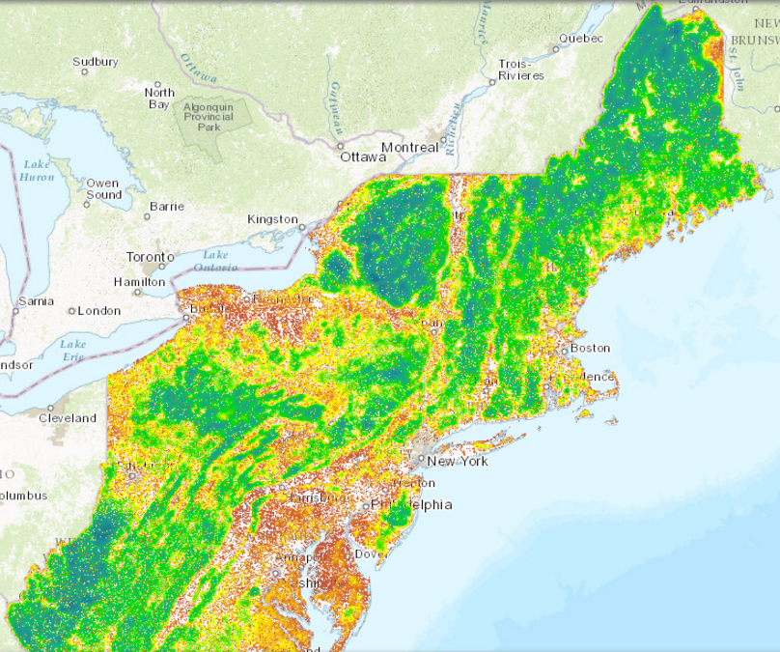
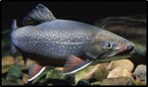
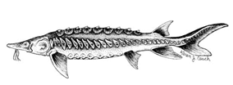
Habitat for Representative Species
UMass Designing Sustainable Landscapes project + others
30 representative species of terrestrial and wetland wildlife
Brook trout and anadromous fish

Slide 13
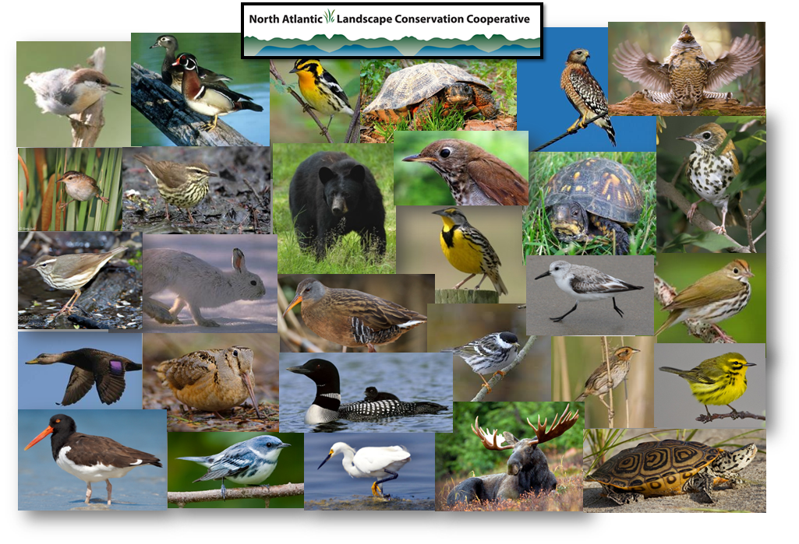
Click for Species List

Slide 14
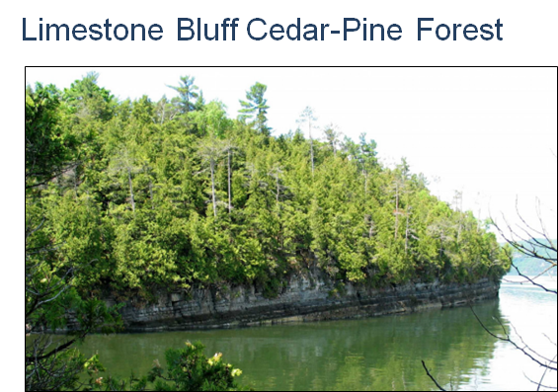
State priority natural communities
State natural heritage programs
Rare natural community locations have been received from all Northeast states

Slide 15
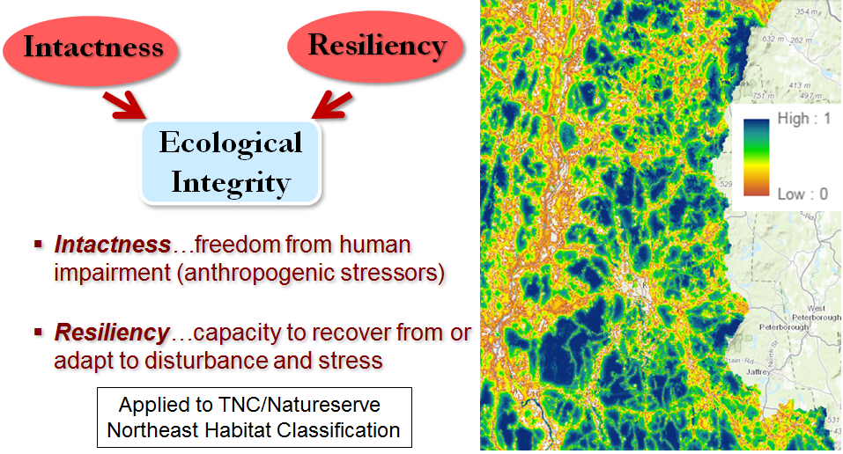
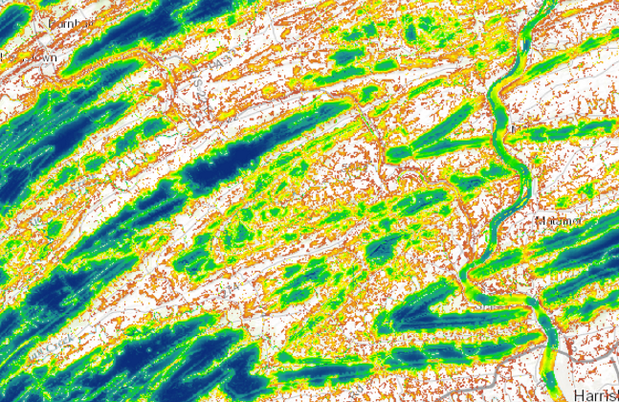
Index of Ecological Integrity
UMass Designing Sustainable Landscapes project

Slide 16
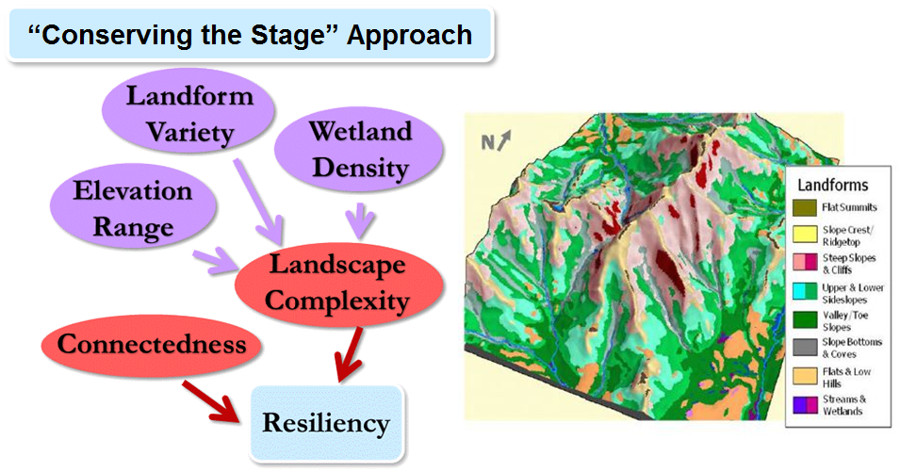
Terrestrial Resilience
The Nature Conservancy

Slide 17
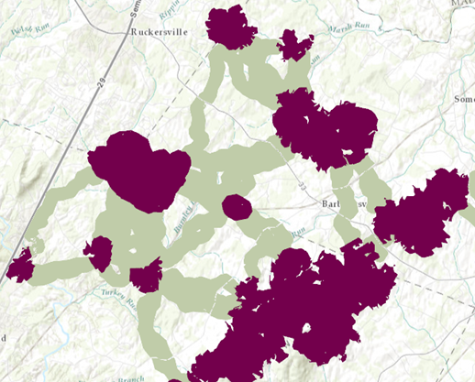
What are the components?
Terrestrial and wetland core areas
Connectors
Road-bounded natural blocks
Collectively: a network of intact ecosystems resilient under changing conditions and climate

Slide 18
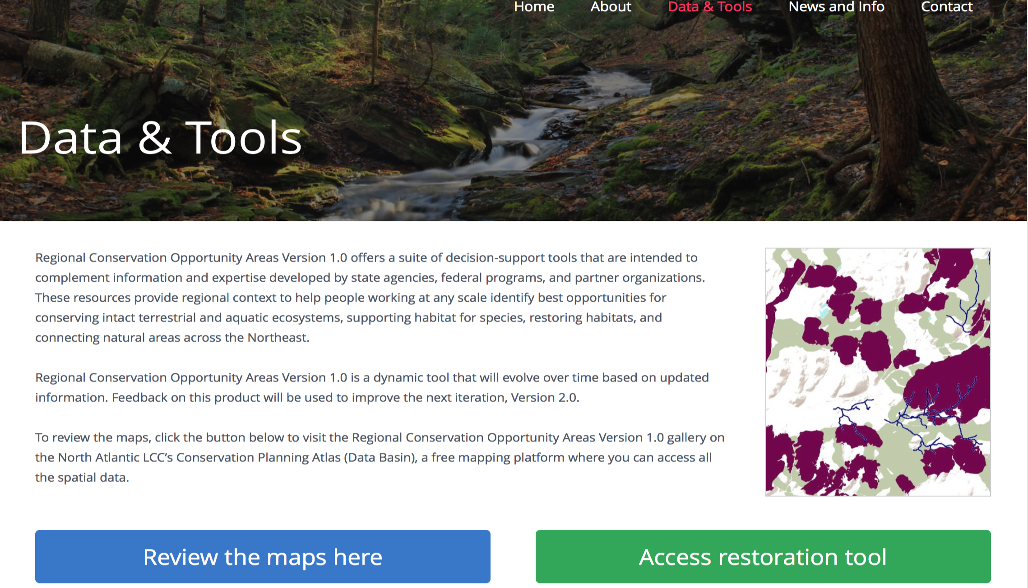

Slide 19
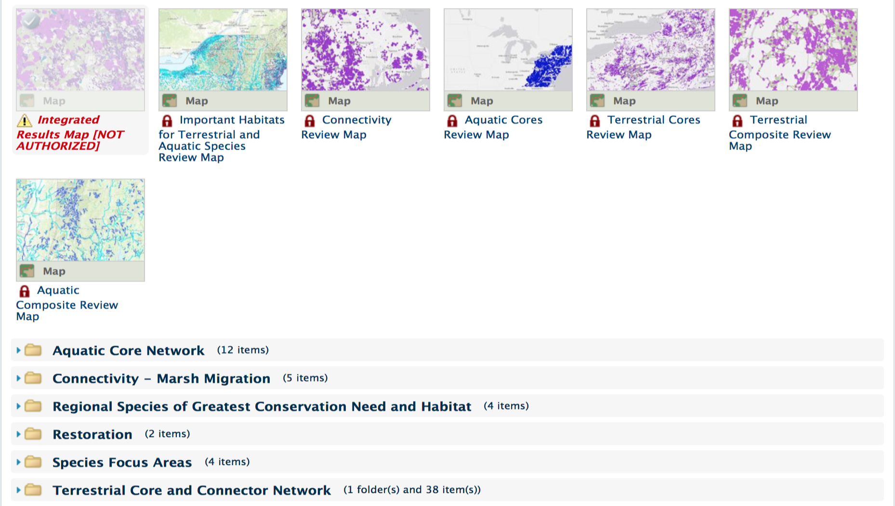

Slide 20
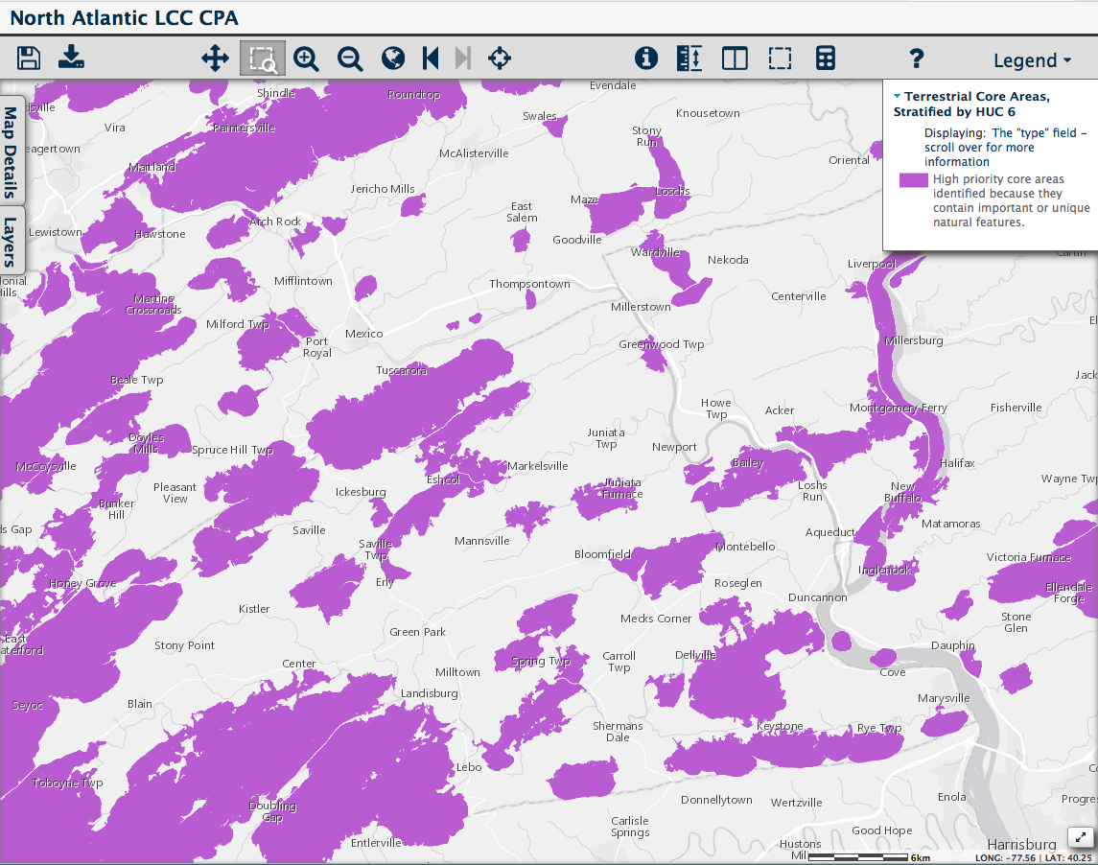
What maps are available?
Core Areas
bear
moose
grouse
woodcock

Slide 21
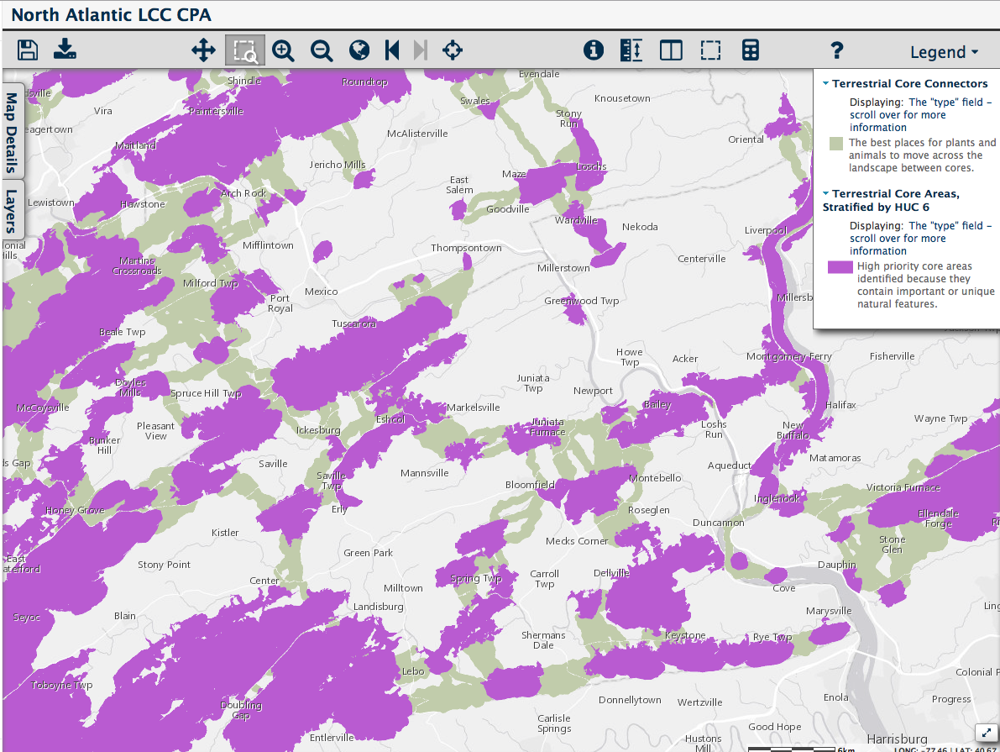
What maps are available?
Connectors
All species

Slide 22
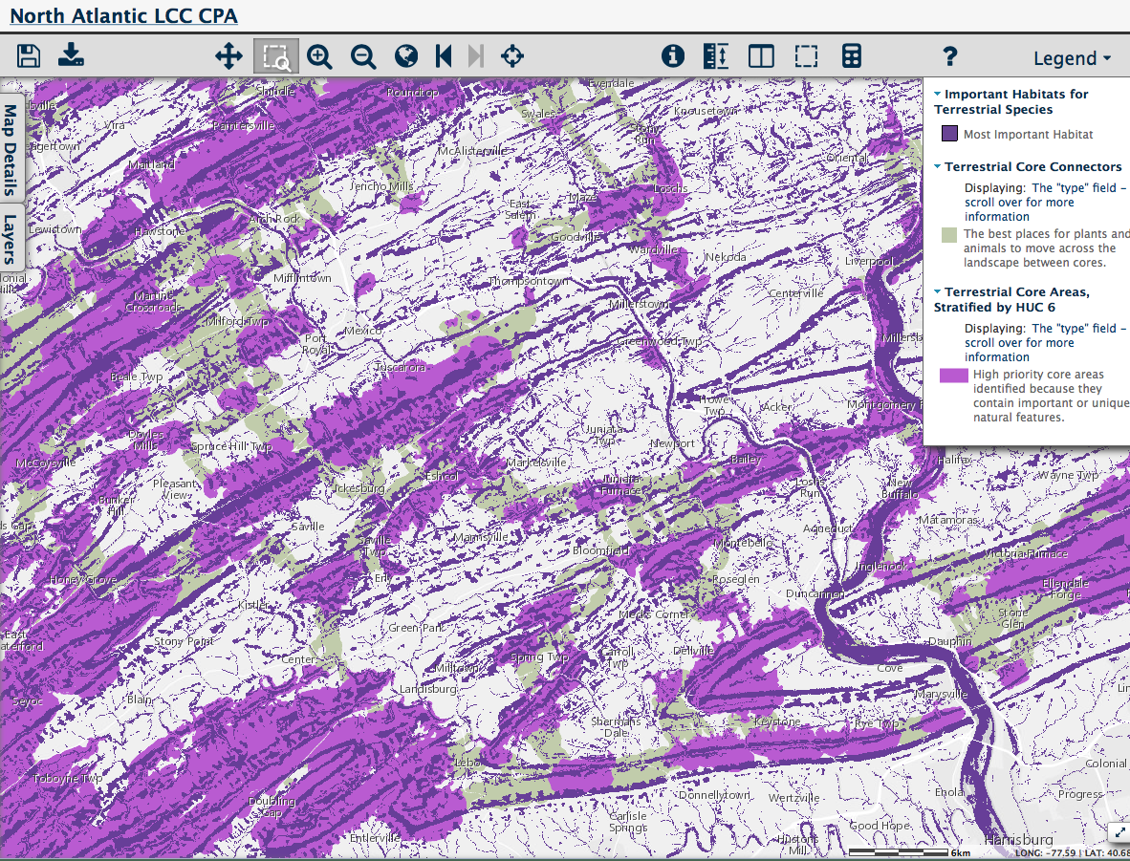
What maps are available?
Important Habitats
All species
riparian
SGCN

Slide 23
What are “important habitats”?
Areas of overlapping habitat for many species
Finding areas of overlap for many species is efficient and helps fill in data gaps.

Slide 24
Analyses of over 3,000 species to identify important habitats
Groups of species have similar requirements
Example:
Karner blue, blue lupine, frosted elfin, and whip-poor-will all use pine barrens, but surveys are incomplete.
When pine barrens and similar systems are modeled using the important habitat approach, new potential locations for species may be “found.”

Slide 25
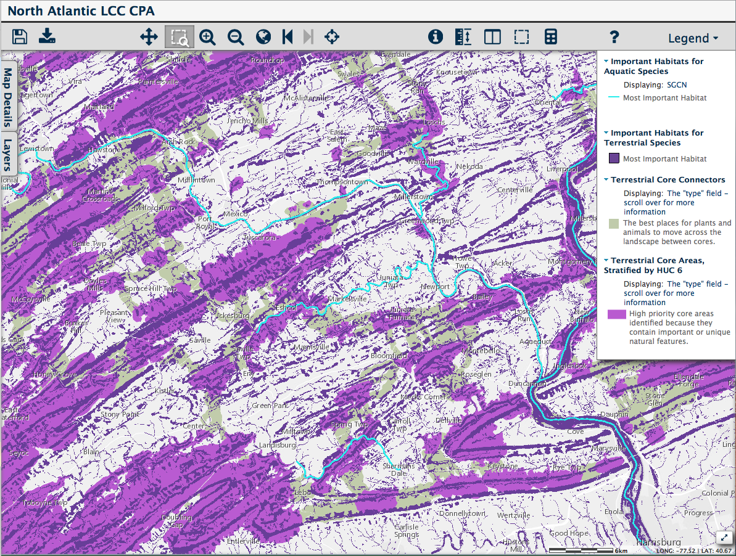
What maps are available?
Important Aquatic Features
SGCN

Slide 26
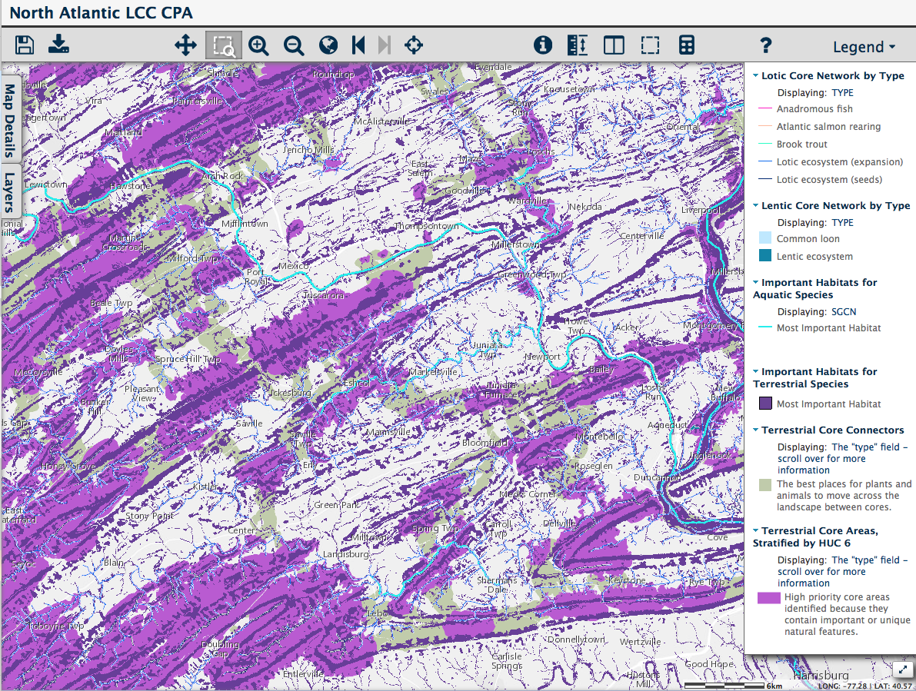
What maps are available?
Aquatic Networks
anadromous fish
Atlantic salmon
brook trout

Slide 27
Landscape Pattern
Terrestrial and wetland core areas
Connectors
Road-bounded natural blocks
Collectively: a network of intact ecosystems resilient under changing conditions and climate

Slide 29
What can it do?
Guide restoration work by:
Displays “expert” scenario maps
Creates custom scenarios
Download results as spreadsheet or map
View hundreds of data layers in a simple format

Slide 30
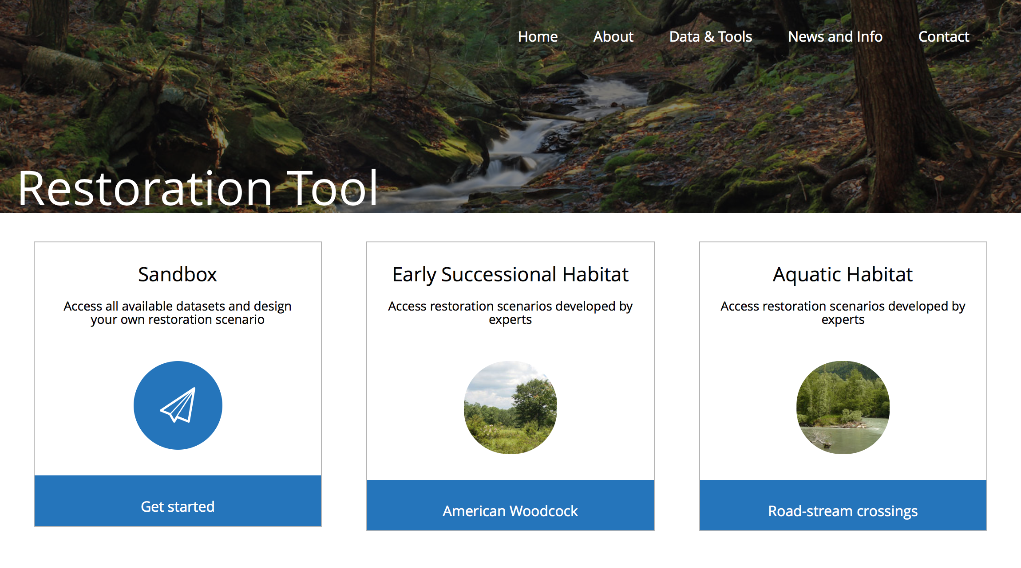

Slide 31
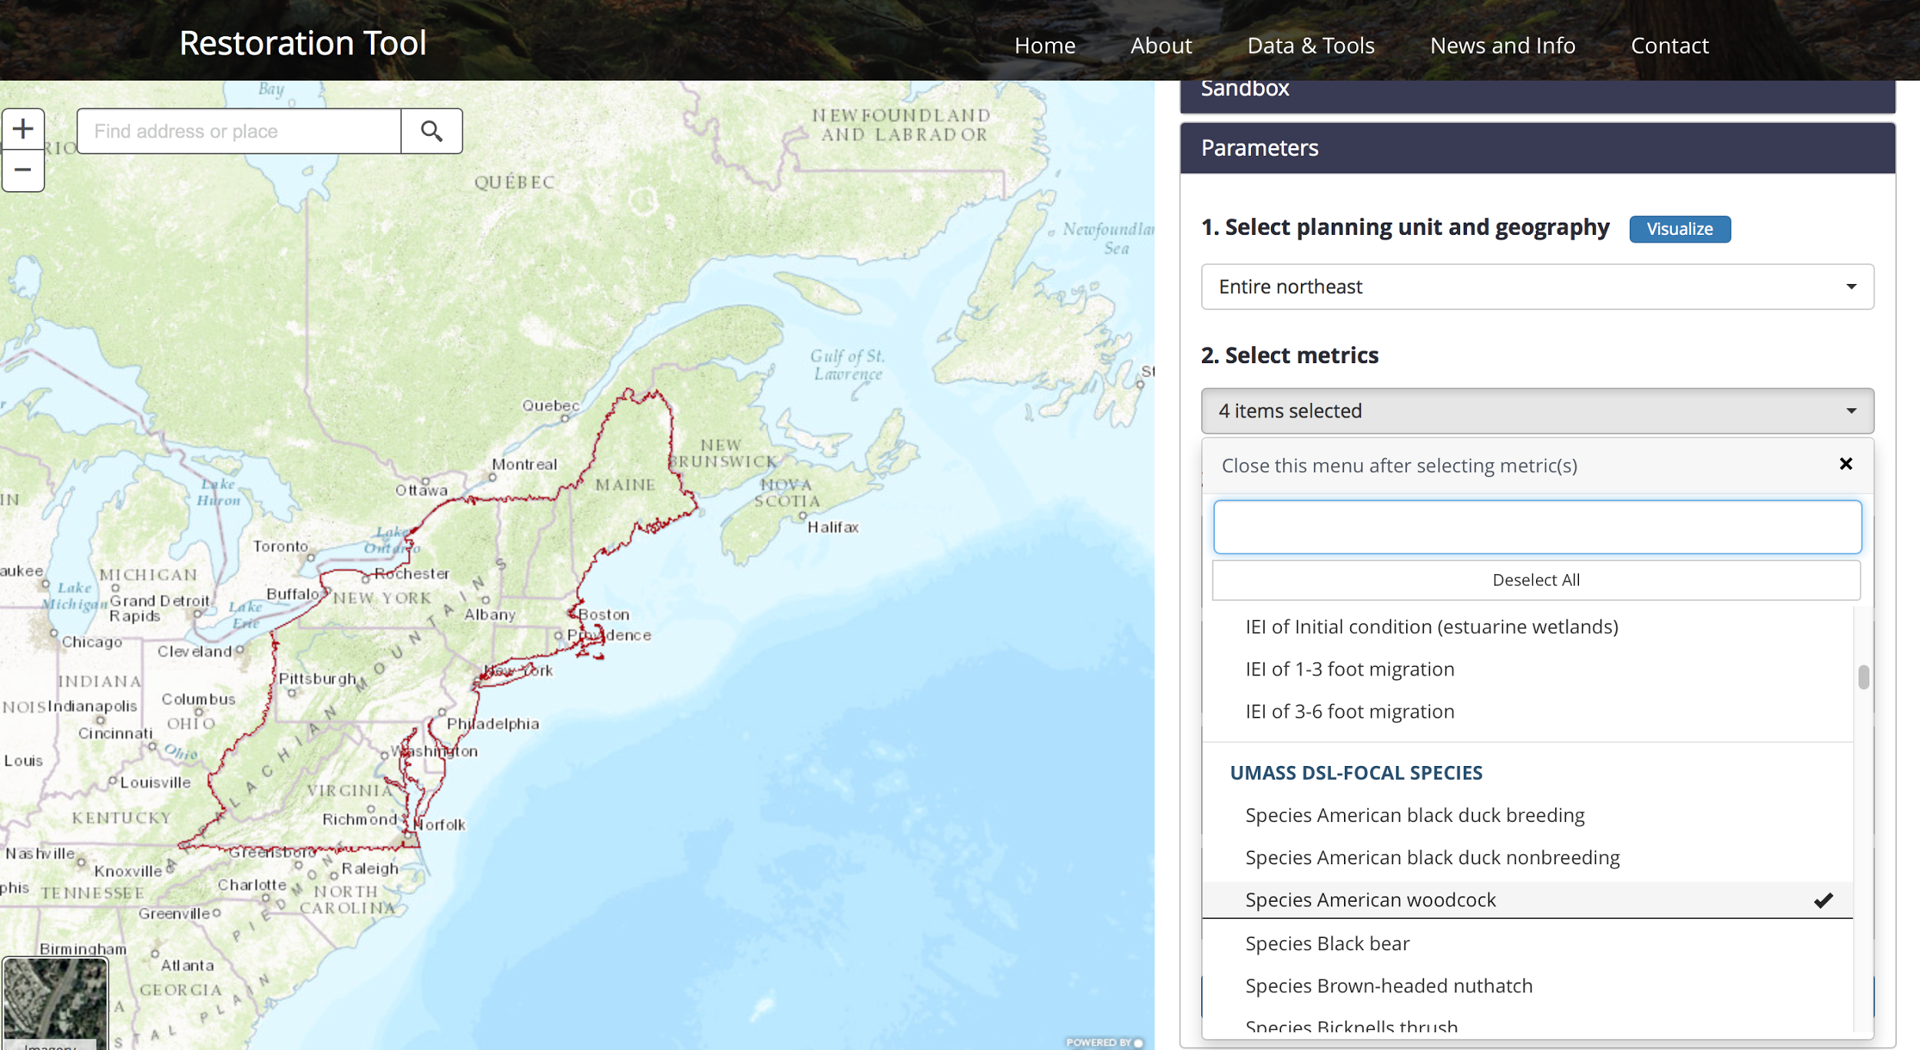
2. Select a target species or habitat.

Slide 32
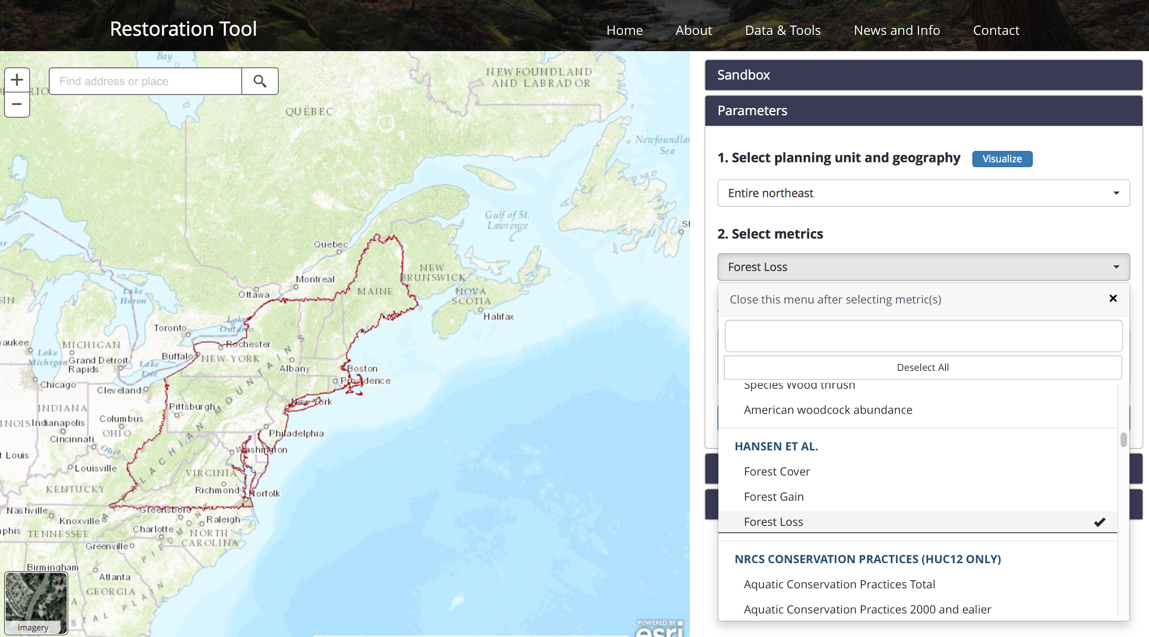
New forest condition metrics identify and age early successional habitat.
3. Select important forest metrics for prioritizing work.

Slide 33
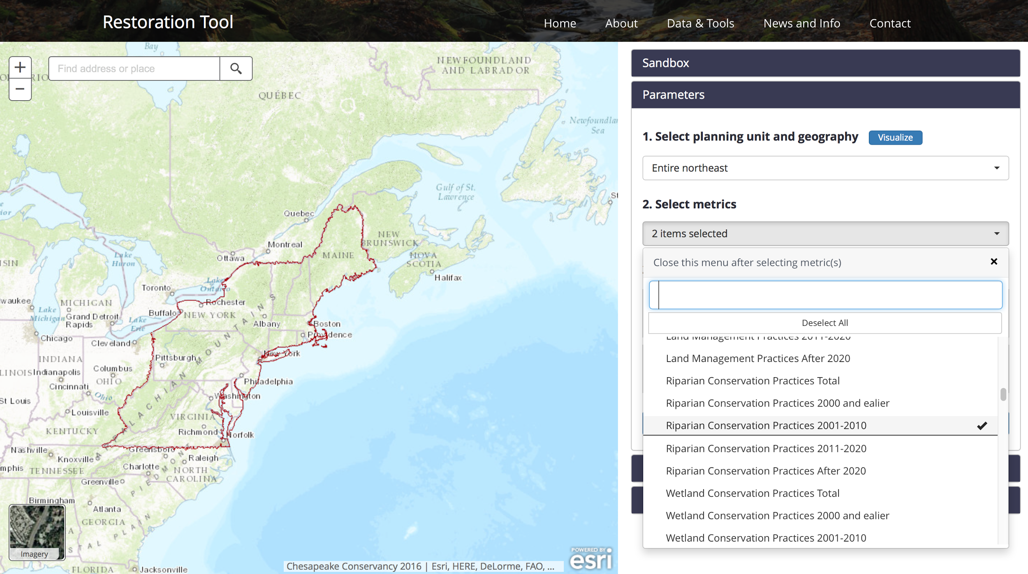
Relevant NRCS conservation practices are available for the whole region.
4. Select NRCS conservation practices to identify areas that might have willing landowners, or areas that need more effort.

Slide 34
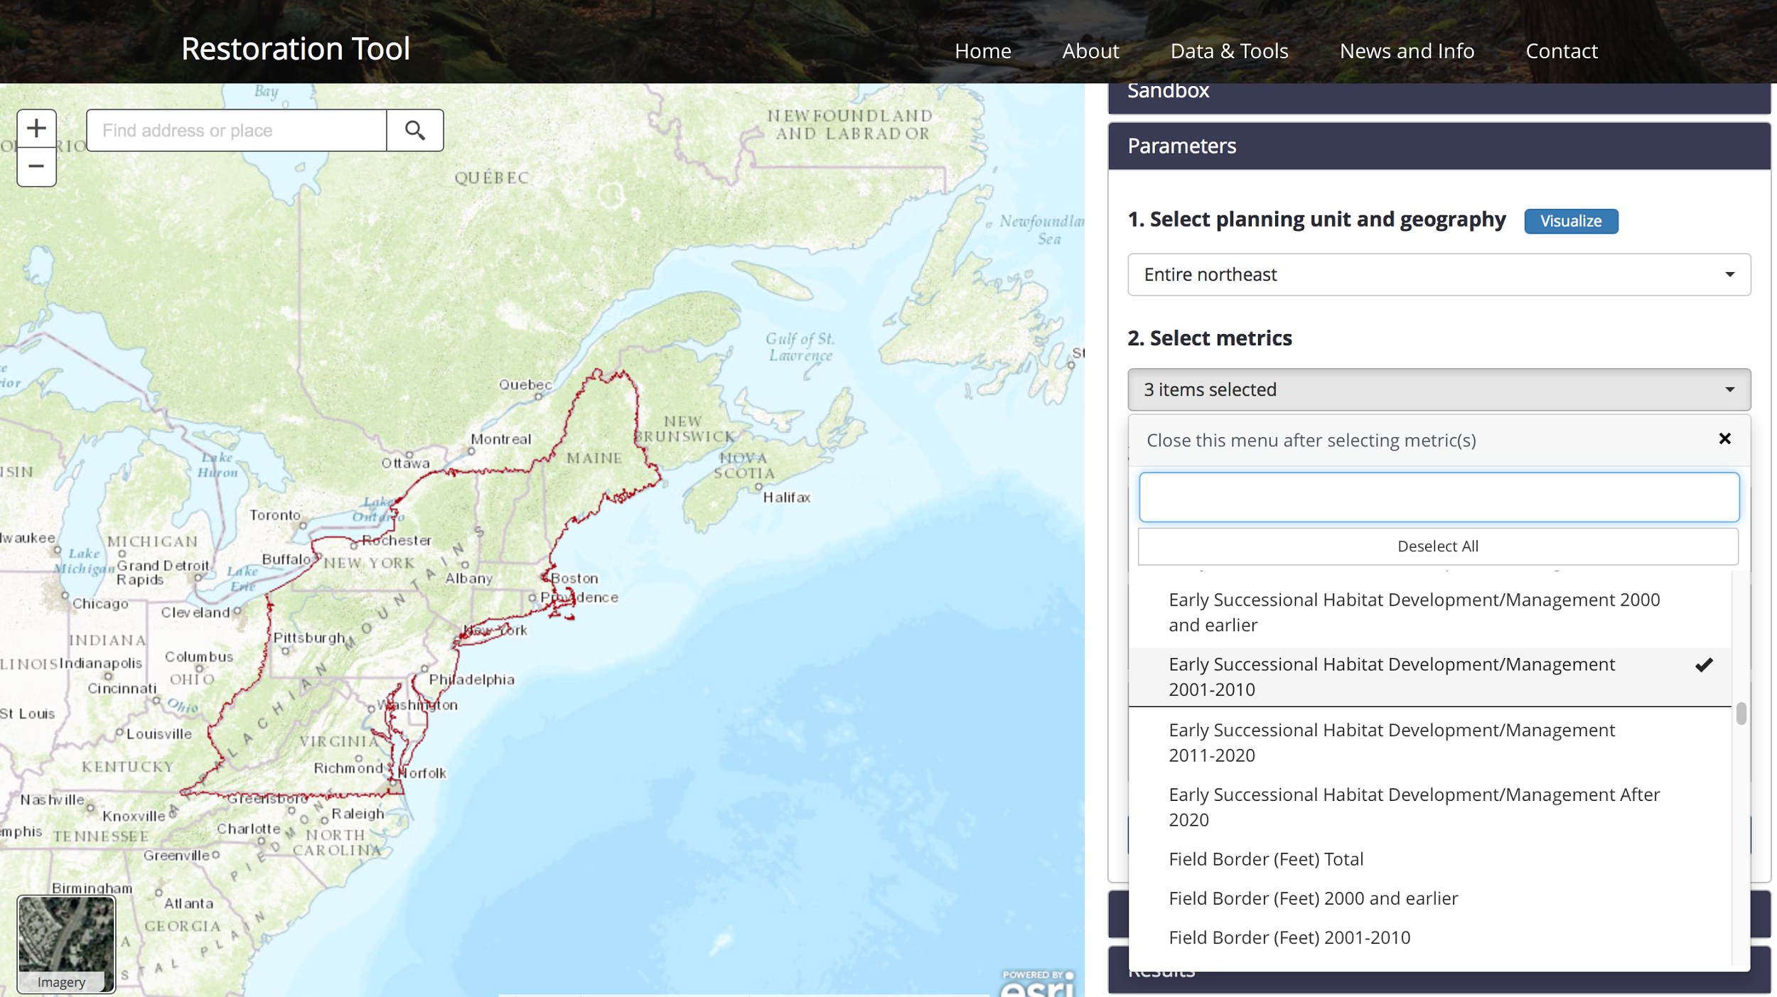
5. NRCS practices are summarized by time period.

Slide 35
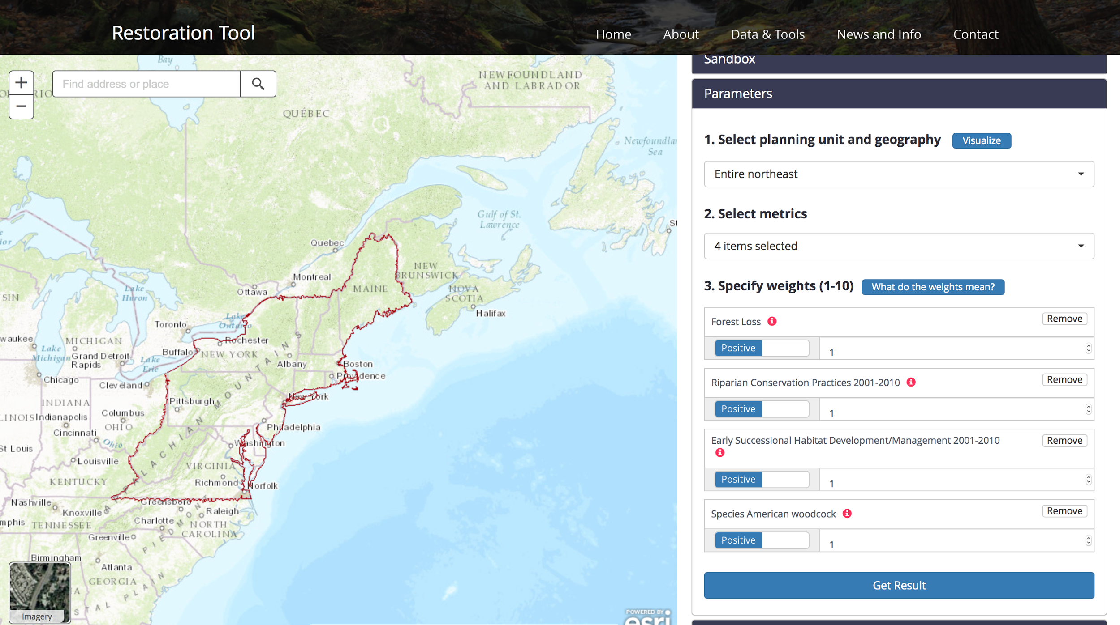
6. Edit the list of metrics.

Slide 36
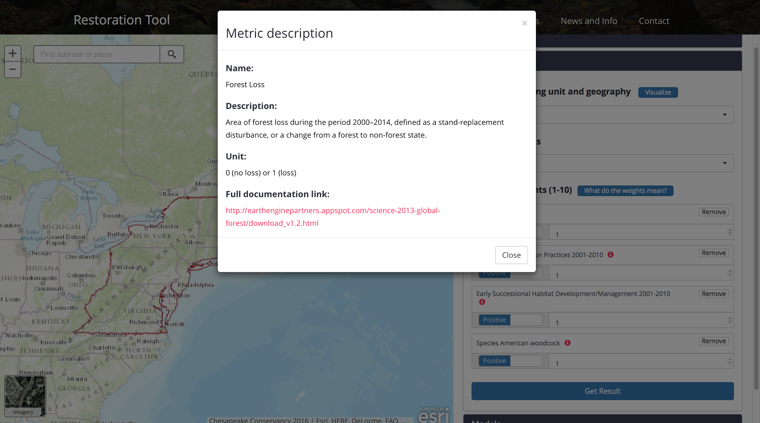
7. Get information about the metrics.

Slide 37
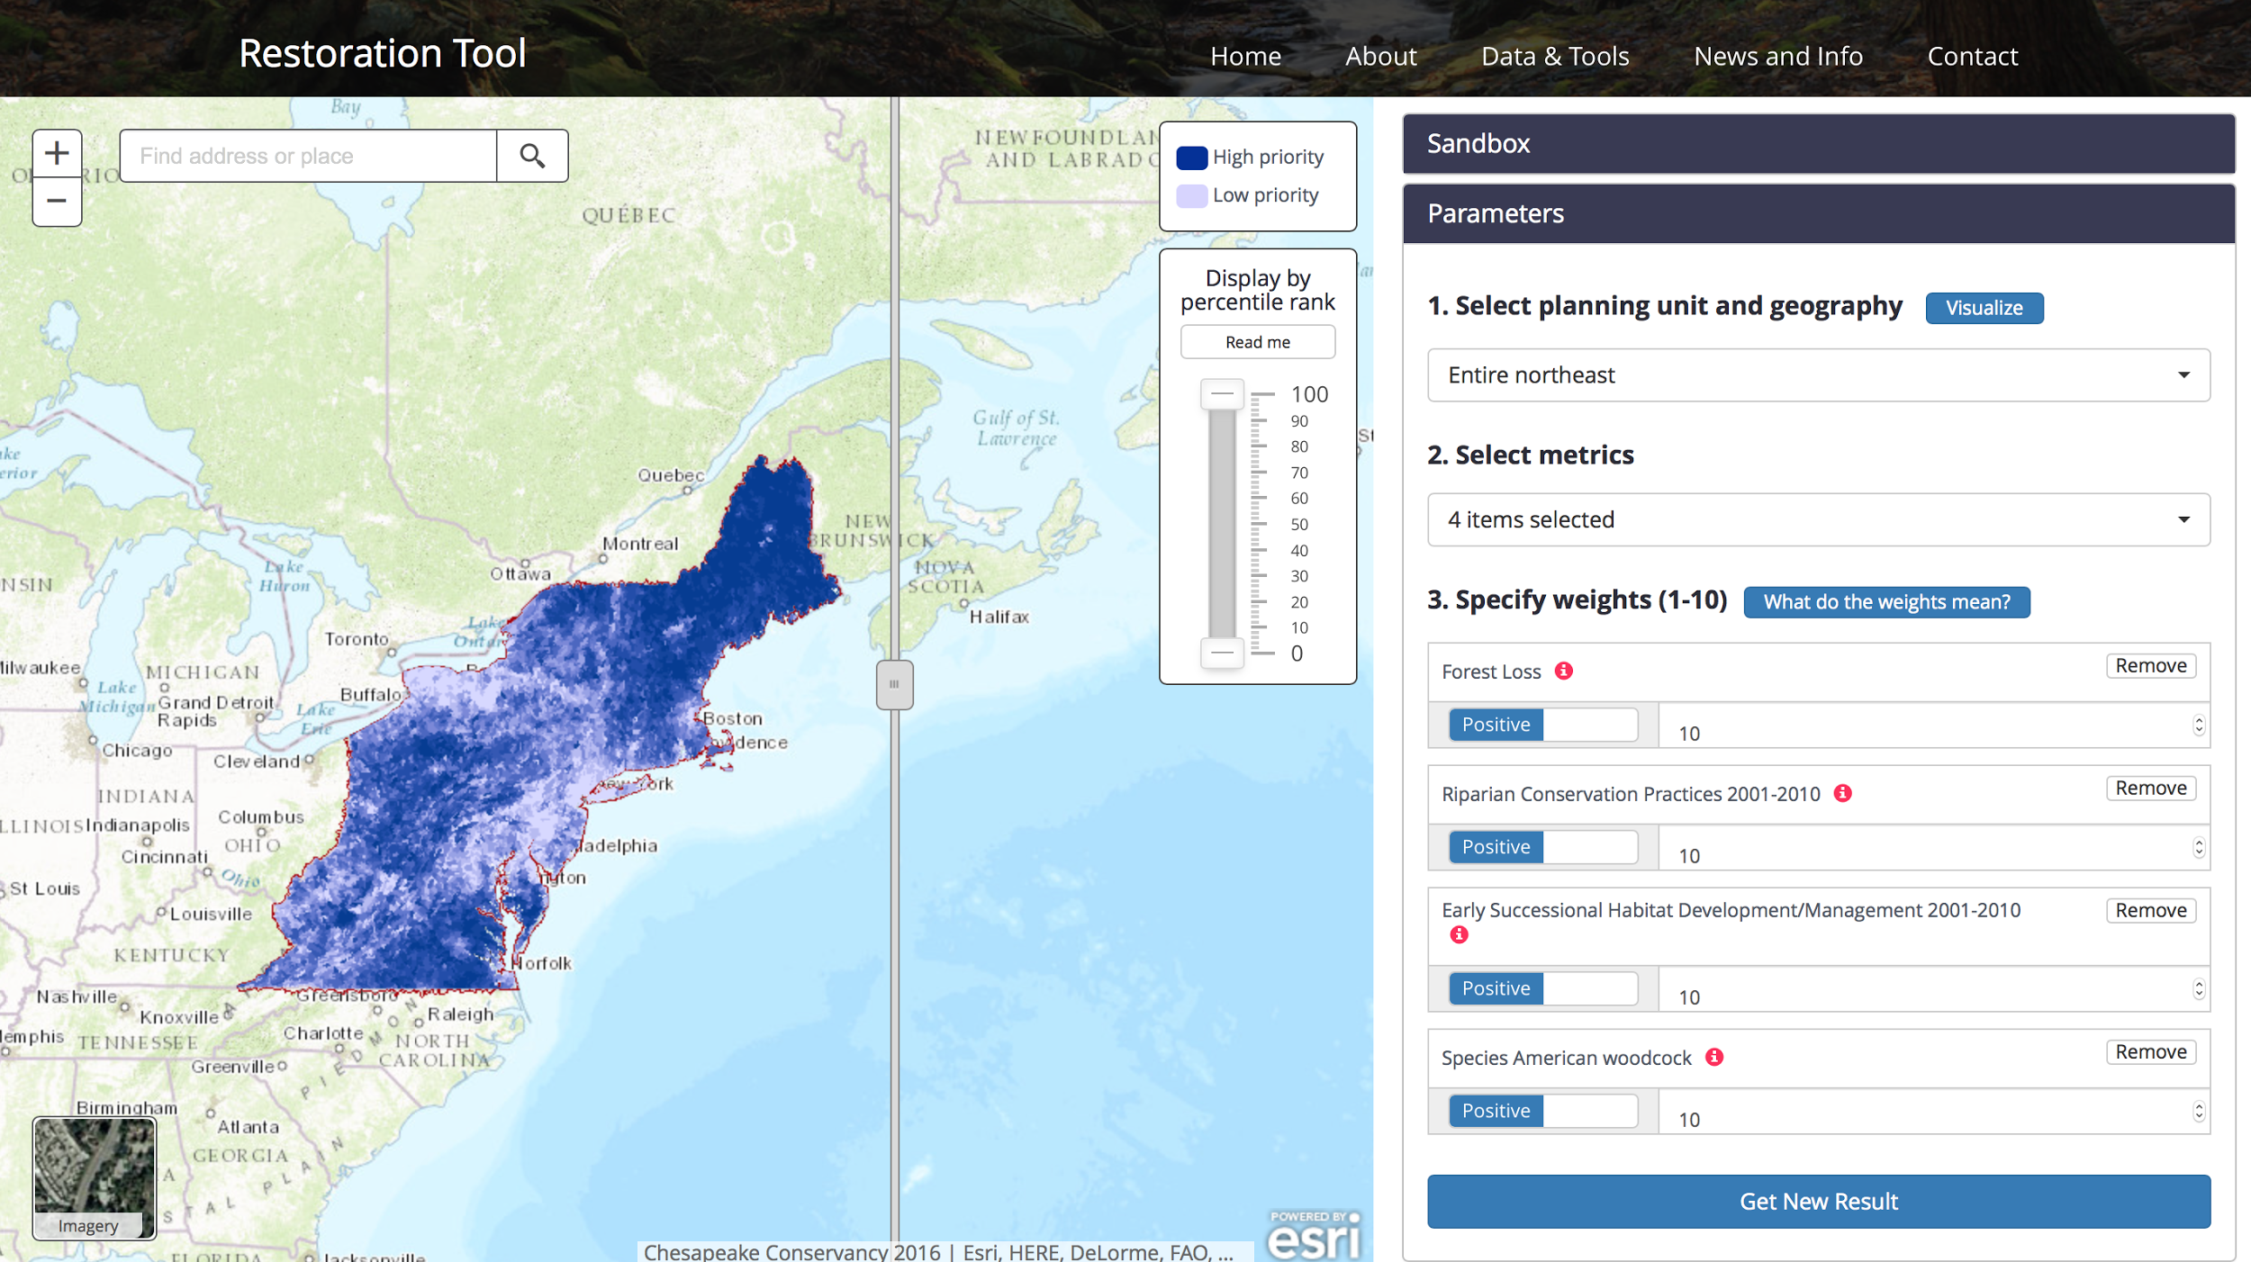
7. Assign weights for the metrics and get a result.

Slide 38
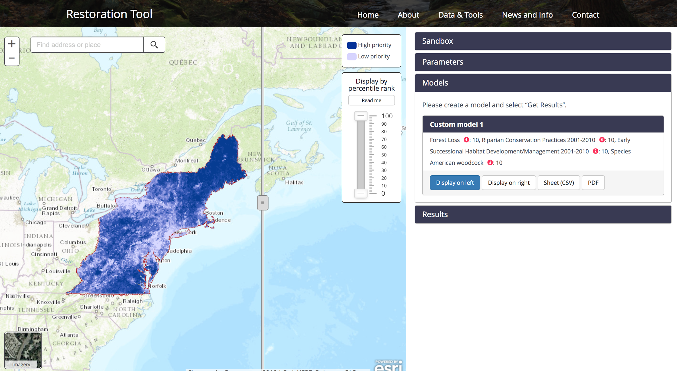
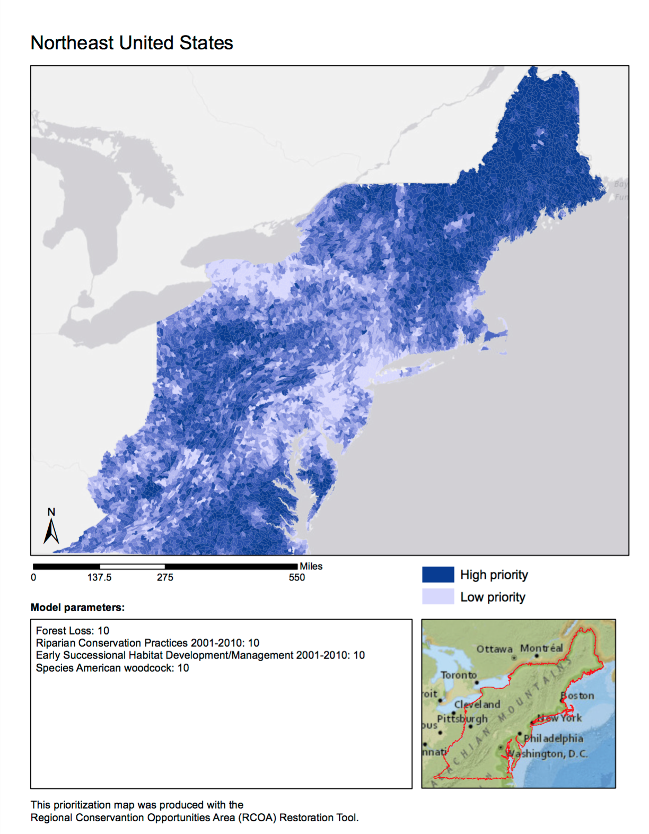
8. Download a map and report to your computer.

Slide 39
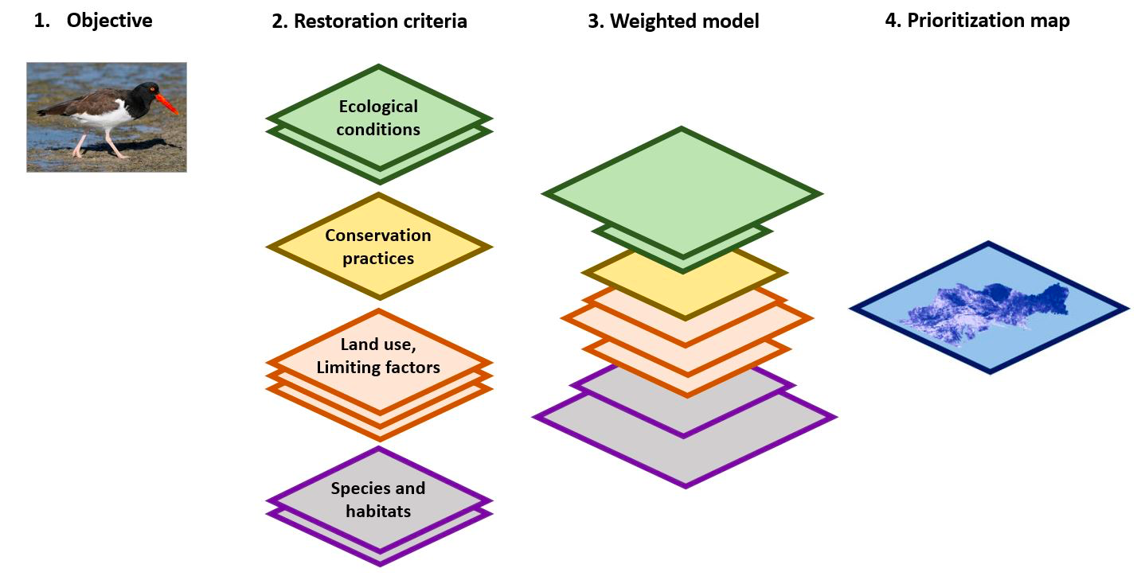
Scenario Building
Priority rank =
sum of weighted metrics
∑

Slide 40
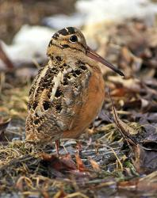
Woodcock scenario
Select and weight specific metrics
Target species or habitats
Woodcock habitat suitability [10]
Woodcock abundance [10]
Ecological site conditions
Wet flats [8]
Conservation practices
Early Successional Habitat Development/Management [10]
Brush Management [6]
Upland Wildlife Habitat Management [8]
Forest Stand Improvement [6]
Prescribed Burning [4]
Current land uses that help or hinder
Synergistic priorities

Slide 41
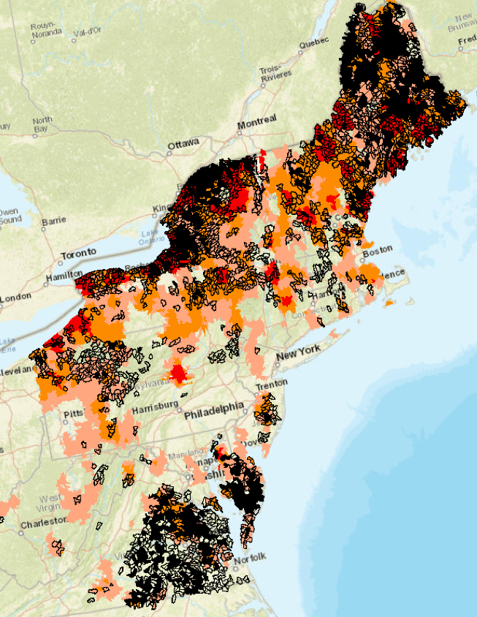
Demonstration of potential results
Solid black shows woodcock focus areas where NRCS has been highly active;
Black outline shows woodcock focus areas where NRCS has been inactive;
Red and orange is woodcock abundance (Throgmarten)

Slide 42
Support for scenario building
Partners are beginning to use the tool to build prioritization scenarios.
NALCC is providing support to partners to guide use of the tool
WMI is developing a woodcock scenario
NE Habitat Technical Committee is developing early successional scenarios
Atlantic Coast JV is evaluating tool for salt marsh migration scenarios

Slide 43
Next Steps
During 2017, based on your input and expected data updates, we will begin Version 2.0.

Slide 44
Discussion
How can your agency use the Version 1.0 products?

Slide 45
Discussion
What support or training needs do you or your staff have to begin using the information?

Slide 46
Discussion
Are there specific applications or management problems you want us to address?

