Slide 1
Communications Update
October 27, 2015
North Atlantic Landscape Conservation Cooperative

Slide 2
Communications Update
Spreading the word
Providing support and outreach
Responding to needs

Slide 3
Spreading the word: What we’re doing
Taking advantage of more outlets
Reaching different audiences
Sharing LCC’s distinct role in the conservation story

Slide 4
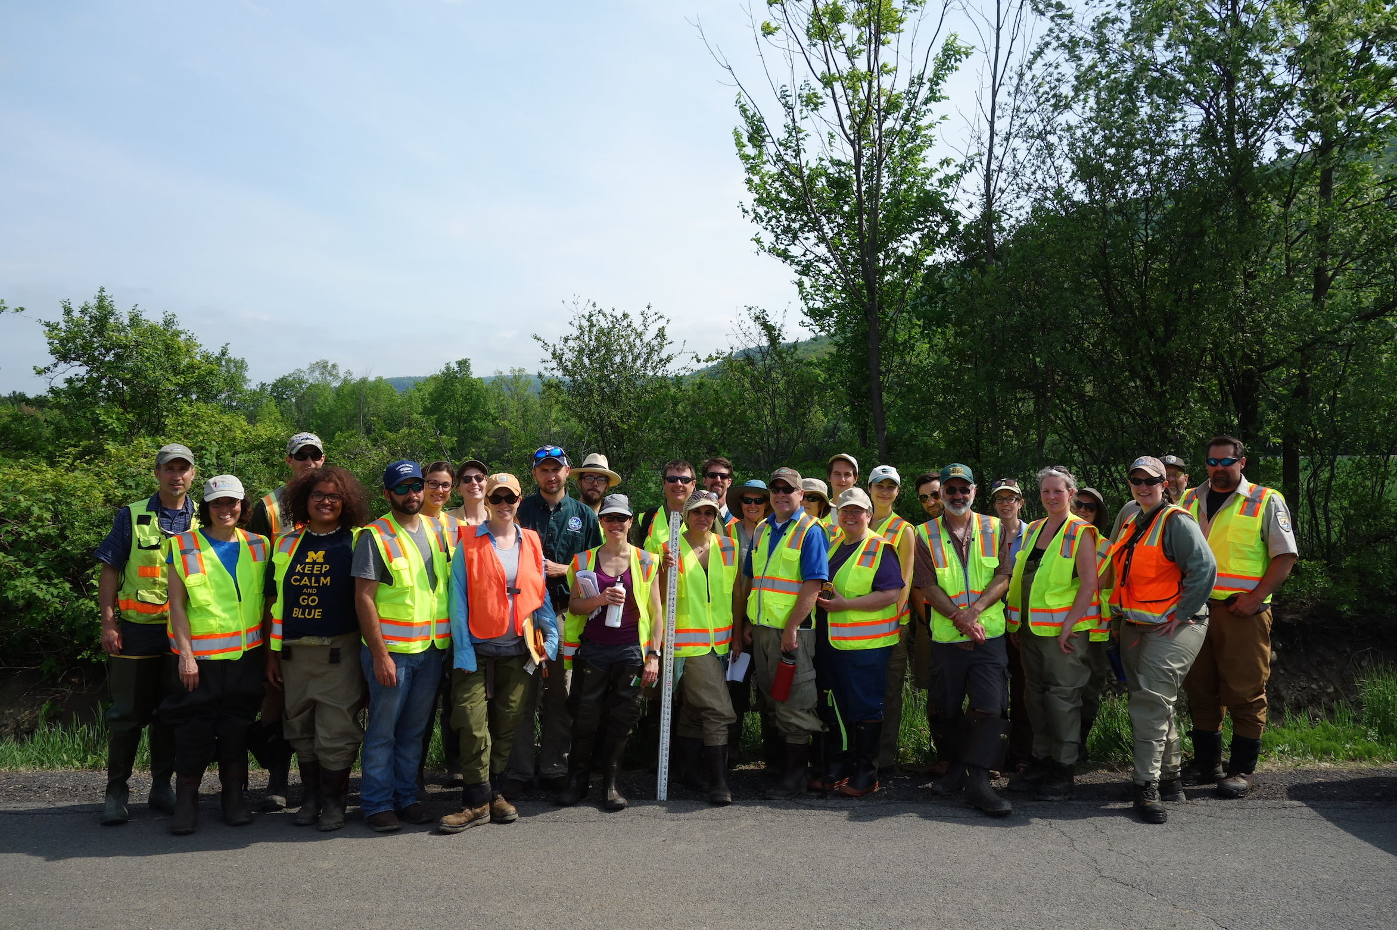
Spreading the word: Highlights
Launch of the North Atlantic Aquatic Connectivity Collaborative

Slide 5
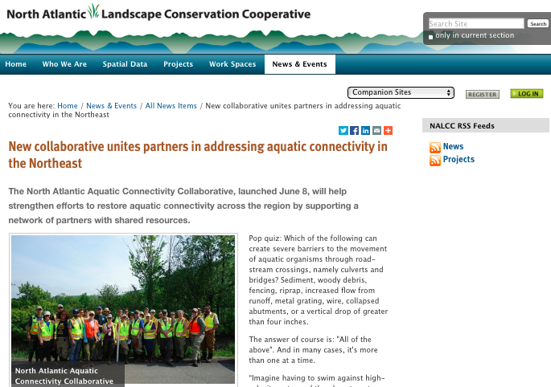
Spreading the word: Highlights
Launch of the North Atlantic Aquatic Connectivity Collaborative
Outlets: North Atlantic LCC website, FWS Northeast blog, UMass Amherst News, Associated Press
Audiences: Partners, general public
North Atlantic LCC’s role: Connecting partners to reconnect streams across the Northeast

Slide 6
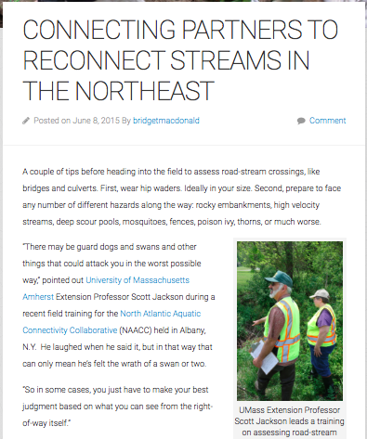
Spreading the word: Highlights
Launch of the North Atlantic Aquatic Connectivity Collaborative
Outlets: North Atlantic LCC website, FWS Northeast blog, UMass Amherst News, Associated Press
Audiences: Partners, general public
North Atlantic LCC’s role: Connecting partners to reconnect streams across the Northeast

Slide 7
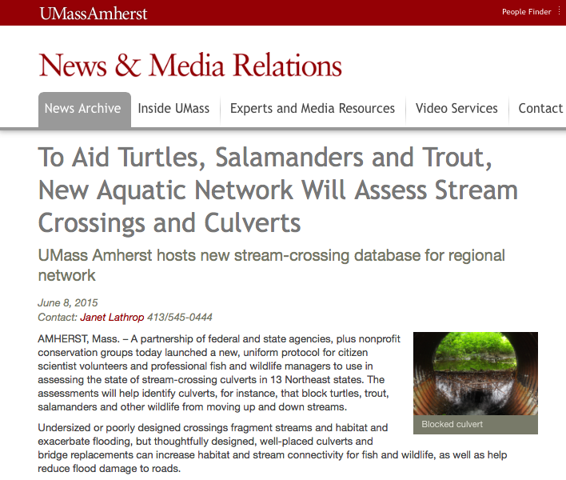
Spreading the word: Highlights
Launch of the North Atlantic Aquatic Connectivity Collaborative
Outlets: North Atlantic LCC website, FWS Northeast blog, UMass Amherst News, Associated Press
Audiences: Partners, general public
North Atlantic LCC’s role: Connecting partners to reconnect streams across the Northeast

Slide 8
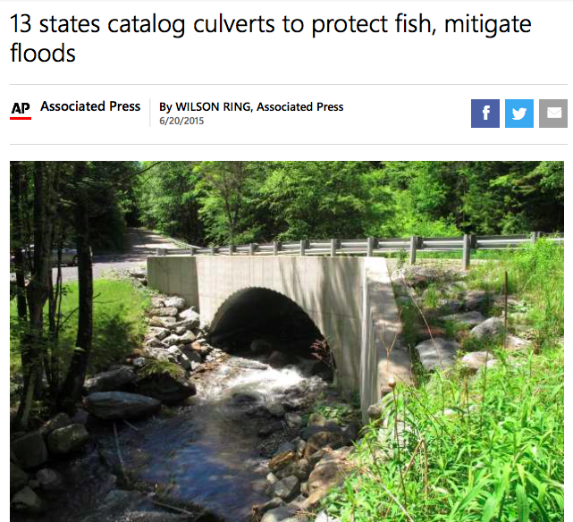
Spreading the word: Highlights
Launch of the North Atlantic Aquatic Connectivity Collaborative
Outlets: North Atlantic LCC website, FWS Northeast blog, UMass Amherst News, Associated Press
Audiences: Partners, general public
North Atlantic LCC’s role: Connecting partners to reconnect streams across the Northeast
Notes:
Associated Press story appeared in 70 news outlets nationwide, including the New York Times, Washington Post, ABC News, and New England Public Radio.

Slide 9
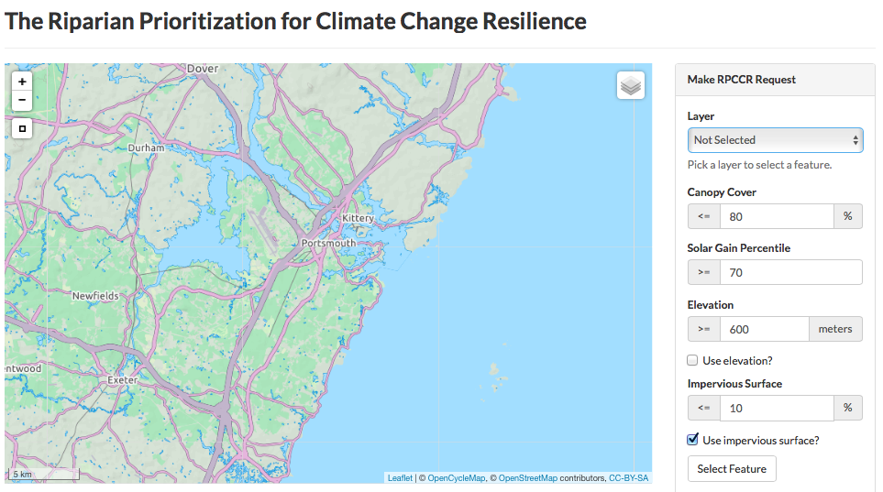
Spreading the word: Highlights
Publicizing new resources for brook trout conservation
Riparian Restoration Decision Support Tool
Appalachian LCC
Notes:
Riparian Restoration Decision Support Tool, Chesapeake Bay Brook Trout Assessment and Decision Support Tool, and Forecasting Changes in Aquatic Systems and Resilience of Brook Trout

Slide 10
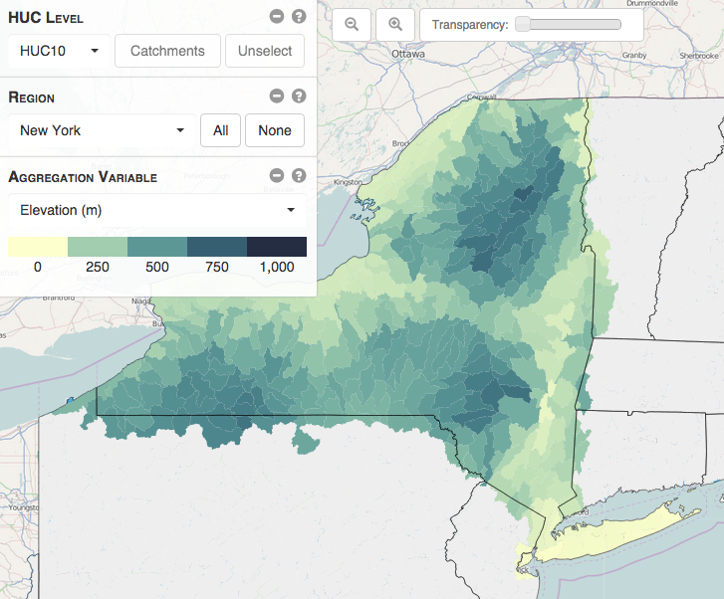
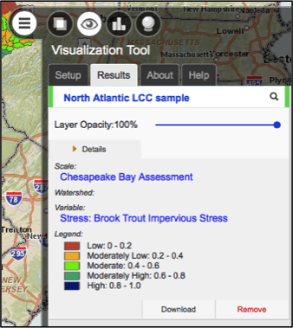
Spreading the word: Highlights
Publicizing new resources for brook trout conservation
Forecasting Changes in Aquatic Systems and Resilience of Brook Trout
North Atlantic LCC
Notes:
Riparian Restoration Decision Support Tool, Chesapeake Bay Brook Trout Assessment and Decision Support Tool, and Forecasting Changes in Aquatic Systems and Resilience of Brook Trout

Slide 11
Spreading the word: Highlights
Publicizing new resources for brook trout conservation
Chesapeake Bay Brook Trout Assessment and Decision Support Tool
North Atlantic LCC
Notes:
Riparian Restoration Decision Support Tool, Chesapeake Bay Brook Trout Assessment and Decision Support Tool, and Forecasting Changes in Aquatic Systems and Resilience of Brook Trout

Slide 12
Spreading the word: Highlights
Publicizing new resources for brook trout conservation
Outlets: North Atlantic LCC Newsletter, LCC Network, FWS Northeast blog, Baltimore Sun
Audiences: Partners, LCC Network, general public
North Atlantic LCC’s role: Supporting science designed to handle complexity of interacting threats to iconic species

Slide 13
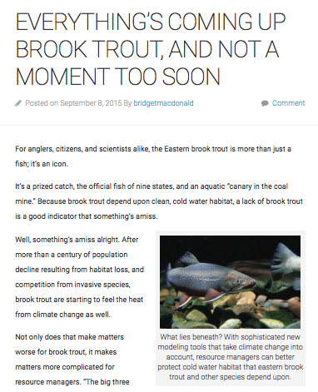
Spreading the word: Highlights
Publicizing new resources for brook trout conservation
Outlets: North Atlantic LCC Newsletter, LCC Network, FWS Northeast blog, Baltimore Sun
Audiences: Partners, LCC Network, general public
North Atlantic LCC’s role: Supporting science designed to handle complexity of interacting threats to iconic species
Notes:
One of the top performing blog posts to date in 2015, based on the number of times the story was viewed - 344, compared to an average of 100 - and was reposted on the LCC Network website

Slide 14
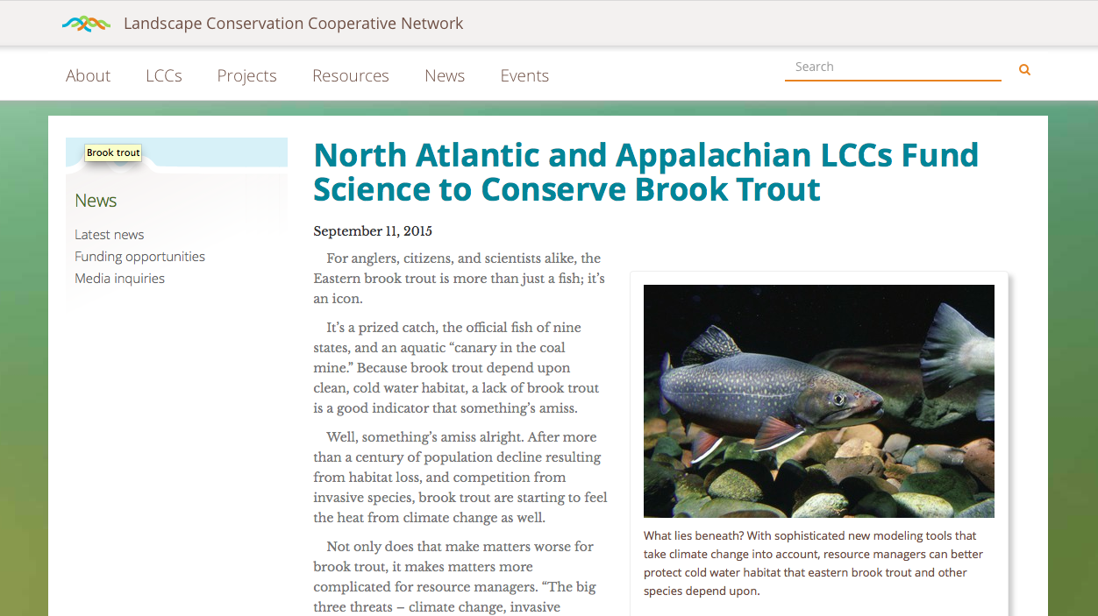
Spreading the word: Highlights
Publicizing new resources for brook trout conservation
Outlets: North Atlantic LCC Newsletter, LCC Network, FWS Northeast blog, Baltimore Sun
Audiences: Partners, LCC Network, general public
North Atlantic LCC’s role: Supporting science designed to handle complexity of interacting threats to iconic species
Notes:
North Atlantic LCC has repeatedly been recognized among Top Five contributors to LCC Network news.

Slide 15
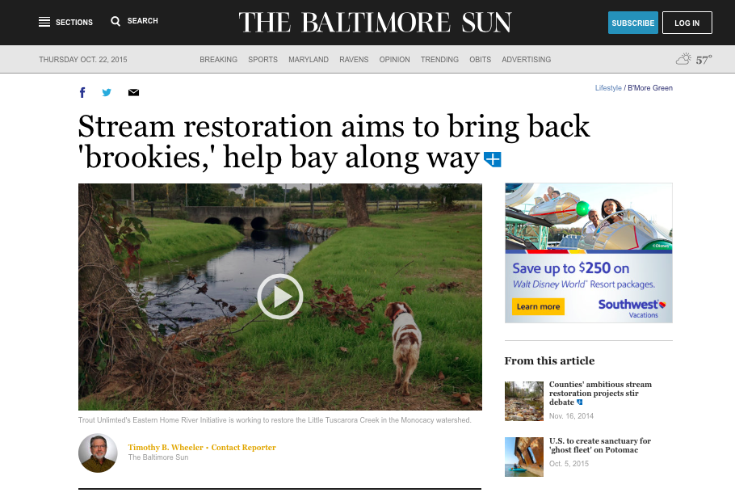
Spreading the word: Highlights
Publicizing new resources for brook trout conservation
Outlets: North Atlantic LCC Newsletter, LCC Network, FWS Northeast blog, Baltimore Sun
Audiences: Partners, LCC Network, general public
North Atlantic LCC’s role: Supporting science designed to handle complexity of interacting threats to iconic species
Notes:
North Atlantic LCC has repeatedly been recognized among Top Five contributors to LCC Network news.

Slide 16
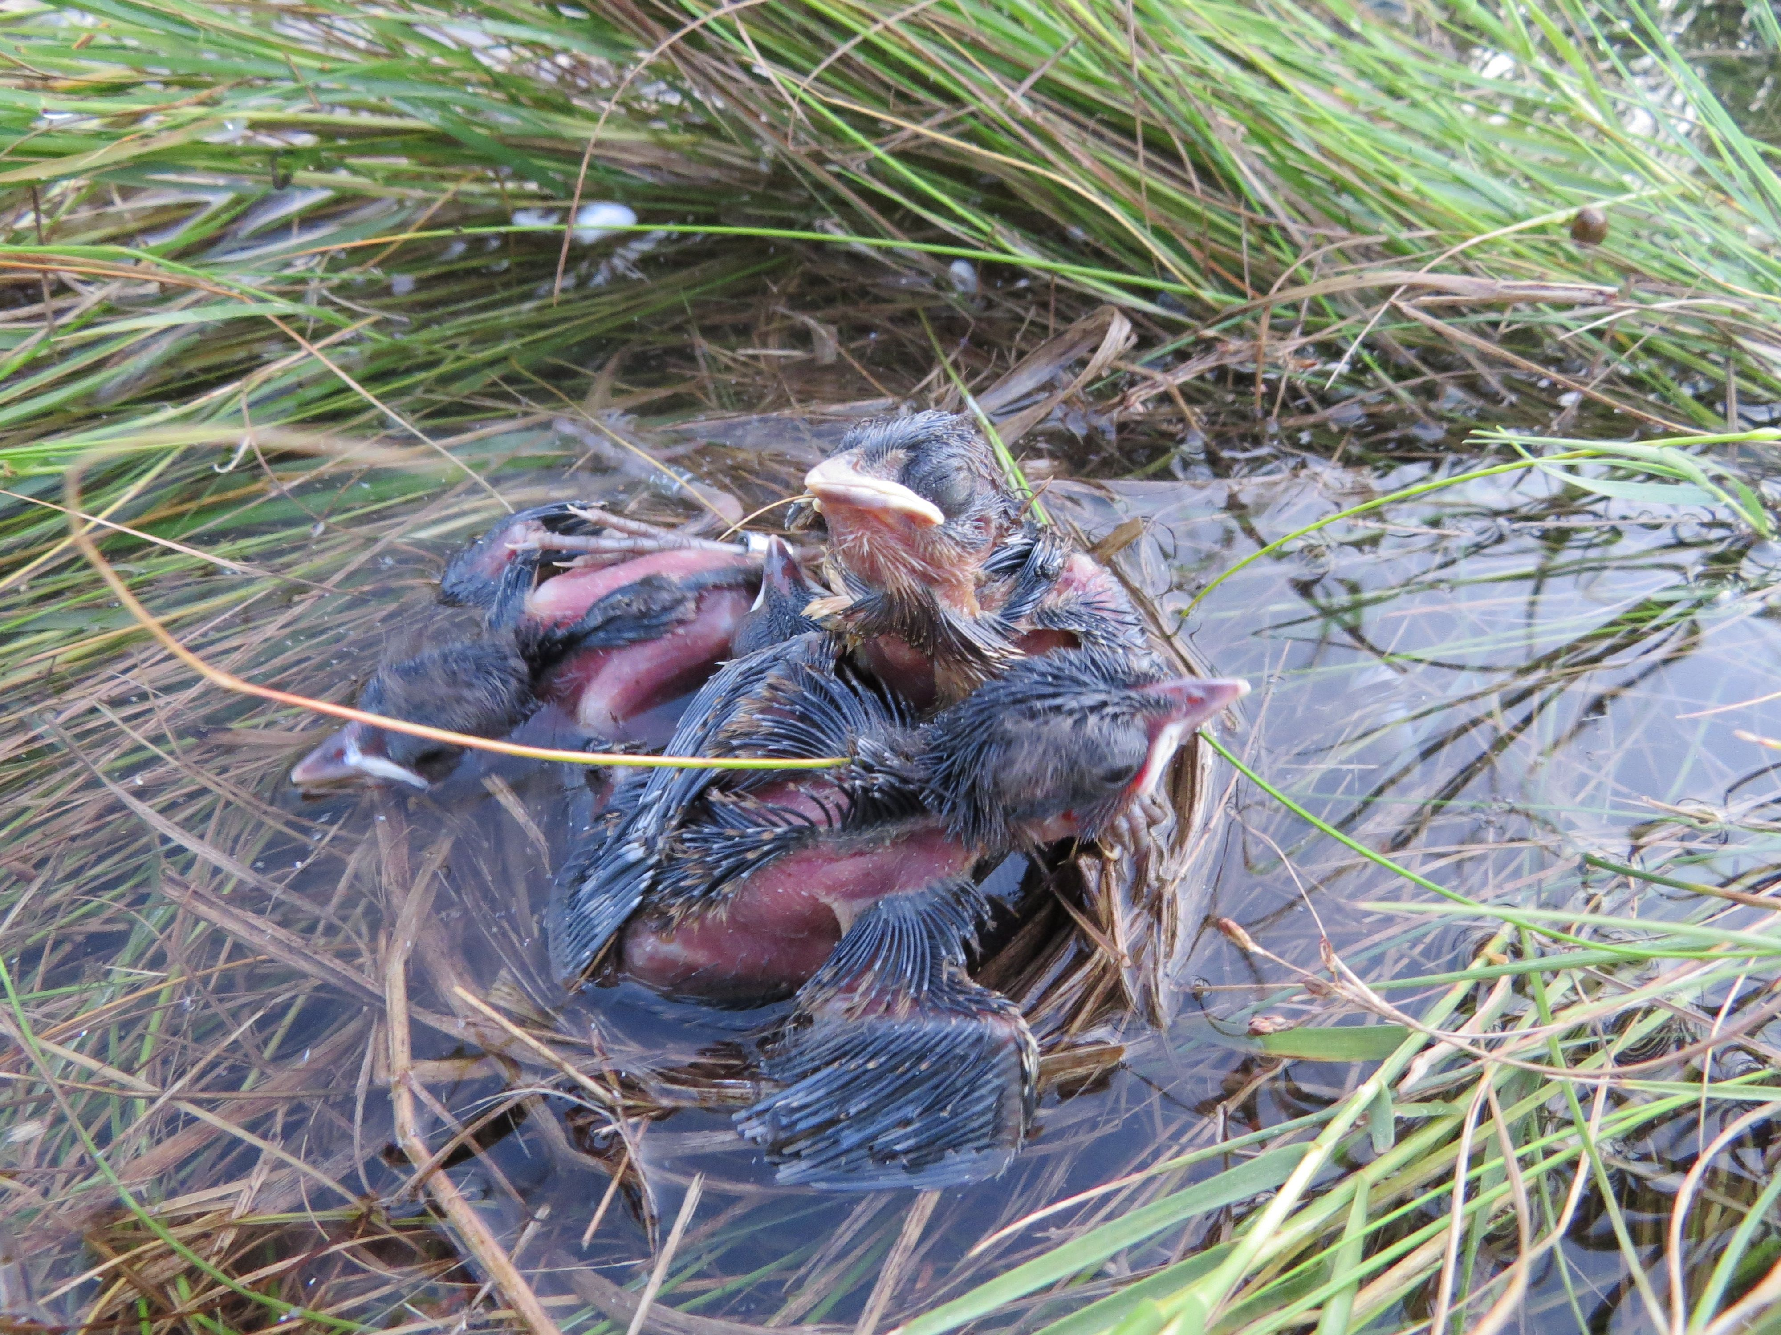
Spreading the word: Highlights
Hurricane Sandy 3rd Anniversary Media Campaign

Slide 17
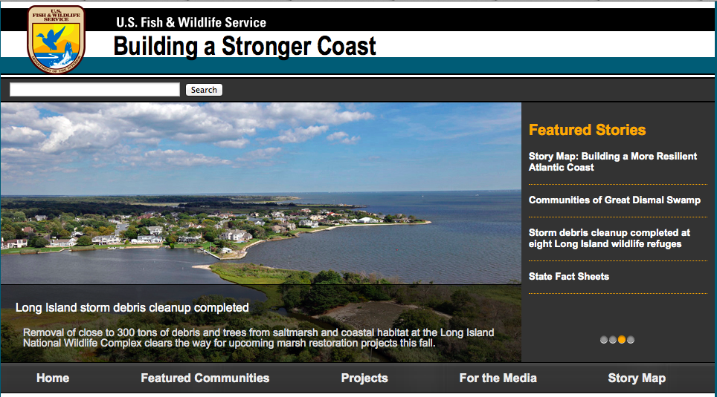
Spreading the word: Highlights
Hurricane Sandy 3rd Anniversary Media Campaign
Outlet: DOI website showcasing success stories for 3rd Anniversary of Hurricane Sandy
Audiences: Department of Interior agencies, general public
North Atlantic LCC’s role: Assessing risks and setting priorities across broad geography

Slide 18
Support and outreach: What we’re doing
Developing content, materials, and strategy
Coordinating publicity
Increasing access

Slide 19
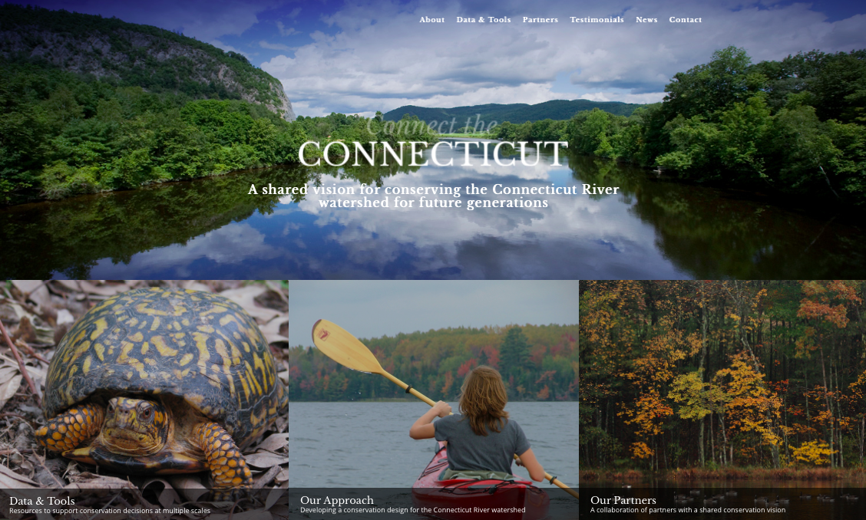
Support and outreach: Examples
Connect the Connecticut
Notes:
Developing content, materials, and strategy

Slide 20
Support and outreach: Examples
Regional Conservation Opportunity Areas

Slide 21
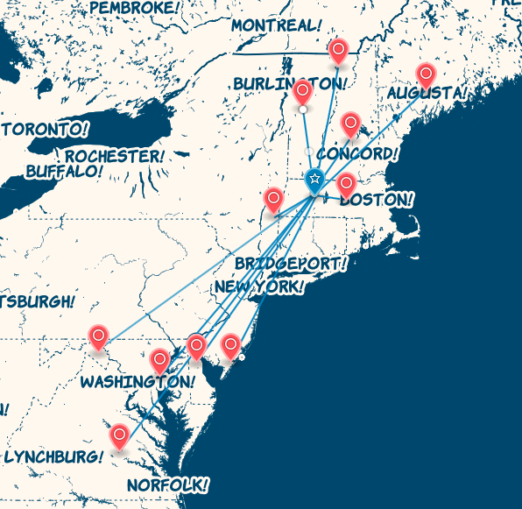
Support and outreach: Examples
North Atlantic LCC on the Road
Notes:
Developing content, materials, and strategy

Slide 22
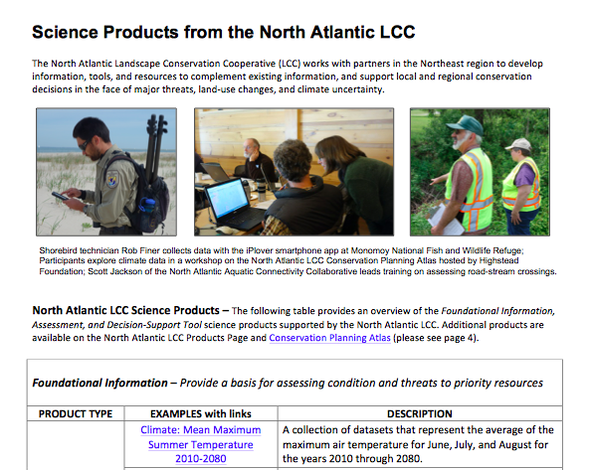
Support and outreach: Examples
North Atlantic LCC on the Road
Product overview
Tailored fact sheets
Targeted presentations

Slide 23
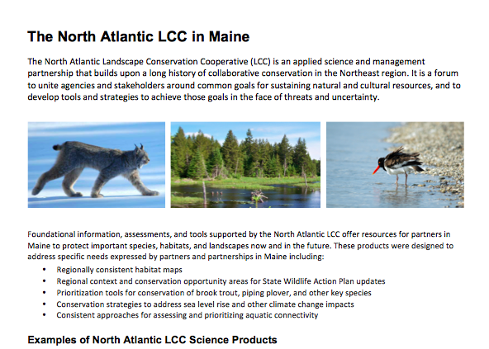
Support and outreach: Examples
North Atlantic LCC on the Road
Product overview
Tailored fact sheets
Targeted presentations

Slide 24
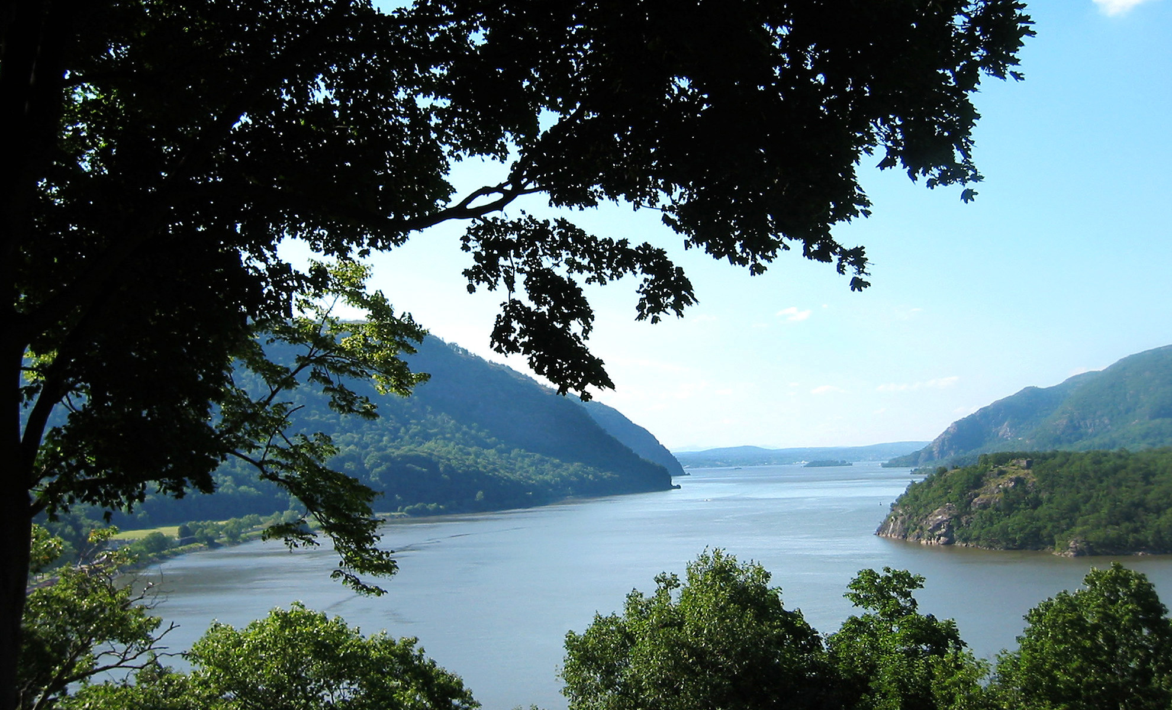
Support and outreach: Examples
North Atlantic LCC on the Road
Product overview
Tailored fact sheets
Targeted presentations

Slide 25
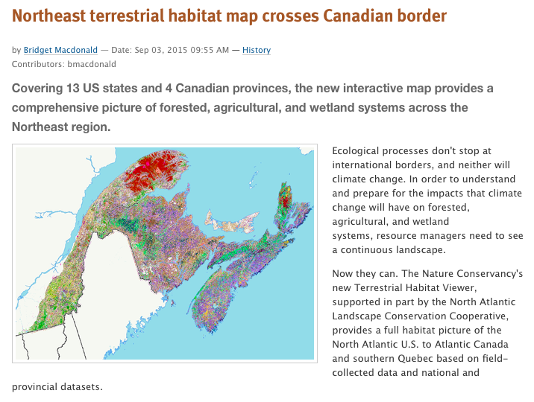
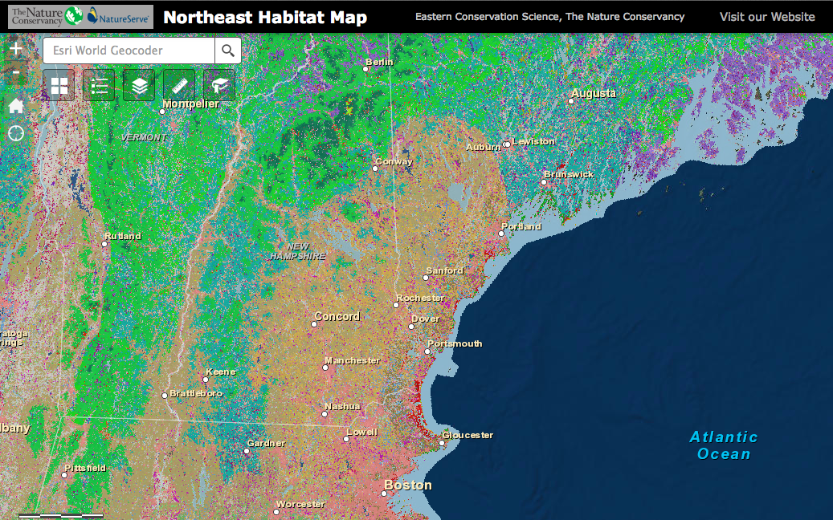
Support and outreach: Examples
The Nature Conservancy’s Northeast Terrestrial Habitat Viewer
Notes:
Coordinating publicity

Slide 26
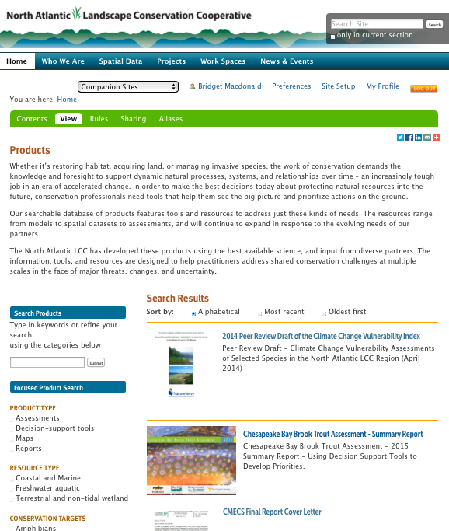
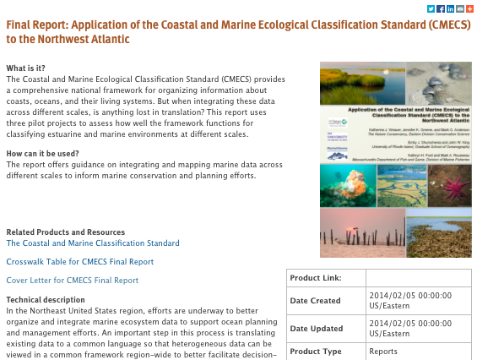
Support and outreach: Examples
North Atlantic LCC Products page – Coming soon
Notes:
Providing access

Slide 27
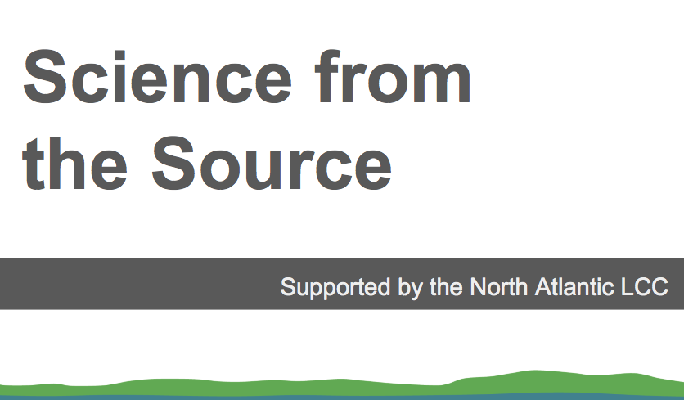
Support and outreach: Examples
Web-based seminar/tutorial series – Coming soon

Slide 28
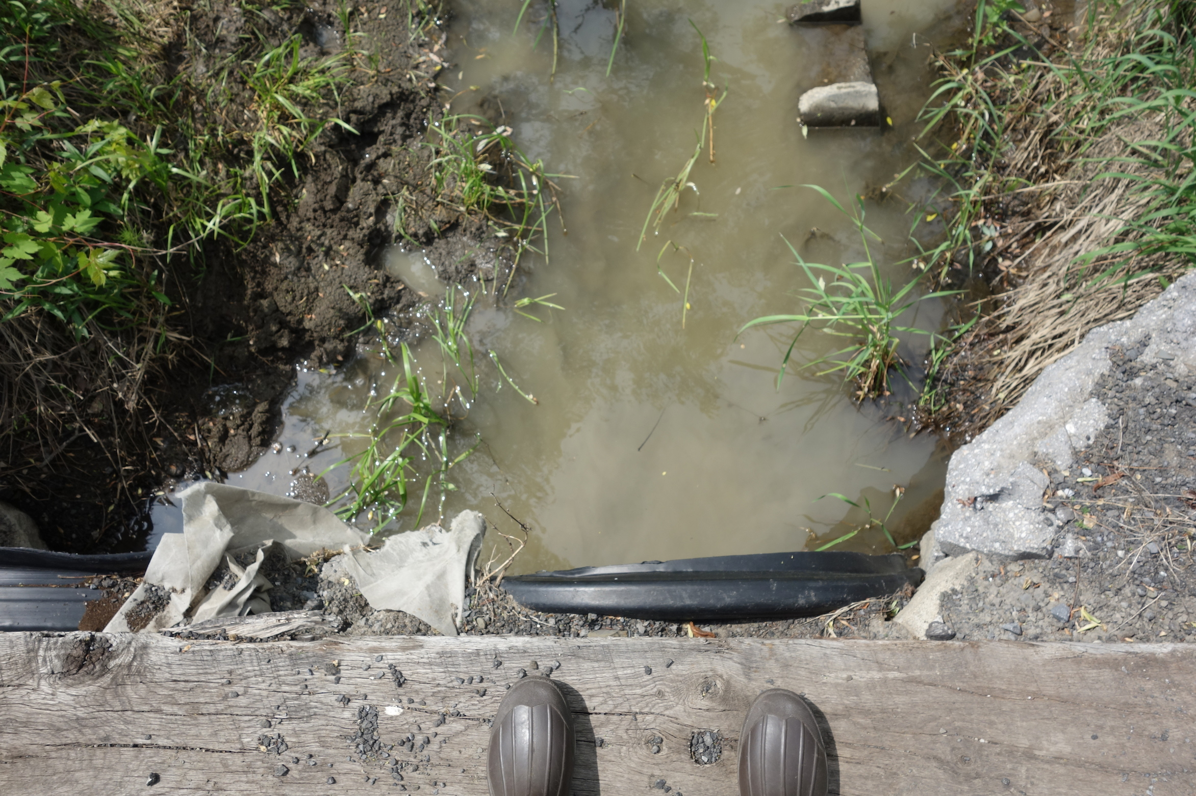
Responding to needs: What’s next?
Providing appropriate technical support
Tracking success on the ground
Refining approach based on feedback

Slide 29
Responding to needs:
Refining our approach

