Slide 1
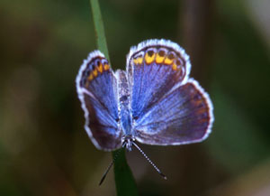
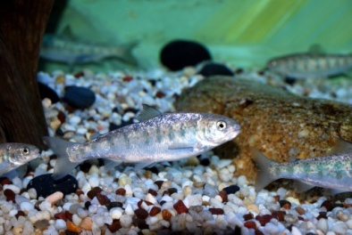
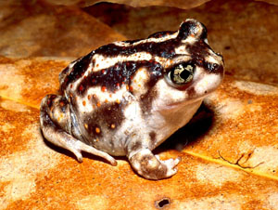
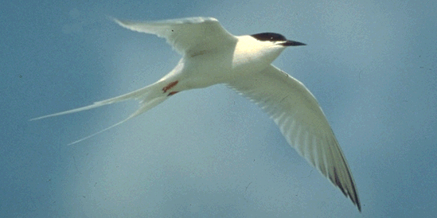
The Northeast Model: the Power of Conservation Consistency Across Boundaries
Steven Fuller, NALCC
John Kostyack & Curtis Fisher, NWF
The Wildlife Management Institute

