Slide 1
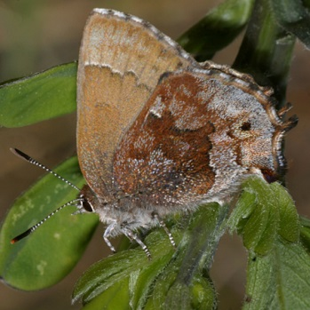
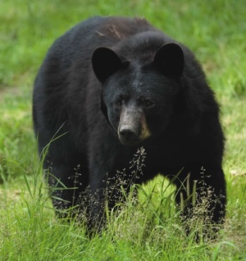
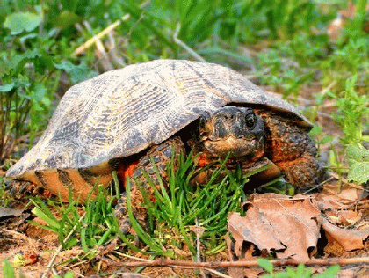
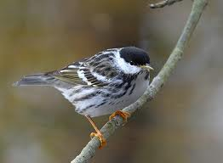
Landscape Conservation Design and the North Atlantic LCC
Scott Schwenk, Science Coordinator
North Atlantic Landscape Conservation Cooperative
North Atlantic LCC Steering Committee Meeting Gardiner, New York
November 5, 2013

Slide 2
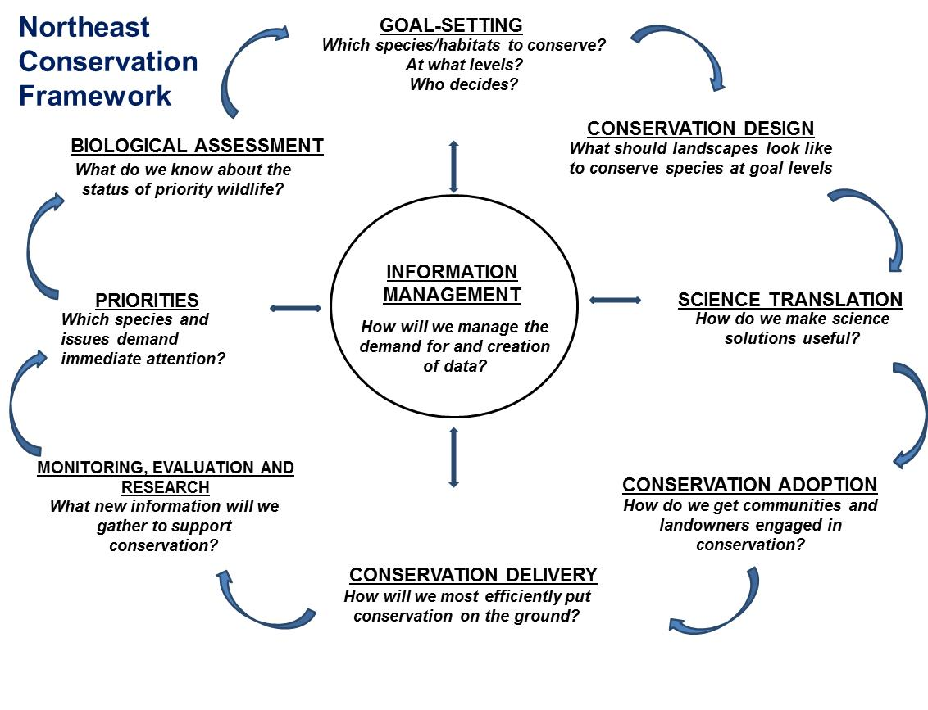
Landscape Conservation Design: A Fundamental LCC Mission
NALCC Conservation Science Strategic Plan:
“LCCs can serve as the forum for the conservation community to define, design, and deliver landscapes that can sustain natural resources at levels desired by society”
CONSERVATION
DESIGN
Notes:
From its inception, our partnership has emphasized the role of the LCC in supporting conservation decisions, including decisions about how much of what to do, where, through landscape conservation design and delivery of conservation design tools and they are featured prominently in our Conservation Science Strategic Plan.

Slide 3
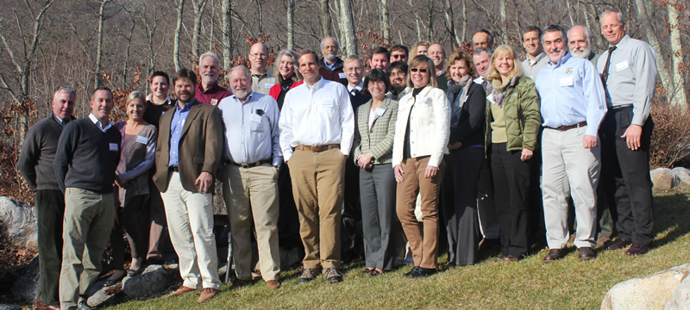
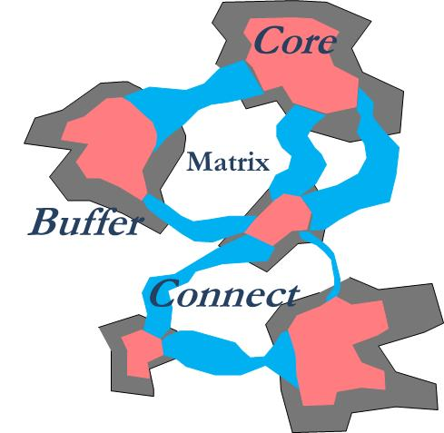
What is Landscape Conservation Design?
An activity
a collaborative effort among partners including agreeing on common priorities
A product
a spatial plan for conservation decisions in an adaptive framework
Notes:
After several years of hard work by staff, investigators, and partners (including years of work through the RCN program), we have reached a critical junction where we are achieving the technical capability for landscape design.
But for landscape conservation design to work, for it to be accepted and adopted, all of us as a partnership – not just PI’s or staff – have to buy-in to the effort, to participate, and contribute. Participation could be at many levels, from less intensive to more intensive. Working collaboratively will be a challenge given the differing priorities, missions, and methods of our organizations.
But our diversity and our range of expertise is also our strength. Collectively we can accomplish much more than if we work by ourselves – that is the whole purpose of the LCC enterprise.

Slide 4
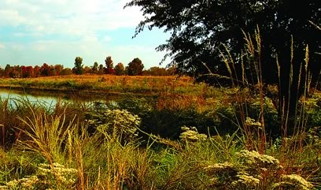
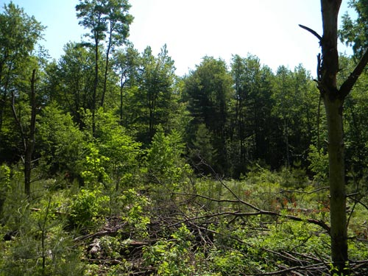
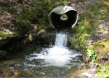
Key Questions to be answered by Landscape Conservation Design
Given regional priorities and context,
Where should we invest in land protection, and how much?
How should we manage protected lands?
Where should we invest in ecological restoration?

Slide 5
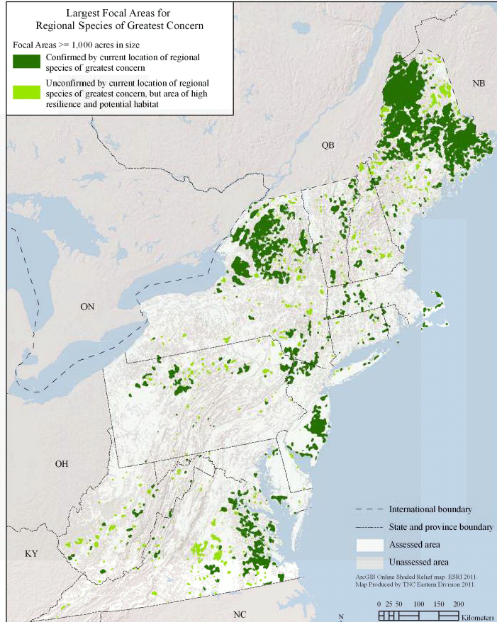
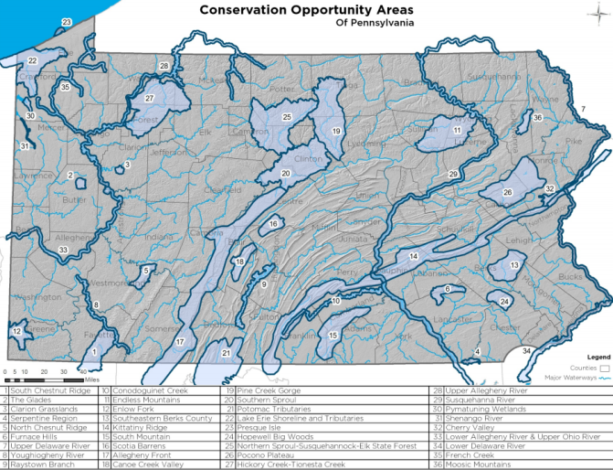
How Could Shared Landscape Conservation Design be Used?
Use Case 1: regional context for priority setting
e.g., inform Conservation Opportunity Areas for State Wildlife Action Plan updates
Notes:
A shared conservation design could be one of the most powerful achievements of our collective partnership and have many applications at different scales across the region, and across the national LCC network.
Connect to work Steve Fuller is leading to synthesize information for State Wildlife Action Plan updates, and how this could take that work to the next level.

Slide 6
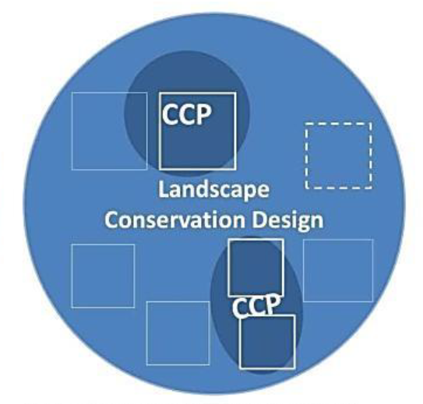
Use Case 2 – Regional Prioritization by Federal Agencies
New Landscape Conservation Planning by National Wildlife Refuge System
Notes:
New process in 2013 for National Wildlife Refuge planning – Comprehensive Conservation Plans (CCPs) in the context of the wider landscape.

Slide 7
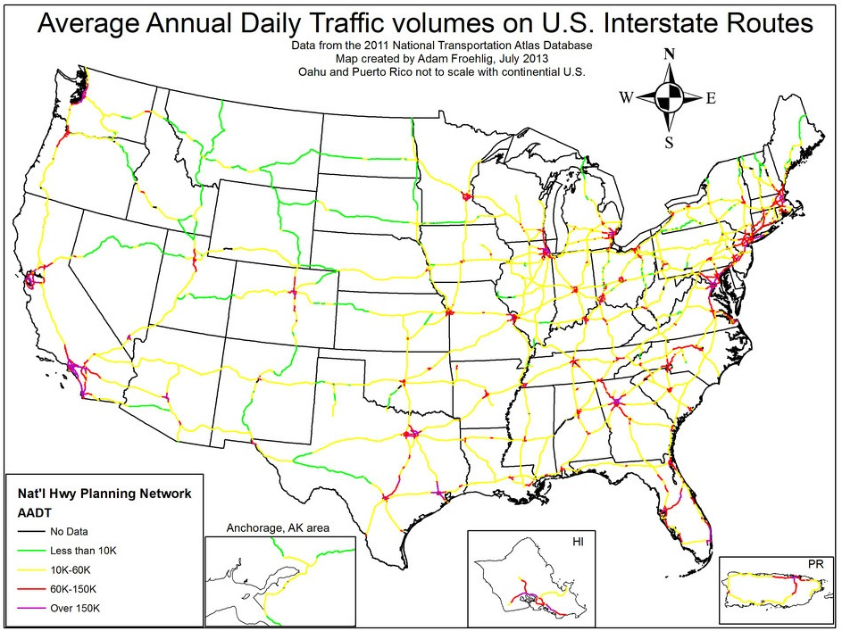
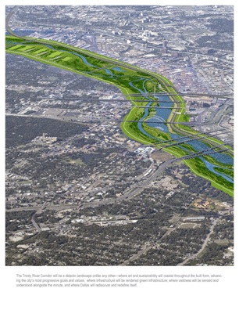
Use Case 3 – Guiding Infrastructure Development

Slide 8
Use Case 4 – Bringing in New Conservation Dollars

Slide 9
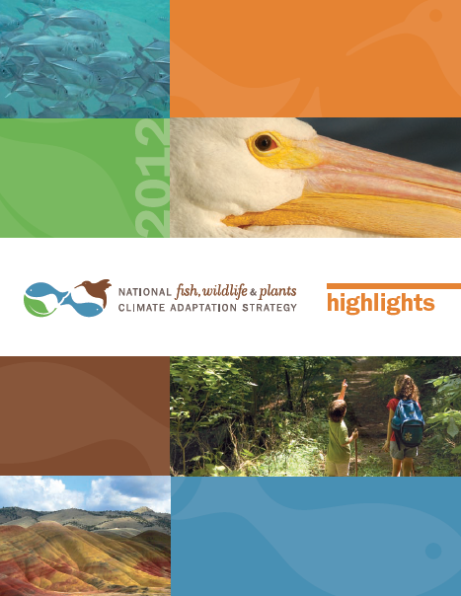
Use Case 5 – National / International Planning
National Fish, Wildlife and Plants Conservation Adaptation Strategy
“identify areas for an ecologically-connected network of terrestrial, freshwater, coastal, and marine conservation areas that are likely to be resilient to climate change and to support a broad range of fish, wildlife, and plants under changed conditions”

Slide 10
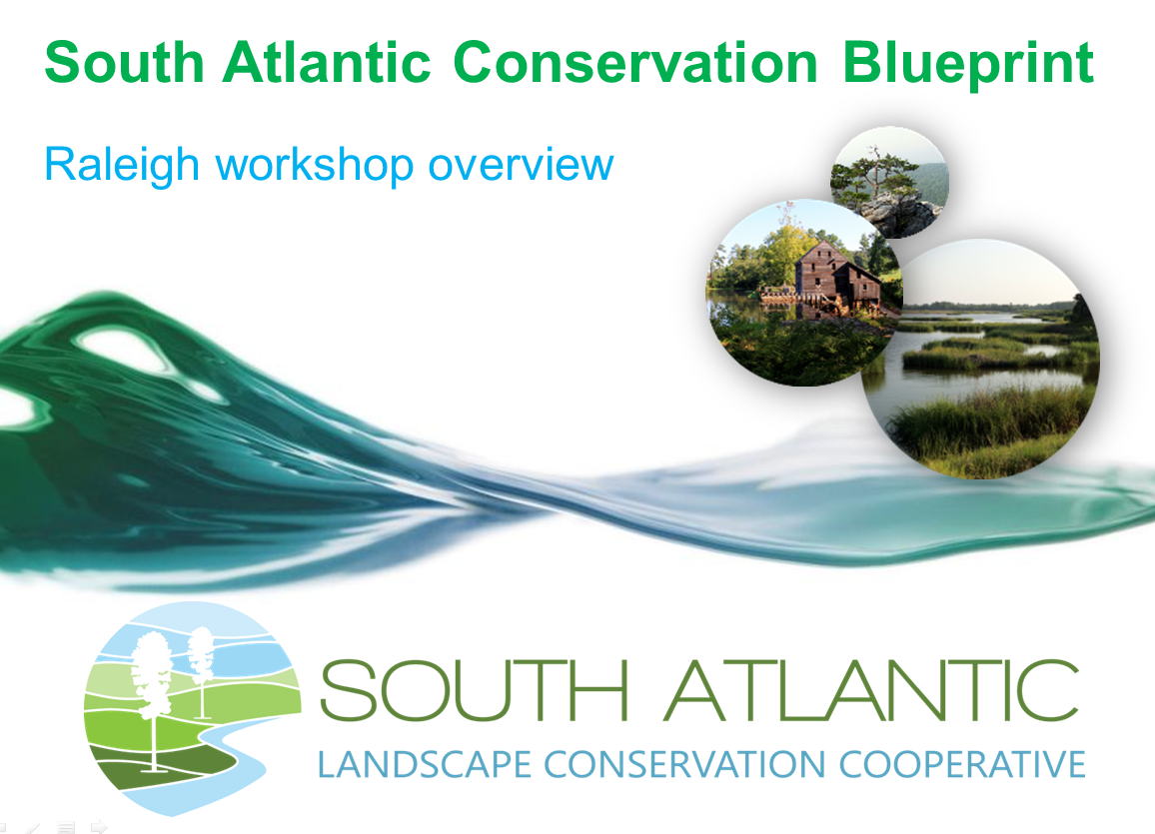
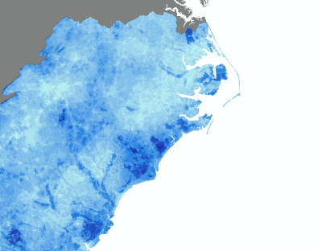
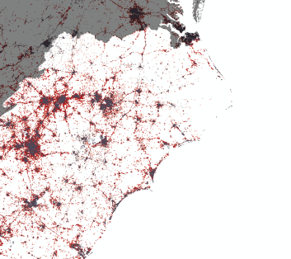
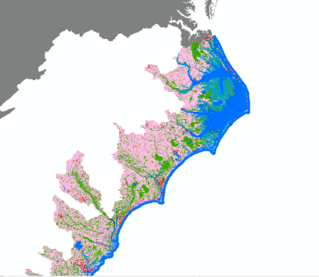
Landscape Conservation Design in the South Atlantic LCC
Set of indicators and targets
Blueprint 1.0

Slide 11
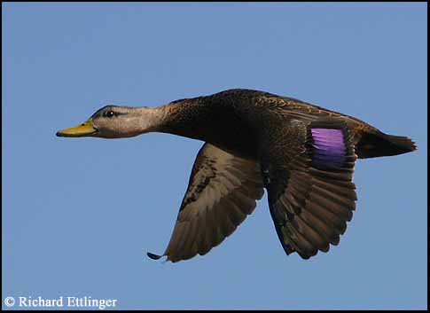
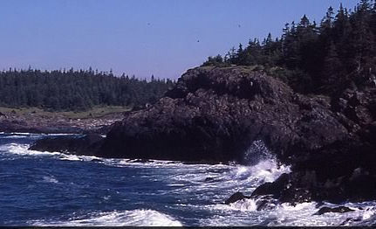
What are we designing conservation for?
Or, how are your organization’s interests reflected in conservation design?
Species
Species that represent the needs of others
Priority species not well-represented (e.g., rare)
Ecosystems [habitat types]
Including the functions they perform and services they produce

Slide 12
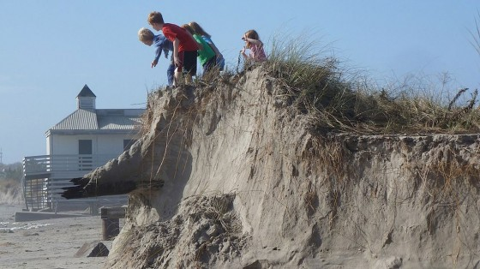
New Conservation Design Paradigm Accounting for Change
Climate change, land use change → no longer assuming static / “stationary”
Paraphrasing TNC:
“species move,
ecosystems
transform”

Slide 13
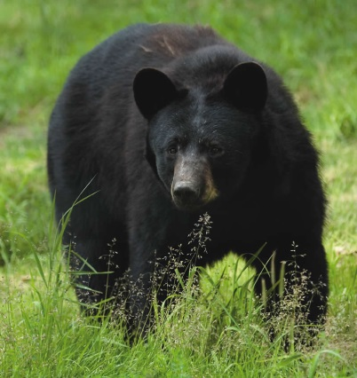
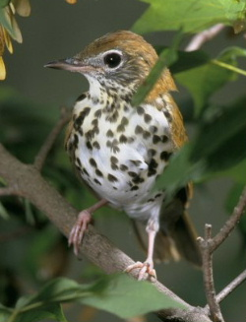
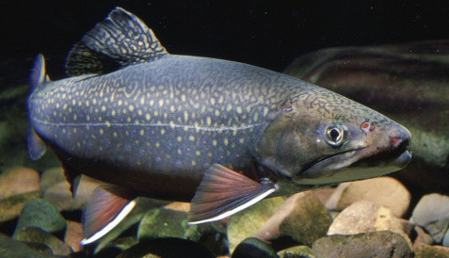
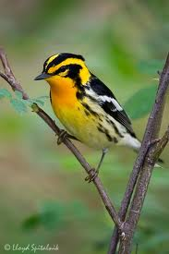
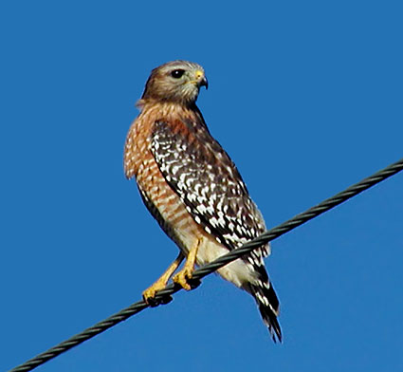
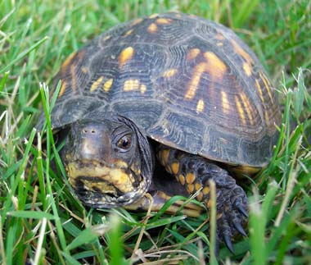
Multi-species Multi-ecosystem
Notes:
Multiple species – use different ecosystems or habitats; game species or rare species or other priorities; different taxa
Multi-ecosystems – terrestrial, wetland, aquatic, coastal, marine

Slide 14
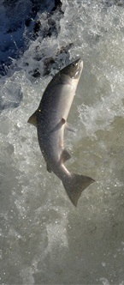
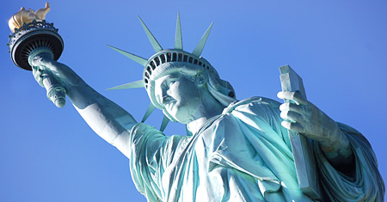
What about cultural resources?
Cultural resources that are also natural resources are ingredients in design
Cultural resources that are not natural resources could be incorporated

Slide 15
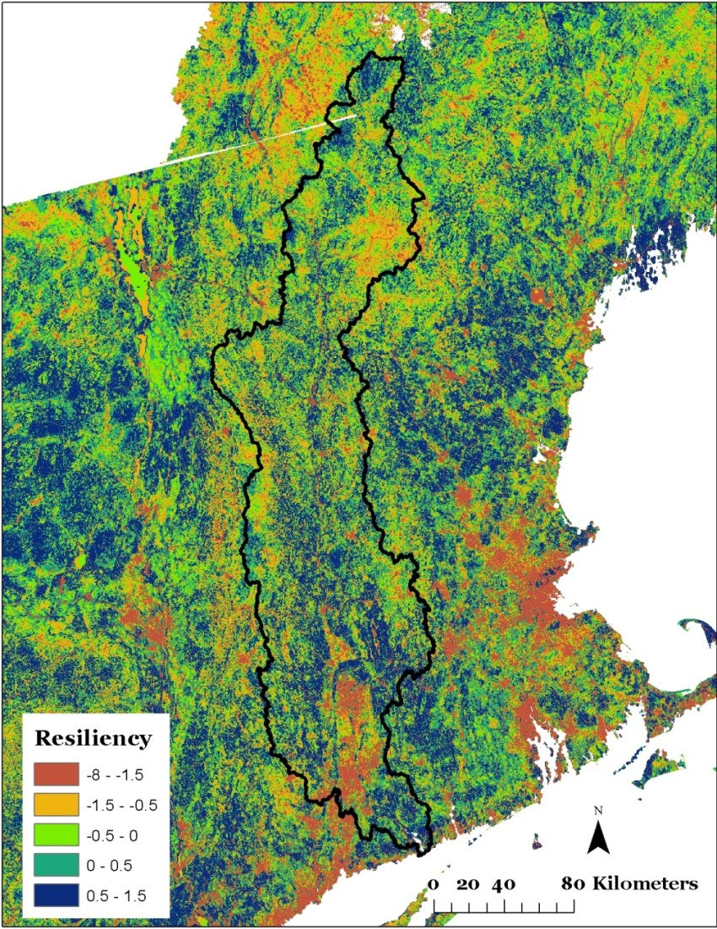
What Do Landscape Conservation Designs Look Like?
A synthesis of multiple partners and their common goals
Multiple scales
Northeast Region
Subregional (ecoregion, large watershed)
State / local / small watershed

Slide 16
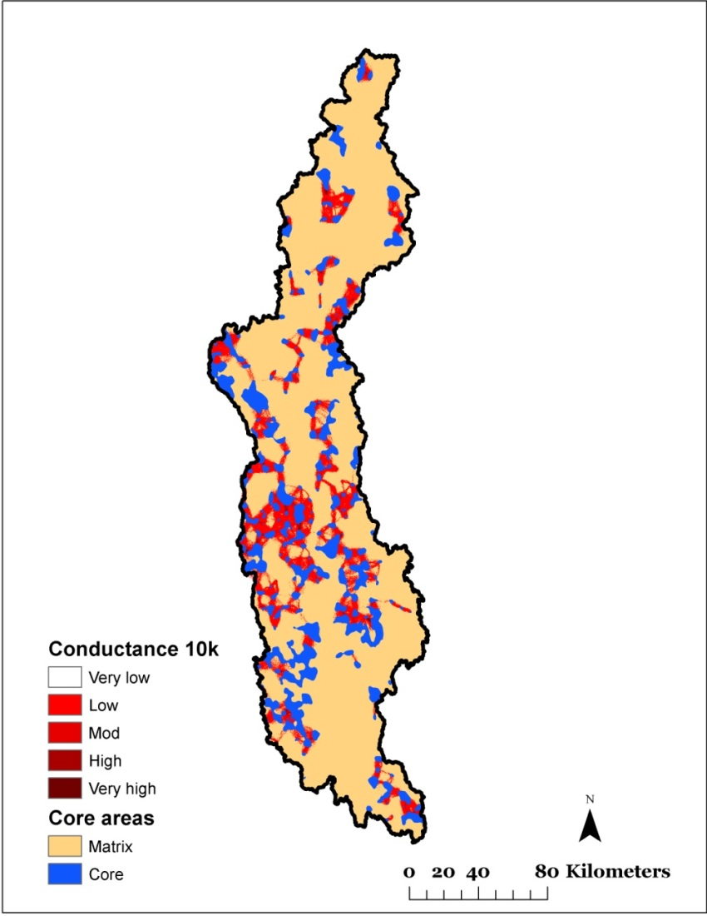
What Do Landscape Conservation Designs Look Like?
A synthesis of multiple partners and their common goals
Multiple scales
Northeast Region
Subregional (ecoregion, large watershed)
State / local / small watershed
Proof of concept:
Conn. River Watershed

Slide 17
First Discussion Session
What are the merits and challenges in preparing large-scale landscape conservation designs in the Northeast at this time?
To what degree does the LCC want to endorse or commit to a single regional landscape conservation design and/or multiple subregional designs?

Slide 18
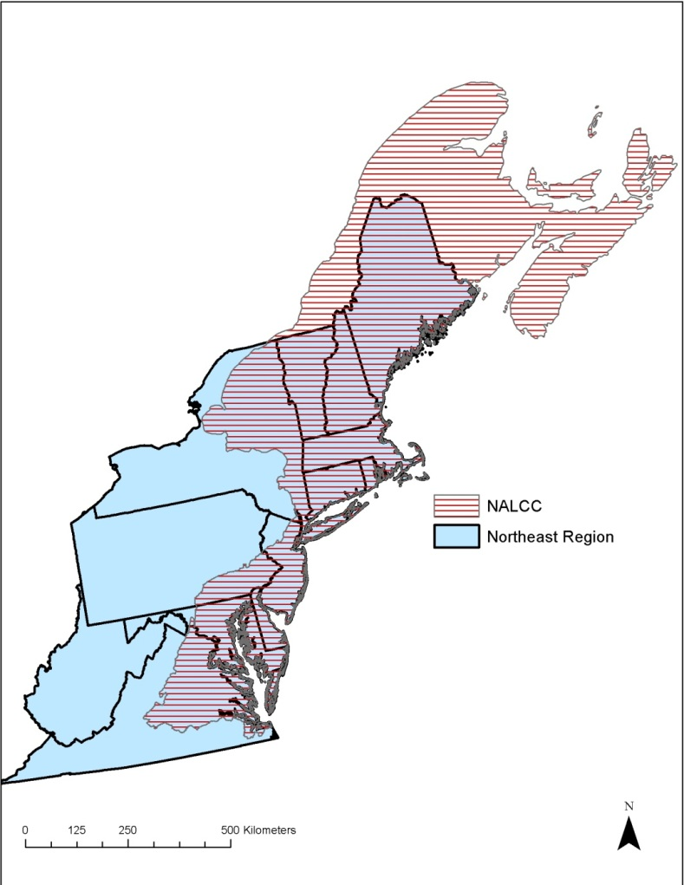
Proof of Concept: Designing Sustainable Landscapes in the Northeast (Kevin McGarigal, UMass Amherst)
Purpose: Assess the capability of current and potential future landscapes in the Northeast to provide integral ecosystems and suitable habitat for a suite of representative species,
and provide guidance for strategic habitat conservation
Phase 1: pilot areas (2011-2012)
Phase 2: full Northeast (2012-2014)
+ expanded pilot watershed work

Slide 19
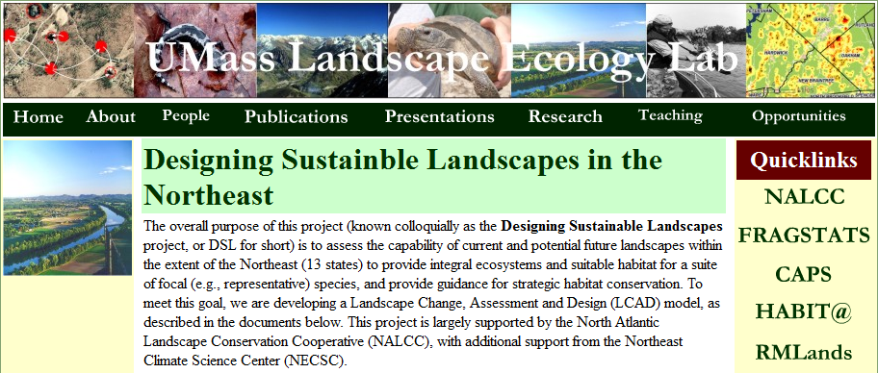
For More Information
Project website:
www.umass.edu/landeco/research/dsl/dsl.html
Links to products:
Overview
Technical docs
Presentations
Phase 1 results
Personal contact:
mcgarigalk@ eco.umass.edu
413-577-0655

Slide 20
Designing Sustainable Landscapes Project
DSL project is developing and implementing a systematic framework for multi-scale landscape conservation to answer questions about protection, management, and restoration priorities.
This framework is called:
Adaptive
Landscape
Conservation
Design

Slide 21
Landscape Conservation Design
Conceptual Framework
Establish Conservation Goals & Objectives
Adjust
Network
Design Network
Ecological
Socio-cultural
Economic
Evaluate
Implement
Monitor

Slide 22
Landscape Conservation Design
Spatial Strategy
How much, of what, where & Why
Core… concentrated areas of high ecological value
Buffer… around core areas to prevent future degradation
Connect… linkages between core areas to facilitate connectivity
Core
Matrix
Buffer
Connect

Slide 23
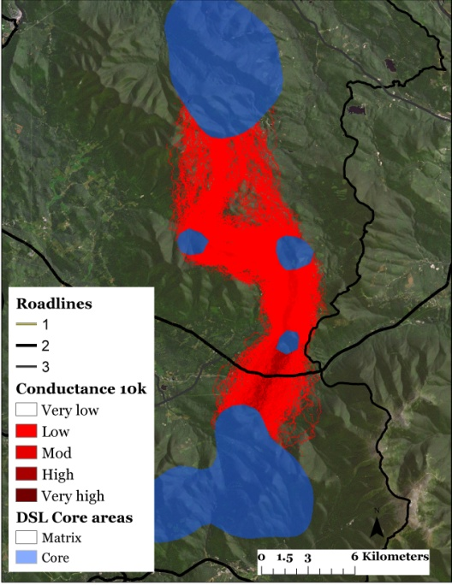
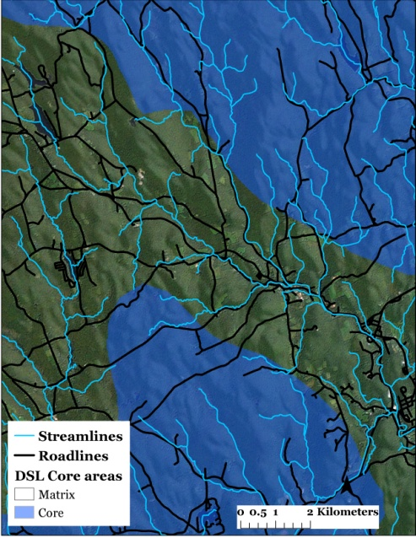
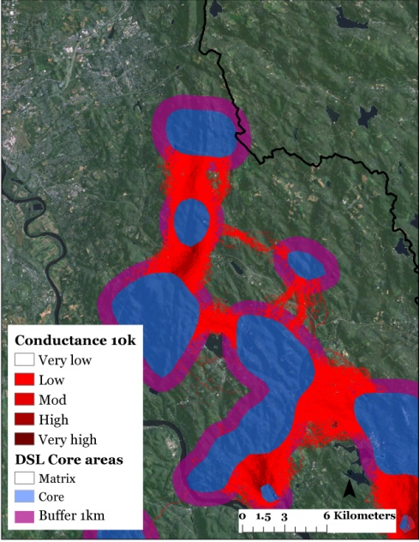
Landscape Conservation Design
Proof of concept: What does it look like?
Connecticut River watershed
Network of protected core areas
Corridors to promote connectivity
Road passage structures and improved culverts to restore connectivity in critical locations
Managed buffers to prevent degradation of cores

Slide 24
Landscape Conservation Design
Key Inputs to Proof of Concept
Species
“Representative” or (surrogate) species (UMass-UVM products)
Priority species not well-represented (NALCC staff products based on NEAFWA data)
Ecosystems
Ecological integrity (UMass product)
Terrestrial resilience (TNC product)

Slide 25
Landscape Conservation Design
Representative (Surrogate) Species
Represent major ecosystems/habitat types and associated species
Brown-headed Nuthatch
Blackburnian Warbler*
Blackpoll Warbler*
Louisiana Waterthrush
Marsh Wren
Northern Waterthrush*
Ovenbird*
Red-shouldered Hawk*
Wood Turtle
Wood Thrush*
American Black Duck
American Oystercatcher
American Woodcock*
Bicknell's Thrush
Black Bear*
Box Turtle
Common Loon
Diamondback Terrapin
Eastern Meadowlark
Moose
Prairie Warbler
Ruffed Grouse
Saltmarsh Sparrow
Wood Duck
Phase 1 ; Phase 2 (in various stages of development)
* Shown in proof-of-concept design

Slide 26
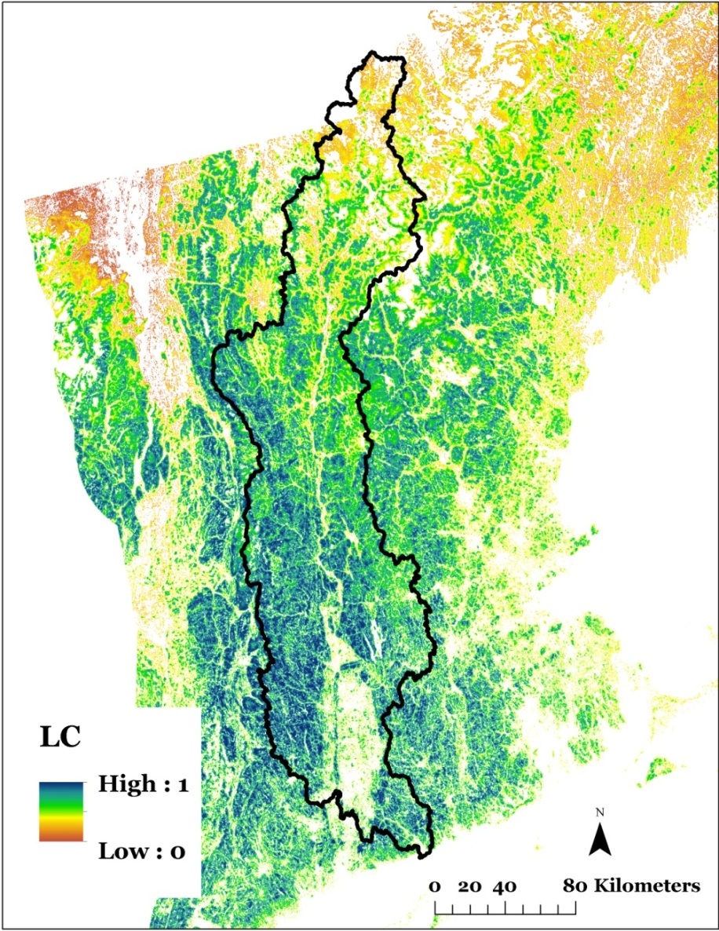
Landscape Conservation Design
Representative (Surrogate) Species
Wood Thrush
Species are weighted based on:
Ubiquity within the landscape and region
Importance of the landscape within the region
Vulnerability to climate and land use change
Other user-defined criteria?

Slide 27
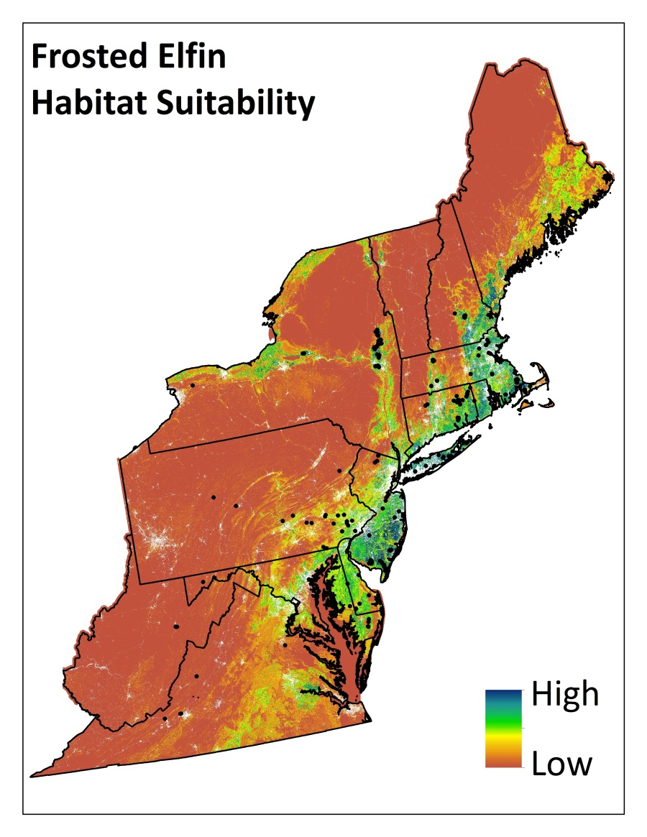
Landscape Conservation Design
Rare species and others not well-represented
Distribution models based on element occurrence data

Slide 28
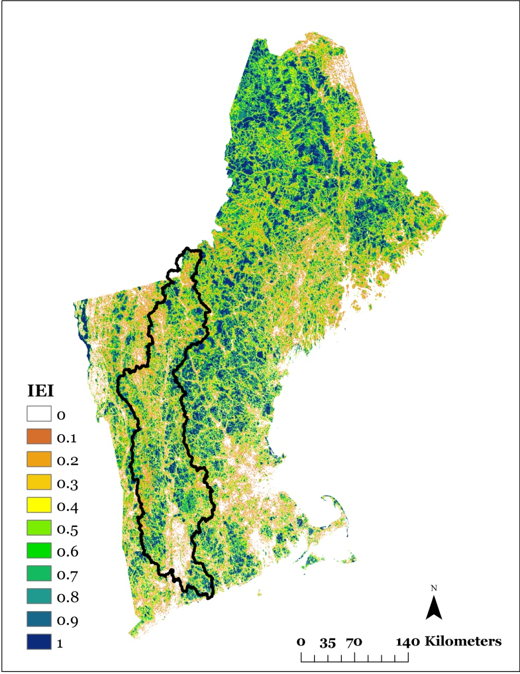
Landscape Conservation Design
Ecological Integrity (UMass)
Index of ecological integrity
Intactness
Adaptive capacity
Resiliency
Ecological Integrity
Diversity
Connectivity

Slide 29
Landscape Conservation Design
Terrestrial Resilience (The Nature Conservancy)
Landform
Variety
TNC Resiliency
Wetland
Density
Elevation
Range
Landscape
Complexity
Connectedness
Resilience

Slide 30
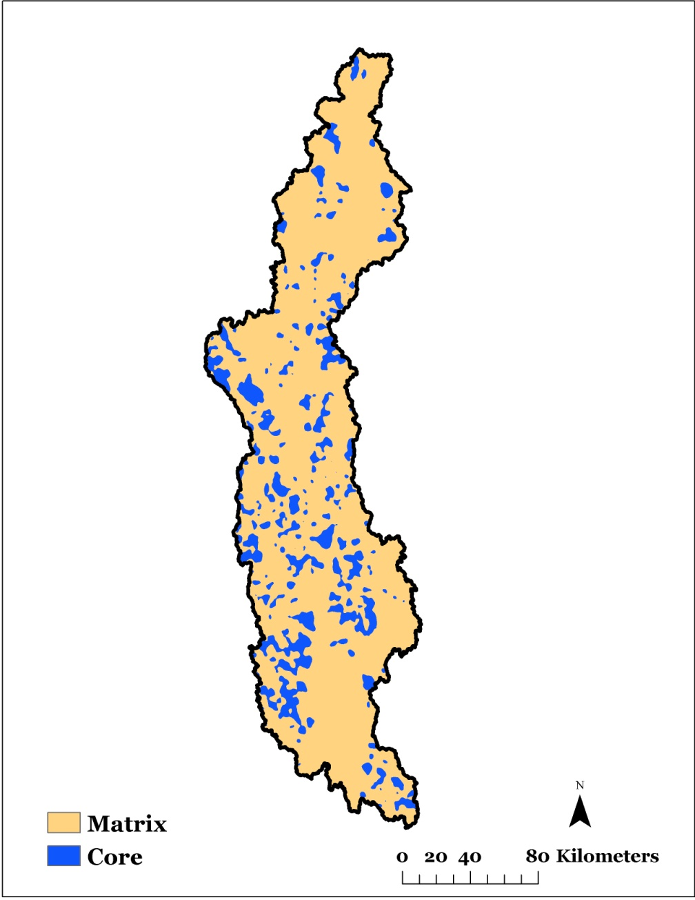
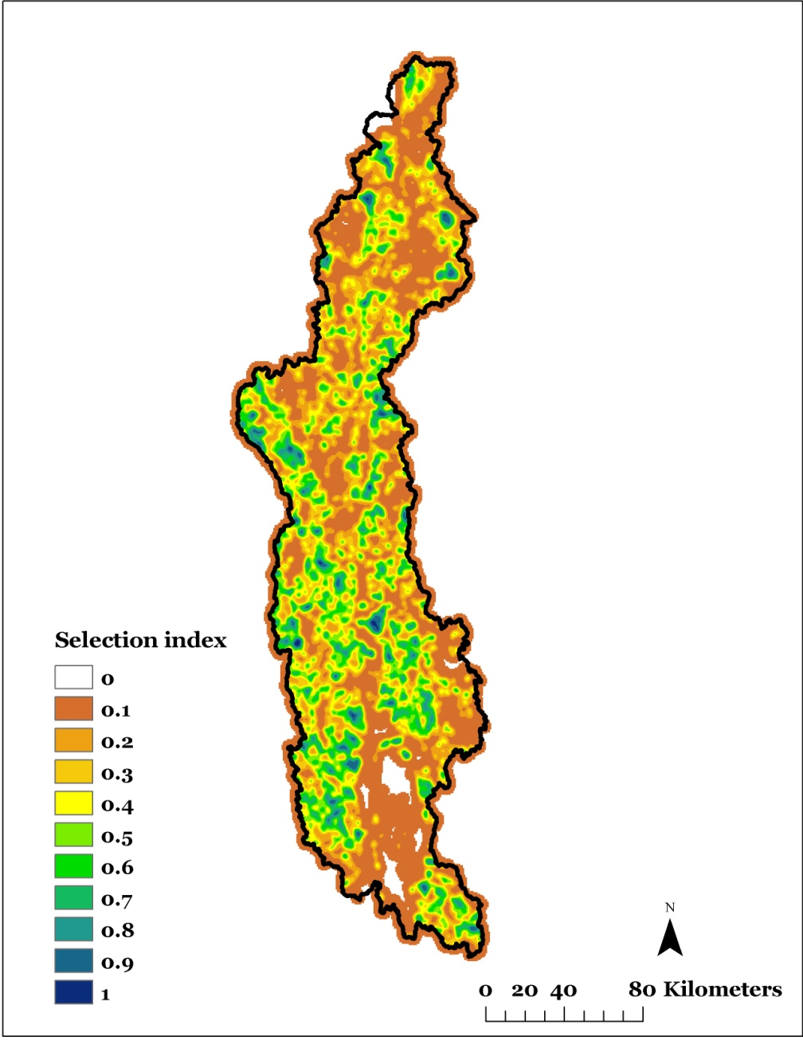
Landscape Conservation Design
Creating Core Areas
Core area network
Representative Species
RSGCNs (Non Rep. Species)
Ecological Integrity and Resilience

Slide 31
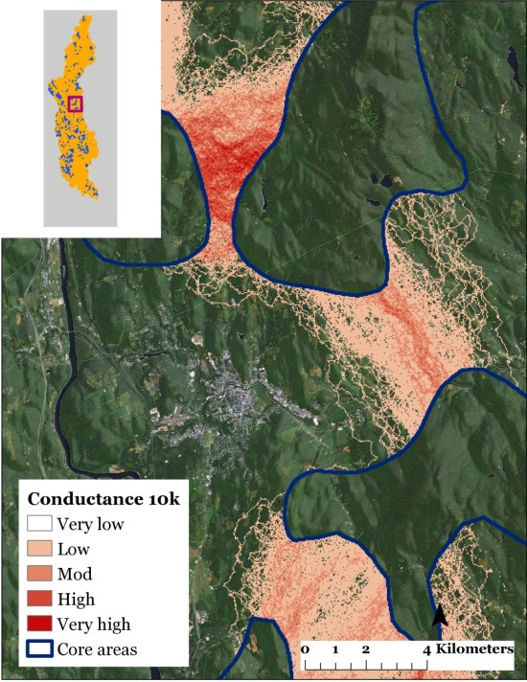
Landscape Conservation Design
Connecting Core Areas
Connect core areas to facilitate ecological flows (adaptive capacity, resiliency)
Corridors between core areas

Slide 32
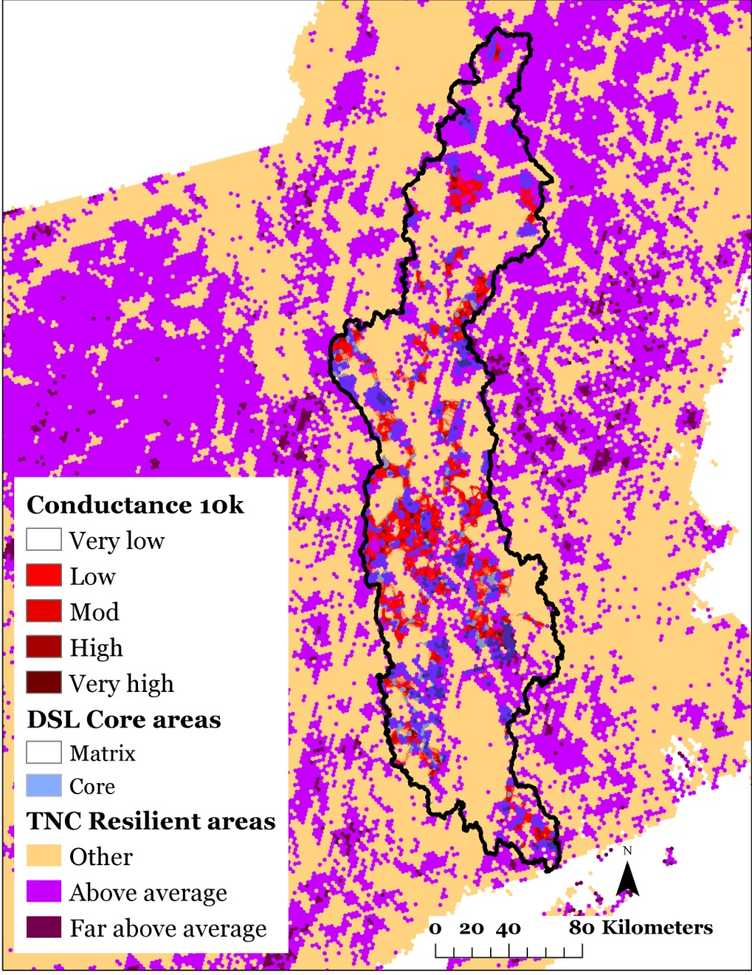
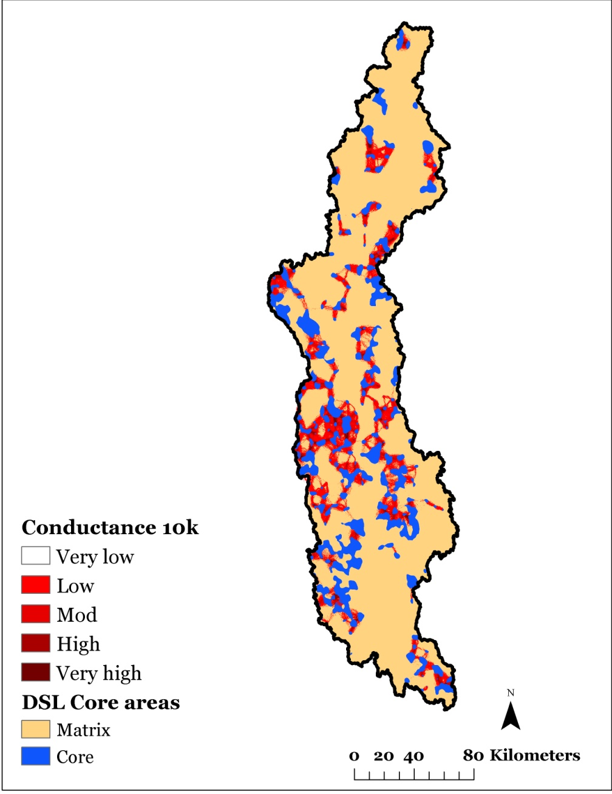
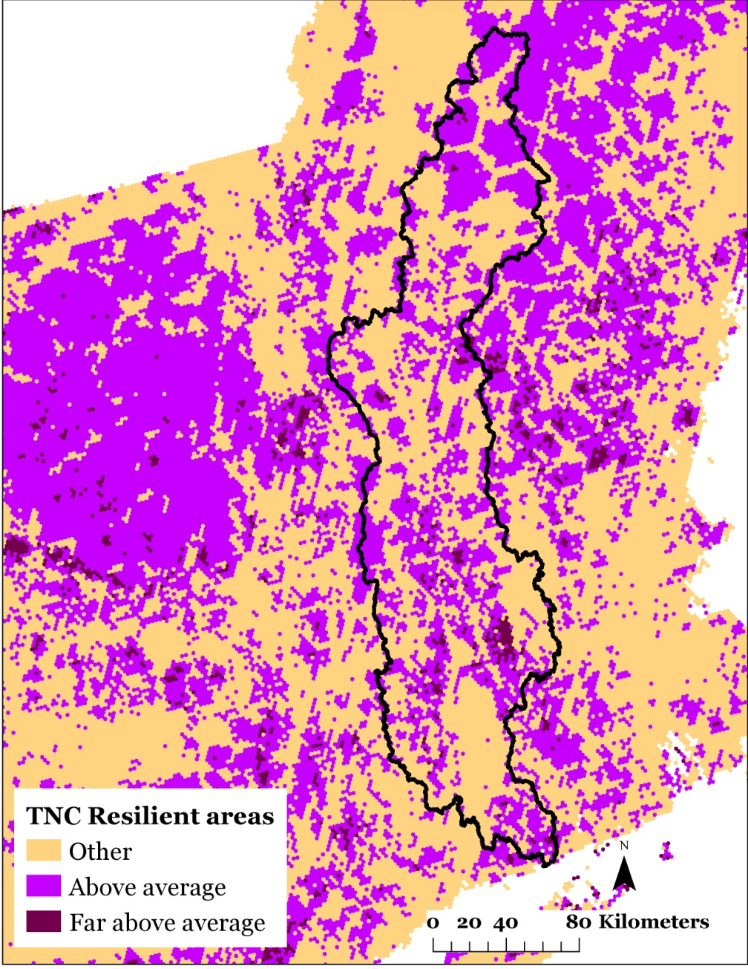
Landscape Conservation Design
How does it Compare?
How does the proof of concept of LCD for the Connecticut River watershed compare to TNC resilient sites?

Slide 33
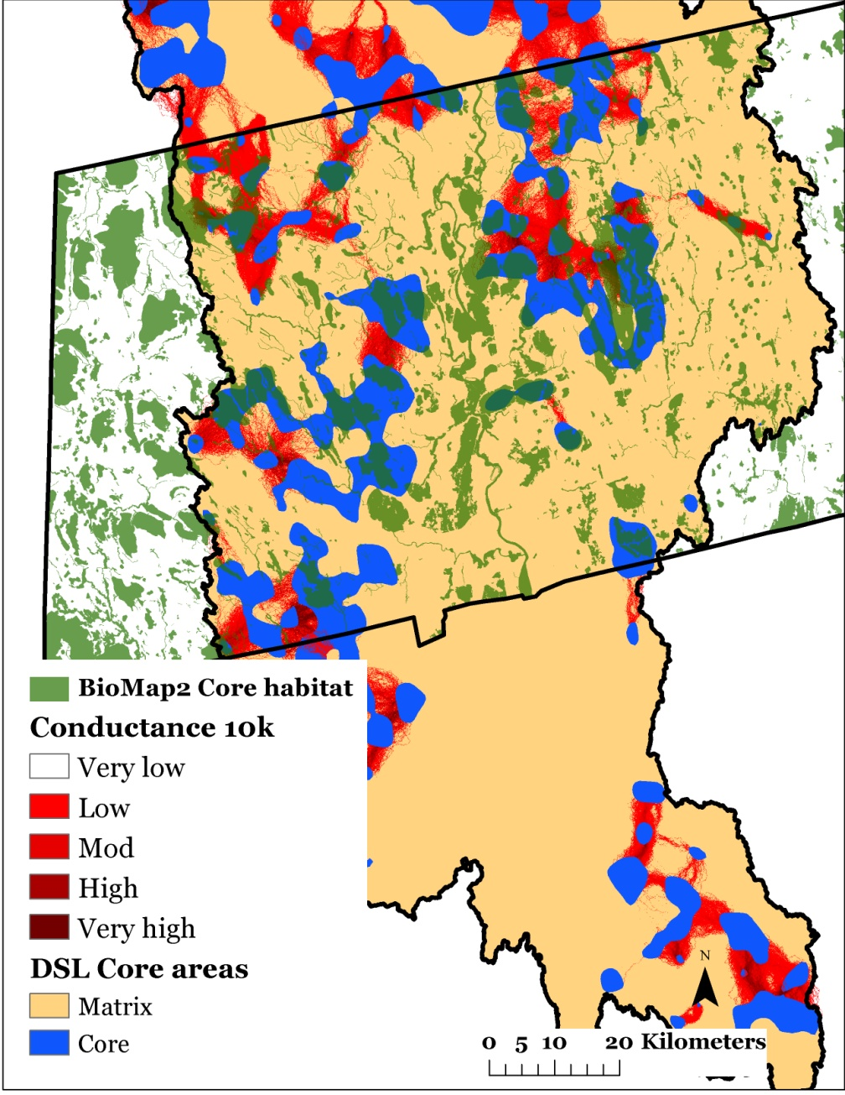
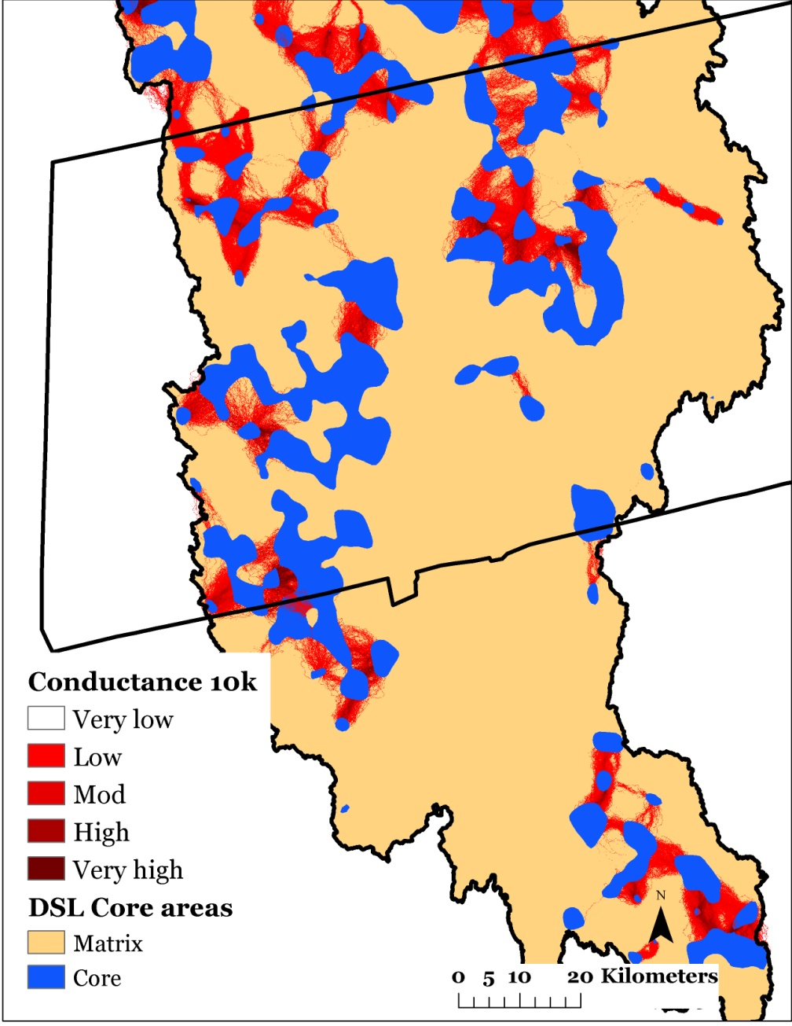
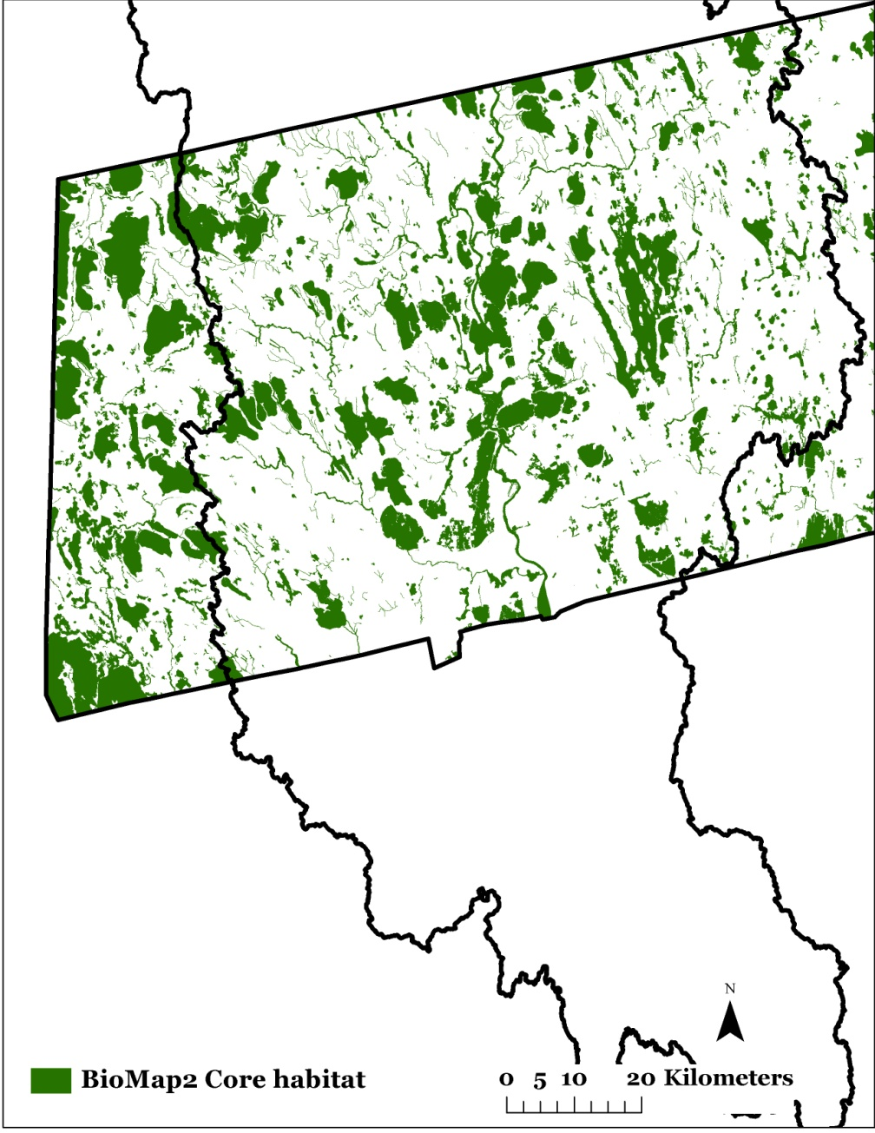
Landscape Conservation Design
How does it Compare?
How does the proof of concept of LCD for the Connecticut River watershed compare to Biomap in Massachusetts?

Slide 34
Aquatic Counterparts to Designing Sustainable Landscapes:
Examples from USGS Forecasting Changes in Aquatic Systems and Brook Trout

Slide 35
Aquatic Counterparts to Designing Sustainable Landscapes: Examples from Downstream Strategies
Brook Trout
Walleye

Slide 36
Landscape Conservation Design
What Distinguishes it?
Landscape change model (e.g., urban growth, climate change)
Multi-scale regional scope
Combined ecosystem and focal species approach
Systematic framework for landscape conservation!

Slide 37
Landscape Conservation Design
What Distinguishes it?
Landscape change model (e.g., urban growth, climate change)
Multi-scale regional scope
Combined ecosystem and focal species approach
Systematic framework for landscape conservation!
Northeast
Connecticut River watershed
WestfieldRiver subbasin

Slide 38
Landscape Conservation Design
What Distinguishes it?
Landscape change model (e.g., urban growth, climate change)
Multi-scale regional scope
Combined ecosystem and focal species approach
Systematic framework for landscape conservation!
Ecosystem
Focal Species

Slide 39
Landscape Conservation Design
What Distinguishes it?
Landscape change model (e.g., urban growth, climate change)
Multi-scale regional scope
Combined ecosystem and focal species approach
Systematic framework for landscape conservation!

Slide 40
Landscape Conservation Design
Major Decision Points
Choosing landscape extent
Establishing conservation goals & objectives
Weighting ecological systems and focal species
Determining how much area to include in the conservation network
Deciding on what other socio-cultural and economic factors to consider
Monitoring and evaluation?
?

Slide 41
Landscape Conservation Design
Partnership
Choosing landscape extent
Establishing conservation goals & objectives
Weighting ecological systems and focal species
Determining how much area to include in the conservation network
Deciding on what other socio-cultural and economic factors to consider
Monitoring and evaluation?

Slide 42
Next Steps and Timing
Develop the conservation design process in a pilot area, Connecticut River Watershed
Partnership involvement
Technical components
Complete DSL Phase 2, June 2013
Expand to other areas?
Expand to a regionwide design?
Continue testing, refining, and expanding (e.g., sea-level rise, stream projections)
Your organization’s role?

Slide 43
Second Discussion Session
Merits and challenges: large-scale landscape conservation designs in the Northeast?
Endorse or commit to a single regional or multiple subregional conservation designs?
How do partners wish to be involved?
How can a pilot design effort for the Connecticut River Watershed best inform region-wide designs?
What are realistic timelines and milestones?
How should future LCC science projects and science delivery activities reflect landscape conservation design?

