Slide 1
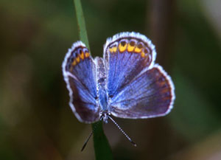
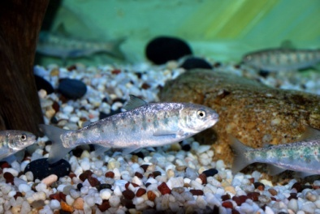
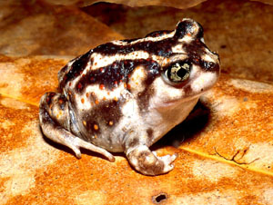
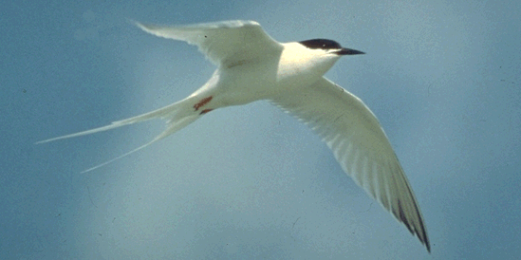
Progress Relative to the Northeast Conservation Framework and Strategic Plan Setting the Stage for Conservation Design and Delivery
Andrew Milliken
North Atlantic Landscape Conservation Coordinator
U.S. Fish and Wildlife Service
North Atlantic LCC Steering Committee Meeting Gardiner, New York
November 5, 2013
Notes:
Where are we today and where do we need to go. Recognizing that where we are today is the result of strategic discussions, decisions and investments of this group and the larger partnership over the last few years I wanted to frame these discussions about conservation design, science delivery, and communications by reviewing the goals, progress, products of the LCC relative to Conservation Framework and Strategic Plan

Slide 2
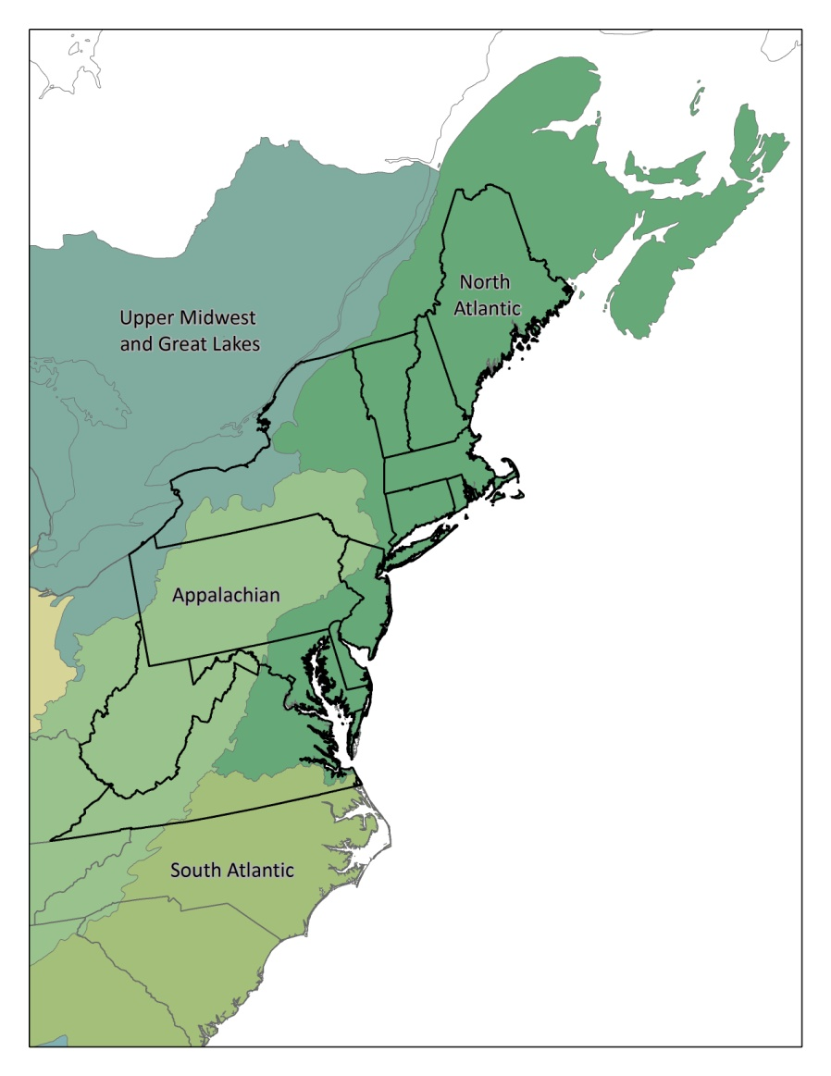
North Atlantic LCC
Vision: Landscapes that sustain our natural resources and cultural heritage maintained in a healthy state through active collaboration of conservation partners and partnerships in the North Atlantic region
Mission
Partnership
Conservation Framework and Strategic Plan
Science Needs and Projects
Science Delivery
Communications
Notes:
We set about to achieve a vision of sustainable landscapes for natural and cultural resources by agreeing on a mission, developing a partnership, agreeing on a framework and strategic plan to guide our work, investing in science projects to address priority needs and more recently by recognizing the increased importance of delivering and communicating about the science information and tools.

Slide 3
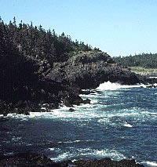
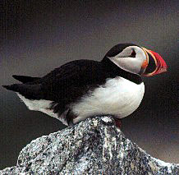
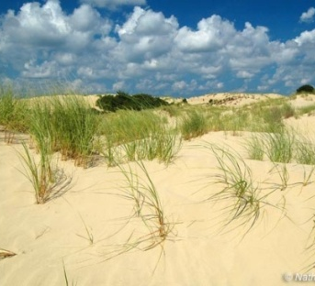
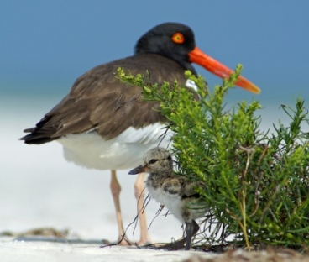
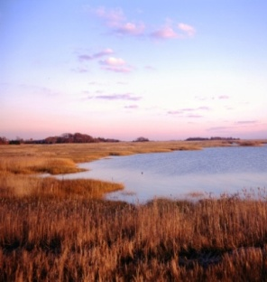
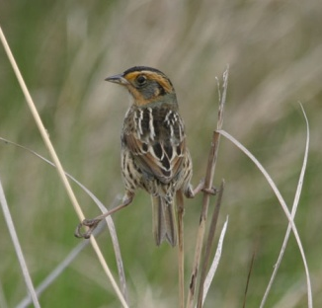
North Atlantic LCC - Mission
The North Atlantic Landscape Conservation Cooperative provides a partnership in which the conservation community works together to address increasing land use pressures and widespread resource threats and uncertainties amplified by a rapidly changing climate.
Notes:
Our two part mission is first about coming together as a partnership to address landscape scale threats and issues that no one agency or organization can address alone.

Slide 4
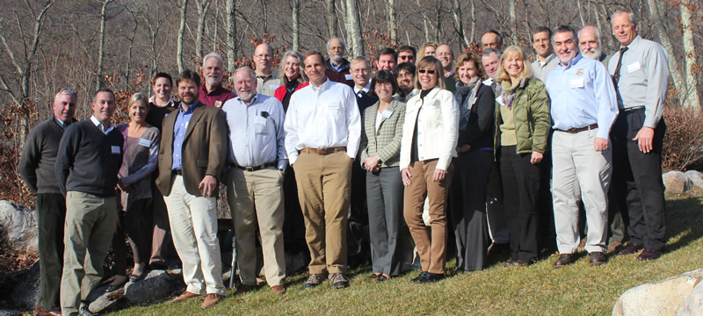
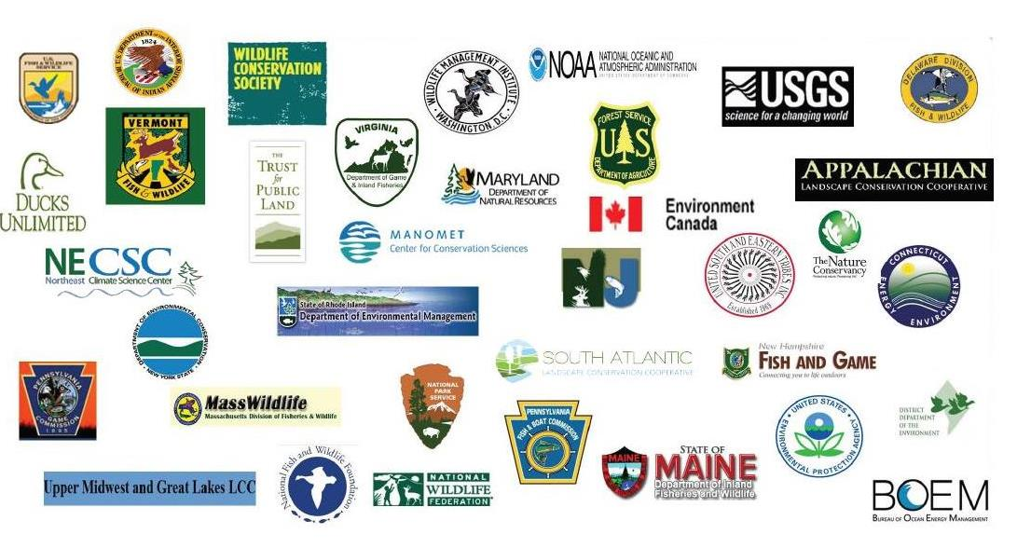
North Atlantic LCC Partnership
Steering Committee
32 Members (14 State, 1 Tribal, 8 Fed., 2 Canadian, 8 NGO, CSC)
Technical Committees
43 members (7 State, 24 Fed., 1 Can., 8 NGO, 3 LCC) aquatic, terrestrial/wetland and coastal/marine subteams
Multiple project oversight teams
Science Delivery Team
30 members (8 State, 10 Fed., 9 NGO, 3 LCC)
LCC Staff - (4 full time, 3 part time)
Notes:
And we now have over 100 partners in the region directly involved in the cooperative

Slide 5
North Atlantic LCC - Mission
The North Atlantic Landscape Conservation Cooperative provides a partnership in which the conservation community works together to address increasing land use pressures and widespread resource threats and uncertainties amplified by a rapidly changing climate.
The partners and partnerships in the cooperative address these regional threats and uncertainties by agreeing on common goals and jointly developing and delivering the scientific information and tools needed to prioritize and guide more effective conservation actions by partners toward those goals.
Notes:
And the second part of our mission is about jointly developing and delivering scientific information and tools needed to prioritize and guide more effective conservation actions by partners toward common goals working towards the vision of sustainable landscapes

Slide 6
Northeast
Conservation Framework
GOAL-SETTING
Albany II
Which species/habitats to conserve? At what levels?
Who decides?
CONSERVATION DESIGN
BIOLOGICAL ASSESSMENT
What should landscapes look like to conserve species at goal levels
What do we know about the status of priority wildlife?
INFORMATION MANAGEMENT
PRIORITIES
SCIENCE TRANSLATION
Which species and issues demand immediate attention?
How will we manage the demand for and creation of data?
How do we make science solutions useful?
MONITORING, EVALUATION AND RESEARCH
CONSERVATION ADOPTION
What new information will we gather to support conservation?
How do we get communities and landowners engaged in conservation?
CONSERVATION DELIVERY
How will we most efficiently put conservation on the ground?
Notes:
And recognizing that to be strategic about our science investments we need a common framework that links together planning, design, delivery and evaluation, Northeast conservation partners agreed on a common regional conservation framework at the Albany II meeting, June 2011.
The components of this framework became the basis for our strategic plan.

Slide 7
Science Needs & Projects
Strategic Plan criteria for prioritizing needs
Foundational needs for organizing landscape conservation (consistent mapping, decision frameworks)
Needs that address major threats and uncertainties to sustaining natural or cultural resources in the North Atlantic LCC (land use change, climate impacts, energy)
Needs that address conservation needs for multiple species, habitats, ecosystems or other features.
Needs that will inform conservation decisions and actions
Needs that are priorities for existing partnerships in the North Atlantic LCC (NEAFWA, JVs, FHPs, NEPARC etc.)
Notes:
The strategic plan also set out criteria for focusing our work to achieve our mission by addressing foundational needs, addressing major threats and uncertainties, considering needs that address multiple species, habitats, ecosystems or other features and most importantly targeting science to inform conservation decisions and actions. The strategic plan also recognized the importance of building off of existing priorities and work particularly off of existing regional partnerships.

Slide 8
Northeast
Conservation Framework
GOAL-SETTING
Albany II
Which species/habitats to conserve? At what levels?
Who decides?
CONSERVATION DESIGN
BIOLOGICAL ASSESSMENT
What should landscapes look like to conserve species at goal levels
What do we know about the status of priority wildlife?
INFORMATION MANAGEMENT
PRIORITIES
SCIENCE TRANSLATION
Which species and issues demand immediate attention?
How will we manage the demand for and creation of data?
How do we make science solutions useful?
MONITORING, EVALUATION AND RESEARCH
CONSERVATION ADOPTION
What new information will we gather to support conservation?
How do we get communities and landowners engaged in conservation?
CONSERVATION DELIVERY
How will we most efficiently put conservation on the ground?
Notes:
Focus or niche of LCC in this framework in order to support conservation decision making has been on conservation design - the science needed to guide conservation decisions towards a vision of sustainable landscapes – specifically addressing the questions how much of what conservation actions are needed where to sustain natural and cultural resources, more specifically how much of what conservation actions are needed where to sustain fish, wildlife and plant species and the ecosystems upon which they depend

Slide 9
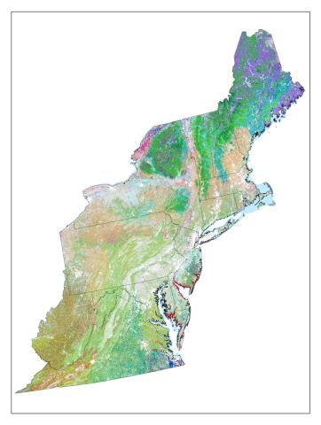
Foundational Needs Mapping Example: Northeast Terrestrial Habitat Map
Other Foundational Mapping
Aquatic Map Revisions
NWI Updates
Coastal and Marine Classification & Map
Compilation of Regional Vernal Pool Data
Culvert/Road Stream Crossings and Aquatic Connectivity
North Atlantic LCC Role | Support revising NEAFWA-sponsored project by NatureServe, TNC and UMass
Products | Classified terrestrial habitat map
Available Now | Piedmont revisions (2012)
Available within 3-6 months | Revisions to reflect roads, streams, & 2006 development Revisions to reflect revised coastal NWI
Longer Term | Expansion to Canadian portion of LCC (2015)
Notes:
One key part of delivering actions in the right places has been addressing foundational needs particularly regionally consistent mapping to set the stage for regional assessments and design, an example of which is the Northeast Terrestrial Habitat Classification and Map developed for NatureServe and The Nature Conservancy for NEAFWA and revised, added to and updated through LCC projects. Other foundational mapping projects are listed here including the proposed culvert mapping. (Handout on projects)

Slide 10
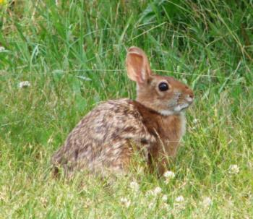
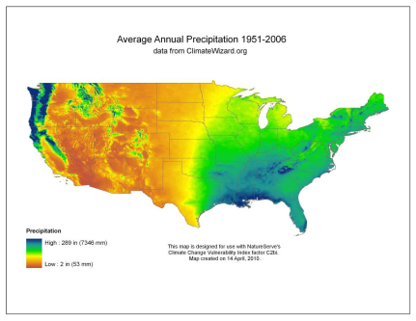
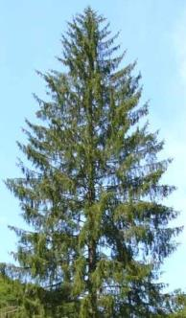
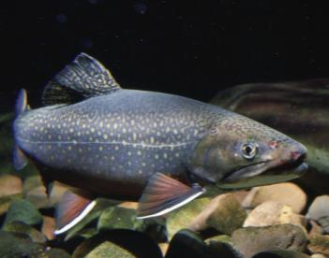
Vulnerability Assessments Example: Species Vulnerability to Climate Change
North Atlantic LCC Role | Supporting assessment by NatureServe using Climate Change Vulnerability Index (CCVI)
Products | Report on vulnerability of 64 high regional concern, representative, and foundational species
Available Now | Draft report in review (Aug. 2013)
Available within 3-6 months | Final report
Longer Term
Other Vulnerability Assessments:
Regional Habitat Vulnerabilities to Climate Change
Piping Plover-Beaches Vulnerability to Sea Level Rise & Increased Storms
Brook Trout-Cold Water Streams Vulnerability to Changing Flow and Temperature
Notes:
A second specific category of needs addressed were regional vulnerability assessments to climate change such as this recently completed regional species vulnerability report for 64 high regional concern, foundational and representative species by NatureServe. The LCC also supported additional phases of the regional habitat vulnerability assessment and specific assessments for piping plovers and brook trout.

Slide 11
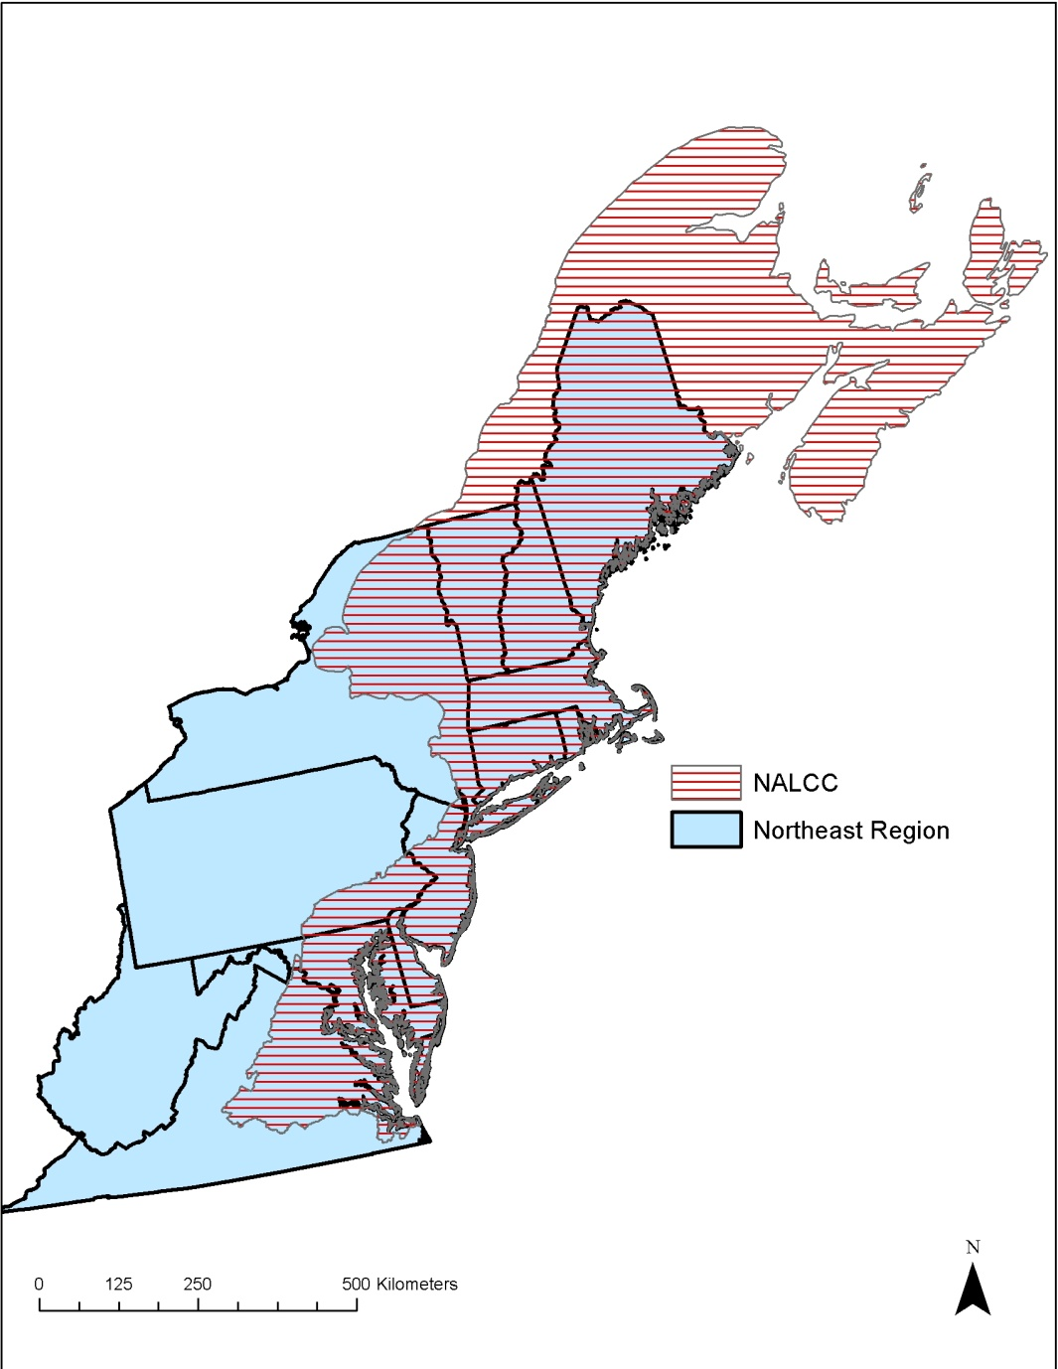
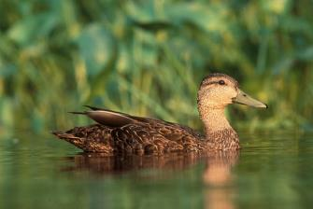
Conservation Design Example: Designing Sustainable Landscapes
North Atlantic LCC Role | Sponsoring project led by UMass Amherst
Products | Extensive spatial datasets, current and future species capability and ecological integrity, decision support tool for landscape design
Available Now | Selected spatial data for entire Northeast, including climate
Available within 3-6 months | Additional regional spatial data Regional models for 10 rep. species Pilot design effort in CT River watershed
Longer Term | Complete datasets, regional & subregional landscape conservation design tools (June 2014)
Other Conservation Design
Decision Support Tool to Assess Aquatic Habitats and Threats
Forecasting Changes in Aquatic Systems and Resilience of Brook Trout
Priority Amphibian and Reptile Conservation Areas (PARCAs)
Marine Bird Mapping and Risk Assessment
Notes:
The area of greatest emphasis in LCC projects has been on the development of conservation design and decision support tools specifically addressing the questions how much of what conservation actions are needed where to sustain natural and cultural resources under both current and projected future conditions including the Designing Sustainable Landscapes project being led by the University of Massachusetts that links together projections of landscape change with species and habitat assessments and landscape conservation design. Two aquatic equivalent projects are underway as is and amphibian and reptile and marine bird project

Slide 12
Northeast Conservation Framework Workshop (Albany II) Results
Overall priorities
Effective information management
LCC Information Management Needs Assessment and development of Data Basin and Synthesis of RCN and LCC products
Communications, dissemination and adoption
LCC Communications and Science Delivery
Expedited delivery of the right actions in the right places (focus areas, landscape design)
LCC projects to complete mapping and assessments, develop conservation design approaches and deliver them to partners at various scales
Notes:
As the Northeast Conservation Partners agreed on this overall framework to ensure that the science fits together, they also emphasized three themes which are consistent with subsequent discussions by this steering committee They include the need for
Develop an effective information management system: A set of immediate needs were identified related to the development of an information management system that will provide easy access for states, LCCs and other partners to conservation information and tools produced by or compiled in support of regional projects
Result - LCC Information Management Assessment and development of Data Basin and Synthesis of RCN and LCC products
Immediate focus on communications, dissemination and adoption: There was consensus on an immediate need to better communicate regional projects and disseminate the results in a way that is meaningful
Result - LCC Science Delivery and Communications science delivery is focusing communications (discussion tomorrow)
Expediting delivery of the right actions in the right places: There was a set of immediate needs identified related to finishing and validating mapping of species and habitats and identifying conservation focus areas based on a variety of approaches.
Result - LCC projects to complete mapping and assessments, develop conservation design approaches

Slide 13
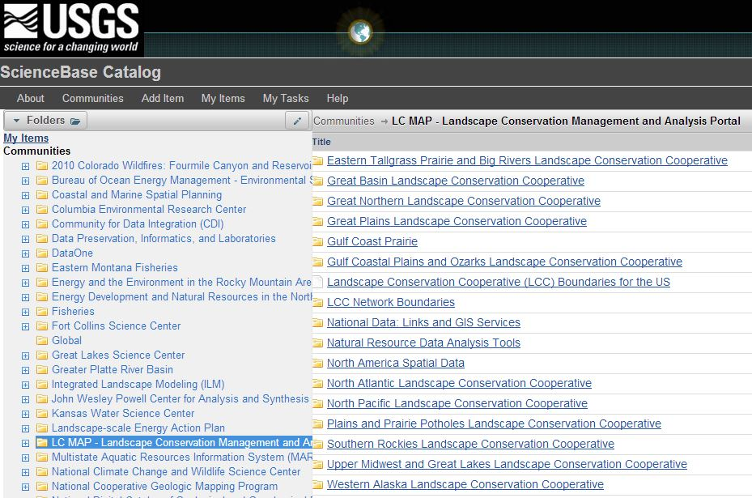
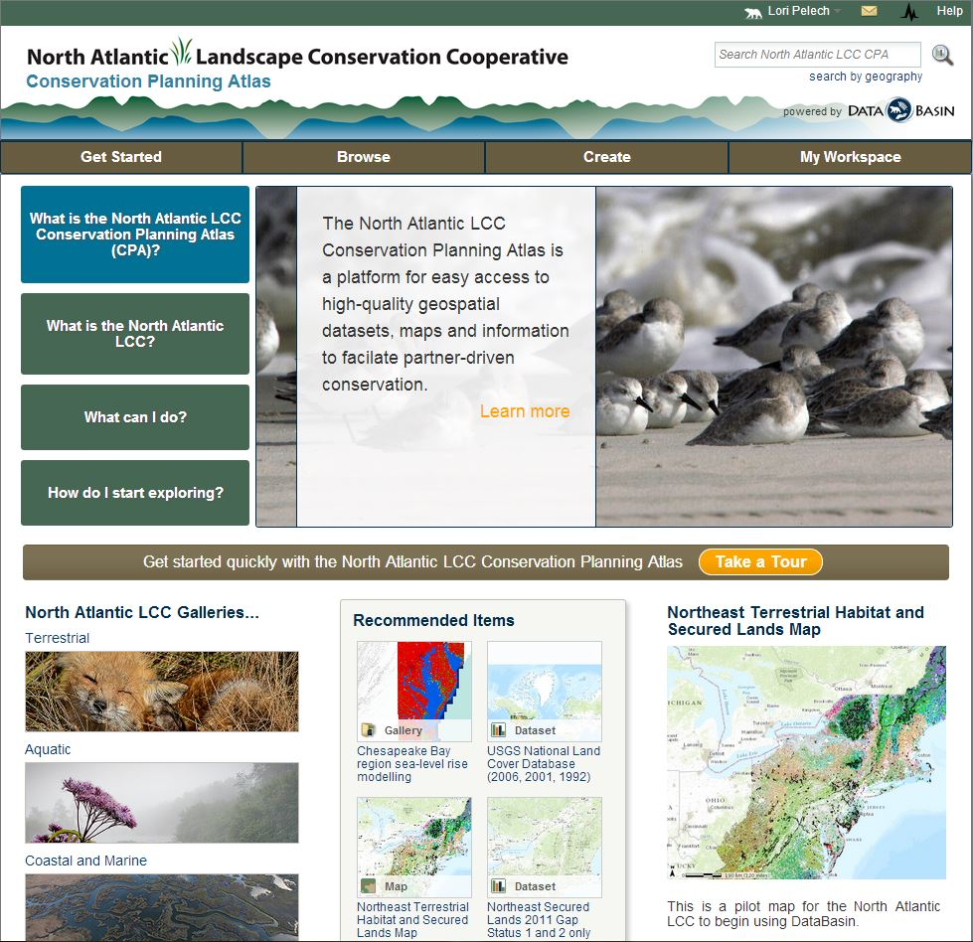
LCC Information Management
http://nalcc.databasin.org/
Notes:
As I mentioned, the LCC also responded to the need for effective management of the increasing amount of information coming our of various partner and LCC projects by conducting an extensive information management needs assessment and with the approval of the board in July, the development of an information management system on Databasin where there is now a North Atlantic LCC Conservation Planning Atlas Site that allows for querys and downloading of spatial data as well as on-line visualizations and mapping
The LCC has now compiled regionally consistent information, maps, tools and other products from these LCC projects along with NEAFWA (RCN) and other sources and are making this information available through an information management system for partners in the Northeast Region
Conservation Planning Atlas (Databasin) - Download or Visualization
TNC and LCC positions - assemble, synthesize and make information available

Slide 14
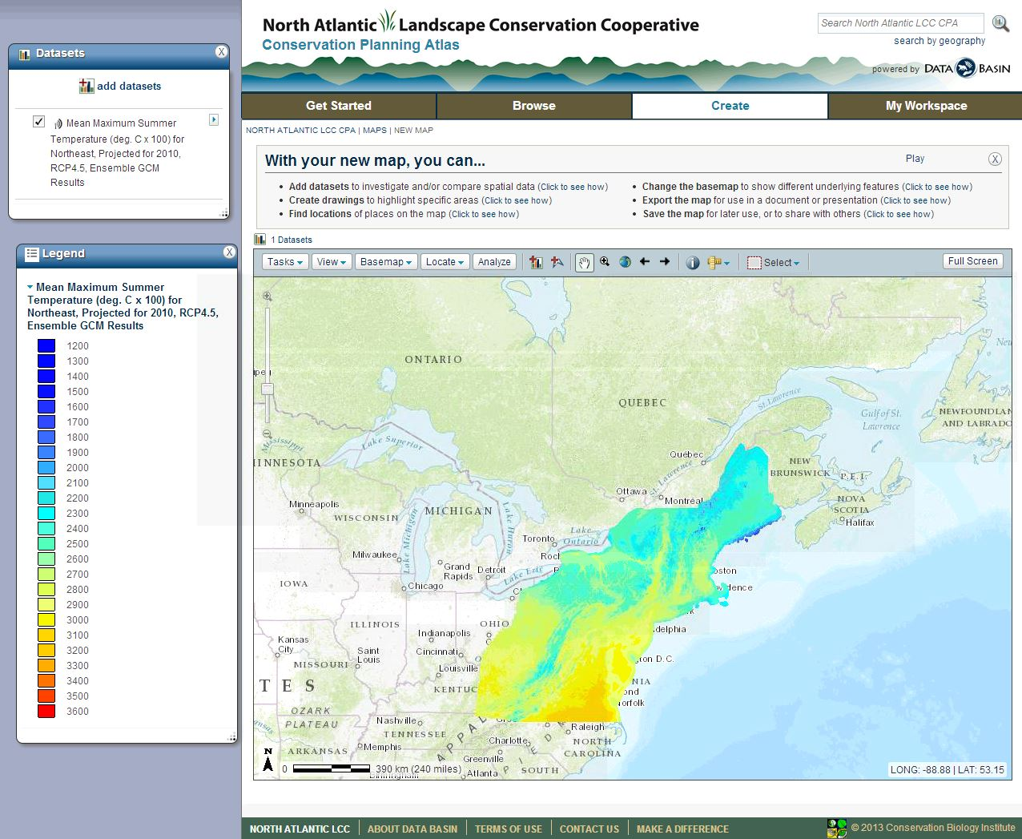

Slide 15
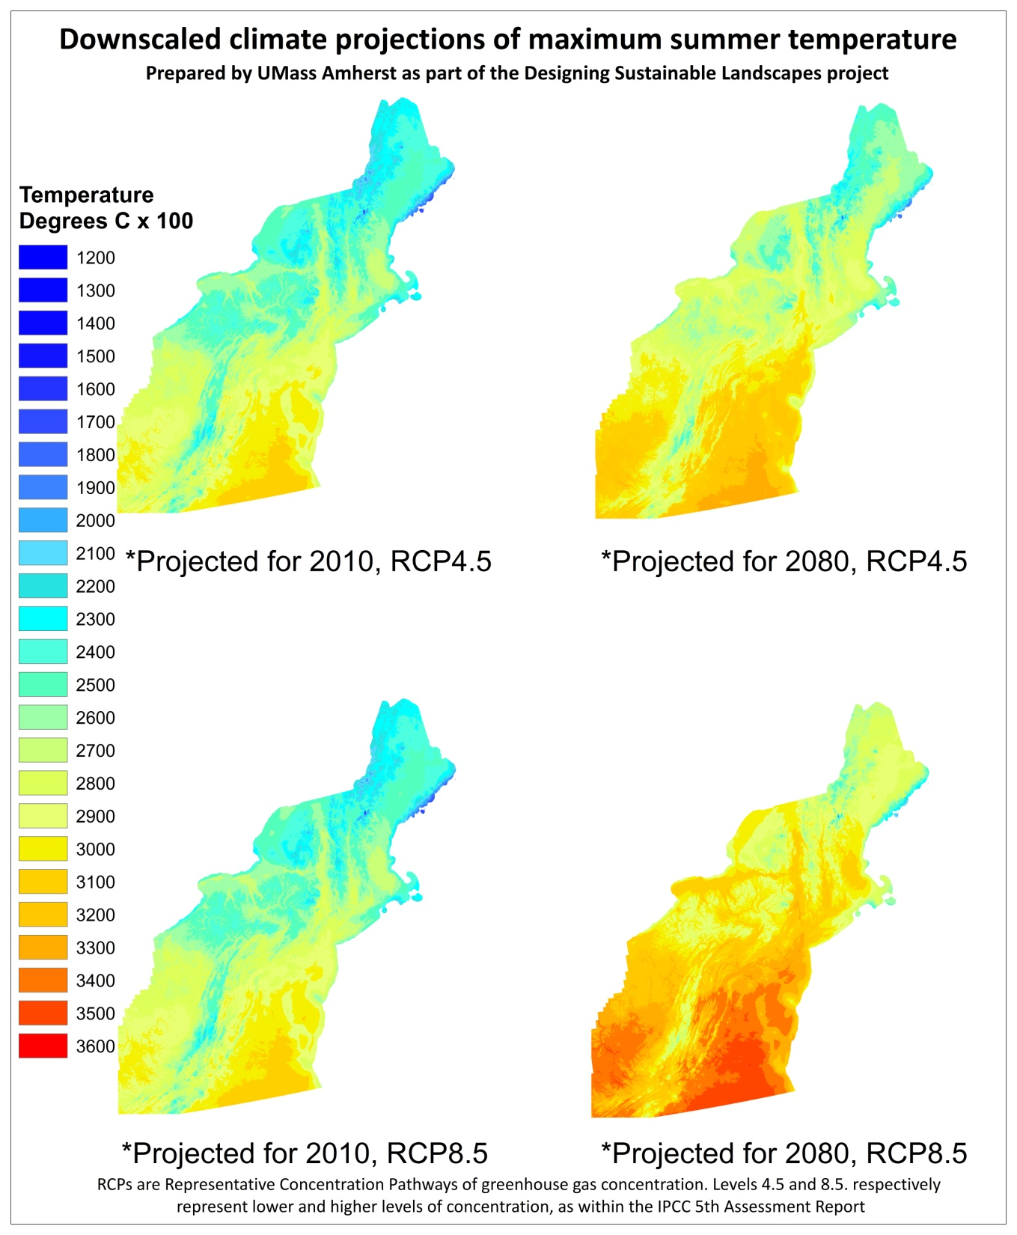
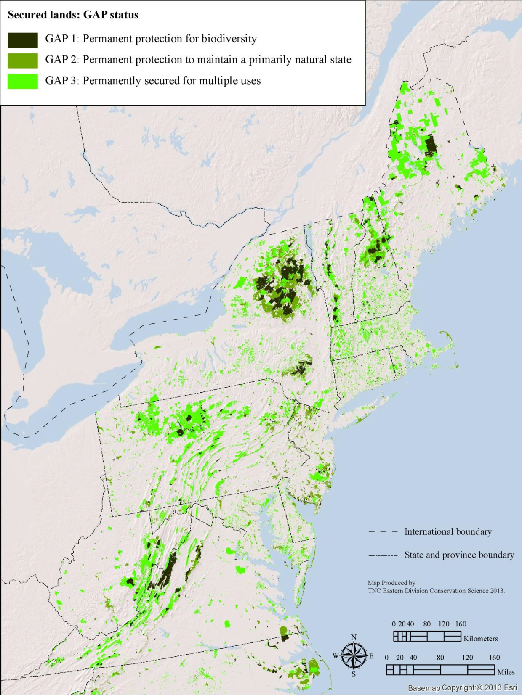
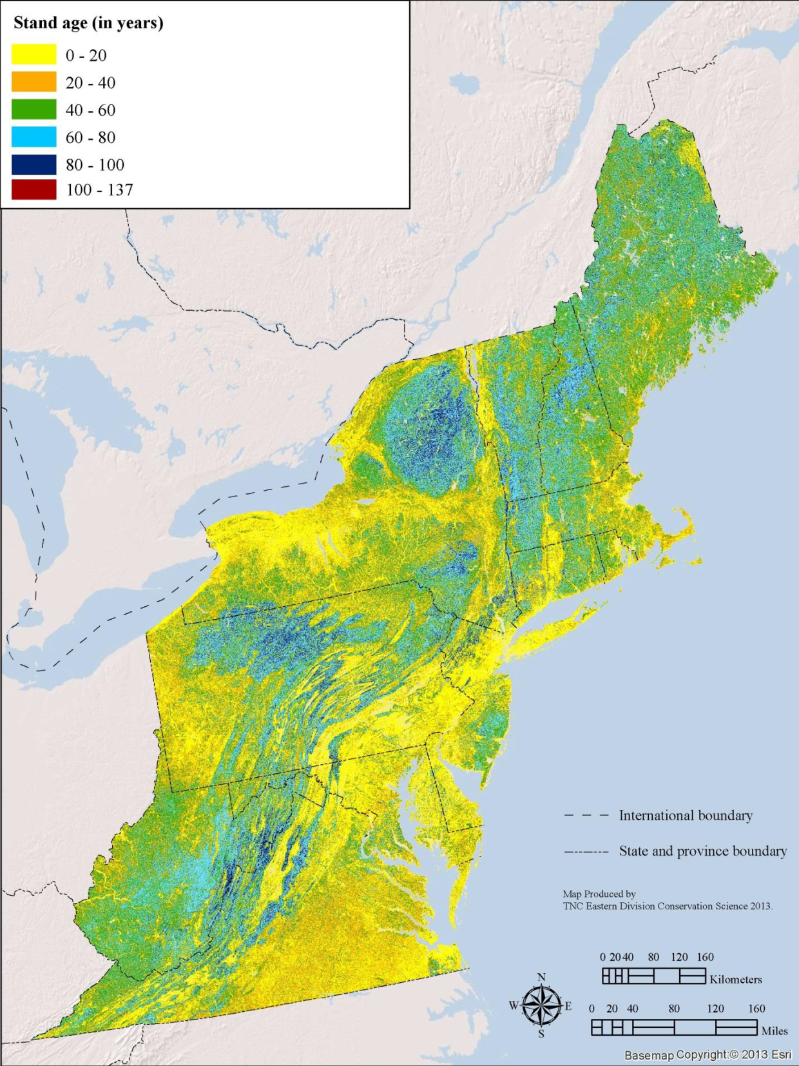
Consistent data layers
As a result of LCC, RCN and other regional conservation science projects There are now > 100 regionally consistent spatial data layers available
Notes:
Development of regionally consistent data layers are a huge part of several of the conservation design projects and an important resource or conservation planners by themselves as well as part of their projects. Such as this example of downscaled climate data under two scenarios which is available for various uses.

Slide 16
Science Delivery
LCC is supporting demonstration projects
LCC Science Delivery Team has developed initial plan for Science Delivery
Program Development and Capacity
Partner Support Grants and Demonstration Projects
Information Support and Access Needs
Notes:
And as this committee has recognized, Making information and tools available is not enough, need a commitment to translating and providing technical assistance to partners to help them adopt and use this information
LCC began demonstration projects last year, this year have stepped back to get the bigger picture of what is needed for science delivery. You will hear from the science delivery team during the Wednesday morning session.
They will talk to you about how the LCC needs to make decisions about how to best deliver the information and conservation designs through information management, science translation, conservation adoption and communications.

Slide 17
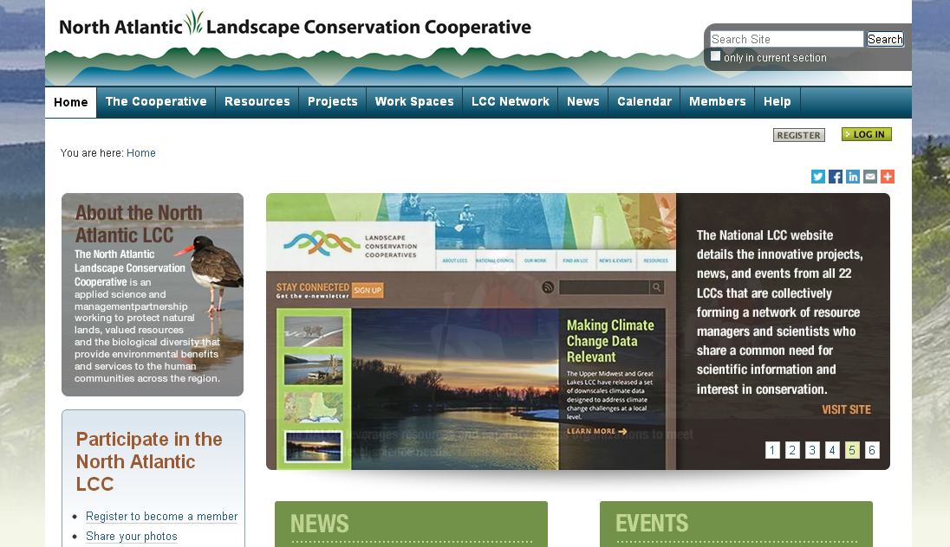
Communications
Provide consistent, clear and comprehensive communications demonstrating
the North Atlantic LCC’s relevance and value to the communities it serves;
transparency and accountability to partners, Congress and the American public; and
the capability to help meet the conservation challenges of the 21st century.
Notes:
As important as developing science and tools, making information available and delivering science to partners in the scales and formats that they need is a clear plan for communications and set of communications tools such as the LCC website. David Eisenhauer will be leading a discussion on communications tomorrow morning.

Slide 18
Summary: Where We Are
LCC had developed the partnership and capacity to achieve its mission
LCC and partners have supported projects consistent with the northeast conservation framework and strategic plan
Projects are at the stage where information and tools are becoming available
Information and tools being made available through information management system
We are increasing our communications capability
We are focusing on the best ways to deliver the information through Science Delivery Team
Notes:
To summarize where we are:

Slide 19
Where We Need to Go Putting the Tools Together and Delivering Them
Science Development, Information Management, Science Delivery, Communications and…
Landscape Conservation Design
How much of what conservation actions are needed where to sustain natural and cultural resources across the region and landscapes within the region?
Collaborative process for agreeing on common goals and developing landscape conservation designs (conservation blueprints)
Notes:
A critical set of next steps for the LCC to achieve its mission is to collaboratively put the information and science together for effectively prioritizing decisions about where we as a set of partners need to do how much of what conservation actions to sustain natural resources across the region and landscapes within the region, we need to utilize the regional information for landscape conservation assessments and designs or (conservation blueprints) that tell us where to focus

